Slide 1
HEROKU THE CLOUD SOFTWARE
Under the guidance of,
Prof. Sridhar K N Rao,
Dept. of CSE,
CIT,Gubbi
Prepared by,
Rashmi T V,
I Sem CSE, M.Tech,
CIT,Gubbi

Slide 2
CONTENTS
Introduction
Steps To Install Heroku
Heroku Architecture
Heroku Features
Summary
References

Slide 3
INTRODUCTION
HEROKU
It is a cloud software,that works as Platform as a Service.
PaaS is the cloud service model that provides the tools to build software applications on the cloud.
It is pronounced as ‘her-oh-koo’.
It is a cloud application platform that provides flexibility in choosing an appropriate programming language to develop web apps.

Slide 4
STEPS TO INSTALL HEROKU
There are few steps which we need to follow to work on heroku
1. Get a Heroku account (https://www.heroku.com).
2. Install Heroku toolbelt client (https://toolbelt.heroku.com/).
3. Set up SSH for user account.

Slide 5
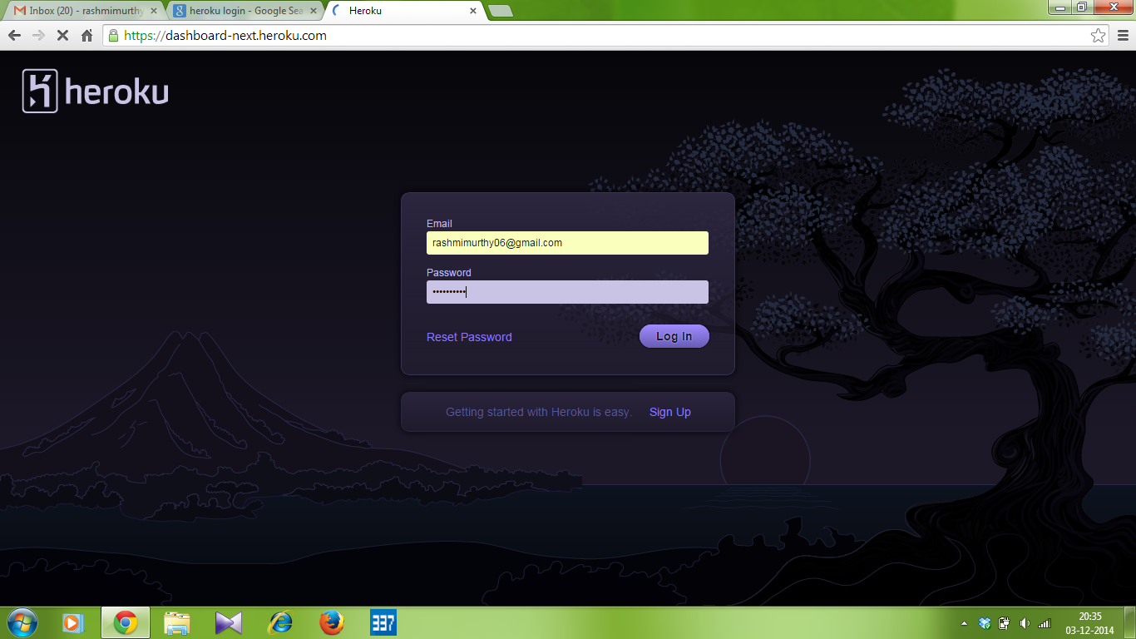
Heroku signup:
In order to work with heroku,first we have to signup the heroku account.
The screenshot shows the signup page to create a new heroku account.

Slide 6
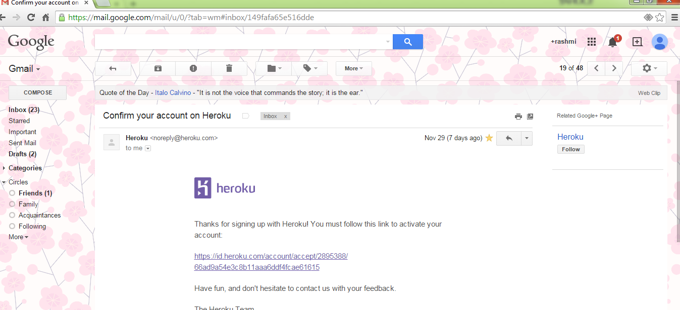
Once you entered an e-mail address, need to validate your credentials by
logging in to your e-mail account and verifying your account credentials for Heroku.
Consider the following screenshot:

Slide 7
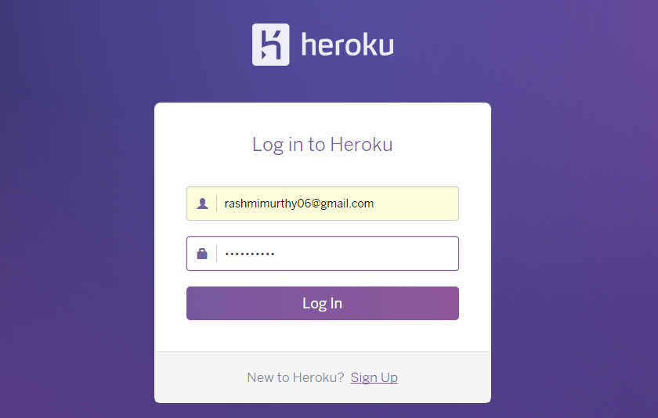
Login to the heroku account to start deploying app

Slide 8
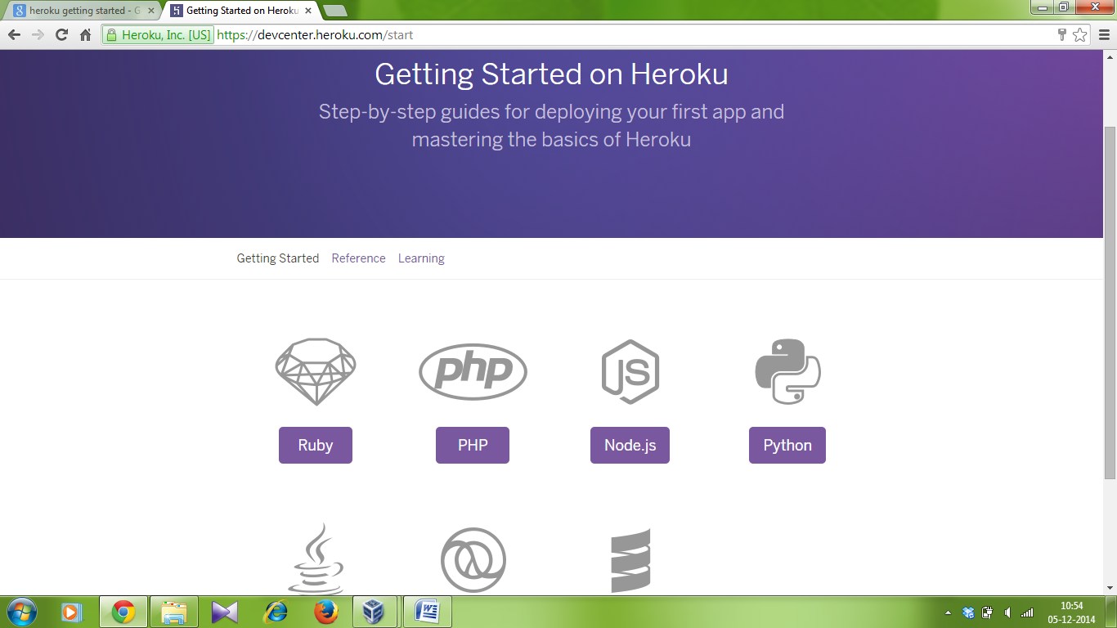
Once you login ,it will show the page as below ,to select the language and to work with that.

Slide 9
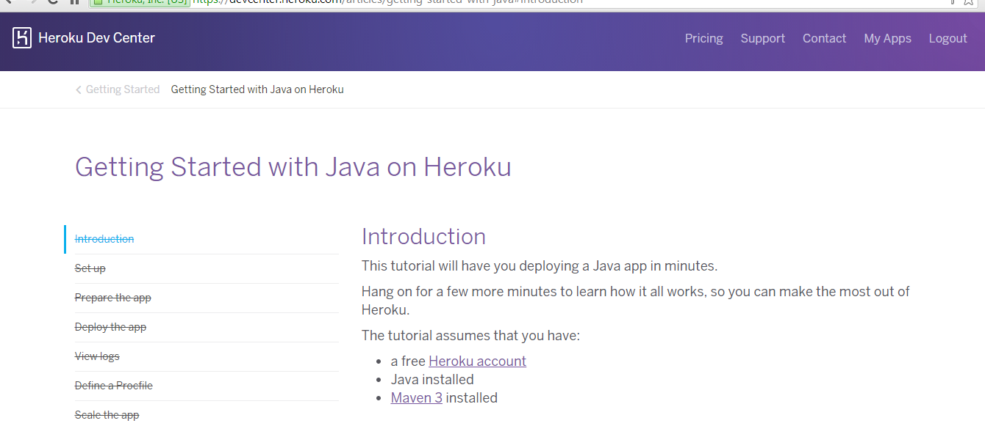
Once you get the getting started page,select any of the language to deploy the apps. I started with Java on Heroku.

Slide 10
Once you entered into the getting started with java on heroku page,first we need to download the heroku toolbelt to work .
Once you installed, we can use the heroku command from command shell.
Then use the Git Bash ,application to open a command shell on windows.
Login using the email address and password, as that of the similar type we did while creating heroku account.
Authenticating is required both from heroku and git ,to work further.
(The screenshots of both the steps is shown in next slides.)

Slide 11
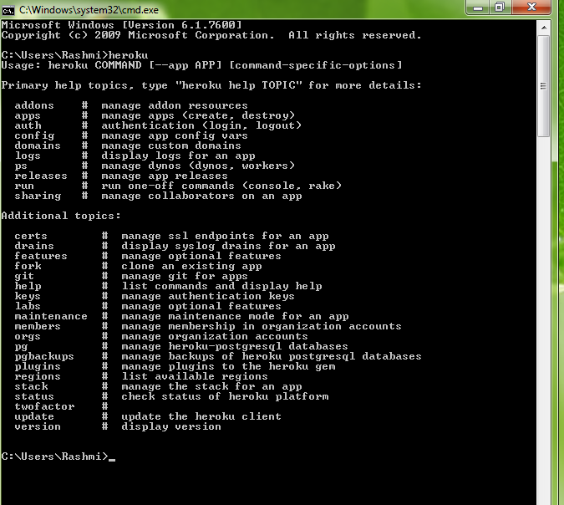
Check if heroku installed properly and open the command prompt and type heroku,it gives the usages,as shown in the screen shot.

Slide 12
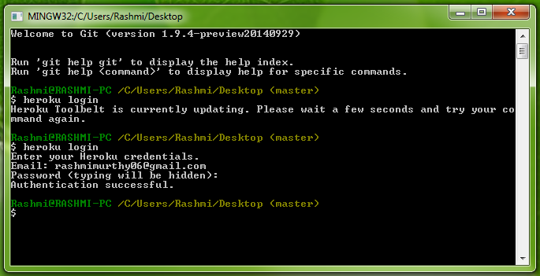
Use the git bash prompt and type heroku login , it will ask to enter the email address and
Password. If authentication is successful,the prompt will show this.

Slide 13
After getting the successful authentication,the next step is to prepare the application,that can be deployed later.
Execute the following commands to clone the sample application.
git clone https://github.com/heroku/java-getting-started.git
cd java-getting-started
Once the application is prepared, deploy the application by making use of the following commands.
heroku create –http-git ( this will create an app,a git remote is also created in the locall git repository.)
Now deploy the code by giving the command git push heroku master
The application is now deployed.ensure atleast one application is running ; by giving the cmd as heroku ps:scale web=1,
now visit the app at theURL generated by its app name.

Slide 14

This shows the app generated by the URL

Slide 15
Once the app is generated at the browser, view the log details in the git
Type the command as heroku logs --tail , visit the browser again, and we will see another log message generated.

Slide 16
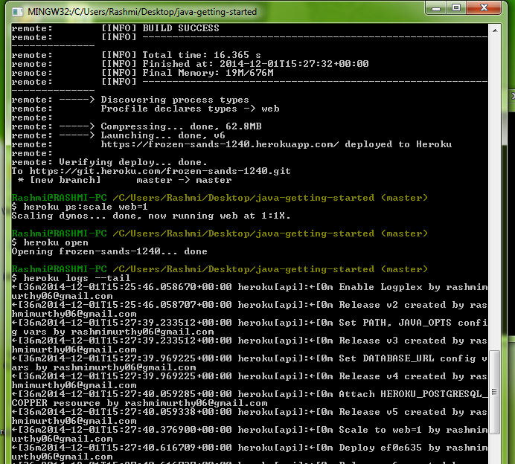
Screenshot showing view logs

Slide 17
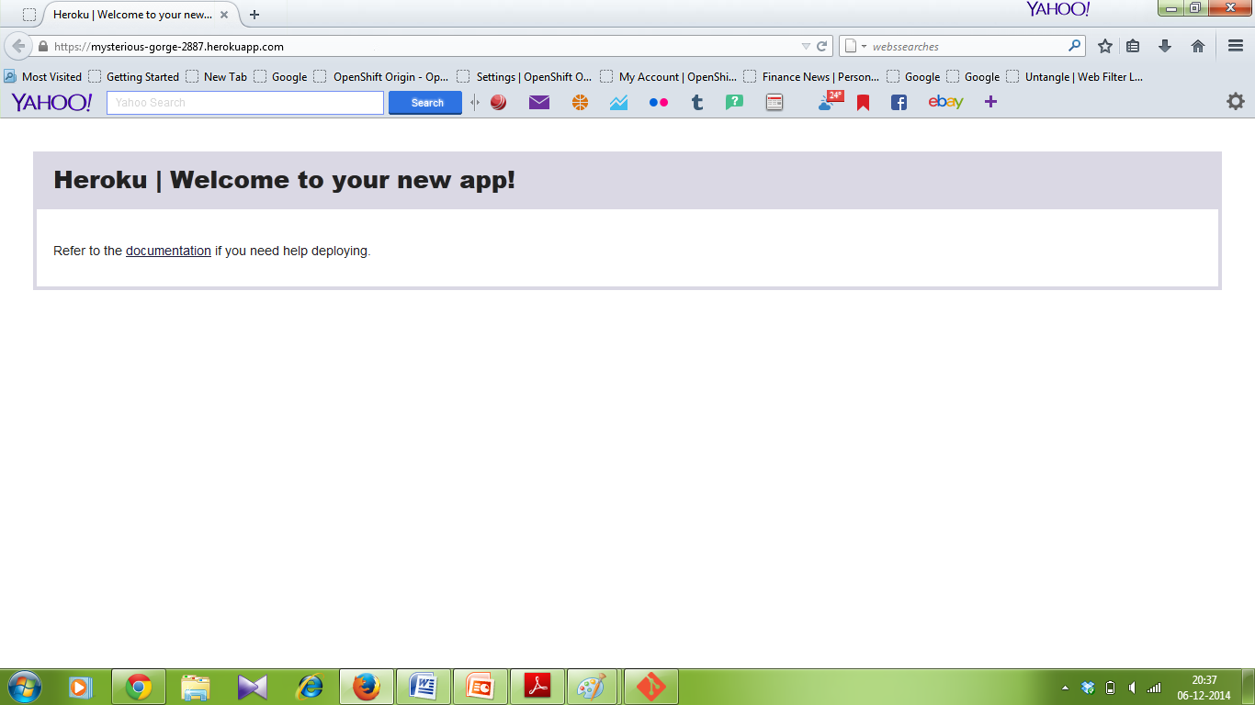
This is the new app generated in the browser.

Slide 18
The next step is to define a procfile in the textfile in the root directoryof heroku.
To run apps locally under windows, type the below commands,
Create a new file, Procfile.windows
Add a line to indicate how to start the app under Windows: web: java %JAVA_OPTS% -cp target\classes;"target\dependency\*" Main
When you see instructions to run your app with foreman, append an extra -f Procfile.windows flag to ensure your Windows-specific Procfile is picked up.
For example: foreman start web -f Procfile.windows

Slide 19
The next step is to scale the application .after that declare the application dependencies by giving some of the install commands.
Use system. properties command to run the java programs.

Slide 20
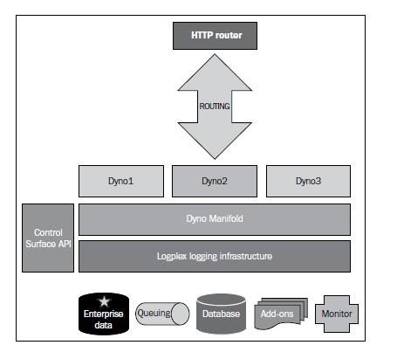
HEROKU ARCHITECTURE
The figure shows the architecture of the Heroku platform.
It consist of platform stack comprising of language runtime, various libraries, operating system and underlying infrastructure.

Slide 21
HEROKU FEATURES
Heroku is a fully featured PaaS,that provides a complete stack of true PaaS features.
It provides flexible process control and scalable web and work type to run from a procfile.
Heroku prefers convenience over configuration, hence the configuration architecture is intentionally simplistic to use.
Whenever new code, add-ons, or a configuration is in place, Heroku creates a new release automatically.
Heroku provides a rich set of capabilities to manage app.
Security with heroku;1. Heroku provides the ability to set up an SSL endpoint for your application to enable secure communication to your deployed application.2. Heroku also supports SSH keys to enable a secure transfer of developer code to/from the platform.

Slide 22
SUMMARY
We know about the Heroku software and its installation to work with it.This is one of the best leading PaaS service, using by many of the business communities.
It helps in understanding the cloud software and its working by providing the simple steps for downloading and installing the software and by giving the support through different tutorials .

Slide 23
REFERENCES
www.heroku.com
Heroku Dev Center
https://devcenter.heroku.com/start
Cloud Application Development by Anubhav Hanjura

Slide 24
Thank you

