Slide 1
Sentinel AI
Stellantis – Atos
Connected Vehicles

Slide 2
Contents
01
The Challenge
02
The Opportunity
03
Introducing SentinelAI
04
Overview - SentinelAI
05
Architecture
06
Future Vision

Slide 3
The Challenge - Current Operational Pain Points
Overcoming inefficiencies in modern incident response
Slow & Manual Investigation: On-call engineers manually grep logs, craft Kibana DSL queries, and correlate timestamps across multiple browser tabs for every incident
The Incident Time Drain: On-call engineers spend 40–60% of incident response time manually querying ELK, correlating signals, and writing post-incident Root Cause Analyses (RCAs)
Knowledge Silos & Repetitive Work: Senior engineers carry tribal knowledge while junior engineers struggle with ELK/Kafka query syntax and miss key signals. Similar failures are investigated from scratch every rotation because past incidents are not indexed or searchable.
RCA Bottleneck: Post-incident RCAs are written hours or days later relying on fading memory, or are skipped entirely under time pressure.

Slide 4
The Opportunity – Why an AI Layer on Top of Observability?
Moving from raw operational signals to automated reasoning
AIOps
AIOps Paradigm Shift: Observability data is raw signal, not direct insight. SentinelAI provides an AI-assisted layer that turns logs and raw observability data into summaries, hypotheses, and recommended actions.
MTTR
Proven Market Results: Early adopters of AI copilots embedded in observability platforms report a 30–50% reduction in Mean-Time-To-Resolve (MTTR).
Memory
Unifying Institutional Memory: SentinelAI adds memory, reasoning, and live investigation capabilities to your stack. A specialized Knowledge Service makes each resolved incident reusable for the next occurrence.
IP
IP Ownership: Building this capability on our own stack allows us to own the Intellectual Property (IP) rather than depending entirely on closed third-party vendor platforms.

Slide 5

Introducing SentinelAI – Platform Overview
Automated log analysis and live observability query orchestration
An AI-assisted incident investigation platform combining log analysis, live observability queries, and engineering context to help teams understand incidents faster and produce structured RCA output
Log RCA
Live ELK Investigation
Engineering Context
Paste logs or upload files. AI analyzes and produces structured root cause analysis with issue, root cause, impacted service, and recommended fix.
Query Elasticsearch directly. Retrieve recent logs, summarize them, and get AI-generated investigation results with suspicious log lines and recommended actions.
Automatically enrich RCA with metadata from GitHub, Jira, Confluence, and Jenkins. Connect incidents to deployments, code changes, and team context.

Slide 6
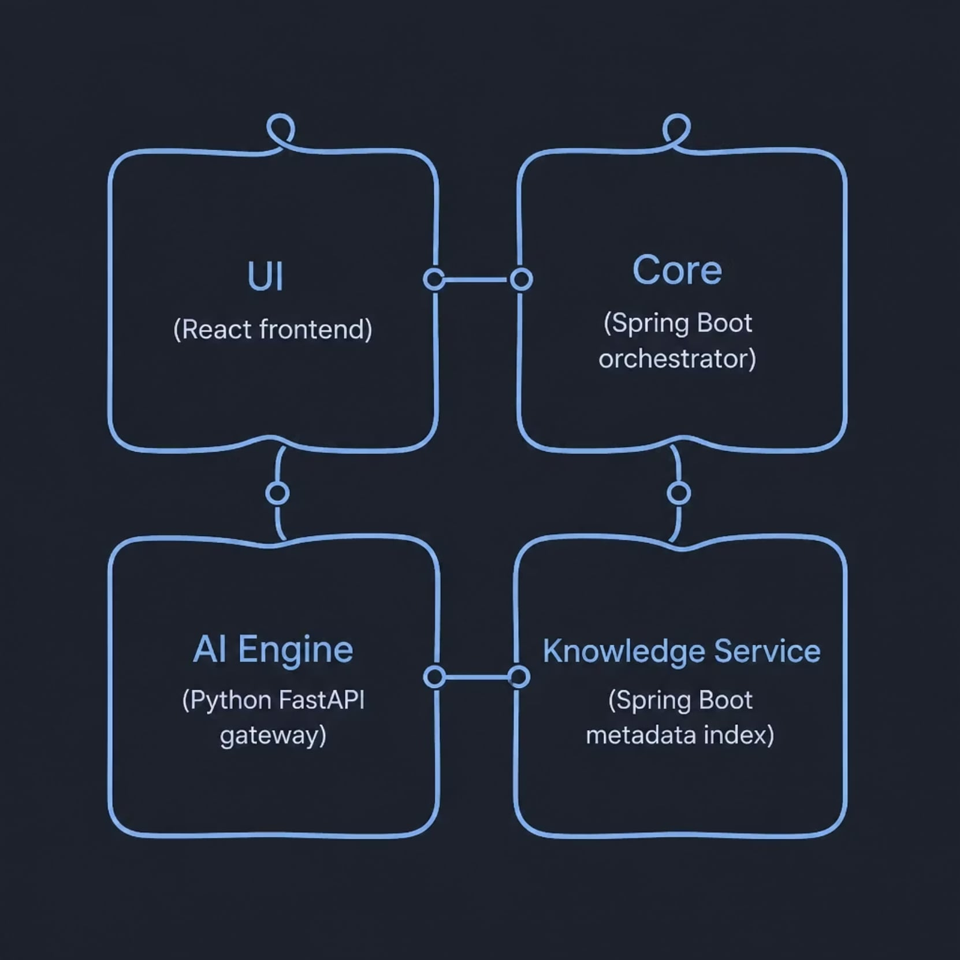
Overview – Sentinel AI
Architecture and Services
Architecture – At a Glance
UI — React interface for RCA and ELK investigation
Core — Spring Boot orchestration for RCA, log ingestion, and Elasticsearch
AI Engine — Python FastAPI routing to Groq, Ollama, HuggingFace, or OpenAI
Knowledge Service — Spring Boot microservice indexing GitHub, Jira, Confluence, and Jenkins

Slide 7
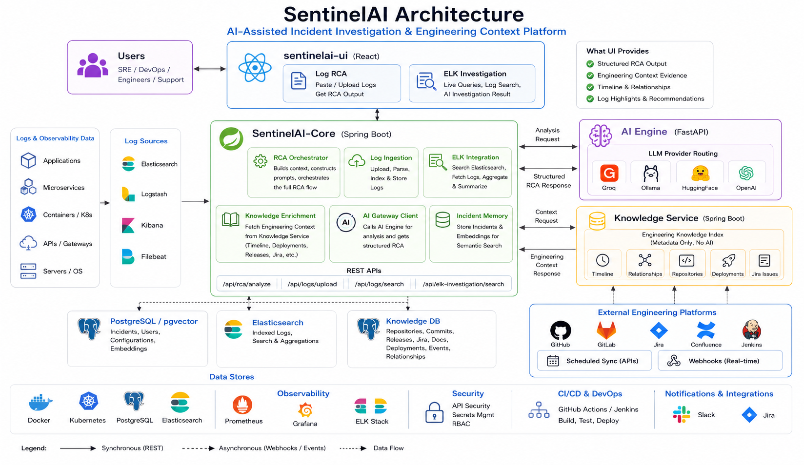

Slide 8


Future Vision
Enterprise AI SRE Copilot
The On-Call Experience — with SentinelAI Fully Realised
Alert fires
Agent reasons
01
02
🚨 Alert fires
🧠 Agent reasons
Understands goal: 'investigate payment service degradation'
03
04
🔍 Agent queries
📝 Agent correlates
Calls ELK · Kafka · deployment history · incident KB — all auto
Links deploy v2.3.1 to error spike 18 min later via timeline
05
06
🔗 Agent drafts
✅ Human approves
Prepares RCA, runbook + Jira ticket draft
On-call reviews in < 2 min and resolves incident
Why This Matters:
The agent will reason over ELK, Kafka, deployments, releases and engineering knowledge
SentinelAI-Knowledge-Service becomes the memory layer for past incidents and change history
The human approves in minutes while the agent drafts RCA, runbooks and Jira actions
This moves the platform from demo to an enterprise-ready operations copilot
Capability Readiness:
✅ Multi-step ReAct loop [designed]
✅ Tool registry [designed]
✅ ElkClient + RAG [built]
🔭 Kafka triggers [P2 roadmap]
Continuous Cycle

