Slide 1
Sentinel AI
Stellantis – Atos
Connected Vehicles

Slide 2
Contents
01
The Challenge
02
The Opportunity
03
Introducing SentinelAI
04
Overview - SentinelAI
05
Architecture
06
Future Vision
07
Strategic ROI

Slide 3
The Challenge - Current Operational Pain Points
🔍 Slow and Manual Investigation: When a production issue occurs, engineers must manually collect information from multiple tools such as logs, monitoring dashboards, GitHub, Jira, and deployment systems before they can even begin troubleshooting.
⏱️ Longer Incident Resolution Time: A significant portion of incident response time is spent gathering and correlating information instead of fixing the actual problem, increasing Mean Time to Resolution (MTTR).
🧠 Knowledge Is Scattered: Critical knowledge is spread across logs, documentation, Jira tickets, code repositories, and the experience of senior engineers. This makes it difficult for teams to quickly find relevant information or learn from previous incidents.
🔄 Repeated Investigation Effort: Similar production issues are investigated repeatedly because historical incidents, root causes, and resolutions are not centrally connected or easily searchable.

Slide 4
The Opportunity – Why an AI Layer on Top of Observability?
🤖 Turn Raw Data into Actionable Insights: Production logs, monitoring data, and engineering tools generate huge amounts of information. SentinelAI correlates this data and provides clear, evidence-based insights instead of leaving engineers to manually analyze thousands of log lines.
Faster Recovery Times: Companies using AI-assisted triage tools resolve their system outages 30% to 50% faster than those using traditional manual methods.
Searchable Outage Memory: SentinelAI remembers past system issues and how they were solved. When a similar problem occurs, engineers can search and reuse the previous solution instantly instead of troubleshooting from scratch.
Full Intellectual Property Ownership: Because we build this tool directly on our own tech stack, we own 100% of the software and intellectual property. This eliminates monthly subscription costs and stops us from being locked into expensive third-party platforms
IP

Slide 5
Business Value at a Glance
🚀 Slow and Manual Investigation: : When a production issue occurs, engineers must manually collect information from multiple tools such as logs, monitoring dashboards, GitHub, Jira, and deployment systems before they can even begin troubleshooting.
🤖 AI-Assisted Investigation : SentinelAI combines runtime observability with organizational engineering knowledge to generate structured, evidence-based Root Cause Analysis, helping engineers make faster and more informed decisions.
📚 Organizational Knowledge Reuse : Every incident becomes part of a searchable engineering knowledge base. Previous investigations, deployments, documentation, and resolutions can be reused, reducing repeated troubleshooting and minimizing dependency on individual experts.
📈 Improved Productivity & Business Impact : By reducing manual investigation effort and providing consistent RCA, SentinelAI enables engineering teams to resolve incidents more efficiently, improve service reliability, and focus on delivering business value.

Slide 6

Introducing SentinelAI – Platform
Automated log analysis and live observability query orchestration
An AI-assisted incident investigation platform combining log analysis, live observability queries, and engineering context to help teams understand incidents faster and produce structured RCA output
Log RCA
Live ELK Investigation
Engineering Context
Paste logs or upload files. AI analyzes and produces structured root cause analysis with issue, root cause, impacted service, and recommended fix.
Query Elasticsearch directly. Retrieve recent logs, summarize them, and get AI-generated investigation results with suspicious log lines and recommended actions.
Automatically enrich RCA with metadata from GitHub, Jira, Confluence, and Jenkins. Connect incidents to deployments, code changes, and team context.

Slide 7
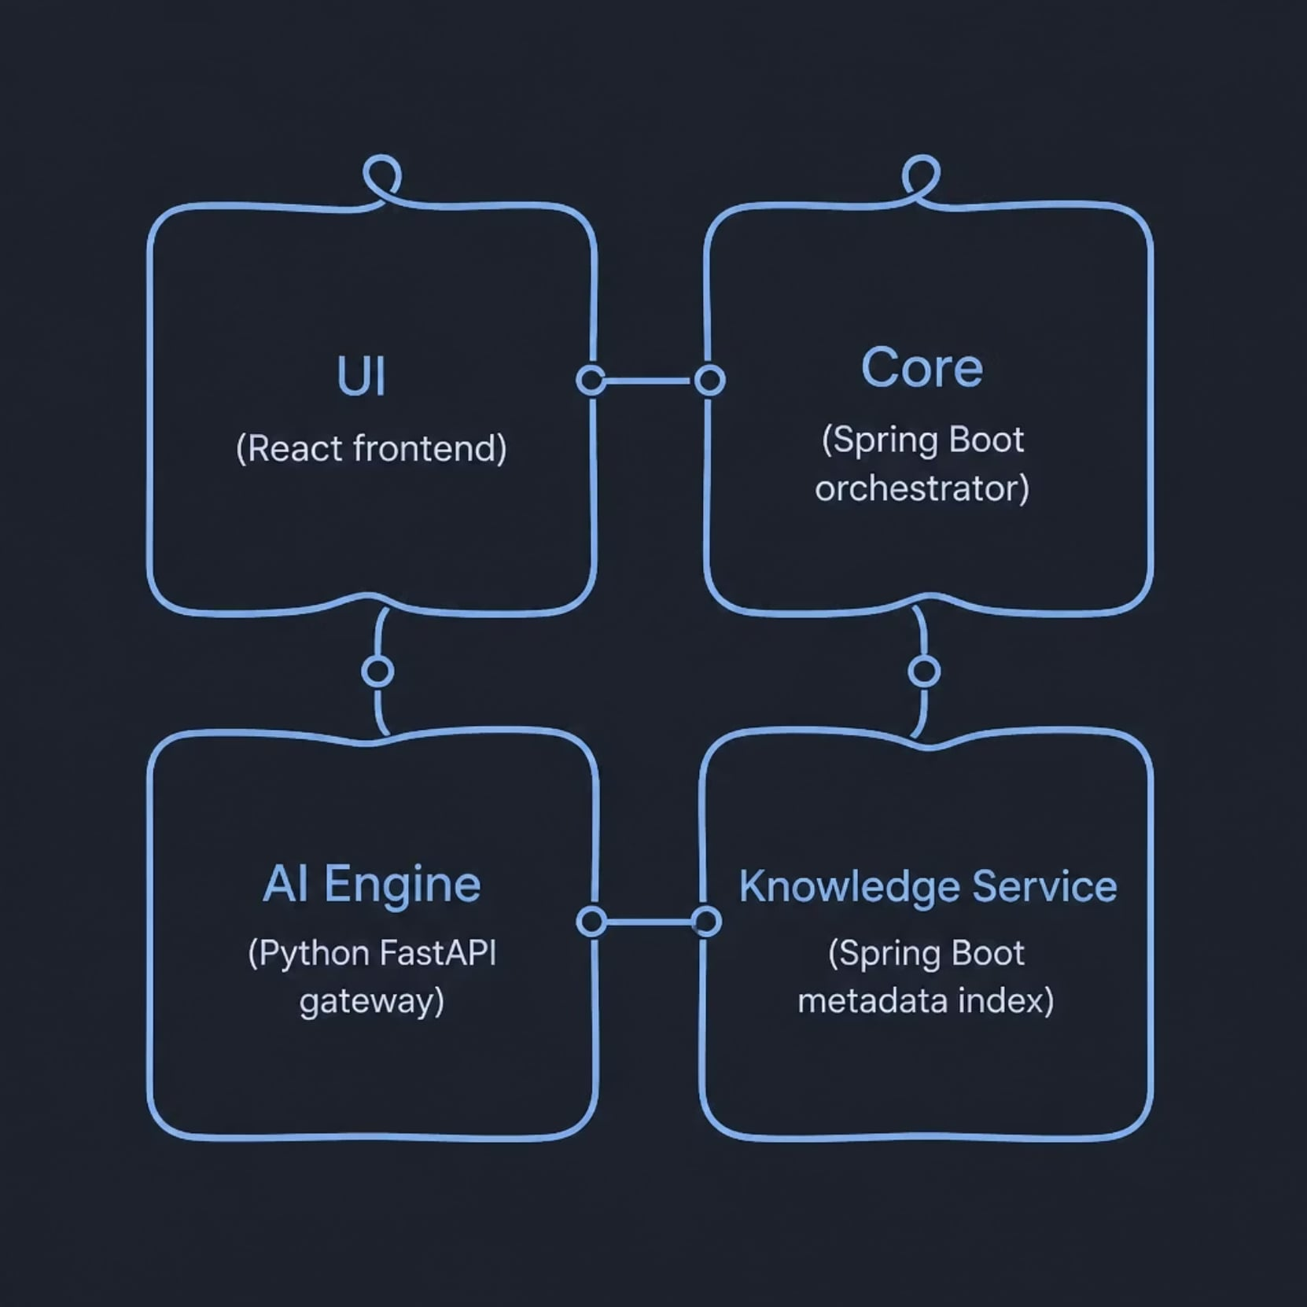
Overview – Sentinel AI
Architecture and Services
Architecture – At a Glance
UI — React interface for RCA and ELK investigation
Core — Spring Boot orchestration for RCA, log ingestion, and Elasticsearch
AI Engine — Python FastAPI routing to Groq, Ollama, HuggingFace, or OpenAI
Knowledge Service — Spring Boot microservice indexing GitHub, Jira, Confluence, and Jenkins

Slide 8
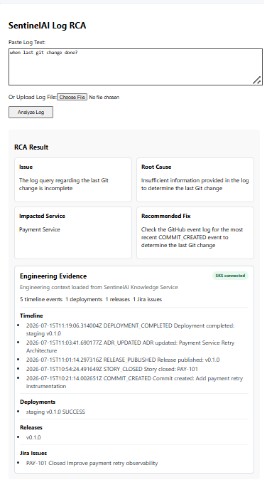



End-to-End RCA Workflow
Input
Paste log text or upload a file from the UI
Process
Send content to Core via the RCA API
Output
Structured RCA with issue, root cause, impacted service, and recommended fix
Enrich
Optionally add engineering context from the Knowledge Service

Slide 9
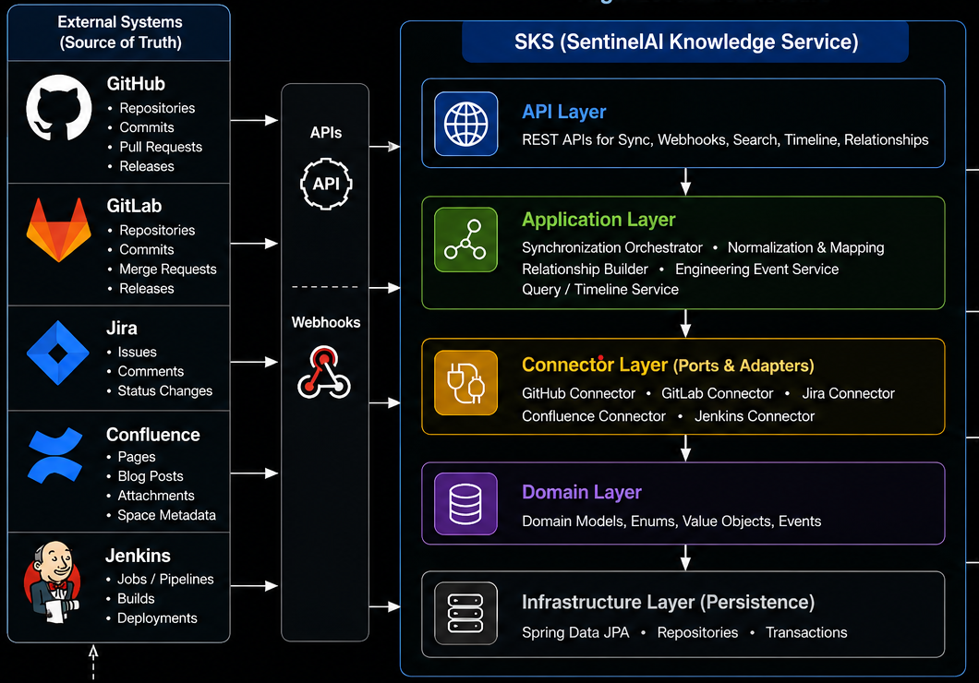
Engineering Knowledge Enrichment
SentinelAI connects incident investigation to the broader engineering ecosystem by enriching Root Cause Analysis with vital engineering context.
Source Sync
Sync metadata from GitHub, Jira, Confluence, and
Jenkins
Webhook Ingestion
Ingest real-time webhook events from those systems
Context APIs
Expose timeline, relationship, repository, deployment,
release, and Jira search APIs
Normalized Index
Build a normalized engineering knowledge index without performing AI reasoning itself

Slide 10
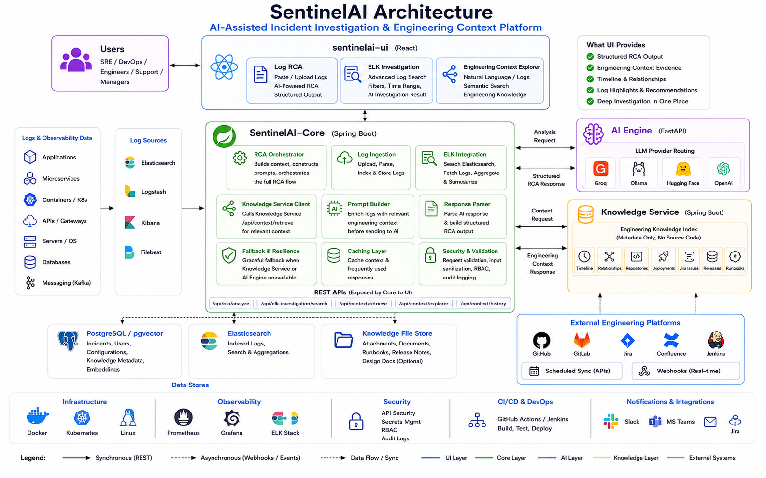

Slide 11

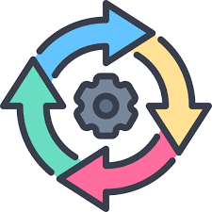
Future Vision
Enterprise AI SRE Copilot
The On-Call Experience — with SentinelAI Fully Realised
Alert fires
Agent reasons
01
02
🚨 Alert fires
🧠 Agent reasons
Understands goal: 'investigate payment service degradation'
03
04
🔍 Agent queries
📝 Agent correlates
Calls ELK · Kafka · deployment history · incident KB — all auto
Links deploy v2.3.1 to error spike 18 min later via timeline
05
06
🔗 Agent drafts
✅ Human approves
Prepares RCA, runbook + Jira ticket draft
On-call reviews in < 2 min and resolves incident
Why This Matters:
The agent will reason over ELK, Kafka, deployments, releases and engineering knowledge
SentinelAI-Knowledge-Service becomes the memory layer for past incidents and change history
The human approves in minutes while the agent drafts RCA, runbooks and Jira actions
This moves the platform from demo to an enterprise-ready operations copilot
Capability Readiness:
✅ Multi-step ReAct loop [designed]
✅ Tool registry [designed]
✅ ElkClient + RAG [built]
🔭 Kafka triggers [P2 roadmap]
Continuous Cycle

Slide 12



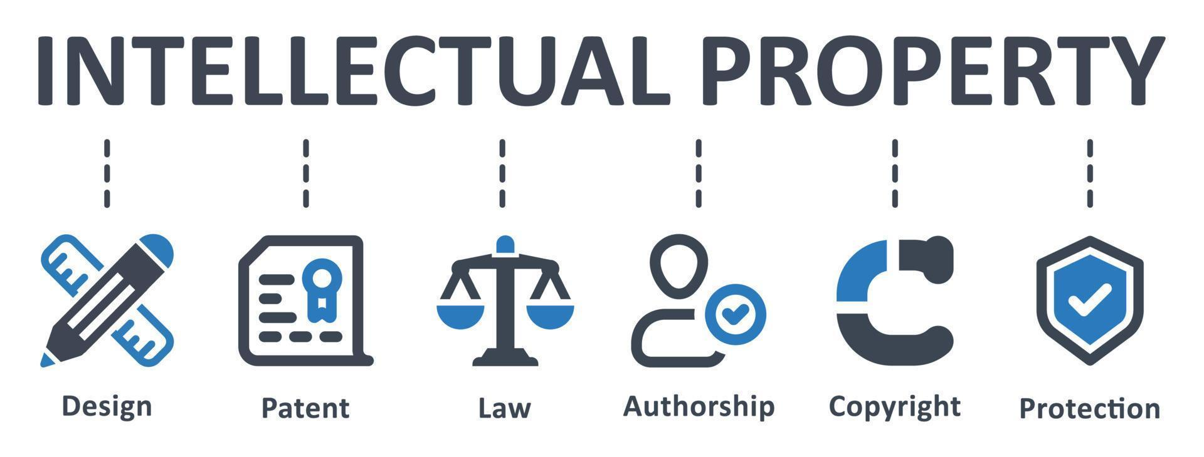
Strategic ROI
Reclaiming Engineering Hours: Support teams currently loose 40% to 60% of their incident response time on manual log searches and drafting reports. SentinelAI automates these repetitive tasks, winning back hundreds of highly paid engineering hours.
Flexible Budget Control: You can run free local models with zero API licensing fees or host budget-friendly custom models to match your operational needs. Upgrading or swapping AI models requires no software rewrites. Our pluggable design completely eliminates future developer maintenance costs when switching AI providers.
Easier Onboarding & Shared Knowledge: Critical knowledge is no longer locked inside senior engineers' heads. SentinelAI translates complex raw logs into plain-English summaries and clear steps, helping junior engineers resolve issues quickly without getting stuck.
Owning Your Intellectual Property: Instead of paying expensive monthly per-seat subscription fees to external vendors, you build this directly on your own infrastructure and own 100% of the technology asset.

