Slide 1
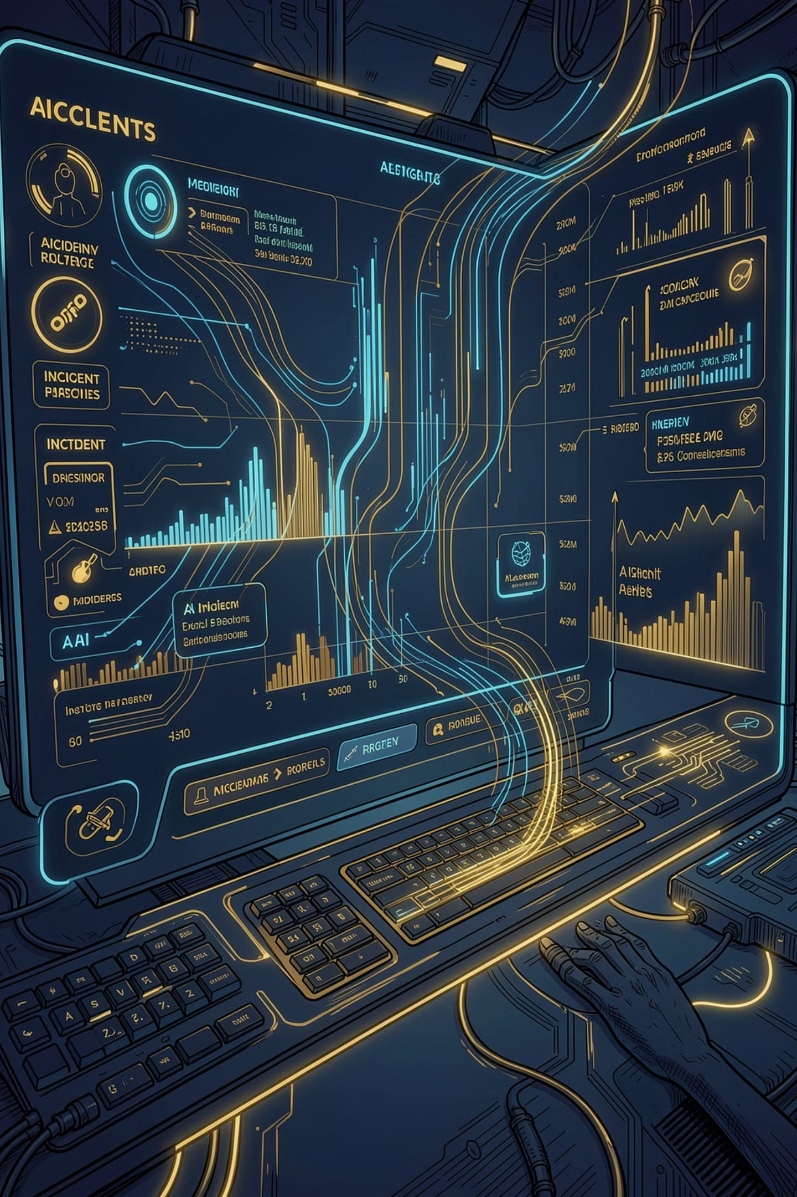
SentinelAI
An AI-assisted incident investigation platform that combines log analysis, live observability queries, and engineering context to help teams understand incidents faster and produce structured RCA output.
INCIDENT INVESTIGATION
AI-POWERED
RCA AUTOMATION

Slide 2

Current Pain Points in Incident Investigation
🐢 Slow & Manual
Engineers manually grep logs, craft Kibana DSL queries, and correlate timestamps across multiple browser tabs — for every incident.
🔁 Repetitive Work
Similar failures are investigated from scratch every on-call rotation. No memory, no learning loop.
🧩 Knowledge Silos
Senior engineers carry tribal knowledge. Junior engineers struggle with ELK/Kafka query syntax and miss key signals.
📝 RCA Bottleneck
Post-incident RCAs are written hours or days later, relying on fading memory — or skipped entirely under time pressure.
📉 No Pattern Reuse
Past incidents are not indexed or searchable. The same root causes recur because no institutional memory is built.
The Solution: We need an AI-assisted layer that turns raw observability data into summaries, hypotheses and recommended actions.

Slide 3

Why an AI Layer on Top of Observability?
AIOps Theory:
Observability data is raw signal, not insight
SentinelAI adds memory, reasoning and live investigation
The platform turns logs into RCA, context and action
Knowledge Service makes each incident reusable for the next one
The Challenge:
On-call engineers spend 40–60% of incident response time manually querying ELK, correlating signals and writing RCAs.
Market Momentum:
Major vendors — Datadog, Dynatrace, New Relic, AWS — are racing to embed AI copilots into observability platforms. Early adopters report 30–50% reduction in mean-time-to-resolve (MTTR) with AI-assisted triage.
Why SentinelAI:
Build this capability on our own stack, own the IP, demonstrate it to clients. Distributed, cloud-native systems generate millions of log events every hour. The question is not whether to add AI to observability — it is how quickly we can build it and how well we make it work.

Slide 4

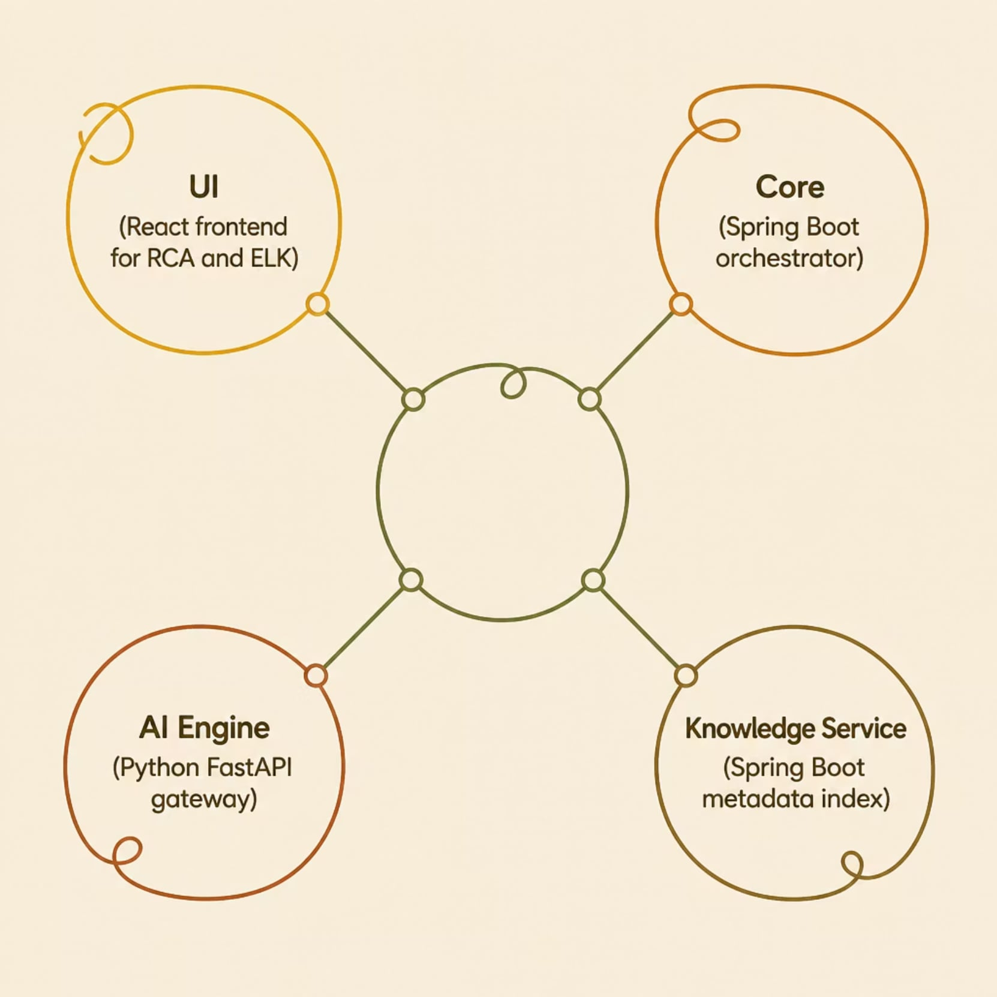
Architecture at a Glance
Four Runnable Parts
UI — React interface for RCA and ELK investigation
Core — Spring Boot orchestration for RCA, log ingestion, and Elasticsearch
AI Engine — Python FastAPI routing to Groq, Ollama, HuggingFace, OpenAI, OpenRouter
Knowledge Service — Spring Boot microservice indexing GitHub, Jira, Confluence, and Jenkins

Slide 5
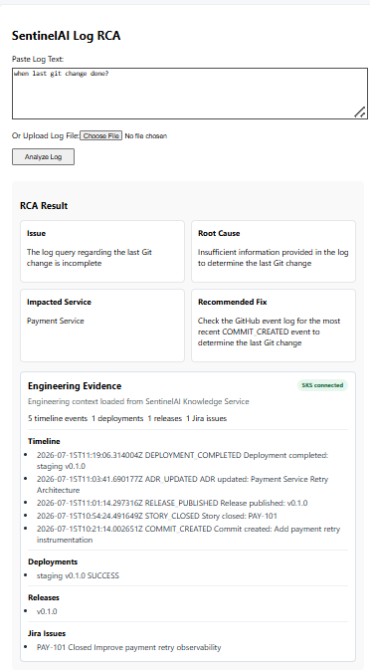





Log RCA Workflow
Input
Paste log text or upload a file from the UI
Process
Send content to Core via the RCA API
Output
Structured RCA with issue, root cause, impacted service, and recommended fix
Enrich
Optionally add engineering context from the Knowledge Service

Slide 6
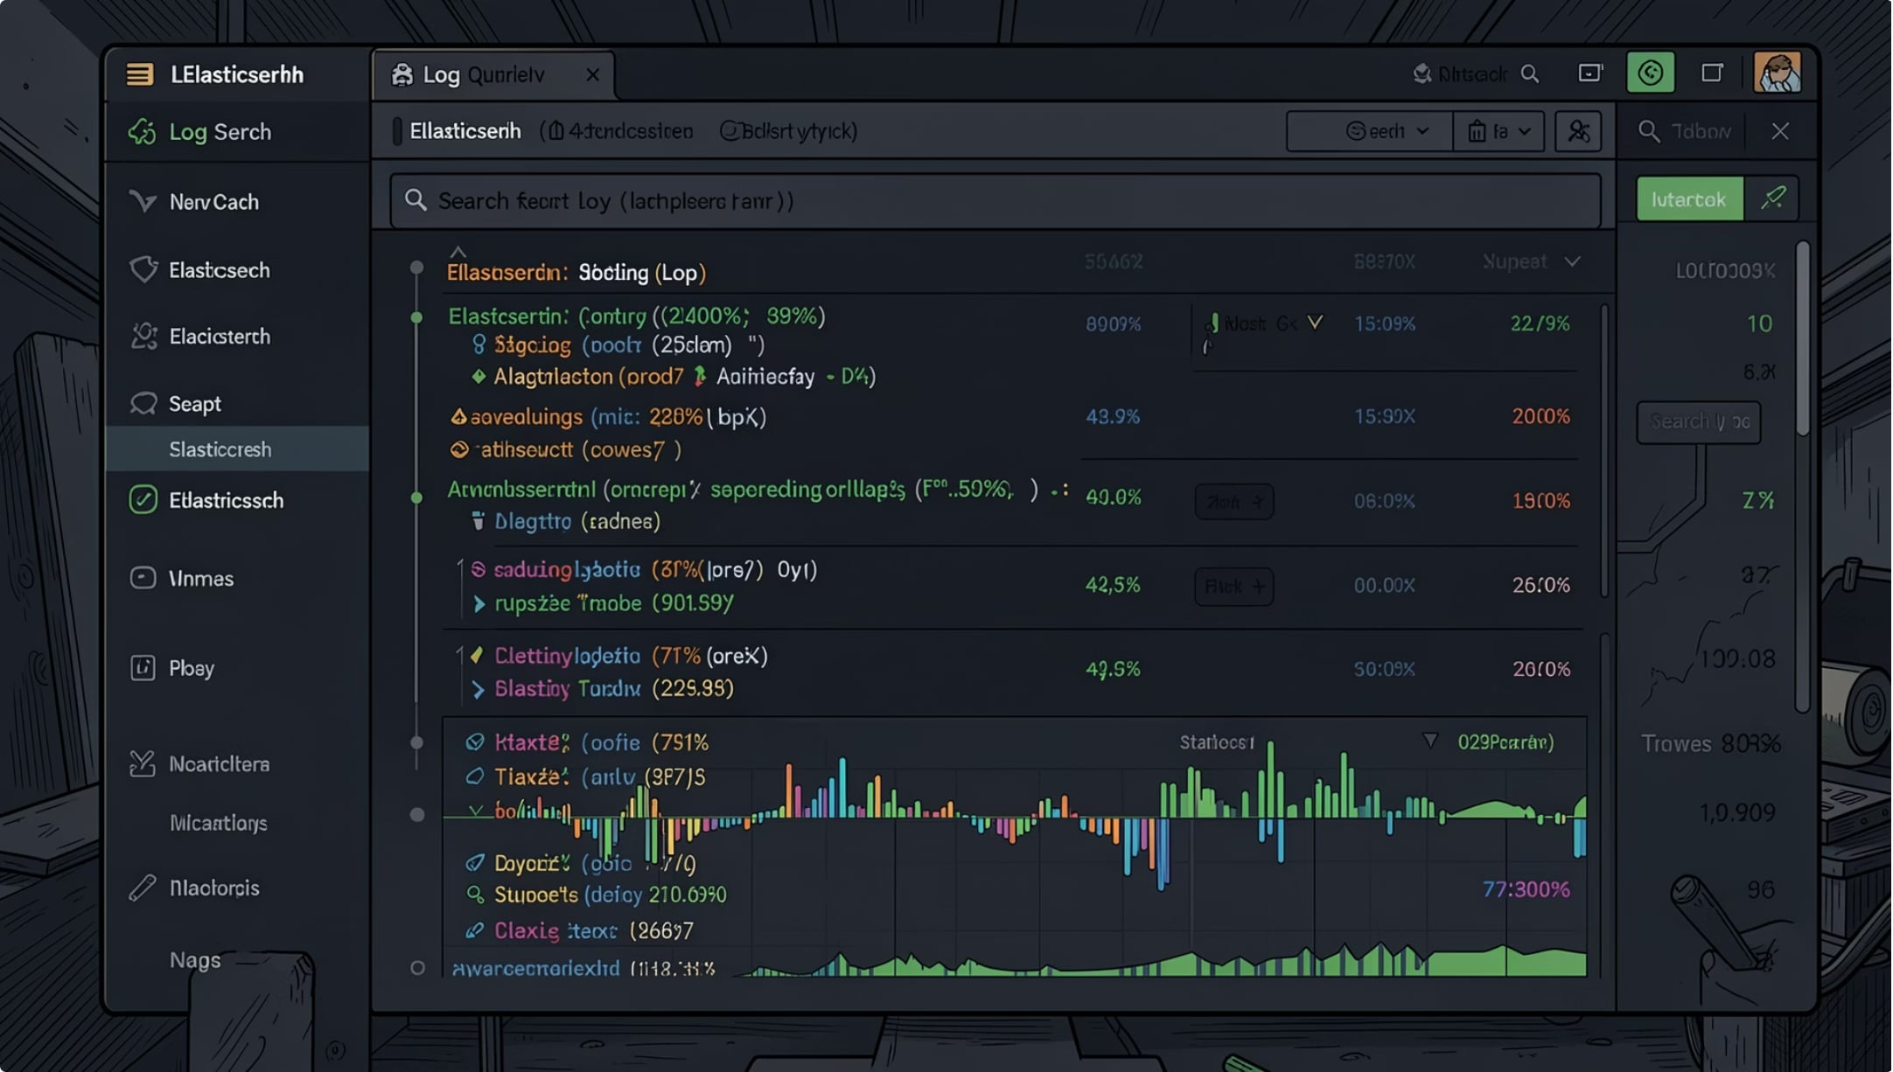
Live ELK Investigation
How it works
Query Elasticsearch directly from the UI using service, severity, and timeframe
Retrieve recent logs, summarize them, and produce an AI-generated investigation result
Return suspicious log lines along with the likely root cause and recommended action
Response Fields
summary — AI one-paragraph incident summary
probableRootCause — Most likely cause with log evidence
impactedService — Service(s) affected
recommendedAction — Suggested remediation steps
suspiciousLogs[] — Specific log lines flagged by AI

Slide 7
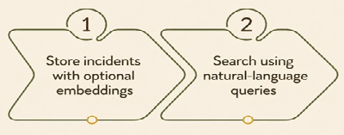

Semantic Retrieval & Incident Memory
Store Incidents
Natural-Language Search
Upload incidents and optionally create embeddings for semantic retrieval
Search stored incidents using natural-language queries when embeddings are enabled
Postgres/pgvector is used for embedding storage

Slide 8
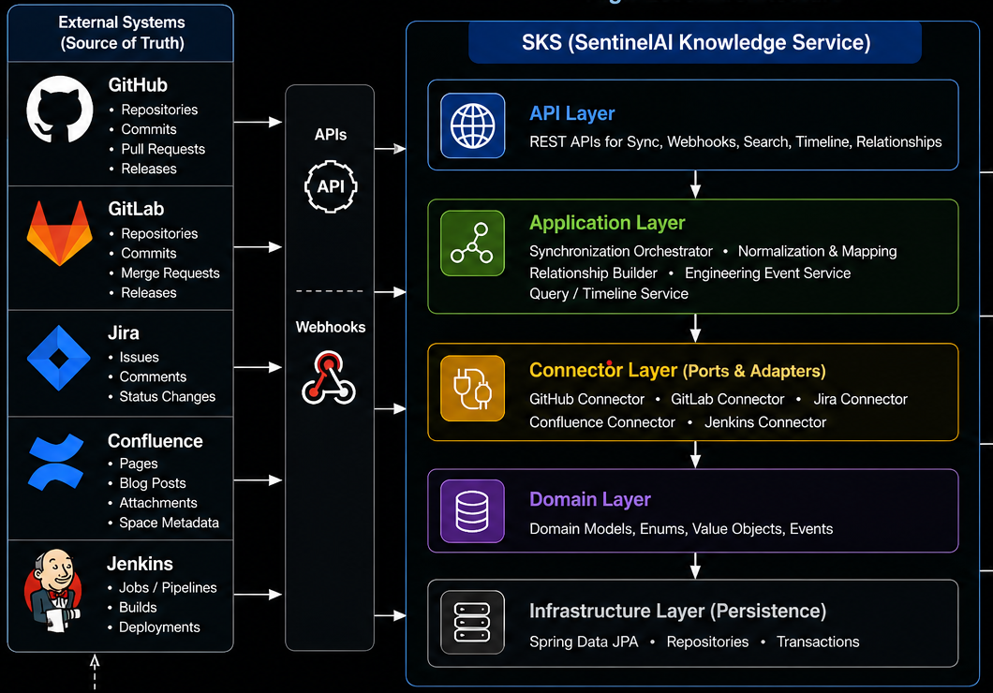
Engineering Knowledge Enrichment
Source Sync
Sync metadata from GitHub, Jira, Confluence, and Jenkins
Webhook Ingestion
Ingest real-time webhook events from those systems
Context APIs
Expose timeline, relationship, repository, deployment, release,
and Jira search APIs
Normalized Index
Build a normalized engineering knowledge index without
performing AI reasoning itself

Slide 9
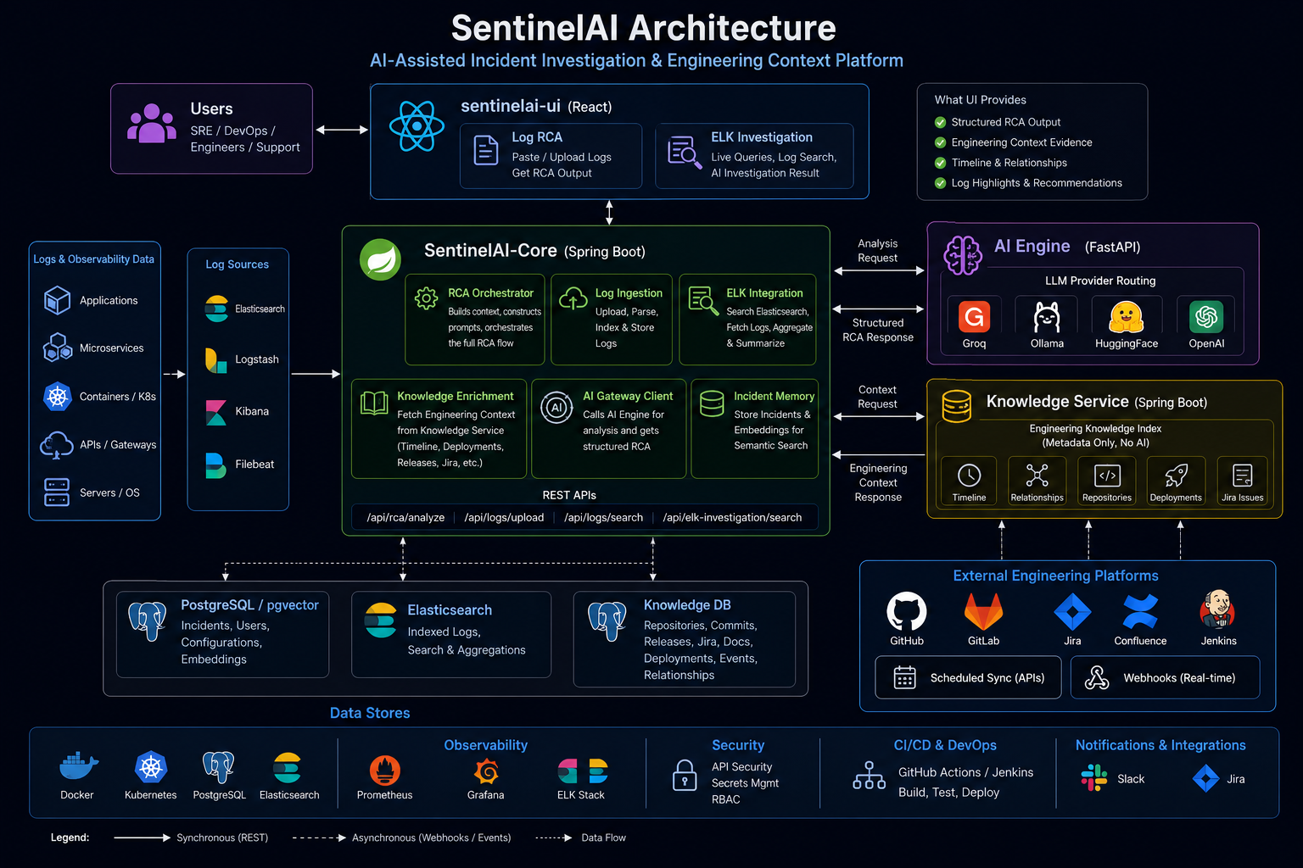

Slide 10
Pluggable Ai Providers Architeture
Swap LLM providers with a single config change — no Core code changes
Groq
Ollama
Cloud inference
~3 s latency
Llama 3.3 70B
Default provider
Fully local
Data residency
No API keys
Local dev & PoC
OpenAI
HuggingFace
GPT-4o / 4.1
Azure OpenAI
Enterprise grade
High accuracy
Open-source
Custom fine-tunes
Research use
Cost-efficient
OpenRouter
AWS Bedrock
Claude / Titan
AWS-native
Enterprise security
Compliance ready
Cloud inference
~3 s latency
Llama 3.3 70B
Default provider
Configuration (application.yaml):
sentinelai.ai-engine.url: http://localhost:8000/analyze
sentinelai.ai-engine.provider: groq
sentinelai.semantic-search.enabled: true
sentinelai.elk.enabled: true
Benefits:
Cost flexibility: Groq for speed · Ollama for data-residency · Azure OpenAI for enterprise compliance
Fully decoupled: SentinelAI-Core is provider-agnostic. Business logic never changes when you swap models.

Slide 11
API Highlights
Core APIs
Knowledge Service APIs
POST /api/rca/analyze
POST /api/logs/upload
POST /api/logs/search
POST /api/elk-investigation/search
POST /api/sync/{github|jira|confluence|jenkins|all}
POST /api/webhooks/{sourceSystem}
GET /api/timeline · /relationships · /repositories
GET /api/deployments · /releases · /jira/issues
Core uses sentinelai.ai-engine.url and sentinelai.ai-engine.provider for AI routing. Knowledge Service configuration is driven through sentinelai.knowledge.platforms settings. The Knowledge Service is optional for RCA — if unavailable, Core continues RCA generation without engineering context.

Slide 12
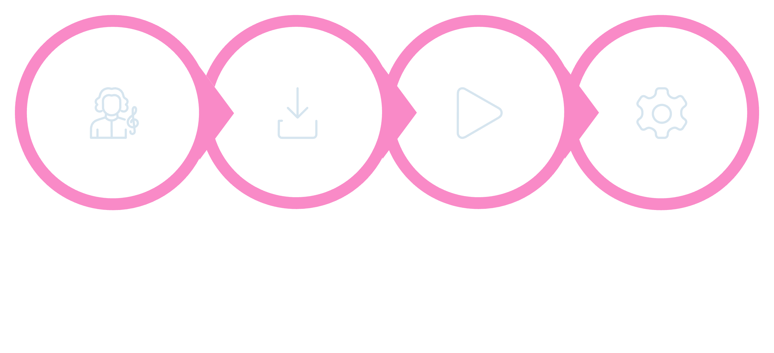
Local Run Guide
Run Individually
Start Infra
Seed ELK
Start All
Each service can also be started individually — AI Engine via uvicorn, Core and Knowledge Service via mvnw.cmd spring-boot:run, and UI via npm start.

Slide 13
Status & What's Next
✅ Implemented Now
🔭 Planned or Evolving
RCA analysis from logs
Live ELK investigation
AI provider routing (Groq, Ollama, HuggingFace, OpenAI)
Knowledge Service sync and webhook ingestion
Engineering-context enrichment for RCA
Deeper incident correlation across systems
Real-time Kafka-based monitoring
Automated Jira/Slack remediation workflows
Stronger production-grade integrations with enterprise platforms

Slide 14

Future Vision — Enterprise AI SRE Copilot
SentinelAI as the central AI brain for production operations
The On-Call Experience — with SentinelAI Fully Realised
01
02
🚨 Alert fires
🧠 Agent reasons
PagerDuty/alerting triggers. Agent receives context.
Understands goal: 'investigate payment service degradation'
03
04
🔍 Agent queries
📝 Agent correlates
Calls ELK · Kafka · deployment history · incident KB — all auto
Links deploy v2.3.1 to error spike 18 min later via timeline
05
06
🔗 Agent drafts
✅ Human approves
Prepares RCA, runbook + Jira ticket draft
On-call reviews in < 2 min and resolves incident
Why This Matters:
The agent will reason over ELK, Kafka, deployments, releases and engineering knowledge
SentinelAI-Knowledge-Service becomes the memory layer for past incidents and change history
The human approves in minutes while the agent drafts RCA, runbooks and Jira actions
This moves the platform from demo to an enterprise-ready operations copilot
Capability Readiness:
✅ Multi-step ReAct loop [designed]
✅ Tool registry [designed]
✅ ElkClient + RAG [built]
🔭 Kafka triggers [P2 roadmap]
🔭 OIDC / RBAC [P2 roadmap]
🔭 Feedback / LLMOps [P2 roadmap]
The components are either built or clearly designed. SentinelAI is not a demo — it is a foundation.

