Slide 1
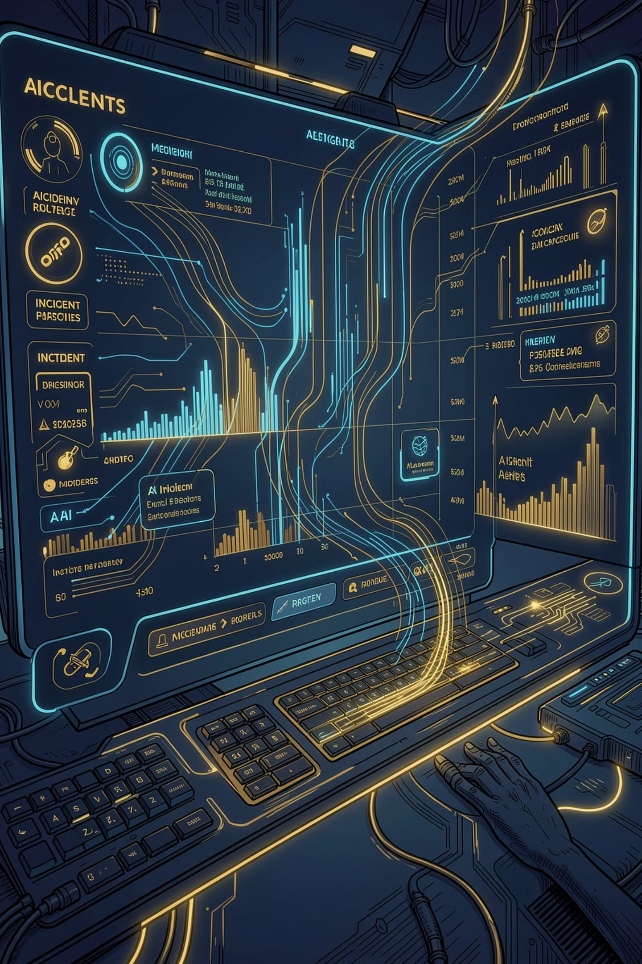
SentinelAI
An AI-assisted incident investigation platform that combines log analysis, live observability queries, and engineering context to help teams understand incidents faster and produce structured RCA output.
INCIDENT INVESTIGATION
AI-POWERED
RCA AUTOMATION

Slide 2
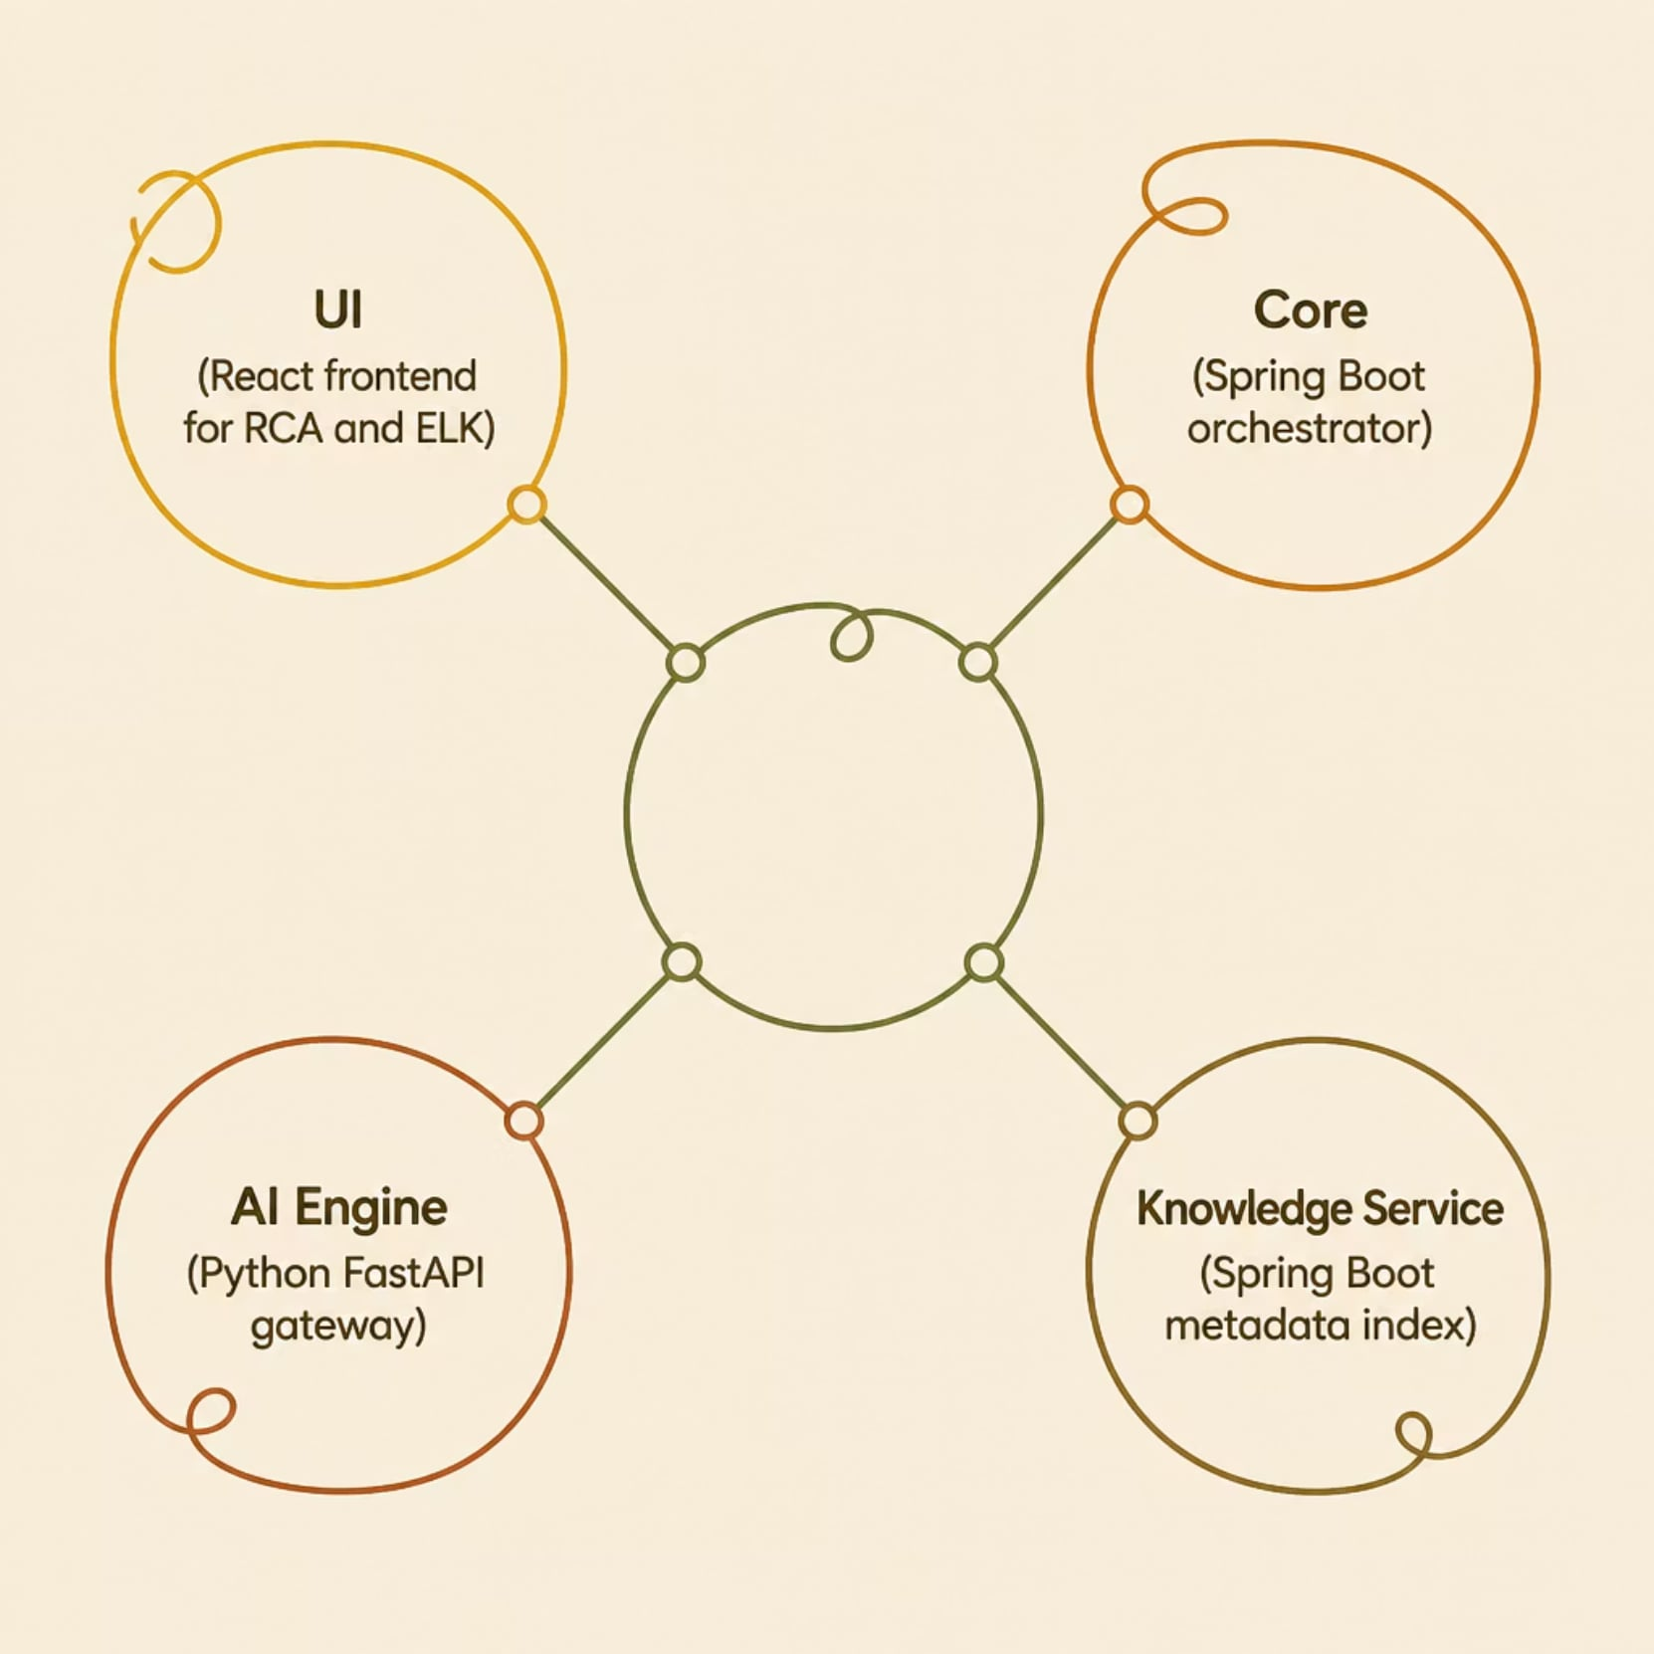
Architecture at a Glance
Four Runnable Parts
UI — React interface for RCA and ELK investigation
Core — Spring Boot orchestration for RCA, log ingestion, and Elasticsearch
AI Engine — Python FastAPI routing to Groq, Ollama, HuggingFace, or OpenAI
Knowledge Service — Spring Boot microservice indexing GitHub, Jira, Confluence, and Jenkins

Slide 3





Log RCA Workflow
Input
Paste log text or upload a file from the UI
Process
Send content to Core via the RCA API
Output
Structured RCA with issue, root cause, impacted service, and recommended fix
Enrich
Optionally add engineering context from the Knowledge Service

Slide 4
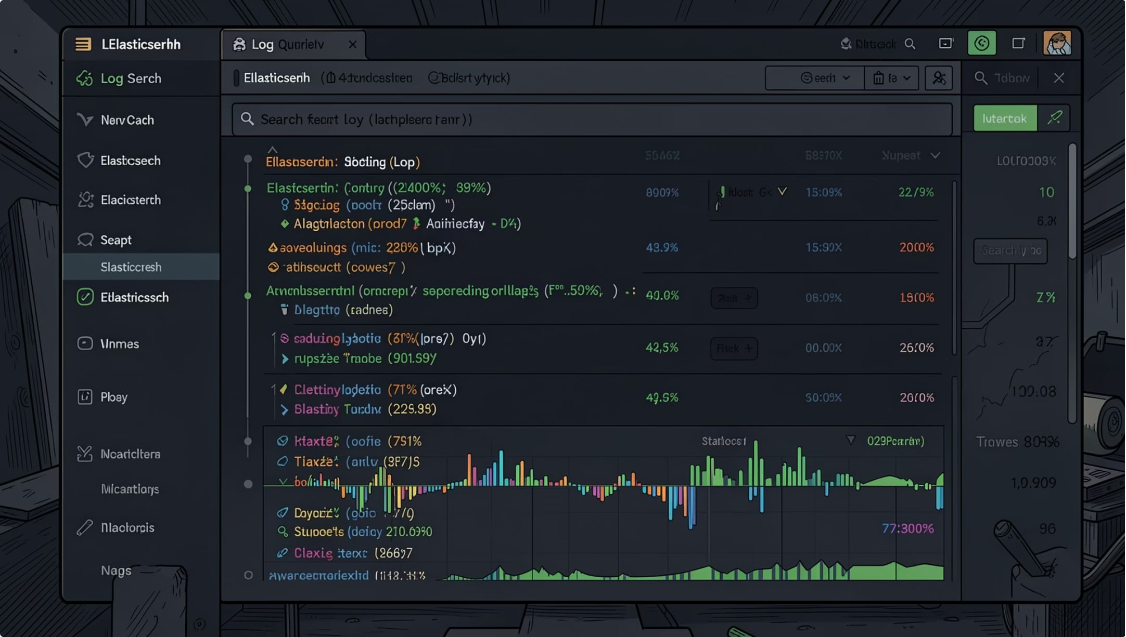

Live ELK Investigation
How It Works
Query Elasticsearch directly from the UI using service, severity, and timeframe
Retrieve recent logs, summarize them, and produce an AI-generated investigation result
Return suspicious log lines along with the likely root cause and recommended action
ELK investigation is controlled through sentinelai.elk.enabled, sentinelai.elk.url, sentinelai.elk.index, and sentinelai.elk.max-log-results configuration settings.

Slide 5


Semantic Retrieval & Incident Memory
Store Incidents
Natural-Language Search
Upload incidents and optionally create embeddings for semantic retrieval
Search stored incidents using natural-language queries when embeddings are enabled
Postgres/pgvector is required for embedding storage — configured via postgres-docker-compose.yml.

Slide 6
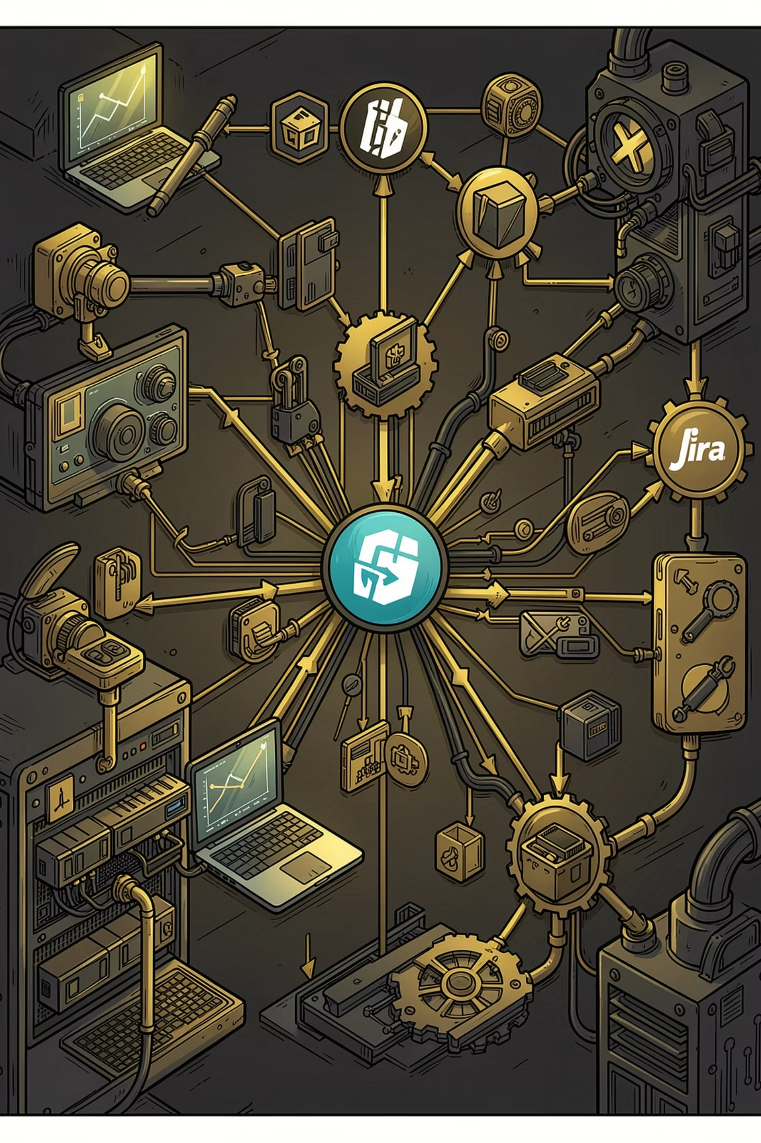
Engineering Knowledge Enrichment
Source Sync
Sync metadata from GitHub, Jira, Confluence, and Jenkins
Webhook Ingestion
Ingest real-time webhook events from those systems
Context APIs
Expose timeline, relationship, repository, deployment, release, and Jira search APIs
Normalized Index
Build a normalized engineering knowledge index without performing AI reasoning itself

Slide 7
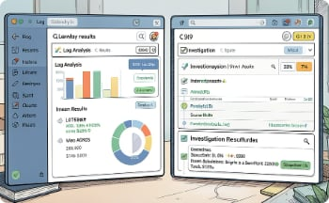
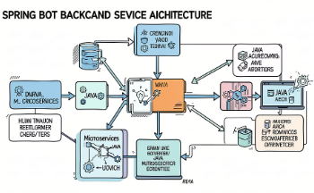
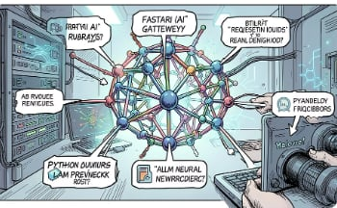
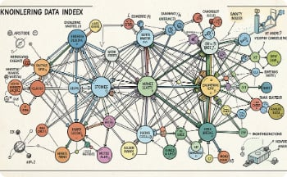
Main Components
sentinelai-ui
SentinelAI-Core
SentinelAI-Engine
SentinelAI-Knowledge-Service
Two main screens: Log RCA and ELK Investigation. Calls Core endpoints and displays structured RCA output and engineering context evidence.
Orchestrates RCA generation and live investigation flows. Integrates with Elasticsearch and the AI Engine. Exposes REST endpoints for logs, RCA, and ELK investigation.
Routes analysis requests to the configured provider. Supports Groq, Ollama, HuggingFace, and OpenAI-compatible providers. Returns structured RCA JSON to Core.
Stores normalized engineering metadata only. Supports webhook-driven ingestion and scheduled or manual sync. Exposes APIs for timeline, relationships, repositories, deployments, releases, Jira issues, and search.

Slide 8
API Highlights
Core APIs
Knowledge Service APIs
POST /api/rca/analyze
POST /api/logs/upload
POST /api/logs/search
POST /api/elk-investigation/search
POST /api/sync/{github|jira|confluence|jenkins|all}
POST /api/webhooks/{sourceSystem}
GET /api/timeline · /relationships · /repositories
GET /api/deployments · /releases · /jira/issues
Core uses sentinelai.ai-engine.url and sentinelai.ai-engine.provider for AI routing. Knowledge Service configuration is driven through sentinelai.knowledge.platforms settings. The Knowledge Service is optional for RCA — if unavailable, Core continues RCA generation without engineering context.

Slide 9

Local Run Guide
Run Individually
Start Infra
Seed ELK
Start All
Each service can also be started individually — AI Engine via uvicorn, Core and Knowledge Service via mvnw.cmd spring-boot:run, and UI via npm start.

Slide 10
Status & What's Next
✅ Implemented Now
🔭 Planned or Evolving
RCA analysis from logs
Live ELK investigation
AI provider routing (Groq, Ollama, HuggingFace, OpenAI)
Knowledge Service sync and webhook ingestion
Engineering-context enrichment for RCA
Deeper incident correlation across systems
Real-time Kafka-based monitoring
Automated Jira/Slack remediation workflows
Stronger production-grade integrations with enterprise platforms
📂 Repo Navigation
Each service has its own README: sentinelai-ui/, SentinelAI-Core/, SentinelAI-Engine/, SentinelAI-Knowledge-Service/. Architecture diagrams: SentinelAI-Architecture-v2.drawio, SentinelAI-ELK-Investigation-v1.drawio, SentinelAI-Agentic-Flow-v1.drawio.

