Slide 1
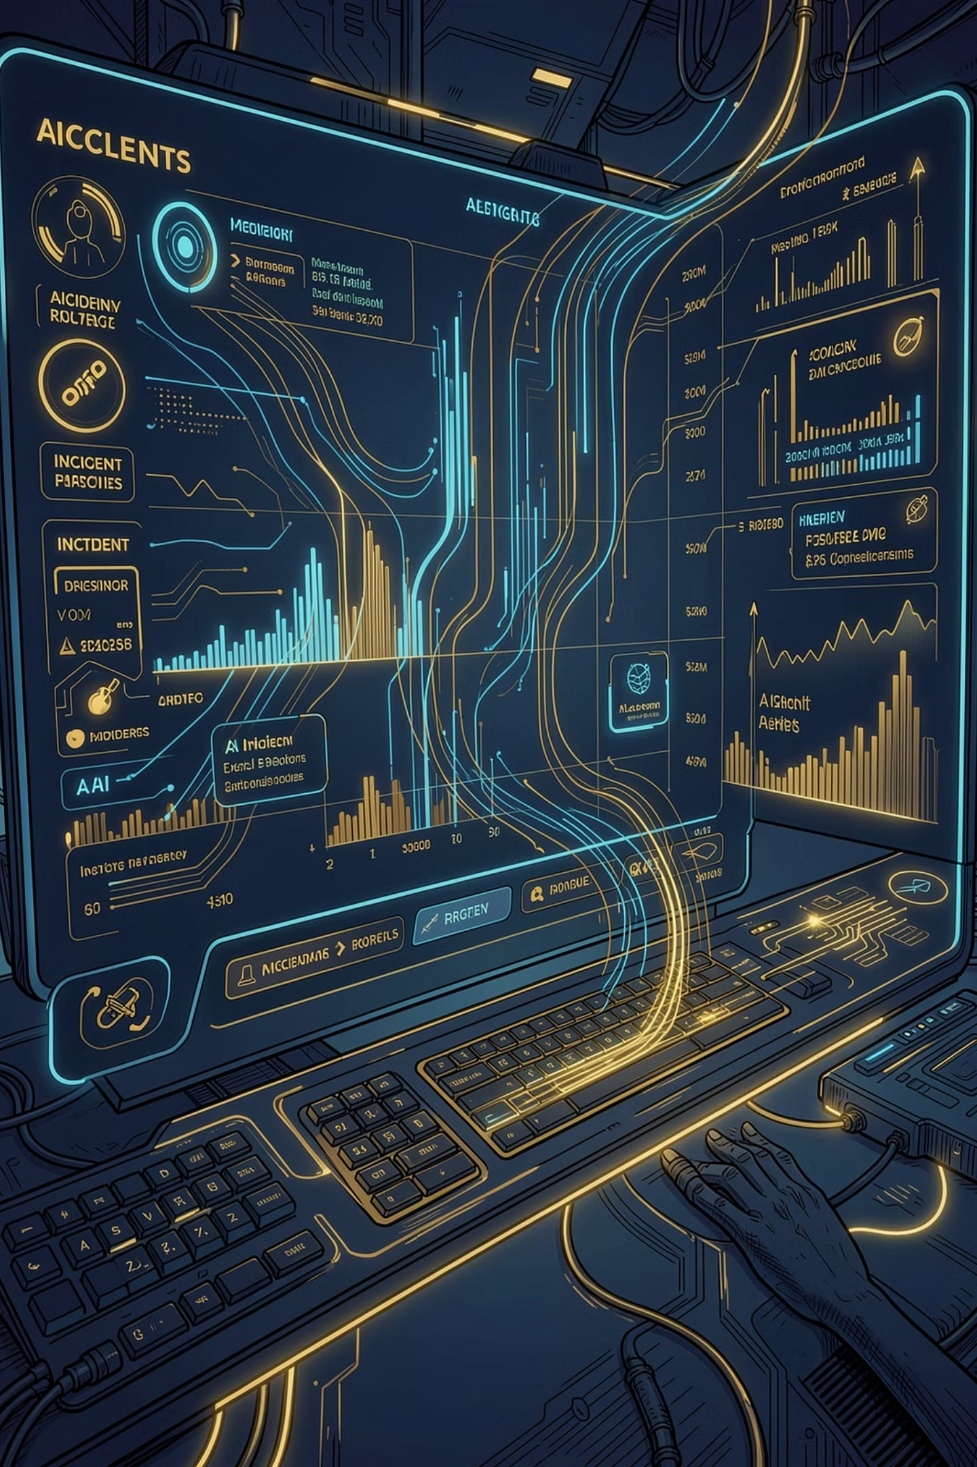
SentinelAI
Accelerate incident investigation with AI-powered root cause analysis. Reduce MTTR by combining log analysis, live observability, and engineering context into a single intelligent platform.
FASTER RCA
AI-POWERED
STRUCTURED OUTPUT

Slide 2
The Incident Investigation Challenge
Problem statement:
Business impact:
Incidents are expensive: every minute of downtime impacts customers and revenue
Investigation is manual and slow: engineers manually search logs, correlate data, and piece together root causes
Knowledge is scattered: context lives in GitHub, Jira, Confluence, Jenkins—not in the incident investigation flow
RCA is inconsistent: different teams produce different quality root cause analyses
High MTTR (Mean Time To Resolution)
Repeated incidents from same root causes
Inconsistent incident documentation
Engineering time spent on manual investigation instead of prevention

Slide 3
Why AI for Incident Investigation?
1
2
Pattern Recognition at Scale
Instant Context Correlation
AI can analyze thousands of log lines and identify patterns humans would miss
Connect logs to deployments, code changes, and infrastructure events automatically
3
4
Structured Output
Augment, Not Replace
Generate consistent, machine-readable RCA that feeds into downstream systems
AI assists engineers with faster analysis, not autonomous decision-making

Slide 4

SentinelAI: The Solution
SentinelAI is designed to address the challenges of incident investigation, providing an intelligent platform to accelerate root cause analysis and reduce MTTR.
Log RCA
Live ELK Investigation
Engineering Context
Paste logs or upload files. AI analyzes and produces structured root cause analysis with issue, root cause, impacted service, and recommended fix.
Query Elasticsearch directly. Retrieve recent logs, summarize them, and get AI-generated investigation results with suspicious log lines and recommended actions.
Automatically enrich RCA with metadata from GitHub, Jira, Confluence, and Jenkins. Connect incidents to deployments, code changes, and team context.

Slide 5
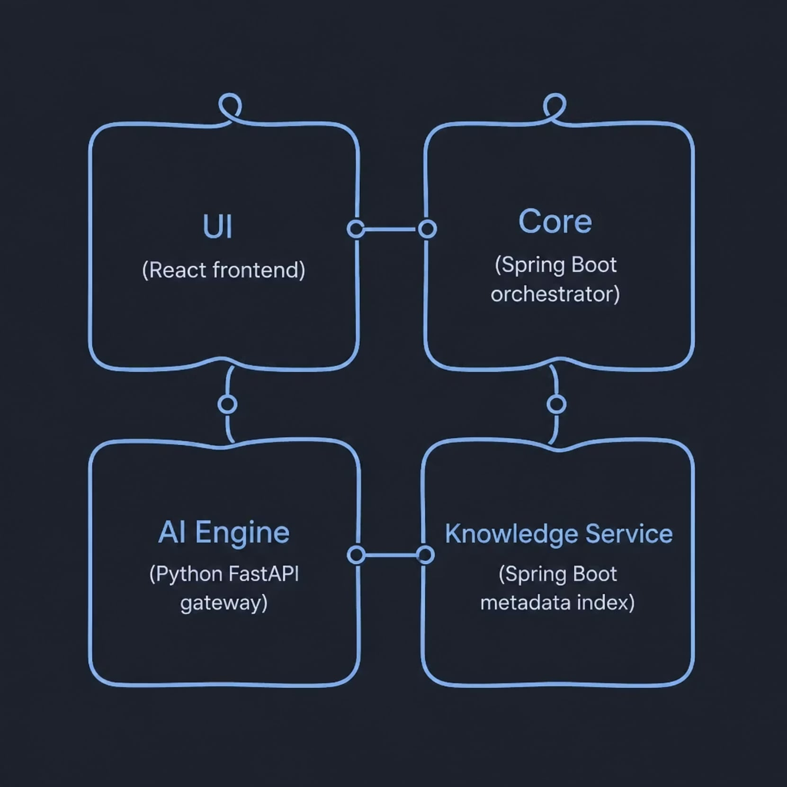
Architecture at a Glance
UI — React interface for RCA and ELK investigation
Core — Spring Boot orchestration for RCA, log ingestion, and Elasticsearch
AI Engine — Python FastAPI routing to Groq, Ollama, HuggingFace, or OpenAI
Knowledge Service — Spring Boot microservice indexing GitHub, Jira, Confluence, and Jenkins
This high-level overview illustrates the core components of the SentinelAI platform and their relationships.

Slide 6
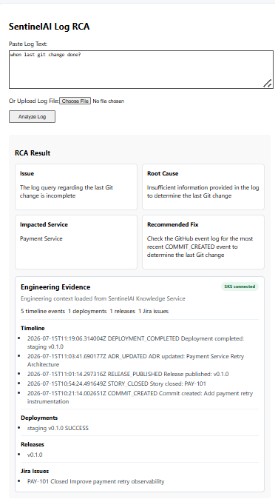



End-to-End RCA Workflow
Input
Paste log text or upload a file from the UI
Process
Send content to Core via the RCA API
Output
Structured RCA with issue, root cause, impacted service, and recommended fix
Enrich
Optionally add engineering context from the Knowledge Service

Slide 7
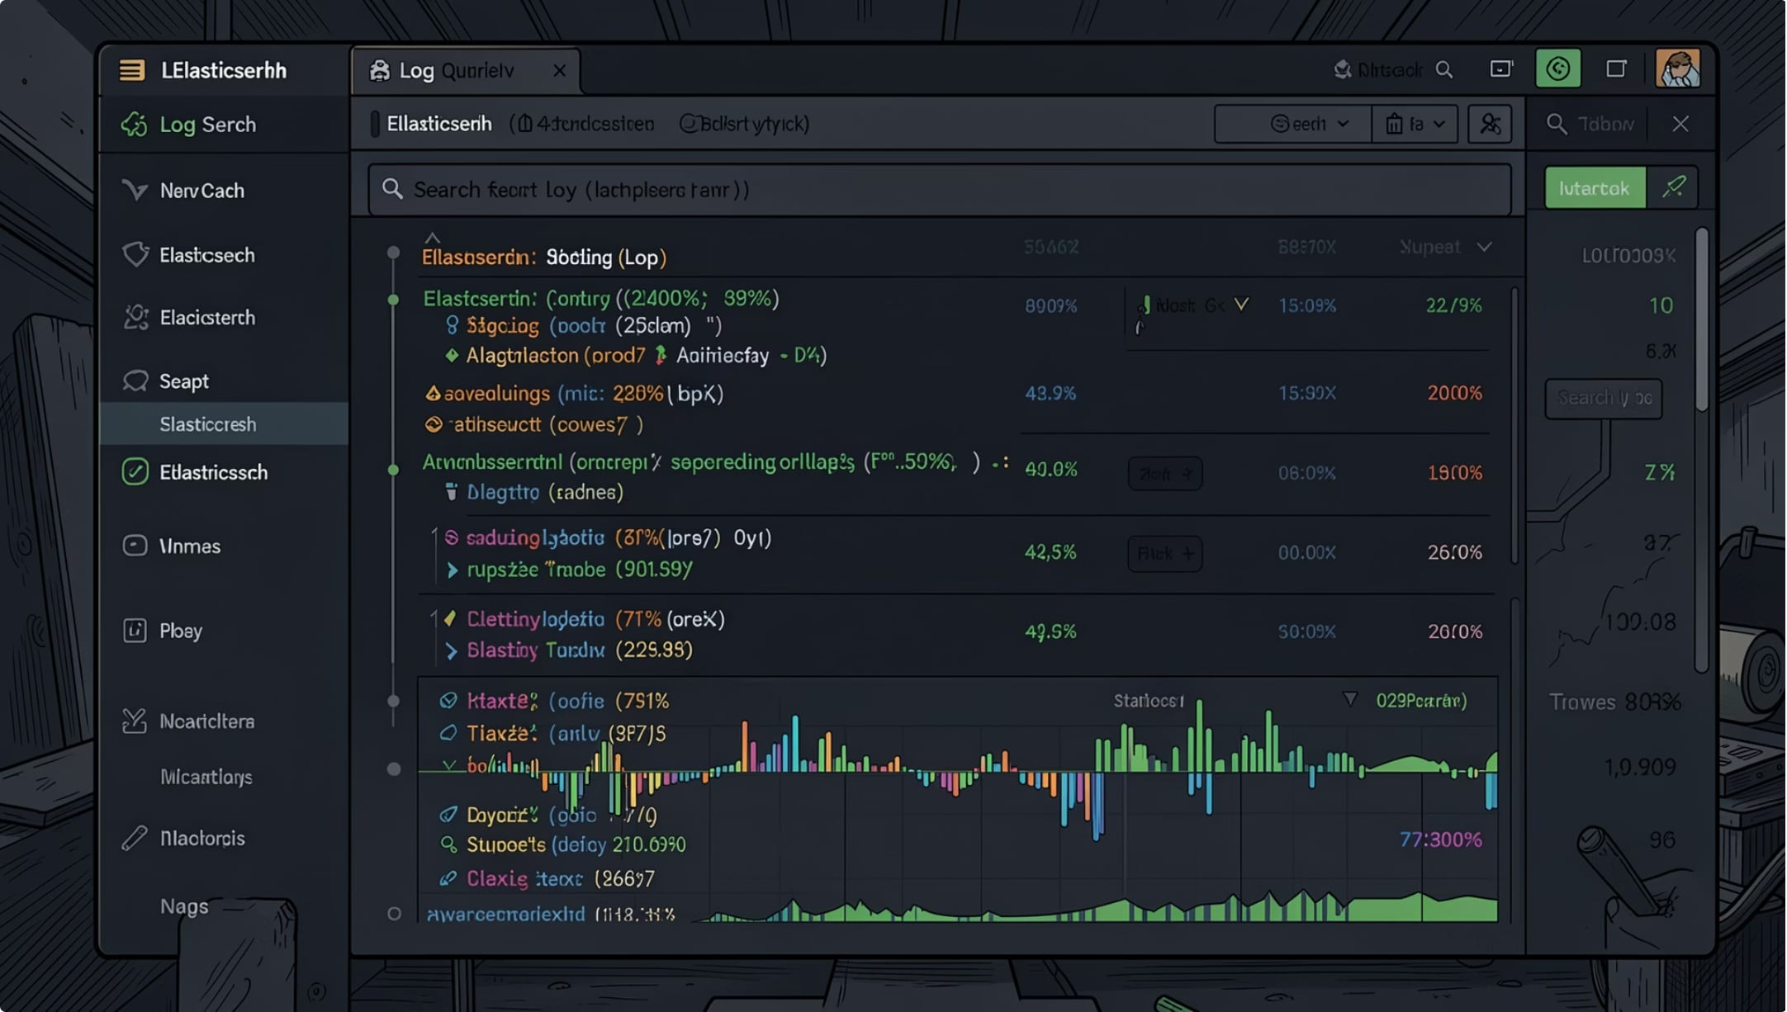
Live ELK Investigation
How it works
Query Elasticsearch directly from the UI using service, severity, and timeframe
Retrieve recent logs, summarize them, and produce an AI-generated investigation result
Return suspicious log lines along with the likely root cause and recommended action
Response Fields
summary — AI one-paragraph incident summary
probableRootCause — Most likely cause with log evidence
impactedService — Service(s) affected
recommendedAction — Suggested remediation steps
suspiciousLogs[] — Specific log lines flagged by AI

Slide 8
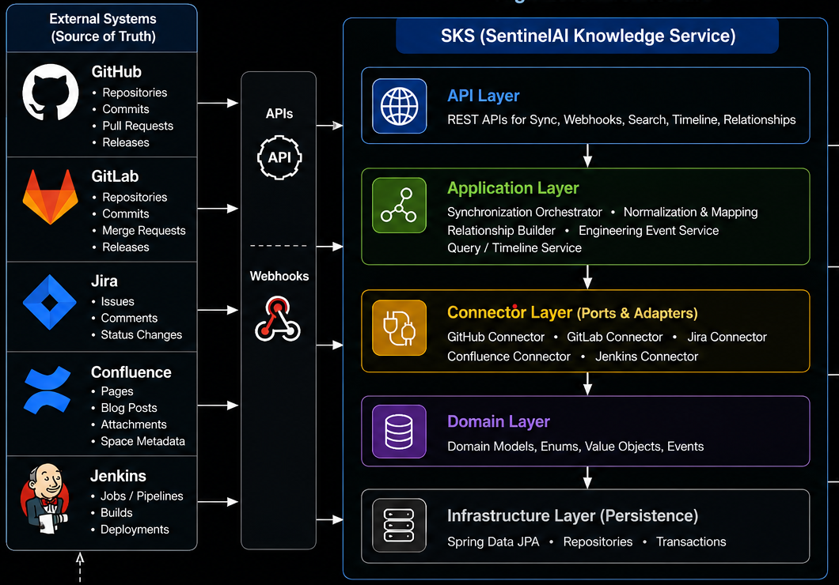
SentinelAI connects incident investigation to the broader engineering ecosystem by enriching Root Cause Analysis with vital engineering context.
Engineering Knowledge Enrichment
Source Sync
Sync metadata from GitHub, Jira, Confluence, and Jenkins
Webhook Ingestion
Ingest real-time webhook events from those systems
Context APIs
Expose timeline, relationship, repository, deployment, release,
and Jira search APIs
Normalized Index
Build a normalized engineering knowledge index without
performing AI reasoning itself

Slide 9
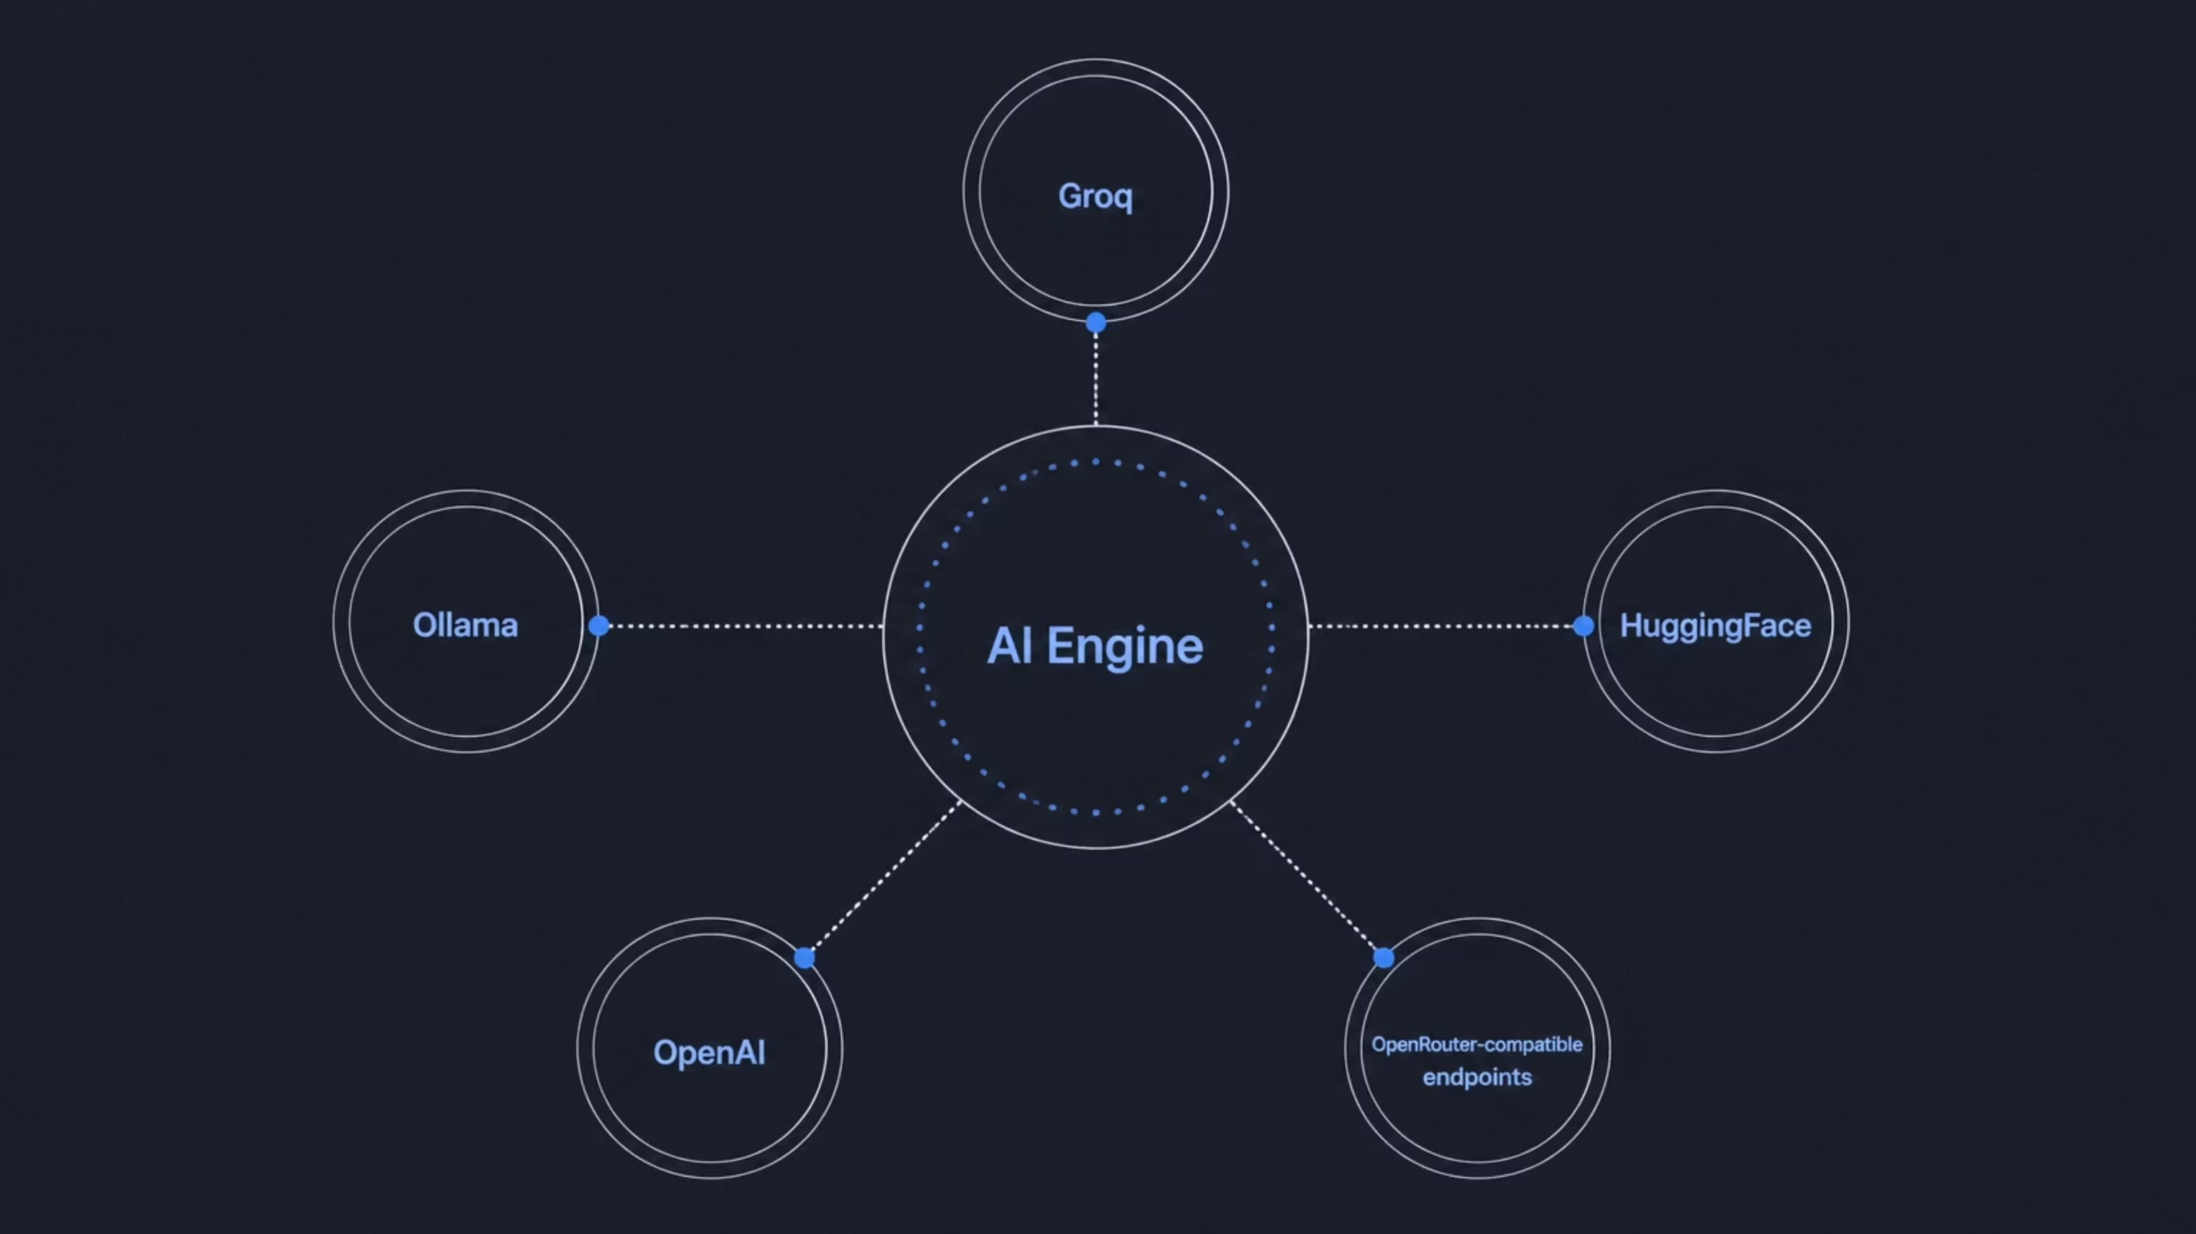
AI Architecture & Multi-LLM Support
Flexible AI Provider Routing
SentinelAI is AI-provider agnostic. The AI Engine routes
analysis requests to the configured provider.
Supported providers: Groq, Ollama, HuggingFace, OpenAI, and OpenRouter-compatible endpoints
Core uses sentinelai.ai-engine.url and sentinelai.ai-engine.provider for AI routing
This flexibility allows teams to choose the best
provider for their cost, latency, and privacy requirements.
This flexible AI provider routing represents a strategic advantage, allowing for significant flexibility and cost optimization by enabling teams to select the most suitable LLM provider based on their specific requirements.

Slide 10
Technology Stack
A clean, professional, and easy-to-scan overview of SentinelAI's technology stack for technical architects.
Frontend
Data & Observability
React
Elasticsearch (ELK)
PostgreSQL with pgvector (for semantic search)
Backend Services
Spring Boot (Core, Knowledge Service)
Python FastAPI (AI Engine)
Integrations
GitHub, Jira, Confluence, Jenkins
Groq, Ollama, HuggingFace, OpenAI
Infrastructure
Docker & Docker Compose
Microservices architecture

Slide 11
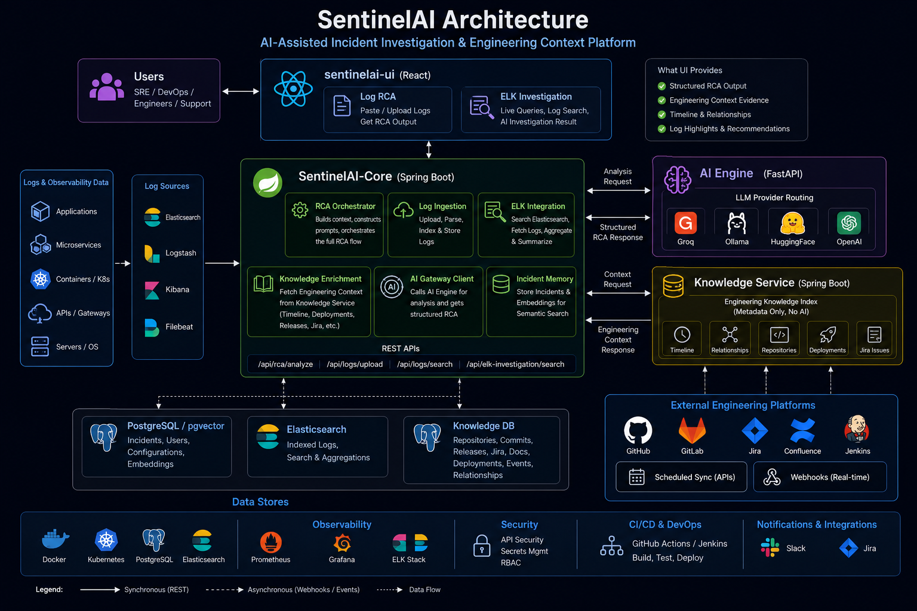

Slide 12
Current Status: What's Implemented
RCA analysis from logs (structured output)
Live ELK investigation with AI-powered summarization
AI provider routing (Groq, Ollama, HuggingFace, OpenAI)
Knowledge Service sync and webhook ingestion
Engineering-context enrichment for RCA
Semantic retrieval with pgvector embeddings
Multi-service microservices architecture
Docker-based local development environment
These features represent production-ready functionality, rigorously developed and tested to provide immediate value for accelerating incident investigation and reducing MTTR.

Slide 13

Roadmap: What's Next
This is a living roadmap, and the SentinelAI platform is designed for continuous evolution, driven by the needs of modern incident management. Our forward-looking vision focuses on building an even more intelligent, proactive, and integrated solution.
🔭 Planned or Evolving
Deeper incident correlation across systems
Real-time Kafka-based monitoring and alerting
Automated Jira/Slack remediation workflows
Stronger production-grade integrations with enterprise platforms
Advanced incident pattern learning and prevention
Multi-incident correlation and trend analysis

Slide 14
Business Benefits
SentinelAI delivers tangible business value by streamlining incident management and enhancing operational efficiency.
Reduce MTTR
Improve RCA Quality
Faster incident investigation means faster resolution and less customer impact
Consistent, structured root cause analysis across all teams
Reduce Toil
Scalable Knowledge
Engineers spend less time manually searching logs and more time on prevention
Engineering context is automatically indexed and searchable, not siloed
Cost Optimization
Competitive Advantage
Flexible AI provider routing allows teams to optimize for cost and performance
Faster incident response improves customer trust and retention

Slide 15
Enterprise Ready Architecture – With Scale
This architecture is designed for enterprise scale and reliability, ensuring robust performance under demanding conditions.
Microservices Design
Flexible AI Provider Routing
Decoupled Knowledge Service
Each component (UI, Core, AI Engine, Knowledge Service) can scale independently
Services can be deployed, updated, and scaled without affecting others
Not locked into a single LLM provider
Can switch providers or use multiple providers based on workload and cost
Engineering context is optional for RCA—Core continues without it if unavailable
Knowledge Service can be scaled separately to handle high-volume metadata ingestion
Stateless Processing
Extensible Integration Points
RCA analysis is stateless, allowing horizontal scaling
Multiple instances can process requests in parallel
Webhook-driven ingestion allows real-time updates from any system
APIs expose normalized data for downstream consumption

Slide 16

Getting Started: Local Development
SentinelAI offers a developer-friendly and easy-to-set-up local environment, allowing you to quickly get started with development and testing.
Quick Start
Start Infrastructure - Run docker-compose to spin up Elasticsearch, PostgreSQL, and other dependencies
Seed ELK - Load sample log data into Elasticsearch for testing
Start All Services - Launch all four services (UI, Core, AI Engine, Knowledge Service) together
Run Individually - Or start each service independently for development
Each Service
AI Engine: uvicorn
Core & Knowledge Service: mvnw.cmd spring-boot:run
UI: npm start
Repository Structure
sentinelai-ui/ — React frontend
SentinelAI-Core/ — Spring Boot orchestrator
SentinelAI-Engine/ — Python FastAPI gateway
SentinelAI-Knowledge-Service/ — Spring Boot metadata service

Slide 17

Future Vision — Enterprise AI SRE Copilot
SentinelAI as the central AI brain for production operations
The On-Call Experience — with SentinelAI Fully Realised
01
02
🚨 Alert fires
🧠 Agent reasons
PagerDuty/alerting triggers. Agent receives context.
Understands goal: 'investigate payment service degradation'
03
04
🔍 Agent queries
📝 Agent correlates
Calls ELK · Kafka · deployment history · incident KB — all auto
Links deploy v2.3.1 to error spike 18 min later via timeline
05
06
🔗 Agent drafts
✅ Human approves
Prepares RCA, runbook + Jira ticket draft
On-call reviews in < 2 min and resolves incident
Why This Matters:
The agent will reason over ELK, Kafka, deployments, releases and engineering knowledge
SentinelAI-Knowledge-Service becomes the memory layer for past incidents and change history
The human approves in minutes while the agent drafts RCA, runbooks and Jira actions
This moves the platform from demo to an enterprise-ready operations copilot
Capability Readiness:
✅ Multi-step ReAct loop [designed]
✅ Tool registry [designed]
✅ ElkClient + RAG [built]
🔭 Kafka triggers [P2 roadmap]
🔭 OIDC / RBAC [P2 roadmap]
🔭 Feedback / LLMOps [P2 roadmap]
The components are either built or clearly designed. SentinelAI is not a demo — it is a foundation.

Slide 18

Next Steps & Call to Action
The Opportunity
SentinelAI represents a strategic investment in incident management excellence. By combining AI-powered analysis with engineering context, we can significantly reduce MTTR, improve RCA quality, and free up engineering resources for prevention and innovation.
What We're Asking For
Approval to continue development and refinement
Resources for production deployment and integration
Cross-team collaboration for knowledge service integration
Feedback from engineering teams on priorities and use cases
Timeline
Phase 1 (Immediate)
Production deployment and team onboarding
Phase 2 (Q3)
Advanced integrations and automation workflows
Phase 3 (Q4)
Enterprise-grade monitoring and analytics

