Slide 1
EJB3 Java Persistence API
POJO based persistence

Slide 2
EJB3 JPA: Goals
Provide full Object/Relational Model
Improve modeling capabilities
  Inheritance and polymorphism
Standardize O/R mapping
  Annotations and O-R XML
Make entities usable outside the container
Expanded EJBQL
Facilitate testability

Slide 3
EJB 3.0 Java Persistence API
Simplification of container-managed persistence
  POJO / JavaBeans architecture approach
  Support use of new()
  Allow for use of entities outside the container
    Web container
    Java SE
Support for light-weight domain modeling, including
  Inheritance and polymorphism
  Object-relational mapping metadata
Elimination of need for data transfer objects and related anti-patterns

Slide 4
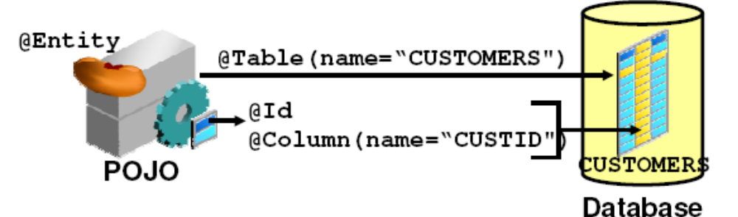
JPA Entity
An JPA entity:
  Is a lightweight object that manages persistent data
  Is defined as a plain old Java object (POJO) marked with the ENTITY annotation (no interfaces required)
  Must implement the java.io.Serializable interface to be passed by value to a remote application
  Is mapped to a database by using annotations

Slide 5
Entity Annotations
@Entity
@Table(name=“AUCTION_ITEM”)
public class Item {
private long id;
private String description;
private String productName;
private Set<Bid> bids = new HashSet();
private User seller;
@Id @GeneratedValue
@Column(name=“ITEM_ID”)
public long getId() {
return id;
}
public void setId(long id) {
this.id = id;
}
relational table declaration
auto-key generation

Slide 6
Features of Entities
  Persistability
  Identity
  Transactionality
Neelam Agarwal

Slide 7
Creating Entity
  @Entity
  public class Employee {
  @Id private int id;
  private String name;
  private long salary;
  public Employee() {}
  public Employee(int id) { this.id = id; }
  public int getId() { return id; }
  public void setId(int id) { this.id = id; }
  public String getName() { return name; }
  public void setName(String name) { this.name = name; }
  public long getSalary() { return salary; }
  public void setSalary (long salary) { this.salary = salary; }
  }
Neelam Agarwal

Slide 8
Entity Manager
  This API is implemented by the entity manager and encapsulated almost entirely within a single interface called EntityManager.
  Until an entity manager is used to actually create, read, or write an entity, the entity is nothing more than a regular (nonpersistent) Java object.
  When an entity manager obtains a reference to an entity, either by having it explicitly passed in as an argument to a method call or because it was read from the database, that object is said to be managed by the entity manager.
  The set of managed entity instances within an entity manager at any given time is called its persistence context.
Neelam Agarwal

Slide 9
Obtaining EntityManager
  EntityManager object can be accessed from EntityManagerFactory
  EntityManagerFactory exists itself as persistent.xml file which contains all the configuration about connection setting.
Neelam Agarwal

Slide 10
Syntax to obtain object.
EntityManagerFactory emf Persistence.createEntityManagerFactory("EmployeeService");
EntityManager em=emf.createEntityManager();
Persisting an Object
Employee emp = new Employee(158);
em.persist(emp);
Removing an Entity
Employee emp = em.find(Employee.class, 158);
em.remove(emp);
Neelam Agarwal

Slide 11
Updating an Entity
  Employee emp = em.find(Employee.class, 158);
  emp.setSalary(emp.getSalary() + 1000);
  Starting Transaction
    Em.getTransaction.begin();
  Stopping Transaction
    Em.getTransaction.commit();
Neelam Agarwal

Slide 12
Entity Annotations
@Entity
@Table(name=“AUCTION_ITEM”)
public class Item {
private long id;
private String description;
private String productName;
private Set<Bid> bids = new HashSet();
private User seller;
@Id @GeneratedValue
@Column(name=“ITEM_ID”)
public long getId() {
return id;
}
public void setId(long id) {
this.id = id;
}
create table AUCTION_ITEM
(
ITEM_ID Number,
DESC varchar(255),
ProductName varchar(255),
USER_ID Number
);

Slide 13
Entity Annotations
…
@Column(name=“DESC”, length=500)
public String getDescription() {
return description;
}
public void setDescription(String desc) {
this.description = desc;
}
public String getProductName() {
return productName;
}
protected void setProductName(String name) {
this.productName = name;
}
column mapping
intuitive defaults

Slide 14
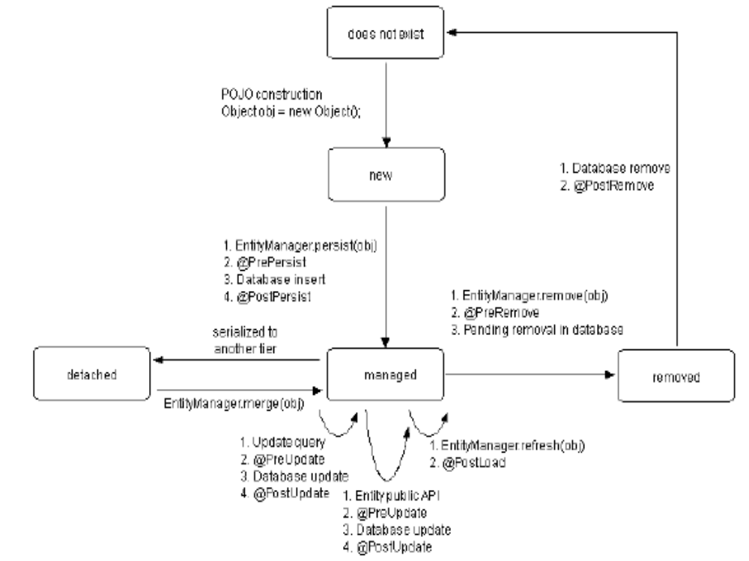
Life cycle of a JPA Entity
Neelam Agarwal

Slide 15
Persistent state and access to it
Access to fields
  By persistence provider
    Property-based: through JavaBeans property accessors
      Annotate getter (!)
      Accessors must be public or protected
      Exclusion from persistent state: @Transient
    Field-based: direct
      Annotate fields
      Exclusion from persistent state: transientor @Transient
  By clients of entity: only through accessors
    Fields must not be public
    (And should really be private)

Slide 16
Persistent state
Types of fields/properties
  Primitives, primitive wrappers, String
  BigInteger, BigDecimal
  Date, Calendar
  java.sql-types: Date, Time, Timestamp
  Char[], Character[]
  Byte[], Byte[]
  Collection(sub-) interfaces
    Collection, Set, List, Map
  Enums
  Entities
  Embeddables

Slide 17
Mapping to Table
  @Entity
  @Table(name="EMP")
  Public class Employee { ... }
Neelam Agarwal

Slide 18
Column Mapping
  Mapping Attributes to Column
@Entity
public class Employee {
@Id
@Column(name="EMP_ID")
private int id;
private String name;
@Column(name="SAL")
private long salary;
@Column(name="COMM")
private String comments;
// ...
}
Neelam Agarwal

Slide 19
Lazy Fetching
  We want some data to be retreived only when or if it is required.
@Entity
public class Employee {
// ...
@Basic(fetch=FetchType.LAZY)
@Column(name="COMM")
private String comments;
// ...
}
Neelam Agarwal

Slide 20
Temporal Type
  Temporal types are the set of time-based types that can be used in persistent state mappings. The list of supported temporal types includes the three java.sql types java.sql.Date, java.sql.Time, and java.sql.Timestamp, and it includes the two java.util types java.util.Date and java.util.Calendar.
Neelam Agarwal

Slide 21
Mapping Temporal Types
@Entity
public class Employee {
@Id
private int id;
@Temporal(TemporalType.DATE)
private Calendar dob;
@Temporal(TemporalType.DATE)
@Column(name="S_DATE")
private Date startDate;
// ...
}
Neelam Agarwal

Slide 22
Configuring Primary keys
  Primary key can be generated through
    Automatic ID Generation
    ID Generation using Table
    ID Generation using Database sequence
Dimple Gulati

Slide 23
Automatic ID Generation
  If an application does not care what kind of strategy it has to use to generate values.
  Using Auto ID Generator
@Entity
public class Employee {
  @Id @GeneratedValue(strategy=GenerationType.AUTO)
  private int id;
  // ...
  }
Neelam Agarwal

Slide 24
ID Generation using Table
  The most flexible and portable way to generate id is through database table.
  It allows you to work with different databases as will as allows you to store multiple different identifier sequence.
  An id table should have two column , first column is of string type used to identify particular sequence name and second is value column which will actually store identity value.
Neelam Agarwal

Slide 25
@Id
@TableGenerator(name="Address_Gen",
table="ID_GEN",
pkColumnName="GEN_NAME",
valueColumnName="GEN_VAL",
pkColumnValue="Addr_Gen",
initialValue=10000,
allocationSize=100)
@GeneratedValue(generator="Emp_Gen“,strategy=GenerationType.TABLE)
private int id;
Neelam Agarwal

Slide 26
Id Generation using Database Sequence
  @SequenceGenerator(name="Emp_Gen", sequenceName="Emp_Seq")
  @Id @GeneratedValue(generator="Emp_Gen")
  private int getId;
Neelam Agarwal

Slide 27
Embedded Objects
Embedded Objects
  Aggregated objects whose properties can be mapped
  @Embedded, @Embeddable

Slide 28
Embedded Objects
@Entity
public class Owner {
private long id;
private String name;
private Address address;
@Id @GeneratedValue
public long getId() {
return id;
}
public void setId(long id) {
this.id = id;
}
public String getName() {
@Embeddable
public class Address {
private String street;
private String city;
private String state;
@Column(“STREET”)
public String getStreet() {
return street;
}
public void setStreet(String street) {
this.street = street;
}
public String getCity() {
return city;
}

Slide 29
Embedded
…
@Embedded({
@AttributeOverride(name=“street”, @Column(name=“STREET”)),
@AttributeOverride(name=“city”, @Column(name=“CITY”)),
@AttributeOverride(name=“state”, @Column(name=“STATE”))})
public Address getAddress() {
return address;
}
public void setAddress(Address address) {
this.address = address;
}
…

Slide 30
Primary Keys
A primary key may be simple or composite
  Simple primary key by marking single field/property
  Composite primary key by introducing primary key class
    types/names of constituents must be the same in entity class and primary key class
    Both can have different access types (field, property)
Primary key class must define consistent equals & hashCode contract

Slide 31
Composite primary key
Characterstics
  It is a POJO class.
  It must be public and must have a public no-argument constructor.
  If you use property-based access, the properties of the primary key class must be public or protected.
  It must be serializable.
  It must define equals and hashCode methods.
  The semantics of value equality for these methods must be consistent with the database equality for the database types to which the key is mapped.

Slide 32
Composite Keys
@Entity
public class Owner {
private OwnerPK pk;
private Address address;
@EmbeddedId
public OwnerPK getId() {
return id;
}
public void setId(OwnerPK id) {
this.id = id;
}
@Embeddable
public class OwnerPK {
private String name;
private long ssn;
@Column(“NAME”)
public String getName() {
return street;
}
public long getSSN() {
return sn;
}
…

Slide 33
Composite Keys
@Entity
@IdClass(OwnerPK.class)
public class Owner {
@Id String name;
@Id long ssn;
@Embedded Address address;
…
}
@Embeddable
public class OwnerPK {
private String name;
private long ssn;
@Column(“NAME”)
public String getName() {
return street;
}
public long getSSN() {
return sn;
}
…

Slide 34
Mapping Relationships between Entities
Annotations for entity relationships
  @ManyToOne, @OneToOne, @OneToMany, @ManyToMany
  AssociationTable
Supports lazy and eager loading of relationships
Cascades: delete, create, and merge
No CMR: You must manage your relationships.

Slide 35
Entity Relationships
lazy/eager loading
@OneToOne(fetch=LAZY)
@JoinColumn(name=“OWNER_ID”)
public Owner getOwner() {
return owner;
}
public void setOwner(Owner owner) {
this.owner = owner;
}
@OneToMany(cascade=ALL)
@JoinColumn(name=“ITEM_ID”)
public Set<Bid> getBids() {
return bids;
}
public void setBids(Set<Bid> bids) {
this.bids = bids;
}
various cascade types

Slide 36
Entity Relationships
@OneToOne(fetch=LAZY)
@JoinColumn(name=“OWNER_ID”)
public Owner getOwner() {
return owner;
}
public void setOwner(Owner user) {
this.owner = owner;
}
@OneToMany(cascade=ALL)
@JoinColumn(name=“ITEM_ID”)
public Set<Bid> getBids() {
return bids;
}
public void setBids(Set<Bid> bids) {
this.bids = bids;
}
create table AUCTION_ITEM
(
ITEM_ID Number,
DESC varchar(255),
ProductName varchar(255),
OWNER_ID Number
);
create table BID
(
…
ITEM_ID Number
…
);

Slide 37
No CMR
@OneToMany(cascade=ALL)
@JoinColumn(name=“ITEM_ID”)
public Set<Bid> getBids() {
return bids;
}
public void addBid(Bid bid) {
getBids().add(bid);
bid.setItem(this);
}

Slide 38
ManyToMany mapping
@ManyToMany(cascade=PERSIST)
@JoinTable(
name="EJB_PROJ_EMP",
joinColumns=@JoinColumn(name="EMP_ID", referencedColumnName="EMP_ID"),
inverseJoinColumns=@JoinColumn(name="PROJ_ID", referencedColumnName="PROJ_ID")
)

Slide 39
Inheritance and Polymorphism
Customer
ValuedCustomer
GoldCustomer

Slide 40
Inheritance
Persistence mapping supports inheritance
  Single table per hierarchy – SINGLE_TABLE
  Join table per subclass – JOINED
  Distinct table per subclass – TABLE_PER_CLASS
Queries on class hierarchy are polymorphic

Slide 41
Inheritance – SINGLE_TABLE
@Entity
@Table(name="Animal")
@Inheritance(strategy=InheritanceType.SINGLE_TABLE)
@DiscriminatorColumn(name="TYPE")
public class Animal {
@Id private int id;
@Column(name="AVG_WEIGHT")
private int averageWeight;
...
}
@Entity
@Inheritance(strategy=InheritanceType.SINGLE_TABLE)
public class Dog extends Animal{
@Column(name="BREED")
private String breed;
...
}

Slide 42
Inheritance – SINGLE_TABLE
create table Animal
(
ID Number,
TYPE varchar(255),
AVG_WEIGHT Number,
BREED varchar(255)
);

Slide 43
Inheritance – JOINED
@Entity
@Inheritance(strategy=InheritanceType.JOINED)
public class Animal{
@Id private int id;
@Column(name="AVG_WEIGHT")
private int averageWeight;
...
}
@Entity
@InheritanceJoinColumn(name="DOGGY_ID")
public class Dog extends Animal{
@Column(name="BREED")
private String breed;
...
}

Slide 44
Inheritance – JOINED
create table Animal
(
ID Number,
TYPE varchar(255),
AVG_WEIGHT Number
);
create table Doggy
(
DOGGY_ID Number,
BREED varchar(255)
);

Slide 45
Inheritance – TABLE_PER_CLASS
@Entity
@Inheritance(strategy=InheritanceType.TABLE_PER_CLASS)
public class Animal{
@Id private int id;
@Column(name="AVG_WEIGHT")
private int averageWeight;
...
}
@Entity
public class Dog extends Animal{
@Column(name="BREED")
private String breed;
...
}

Slide 46
Inheritance – TABLE_PER_CLASS
create table Kitty
(
ID Number,
TYPE varchar(255),
AVG_WEIGHT Number
BREED varchar(255),
LIVES Number
);
create table Doggy
(
DOGGY_ID Number,
TYPE varchar(255),
AVG_WEIGHT Number
BREED varchar(255)
);

Slide 47
Interacting with Entity Bean

Slide 48
Entity Manager
Entities created as any plain Java object
  Customer cust = new Customer();
Plain Java objects and homeless
Can be detached and reattached to container
  Can be serialized to remote client
  Remote client can perform updates on local copy
  Copy can be sent back to server and merged back in
Persisted by the EntityManager service
  All access through this service
  Creation, retrieval, removal, and merging
  Analogous to Hibernate Session

Slide 49
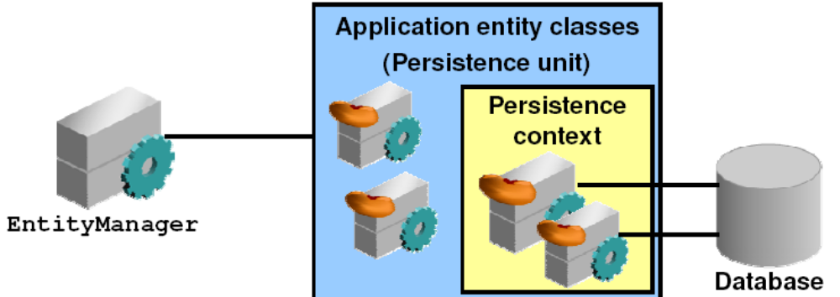
What is EntityManager?
EntityManager is:
  An API that manages the lifecycle of entity instances
  Associated with a persistence context
  An object that manages a set of entities defined by a persistence unit

Slide 50
Container Managed EM
Application
Injection
Or
JNDI lookup
EntityManager

Slide 51
Application Managed EM
Application
EntityManager
Find(…)
Close()
Persist()
Create*Query()
EntityManagerFactory
createEntityManager()
EntityTransaction
isActive()
Begin()
Commit()
Persistence
createEntityManagerFactory()

Slide 52
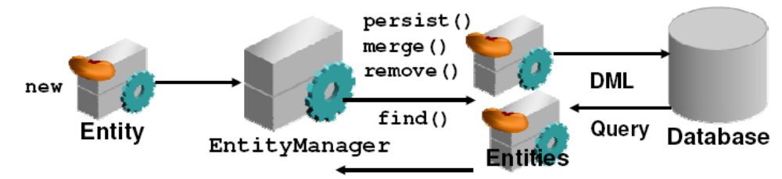
Managing Persistence of Entites
The lifecycle of an entity is managed by using the EntityManager interface
An entity can be created by using:
  The new operator (create detached instance)
  The EntityManager Query API (synchronized with the database)
An entity is inserted, updated, or deleted from a database through the EntityManager API

Slide 53
Entity States
new
Persistent id? | Associated w/ PC ?
No | No
Yes | Yes
Yes | Yes
Yes | No
Persist ()
merged
remove ()
persist ()
Commit
Rollback
serialize
removed
merge ()
detached

Slide 54
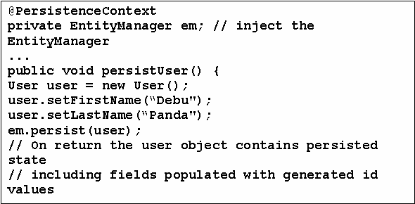
Manipulate Data
To insert new data:
  Create a new entity object
  Call the EntityManager persist() method

Slide 55
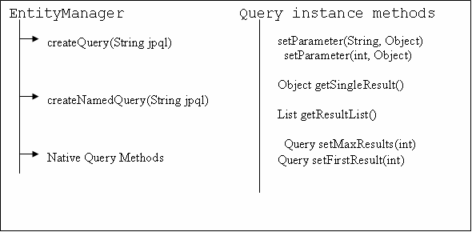
Retrieving Entities by Using the Query API
The EntityManager interface provides the Query API methods to execute EJB QL statements:

Slide 56
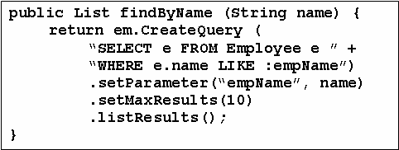
Query API
Queries can be expressed in JPQL or native SQL
Can be dynamic or stored as a named query on entities

Slide 57
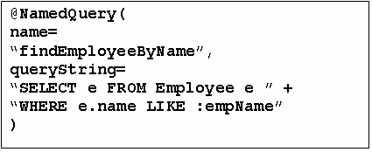
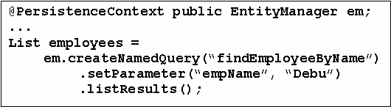
Named Queries

Slide 58
JPQL Enhancements over EJBQL
Simplified Syntax
Bulk update and delete operations
Projection list (SELECT clause)
Group by, Having
Subqueries (correlated and not)
Additional SQL functions
  UPPER, LOWER, TRIM, CURRENT_DATE,…
Dynamic queries
Polymorphic queries

Slide 59
Native SQL Queries
Allow direct SQL over actual database schema
  Very useful for some applications
  Database portability overrated for some applications
Allow SQL query results to be mapped into entity beans and/or instances of other Java classes

