Slide 1


Slide 2

Eliminated requirement for Home Interface
  Not needed for session beans
Business interface is a POJo
  Bean can implement it
  Bean can have more than one business interface
  Can support remote access
  EJB(Local)Object removed from client view
  RemoteExceptions are removed from programmer and client view
Eliminated requirement for unnecessary callback methods
  Removed requirement to implement javax.ejb.SessionBean

Slide 3

Dependency Injection
  Field and property injection supported
  Most J2EE resource types supported: ejb-ref, ejb-local-ref, resource-ref, resource-env-ref and environment-entry
Enhanced lifecycle methods
  Custom methods for standard lifecycle events
  Callback listener classes may be used to delegate lifecycle management
Interceptors
  Interceptor classes may be registered to intercept business methods
  Provides equivalent of AOP around advice

Slide 4

Business interface is plain Java interface
  No required component interface (EJB(Local)Object)
Default is local business interface
  Use @Local and @Remote
    If more than one interface implemented
    If a remote interface is required
    May appear on business interface or bean class
  Serializable, Exteranlizable can’t be business interfaces

Slide 5
Declare arbitrary exceptions on business methods
  Don’t use RemoteException
  Remote Client sees EJBException
No need for home interface
  Lookup (incl. injection) returns EJB instance

Slide 6

@Stateless annotation
  No need to implement SessionBean
Lifecycle callbacks
  @PostConstruct, @PreDestroy
@WebService, @WebMethod for definition of web services (JSR 181)

Slide 7

@Stateful annotation
  No need to implement SessionBean or Serializable
Implementation of SessionSynchronization supported
Lifecycle callbacks
  @PostConstruct, @PreDestroy
  @PostActivate, @PrePassivate
Lookup return instance
  Typically needs initialization via business method(s)!
@Remove annotates a “normal” business method
  Client initiates removal by calling this method
  Removal through container after completion

Slide 8

Doesnot exist
newInstance()
Dependency injection
setSessionContext()
@PostConstructor
ejbCreate
@PreDestroy or ejbRemove()
method
Method-ready pool
ejbTimeout

Slide 9

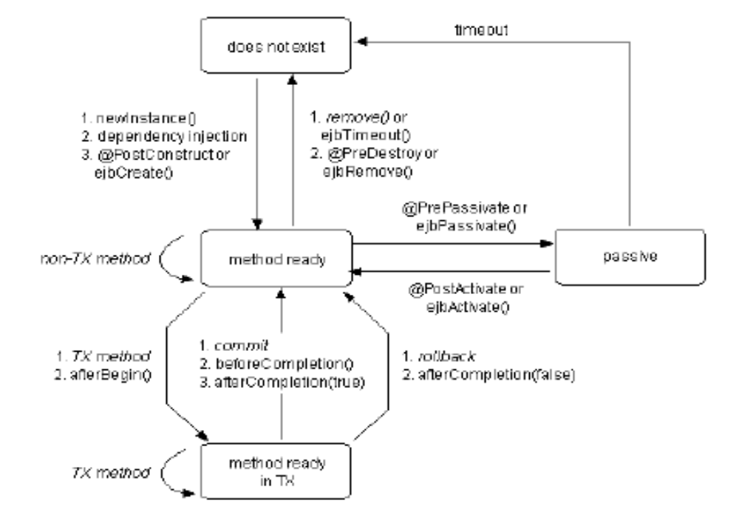

Slide 10

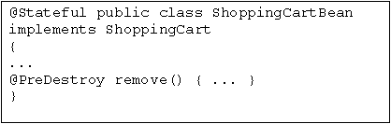
No need to implement unnecessary call back methods
Mark any arbitrary methods as callback method using annotations or XML
Callbacks may throw runtime exceptions causing transactions to roll back, but must not throw application exceptions

Slide 11


Slide 12

Homes eliminated
  With metadata, injection, easy lookup(), etc.,
  Homes not needed for session beans
  Stateless SessionBean homes
  not very useful anyway
Stateful SessionBean homes have useful create methods
  But: shifting functionality to “initialization” business method enables home to be eliminated
  @Remove annotation completes the picture

Slide 13

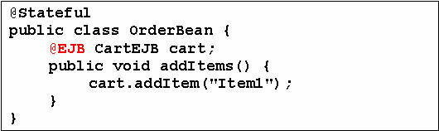

Slide 14

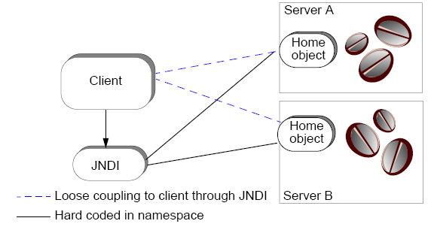
Allows for federation of namespaces
Can access namespaces on remote machines

Slide 15

API to access naming/directory services
SPI to any underlying service provider:
  CORBA Naming Service
  LDAP
  RMI registry
  Proprietary
Directory services (attributes) are not used with EJB.

Slide 16

Place a namespace location and context factory class into a Hashtable
1 Hashtable props = new Hashtable();
2
3 props.put(“java.naming.factory.initial”,
4 “vendor.jndi.ContextFactory”);
5
6 props.put(“java.naming.provider.url”, “the.server.com:81”);
Establish a network connection to the root of the namespace
9 javax.naming.InitialContext jndiCtx = null;
10
11 try {
12 jndiCtx = new InitialContext(props);
13 } catch (javax.naming.NamingException ne) {}

