Slide 1
MENTAL FITNESS TRACKER
WELCOME

Slide 2

STUDENT DETAILS
DHARANIKOTA PRAVEEN KUMAR
Skills Build Email ID : dharanikotapraveen161@gmail.com
College Name : St. Ann’s College of Engineering and Technology
College State : Andhra Pradesh
Internship Domain : Artificial Intelligence
Start and End Date : 12/06/2023 – 24/07/2023

Slide 3

PROBLEM STATEMENT
In the present fast growing and demanding world, mental health and well being are crucial for leading a fullfill life. Mental fitness refers to the state of one's psychological well-being, encompassing emotional, cognitive, and social aspects of life. In recent times, the prevalence of stress, anxiety, depression, and other mental health issues has been on the rise, affecting individuals of all ages and backgrounds. A decline in mental fitness can lead to various negative outcomes, including decreased productivity, impaired decision-making, strained relationships, and an overall diminished quality of life.

Slide 4

AGENDA
To address the above challenges , the development of a comprehensive MENTAL FITNESS TRACKER is proposed. It allows users to set specific mental health goals, such as reducing stress, improving focus, or managing anxiety. Provide tools for users to track their progress over time and celebrate milestones.
The main point of a mental fitness tracker is to promote and support positive mental health and well-being. It aims to help users develop and maintain good mental health habits, improve emotional resilience, and enhance overall psychological wellness.

Slide 5

PROJECT OVERVIEW
Fully functional Mental Fitness Tracker web or mobile application, designed with a user-friendly interface.
Robust emotional state analysis algorithms and personalized mental fitness plan generation.
Data storage and management system, ensuring user privacy and security.
Progress tracking and visualization tools for users to monitor their mental fitness journey.
Comprehensive testing documentation to ensure the tracker's reliability and accuracy.

Slide 6

WHO ARE THE END USERS
The Mental Fitness Tracker should cater to a broad range of users, including students, working professionals, parents, and anyone seeking to improve their mental health and resilience.
In this most of the users are who are taking a lot of work pressures and gaining stress.
And also other users are Stress management seekers, anxiety and depression thoughts, students, corporate employees and senior citizens.

Slide 7
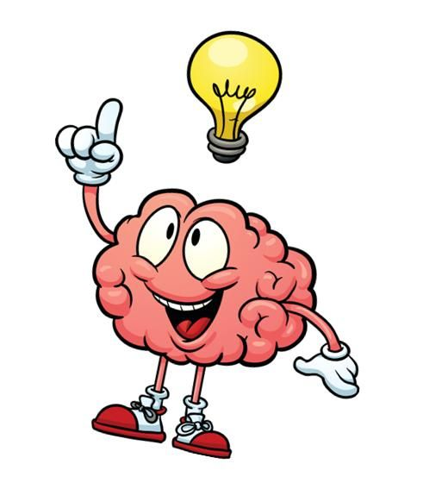
YOUR SOLUTION AND IT’S VALUE PROPOSITION
First of all after receiving data we can merge the two datasets. By using Exploratory Analysis we can analyse the levels of fitness in each body.
Finally, we conclude Linear and Random Forest Regression.
Overall, the main point of a mental fitness tracker is to empower users to take an active role in their mental health, fostering a positive and proactive approach to emotional well-being. It complements traditional mental health care and serves as a valuable tool in promoting mental fitness, resilience, and self-awareness.

Slide 8

HOW DID YOU CUSTOMIZE THE PROJECT AND MAKE IT YOUR OWN
In this I customize many modifications and some other changes. With this customization this tracker can developed in an advanced way
After merging datasets a simple data cleaning will be concluded for filtering unwanted data.
Then an Exploratory analysis will be done. After that year wise variations in mental fitness of different countries will observed. Due to this we can calculate the efficiencies of this tracker.
Periodically evaluating the tracker's effectiveness through user feedback and data analysis to make improvements and updates as needed.

Slide 9
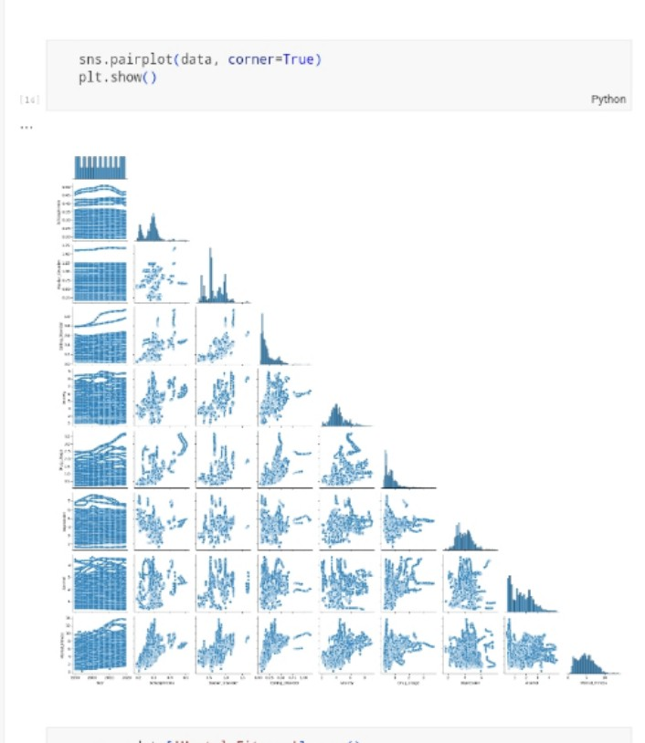
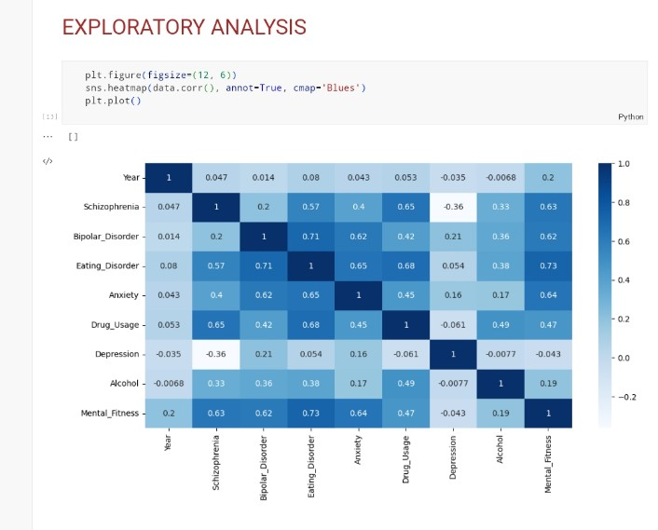
Exploratory Analysis

Slide 10
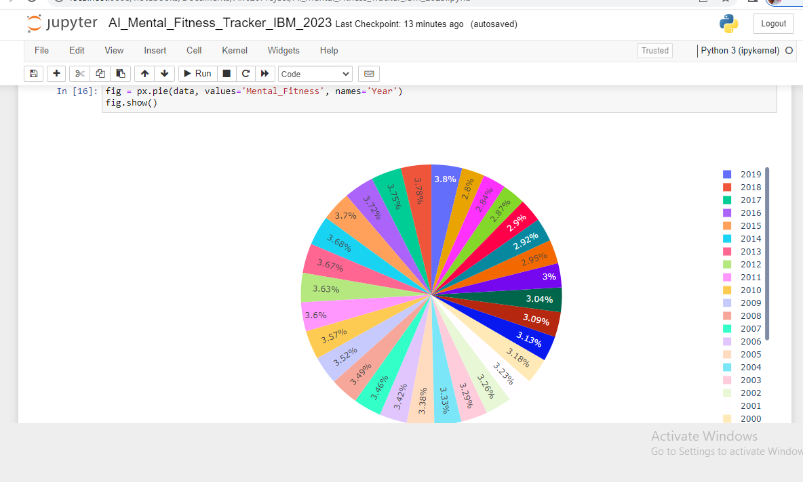
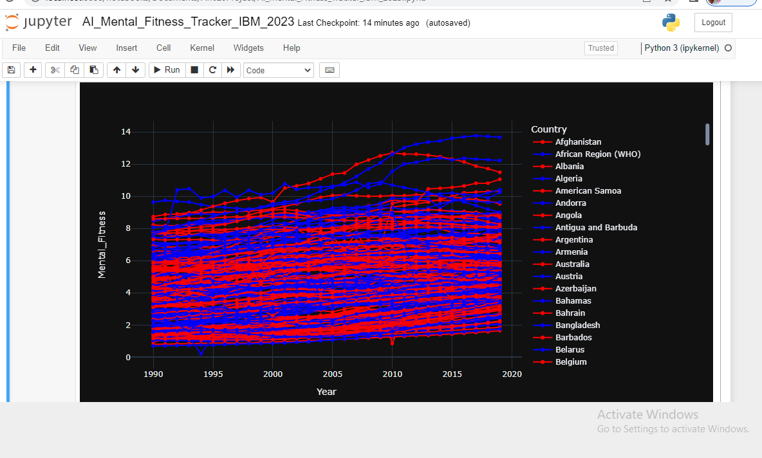
Yearwise variations in mental fitness of different countries

Slide 11

MODELLING
Here, I use two Machine Learning Algorithms and also compared their performences
Those two ML algorithms are Linear Regression and Random Forest Regression.
Each ML algorithm is Trained and Tested.
By the results of those tests we can calculate RMSE and MSE values.
With these values we can identifies the maximum and minimum accuracies of mental fitness.
Let see the following results of two algorithms.

Slide 12
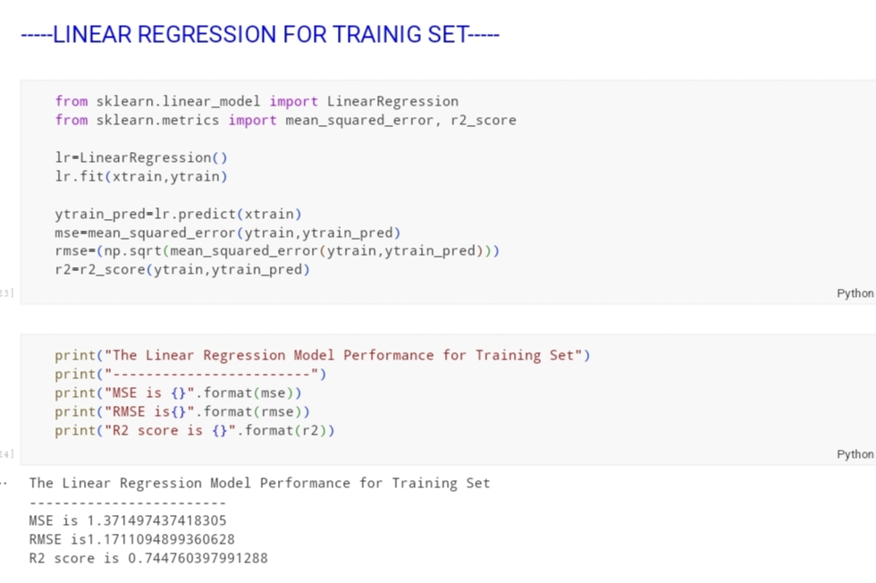
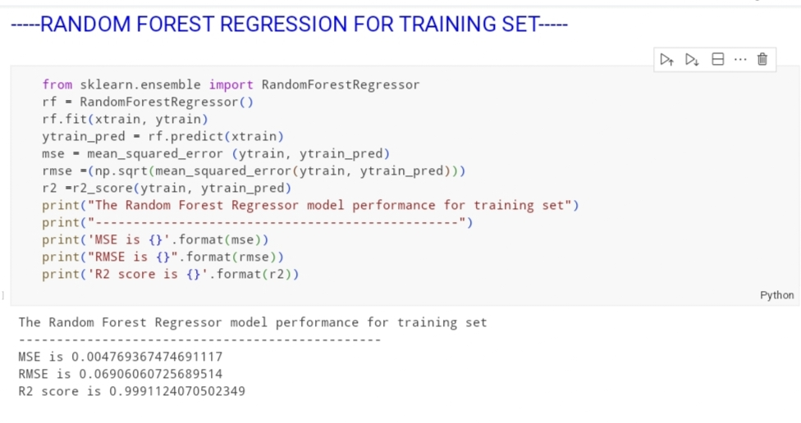

Slide 13
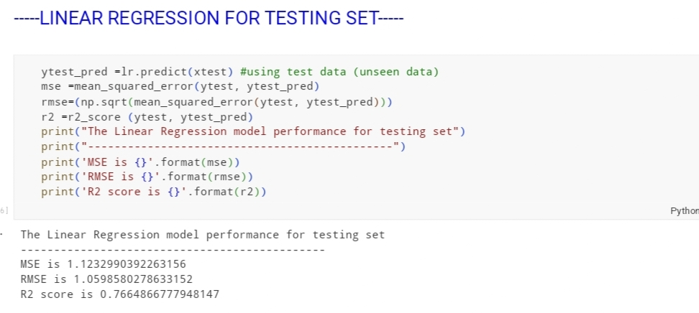
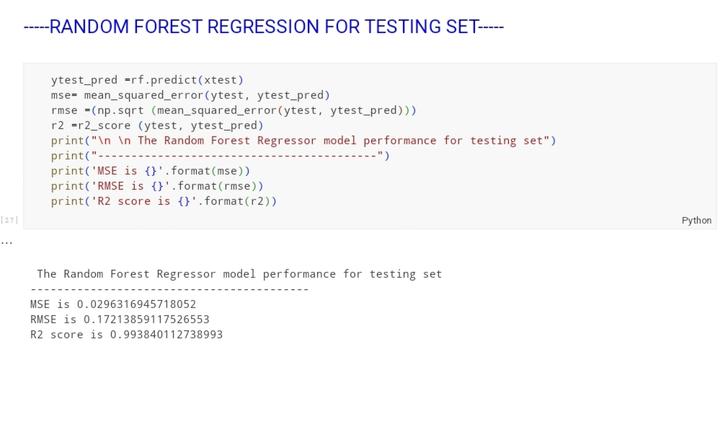

Slide 14
RESULTS
From the above results we can observe that Root Mean Square Error(RMSE) value for Linear regression is high and low for Random Forest Regression.
And also Mean Square Error(MSE) is high for Linear and low for Random Forest Regression.
So, where error values are low that would be the best method and gives high accuracy.
Finally, RMSE is the suggest model for valuable insights of mental fitness based on available data.
The success of Mental Fitness Tracker project will be determined by its effectiveness in aiding user’s mental well-being.

Slide 15
LINKS
GITHUB LINK :-
https://github.com/praveend2023/Mental_Fitness_Tracker_IBM_2023.git

Slide 16


