Slide 1
Retail Sales Forecast

Slide 2
Insights

Slide 3
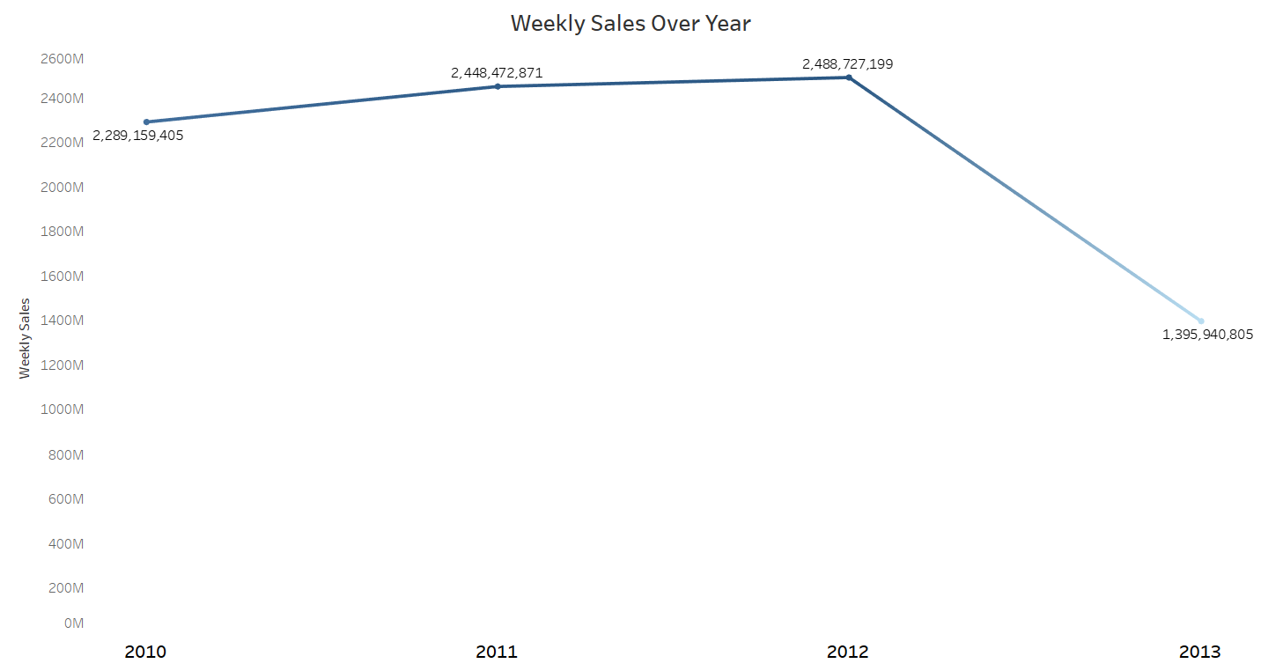
Time Analysis
As per analysis weekly sales decreased after the year 2012

Slide 4
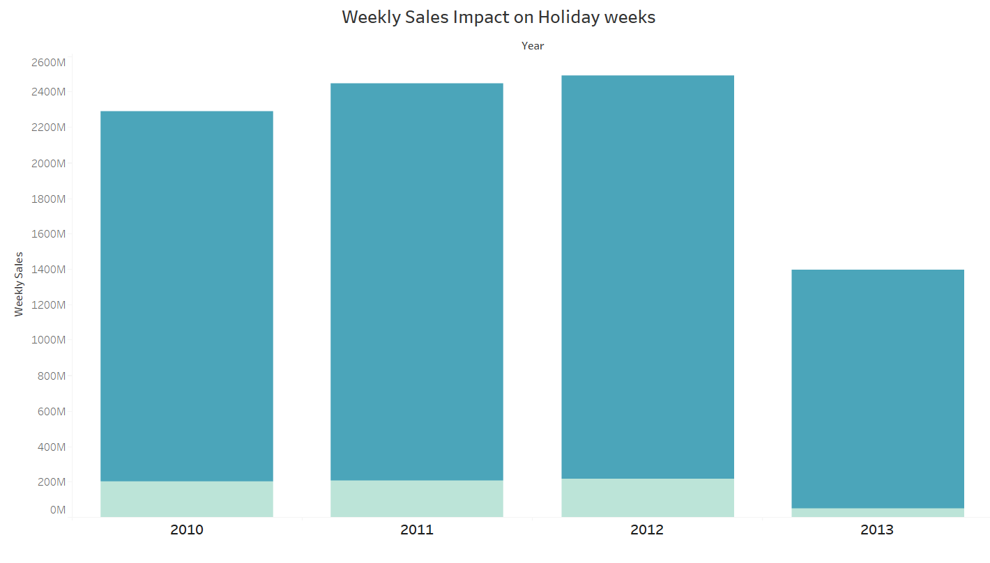
Weekly sales on Holidays
When Compared to Holidays , Non Holidays(dark blue) has got highest weekly sales

Slide 5
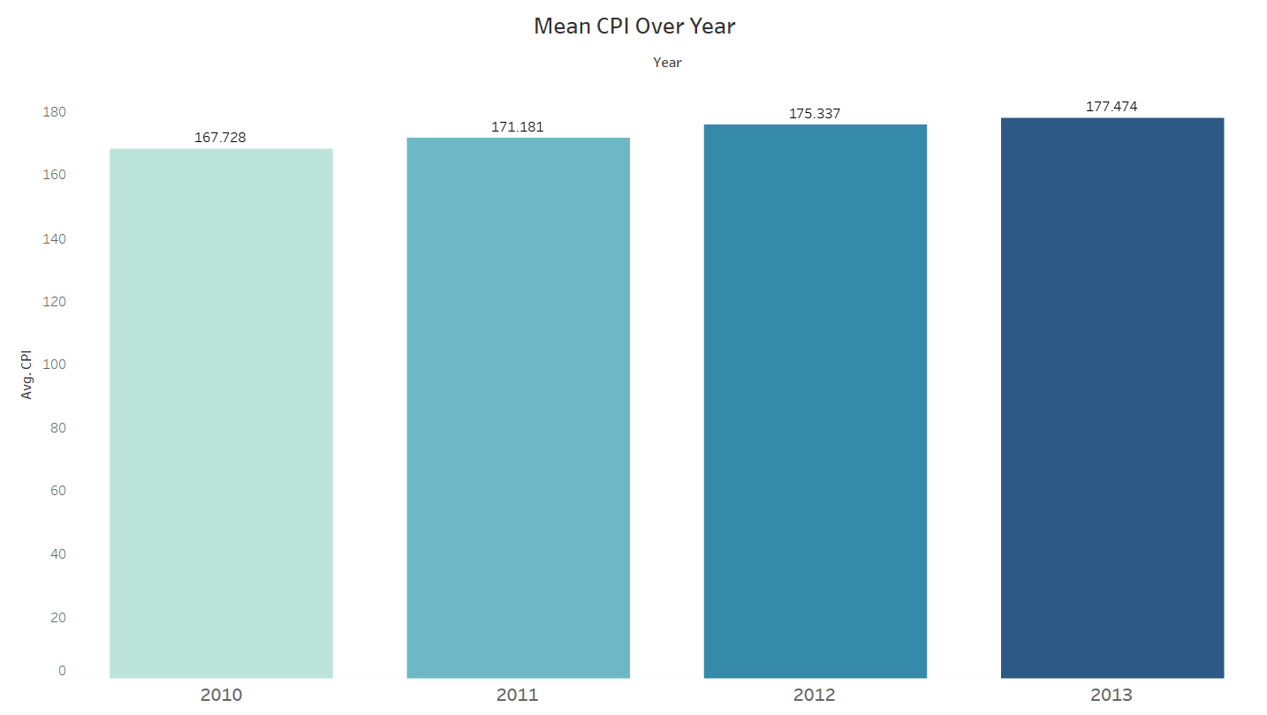
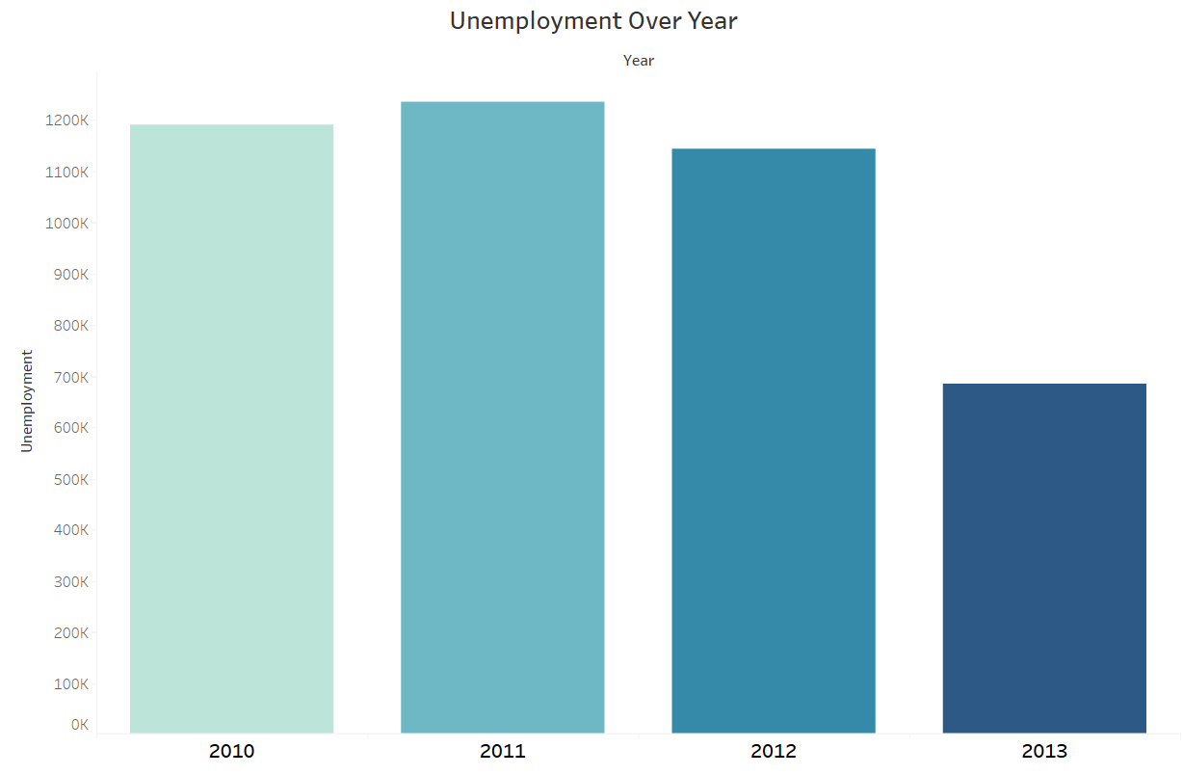
Economic Indicator
Customer Price Index Increased over time as well the unemployment rate decreased

Slide 6
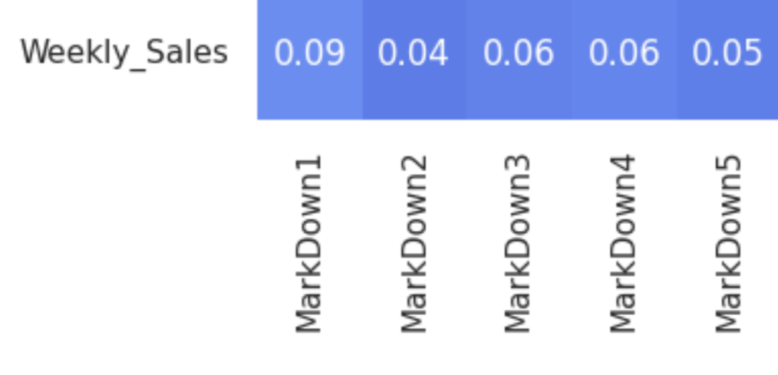
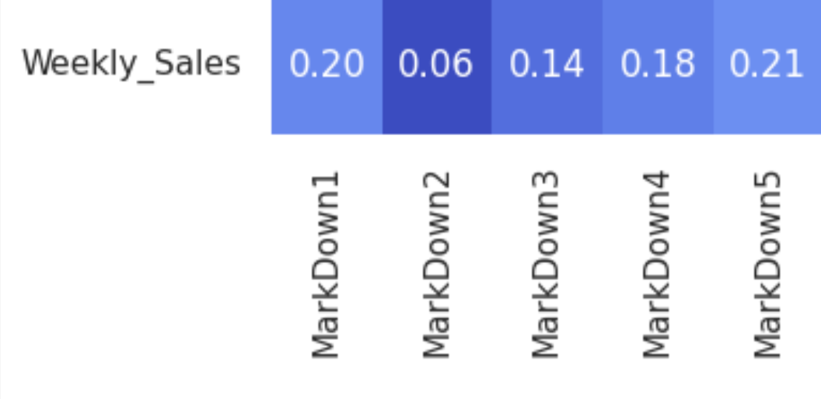
Markdown And Weekly Sales Correlation
Linear
Non Linear

Slide 7
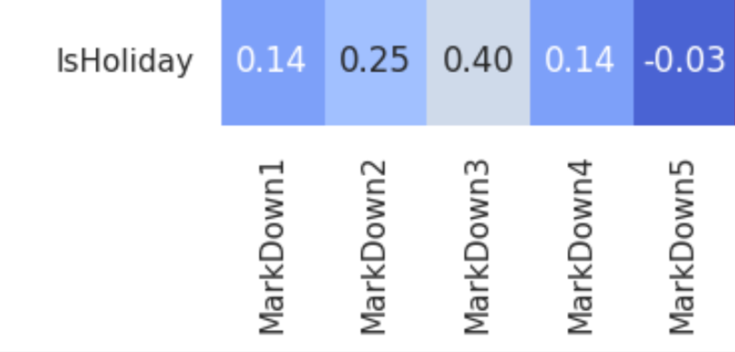
Markdown And Holiday Correlation
The Features Holiday and Markdown has positive correlation

Slide 8
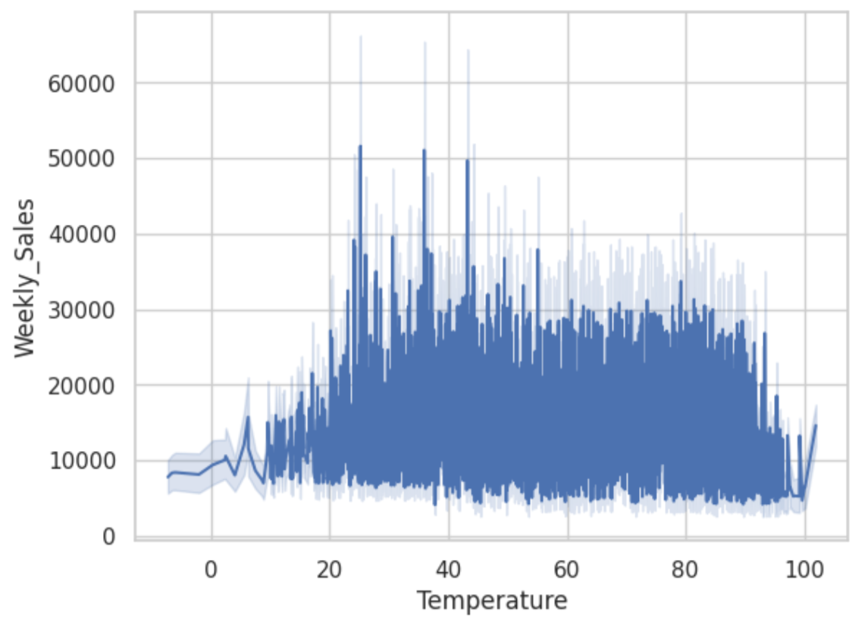
Temperature Impact On Weekly sales
The Store Temperature From 25 to 45 has got more weekly sales

Slide 9
Model

Slide 10
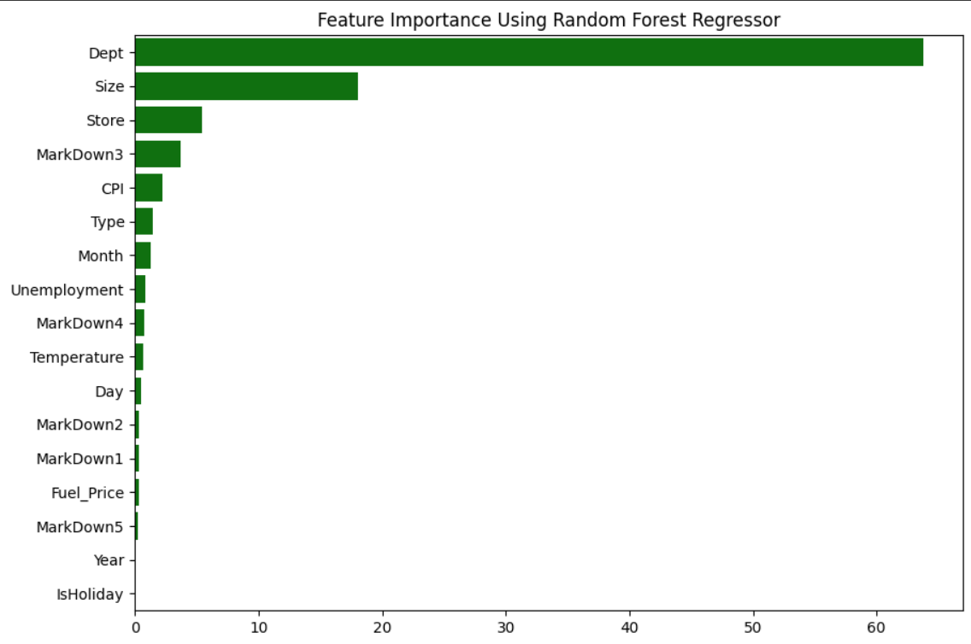
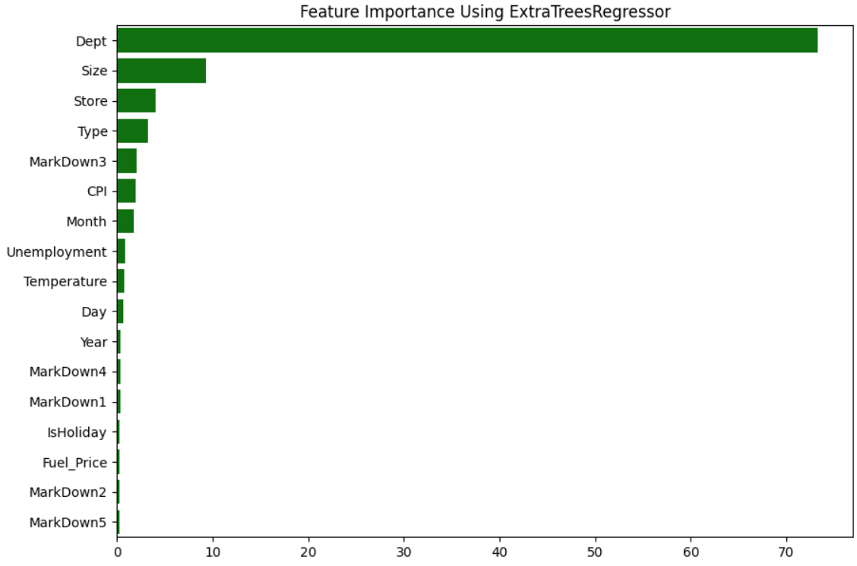
Feature Importance
To Predict weekly sales , we built the model on two algorithm Random forest Regressor , Extra Trees Regressor
Both models says that the features Dept , Size , Store , Type , Cpi , Markdown3 and 4,month , Temperature has more
importance when predict the weekly sales so this helps to know which feature contributes the most

Slide 11
Recommendation
Store Level
The stores 20,4,13,14,2,10,27,6,1,30 has got highest weekly sales when compared to others stores so need to improve the revenue of others store
How we can ? Why did revenue decrease?
one of the reason is Temperature , yes temperature is the important thing to attract customer , on average these lower weekly sales stores has 57 c. on sales hours
Solution :
So having temperature in the 25 to 45 will be the ideal to increase the weekly sales

Slide 12
Recommendation
Holiday Week Impact On Weekly Sales :
When compared to holiday weeks ,the non holiday weeks has higher weekly sales from the year 2010 to 2013
But after the year 2012 there had the sudden decrease in weekly sales
Why did sudden decrease happen on weekly sales?
The one of the reason is fuel price is decreased than before year , so people can able travel long distance for purchase
Average Fuel price of the year 2013 is 3.60
Solution : Want more features regarding products so we can conclude this

Slide 13
Recommendation
Markdown Impact On Weekly Sales :
As per analysis of the data from the year 2010 to 2013 the markdown features did not have linear relationship on weekly sales but it has some non linear relationship on weekly sales
Conclusion :
The markdown feature did not impact the weekly sales at good level and also it does not give more value contribution while predicting the target variable (weekly sales)

Slide 14
Recommendation
Economic indicators impact on weekly sales:
Customer price index values increased in the year of 2013 and average CPI is 177.47,
There are some reasons behind it as per the analysis i found listed some reasons below
Reason :
The unemployment rate decrease in the year of 2013 when compared to before years so this may be the point of CPI increased.

Slide 15
Recommendation
Other impacts on Weekly:
Size : Higher the size of the store impacts the weekly sales because the people can visit stores if they have more space to review products
Department : The feature department plays major role when predicting the response variable weekly sales so we have more information about department then we analysis which departments and products that people interested to bug .

