Slide 1
Implementation of a 2-level Cache Simulator with a Hybrid Prefetcher

Slide 2
Contents
Specifications
Cache
Memory Queues
CPU
Prefetcher

Slide 3
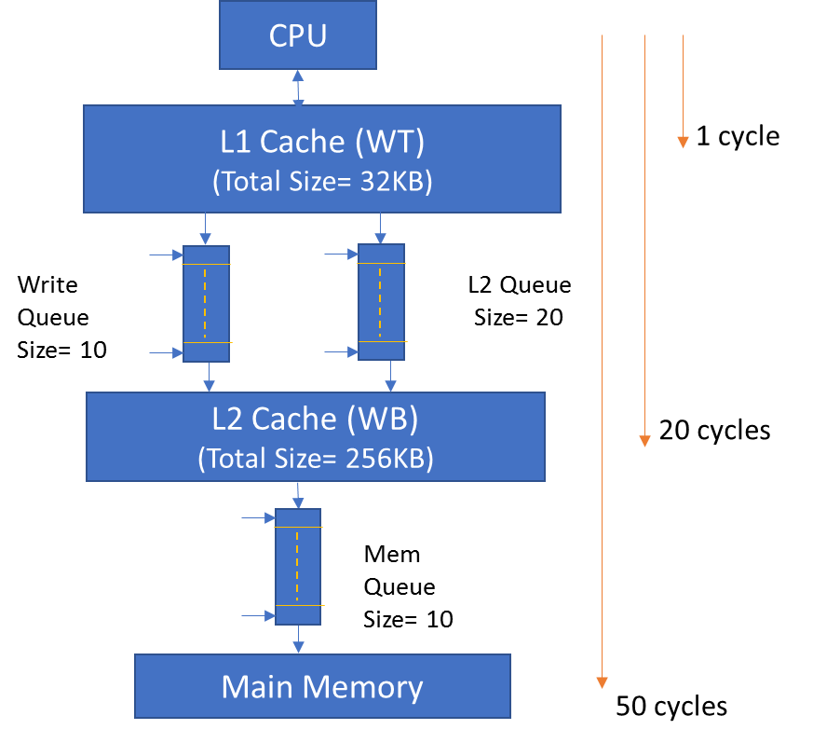
Specifications

Slide 4
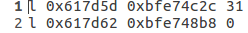
Input Trace File
Input trace file is generated using Memtracer.
From Ubuntu linux terminal,
./pin -t memtracer -- /path/to/program

Slide 5
Contents
Specifications
Cache
Memory Queues
CPU
Prefetcher

Slide 6
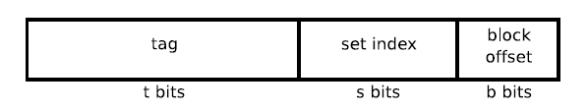
Cache Structure
Index bits indicates which set
Offset indicates which line in the set
Tag is the address to be compared in that location
If(tag==address && valid bit ==1) Cache hit
Else Cache miss

Slide 7
Valid Bit and Dirty Bit
Valid bit is a bit of information that indicates whether the data in a block is valid (1) or not (0).
Dirty bit indicates whether the data is modified after the access.

Slide 8
Write-back and Write-through
Write-back
A Write-back cache does not immediately notify higher level of memory about its changes.
Because of this, a cache line should be written back to the higher memory before evicting the line from the cache.
Write-through
A Write-through cache immediately notifies higher level of memory about the changes.
Due to this, a cache line can always be invalidated without writing back, since memory already has an up-to-date copy of the line.
Here L1 cache is write-through and L2 cache is write-back.

Slide 9

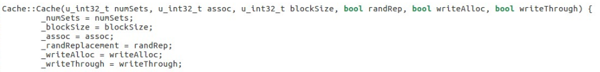
L1 & L2 Arguments

Slide 10
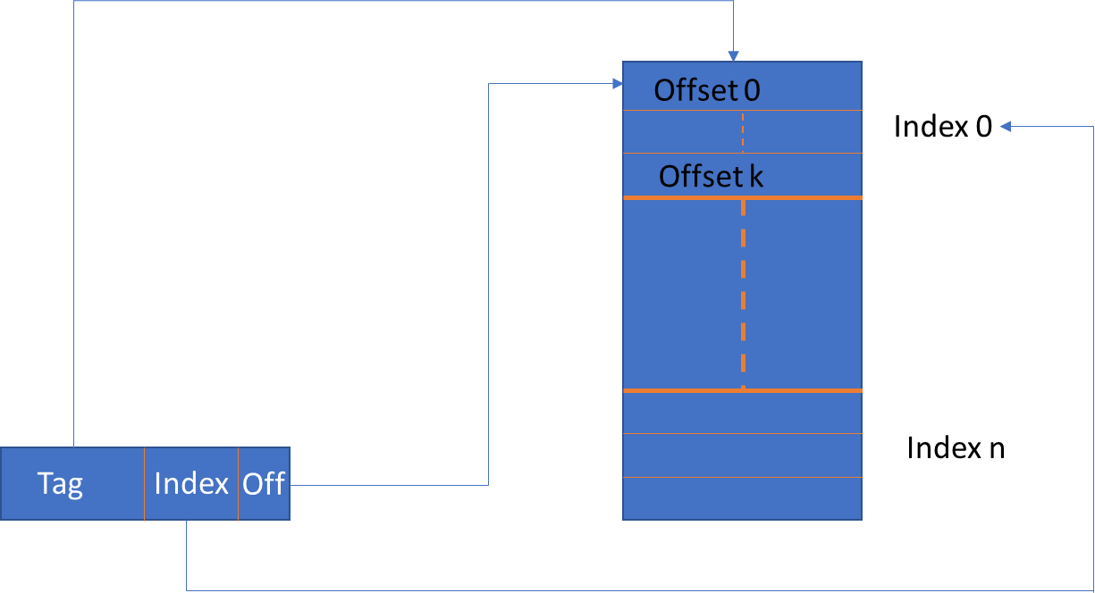
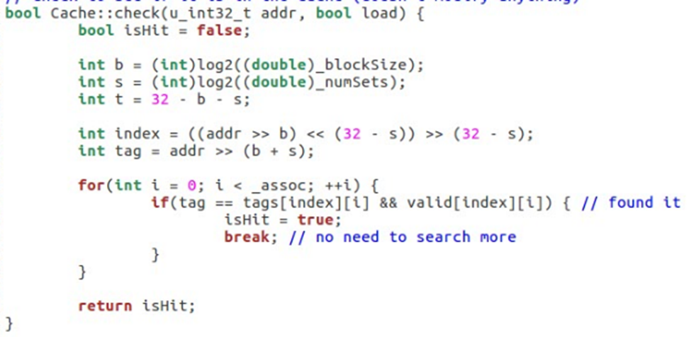
Address Translation

Slide 11
Least Recently Used (LRU)
When a cache miss occurs, a least recently used data in that cache is evicted and replaced by the required data. This is known as Least Recently Used (LRU) method
LRU value of a particular address is set to 0 on a cache hit
LRU value is incremented on a cache miss
The line having larger LRU value is evicted and replaced with the recent miss

Slide 12
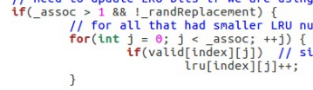
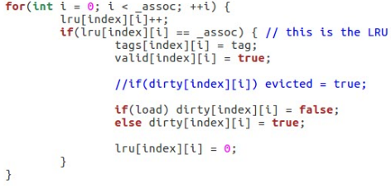
LRU
LRU bits to track which block is oldest

Slide 13
Contents
Specifications
Cache
Memory Queues
CPU
Prefetcher

Slide 14
Memory Queue
A memory queue is used to process requests in an orderly manner .
First In and First Out (FIFO ) policy is used .
The elements in the queue is added at the rear end
Retrieved at the front end
Circular buffer is used .

Slide 15
Queues used:
L2 Queue
Write buffer
Memory Queue

Slide 16
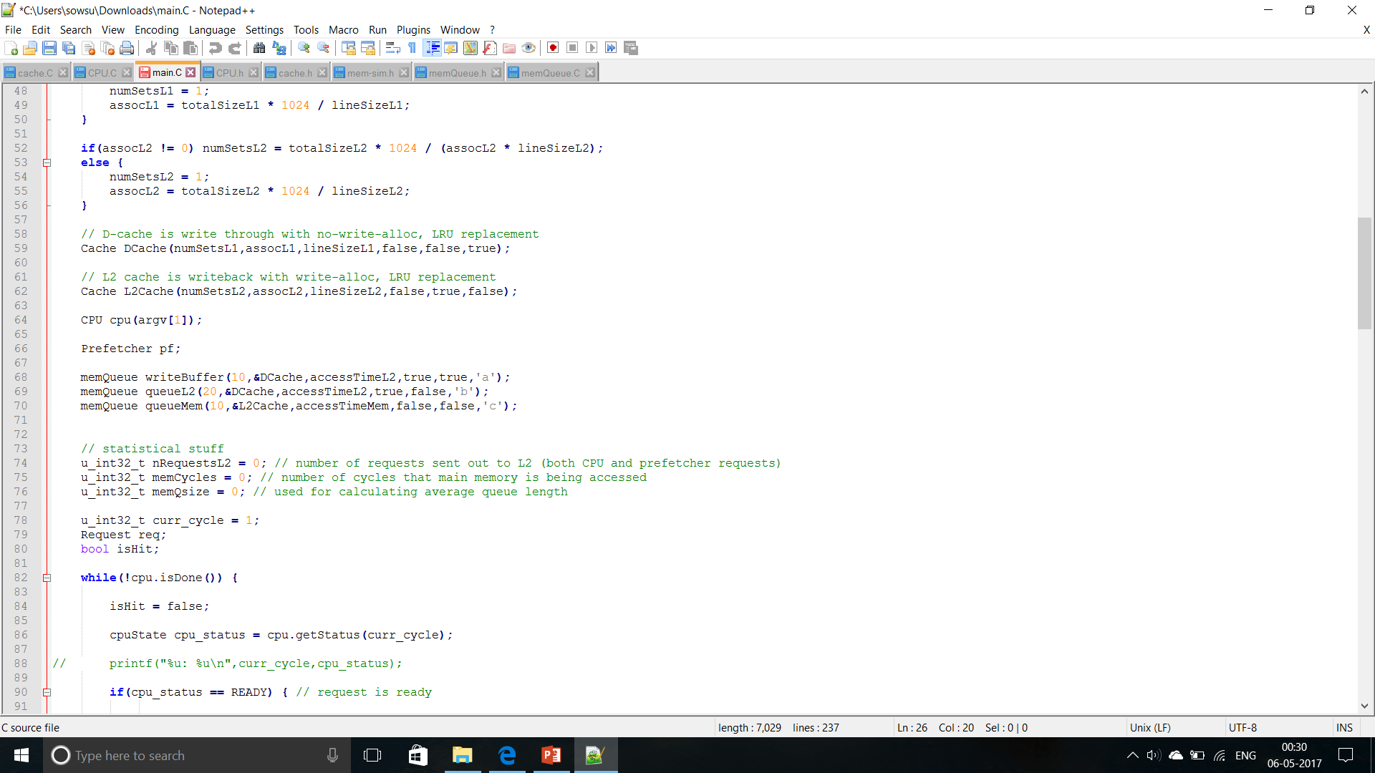
L2 Queue
INITIALIZATION :
The queue is initialised for load functions .
D cache is the source for the queue .
The latency is based on the L2 cache ‘s accessTime
In order pipelining is used .

Slide 17
Write Buffer
INITIALIZATION :
The queue is initialised for store functions .
D cache is the source for the queue .
The latency is based on the L2 cache ‘s accessTime (20 cycles)
In order pipelining is used .

Slide 18
Contents
Specifications
Cache
Memory Queues
CPU
Prefetcher

Slide 19
Memory Queue
INITIALIZATION :
The queue is initialised for load functions .
L2 cache is the source for the queue .
The latency is based on the main memory’s accessTime (50 cycles)
It is not pipelined .

Slide 20
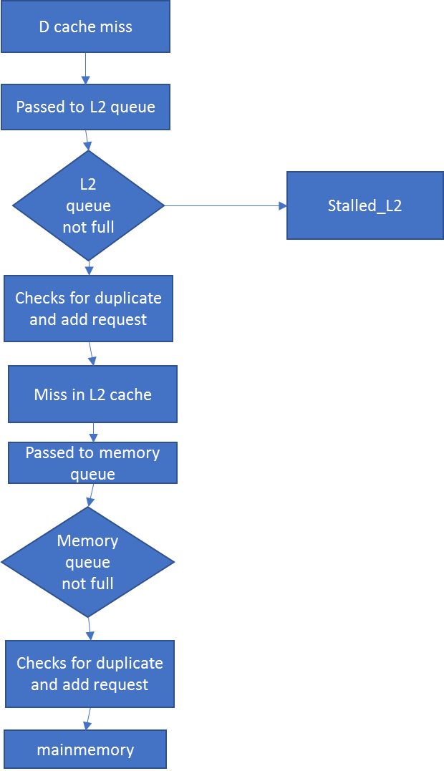
During Load
During D cache miss , L2Queue is accessed
The request is sent to the L2 queue
If the queue is not full ,the request is checked for duplicate entry and gets added to queue
If full , the STALLED_L2 state is reached
It is then passed to L2 cache , upon cache miss in L2 it is passed to memory queue and removed from L2 queue
Memory queue functions in a similar way to L2 queue and passed to the main memory

Slide 21
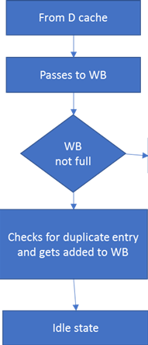
During Store
The WB adds the request when it is not full and by checking for duplicate entry
If WB is full , it passes to the STALLED_WB state
When the request is added ,it goes to the idle state
Stalled_WB

Slide 22
Contents
Specifications
Cache
Memory Queues
CPU
Prefetcher

Slide 23
Central Processing Unit
FUNCTIONS :
Processes sequence of stored instructions
Follows fetch ,decode and execution in their operation

Slide 24
CPU States
IDLE: No request at the given time
READY: set to execute instructions
WAITING: Waiting for request to be fetched from L2 cache or Main Memory
STALLED_WB: state in which the task is stalled when the write buffer is full
STALLED_L2: state in which the task is stalled when the L2 queue is full

Slide 25
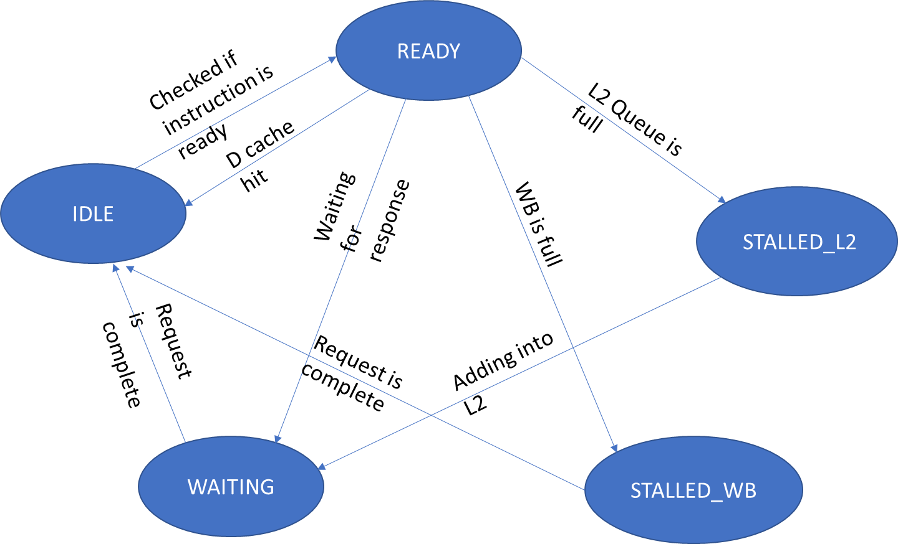
Memory cycle

Slide 26
Prefetcher
Introduction
Types
Challenges in Prefetching
Prefetching Models
Sequential Prefetching
Stride Prefetching
Hybrid Prefetching

Slide 27
Introduction
Idea: Fetch the data before it is needed (i.e. pre-fetch) by the program
Why?
Memory latency is high. If we can prefetch accurately and early enough, we can reduce/eliminate that latency.
Can eliminate compulsory cache misses
Involves predicting the addresses that will be needed in the future.
Works if programs have a predictable miss address patterns
Can reduce both miss rates and latencies

Slide 28
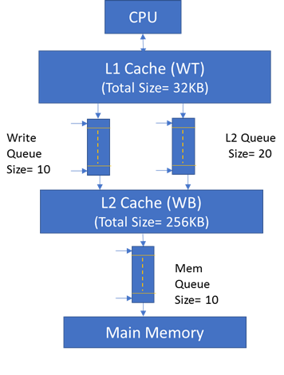
Introduction
Prefetcher

Slide 29
Prefetcher
Introduction
Types
Challenges in Prefetching
Prefetching Models
Sequential Prefetching
Stride Prefetching
Hybrid Prefetching

Slide 30
Types
Data or instruction prefetching
Prefetching performed for either data or instruction blocks.
Data prefetching- irregular patterns; hence complex
Hardware or software prefetching
Hardware- may use storage structures to detect access pattern and then prefetch.
Software- Inserting prefetch instructions in source-code based on program control flow and then prefetch.

Slide 31
Comparison of H/W and S/W prefetching
S/W prefetching
requires programmer or compiler intervention
works well only with loops where there is regular array access
More CPU overhead
H/W prefetching
requires special hardware mechanisms
work dynamically based on the program's behavior at runtime
Less CPU overhead

Slide 32
Prefetcher
Introduction
Types
Challenges in Prefetching
Prefetching Models
Sequential Prefetching
Stride Prefetching
Hybrid Prefetching

Slide 33
Challenges in Prefetching
What?
Prefetching useless data wastes memory BW, cache buffer space
Hence, accurate prediction of addresses to prefetch is important
Varies on the prefetching algorithm
When?
Prefetching too early causes data eviction even before access
Delayed prefetching might not hide the whole memory latency
Timing the prefetcher to stay ahead of the processor’s access stream
Where?
If prefetched data placed in cache directly, evicts useful data – cache pollution
If maintaining a separate prefetcher buffer, design gets complicated

Slide 34
Challenges in Prefetching
Which?
Deciding on which levels the prefetched data is placed.
If placed in first level cache, less access time but also less data could be prefetched.
If placed in higher order cache, more access time but relatively large data could be prefetched

Slide 35
Prefetcher
Introduction
Types
Challenges in Prefetching
Prefetching Models
Sequential Prefetching
Stride Prefetching
Hybrid Prefetching

Slide 36
Sequential Prefetching
Simplest form of prefetching
Prefetches N cache blocks from memory
Advantages:
Needs no sophisticated pattern detection
Works well for sequential access patterns
Spatial Locality
Disadvantage:
With irregular patterns, wastes system bandwidth

Slide 37


Slide 38
Stride Prefetching
Idea:
Record the distance between the memory addresses referenced by a load instruction (i.e. stride of the load) as well as the last address referenced by the load
Next time the same load instruction is fetched, prefetch last address + stride
Uses a table called Reference Prefetching Table (RPT)
categorizes the prefetched information before sending it to cache.
Consists of the following columns
Tag
Check
Instruction Tag
Previous Address
Stride

Slide 39
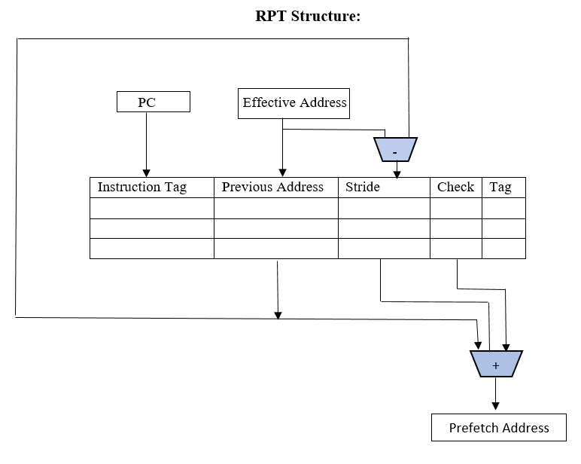
Stride Prefetching

Slide 40
Stride Prefetching
Tag:
- Checks whether the prefetched RPT row is utilized by the processor or not
Check:
High
when there is an address miss, an address that is offset by stride is prefetched.
If the addresses get hit in the next cycle, next block is offset by the same stride.
Now this stride has a high confidence value(check bit=1)
Low
If there is a miss with a calculated stride, next stride value is changed.
The confidence value for the stride is lowered(check bit=0)

Slide 41
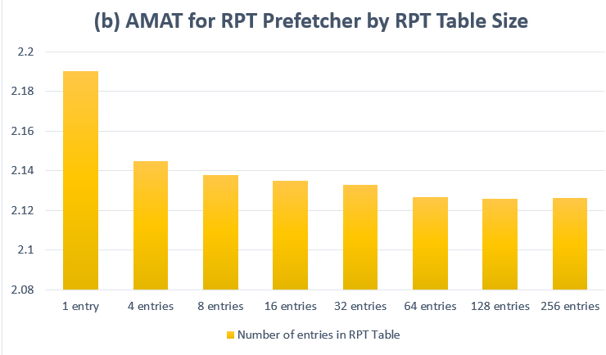

Slide 42
Hybrid Prefetching
Merges sequential and stride prefetching models
Implementation:
Here, N block sequential access is used initially and RPT table is retained from stride model for the following accesses.
When RPT is empty, the N blocks of instructions are fetched, parallelly setting the stride value.
From the next cycle, blocks are prefetched based on stride value
Setting the Check flag and Tag flags are the same as in Stride model
If in case the stride confidence value is low, N sequential block access method is followed.
This model combines the advantages of both the models– lowers the compulsory and capacity misses.

Slide 43
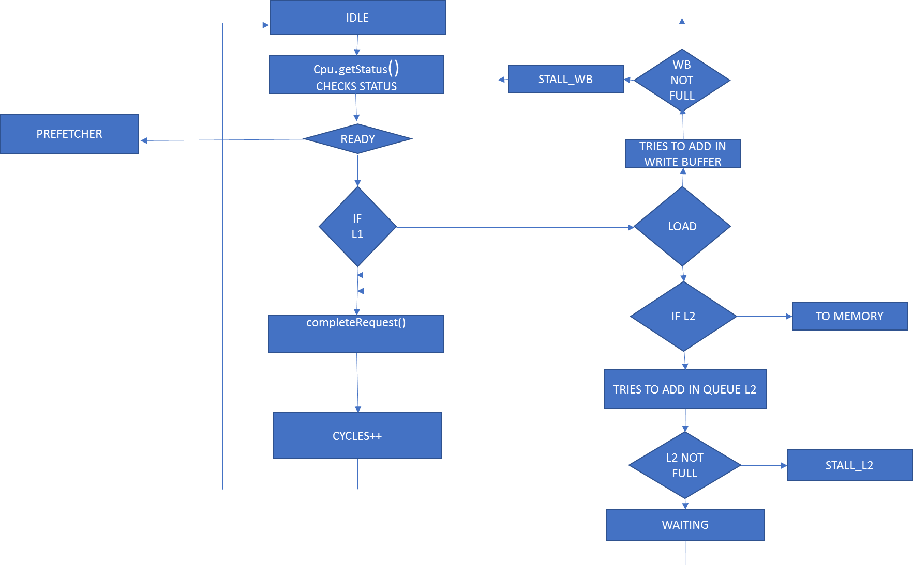
Flowchart

Slide 44


Slide 45


Slide 46


Slide 47


Slide 49
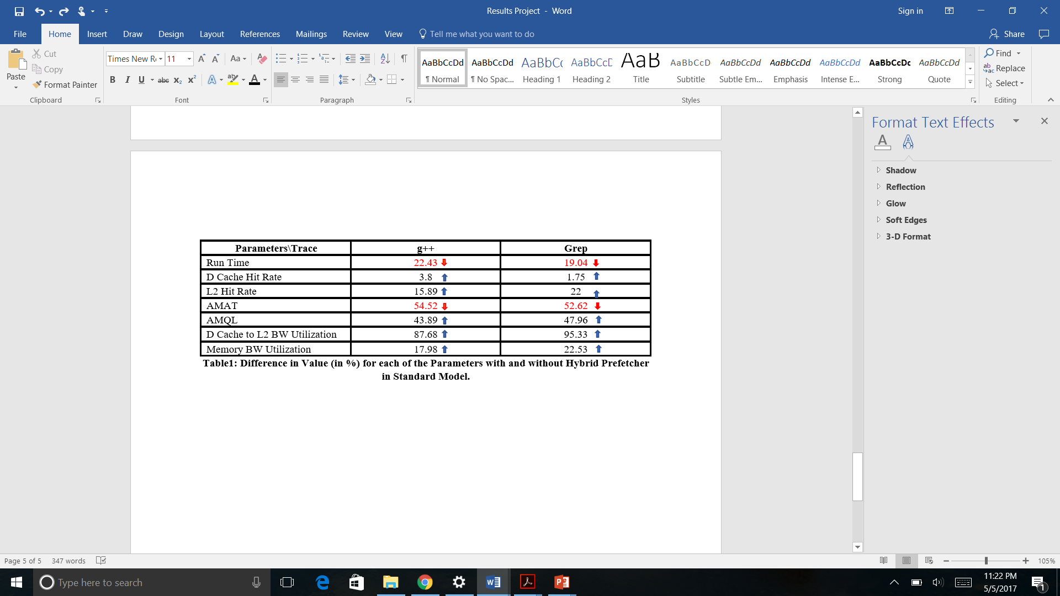

Slide 50
THANK YOU!

