Slide 1
Wafer Defect Classification
Praveen Gunturi
Instructor: Dr. Masoud Yari

Slide 2
Motivation
Semiconductor manufacturing requires high yield
Yield = $$\frac{\# Good Dies in a given wafer}{\# Total dies in a given wafer}$$
Bad dies are considered defects and this reduce production yield
The defects on the wafer falls into certain categories
Classification of these categories are manual and inconsistent due to subjective
Goal: Automated defect classification using ML

Slide 3
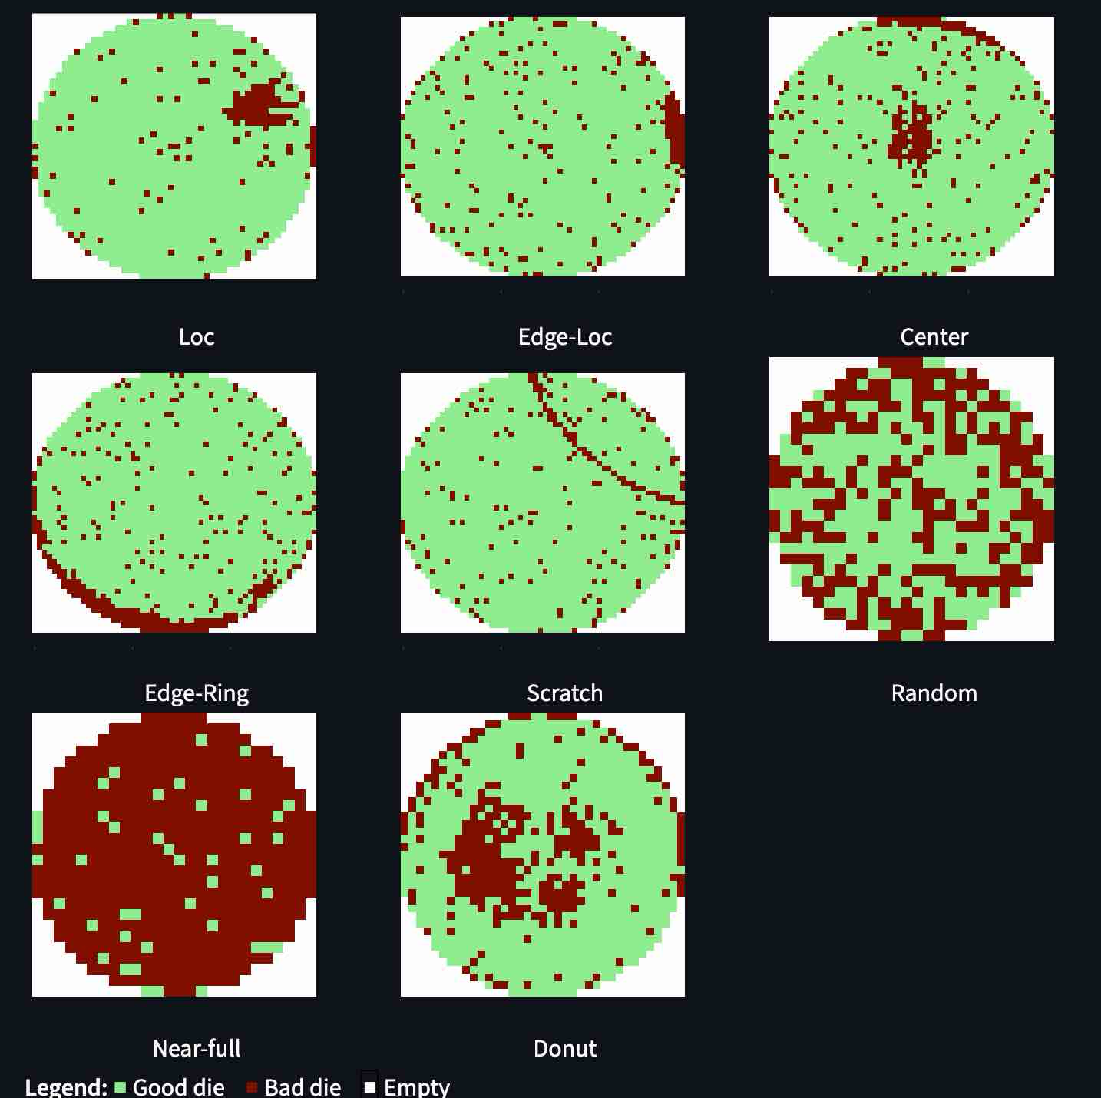
Defect Classification from Wafer maps
Localized (Loc): Appears as clusters and not at center
Edge loc (Edge-Loc): Appears as clusters and at the edge
Center: Apperas as cluster and at the center of the wafer
Edge-Ring: Appears as ring pattern and at the edge of the wafer
Scratch: Appears as a straight line or ring going through wafer and the width is only 1-3 dies
Random: No specific pattern and defects are scattered across all dies
Near-full: Most of the wafer have defects
Donut: Appears as ring at the edge and cluster at the center

Slide 4
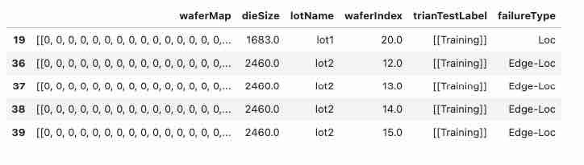
Dataset
Contains
Wafer maps
Defect labels
Die size information
Filtered data:
Remove missing labels
Remove Defect category with “none” class
Filter by die size

Slide 5
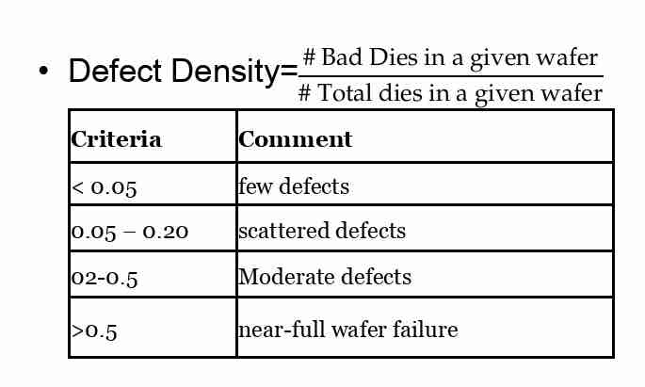
Feature Extraction
Feature | Center | Donut | Edge-Ring | Edge-Loc | Loc | Scratch | Random | Near-Full
defect_density | L | M | M | L | L | L | M | H
centroid_x / centroid_y | Center | Center | Edge distributed | Near edge | Any location | Line direction | Random | Whole wafer
radial_mean | L | M | H | H | Var | Var | M | M
radial_std | L | L | L | M | M | M | H | M
radial_skew | M | M | M | Var | Var | Var | M | L
edge_ratio | L | L | H | H | L | M | M | H
q1, q2, q3, q4 | Balanced | Balanced | Balanced | One quadrant | One quadrant | One or two | Balanced | Balanced
spread | L | M | M | L | L | H | H | H
ring_score | L | H | H | L | L | L | L | M
center_ratio | H | L | L | L | L | L | M | M
angular_variance | M | H | H | L | L | L | H | H
cluster_density | H | M | M | H | H | M | L | M
Example Feature
Some more feature criteria are in Appendix
Grid coordinates are normalized relative to wafer center
This allows spatial features to be computed consistently

Slide 6
Baseline Model
Extract features shown in Feature Extraction Slide
Train/test split (80/20)
Train classifier
Evaluate performance metrics:
Accuracy
Balanced Accuracy
Recall per class
Confusion matrix

Slide 7
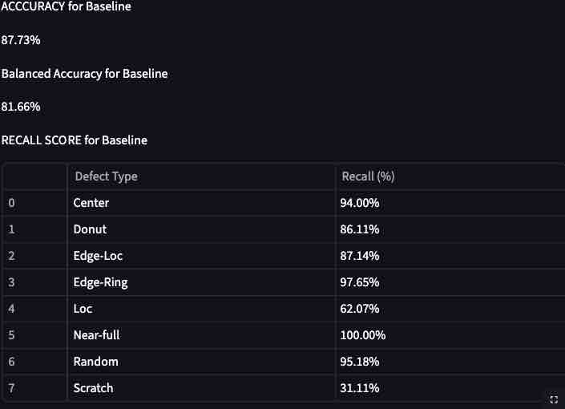
Preliminary results

Slide 8
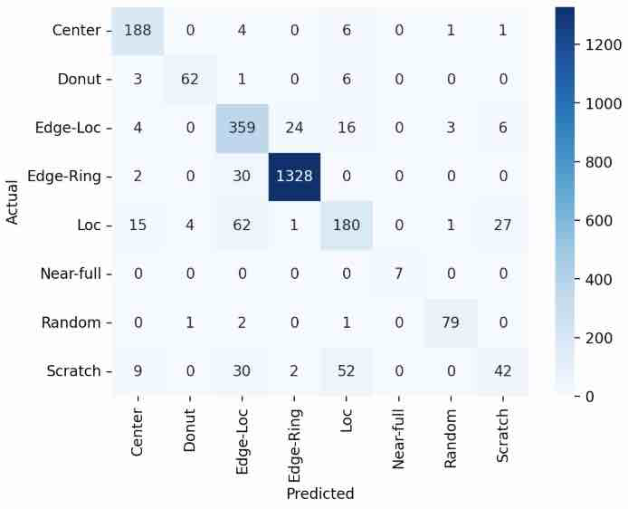
Confusion Matrix

Slide 9
Milestone2
Optimize RandomForestClassifier
Implement:
Logistic Regression
LDA
QDA
SVM
Bias-Variance Trade-off
Etrain vs Complexity
Etest vs Complexity
Future Work:
After optimizing, feed this data to Fab to verify any process issues, tool issues

Slide 10
Appendix: Feature parameters criteria

Slide 11
Feature parameters criteria
Defect Density=$$\frac{\# Bad Dies in a given wafer}{\# Total dies in a given wafer}$$
Centroid_x, Centroid_y
Radial Mean
Radial_std
Criteria | Comment
< 0.05 | few defects
0.05 – 0.20 | scattered defects
02-0.5 | Moderate defects
>0.5 | near-full wafer failure
Criteria | Comment
< 0.3 | Central defects
0.3-0.6 | Mild wafer defects
> 0.6 | Edge defects
Criteria | Comment
< 0.05 | Ring like pattern
0.05-0.2 | Cluster
> 0.2 | Scattered
Criteria | Comment
< 0.2 | Defects near Center
0.2-0.6 | Mild wafer region
> 0.6 | Near wafer edge

Slide 12
Feature parameters criteria (Cont)
Radial Skew
Edge Ratio
Q1, Q2, Q3, Q4
Spread
Criteria | Comment
> 0.5 | Defects skewed towards edge
-0.5 to 0.5 | Symmetric distribution
< -0.5 | Defects concentrated at the center
Criteria | Comment
0.25 | Uniform distribution
One quadrant > 0.5 | Localized defect
Two quadrant dominant | Scratched pattern
Criteria | Comment
< 0.2 | Few edge defects
0.2 to 0.5 | Mixed distribution
> 0.5 | Edge defects dominant
Criteria | Comment
0.25 | Uniform distribution
One quadrant > 0.5 | Localized defect
Two quadrant dominant | Scratched pattern

