Slide 1
Introduction to Cloud Computing
2013.10.6
Sayed Chhattan Shah, PhD
Senior Researcher
Electronics and Telecommunications Research Institute, Korea https://sites.google.com/site/chhattanshah/

Slide 2
Outline
Introduction
Characteristics
Service Models
  Software as Service
  Platform as Service
  Infrastructure as Service
Deployment Models
  Private Clouds
  Public Clouds
  Hybrid Clouds

Slide 3
Introduction to Cluster Computing http://www.slideshare.net/chhattanshah/cluster-and-grid-computing

Slide 4
Introduction to Grid Computing http://www.slideshare.net/chhattanshah/cluster-and-grid-computing

Slide 5
What is Cloud Computing?
Internet based development and services
Everything — from computing power to computing infrastructure and applications are delivered as a service
NIST Definition
“A model for enabling ubiquitous, convenient, on-demand network access to a shared pool of configurable computing resources that can be rapidly provisioned and released with minimal management effort or service provider interaction”

Slide 6
Key Characteristics
On-demand self-service
  Users can obtain, configure and deploy cloud services without requiring human interaction with each service’s provider
Broad network access
  Capabilities are available over the network and accessed through standard mechanisms
Resource pooling
  The provider’s computing resources are pooled to serve multiple consumers

Slide 7
Key Characteristics
Rapid elasticity
  Gives the illusion of infinite computing resources available on demand
  Rapidly provide resources in any quantity at any time
Measured service
  Services must be priced on a short term basis allowing users to release resources as soon as they are not needed
  Must implement features to allow efficient trading of service such as pricing, accounting, and billing

Slide 8
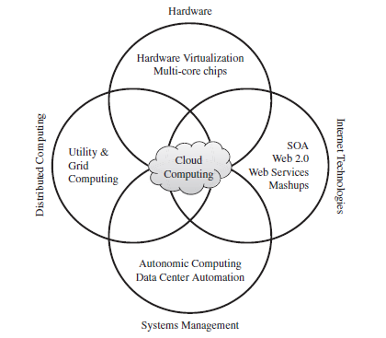
Why Now?
Experience with very large datacenters
Other factors
  Pervasive broadband Internet
  Fast x86 virtualization
  Pay-as-you-go billing model
  Standard software stack

Slide 9
Why Now?
Hardware Virtualization
  Refers to the creation of a virtual machine that acts like a real computer with an operating system
Virtual Machine
  A software implementation of a machine that executes programs like a physical machine
VM Technology
  Allows multiple virtual machines to run on a single physical machine
App
App
App
App
App
Guest OS
(Linux)
Guest OS
(NetBSD)
Guest OS
(Windows)
VM
VM
VM
Virtual Machine Monitor (VMM) / Hypervisor
Hardware

Slide 10
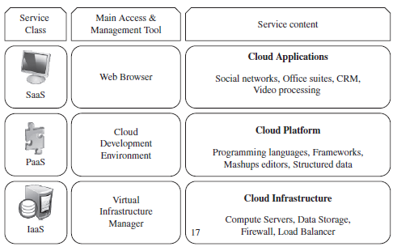
Service Models
Cloud computing providers offer their services according to several fundamental models

Slide 11
Service Models
Cloud Software as a Service
  Use the provider’s applications running on a cloud infrastructure
  Accessible from various client devices through thin client interface such as a web browser
  Consumer does not manage or control the underlying cloud infrastructure including network, servers, operating systems, storage
  Google Apps, Microsoft Office 365, Petrosoft, Onlive, GT Nexus, Marketo, Casengo, TradeCard, Rally Software, Salesforce, ExactTarget and CallidusCloud

Slide 12
Service Models
Cloud Platform as a Service
  Cloud providers deliver a computing platform, typically including operating system, programming language execution environment, database, and web server
  Application developers can develop and run their software solutions on a cloud platform without the cost and complexity of buying and managing the underlying hardware and software layers
  AWS Elastic Beanstalk, Cloud Foundry, Heroku, Force.com, Engine Yard, Mendix, OpenShift, Google App Engine, AppScale, Windows Azure Cloud Services, OrangeScape and Jelastic.

Slide 13
Service Models
Cloud Infrastructure as a Service
  Cloud provider offers processing, storage, networks, and other fundamental computing resources
  Consumer is able to deploy and run arbitrary software, which can include operating systems and applications
  Amazon EC2, Google Compute Engine, HP Cloud, Joyent, Linode, NaviSite, Rackspace, Windows Azure, ReadySpace Cloud Services, and Internap Agile

Slide 14
Deployment Models
Private Cloud
  Cloud infrastructure is operated solely for an organization
Community Cloud
  Shared by several organizations and supports a specific community that has shared concerns
Public Cloud
  Cloud infrastructure is made available to the general public
Hybrid Cloud
  Cloud infrastructure is a composition of two or more clouds

Slide 15
Advantages of Cloud Computing
Improved performance
  Better performance for large programs
Unlimited storage capacity and computing power
Reduced software costs
Universal document access
  Just computer with internet connection is required
Instant software updates
    No need to pay for or download an upgrade

Slide 16
Advantages of Cloud Computing
Easier group collaboration
Device independence

Slide 17
Disadvantages of Cloud Computing
Requires a constant Internet connection
Does not work well with low-speed connections
Can be slow
  Even with a fast connection, web-based applications can sometimes be slower than accessing a similar software program on your desktop PC
  Everything about the program, from the interface to the current document, has to be sent back and forth from your computer to the computers in the cloud

Slide 18
Disadvantages of Cloud Computing
HPC Systems
  Not clear that you can run compute-intensive HPC
  applications that use MPI or OpenMP
  Scheduling by user?
General Concerns
  Each cloud system uses different protocols and different APIs
    may not be possible to run applications between cloud based systems
  Amazon has created its own DB system and workflow system so your normal applications will have to be adapted to execute on these platforms

Slide 19
Disadvantages of Cloud Computing
  Privacy
    Given greater powers to telecommunication companies to monitor user activity
    NSA recorded over 10 million telephone calls between American citizens
    Legal concerns over jurisdiction
  Interoperability and portability
    Lack of standards between cloud providers

Slide 20
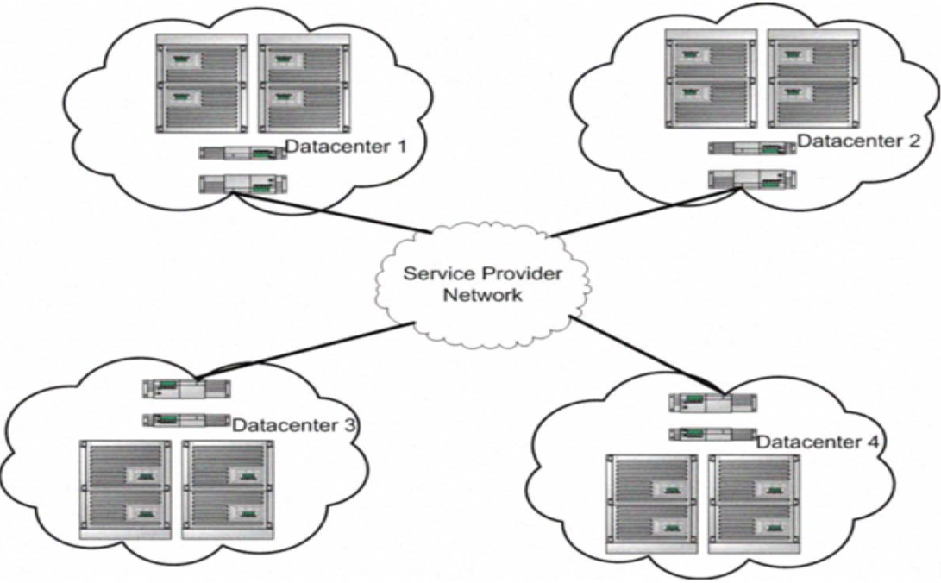
Distributed Cloud Systems
Cloud-computing resources are geographically distributed over a large number of locations in a wide-area network
Distributed cloud architectures consist of a large number of small sized data centers distributed across a geographic area
Customer requests can be serviced from locations closest to them

