Slide 1
Cluster and Grid Computing
2013.10.6
Sayed Chhattan Shah, PhD
Senior Researcher
Electronics and Telecommunications Research Institute, Korea

Slide 2
Outline
Cluster Computing
  Architecture
  Key Components
Grid Computing
  Architecture
  Key Components
  Resource Management
    Discovery
    QoS Support
    Scheduling

Slide 3
Cluster Computing

Slide 4
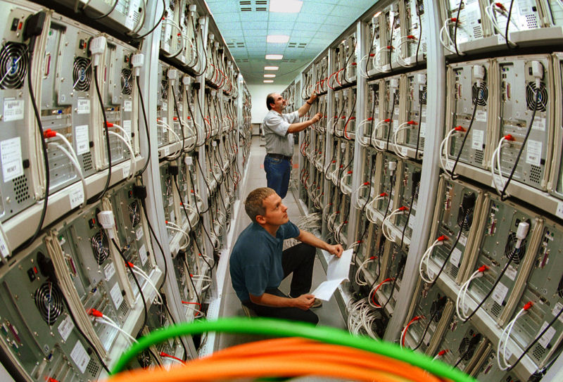
Cluster
A type of distributed system
A collection of workstations of PCs that are interconnected by a high-speed network
Work as an integrated collection of resources
Have a single system image spanning all its nodes

Slide 5
Cluster Computer Architecture
Parallel Applications
Parallel Applications
Parallel Applications
Sequential Applications
Sequential Applications
Sequential Applications
Parallel Programming Environment
Cluster Middleware
(Single System Image and Availability Infrastructure)
PC/Workstation
PC/Workstation
PC/Workstation
PC/Workstation
Communications
Software
Communications
Software
Communications
Software
Communications
Software
Network Interface Hardware
Network Interface Hardware
Network Interface Hardware
Network Interface Hardware
Cluster Interconnection Network/Switch

Slide 6
Prominent Components of Cluster Computers
Multiple High Performance Computers
  PCs
  Workstations
State of the art Operating Systems
  Linux (MOSIX, Beowulf, and many more)
  Microsoft NT (Illinois HPVM, Cornell Velocity)
  SUN Solaris (Berkeley NOW, C-DAC PARAM)
  IBM AIX (IBM SP2)

Slide 7
Prominent Components of Cluster Computers
High Performance Networks
  Ethernet (10Mbps),
  Fast Ethernet (100Mbps),
  Gigabit Ethernet (1Gbps)
  SCI (Scalable Coherent Interface- MPI- 12µsec latency)
  ATM (Asynchronous Transfer Mode)
  Myrinet (1.2Gbps)
  Digital Memory Channel
  FDDI (fiber distributed data interface)
  InfiniBand

Slide 8
Prominent Components of Cluster Computers
Fast Communication Protocols and Services
  Active Messages (Berkeley)
  Fast Messages (Illinois)
  U-net (Cornell)
  XTP (Virginia)
  Virtual Interface Architecture (VIA)

Slide 9
Prominent Components of Cluster Computers
Myrinet
QSnet
Giganet
ServerNet2
SCI
Gigabit
Ethernet
Bandwidth
(MBytes/s)
140 – 33MHz
215 – 66 Mhz
208
~105
165
~80
30 - 50
MPI
Latency (µs)
16.5 – 33Nhz
11 – 66 Mhz
5
~20 - 40
20.2
6
100 - 200
List price/port
$1.5K
$6.5K
~$1.5K
$1.5K
~$1.5K
~$1.5K
Hardware
Availability
Now
Now
Now
Q2‘00
Now
Now
Linux Support
Now
Late‘00
Now
Q2‘00
Now
Now
Maximum
#nodes
1000’s
1000’s
1000’s
1000’s
64K
1000’s
Protocol
Implementation
Firmware on adapter
Firmware
on adapter
Firmware on adapter
Implemented in hardware
Firmware
on adapter
Implemented
in hardware
VIA support
Soon
None
NT/Linux
Done in hardware
Software
TCP/IP, VIA
NT/Linux
MPI support
3rd party
Quadrics/
Compaq
3rd Party
Compaq/3rd party
3rd Party
MPICH – TCP/IP
Notes:
$ figures as per summer (June) 00
Myrinet GM-MPI 215 MBytes/s – 11us latency - It was with a Lanai9 at 132 MHz available now.

Slide 10
Prominent Components of Cluster Computers
Cluster Middleware
  Resource management and scheduling
  Fault handling
  Migration
  Load balancing

Slide 11
Grid Computing

Slide 12
Overview: Clusters x Grids
Grid Computing
Cluster - How can we use local networked resources to achieve better performance for large scale applications?
  High speed networks
  Centralized resource and task management
How can we put together geographically distributed resources to achieve even better results?
  Distributed resource and task management
  No high speed connections

Slide 13
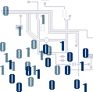
Basic Idea
Computing power should be available on demand, for a fee
  Just like the electrical power grid.
Access to
Information Grid
Customer
Information
Generators
Information Distributed
Over the Grid
Notes:
Customers want
Cost effective Service on demand
With Quality of Service according to well defined
Service level agreements
Not worried about details of generation

Slide 14
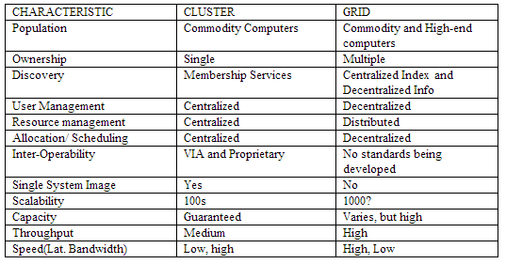
Grid and Cluster
Notes:
Customers want
Cost effective Service on demand
With Quality of Service according to well defined
Service level agreements
Not worried about details of generation

Slide 15
Why Grid Computing?
Core networking technology now accelerates at a much faster rate than advances in microprocessor speeds
Exploiting under utilized resources
Parallel CPU capacity
Access to additional resources

Slide 16
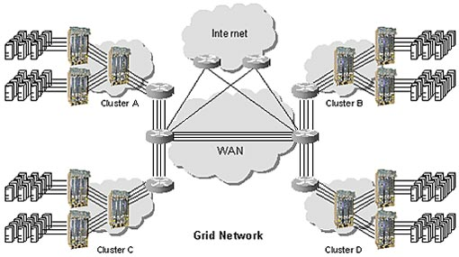

Grid Computing
Several clusters in Grid
May include super computers, desktops, laptops, mobile devices

Slide 17
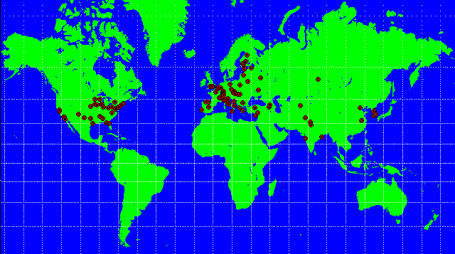
CERNs Large Hadron Collider
1800 Physicists, 150 Institutes, 32 Countries
100 PB of data by 2010; 50,000 CPUs?

Slide 18

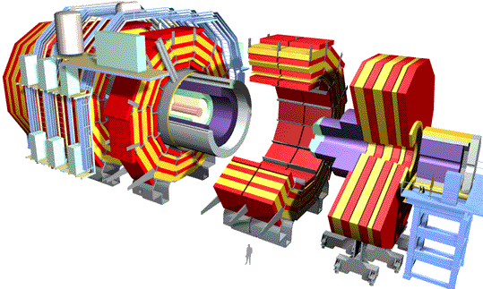
Data Grids for High Energy Physics
~PBytes/sec
Online System
~100 MBytes/sec
1 TIPS is approximately 25,000
SpecInt95 equivalents
There is a “bunch crossing” every 25 nsecs.
There are 100 “triggers” per second
Each triggered event is ~1 MByte in size
Offline Processor Farm
~20 TIPS
~100 MBytes/sec
Tier 0
CERN Computer Centre
HPSS
~622 Mbits/sec or Air Freight (deprecated)
Tier 1
France Regional Centre
HPSS
Germany Regional Centre
HPSS
Italy Regional Centre
HPSS
FermiLab ~4 TIPS
HPSS
~622 Mbit/sec
Tier 2
Caltech ~1 TIPS
Tier2 Centre ~1 TIPS
Tier2 Centre ~1 TIPS
Tier2 Centre ~1 TIPS
Tier2 Centre ~1 TIPS
~622 Mbits/sec
Institute ~0.25TIPS
Institute
Institute
Institute
Physicists work on analysis “channels”.
Each institute will have ~10 physicists working on one or more channels; data for these channels should be cached by the institute server
Physics data cache
~1 MBytes/sec
Tier 4
Pentium II 300 MHz
Pentium II 300 MHz
Physicist workstations
Pentium II 300 MHz
Pentium II 300 MHz

Slide 19
Grid Components
Applications and Portals
Grid
Apps.
Scientific
Engineering
Collaboration
Prob. Solving Env.
…
Web enabled Apps
Development Environments and Tools
Grid
Tools
Languages
Libraries
Debuggers
Monitoring
Resource Brokers
…
Web tools
Distributed Resources Coupling Services
Grid
Middleware
Security
Information
Process
Resource Trading
Market Info
…
QoS
Local Resource Managers
Operating Systems
Queuing Systems
Libraries & App Kernels
…
TCP/IP & UDP
Grid
Fabric
Networked Resources across Organisations
Computers
Clusters
Storage Systems
Data Sources
…
Scientific Instruments

Slide 20
Challenging Technical Requirements
Dynamic formation and management of virtual organizations
Online negotiation of access to services
  who, what, why, when, how
Establishment of applications and systems able to deliver multiple qualities of service
Autonomic management of infrastructure elements

Slide 21
Selected Major Grid Projects
Name | Sponsors | Focus
Access Grid | NSF | Create & deploy group collaboration systems using commodity technologies
BlueGrid | IBM | Grid testbed linking IBM laboratories
DISCOM | DOE Defense Programs | Create operational Grid providing access to resources at three U.S. DOE weapons laboratories
DOE Science Grid | DOE Office of Science | Create operational Grid providing access to resources & applications at U.S. DOE science laboratories & partner universities
Earth System Grid (ESG) | DOE Office of Science | Delivery and analysis of large climate model datasets for the climate research community
European Union (EU) DataGrid | European Union | Create & apply an operational grid for applications in high energy physics, environmental science, bioinformatics

Slide 22
Selected Major Grid Projects
Name | Sponsor | Focus
EuroGrid, Grid Interoperability (GRIP) | European Union | Create tech for remote access to supercomping resources & simulation codes; in GRIP, integrate with Globus Toolkit™
Fusion Collaboratory | DOE Off. Science | Create a national computational collaboratory for fusion research
Globus Project™ | DARPA DOE NSF NASA | Research on Grid technologies; development and support of Globus Toolkit™; application and deployment
GridLab | European Union | Grid technologies and applications
GridPP | U.K. eScience | Create & apply an operational grid within the U.K. for particle physics research
Grid Research Integration Dev. & Support Center | grids-center.org NSF | Integration, deployment, support of the NSF Middleware Infrastructure for research & education

Slide 23
Selected Major Grid Projects
Name | Sponsor | Focus
Grid Application Dev. Software | NSF | Research into program development technologies for Grid applications
Grid Physics Network | NSF | Technology R&D for data analysis in physics expts: ATLAS, CMS, LIGO, SDSS
Information Power Grid | NASA | Create and apply a production Grid for aerosciences and other NASA missions
International Virtual Data Grid Laboratory | NSF | Create international Data Grid to enable large-scale experimentation on Grid technologies & applications
Network for Earthquake Eng. Simulation Grid | NSF | Create and apply a production Grid for earthquake engineering
Particle Physics Data Grid | DOE Science | Create and apply production Grids for data analysis in high energy and nuclear physics experiments

Slide 24
Overview: Clusters x Grids
Desktop Grid
A large proportion of personal computer’s computational power is left unused
A desktop grid takes this unused capacity
  Local Desktop Grid
    Comprised mainly of a set of computers at one location
  Volunteer Desktop Grid
    Resources in a volunteer desktop grid are provided by citizens all over the world

Slide 25
Types of Grids
Computational Grid
  Processing power is the main computing resource shared amongst nodes
  Distributed Supercomputing
    Executes the application in parallel on multiple machines to reduce the completion time
  High throughput
    Increases the completion rate of a stream of jobs
Data Grid
  Data storage capacity as the main shared resource amongst nodes

Slide 26
Resource Management

Slide 27
Overview: Clusters x Grids
Resource Management System
Manages the pool of resources available to Grid
  Processors
  Network bandwidth
  Disk storage
The pool includes resources from different providers
  RMS should maintain the required level of trust
    Without affecting performance
  RMS should adhere to different policies
  RMS should meet QoS requirements

Slide 28
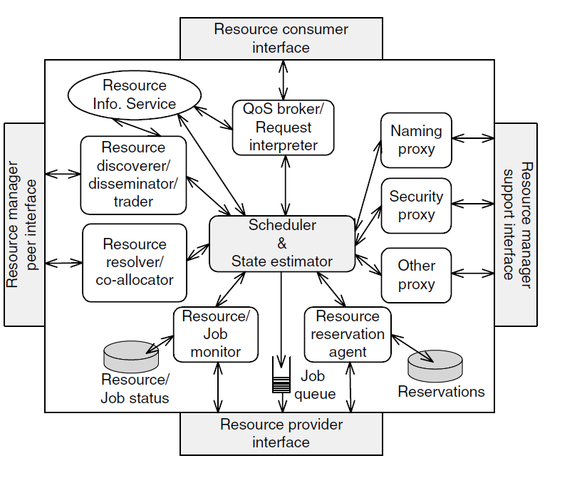
Overview: Clusters x Grids
Core Functions of Resource Management System

Slide 29
Overview: Clusters x Grids
Core Functions of Resource Management System
Resource Dissemination and Discovery Protocols
  Used to determine the state of the resources
    Resource Dissemination Protocol
      Provides information about the resources
    Discovery Protocol
      Provides a mechanism by which resource information can be found
Resource resolution and co-allocation protocols
  To schedule the job at the remote resource
  Simultaneously acquire multiple resources

Slide 30
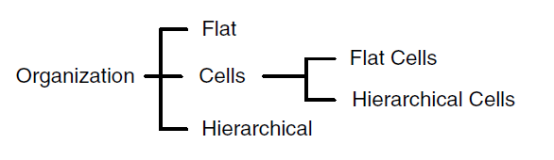
Overview: Clusters x Grids
Resource Management System
Machine Organization
  Organization of the machines in the Grid affects the communication patterns and thus
    determines the scalability

Slide 31
Overview: Clusters x Grids
Resource Management System
  Centralized Organization
    a single controller or designated set of controllers performs the scheduling for all machines
    suffer from scalability issues
  Decentralized Organization
    Roles are distributed among machines
    Sender initiated
    Receiver initiated

Slide 32
Overview: Clusters x Grids
Resource Management System
  Flat Organization
    All machines can directly communicate with each other without going through
  Hierarchical Organization
    Machines in the same level can directly communicate with the machines directly above them or below them
  Cell or Group Organization
    Machines within the cell communicate between themselves using flat organization
    Designated machines within the cell function acts as boundary elements that are responsible for all communication outside the cell
      Flat cell structure has only one level of cells
      Hierarchical cell structure can have cells that contain other cells

Slide 33
Overview: Clusters x Grids
Resource Management System
QoS Support
  QoS is not limited to network bandwidth but extends to the processing and storage capabilities of the nodes
  Resource reservation is one of the ways of providing guaranteed QoS
  Key components of QoS
    Admission control determines if requested level of service can be given
    Policing ensures that job does not violate agreed upon level of service

Slide 34
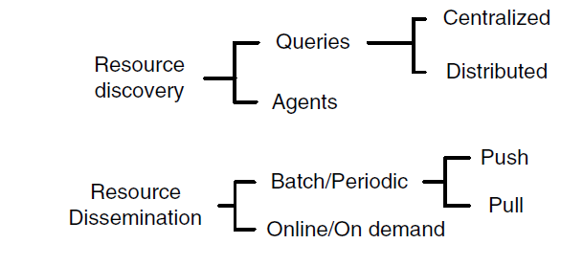
Overview: Clusters x Grids
Resource Management System
Resource Discovery and Dissemination
  Discovery is initiated by applications to find suitable resources
  Dissemination is initiated by resources to find suitable application

Slide 35
Overview: Clusters x Grids
Resource Management System
Scheduling
  Determining when and where the jobs are executed and how many resources are allocated
  Time-shared job-scheduling approaches
    Multiple jobs share the same resources
  Space-shared job-scheduling approaches
    Multiple jobs can run at any point of time by the available nodes
  Gang or Synchronous Scheduling
    Scheduling all tasks of application at the same time
  Loosely coordinated co-scheduling
    Schedule communicating tasks of application at the same time

Slide 36
Overview: Clusters x Grids
Resource Management System
Scheduling Objectives
  Minimize response time and
  Maximize system utilization
  Trade-off
    Maximizing system utilization may increase response time

Slide 37
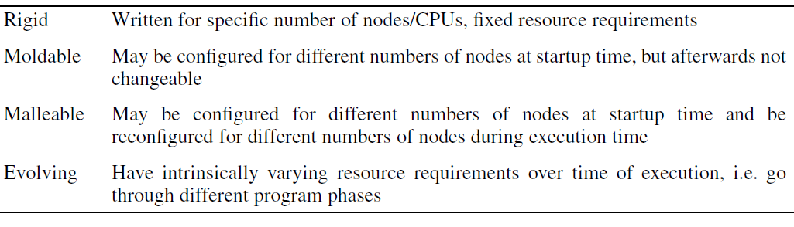
Overview: Clusters x Grids
Resource Management System
Job Requirements
  Independent jobs
  Dependent jobs
    Precedence dependency
    Parallel Dependency

Slide 38
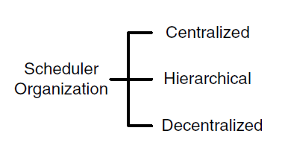
Overview: Clusters x Grids
Resource Management System
Scheduling

Slide 39
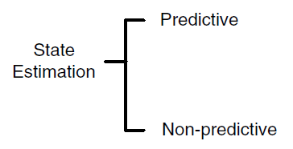
Overview: Clusters x Grids
Resource Management System
State Estimation
  Predictive state estimation uses current and historical job and resource status information
  Non-predictive state estimation uses only the current job and resource status information

Slide 40
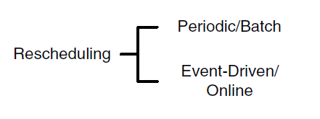
Overview: Clusters x Grids
Resource Management System
Rescheduling
  To improve utilization, balance load, etc
  Periodic or batch rescheduling approaches group resource requests and system events which are then processed at intervals
  Event driven online rescheduling performs rescheduling as soon the RMS receives the resource request or system event

