Slide 1
Presentation Analyzing Hospital Inpatient Data Knee Arthroplasty Focus
Praveen Venkateshan July 25, 2024

Slide 2
Agenda
01
02
03
04
Introduction
Data Exploration and Cleaning
Solving Key Research Challenges in Knee Arthroplasty
Limitations

Slide 3

Introduction
01
Knee arthroplasty involves replacing damaged knee joints with artificial ones to relieve pain and restore function.
It primarily affects patients with severe osteoarthritis, rheumatoid arthritis, post-traumatic arthritis, and knee deformities.
Knee arthroplasty is most common in adults aged 60 and older, increasingly performed in those aged 40 to 60, and occasionally in individuals under 40 due to trauma or early-onset arthritis.

Slide 4
02
Data Exploration and Cleaning
Converted 'Length of Stay' from categorical to numeric and discarded 'Discharge Year' as it only contained the year 2021.
Extracted knee arthroplasty patients using the 'APR DRG Description' attribute.
Removed irrelevant attributes with IDs and codes, and handled missing values by eliminating columns with over 40% missing data and imputing the rest.
Excluded Payment Typology 2 and 3 due to missing values, focusing on Payment Typology 1.
Created a 'Payment Type' feature by classifying Payment Typology 1 into 'Government Insurance' and 'Private Payer'

Slide 5
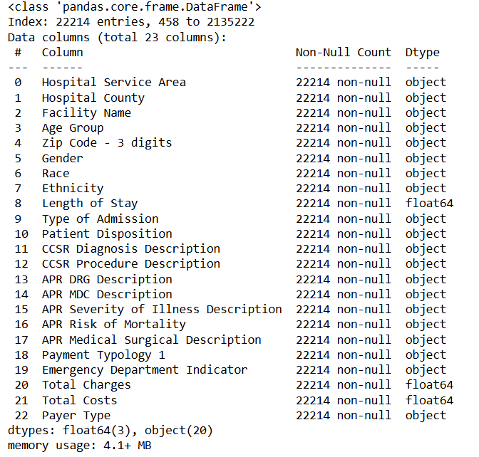

Slide 6
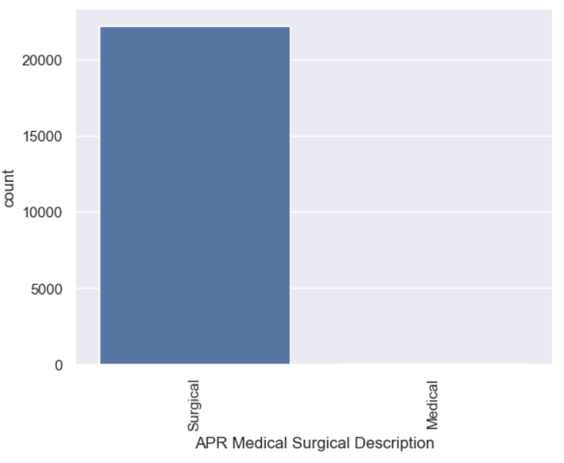
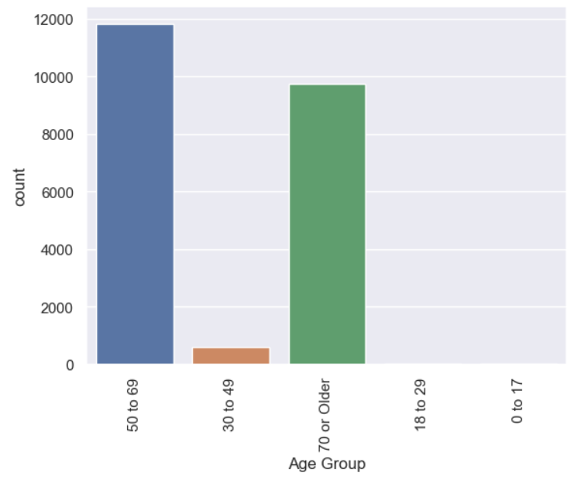
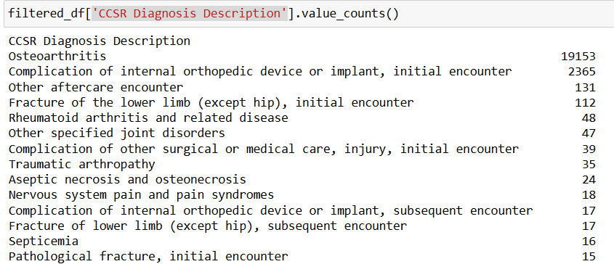
Univariate Analysis
From the plots above, we can clearly observe the data is related to knee arthroplasty, as discussed in the Introduction.

Slide 7
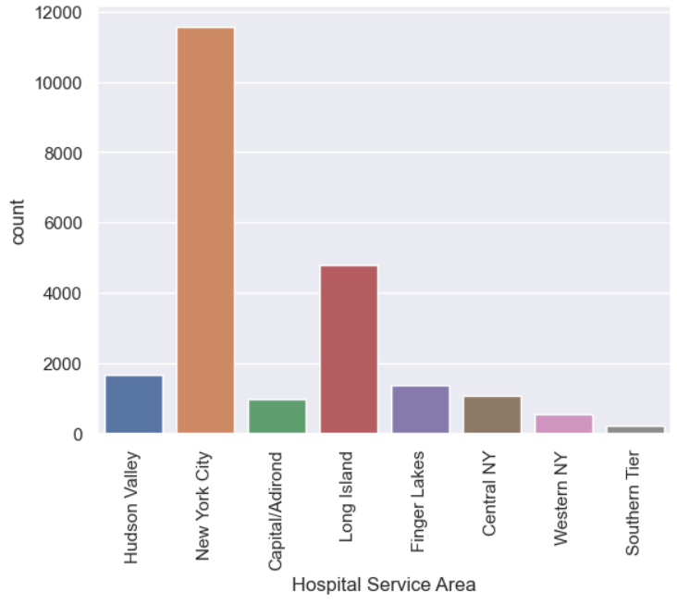
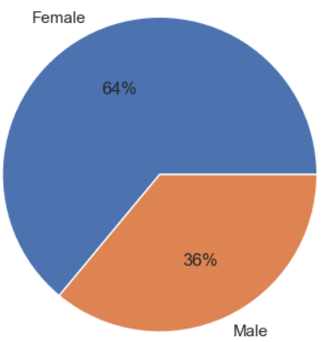
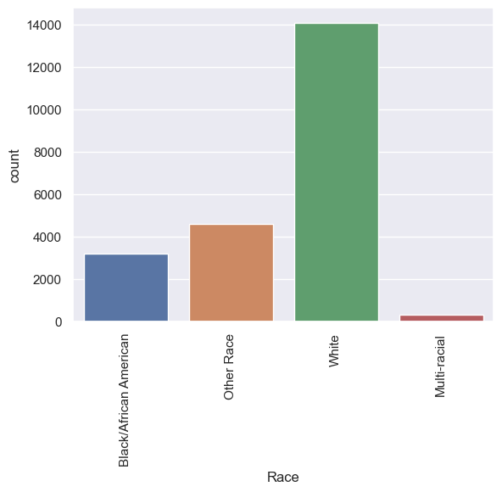
The above plots reveal that the majority of knee arthroplasty patients are from New York City, with a predominance of females and individuals of White race.

Slide 8
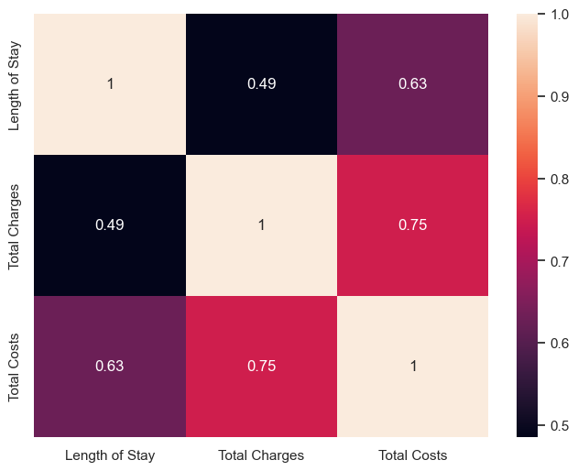
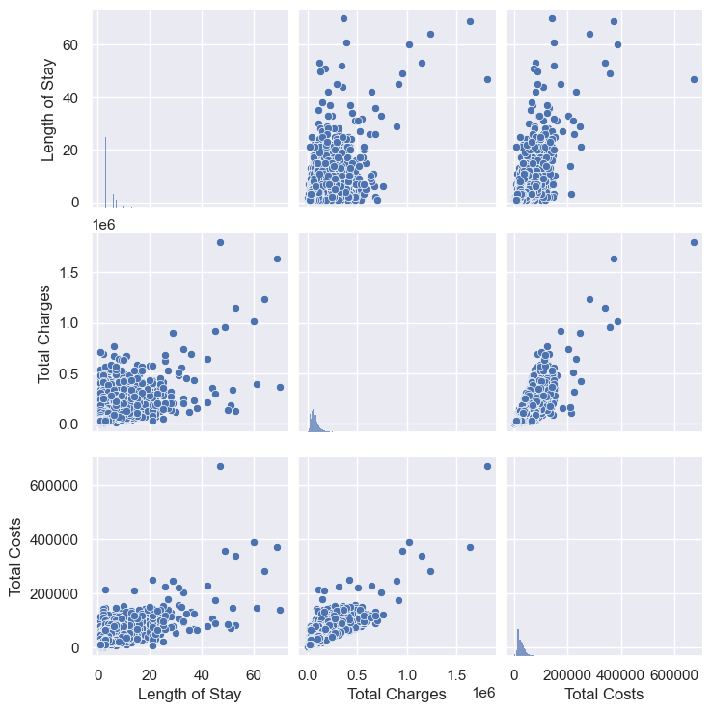
Bivariate Analysis
I plotted a heat map and pair plot using all continuous attributes and observed a positive correlation among them.

Slide 9
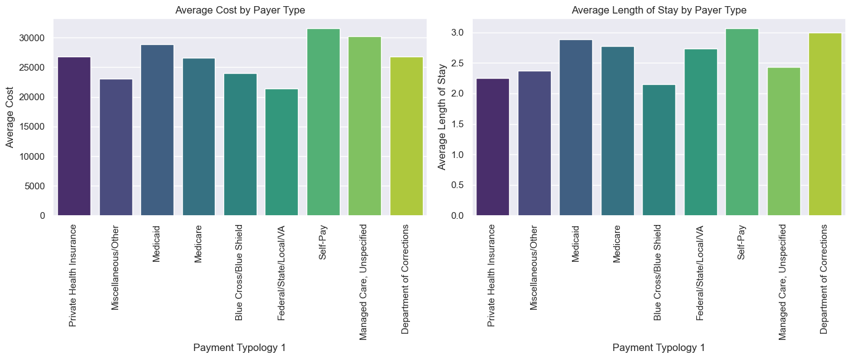
03
Solving Key Research Challenges in Knee Arthroplasty
Describe cost and hospital length of stay (LOS), by payer type (Payment Typology)
I used the mean values of Total Cost and Length of Stay to analyze them concerning the type of payer. The data revealed that both the average Length of Stay and Total Cost are higher for self-pay patients.

Slide 10
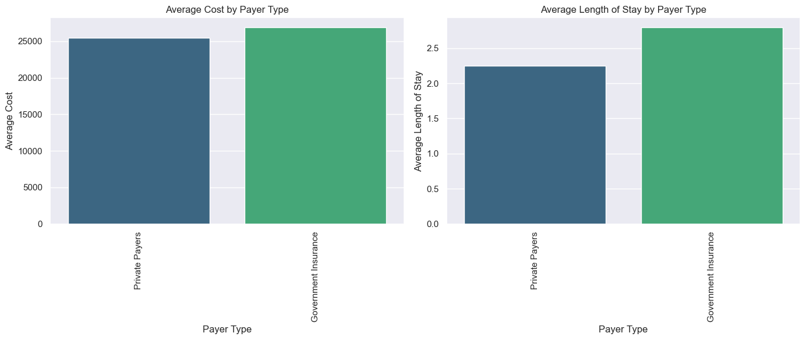
Government Insurance:
Medicare
Medicaid
Federal/State/Local/VA
Department of Corrections
Private Payers:
Private Health Insurance
Blue Cross/Blue Shield
Miscellaneous/Other
Managed Care, Unspecified
Self-Pay
The data revealed that the average Length of Stay and Total Costs appears to be higher for Government Insurance

Slide 11
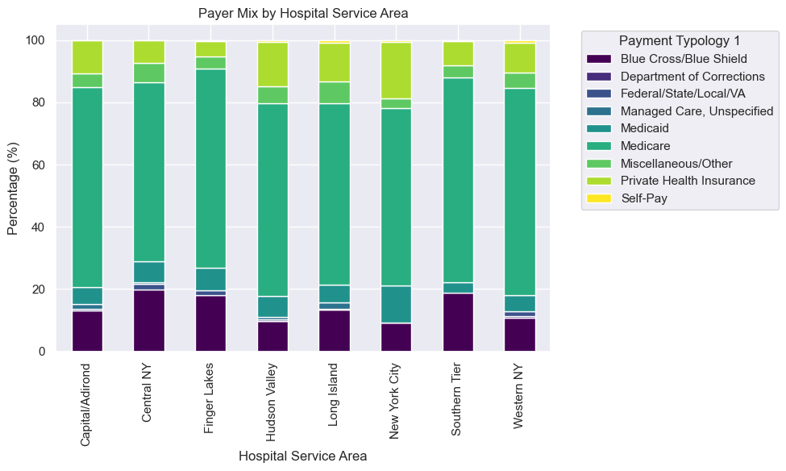
What is the payer mix (distribution of all available payers), by Hospital service area?
I grouped data by hospital service area and payer type, calculated group sizes, converted counts to percentages, and visualized the distribution with a stacked bar chart to show payer mix within each service area.
The analysis revealed that the percentage of Medicare payers is higher across all hospital service areas in New York State.

Slide 12
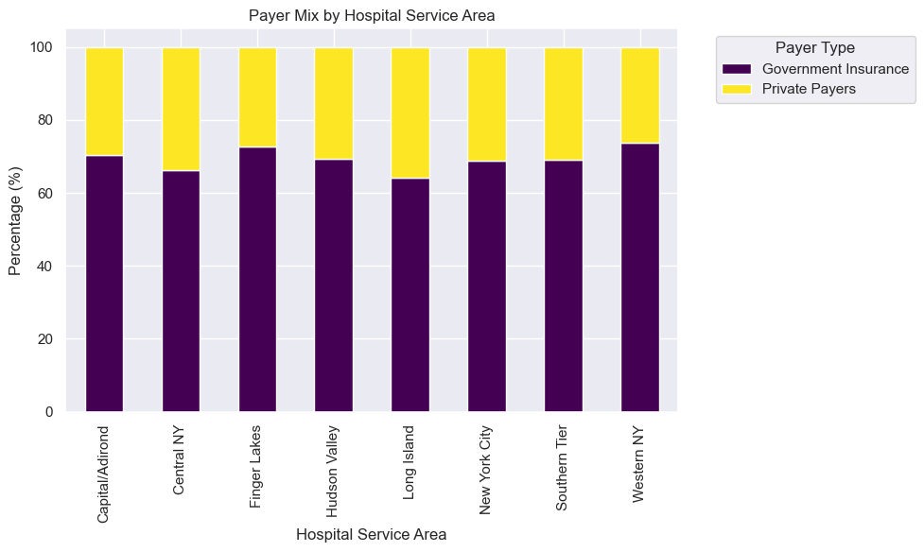
The analysis showed that Government Insurance accounts for over 60% of payers across all hospital service areas in New York State, compared to private payers.

Slide 13
What are the factors that influence cost? How about LOS? Are the factors similar? Why and why not?
I used Feature Importance Analysis using OLS Regression to identify factors influencing Total Costs and Length of Stay.
Converted categorical variables into numerical format using dummy variables.
Normalized continuous variables with MinMaxScaler.
Applied OLS regression to determine feature importance, initially without splitting the data.
Validated the model's reliability by performing train-test splits, ensuring consistent results.

Slide 14
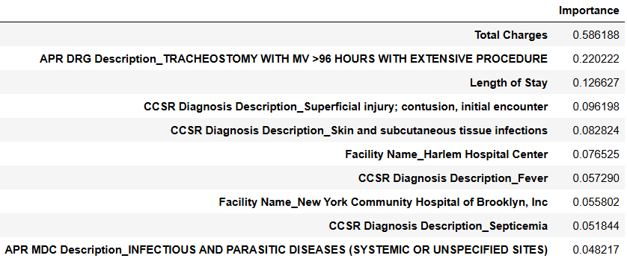
Most Influential Features for Estimating Total Costs
The top 10 important features identified with and without splitting the dataset are largely consistent, indicating stability in feature importance across different modeling approaches.
The R² value of 0.87 suggests a strong fit of the model to the data, demonstrating that the model explains a significant portion of the variance in the target variable.

Slide 15
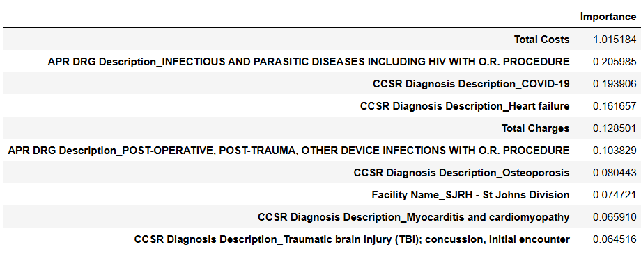
Most Influential Features for Estimating Length of Stay
The top 10 important features identified with and without splitting the dataset are largely consistent, indicating stability in feature importance across different modeling approaches.
The R² value of 0.62 indicates a moderate fit of the model to the data, showing that the model explains a significant portion, but not all, of the variance in the target variable.

Slide 16
Comparing Important features of Total Costs and Length of Stay
Total Costs, APR DRG Description, CCSR Diagnosis Description, and Facility Name are common important features influencing both Total Costs and Length of Stay
Total Costs is more influenced by overall charges and specific procedures, whereas LOS is more affected by Total Costs and diagnoses like COVID-19 and heart failure.
There is overlap in factors affecting Total Costs and LOS, but their specific influences differ.
From this we can conclude that intensity and complexity of care directly impact both Total costs and the Length of Stay.

Slide 17
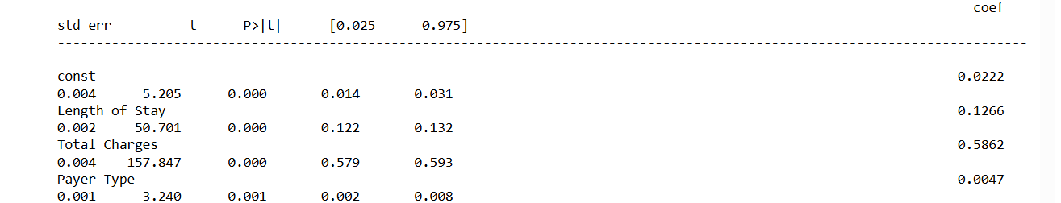
We have a hypothesis that patients with government insurance has higher cost compared to those private payers. How do you test this hypothesis statistically, adjusting for factors that you identified in #3?
Null Hypothesis (H0): There is no difference in the costs between patients with government insurance and those with private payers.
Alternative Hypothesis (H1): Patients with government insurance have higher costs compared to those with private payers.
Given that the p-value for Payer Type is 0.001, which is below the typical significance level of 0.05, we reject the null hypothesis. This result indicates a statistically significant difference in costs between government insurance and private payers, with government insurance being associated with higher costs.
Even when performing hypothesis testing directly with ttest_ind, the p-value remained low, leading to the rejection of the null hypothesis.

Slide 18
Why are these questions important for our business?
Understanding cost and length of stay by payer type helps optimize resource allocation and manage expenses more effectively.
Analyzing payer distribution by region and the impact of different payer types supports strategic decisions on market access.
Testing hypotheses on payer impact helps us understand cost structures and financial effects, which guides our strategies for pricing to meet healthcare economic goals.

Slide 19
04
Limitations
The dataset is restricted to 2021, which may not capture long-term trends or variations
The analysis assumes the identified factors are the main drivers of costs and length of stay, potentially overlooking other relevant variables not included in the model.
Some categorical variables were grouped into broader categories, which may oversimplify the complexity of models.

Slide 20
Thank You

