Slide 1
Introduction
to
DevOps
Praveen Kumar G S

Slide 2
Agenda
What is DevOps?
Why DevOps?
DevOps vs Waterfall model
DevOps lifecycle
DevOps Tools
DevOps best practices
Use case of DevOps pipeline using Jenkins
Conclusion

Slide 3
DevOps
It is the combination of cultural philosophies, practices, and tools that increases an organization’s ability to deliver applications and services at high velocity.

Slide 4
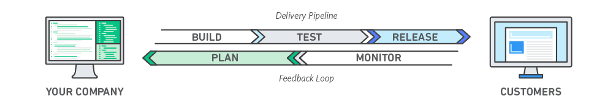
Courtesy: aws.amazon.com

Slide 5
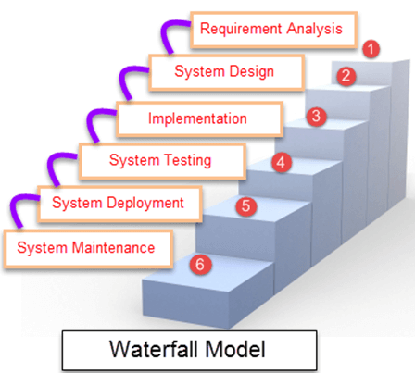
Waterfall Model is a sequential model that divides software development into pre-defined phases.
Each phase must be completed before the next phase can begin with no overlap between the phases.
Each phase is designed for performing specific activity during the SDLC phase.

Slide 6
Waterfall Methodology can be used when:
Requirements are not changing frequently
Application is not complicated and big
Project is short
Requirement is clear
Environment is stable
Technology and tools used are not dynamic and is stable
Resources are available and trained

Slide 7
Disadvantages of Waterfall Model:
No working software is produced until end
It is difficult to measure the progress within the stages
Cannot accommodate the changing requirements.
Excludes the client / end user interaction
Delays testing until after completion.

Slide 8
Key Principles of DevOps:
Fostering a collaborative environment with communication, mutual trust, skill and idea sharing, and problem solving.
Creating a culture of end-to-end responsibility where the whole team is accountable for the results, with no “finger-pointing” between the “Dev” and the “Ops” experts.
Focusing on continuous improvement based on customer feedback and changing technologies with the goal of optimizing the product quality, cost, and speed of the delivery.

Slide 9
Using automation wherever possible to streamline and speed up the development and deployment processes and improve efficiency and reliability.
Delivering a customer-centric approach with short feedback loops in order to fulfil changing customer’s needs.
Learning from failures and creating a climate where they are turned into new opportunities.

Slide 10
DevOps Life Cycle
1. Plan
2. Code
3. Build
4. Test
5. Deployement
6. Operate
7. Monitor.

Slide 11
DevOps Stages
1. Version Control: Maintains different versions of the code ( Source Code Management)
2. Continuous Integration : Compile, validate, code Review, Unit Testing, Integration Testing (Continuous Build)
3. Continuous delivery : Deploying the build applications to the test servers and performing UAT (Continuous Testing)
4. Continuous Deployment: Deploying the tested applications on the prod server for release (Configuration Management and Containerization)

Slide 12
Continuous Integration
Continuous integration is a DevOps software development practice where developers regularly merge their code changes into a central repository, after which automated builds and tests are run.
Continuous integration refers to the build and unit testing stages of the software release process. Every revision that is committed triggers an automated build and test.
Benefits:
Improve Developer Productivity
Find and Address the Bugs Quicker
Deliver Updates Faster

Slide 13
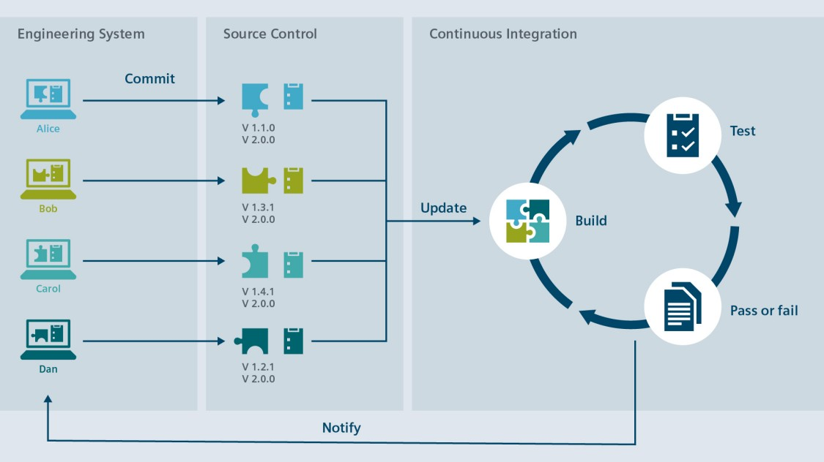

Slide 14
Continuous Delivery Vs Continuous Deployment
Continuous delivery is a software development practice where code changes are automatically prepared for a release to production.
A pillar of modern application development, continuous delivery expands upon continuous integration by deploying all code changes to a testing environment and/or a production environment after the build stage
With continuous delivery, every code change is built, tested, and then pushed to a non-production testing or staging environment. There can be multiple, parallel test stages before a production deployment.
The difference between continuous delivery and continuous deployment is the presence of a manual approval to update to production. With continuous deployment, production happens automatically without explicit approval.

Slide 15
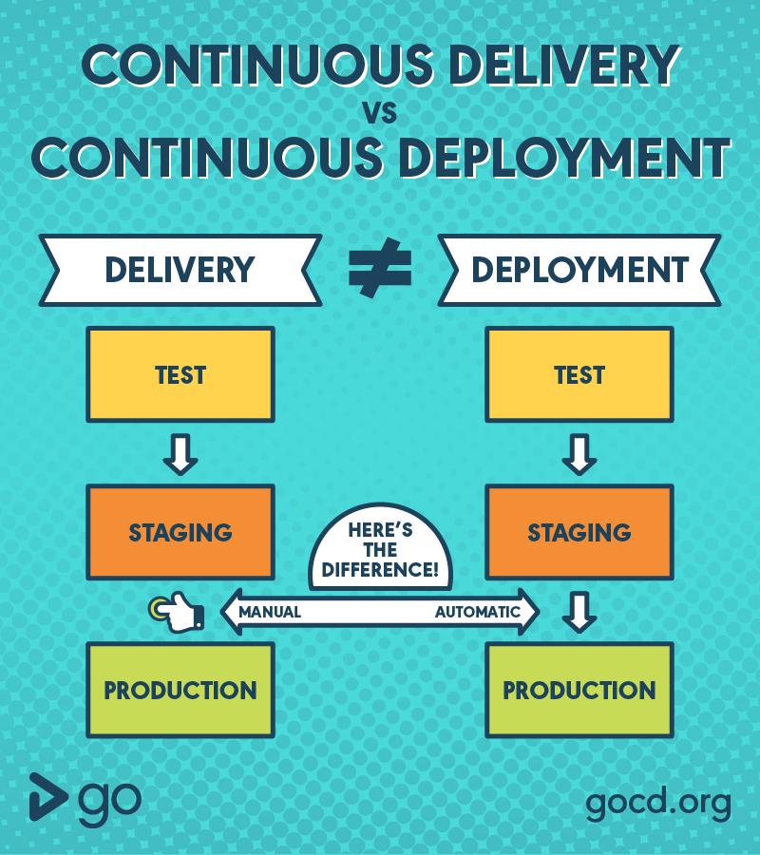

Slide 16
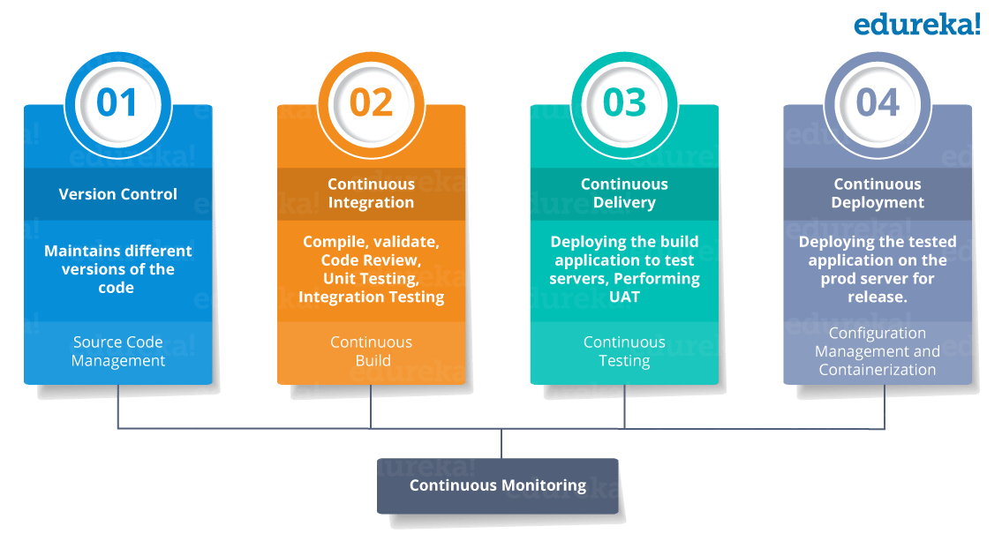
Courtesy: Edureka

Slide 17
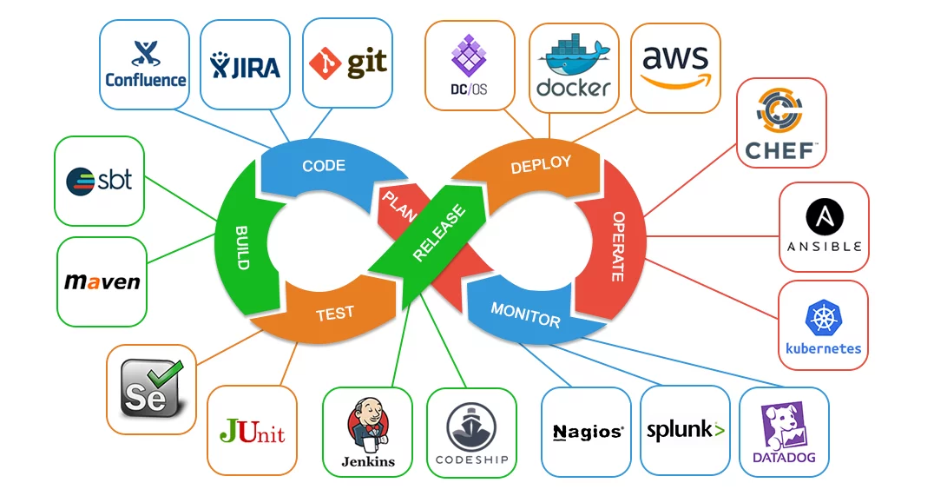

Slide 18
Puppet
Puppet is the most widely used DevOps tool. It allows the delivery and release of the technology changes quickly and frequently. It has features of versioning, automated testing, and continuous delivery. It enables to manage entire infrastructure as code without expanding the size of the team.
Features
Real-time context-aware reporting.
Model and manage the entire environment.
Defined and continually enforce infrastructure.
Desired state conflict detection and remediation.
It inspects and reports on packages running across the infrastructure.
It eliminates manual work for the software delivery process.
It helps the developer to deliver great software quickly.

Slide 19
Ansible
Ansible is a leading DevOps tool. Ansible is an open-source IT engine that automates application deployment, cloud provisioning, intra service orchestration, and other IT tools. It makes it easier for DevOps teams to scale automation and speed up productivity.
Ansible is easy to deploy because it does not use any agents or custom security infrastructure on the client-side, and by pushing modules to the clients. These modules are executed locally on the client-side, and the output is pushed back to the Ansible server.
Features
It is easy to use to open source deploy applications.
It helps in avoiding complexity in the software development process.
It eliminates repetitive tasks.
It manages complex deployments and speeds up the development process.

Slide 20
Nagios
Nagios is one of the more useful tools for DevOps. It can determine the errors and rectify them with the help of network, infrastructure, server, and log monitoring systems.
Features
It provides complete monitoring of desktop and server operating systems.
The network analyzer helps to identify bottlenecks and optimize bandwidth utilization.
It helps to monitor components such as services, application, OS, and network protocol.
It also provides to complete monitoring of Java Management Extensions.

Slide 21
Chef
A chef is a useful tool for achieving scale, speed, and consistency. The chef is a cloud-based system and open source technology. This technology uses Ruby encoding to develop essential building blocks such as recipes and cookbooks. The chef is used in infrastructure automation and helps in reducing manual and repetitive tasks for infrastructure management.
Chef has got its convention for different building blocks, which are required to manage and automate infrastructure.
Features
It maintains high availability.
It can manage multiple cloud environments.
It uses popular Ruby language to create a domain-specific language.
The chef does not make any assumptions about the current status of the node. It uses its mechanism to get the current state of the machine.

Slide 22
Jenkins
Jenkins is a DevOps tool for monitoring the execution of repeated tasks. Jenkins is a software that allows continuous integration. Jenkins will be installed on a server where the central build will take place. It helps to integrate project changes more efficiently by finding the issues quickly.
Features
Jenkins increases the scale of automation.
It can easily set up and configure via a web interface.
It can distribute the tasks across multiple machines, thereby increasing concurrency.
It supports continuous integration and continuous delivery.
It offers 400 plugins to support the building and testing any project virtually.
It requires little maintenance and has a built-in GUI tool for easy updates.

Slide 23
Git
Git is an open-source distributed version control system that is freely available for everyone. It is designed to handle minor to major projects with speed and efficiency. It is developed to co-ordinate the work among programmers. The version control allows you to track and work together with your team members at the same workspace. It is used as a critical distributed version-control for the DevOps tool.
Features
It is a free open source tool.
It allows distributed development.
It supports the pull request.
It enables a faster release cycle.
Git is very scalable.
It is very secure and completes the tasks very fast.

Slide 24
Splunk
Splunk is a tool to make machine data usable, accessible, and valuable to everyone. It delivers operational intelligence to DevOps teams. It helps companies to be more secure, productive, and competitive.
Features
It has the next-generation monitoring and analytics solution.
It delivers a single, unified view of different IT services.
Extend the Splunk platform with purpose-built solutions for security.
Data drive analytics with actionable insight.

Slide 25
Selenium
Selenium is a portable software testing framework for web applications. It provides an easy interface for developing automated tests.
Features
It is a free open source tool.
It supports multiplatform for testing, such as Android and ios.
It is easy to build a keyword-driven framework for a WebDriver.
It creates robust browser-based regression automation suites and tests.

Slide 26
Docker
Docker is a high-end DevOps tool that allows building, ship, and run distributed applications on multiple systems. It also helps to assemble the apps quickly from the components, and it is typically suitable for container management.
Features
It configures the system more comfortable and faster.
It increases productivity.
It provides containers that are used to run the application in an isolated environment.
It routes the incoming request for published ports on available nodes to an active container. This feature enables the connection even if there is no task running on the node.
It allows saving secrets into the swarm itself.

Slide 27
DevOps Tools at a glance
Version Control Tool : Git
Build Tool : Maven
Integration Tool : Jenkins
Containerization Tool : Docker

Slide 28

Git
Git is a free and open source distributed version control system designed to handle everything from small to very large projects with speed and efficiency.
GitHub
GitHub is a product that allows you to host your Git projects on a remote server somewhere (or in other words, in the cloud).
Git Features:
Branching and Merging
Small and Fast
Distributed
Data Assurance
Staging Area
Free and Open Source

Slide 29
Here is a basic overview of how Git works:
Create a "repository" (project) with a git hosting tool (like Bitbucket)
Copy (or clone) the repository to your local machine
Add a file to your local repo and "commit" (save) the changes
"Push" your changes to your main branch
Make a change to your file with a git hosting tool and commit
"Pull" the changes to your local machine
Create a "branch" (version), make a change, commit the change
Open a "pull request" (propose changes to the main branch)
"Merge" your branch to the main branch

Slide 30
create a new repository on the command line
git init
git add <filename>
git commit -m “first commit”
git branch -M main
git remote add origin https://github.com/praveenrps/gaptech.git
git push –u origin master

Slide 31
Maven
Maven is a project management and comprehension tool that provides developers a complete build lifecycle framework.
Development team can automate the project's build infrastructure in almost no time as Maven uses a standard directory layout and a default build lifecycle.
Maven provides developers ways to manage the following −
Builds
Documentation
Reporting
Dependencies
SCMs
Releases
Distribution
Mailing list

Slide 32
Features of Maven
Simple project setup that follows best practices.
Consistent usage across all projects.
Dependency management including automatic updating.
A large and growing repository of libraries.
Extensible, with the ability to easily write plugins in Java or scripting languages.
Instant access to new features with little or no extra configuration.
POM
POM stands for Project Object Model. It is fundamental unit of work in Maven. It is an XML file that resides in the base directory of the project as pom.xml.
The POM contains information about the project and various configuration detail used by Maven to build the project(s).

Slide 33
What is Build Lifecycle?
A Build Lifecycle is a well-defined sequence of phases, which define the order in which the goals are to be executed. Here phase represents a stage in life cycle. As an example, a typical Maven Build Lifecycle consists of the following sequence of phases.
Maven Commands
mvn –version
mvn archetype:generate –DgroupId=com.examples.gap
–DartificatId=my-app
-DarchetypeAritifcatId=maven-archetype-quickstart
-DarchetyeVersion=1.4
-DinteractiveMode=false
mvn package (to build the package)

Slide 34
Although hardly a comprehensive list, these are the most common default lifecycle phases executed.
validate: validate the project is correct and all necessary information is available
compile: compile the source code of the project
test: test the compiled source code using a suitable unit testing framework. These tests should not require the code be packaged or deployed
package: take the compiled code and package it in its distributable format, such as a JAR.
integration-test: process and deploy the package if necessary into an environment where integration tests can be run
verify: run any checks to verify the package is valid and meets quality criteria

Slide 35
Install: install the package into the local repository,
for use as a dependency in other projects locally
deploy: done in an integration or release environment, copies the final package
to the remote repository for sharing, with other developers and projects.
clean: cleans up artifacts created by prior builds
site: generates site documentation for this project

