Slide 1
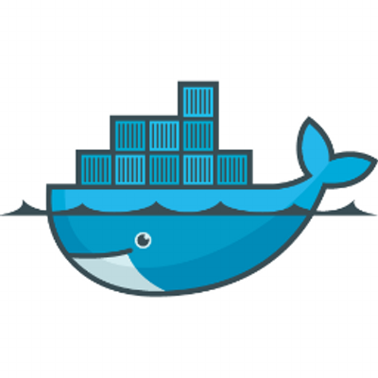
DOCKER
Build once, Configure once and Run Anywhere, Anytime

Slide 2
Docker Topics
Why docker ?
What is docker
Docker Vs Virtual Machines.
Docker architecture and components of docker.
Docker elements.
Docker commands.
How does an image builds, configures, and run ?
use cases

Slide 3
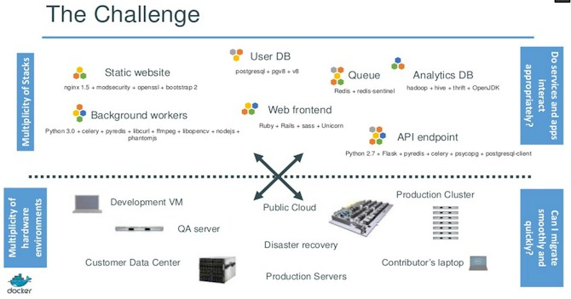
Why Docker

Slide 4
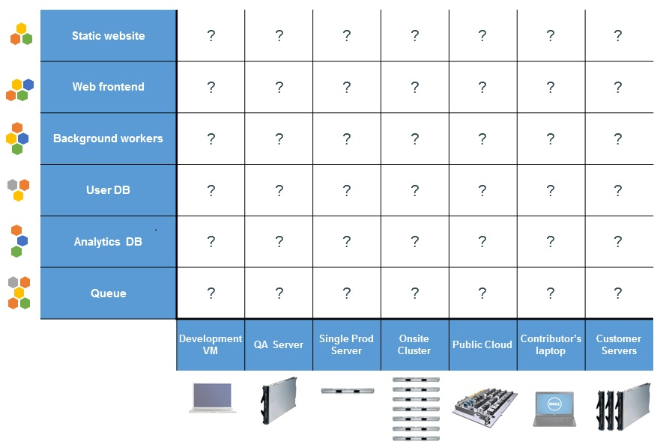

Slide 5
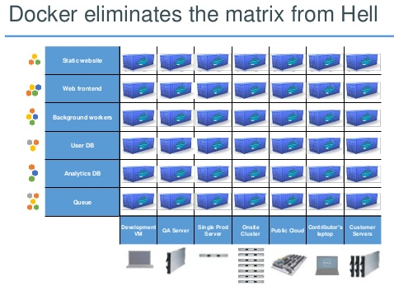

Slide 6
What is a Docker
Docker is an open platform virtualization technology used for developing, shipping, and running applications.
Docker uses linux features like Namespaces, Cgroups for isolation and MCS enforcement feature of SELinux.

Slide 7
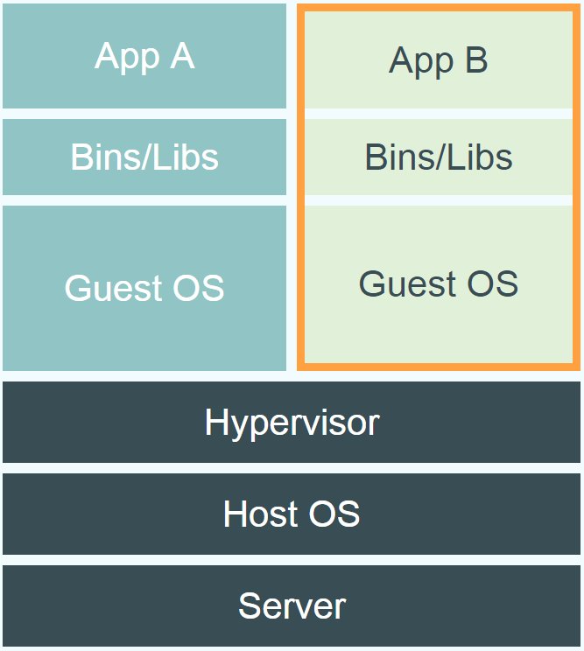
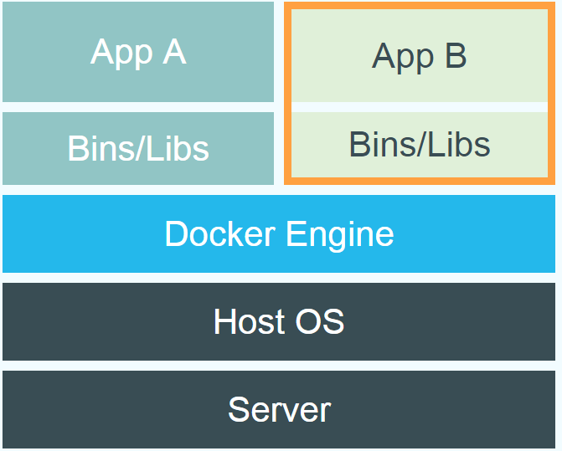
Virtual Machine Vs Docker
Docker
Virtual Machine

Slide 8
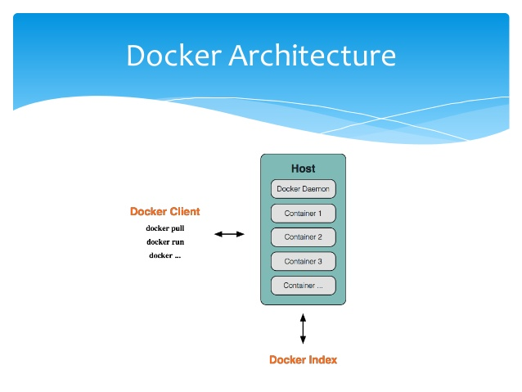

Slide 9
Docker Components
Client: It is the primary user interface to Docker. It accepts commands from the user and communicates back and forth with a Docker daemon
Daemon : It is a process runs on a host machine.
Index : It is a centralized repository with public and private registries.

Slide 10
Docker Elements
Images
Containers
Registries

Slide 11
Images
An Image is a set of components which executes set of instructions.
A docker images are read-only templates
Docker provides a simple way to build new images.
Images are built in the form of layered structure.
Image can be pulled or pushed into registry.
Images are build components.

Slide 12
Containers
Containers are run time components.
Docker containers are similar to directories.
It provides an virtual environment for application to run.
Each container is an isolated and secure platform.

Slide 13
Registries
Registries will hold the images.
Public or Private Registries.
The public registry is called Docker Hub (Default).

Slide 14
Docker Commands
S.No | Command | Description
1. | version | Shows the version of Docker
2. | images | Lists the docker images
3. | exec | Run a command in container
4. | run | Run a command in a new conatiner
5. | search | Finds an image in conatiner
6. | build | Build an image from Dockerfile
7. | import | Create a new file system image from the contents of a tarball
8. | export | Stream the contents of a container as a tar archive
9. | ps | Lists the conatiners
10. | rm | Remove one or more conatiners
Contd.,

Slide 15
S.No | Command | Description
11. | start | Starts a stopped container
12. | stop | Stops a running container
13. | pull | Pull an image or a repository from a Docker registry server
14. | push | Push an image or a repository to a Docker registry server
15. | history | Shows the history of an image
16. | kill | Kills the running container
17. | cp | Copy files/folders from a container's filesystem to the host path
18. | save | Save an image to a tar archive
19. | rmi | Removes an image

Slide 16
Use Cases
1. Create an image from scratch in AWS instance 1
2. copying the tar balls of images from AWS instance 1 to AWS Instance 2
3. creating a private Registry in AWS instance push images on to it and pulling the images from AWS instance 3
4. Log rotations and Load balancing

