Slide 1
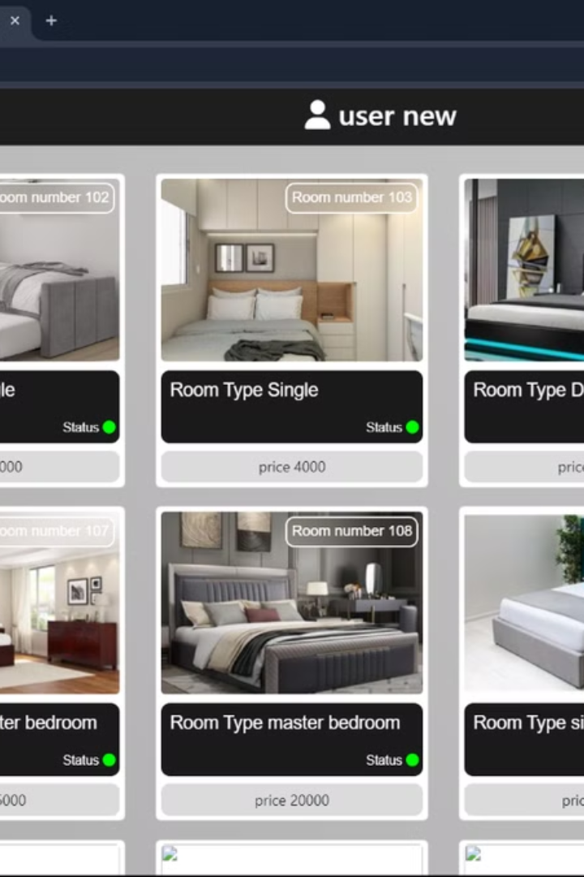
Continental: A React-based Web Application
The Continental is a web application built using React.js, Node.js, MySQL, and Font Awesome. The application features a modern and user-friendly interface, designed to provide a seamless experience for users.
by praveen jadhav
pj

Slide 2

Home Page Design
Full-width Banner
The home page features a full-width banner image that showcases the application's key features and benefits.
Interactive Map
An interactive map allows users to explore available locations and discover nearby options.
Testimonials Section
A dedicated testimonials section provides social proof and builds trust, showcasing positive user experiences.
Call to Action Buttons
Prominent call-to-action buttons encourage users to explore further and engage with the application.

Slide 3

Registration Process
Form Input Fields
1
The registration form is well-organized and includes essential fields such as name, email, password, and contact information.
2
Password Strength Indicator
A password strength indicator helps users create strong and secure passwords, enhancing account security.
Terms and Conditions Agreement
3
Users are required to acknowledge and agree to the terms and conditions before completing the registration process.
4
Confirmation Email
Upon successful registration, a confirmation email is sent to the user, validating their account and providing access to the application.

Slide 4
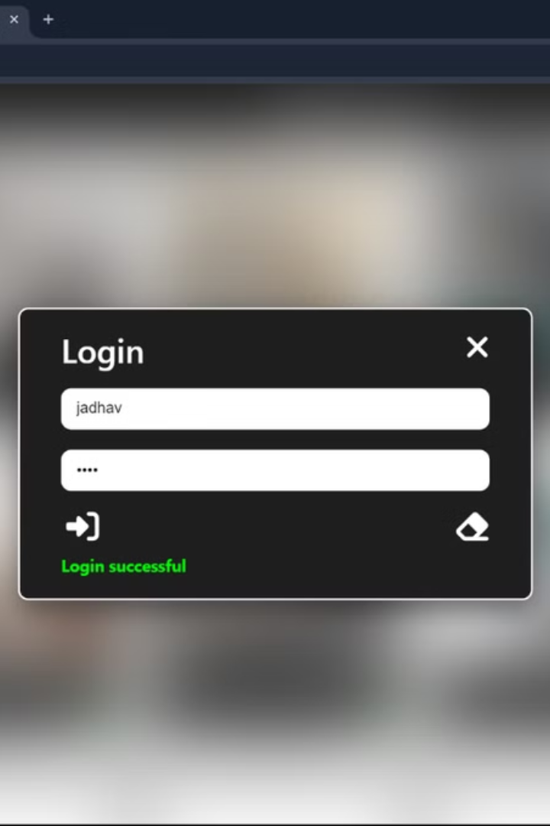
Secure Login
1
Email/Username Login
Users can log in using either their registered email address or username, offering flexibility and convenience.
2
Password Recovery
A password recovery feature allows users to reset their passwords if forgotten, ensuring account accessibility.
3
Two-Factor Authentication (Optional)
An optional two-factor authentication (2FA) feature adds an extra layer of security to user accounts, protecting against unauthorized access.
4
Session Management
The application implements secure session management, maintaining user sessions and ensuring secure access to sensitive information.

Slide 5
Booking Functionality
Search and Filter Options
Availability Calendar
Booking Confirmation
The booking section allows users to easily search for available options based on location, date, time, and specific criteria.
An interactive calendar displays real-time availability for different locations, ensuring users can select suitable booking times.
Upon successful booking, users receive a confirmation email with details of their reservation, including date, time, location, and any additional information.

Slide 6
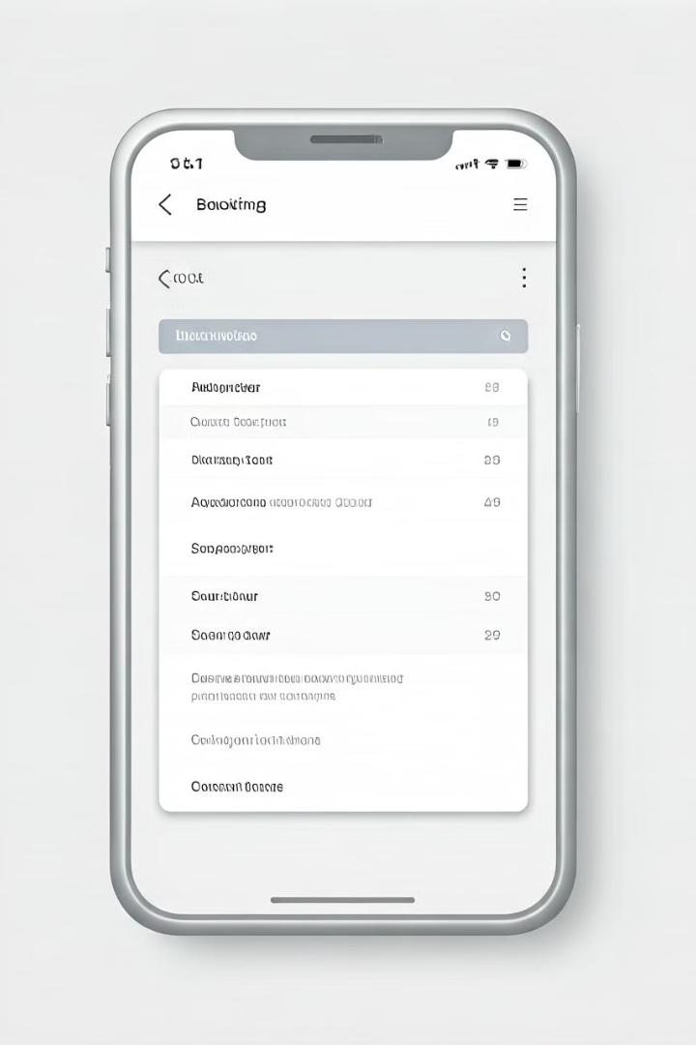




User Interface (UI) Design
Intuitive Navigation
The application's navigation is intuitive and easy to use, allowing users to seamlessly move between different sections and access key features.
User-Friendly Forms
Forms are designed to be user-friendly, with clear labels and instructions, making it easy for users to input information accurately.
Responsive Design
The application is responsive, adapting to different screen sizes and devices, ensuring an optimal user experience across various platforms.
Visual Appeal
The overall UI design is visually appealing and modern, incorporating a consistent color scheme, typography, and imagery, creating an engaging and user-friendly experience.

Slide 7




Backend Development
Node.js Server
MySQL Database
API Endpoints
A Node.js server handles user requests, database interactions, and API endpoints, providing the backend infrastructure for the application.
A MySQL database stores application data, including user information, booking details, and other relevant information.
The application utilizes API endpoints to facilitate communication between the frontend and backend, enabling data exchange and dynamic functionality.

Slide 8

Security Considerations
Input Validation
Validates user input to prevent malicious code injection and ensure data integrity.
Data Encryption
Encrypts sensitive data, such as passwords and user information, to protect against unauthorized access.
Authentication and Authorization
Implements robust authentication and authorization mechanisms to control user access to different sections of the application.

Slide 9

Future Enhancements
1
Payment Integration
2
Real-Time Updates
Integrating a secure payment gateway to enable users to make online payments for bookings.
Implementing real-time updates for booking availability, allowing users to see live status changes.
3
User Reviews and Ratings
4
Personalized Recommendations
Adding a feature for users to leave reviews and ratings, enhancing user engagement and providing valuable feedback.
Leveraging user data to provide personalized recommendations for bookings based on past preferences and location.

