Slide 1
Why Docker?

Slide 2
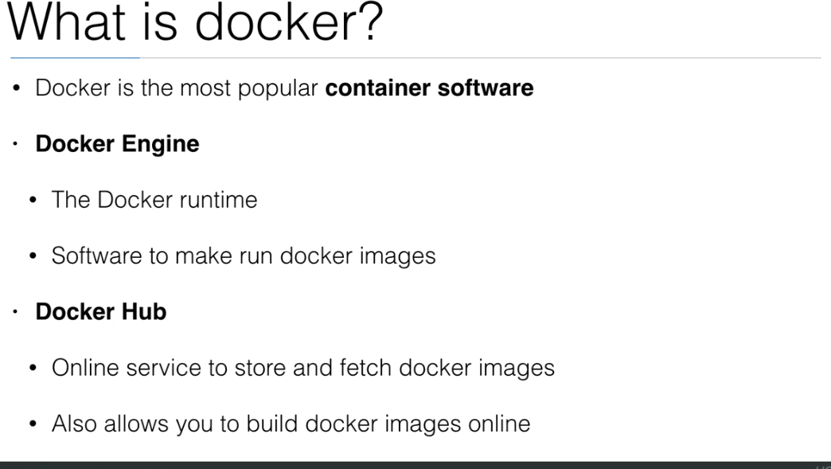

Slide 3
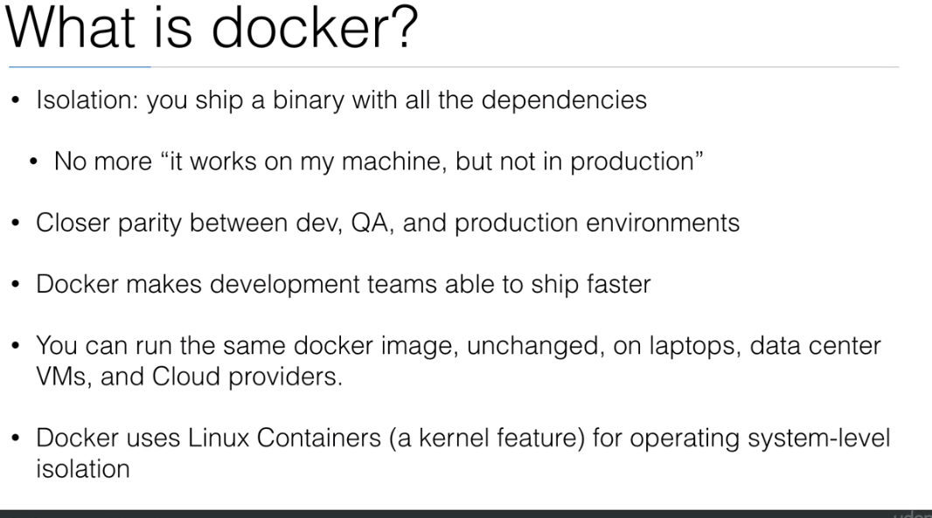

Slide 4
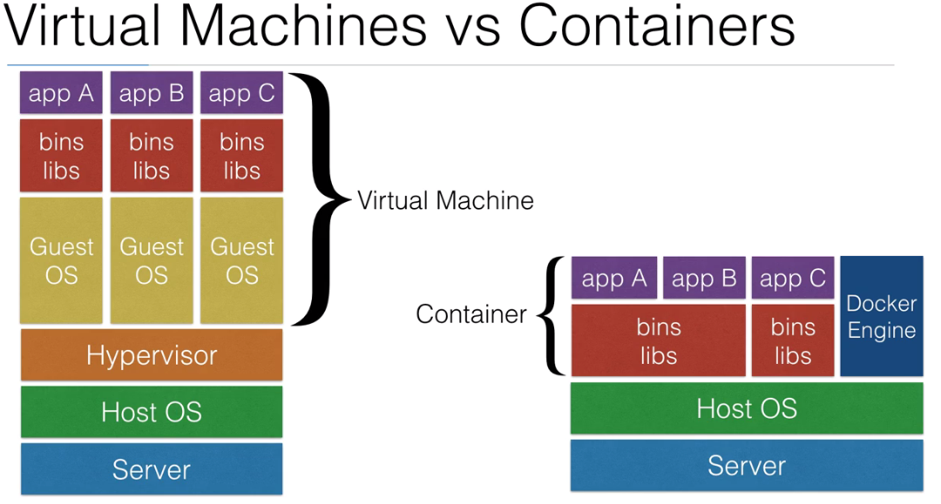

Slide 5
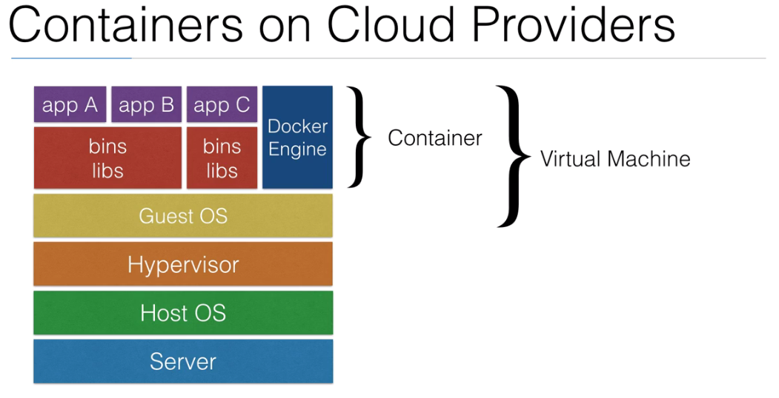

Slide 6
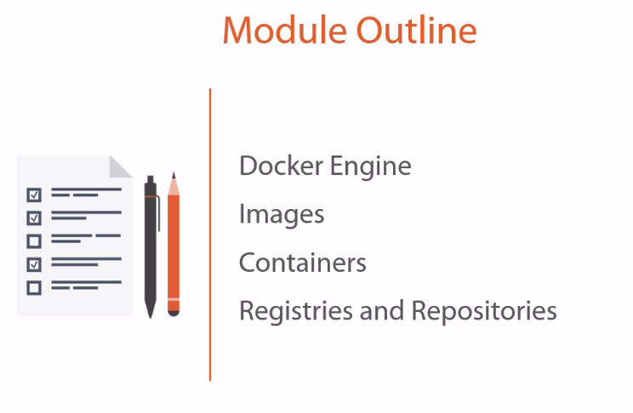

Slide 7
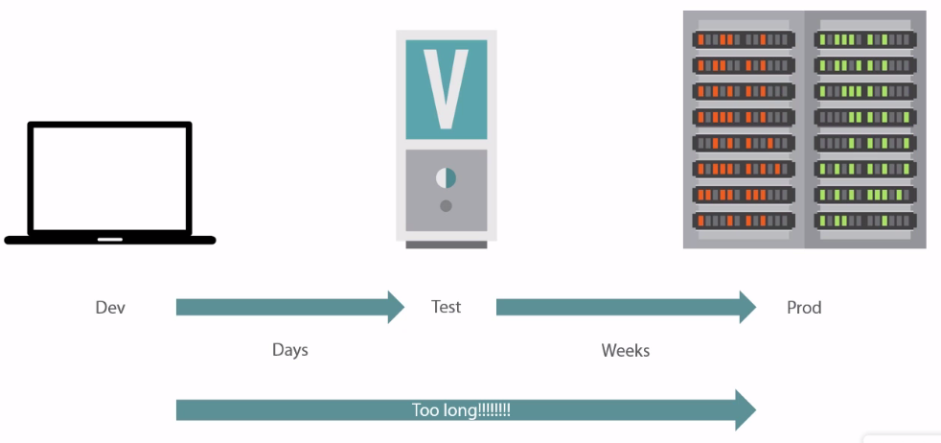
Prior to Containers

Slide 8
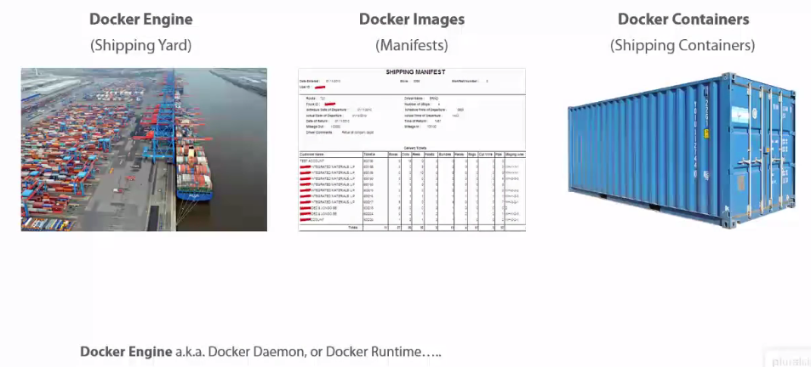

Slide 9
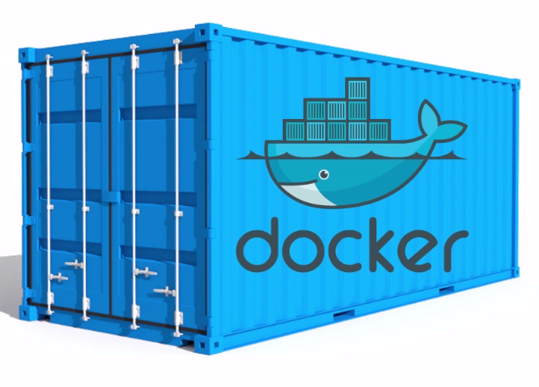
Game Changer

Slide 10
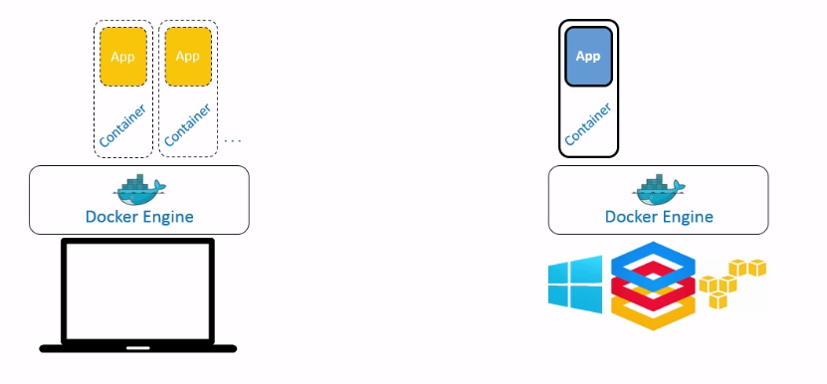
Docker Engine Can be hosted

Slide 11
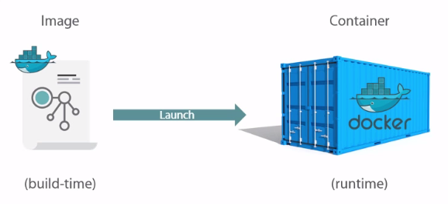
Docker Image

Slide 12
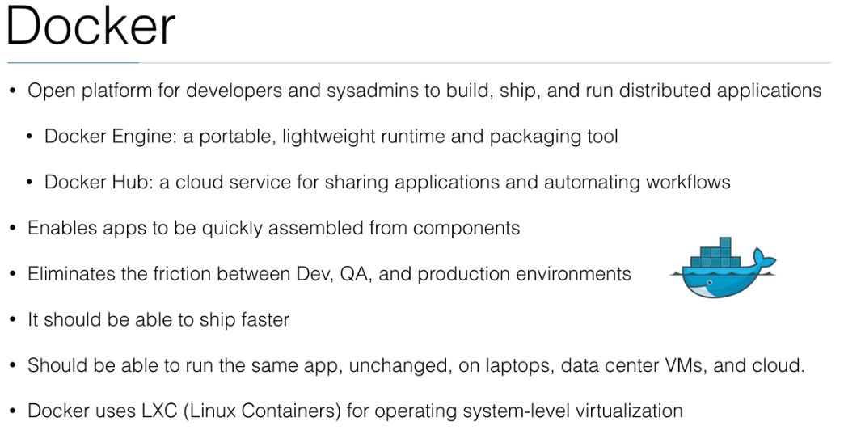
Containerization

Slide 13
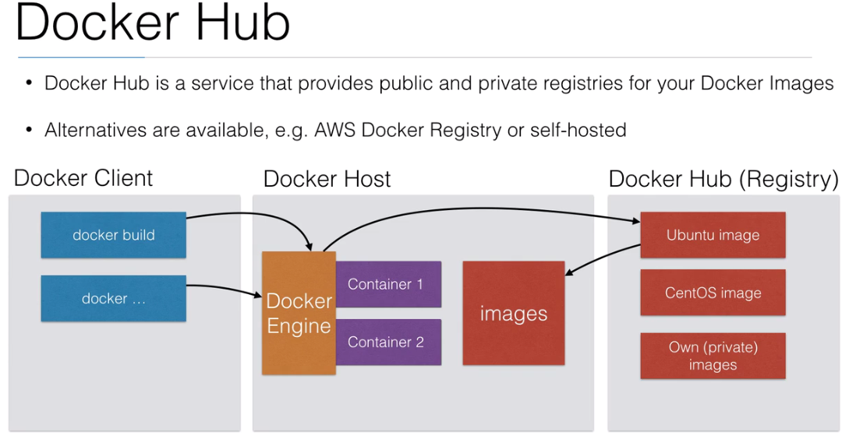

Slide 14
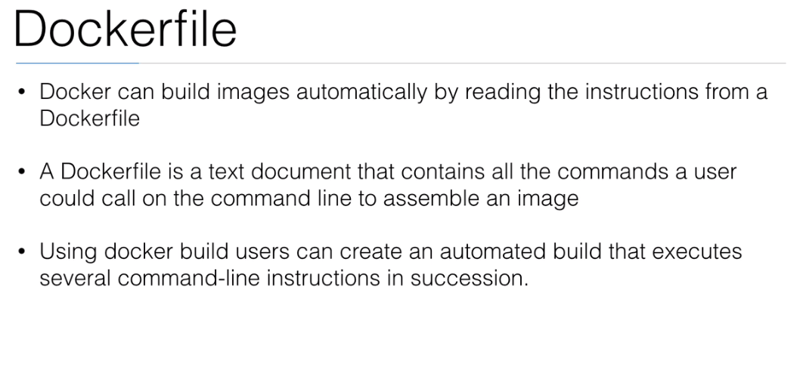

Slide 15
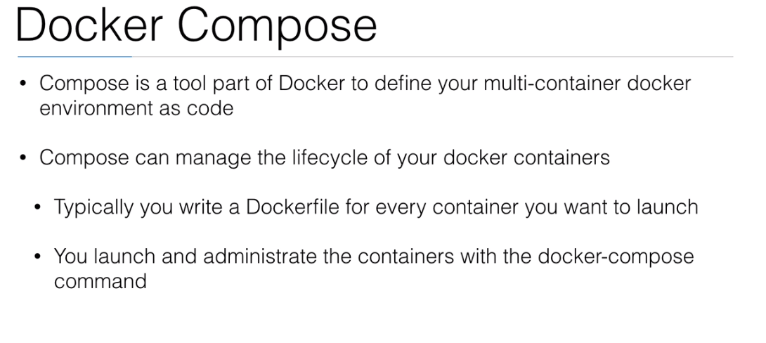
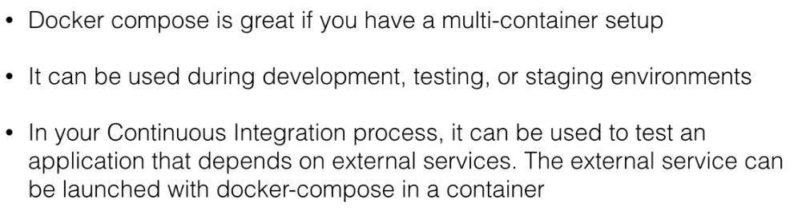

Slide 16
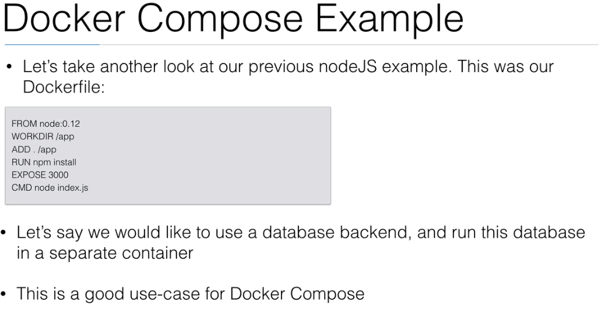

Slide 17
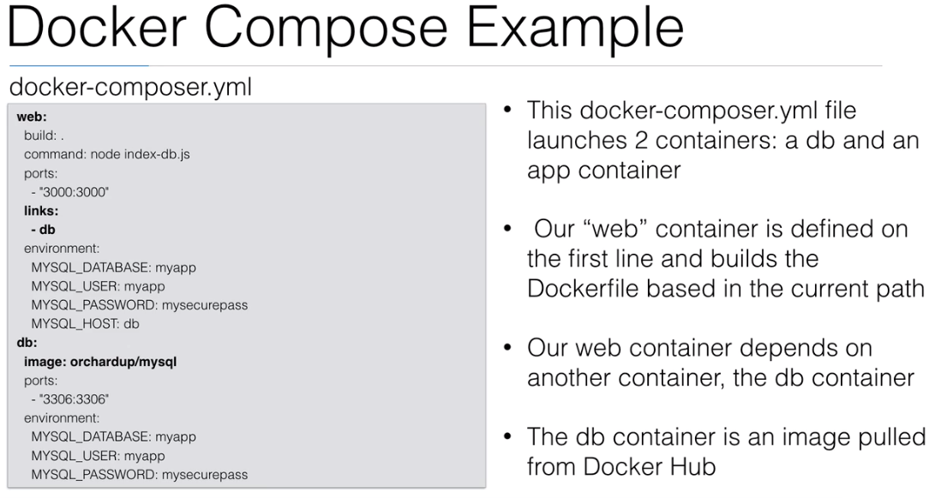

Slide 18
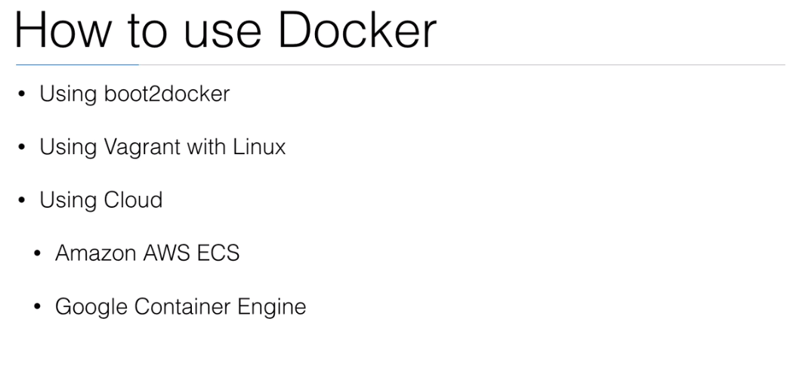

Slide 19
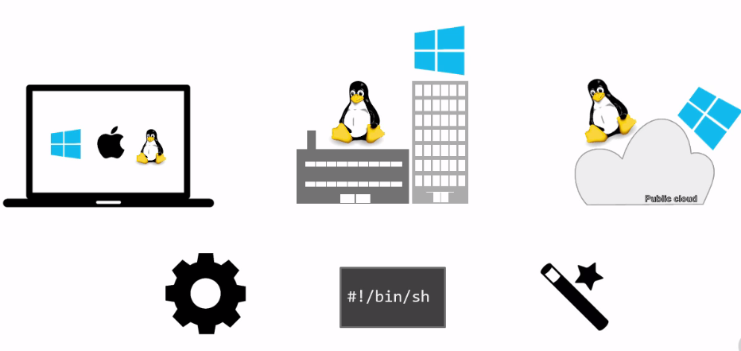
Docker Installation

Slide 20
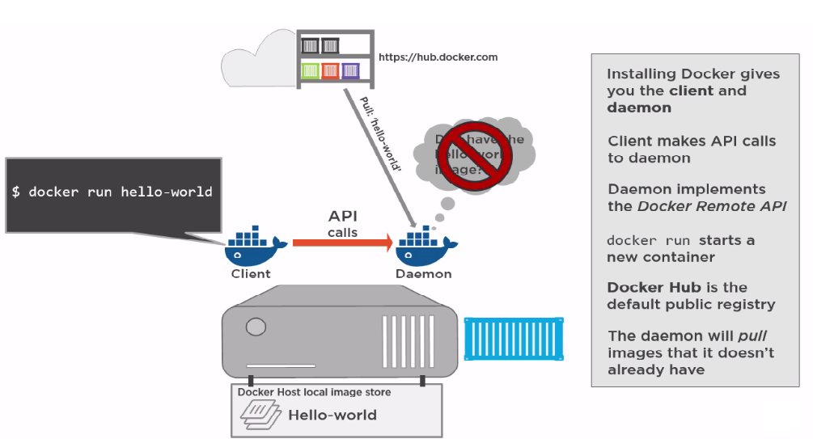
Docker pulling mechanism

Slide 21
Installation of Docker
Login with sudo
Check for docker existance:
service docker.io status
To confirm LTS stable flavour on ubuntu:
uname -a
To sync up package index from source
apt-get update
Now to install docker:
apt-get install -y docker.io
Again Check for docker existance:
service docker.io status
To identify docker version:
docker -v

Slide 22
Installation of Docker
To get more details of docker:
docker version(Client & Server version details)
To know about images and containers:
docker info
To sync with new repo:
apt-get update
To install latest docker:
apt-get install lxc-docker
Again check docker version:
docker version

Slide 23
Docker Commands
To view all images: docker images
Docker pull coreos/apache
To run a docker container:
docker run hello-world
To view containers running:
docker ps( to see running and stopped containers)
docker ps -a ( to see running and stopped containers)
To view all the images:
Docker images
To remove images:
docker rmi hello-world:latest
To run container with port and pull from public hub repo:
Docker run –d –name web –p 80:8080 manee2k6/helllo-world
To run container and exiting without killing it:
Docker run –it –name temp hello-world /bin/bash
CTRL P + Q
To view all images in layers:
ls –l /var/lib/docker/aufs/layers
To pull docker images from Hub:
docker pull –a ubuntu

Slide 24
Docker Commands
To view all images of ubuntu:
docker images ubuntu
Try pulling other docker images from Hub:
docker pull –a fedora
Images locally stored under /var/lib/docker/aufs/
To Push our image to Hub require tag:
docker tag <image ID> <user repo name/repository:1.0>
docker push manee2k6/helloworld:1.0
Here we go to use the image for our runtime environment to spin containers.

Slide 25
Adding user to Docker group
Docker daemen listening sock(docker. sock):
ls -l /run
To run docker as normal user not in docker group:
docker run -it ubuntu /bin/bash
View group:
cat /etc/group
To add user to docker group:
sudo gpasswd -a softgen docker
Try running docker using normal user(Logout and login again):
docker run -it ubuntu /bin/bash
Exit and reach main host:
exit

Slide 26
Configure Docker to communicate over network
Configure Docker To communicate over network:
-docker -v
-netstat -tlp
-service docker stop
-docker -H IpAddress:2375 -d & (2375-Std Non SSL docker port)
Now check docker program runs on pid/program- 1943/docker:
-netstat -tlp
Play around to spin centos docker container:
-docker run -it centos /bin/bash
To check for docker container and Image details:
-docker ps -a

Slide 27
Docker commands
Login to linux box with sudo.

Slide 28


Slide 29
Reference details

