Slide 1

Local Mart
Guided By :
Akshay Sir
Vaishali Mam
Submitted By :
1175 - Rahul Patil
1183 - Pravin Koli

Slide 2
Abstract
This is online shopping portal allow user to show through website. The main concept is to promote local seller. If farmer have something to sell he can do that directly and get good value for his product. This system avoid middle man who buy farmer’s product at low cost and sell at higher cost to consumer.
Here user can buy product also he can add product and perform curd operations like update, delete, add etc. on the product he added. Admin has universal rights.

Slide 3
Proposed System
- System to make buying and selling more easier for local vendor.
- Portal allow user to add product and perform crud operations.
- Differentiate products by categories and custom search options
- Provides security with password encryption and jwt tokes t for Authentication
- Email support for vendor.

Slide 4
Technologies Used
Front End:
- HTML, CSS
- Boor strap
- Angular
Back End:
- Spring Boot
- MySQL
Other:
Operating System : Ubuntu
Browser: Firefox

Slide 5
Features
1. Responsive Website
2. Security
- Authentication Guard
- Password Encryption
- JWT token validation
3. Simple Interface
4. Classification of products by category
5. Search Bar
6. Session storage

Slide 6
Modules
Login Module
- Admin
- User
Product Module
Search Module
Category Module
- all, grocery, daily essential, handicraft, other
Cart Module
Edit Module
- to add and update product

Slide 7
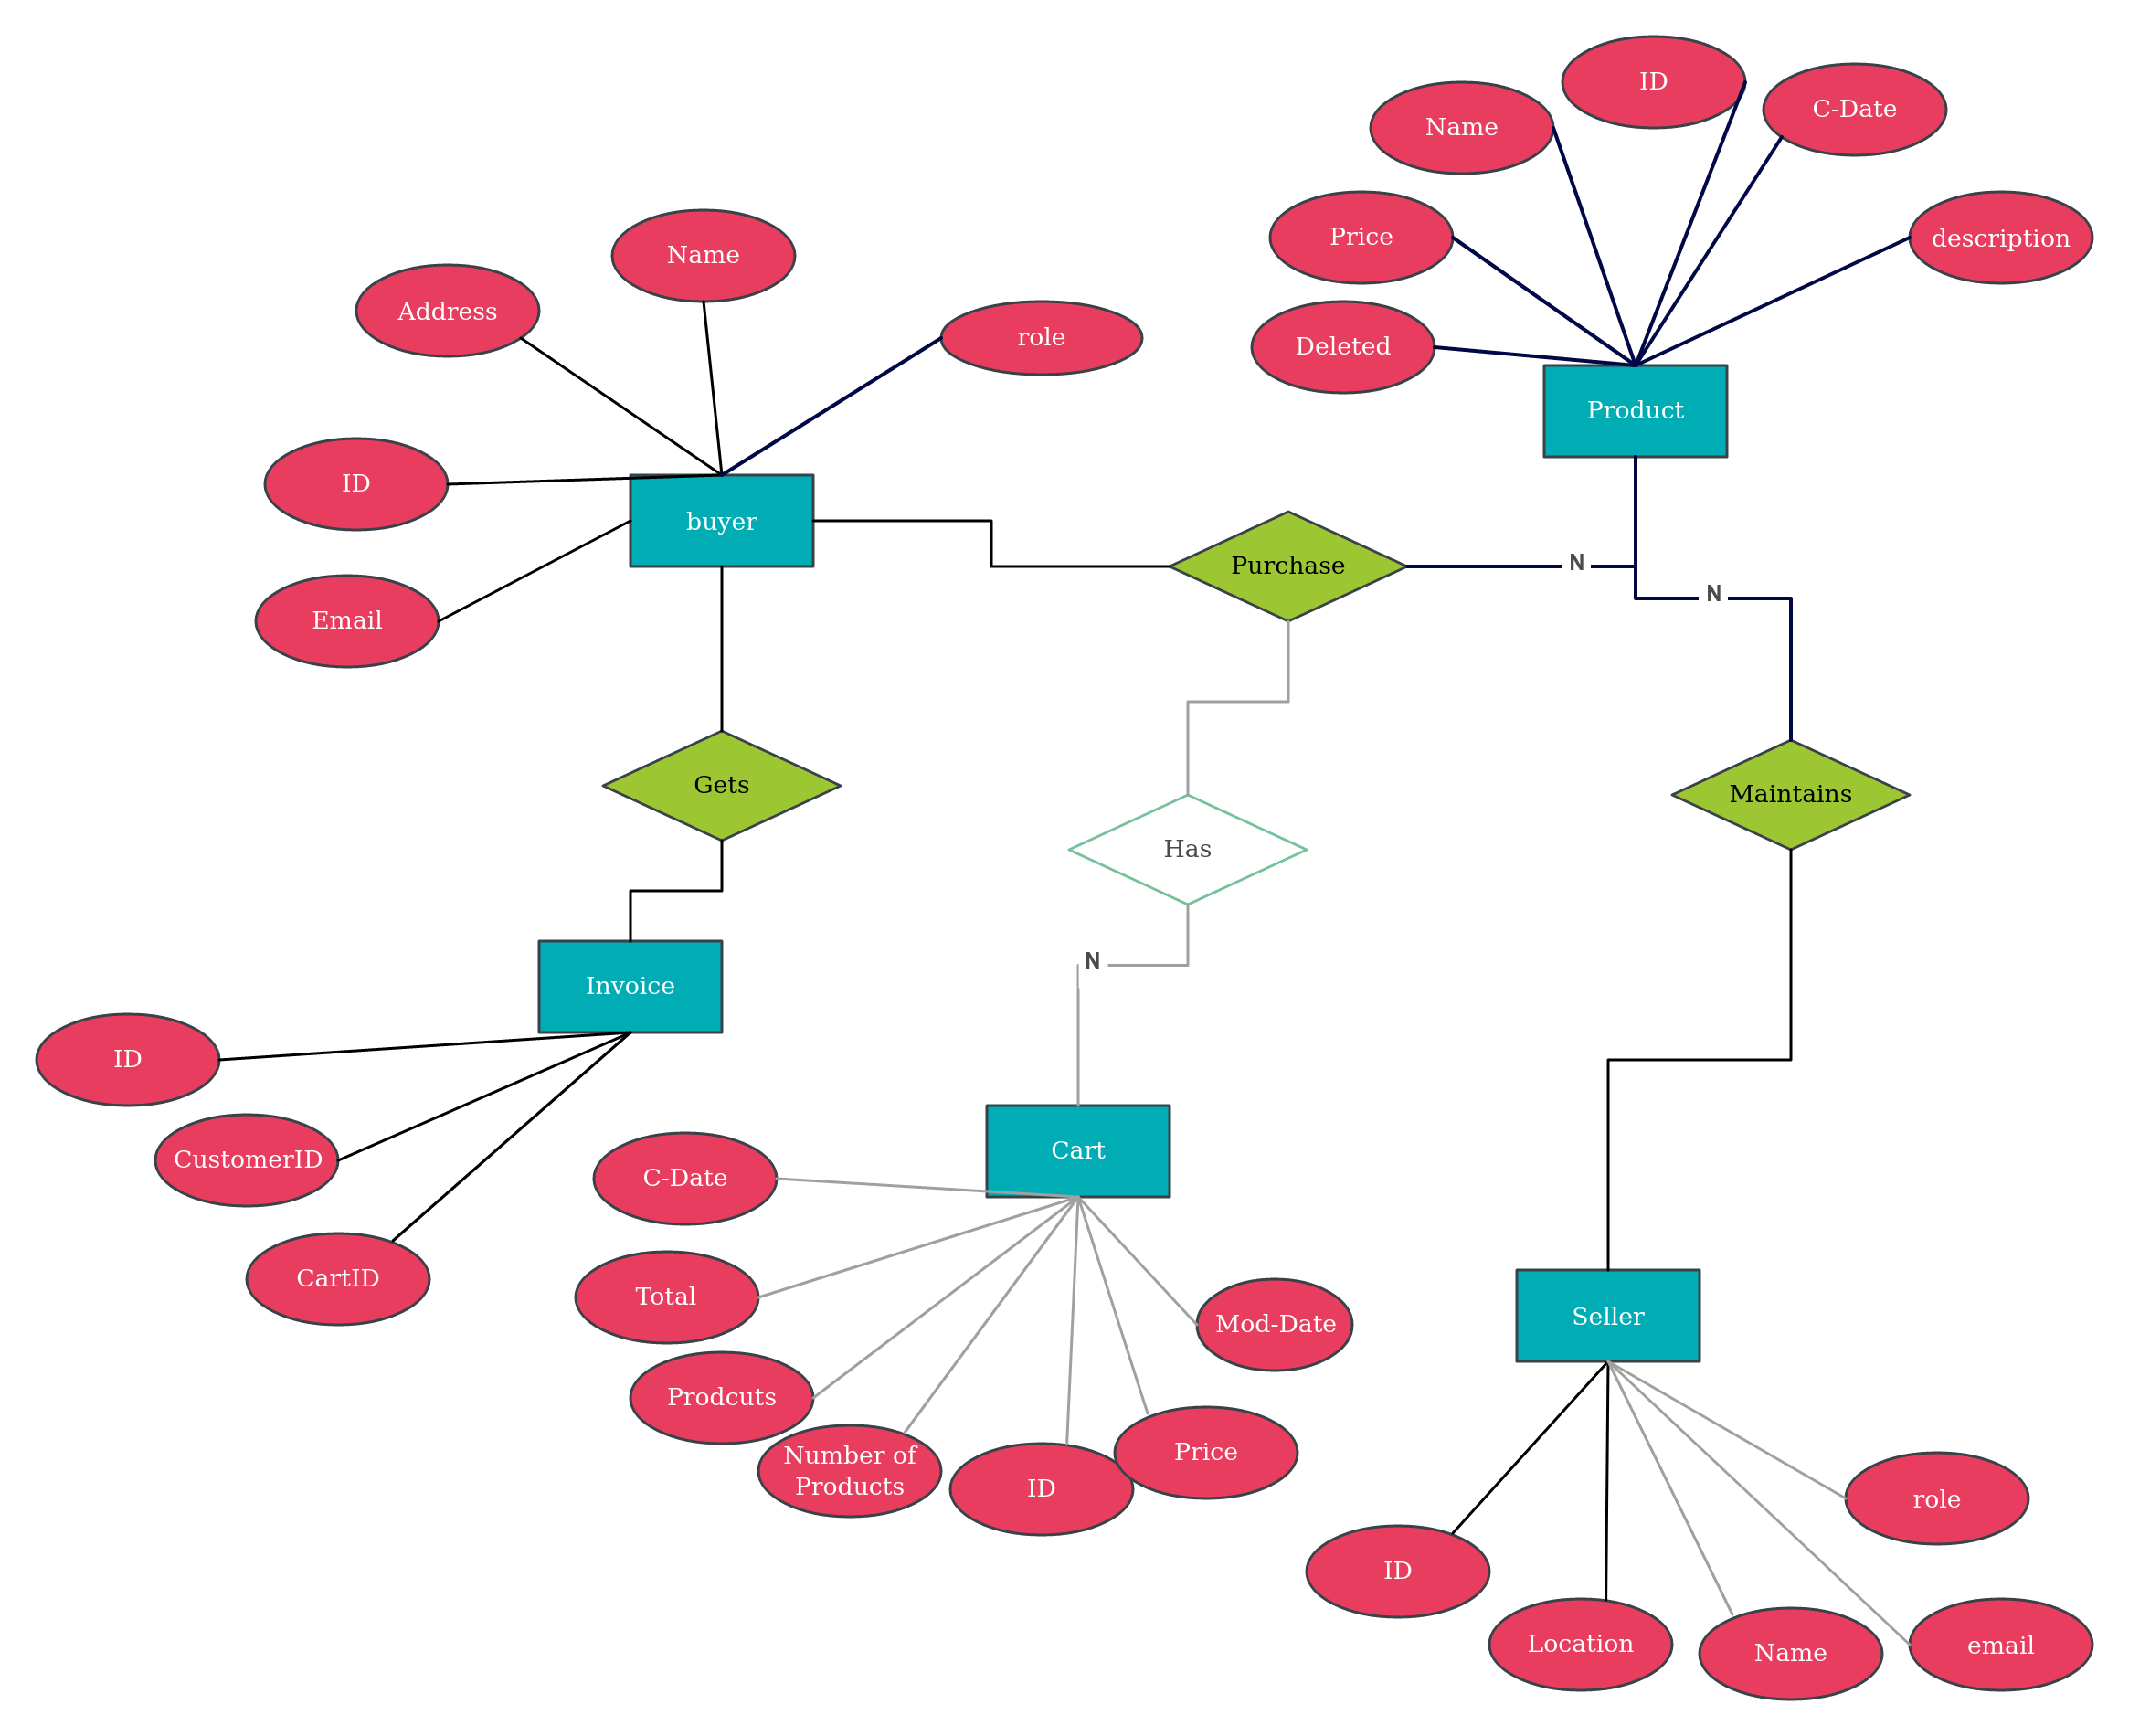
E-R Diagram

Slide 8
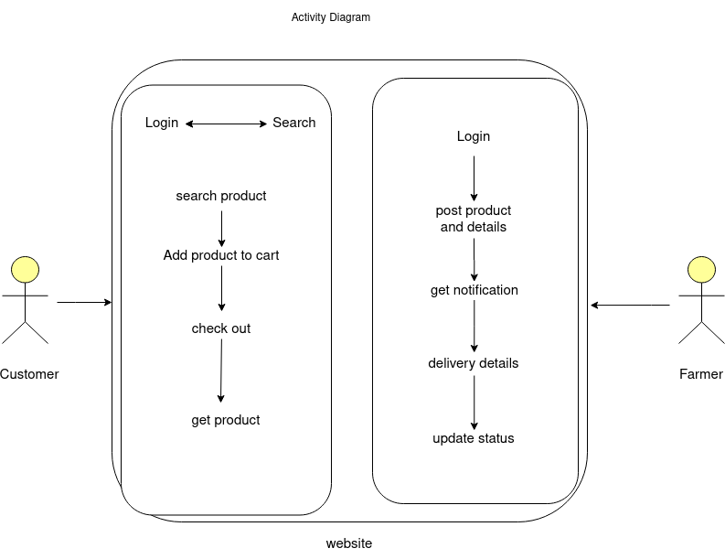
Activity Diagram

Slide 9
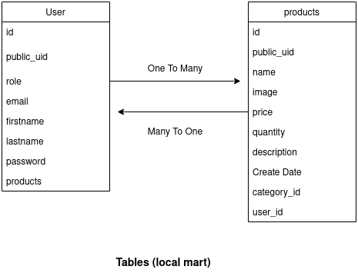
Tables

Slide 10
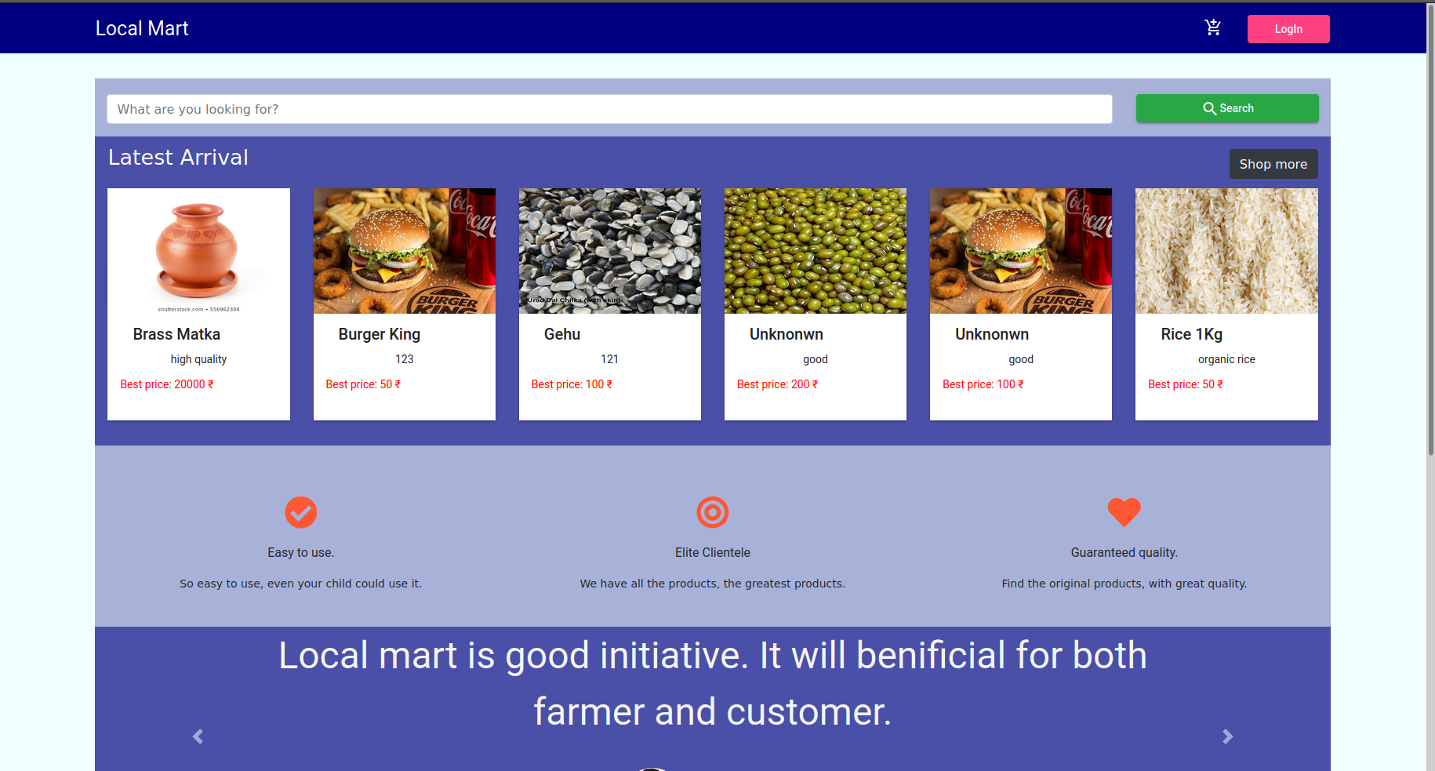
HomePage Component

Slide 11
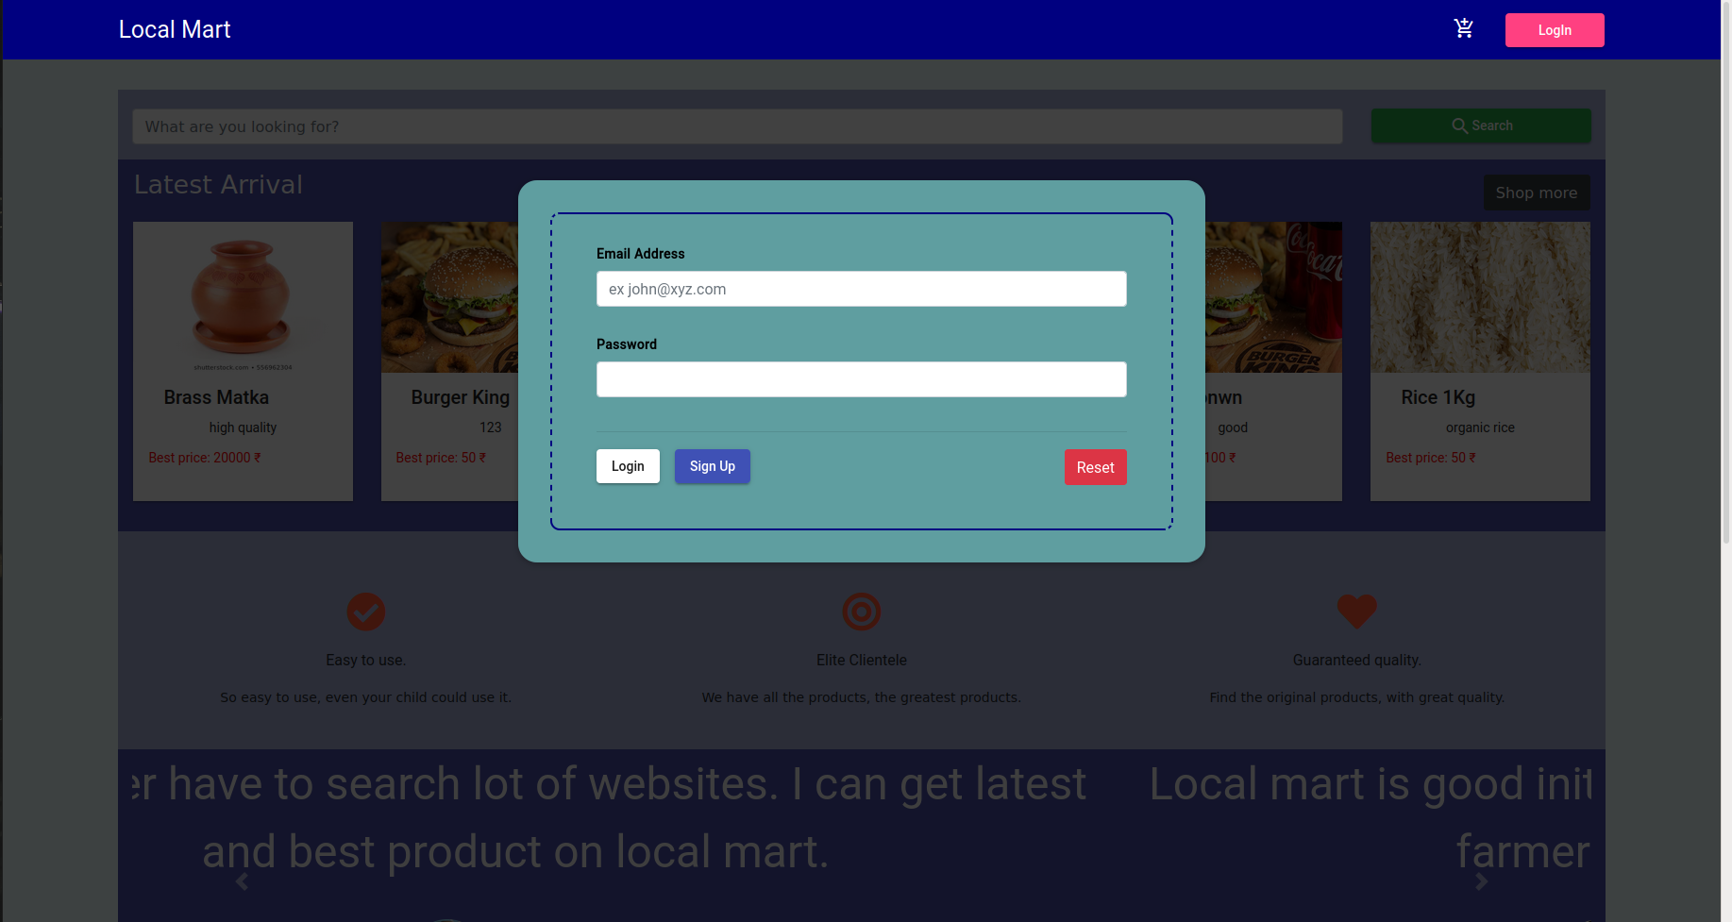
Login Component

Slide 12
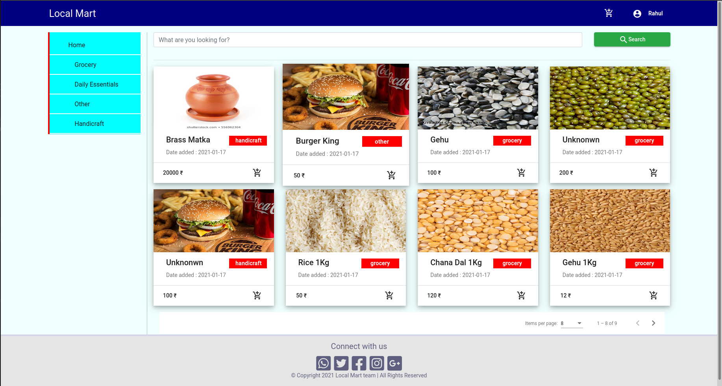
Products Component

Slide 13
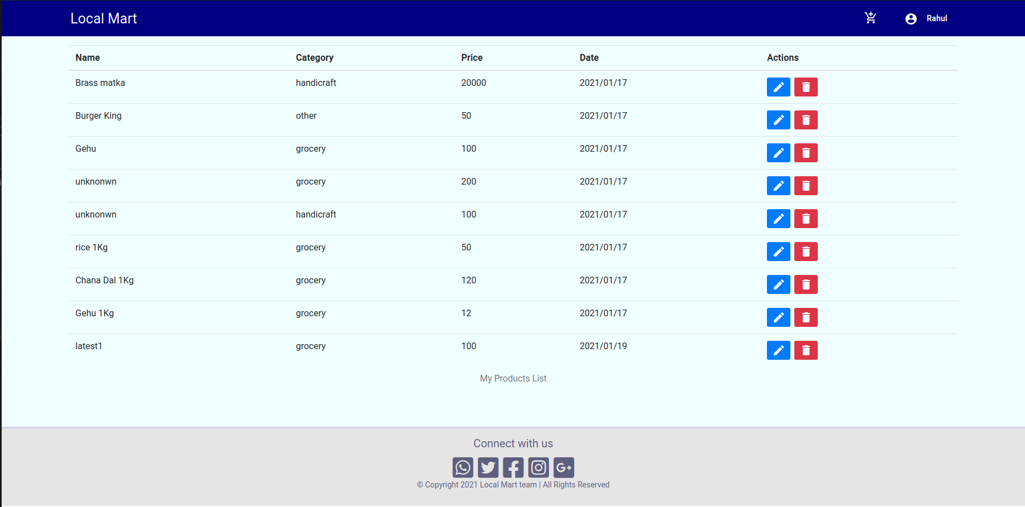
User Products Module

Slide 14
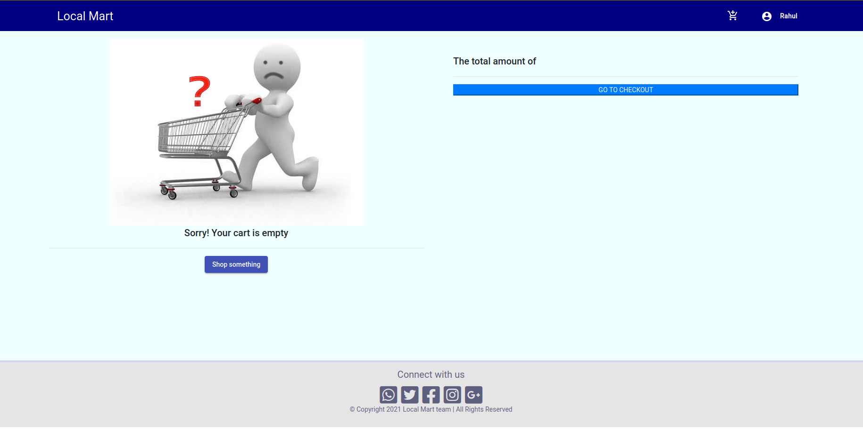
Cart Component

Slide 15
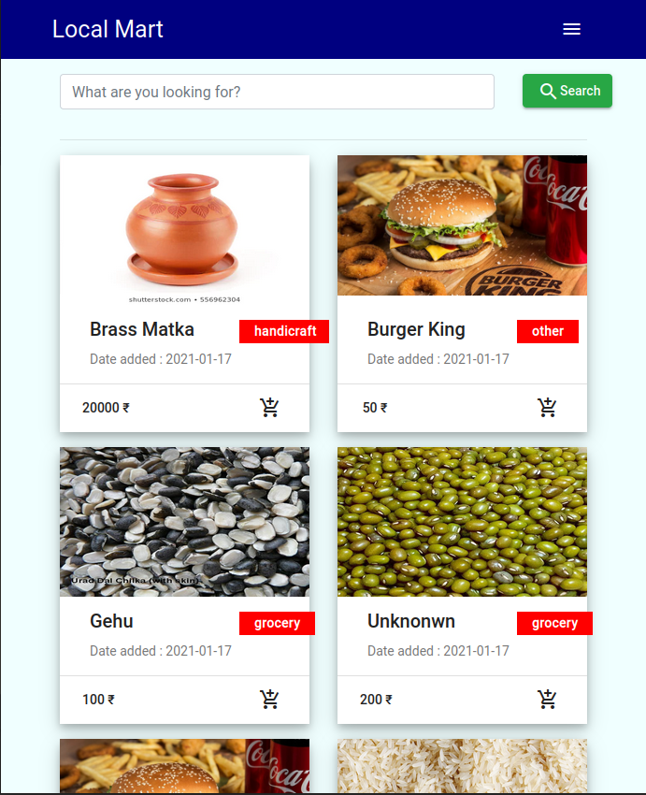
Responsive View 1

Slide 16
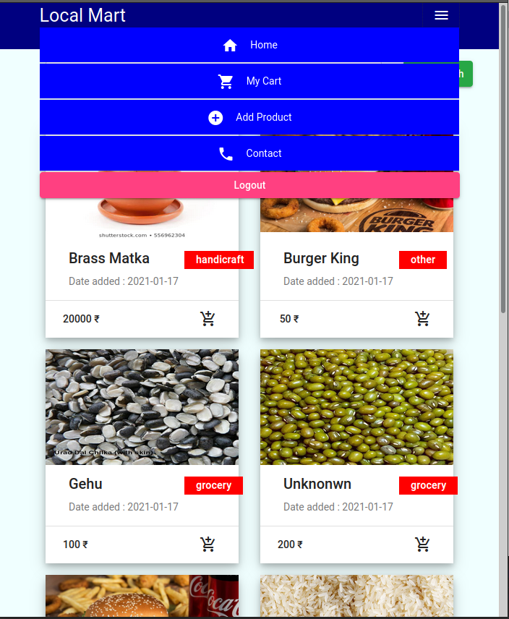
Responsive View 2

Slide 17
Future Scope
- Adding payment gateway to provide security to customer.
- Adding component to filter the products.
- Add labels to product so using label one can search the product.
- Adding Review and rating support.

Slide 18

Thank You

