Slide 1
Stamp detection & Extraction
Praveen Vijayan
A&I – TCS DATA Office
Email : praveen.vijayan@tcs.com

Slide 2
Modules/Steps in identifying stamp
Thresholding
Connected components / blobs based on min & max size
Blurring & Bounding box over probable ROI
Extract those ROI from actual image
Pass each identified ROI through the Stamp classifier**
If Classified as 1 (True), iterate over the image and extract text from it using tesseract
Tag the document/page to the identified text of stamp

Slide 3
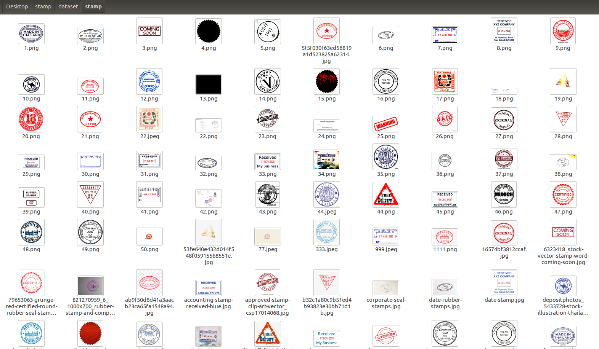
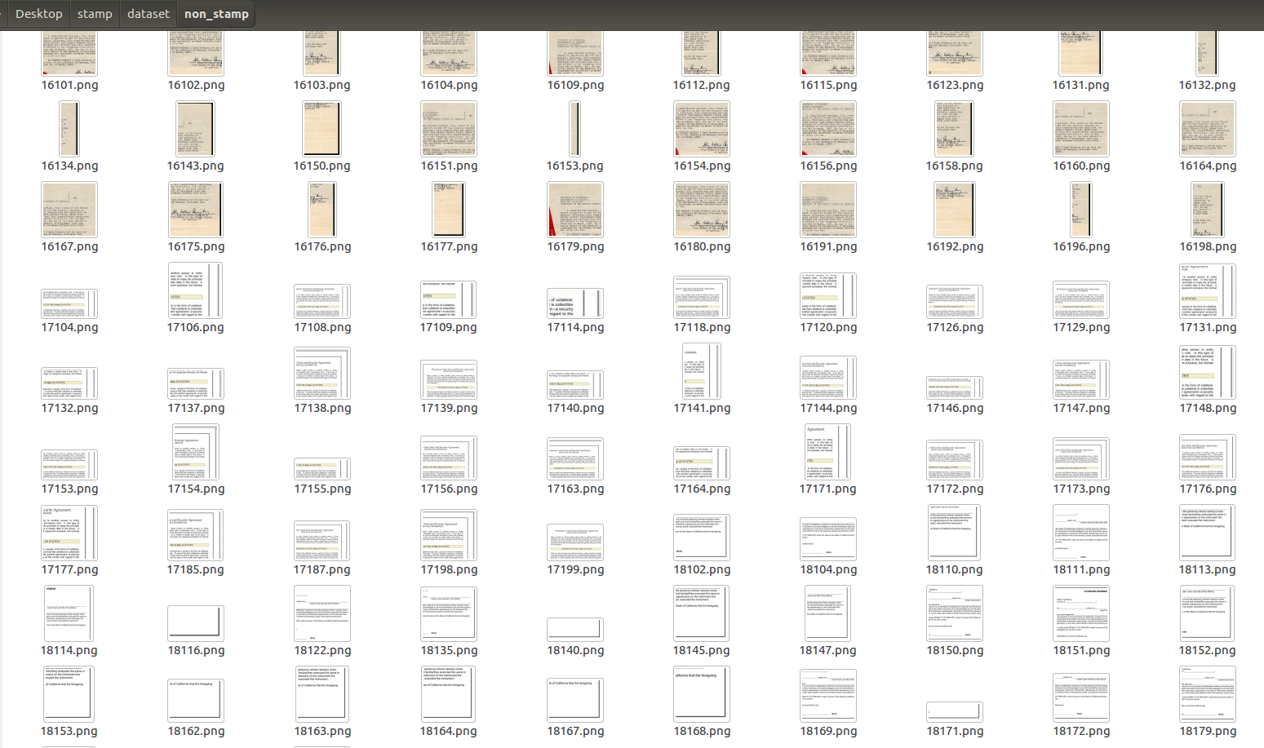
Creating : Stamp classifier
Create Stamp dataset
Create Non –Stamp samples( conditioned random sampling from the documents and filter those images which doesn’t have traces of stamp).
+
-
class
class
Transfer learning : Used deep learning VGG-16 fully collected layer 2 to extract the features from images.
May use principal components to reduce dimension.
Create an optimized classifier using SVM.
Save the classifier using Joblib to use in the main pipeline.
Notes:
11

Slide 4
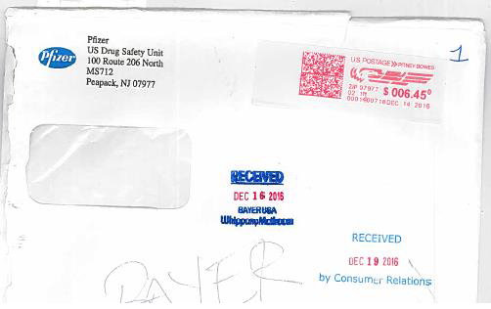
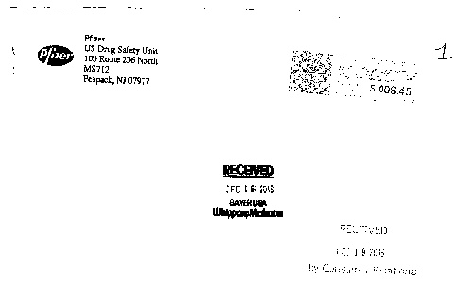
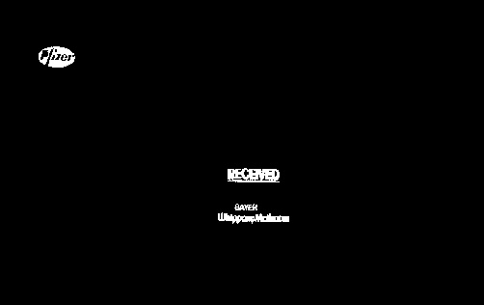
Real example :
Original image
Thresholded image
Connected component/ blobs in the image
1
2
3

Slide 5


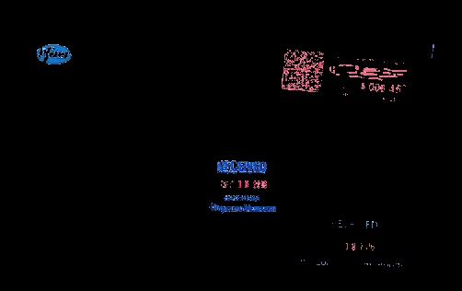
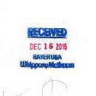
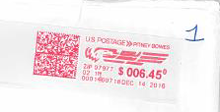

Real example :
Blurring & Bounding box over big
Connected components
Extracted color segments
Probable stamps extracted
4
5
6

Slide 6
Classifier output of stamps
7
1
1
1
1
['RECEIVED', '',
'DEC 19 2016 x',
'by Consumu Relations']
['US D', 'le', 'M871']
['“CHM']
['']

Slide 7
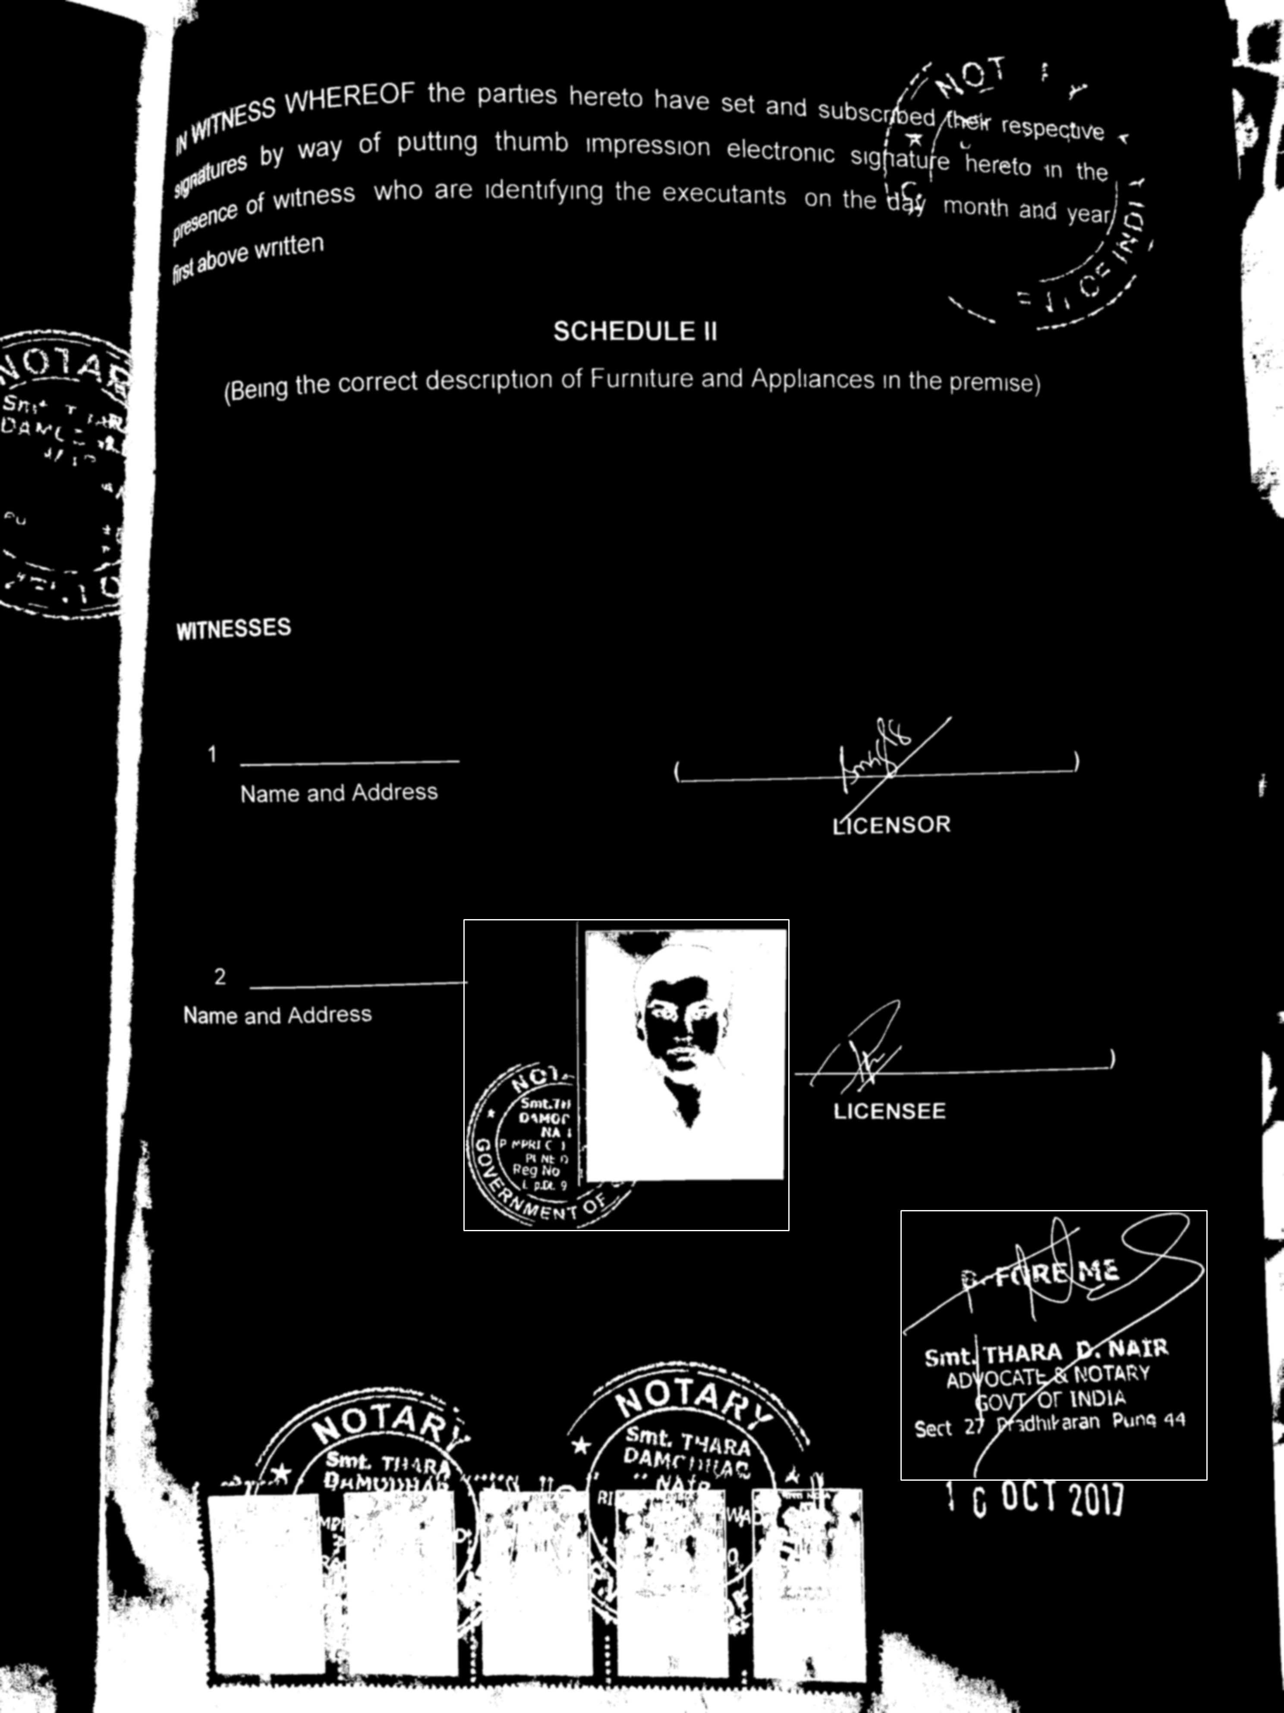
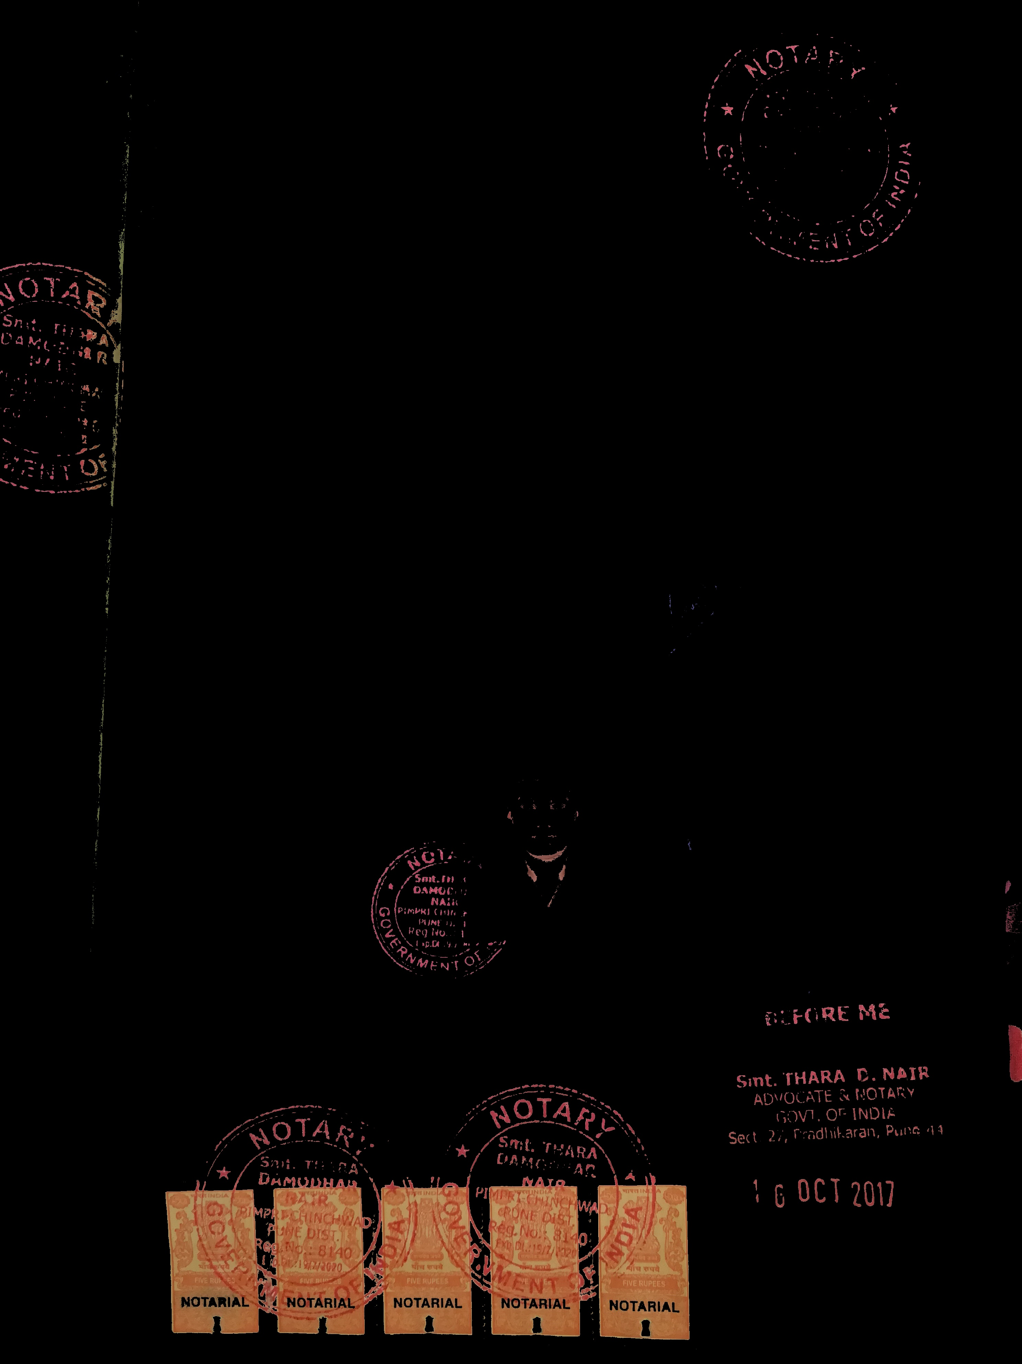
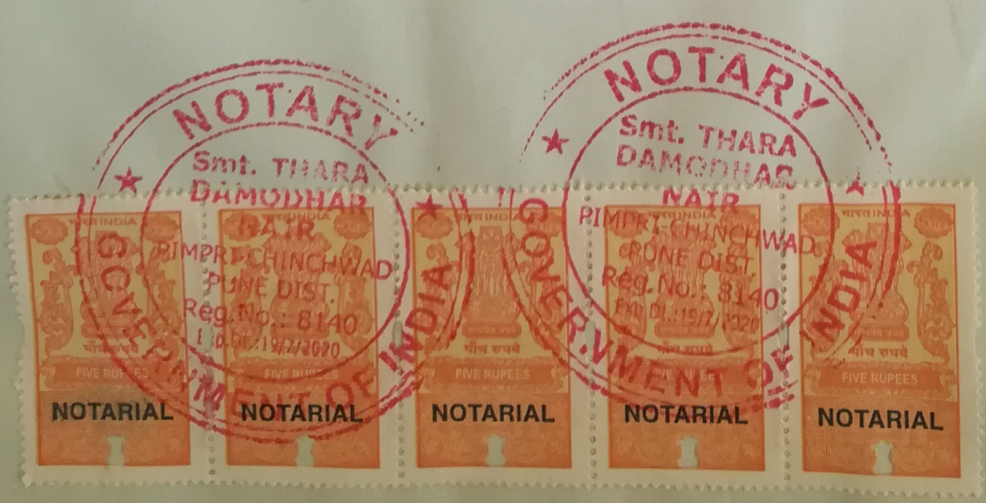

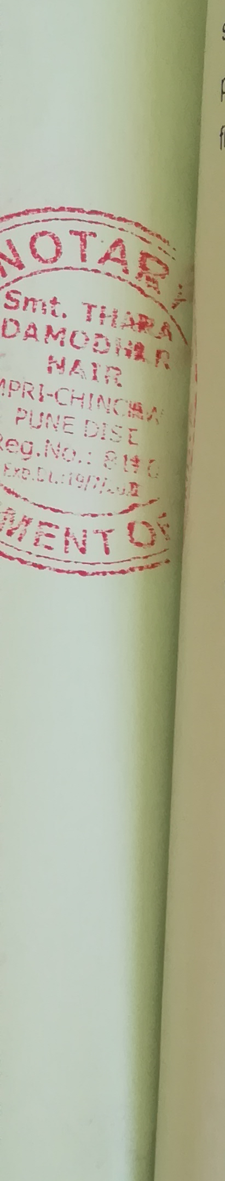
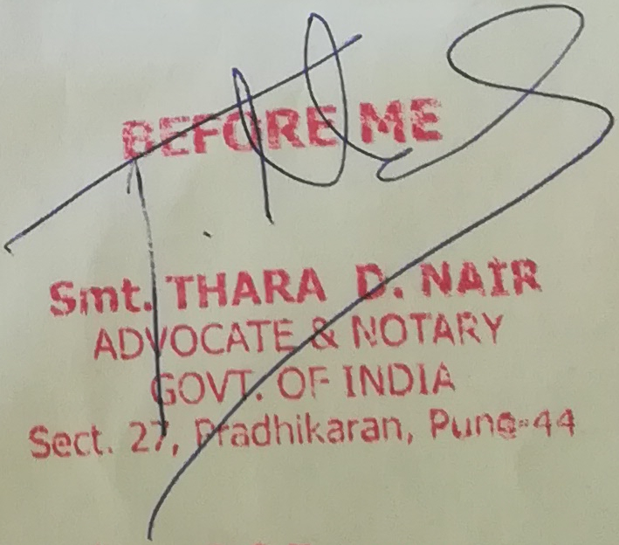
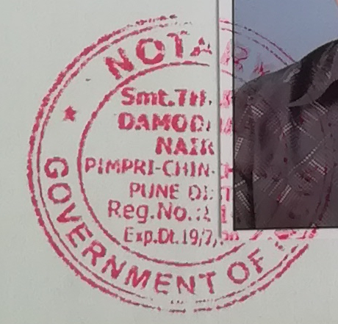
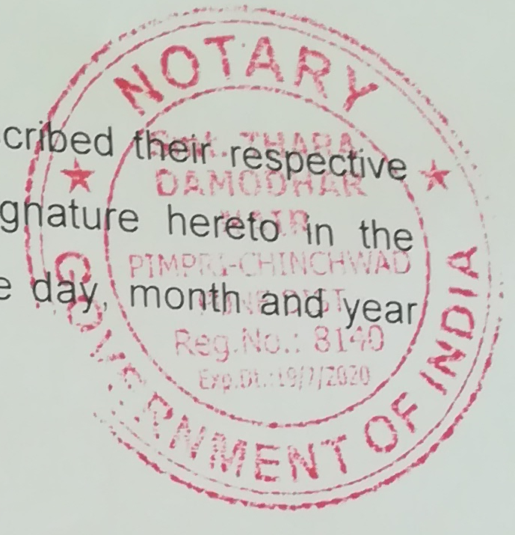
Real example :
Blurring & Bounding box over big
Connected components
Extracted color segments
Probable stamps
4
5
6

Slide 8
Real example :
Blurring & Bounding box over big
Connected components
Extracted color segments
Probable stamps extracted
4
5
6

Slide 9
Classifier output of stamps
7
1
1
0
1
1
0

Slide 10
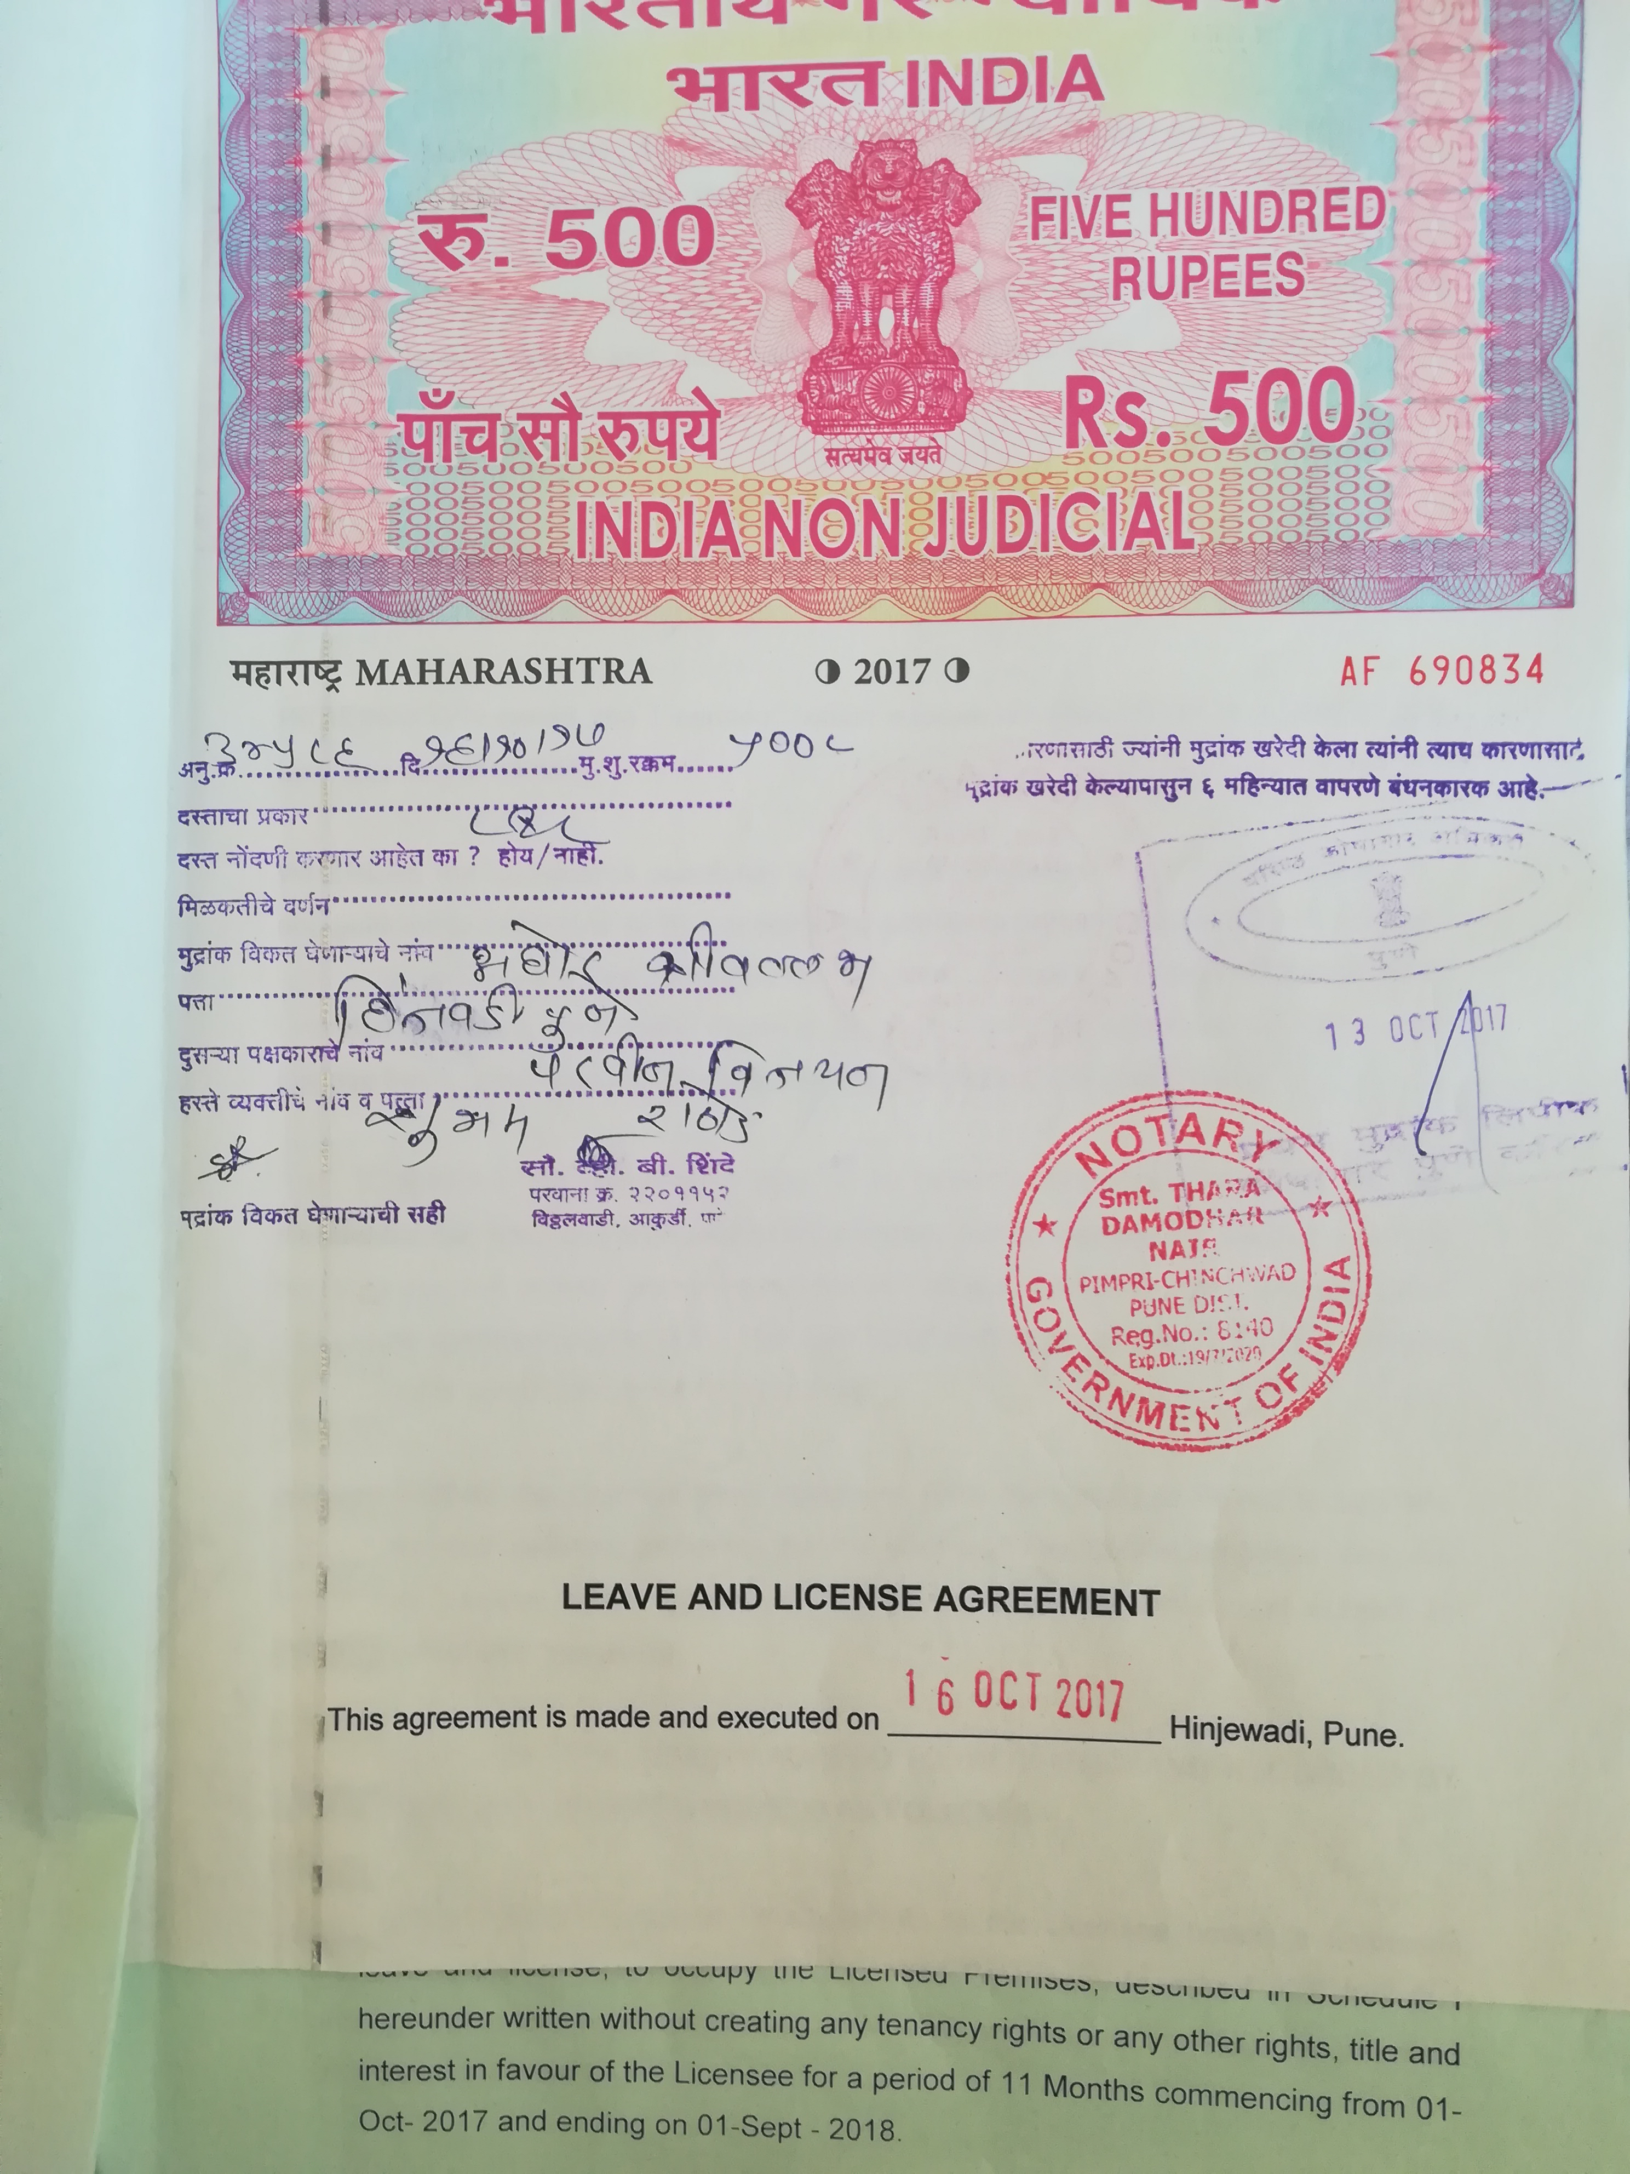
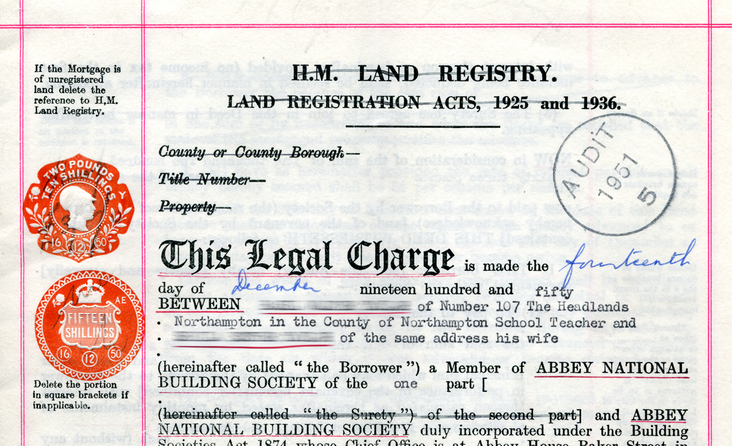
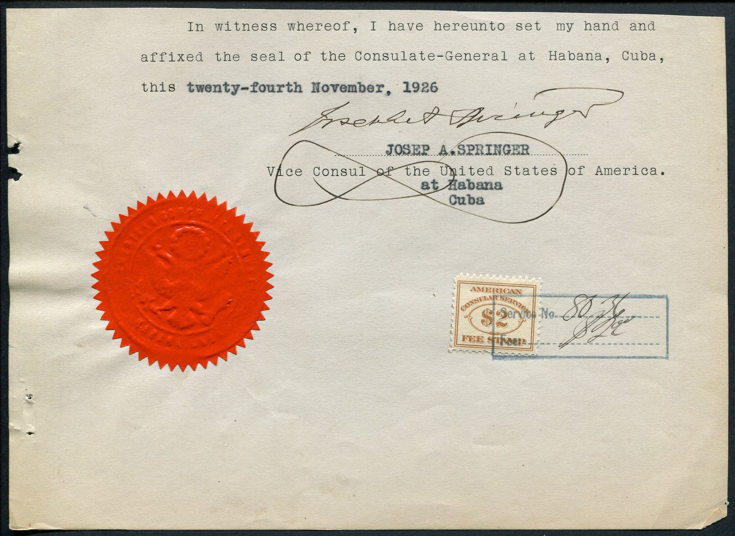
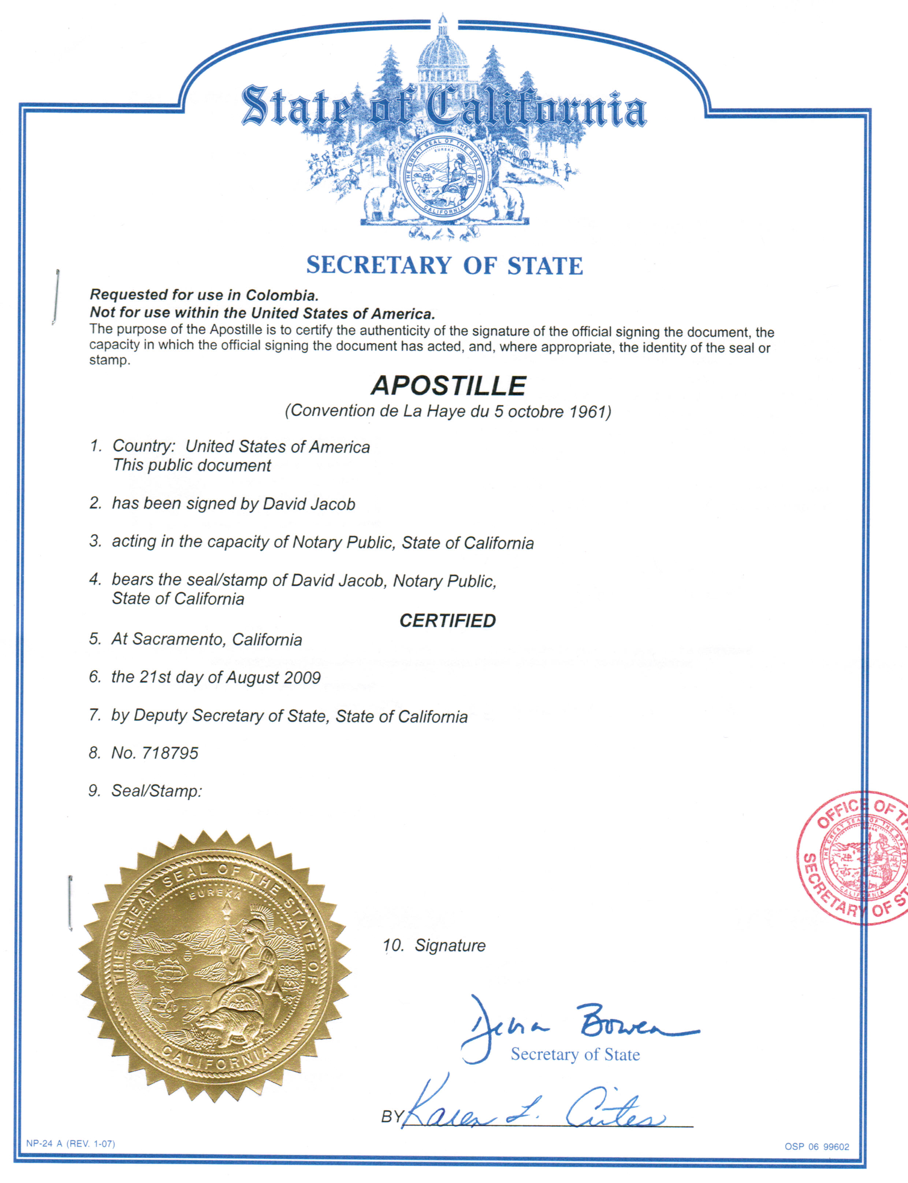
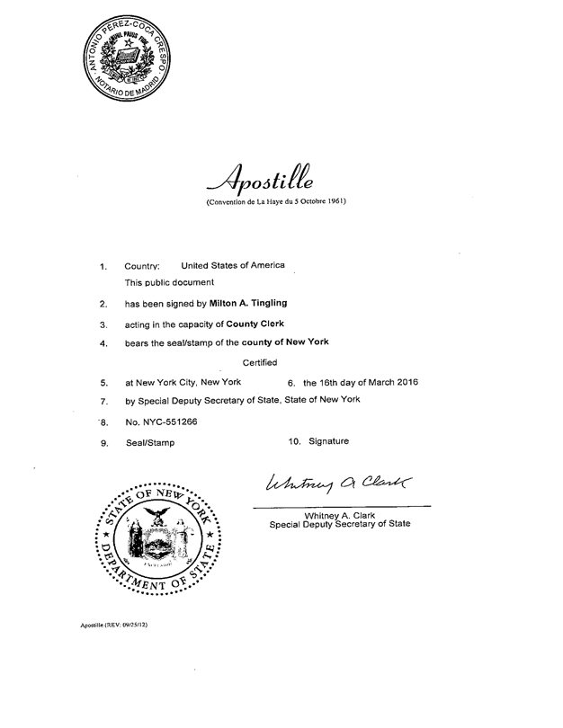
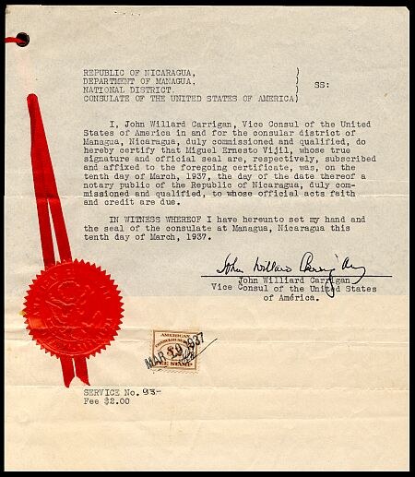
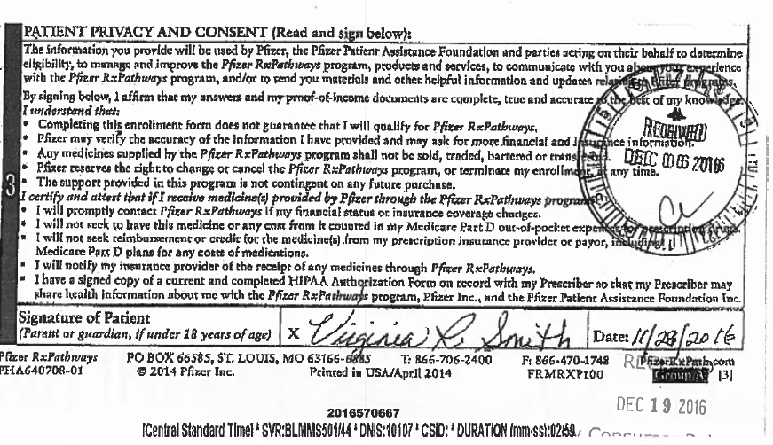
Tested on random documents

Slide 11
Pros of this method
Instead of going for a cascading scanning of probable stamps with a Classifier, preferred image processing method, which is way faster to find ROIs.
Created dataset for non-stamp examples by conditional random sampling from the documents and removing those containing traces of stamps.
At present system is designed in such a way that False positive is better than False negative. Because missing a valid stamp may end up not getting valuable info. Even if its false negative, the last stage of stamp extraction would filter the wrong ones.
Used Deep learning(VGG-16) to capture better features that can distinguish stamps and non stamps.

Slide 12
Further improvements possible
Adaptive thresholding.
Better filter for identifying blobs in a much generalized way.
More examples of Stamps & non-stamps images.
Train for OCR extraction, as tesseract not giving good results on multiple lines or curved areas.

Slide 13

Thank you

