Slide 1
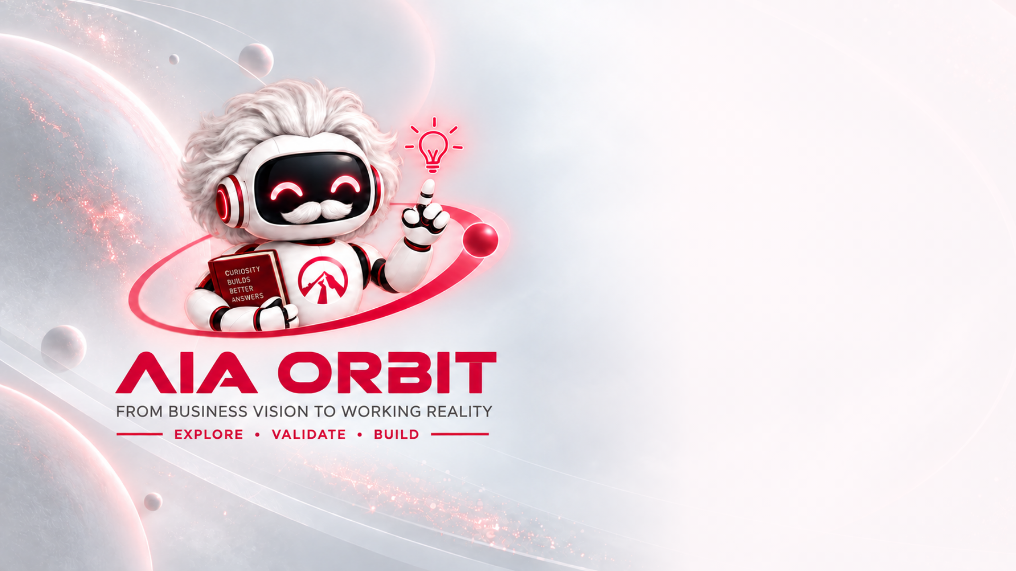
MEET ORBIT
Ask the system itself.
AIA Orbit: a knowledge copilot for our COBOL core systems. Ask, understand, plan, propose. A person decides.
Notes:
Hi, I'm Orbit, AIA's knowledge copilot. Here's what I do, in two minutes.

Slide 2








AIA ORBIT
THE PROBLEM
The rules are locked in old code
Only a few can read it
Business rules live in COBOL programs
THE COST
7 to 15 days per hard question
Answered by hand, by a small specialist team
Slow, risky, dependent
Knowledge walks out
Retirements and role changes take it with them
The business waits in a queue, and the change that follows is hard to scope.
Change is planned in the dark
Impact is found late, after the work has started
7 to 15 days is the COBOL team's estimate of elapsed time, not effort.
Notes:
The rules that run our business live in old COBOL programs. Only a few specialists can read them, so a hard question takes seven to fifteen days, and the knowledge walks out when they leave.

Slide 3





AIA ORBIT
ASK
Ask in plain English
No code knowledge needed
Type a question, with no ticket and no queue
BUSINESS IMPACT
Business or Tech view
Business language for owners, full detail for engineers
Answers on demand
Answers stream in live
Or switch to a complete answer at once
Business owners serve themselves, and specialists stop being a help desk.
Next questions suggested
Follow-ups offered after every answer
Notes:
Ask me in plain English. Choose a business view or a technical view, watch the answer stream in live, and I'll suggest what to ask next.

Slide 4




AIA ORBIT
RULES MADE VISIBLE
The logic becomes readable
Business rules
Plain-language rules drawn from the code
BUSINESS IMPACT
Decision tables
Conditions and outcomes in one grid
Rules the business can read
Business flow
A diagram of how the process runs
Policy logic is no longer visible only to the people who write COBOL.
Data dictionary and relationships
Fields, and which programs share what
Notes:
I make the rules visible: business rules, decision tables, process flows and a data dictionary, all built from the code itself.

Slide 5



AIA ORBIT
SCENARIO WALKTHROUGH
Try a what-if on real logic
Describe a real case
A customer situation, in your own words
BUSINESS IMPACT
Traced step by step
Each condition and result, through the programs
Test a situation first
A clear outcome
With the code reference behind each step
Understand how a case behaves before it reaches a specialist.
Minutes, not days
To be confirmed with AIA's own cases in the pilot
"Minutes" is to be confirmed in the pilot.
Notes:
Put a real scenario to me. I trace it step by step through the programs and show the outcome, in minutes, not days.

Slide 6




AIA ORBIT
TRACEABLE AND SAFE
Answers you can trace
Source citations
Every answer lists the programs behind it
BUSINESS IMPACT
Open the code
See the exact source from any citation
Verifiable, not black-box
Like, regenerate, improve
Feedback to make the next answer better
Owners and auditors can check any answer back to the code.
Guards built in
Prompt-injection filter, personal-data checks, rate limits
Notes:
Every answer cites the programs behind it, and you can open the code. Guards block prompt injection and personal-data requests.

Slide 7
AIA ORBIT
IMPACT ANALYSIS
See what a change will touch
Directly, also, downstream
Programs affected, in layers
BUSINESS IMPACT
Impact map
A picture of the ripple from one change
Impact before you commit
Change impact report
A document to open, review and share
Scope and risk are seen before the work begins, not after.
Asked as a change request
Impact appears in Tech view when you ask for a change
Notes:
Before anything changes, I show what it would touch: directly, also, and downstream, in an impact map and a report.

Slide 8
AIA ORBIT
REQUIREMENTS AND TESTS
A first draft that matches reality
Functional requirement
Drafted from how the system really behaves
BUSINESS IMPACT
Test scenarios
Derived from the rules and the decision table
Better requirements, faster
Ready to export
Download as documents for the project team
Teams start from a draft that matches the system, so fewer surprises later.
Grounded in the code
Not from memory, and not from a stale document
Notes:
Then I draft the functional requirement and the test scenarios, from how the system really behaves, ready to export.

Slide 9
AIA ORBIT
CODING AGENT
From question to a change proposal
Locates the right place
Even in a program too large to read whole
BUSINESS IMPACT
Writes the change
Grounded in the question and the answer
A head start on change
Compiler-checked
Run through a real COBOL compiler
Engineers review a checked proposal instead of starting from a blank file.
A person reviews the diff
A side-by-side comparison, and nothing is applied for them
Notes:
My coding agent goes further. It finds the place, writes the change, checks it with a real COBOL compiler, and a person reviews the difference.

Slide 10

AIA ORBIT
BUILT TO RUN
Run it like a service
Sign-in and accounts
Each person has their own space
BUSINESS IMPACT
History and branches
Return to a conversation, or branch an answer
Managed, measurable
Admin insights
Answer quality, usage and system health
Leaders see usage, quality and risk, not just a chat box.
Security monitoring
Injection attempts and personal-data requests are tracked
Notes:
It's built to run as a service: sign-in, history, admin insights on quality and usage, and security monitoring.

Slide 11
AIA ORBIT
WHAT IT MEANS FOR AIA
Value for every group
Business owners
Specialists
Answers on demand, with no queue.
Fewer repeat questions, more engineering.
Delivery
Risk and audit
Faster change, with less risk.
A stronger audit trail, traced to code.
Notes:
For business owners, answers on demand. For specialists, fewer repeat questions. For AIA, faster change, lower risk and a stronger audit trail.

Slide 12

AIA ORBIT
WHY NOW
Systems stay. Specialists are scarce.
70%+
≈15%
MAS
≈200
of business transactions worldwide are said to run on COBOL (IBM-cited).
projected 2026 IT-spend growth for Asia-Pacific life insurers (Celent).
proposes tighter change-management controls for insurers; 12 months to comply once final.
hours a month if 100 routine questions at 2 hours each need no specialist. An illustration.
Sources: IBM claim as reported by NextBigFuture (2020); Celent, Asia Pacific Life Insurance IT Pressures and Priorities 2026; MAS consultation (law-firm summaries, still a proposal). The 200 hours is an illustration, to be proven with AIA's own numbers.
Notes:
The timing is right. Seventy percent of business transactions are said to run on COBOL, and MAS is proposing tighter change controls. A hundred routine questions a month is about two hundred hours back, an illustration.

Slide 13

AIA ORBIT
LET'S PROVE IT TOGETHER
Just ask Orbit.
A pilot on AIA's own questions and numbers. A person always decides.
Notes:
Let's prove it together. Just ask Orbit.

