Slide 1
Praveenkumar T SQL project - II

Slide 2
Project Title
Hospital Management System
Project Overview
The Hospital Management System is a database-driven project designed to efficiently manage hospital-related information such as patients, doctors, appointments, and billing.
Database Name
hospital_db
Database Structure
The database consists of four main tables:
Patients – Stores patient personal and registration details
Doctors – Stores doctor details such as specialization and consultation fee
Appointments – Manages patient–doctor appointment records
Billing – Stores billing and payment information
SQL Commands Used
DDL (Data Definition Language), DML (Data Manipulation Language),DQL (Data Query Language),Aggregate Functions with GROUP BY, HAVING Clause, JOINS, Subqueries, ORDER BY Clause

Slide 3
SQL Queries Implemented (Questions)
1.Update the city to “Bangalore” for the patient with patient_id = P006.
2.Retrieve the list of patients who are registered after 1st March 2024.
3.Retrieve the total billing amount for each patient by grouping records using the patient ID.
4.Find the total billing amount generated by each doctor.
5.Retrieve patients whose total billing amount exceeds 10,000.
6.Find the patients with above-average billing amounts.
7.List patients in descending order based on their total billing amount.
8.Find the patient with the highest total billing amount.
9.List all patients who have never made any billing payments.
10.Identify doctors who have more than one appointment.
11.Display the number of appointments scheduled for each doctor.
12.Display appointment details including the patient_name, doctor name, and appointment date.
13.List all appointments ordered by appointment date in descending order.
14.Find the appointment date with the highest number of appointments.

Slide 4
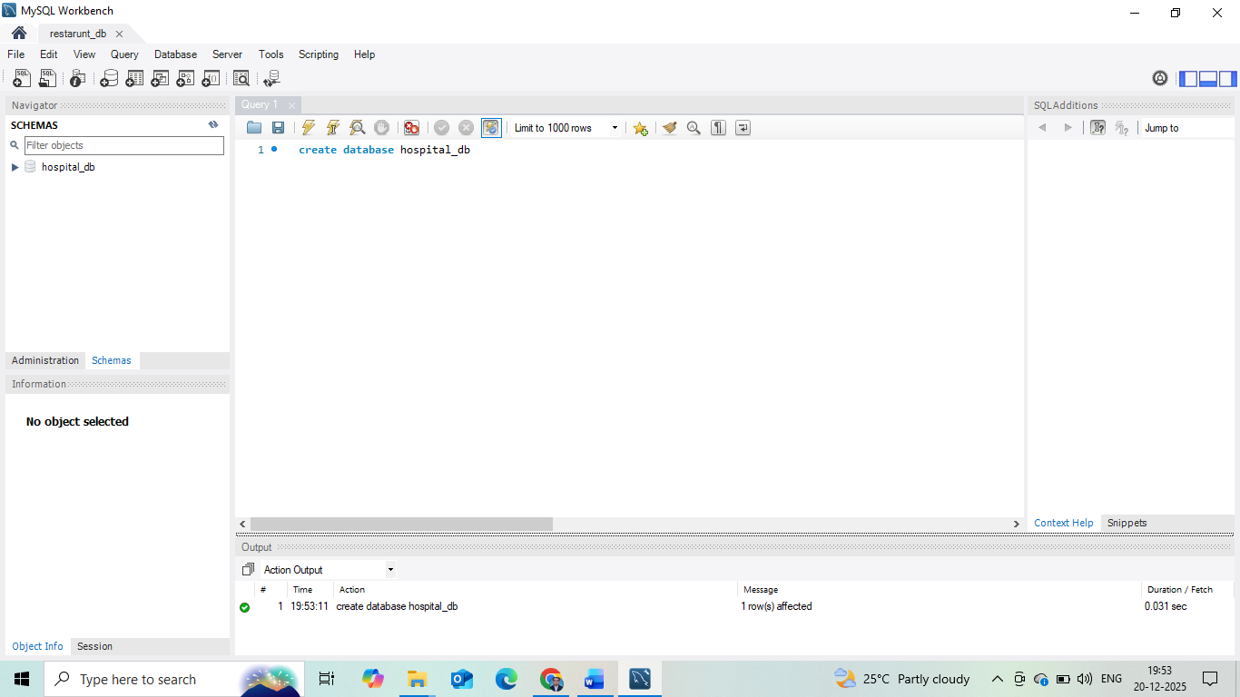

Slide 5
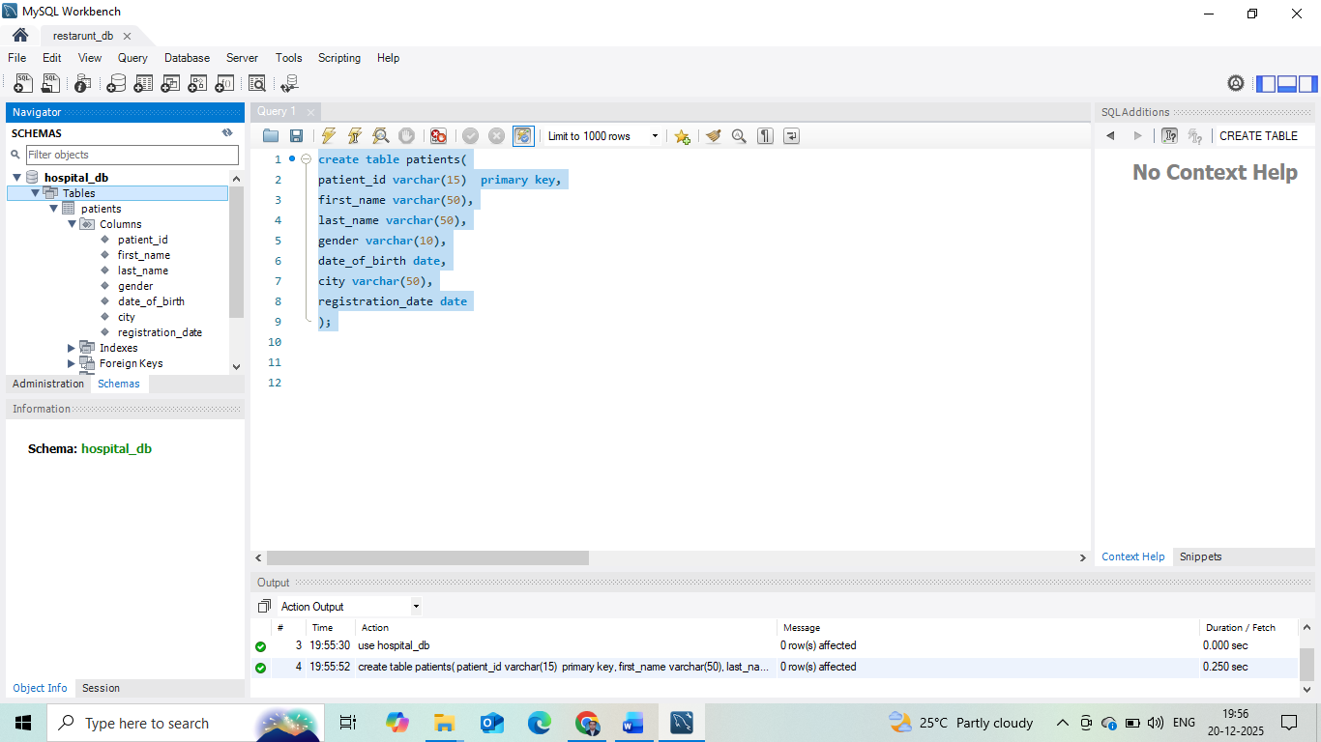

Slide 6
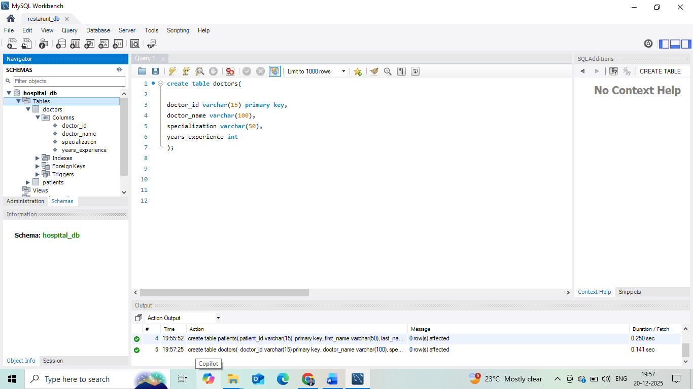

Slide 7
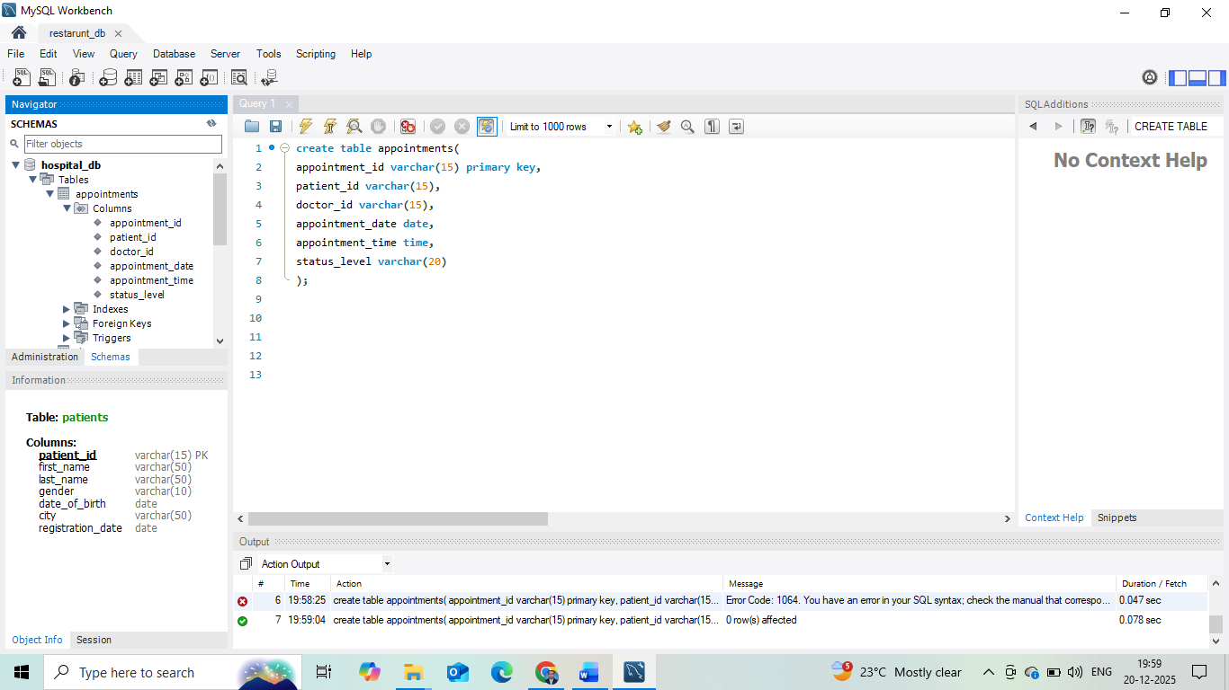

Slide 8
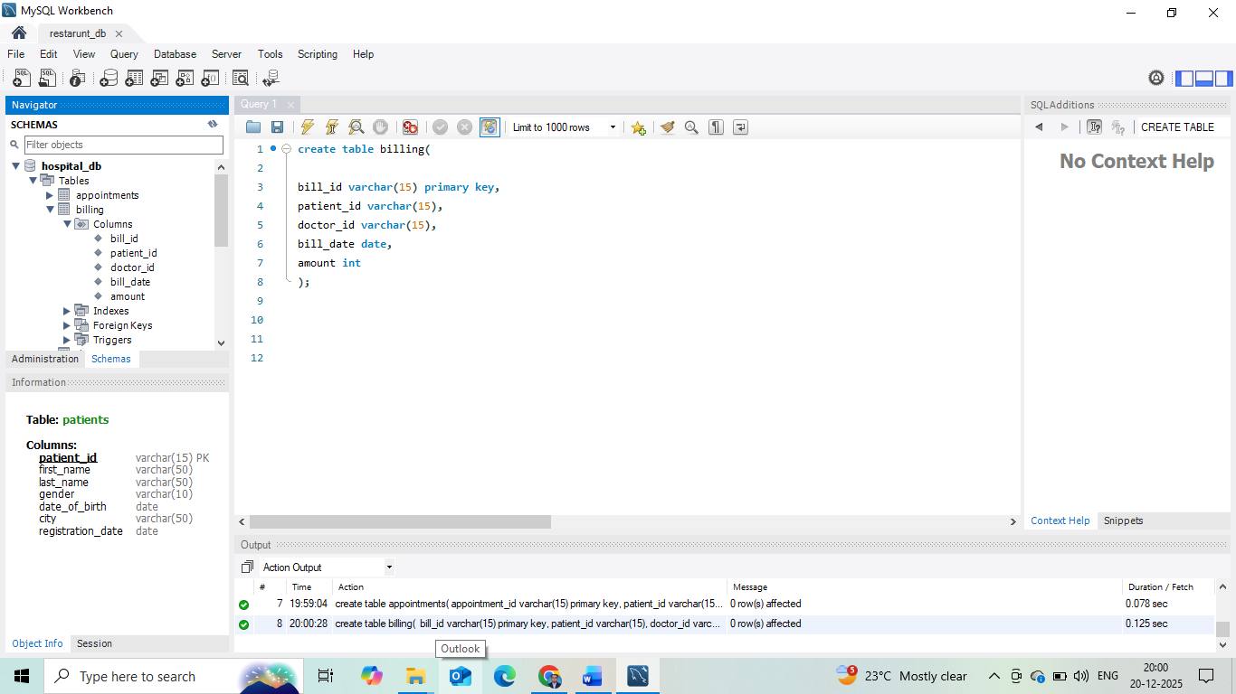

Slide 9
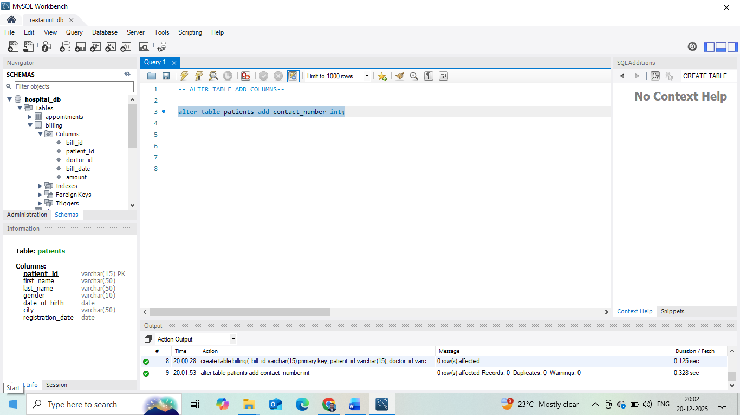

Slide 10
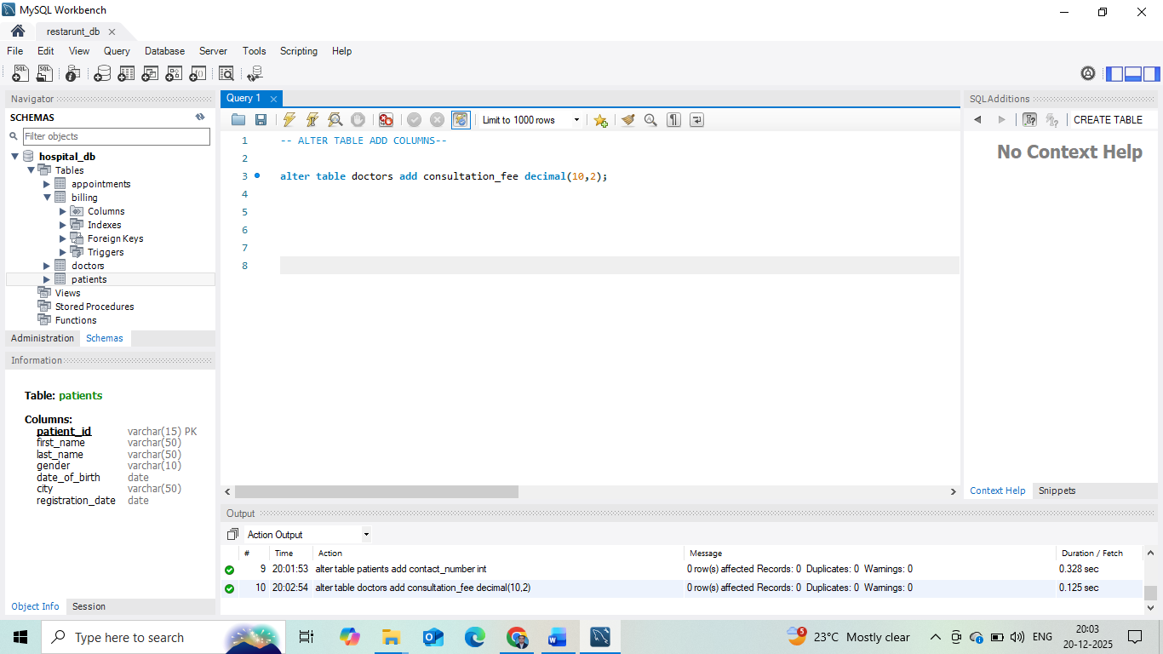

Slide 11
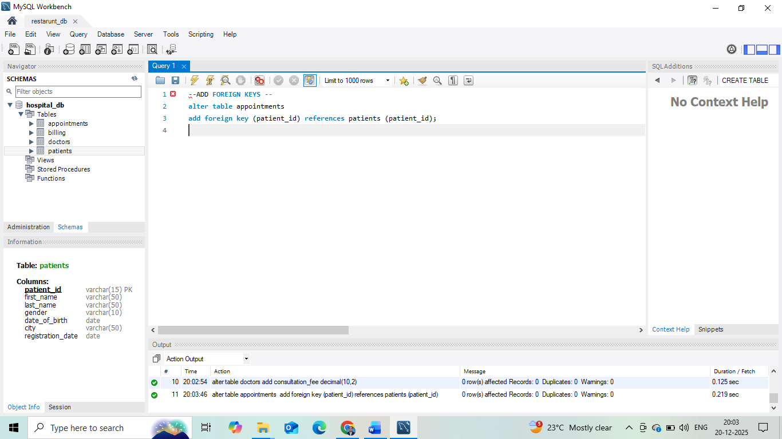

Slide 12
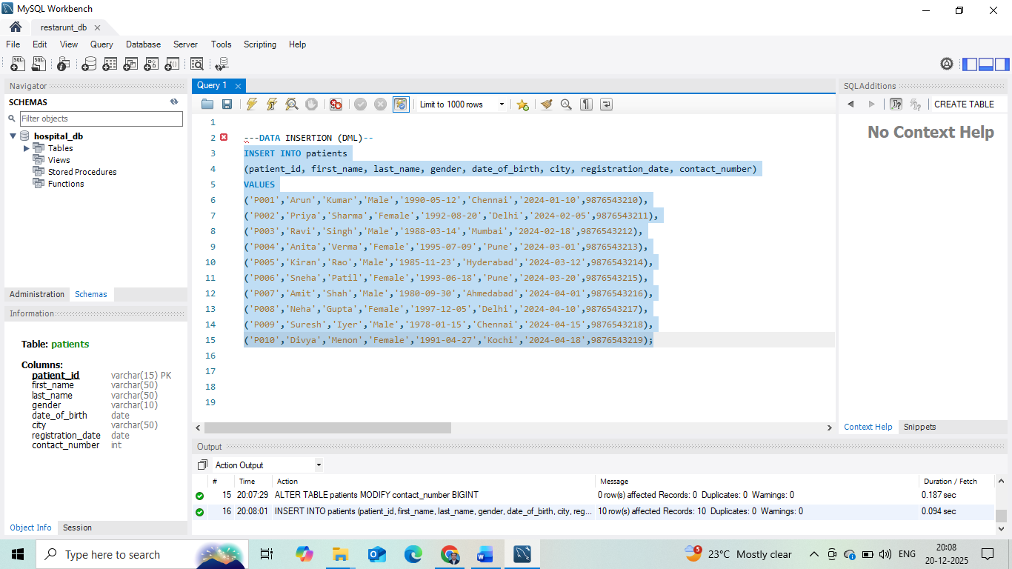

Slide 13
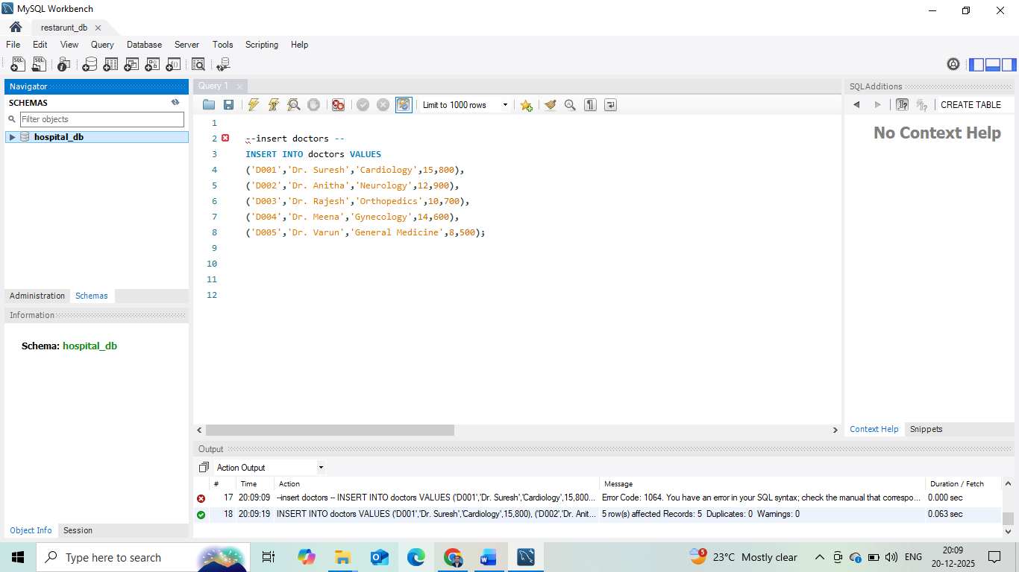

Slide 14
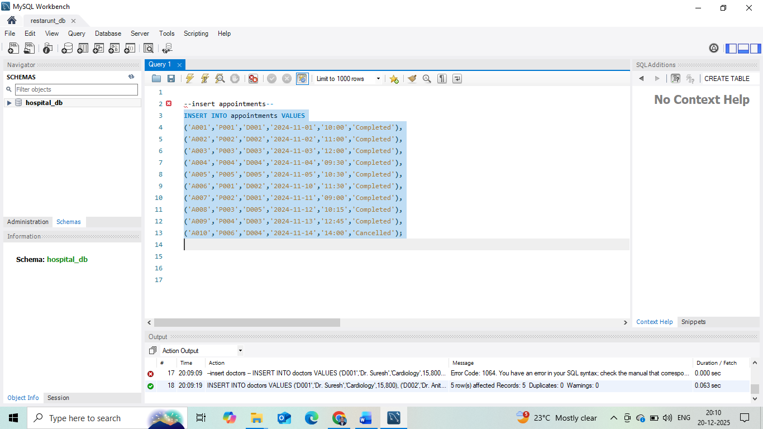

Slide 15
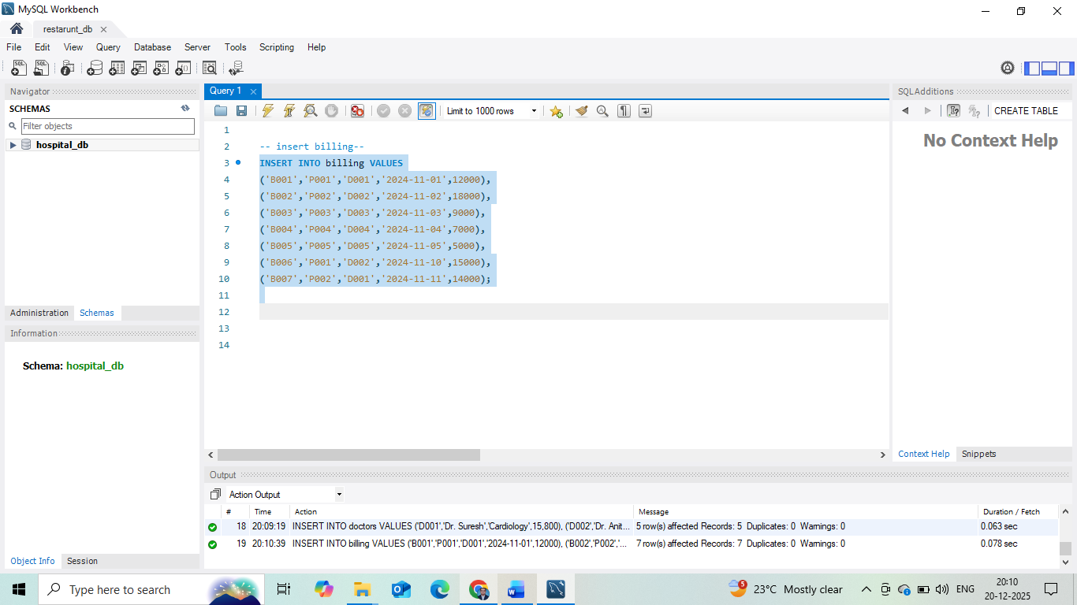

Slide 16
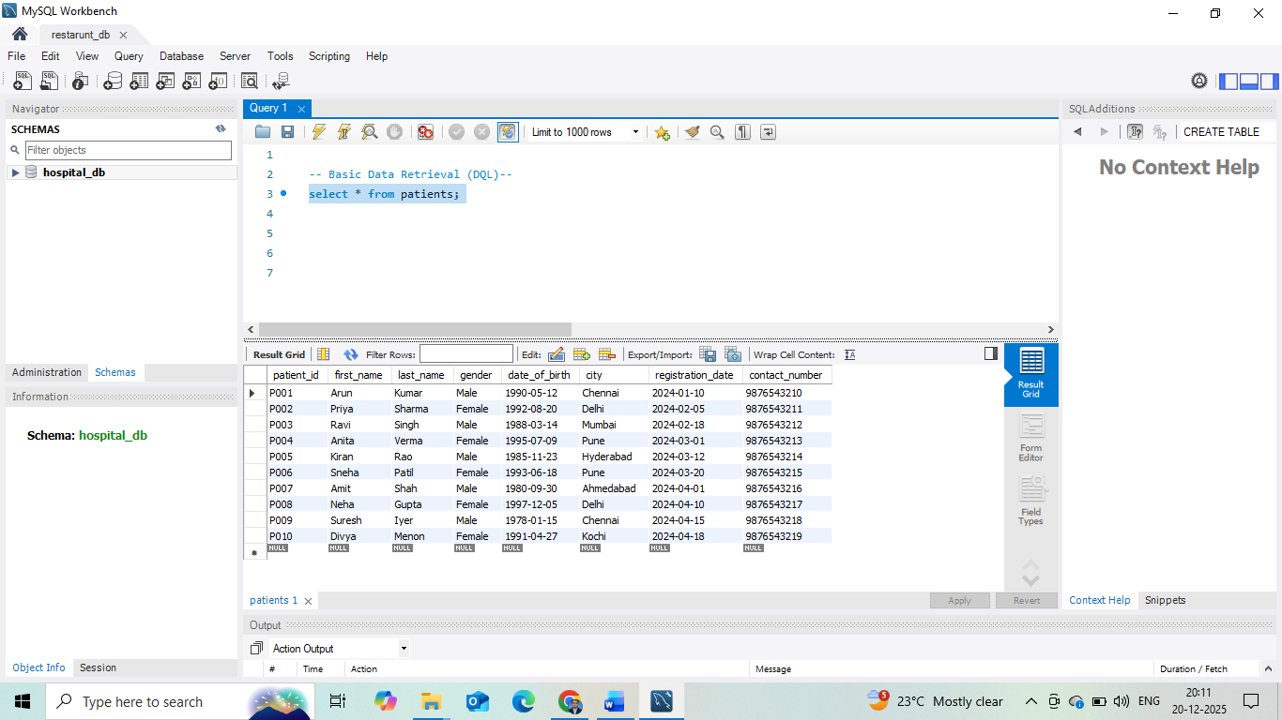

Slide 17
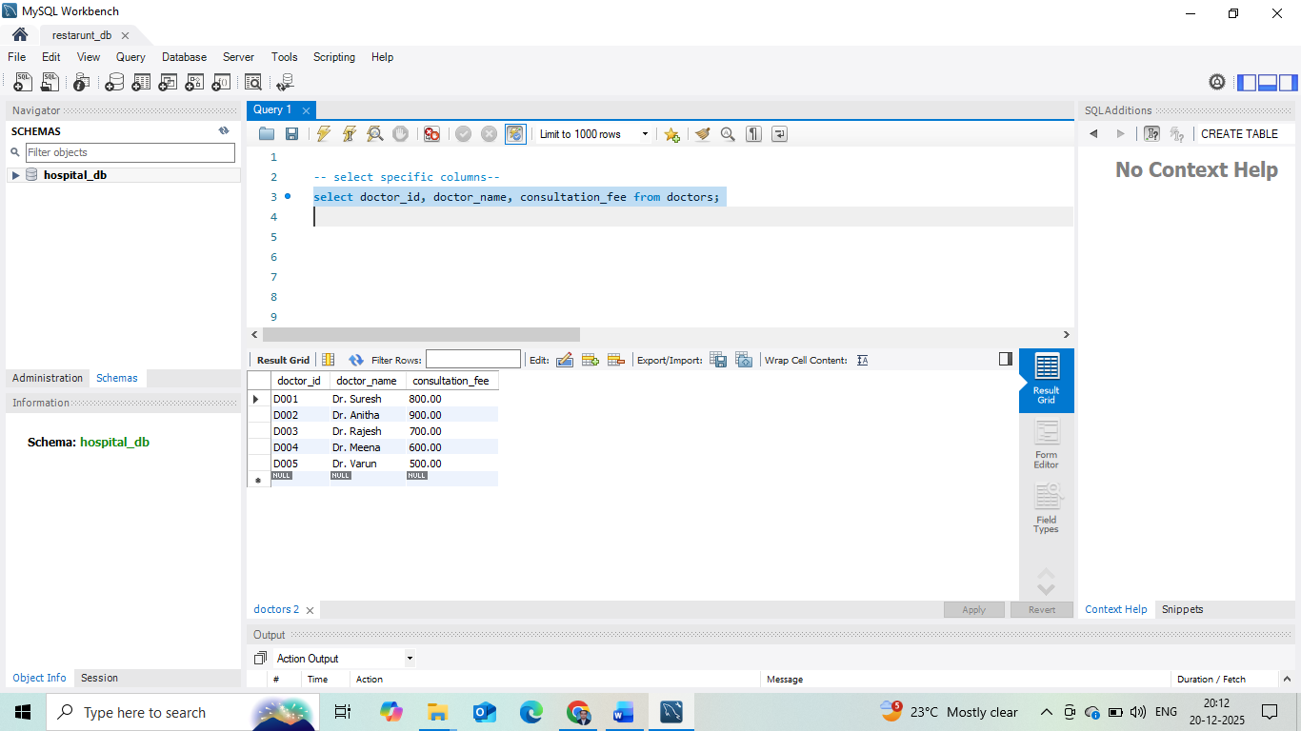

Slide 18
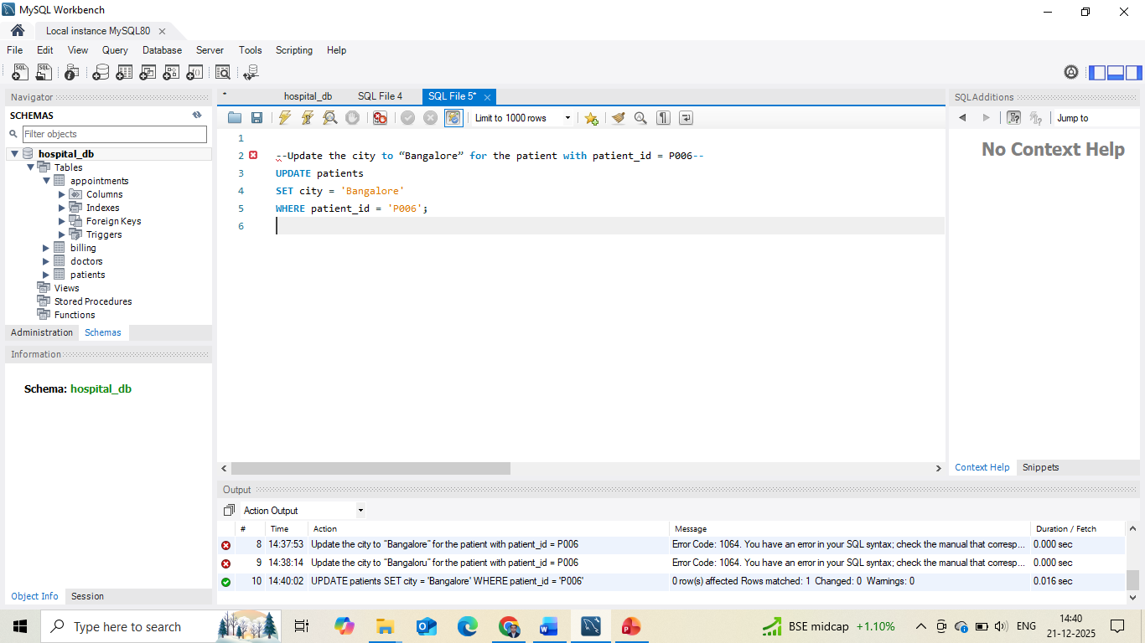

Slide 19
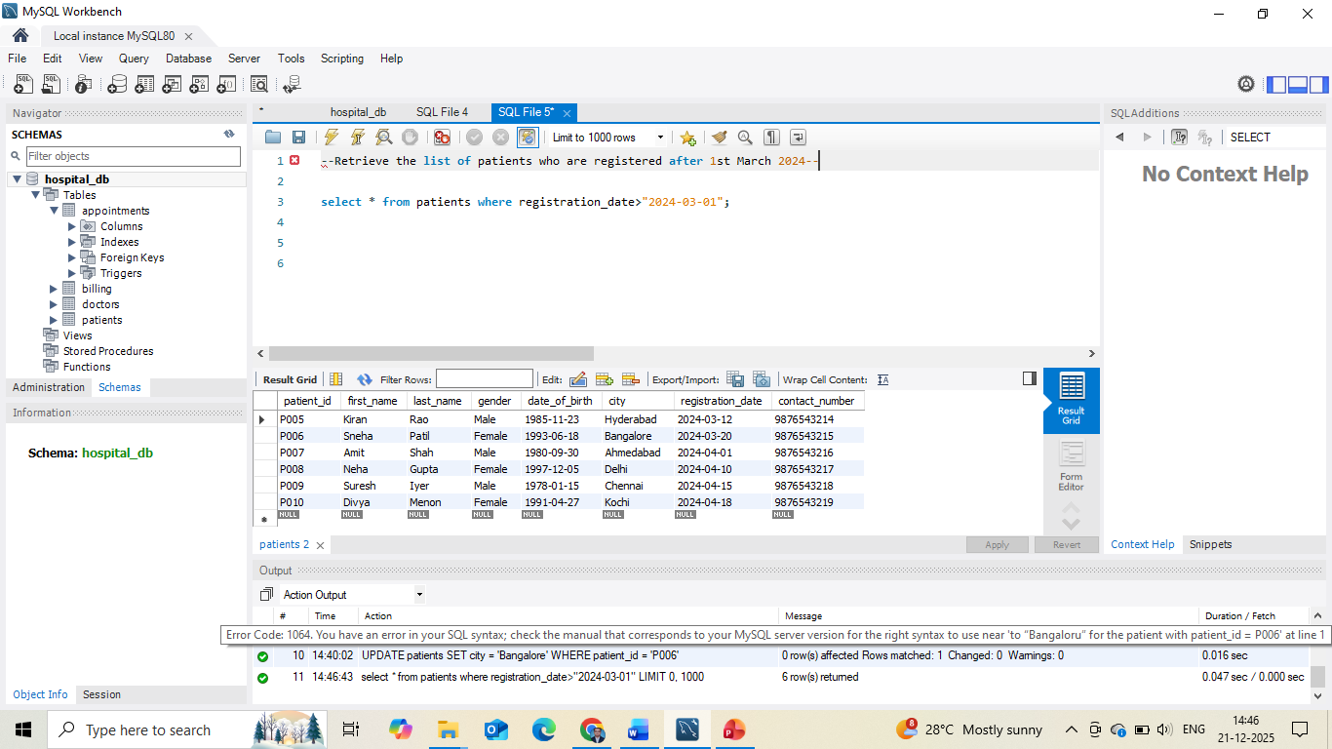

Slide 20
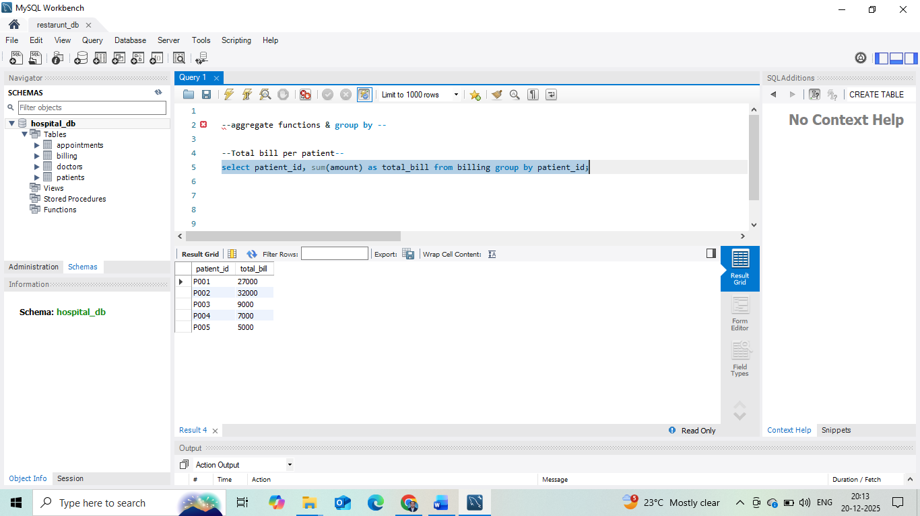

Slide 21
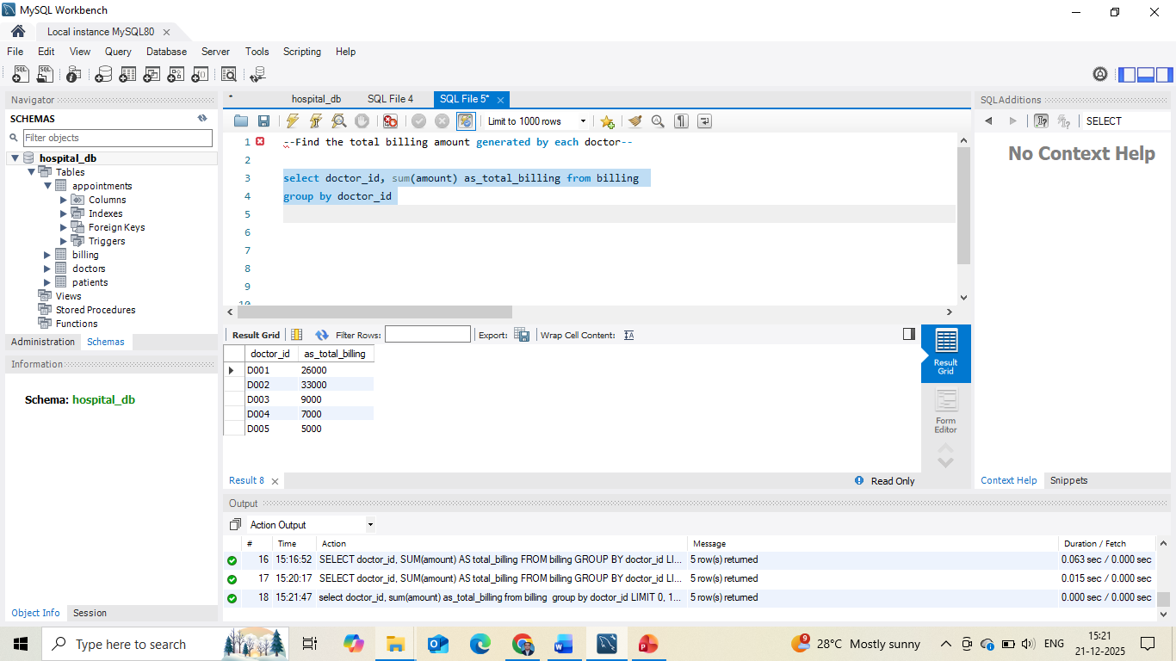

Slide 22
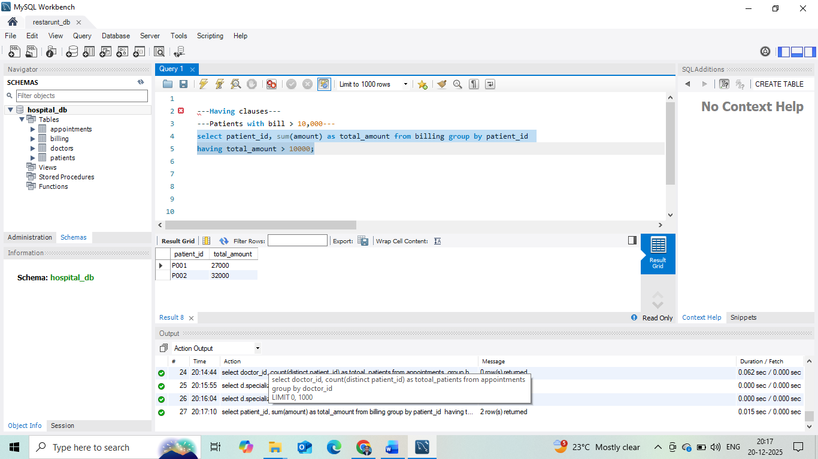

Slide 23
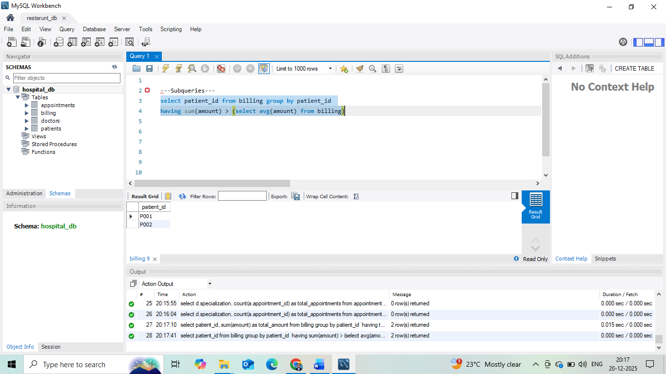

Slide 24
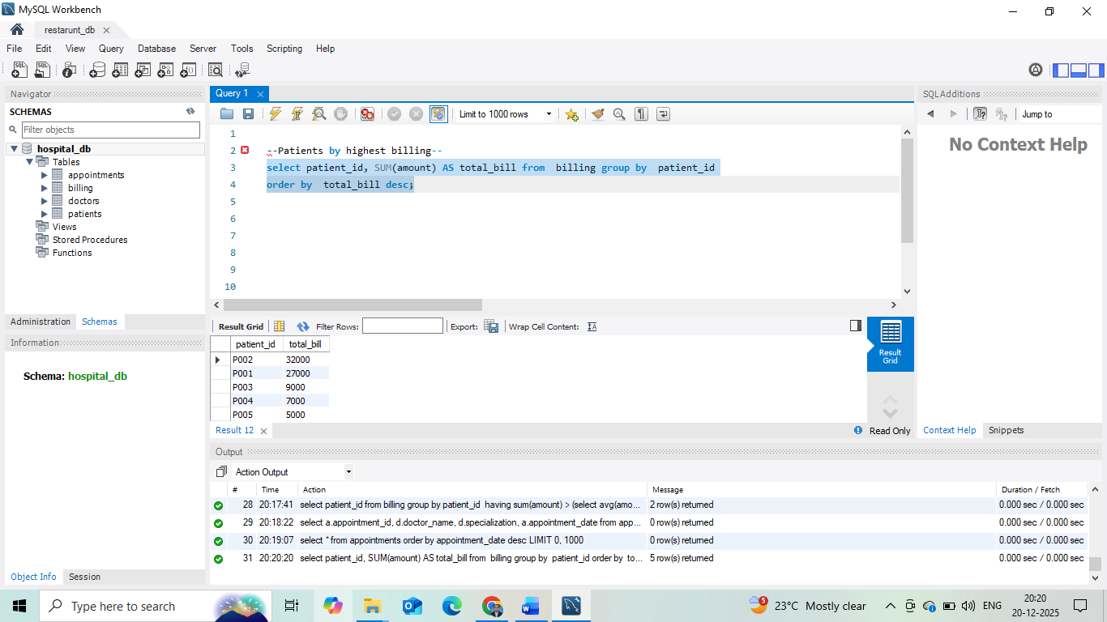

Slide 25
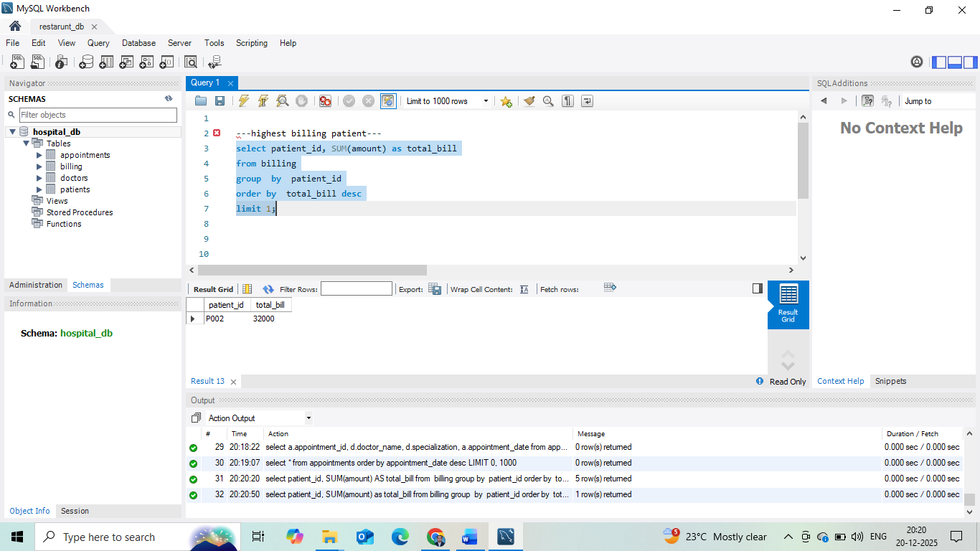

Slide 26
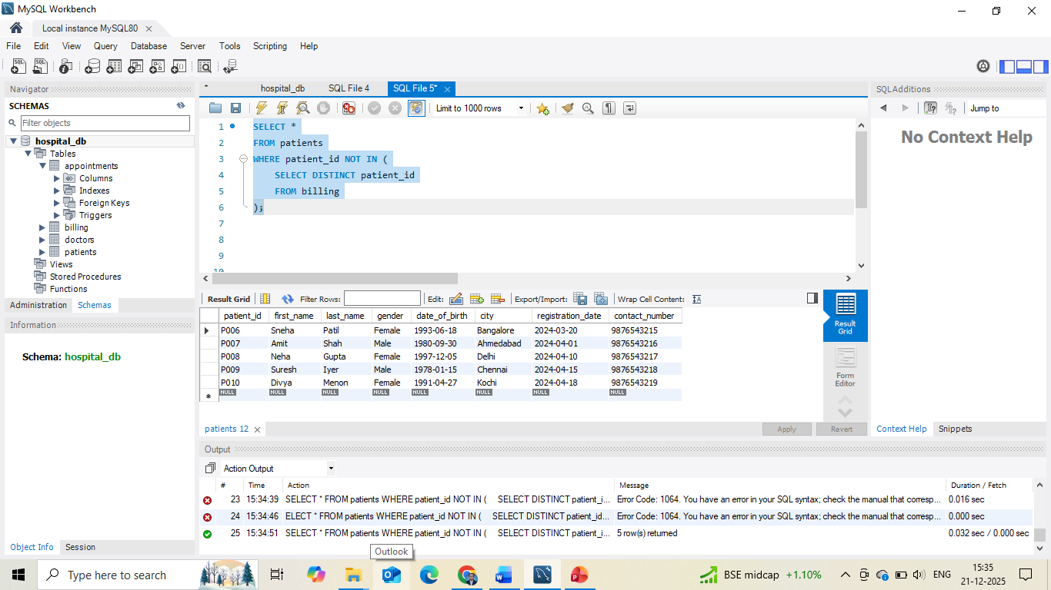

Slide 27
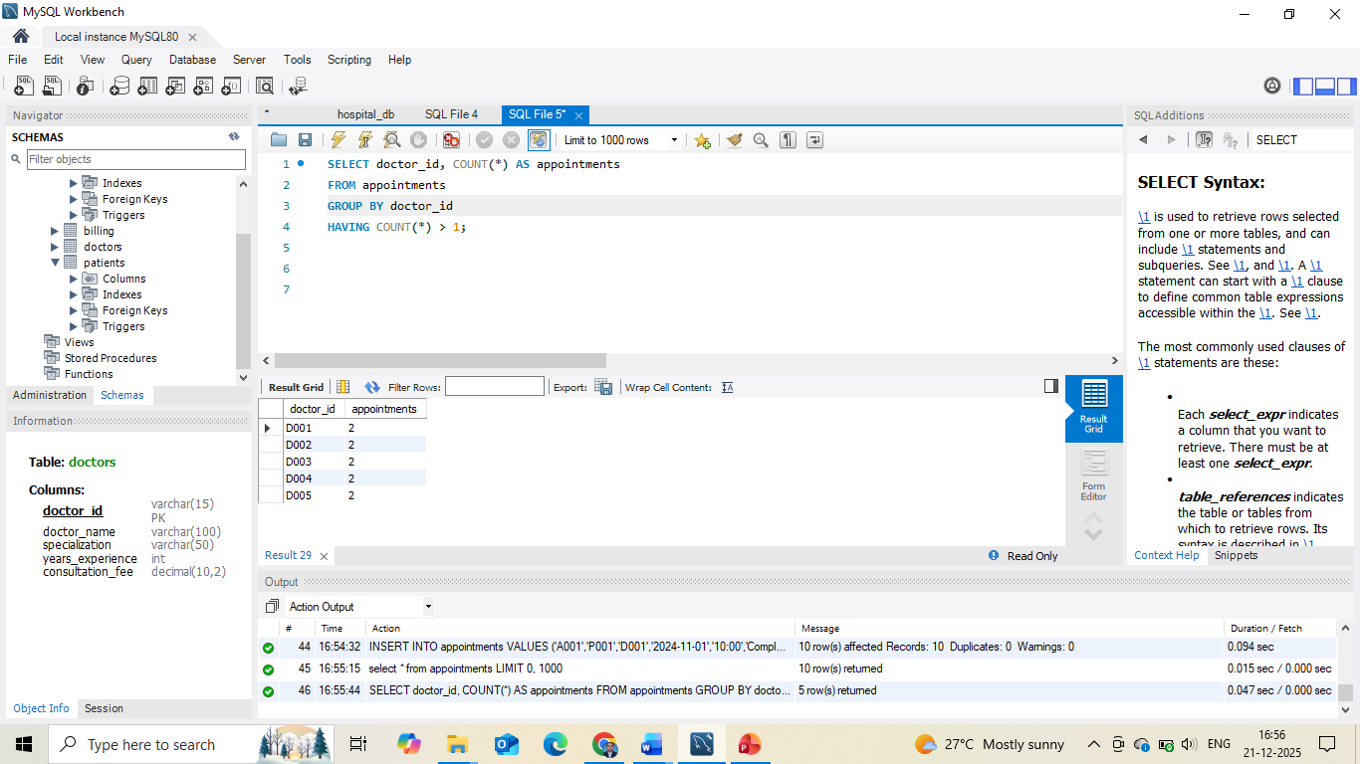

Slide 28
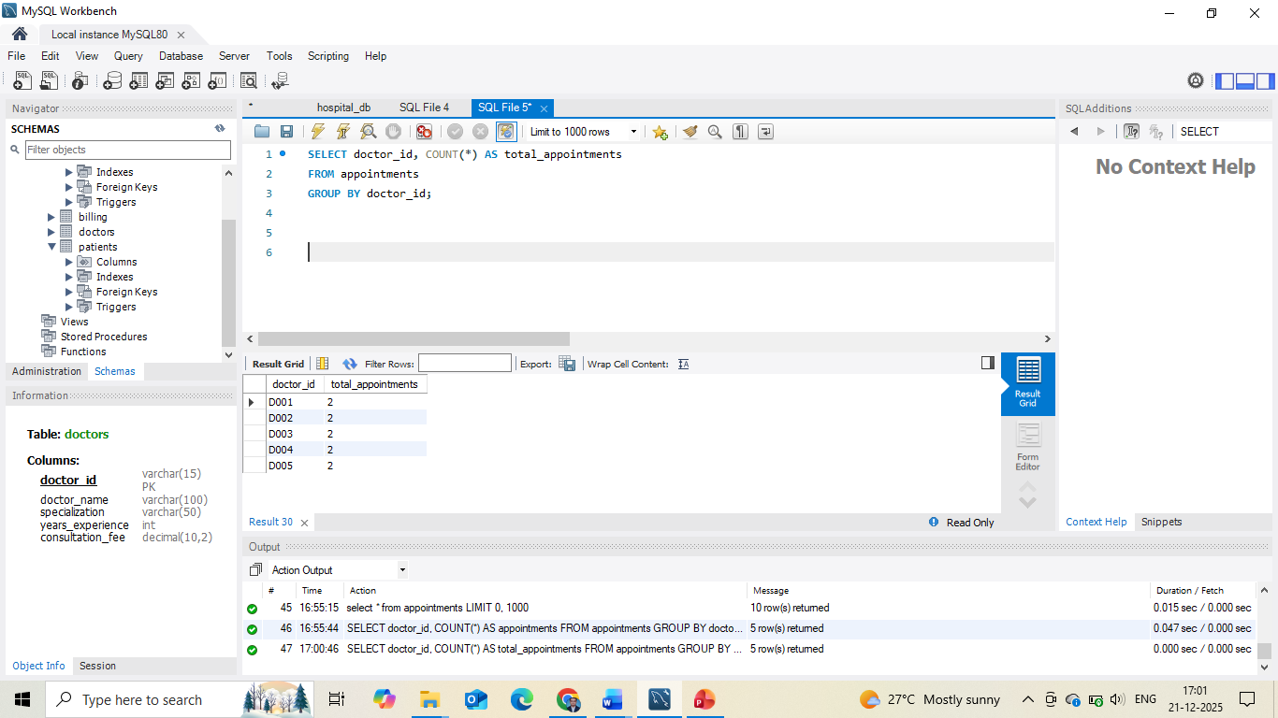
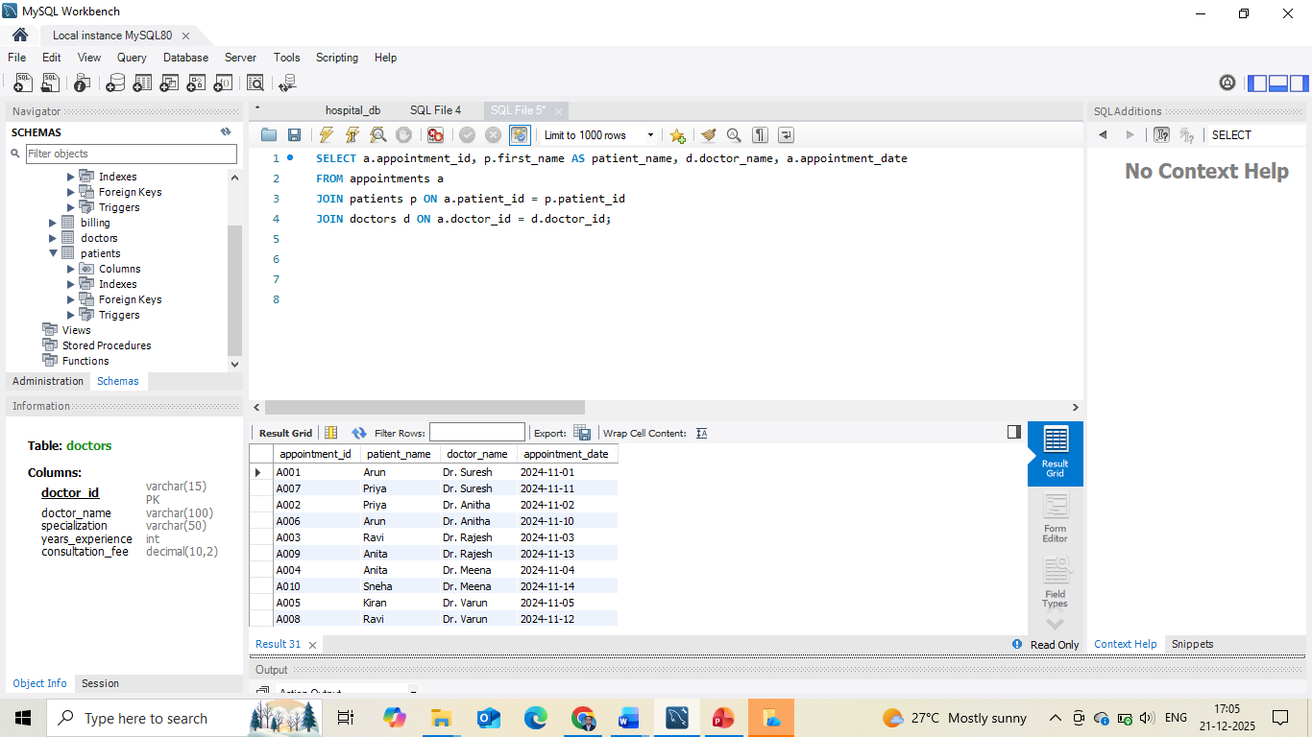

Slide 29
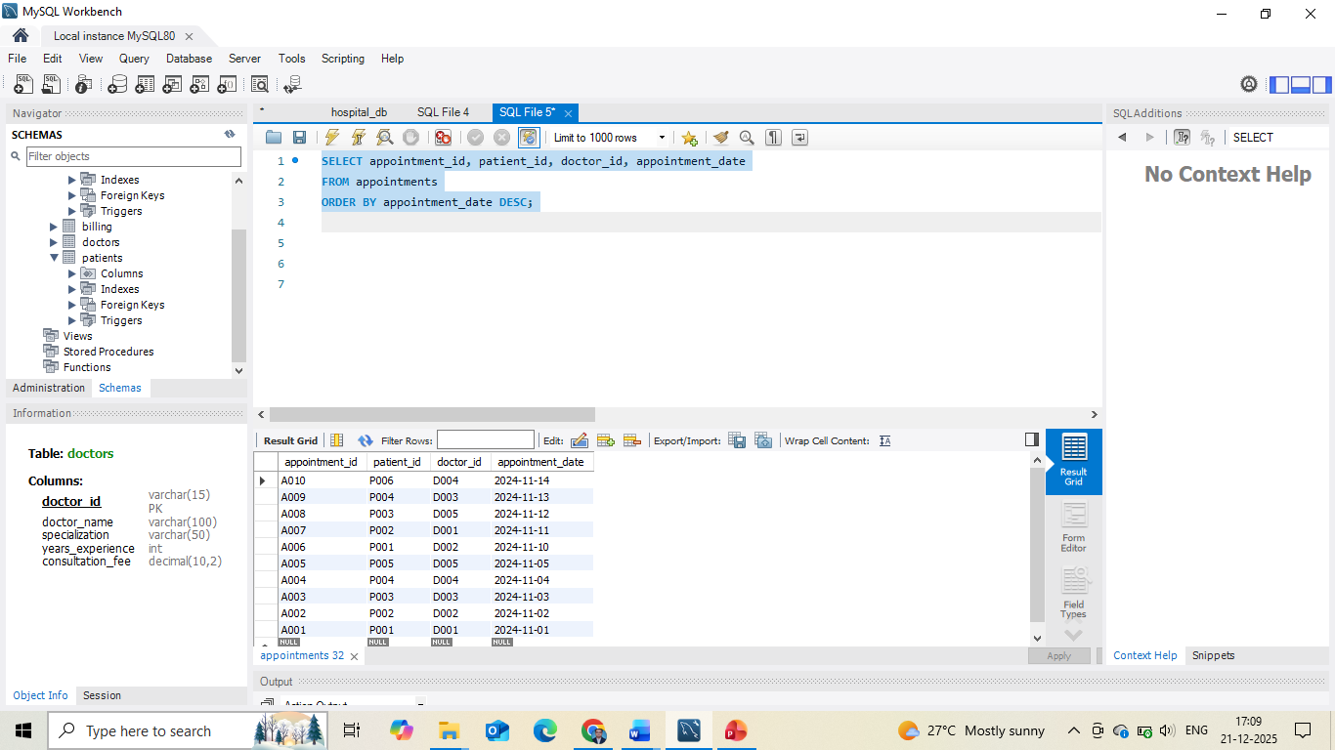

Slide 30
