Slide 1
SHARE TRADING FOR BINOMO USING APPIUM
Name: G . Praveen kumar
Reg.no : 192011203
Dep.t :cse
Subject code :csa3731
Subject : software testing for Android applications
Date : 31-01-2023

Slide 2
PROJECT INCLUDE
Introduction
Abstract
Objective
Proposed work
Flow chart
Concept map
Number of test cases
Apps and tools installation
Appium server
Implementation testing
Testcase outcomes
conclusion

Slide 3
OBJECTIVE
To Test the different strategies (Test Cases) on Binomo Trading Application.
To find all possible Outcomes (Positive and Negative) of the Test.

Slide 4
ABSTRACT
Binomo is trading application which offers trusted services for asset trading in more than one hundred countries around the world.
Binomo is an brokerage application.
Binomo provides them with demat account where you can learn how to trade without risking your deposits.
Binomo helps to Buy and Sell Stocks.
Using Stock charts we can find our share values.

Slide 5
PROPOSED WORK
To develop the share trading application using the android studio.
Run the application using the emulator.
Testing the share trading app for all Possible outcomes.
Running the Appium server inspect the the application.
Then finding all Positive and Negative Outcomes.
Buying , selling Stocks , Trading and Analysis Will be Tested.

Slide 6



APP AND TOOLS IMPLEMENTATION

Slide 7
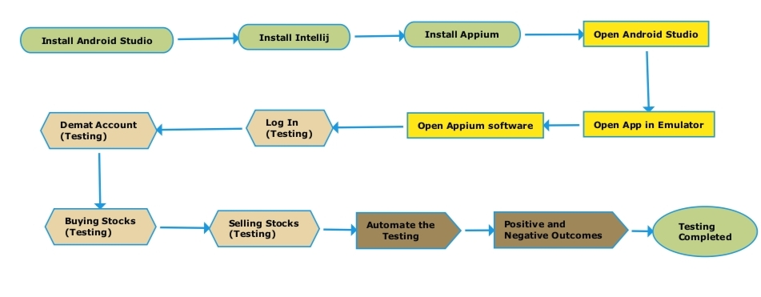
DATA FLOW DIAGRAM

Slide 8
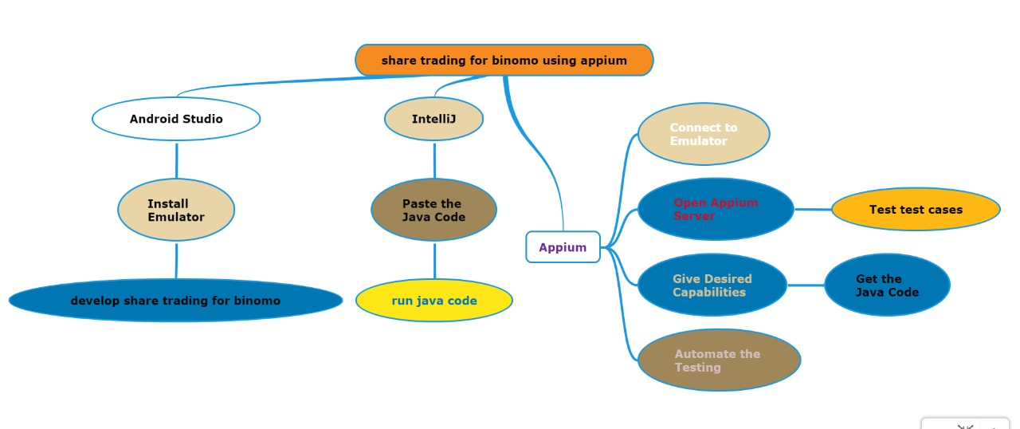
CONCEPT MAP

Slide 9
NO OF TEST CASES
Login
Username
Password
Forgot password
Demat account
Buy stocks
Sell stocks
Trade
Analysis
Logout

Slide 10
APPS AND TOOLS
ANDROID STUDIO
It is Integrated development Environment. It has fast Emulator for App Testing.
Used to Develop applications for Android devices.
It is an open source software.

Slide 11
APPS AND TOOLS
Appium
Open source Automation tool.
It is also a Automation Framework.
Automates different types of mobile applications testing.
It can test web , Native and Hybrid application.
It supports multiple programming languages.
(Java , python , ruby and many more )
It works on Emulator as well as Real Devices.

Slide 12
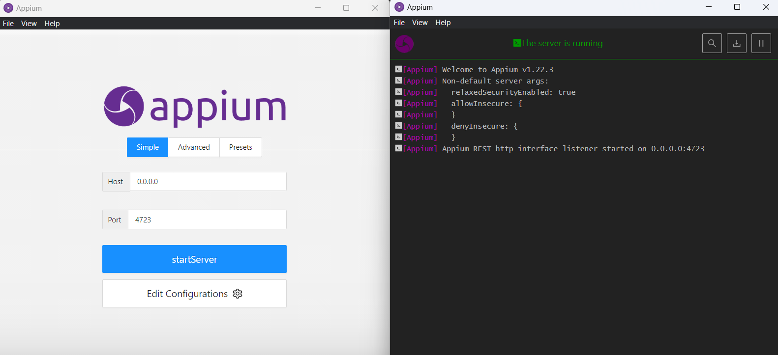
APPIUM SERVER

Slide 13
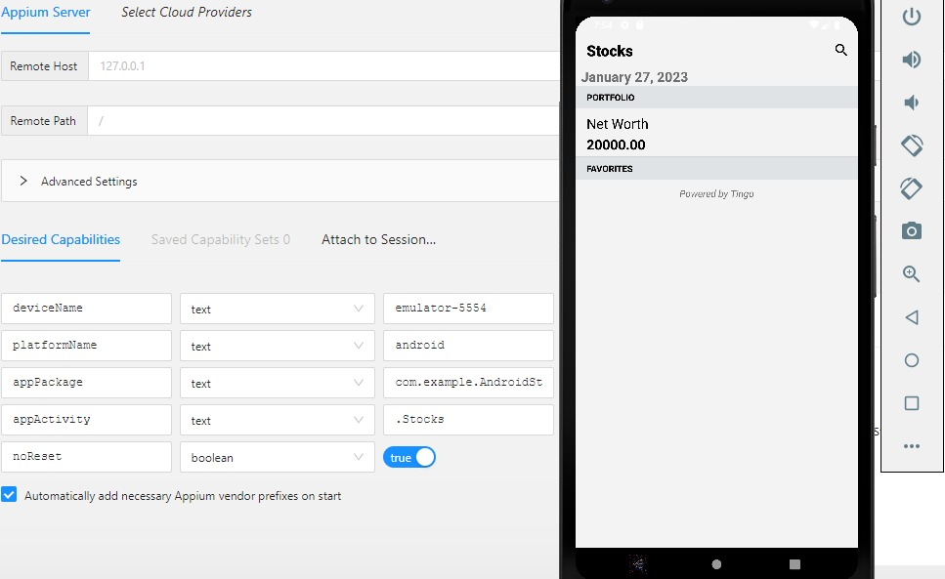
APPIUM SERVER INSPECTOR

Slide 14
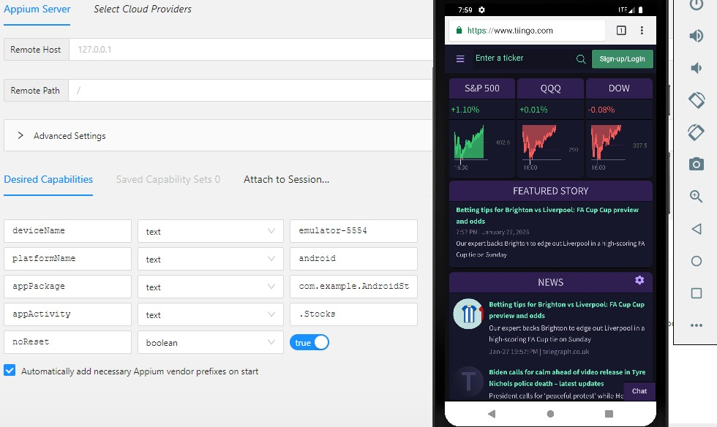
IMPLEMENTATION AND TESTING

Slide 15
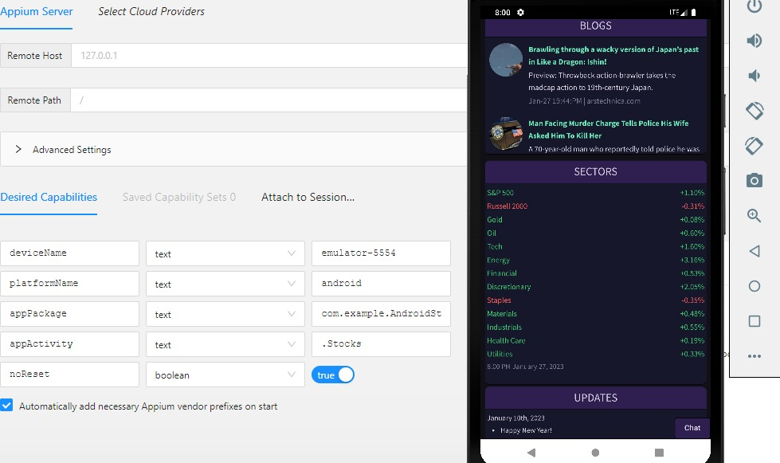
IMPLEMENTATION AND TESTING

Slide 16
TEST CASE OUTCOMES
Test Case | Outcome
Verify if the user is able to Login. | Positive
Verify if the user can login with correct Username. | Positive
Verify if the user can login with the wrong Password. | Negative
Verify if the application is Offline availability. | Negative
Verify if user is able to create Demat account. | Positive
Verify whether the user can Buy the stocks. | Positive
Verify whether the user will Sell stocks. | Positive
Verify if the use can Trade through the stocks. | Positive
Verify if the app can help in Analysis of stocks. | Negative
Verify whether the user can Logout from the application. | Positive

Slide 17
CONCLUSION
HENCE SHARE TRADING APPLICATION IS TESTED USING THE APPIUM SERVER.
70% OF TEST CASES ARE TESTED POSITIVE.
30% OF TEST CASES ARE TESTED NEGATIVE.

