Slide 1
INTRODUCTION
The Real-Time Translator on Calls project bridges language barriers by enabling live voice translation during phone calls. The system captures speech from a caller, translates it into a different language, and returns synthesized speech in near real-time, integrating speech recognition, language translation, and text-to-speech (TTS) synthesis within a Django API linked to a calling app. The main objective is to create an efficient, low-latency system capable of understanding spoken input in one language, translating it to another, and converting the translated text back to speech, even with voice cloning to mimic the original speaker's voice. Key use cases include customer service, international business communication, emergency response, and personal multilingual conversations. Core components include Speech-to-Text (STT) tools like Google Speech Recognition API or OpenAI Whisper, translation models such as Fairseq and Hugging Face MarianMT, TTS tools like Tacotron 2, HiFi-GAN, and GTTS, all orchestrated through a Django REST API. This integration aims to facilitate real-time, cross-language interaction seamlessly for callers from diverse linguistic backgrounds.
EXO PLANET HABITABILITY CLASSIFICAYION

Slide 2
INTRODUCTION(cont..)
Expanding on the Real-Time Translator on Calls project, the system’s architecture is designed to minimize latency, ensuring that translations occur almost instantly to maintain the natural flow of conversation. By leveraging state-of-the-art speech and language processing models, the project prioritizes accuracy and clarity in both translation and voice reproduction. Speech-to-Text (STT) modules quickly convert spoken words to text, while transformer-based machine translation models provide high-quality, context-aware translations. The Text-to-Speech (TTS) component then synthesizes this output, using advanced voice cloning technology when needed to preserve the speaker’s vocal characteristics.

Slide 3
ABSTRACT
The Real-Time Translator on Calls project addresses the challenge of language barriers by providing live translation during phone conversations. The system captures spoken input, translates it into a different language, and then synthesizes the translation into the target language’s speech. By integrating Speech-to-Text (STT), language translation, and Text-to-Speech (TTS) capabilities within a Django REST API, this system offers a smooth, near-instantaneous translation experience. The STT component, powered by tools like Google Speech Recognition and OpenAI Whisper, quickly converts audio input into text, while transformer-based translation models such as Fairseq and Hugging Face MarianMT deliver accurate and context-sensitive translations. The translated text is then synthesized into natural-sounding speech using voice synthesis tools like Tacotron 2, HiFi-GAN, and Wavenet, with optional voice cloning for personalized audio output.
This solution targets sectors such as customer service, international business, emergency response, and personal communication, making multilingual, real-time communication accessible and efficient. With calling app integration and potential support for WebRTC and Twilio, the system manages audio streams in real time, enabling fluid interactions with minimal latency. The system’s Django API orchestrates these AI modules to handle simultaneous, bidirectional translation during calls, ensuring scalability and efficient handling of high traffic. Future improvements aim to refine accuracy, reduce latency further, and enable edge computing for enhanced privacy and offline processing. As a versatile, inclusive communication tool, this project represents a significant advancement in AI-driven language solutions for a globalized world.

Slide 4
LITERATURE SURVEY
Author, Year | TITLE | CONCEPT | PROS | CONS | TOOLS USED
Sarah R.N. McIntyre,2014. | Planetary Magnetism as a Parameter in Exoplanet Habitability | The study focuses on planetary magnetism as a critical parameter influencing the habitability of exoplanets, particularly its role in protecting atmospheres from erosion and maintaining conditions suitable for liquid water. | Understanding Atmosphere Retention | Assumptions in Models Lack of Direct Measurements | Modeling Techniques Data Analysis
R. Brasser, S. Ida, and E. Kokubo, 2014. | A dynamical study on the habitability of terrestrial exoplanets – II The super-Earth HD 40307 g | The study investigates the dynamical stability and habitability of terrestrial exoplanets, particularly focusing on the super-Earth HD 40307 g. It examines how orbital variations and configurations affect long-term climate stability and the potential for supporting life. | Comprehensive An Focus on Habitability analysis | Complexity of Simulation Assumptions in Models Limited Scope | Numerical Simulations HTCONDOR Pool

Slide 5
EXISTING SYSTEM
The Real-Time Translator on Calls project addresses the challenge of language barriers by providing live translation during phone conversations. The system captures spoken input, translates it into a different language, and then synthesizes the translation into the target language’s speech. By integrating Speech-to-Text (STT), language translation, and Text-to-Speech (TTS) capabilities within a Django REST API, this system offers a smooth, near-instantaneous translation experience. The STT component, powered by tools like Google Speech Recognition and OpenAI Whisper, quickly converts audio input into text, while transformer-based translation models such as Fairseq and Hugging Face MarianMT deliver accurate and context-sensitive translations. The translated text is then synthesized into natural-sounding speech using voice synthesis tools like Tacotron 2, HiFi-GAN, and Wavenet, with optional voice cloning for personalized audio output.
This solution targets sectors such as customer service, international business, emergency response, and personal communication, making multilingual, real-time communication accessible and efficient. With calling app integration and potential support for WebRTC and Twilio, the system manages audio streams in real time, enabling fluid interactions with minimal latency. The system’s Django API orchestrates these AI modules to handle simultaneous, bidirectional translation during calls, ensuring scalability and efficient handling of high traffic. Future improvements aim to refine accuracy, reduce latency further, and enable edge computing for enhanced privacy and offline processing. As a versatile, inclusive communication tool, this project represents a significant advancement in AI-driven language solutions for a globalized world.

Slide 6
PROBLEM STATEMENT
In an increasingly globalized world, language barriers pose significant challenges to real-time, seamless communication, particularly during phone calls. Existing translation solutions, such as standalone apps or web-based services, require manual intervention and are typically unable to integrate directly into live phone calls, disrupting conversational flow. These solutions often produce delayed or fragmented translations with robotic voice outputs that do not preserve the speaker’s tone, resulting in unnatural communication experiences. Additionally, current systems may suffer from high latency, dependency on internet connectivity, and lack scalability for high-demand environments like customer service and emergency response. Therefore, there is a critical need for a low-latency, fully integrated, bidirectional real-time translation system that can deliver natural, dynamic speech translations directly within phone calls, enabling fluid, multilingual conversations without interruption.

Slide 7
OBJECTIVE
The objective of this project is to develop a real-time, low-latency translation system that enables seamless multilingual communication during live phone calls. Specifically, the system aims to:
Capture spoken input in one language and convert it to text accurately (speech-to-text).
Translate the text into a target language with high contextual accuracy and grammatical correctness (language translation).
Synthesize the translated text into natural-sounding speech that preserves the speaker’s original tone and style where possible (text-to-speech with voice cloning).
Integrate with calling platforms to provide fluid, bidirectional, and automated translation for ongoing phone conversations.
Ensure minimal latency throughout the process to support smooth, uninterrupted communication.
Offer scalable performance to handle high-demand environments such as customer support, international business, and emergency services.This system will deliver a seamless, efficient, and accessible solution for bridging language gaps, making cross-language phone communication effortless and natural.

Slide 8
PROPOSED SYSTEM
In an increasingly globalized world, language barriers pose significant challenges to real-time, seamless communication, particularly during phone calls. Existing translation solutions, such as standalone apps or web-based services, require manual intervention and are typically unable to integrate directly into live phone calls, disrupting conversational flow. These solutions often produce delayed or fragmented translations with robotic voice outputs that do not preserve the speaker’s tone, resulting in unnatural communication experiences. Additionally, current systems may suffer from high latency, dependency on internet connectivity, and lack scalability for high-demand environments like customer service and emergency response. Therefore, there is a critical need for a low-latency, fully integrated, bidirectional real-time translation system that can deliver natural, dynamic speech Furthermore, these systems often rely on basic synthesized voices, lack real-time bidirectional capabilities, and are highly dependent on network connectivity, limiting their effectiveness in areas with poor connectivity and reducing scalability for high-demand scenarios. There is an urgent need for a robust, fully integrated, low-latency real-time translation solution that can seamlessly facilitate fluent, multilingual phone conversations, offering contextually accurate and natural-sounding translations without interrupting the call experience.

Slide 9
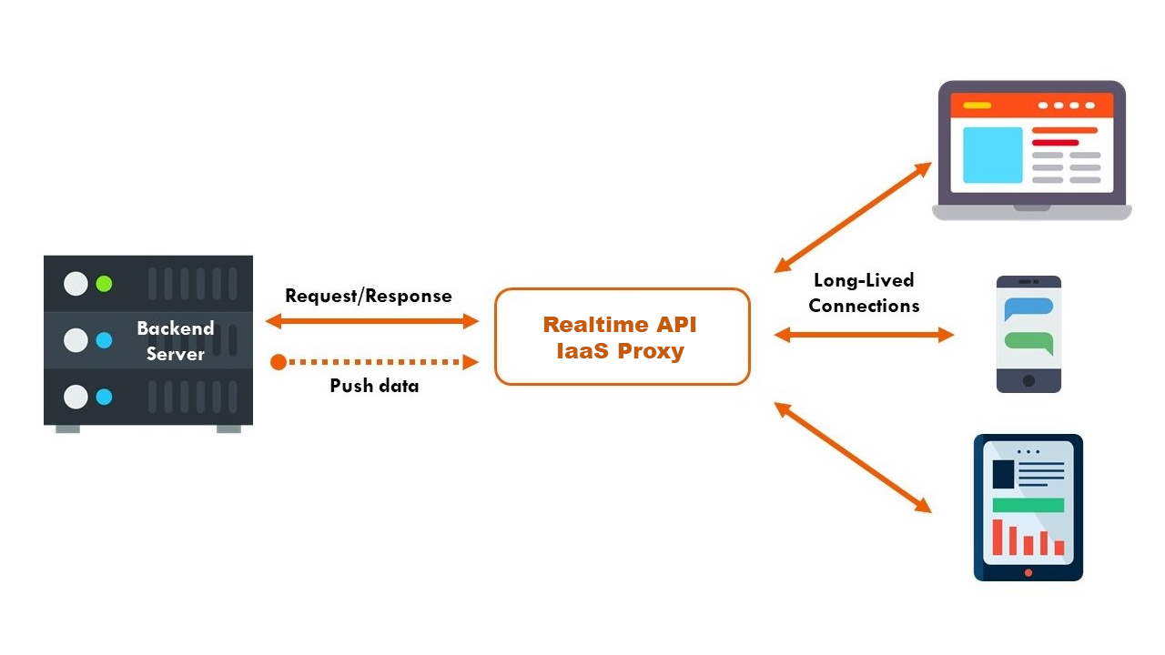
ARCHITECTURE DIAGRAM

Slide 10
SOFTWARE & HARDWARE USED
PROCESSOR – Minimum i5 13th Gen / Ryzen 5 and above.
*RAM – Minimum 8GB RAM and above.
*ROM – Minimum 512GB ROM (SSD/HDD) and above.
*GRAPHICS CARD – Minimum Nvidia GEFORCE
RTX/GTX (1060, 1070, 1080, 1090) and above.
*GRAPHICS CARD Vram – Minimum 4GB Vram and above.
Software specifications:
*OS – Minimum Windows 7 (64-bit) and above

Slide 11
MODULES
The real-time translation system integrates three core modules to facilitate seamless, cross-language communication during live calls. The Speech Translation Module captures and transcribes spoken input into text, then translates it into the target language using tools like Google Speech Recognition API and Fairseq, ensuring contextually accurate and grammatically correct output. To enhance audio quality, the Noise Cancellation and Voice Cloning Module applies digital signal processing to reduce background noise and utilizes TTS models like Tacotron 2 and HiFi-GAN to mimic the speaker’s original tone, providing natural, immersive translations. Finally, the Call Connection and Integration Module manages the live call connection via platforms like Twilio or WebRTC, capturing and routing audio to the Django REST API for processing. This integration supports low-latency, bidirectional communication, allowing users to engage in uninterrupted conversations in their respective languages.

Slide 12
MODULE LEVEL IMPLEMETATION DETAILS
*Speech Translation Module
*Noise Cancellation and Voice Cloning Module
*Call Connection and Integration Module

Slide 13
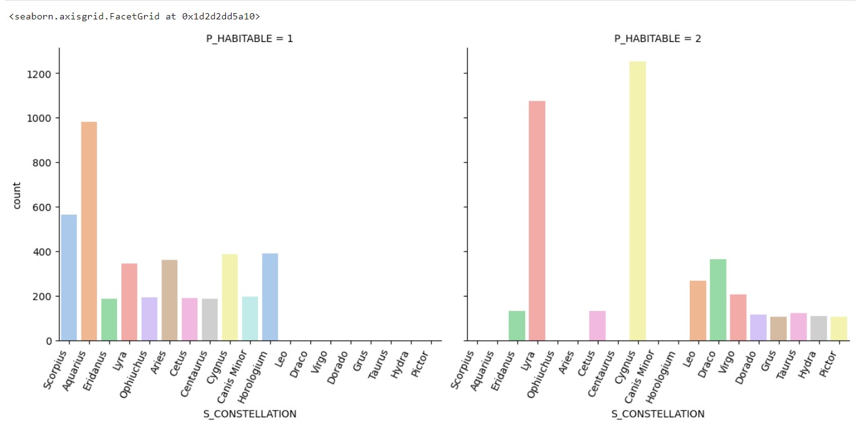
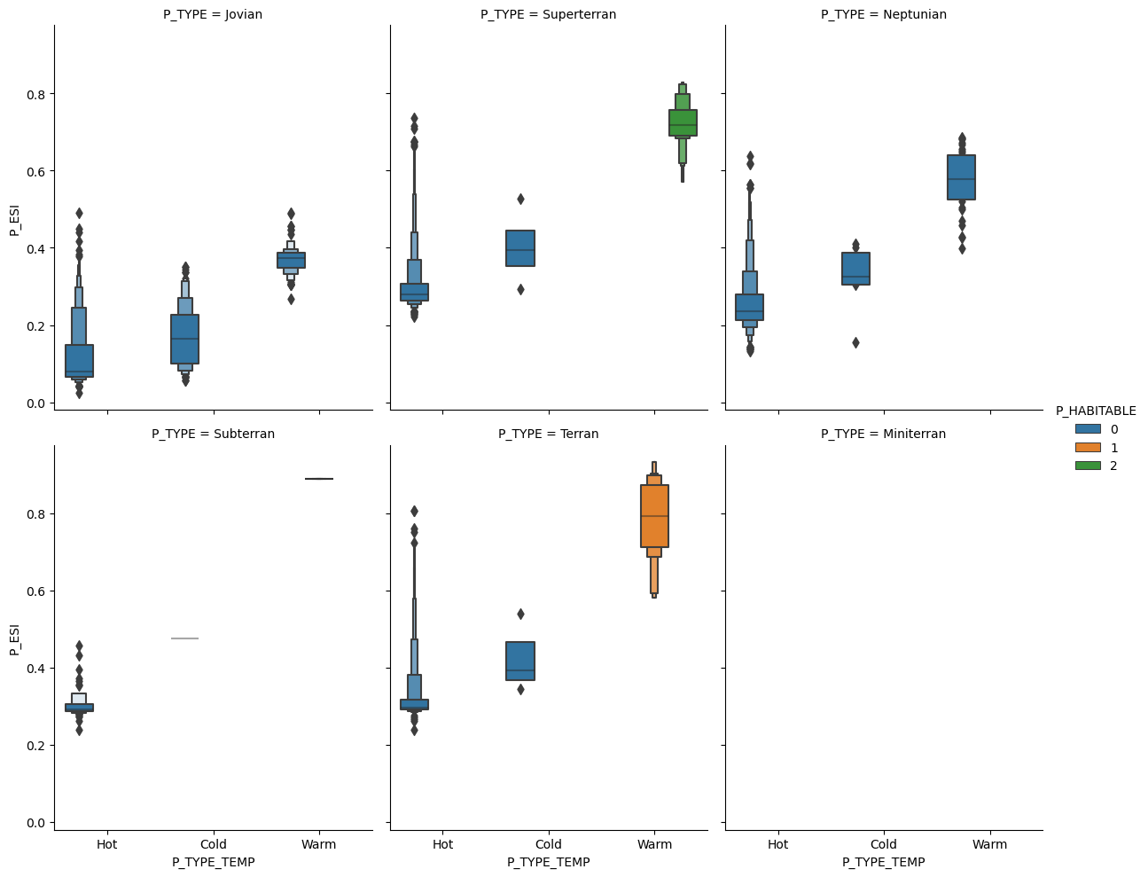
RESULTS AND DISCUSSION

Slide 14
CONCLUSION
The module 1 present-day habitability acts as a preliminary screening tool to find exoplanets that could support life as we know it. It offers important new information on exoplanets that could already have Earth-like circumstances.
The module 2 conservatively habitability represents a significant milestone in the search for potentially habitable exoplanets. By applying strict criteria, you have effectively screened out planets that do not meet the minimum requirements for life as we know it. This ensures that further research resources are directed toward more promising candidates.
The module 3 optimistically habitability expands the scope of your search by considering a wider range of conditions for habitability. This is important for exploring the possibility of life in environments that might differ significantly from Earth's environments.

Slide 15
FUTURE ENHANCEMENT
Improved Contextual Understanding: Implement advanced transformer models like GPT or future AI language models to provide deeper contextual understanding, enabling accurate translation of complex phrases, idioms, and culturally specific references. This could enhance translation accuracy in specialized domains, such as legal, medical, or technical conversations. On-Device Processing for Offline Translation: Leverage edge computing and on-device processing to allow translation services to operate offline or with minimal network dependency. This would make the system more accessible in areas with limited connectivity and improve user privacy by processing data locally.
Enhanced Multimodal Integration: Integrate additional contextual inputs, such as sentiment analysis and user data, to create a more intuitive translation experience. Multimodal inputs can improve accuracy by considering emotional tone, urgency, or relationship dynamics, tailoring translations accordingly
Zero-Latency Translation: As hardware and algorithms evolve, aim to reduce latency to near-zero, enabling real-time, seamless conversation flow.

