Slide 1
Building a credit card fraud detection project involves several steps, including loading and preprocessing the dataset.
STEP 1:
Import Libraries:
Start by importing the necessary Python libraries. You will
typically need libraries like pandas for data manipulation, numpy for
numerical operations, and sklearn for machine learning.
import pandas as pd
import numpy as np
from sklearn.model_selection import train_test_split
from sklearn.preprocessing import StandardScaler
STEP 2:
Load the Dataset:
You need a dataset containing credit card transactions, where
each transaction is labeled as fraudulent or not. You can obtain such a
dataset from various sources, such as Kaggle or your organization's data.
For this example, we'll assume you have a CSV file named
credit_card_data.csv.
# Load the dataset
data = pd.read_csv('credit_card_data.csv')
STEP 3:
Explore the Data:

Slide 2
Before preprocessing, it's important to understand the structure of the
data and get a sense of its contents. Use functions like data.head(),
data.info(), and data.describe() to inspect the dataset.
Data Preprocessing
Handling Missing Values:
Check for missing values and decide how to handle
them. You can either remove rows with missing data or impute missing
values.
STEP 4:
Feature Selection:
Select relevant features or columns that will be used for
modeling. Exclude unnecessary columns.
selected_features = data[['feature1', 'feature2', ...]]
STEP 5:
Split the Data:
Split the dataset into training and testing sets. The testing set is
used to evaluate your model's performance.
X = selected_ features
y = data['fraudulent_ label']
X_ train, X_ test, y_ train, y_ test = train_ test_ split(X, y, test _size=0.2,
random_ state=42)

Slide 3
STEP:6
Feature Scaling:
Standardize or normalize the features to have a mean of 0 and
standard deviation of 1. This is especially important for algorithms like
Support Vector Machines (SVM) and k-Nearest Neighbors (KNN).
scaler = StandardScaler()
X_ train = scaler. fit_ transform (X_ train)
X_ test = scaler. transform (X_ test)
STEP:7
Save Pre- processed Data:
It's a good practice to save the preprocessed data so you can easily use it in the subsequent stages of your project.
preprocessed_data.to_csv('preprocessed_credit_card_data.csv', index=False)
CONCLUSION
Now We have successfully loaded and pre-processed the
dataset. The next steps in your credit card fraud detection project would
involve selecting an appropriate machine learning model, training the
model, and evaluating its performance. Additionally, you will need to
handle class imbalance and consider various evaluation metrics, such
as precision, recall, and F1-score, given the nature of fraud detection
problems.

Slide 4
import numpy as np
import pandas as pd
import matplotlib.pyplot as plt import seaborn as sns
from matplotlib import gridspec
data = pd.read_csv("creditcard.csv")
data.head()
Time | V1 | V2 | V3 | V4 | V5 | V6 | V7 | V8 | V9 ... | V21 | V22
 | V23 | V24 | V25 | V26 | V27 | V28 | Amount |  | Class
0 | 0 -1.359807 -0.072781 2.536347 1.378155 | -0.338321
 | 0.462388 0.239599 0.098698 0.363787 ... | -0.018307
0.277838 | -0.110474 | 0.066928 | 0.128539 | -0.189115 | 0.133558
-0.021053 | 149.62 0.0
1 0
1.191857
-0.078803
0.266151
0.085102
0.166480
-0.255425
0.448154
0.060018
-
0.082361
0.101288
-0.339846
0.167170
...
-0.225775
-0.008983
-0.638672
0.014724
0.125895
 | 2.69 | 0.0
2 | 1 | -1.358354 | -1.340163 | 1.773209 | 0.379780 | -0.503198
1.800499 |  | 0.791461 | 0.247676 | -1.514654 | ... | 0.247998
0.771679 |  | 0.909412 | -0.689281 | -0.327642 | -0.139097 |  | -0.055353
-0.059752 |  | 378.66 0.0
3 | 1 -0.966272 -0.185226 1.792993 -0.863291 |  |  |  |  | -0.010309
 | 1.247203 0.237609 0.377436 -1.387024 ... |  |  |  |  | -0.108300
0.005274 |  | -0.190321 | -1.175575 | 0.647376 | -0.221929 |  | 0.062723
0.061458 |  | 123.50 0.0
4 | 2 -1.158233 0.877737 1.548718 0.403034 |  |  |  |  | -0.407193
 | 0.095921 0.592941 -0.270533 0.817739 ... |  |  |  |  | -0.009431
0.798278 |  | -0.137458 | 0.141267 | -0.206010 | 0.502292 |  | 0.219422
0.215153 |  | 69.99 0.0
5 rows × 31 columns
print(data.shape)
print(data.describe())
(7973, \ | 31) Time | V1 | V2 | V3 | V4
count | 7973.000000 | 7973.000000 | 7973.000000 | 7973.000000 | 7973.000000
mean | 4257.151261 | -0.299740 | 0.295226 | 0.899355 | 0.215736
std | 3198.964299 | 1.498341 | 1.283914 | 1.090297 | 1.447057
min | 0.000000 | -23.066842 | -25.640527 | -12.389545 | -4.657545
25% | 1531.000000 | -1.046362 | -0.237359 | 0.372435 | -0.687521
50% | 3635.000000 | -0.416341 | 0.335446 | 0.948695 | 0.223379
75% | 6662.000000 | 1.122758 | 0.950582 | 1.597949 | 1.131542

Slide 5
max |  | 10981.000000 | 1.685314 | 8.261750 | 4.101716 | 7.380245
... | \ | V5 | V6 | V7 | V8 | V9
count ... mean |  | 7973.000000 -0.025285 | 7973.000000 0.157286 | 7973.000000 -0.026445 | 7973.000000 -0.070525 | 7973.000000 0.655244
... std |  | 1.167218 | 1.325015 | 1.063709 | 1.332568 | 1.156618
... min |  | -32.092129 | -7.574798 | -12.968670 | -23.632502 | -3.878658
... 25% |  | -0.630525 | -0.655399 | -0.517733 | -0.199794 | -0.085635
... 50% |  | -0.107337 | -0.148669 | 0.004732 | 0.016128 | 0.613170
... 75% |  | 0.405082 | 0.555200 | 0.527353 | 0.307111 | 1.294087
... max |  | 11.974269 | 21.393069 | 34.303177 | 3.877662 | 10.392889
...
\ |  | V21 | V22 | V23 | V24 | V25
count |  | 7972.000000 | 7972.000000 | 7972.000000 | 7972.000000 | 7972.000000
mean |  | -0.053715 | -0.165799 | -0.035174 | 0.025977 | 0.088893
std |  | 0.953498 | 0.654858 | 0.488322 | 0.601760 | 0.427505
min |  | -11.468435 | -8.527145 | -15.144340 | -2.512377 | -2.577363
25% |  | -0.271837 | -0.581473 | -0.182989 | -0.340419 | -0.161009
50% |  | -0.130344 | -0.167048 | -0.046107 | 0.089606 | 0.115418
75% |  | 0.044823 | 0.250886 | 0.086806 | 0.421015 | 0.361249
max |  | 22.588989 | 4.534454 | 13.876221 | 3.200201 | 5.525093
 |  | V26 | V27 | V28 | Amount | Class
count |  | 7972.000000 | 7972.000000 | 7972.000000 | 7972.000000 | 7972.000000
mean |  | 0.020256 | 0.016150 | 0.001161 | 65.413540 | 0.003136
std |  | 0.517409 | 0.403570 | 0.275976 | 194.911169 | 0.055915
min |  | -1.338556 | -7.976100 | -3.054085 | 0.000000 | 0.000000
25% |  | -0.363180 | -0.063198 | -0.019081 | 4.617500 | 0.000000
50% |  | -0.015260 | 0.007101 | 0.018443 | 15.950000 | 0.000000
75% |  | 0.329322 | 0.144700 | 0.080563 | 54.910000 | 0.000000
max |  | 3.517346 | 4.173387 | 4.860769 | 7712.430000 | 1.000000
[8 rows x 31 columns]
fraud = data[data['Class'] == 1]
valid = data[data['Class'] == 0] outlierFraction = len(fraud)/float(len(valid)) print(outlierFraction)
print('Fraud Cases: {}'.format(len(data[data['Class'] == 1]))) print('Valid Transactions: {}'.format(len(data[data['Class'] == 0])))
0.0031458411979363283

Slide 6
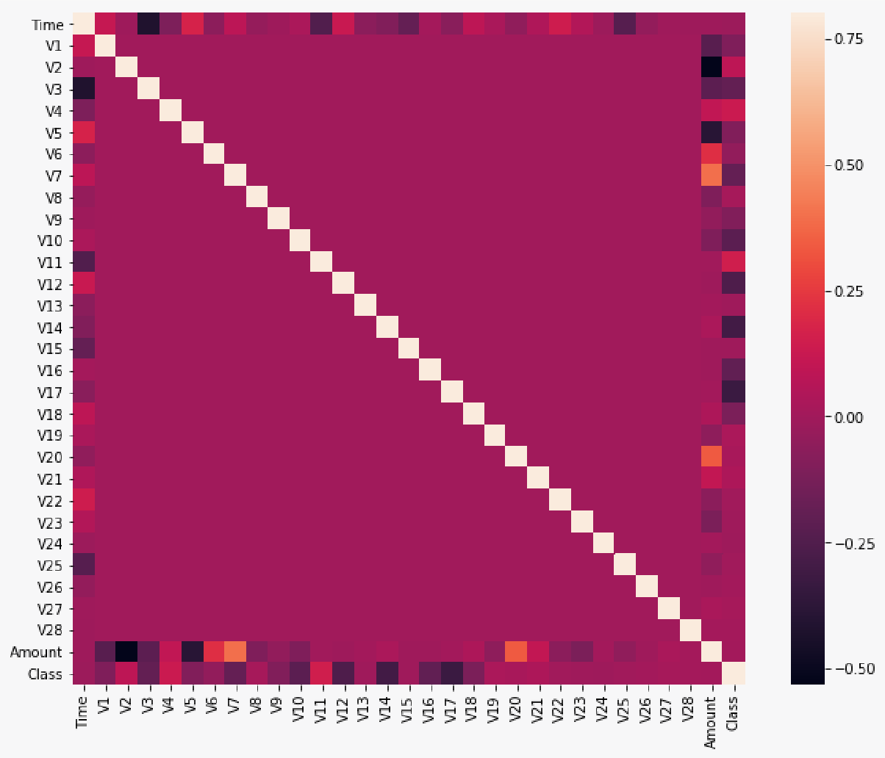
Fraud Cases: 25
Valid Transactions: 7947
corrmat = data.corr()
fig = plt.figure(figsize = (12, 9))
sns.heatmap(corrmat, vmax = .8, square = True) plt.show()

