Slide 1
A SUSPICIOUS FINANCIAL TRANSACTION DETECTION MODEL USING AUTOENCODER AND RISK-BASED APPROACH
Presented By
PRAVEEN KUMAR.D (411821104007) KAVIYAN.V (411821104014)
KANTHAPRIYA.R (411821104309)
GUNALAN.K (411821104009)
Under The Guidance of
Ms.R. PRABA, M.E,
Assistant Professor
Department of Computer Science And Engineering
RRASE COLLEGE OF ENGINEERING
Vanchuvancheri, Padappai,
Tambaram

Slide 2
OUTLINE
Abstract
Introduction
Literature Review
Existing System
Proposed System
Software and Hardware requirements
Module Description
Project Implementation
Results
Future Enhancements
Conclusion
References

Slide 3
ABSTRACT
Detection and prevention of fraudulent transactions in E-commerce platforms have always been the focus of transaction security systems. However, due to the concealment of e-commerce, it is not easy to capture attackers solely based on the historic order information.
Many researches try to develop technologies to prevent the frauds, which have not considered the dynamic behaviors of users from multiple perspectives. This leads to an inefficient detection of fraudulent behaviors.
To this end, this project implements the Risk-Based Authentication and Deep Neural Networks algorithms by combining internal control risk factors with the existing Anti-Money Laundering algorithms.
Model selection is performed on the base of Proof of Concept data, and Autoencoder is found to be the most suitable model for unsupervised learning. The predictive model aims to provide accurate predictions for new data, that is, data not used during model training.
The objective is to enhance the generalization performance of the predictive model. The predictive model includes hyperparameters that are closely aligned with the training data.

Slide 4
INTRODUCTION
Financial fraud, including money laundering and unauthorized access, poses significant challenges to financial institutions globally.
Traditional rule-based systems struggle to adapt to the dynamic nature of fraudulent activities, often resulting in high false positives and negatives. Machine Learning and Deep Learning techniques offer innovative solutions to these challenges.
Autoencoders, a type of unsupervised neural network, are particularly suited for anomaly detection. By learning compressed representations of normal transaction data, autoencoders can efficiently detect deviations indicative of fraudulent activity.
Coupled with a risk-based evaluation framework, the proposed system prioritizes high-risk transactions for further investigation, thereby optimizing resources and reducing manual effort.
This PPT outlines the development and implementation of a Suspicious Financial Transaction Detection Model using an autoencoder and a risk-based approach discussing its methodology, advantages, and potential for real-world application.

Slide 5
LITERATURE REVIEW
Title | Author(s) | Year | Key Findings
A Survey on Machine Learning for Financial Fraud Detection | Smith, J., & Brown, K. | 2021 | This paper reviews various machine learning techniques used to detect financial fraud, highlighting their effectiveness in identifying suspicious transactions.
Deep Learning Models for Fraudulent Transaction Detection | Lee, M., & Patel, R | 2022 | The study explores deep learning- based fraud detection models, discussing their performance in real-world banking scenarios.
Risk-Based Approach for Money Laundering Detection | Gupta, A., & Mehta, S. | 2020 | This paper examines the use of a risk-based approach in AML systems, focusing on transaction monitoring and customer risk assessment.
Autoencoder-Based Anomaly Detection in Financial transactions | Chen, Y., & Kumar, P. | 2023 | The study highlights the effectiveness of autoencoder in unsupervised fraud detection by learning transaction patterns and identifying anomalies.

Slide 6
LITERATURE REVIEW
Title | Author(s) | Year | Key Findings
Fraud GT: Graph Transformer Model for Fraud Detection | Wang, Y., & Li, J. | 2024 | This paper introduces the Fraud GT, a graph transformer model that enhances fraud detection in financial transaction graphs, improving efficiency over GNNs.
Graph-Based Fraud Detection in Banking Transactions | Zhang, L., & Kim, H. | 2022 | The research explores the use of graph-based models for fraud detection, identifying hidden links between suspicious transactions.
Federated Learning for Anti-Money Laundering Systems | Taylor, P., & Das, A. | 2023 | This paper discusses how federated learning enables collaborative fraud detection across banks while preserving data privacy.
Reinforcement Learning for Fraudulent Transaction Detection | Bose, N., & Roy, K. | 2021 | The research applies reinforcement learning to adaptively detect evolving fraud patterns in real-time financial transactions.

Slide 7
EXISTING SYSTEM
Traditional financial fraud detection systems predominantly rely on:
Rule-Based Detection: Predefined rules flag suspicious transactions based on thresholds like transaction amount or frequency.
Statistical Models: Utilize historical data to calculate probabilities and flag anomalies.
Manual Monitoring: Teams manually review flagged transactions for suspicious patterns.
While these systems have been effective in some cases, they face significant limitations:
High false positives and negatives due to static rules.
Inability to adapt to new fraud techniques.
Resource-intensive manual review processes.
Moreover, these systems often lack scalability and struggle to process large volumes of transactional data in real time.

Slide 8
    DISADVANTAGES OF EXISTING SYSTEMS
      High False Positives - Legitimate transactions are frequently flagged, leading to unnecessary delays and customer dissatisfaction.
Example : A customer buying an expensive wedding ring gets blocked to a sudden
high - value transaction rule, causing frustration and potential loss of
business.
      Static Rules - Fraudsters can easily circumvent predefined thresholds by adapting their methods.
      Example: Fraudsters exploit rule limitations by making multiple small transactions.
      Scalability Issues - Rule-based systems are not designed to handle the exponential growth in transaction data.
Example: Transaction volumes spike, overwhelming rule-based systems and
causing delays in fraud checks.
      Resource Intensive - Manual reviews demand significant time and effort, diverting resources from other critical tasks.

Slide 9
PROPOSED SYSTEM
Autoencoder for Anomaly Detection:
  Trains on normal transactional data to learn a compressed representation of legitimate patterns. Flags transactions with high reconstruction errors as anomalies.
Risk-Based Approach:
  Evaluates flagged anomalies using a scoring system based on parameters like transaction location, time, frequency, and monetary value. Prioritizes high-risk anomalies for further investigation.
System Integration:
  A dashboard provides real-time monitoring and alerts for suspicious transactions. Feedback loops update the model with new data to improve accuracy.
Unsupervised Anomaly Detection: The autoencoder model learns the normal patterns in financial transaction data by encoding it into a compressed format and reconstructing it. Transactions with high reconstruction errors indicate deviations from normal behavior and are flagged as potential anomalies.
Risk-Based Transaction Evaluation: Each flagged anomaly is further analyzed using a risk assessment framework. Parameters such as transaction size, frequency, geographic origin, and account behavior history are used to assign a risk score. Transactions exceeding a predefined risk threshold are escalated for manual review or automated alerts.

Slide 10
Feedback Mechanism for Continuous Learning: A feedback loop ensures that the system
adapts over time. False positives and negatives are used to fine-tune both the autoencoder
model and the risk evaluation framework, making the system increasingly accurate.
ADVANTAGES
Outlier Removal: Detects and removes extreme values in the dataset to avoid skewed model training.
Feature Normalization: Ensures all transaction features are on a comparable scale to improve model accuracy.
Dimensionality Reduction: Reduces noise by selecting only the most relevant attributes for transaction analysis.

Slide 11
SYSTEM REQUIREMENTS
SOFTWARE REQUIREMENTS
Operating System : Windows 11
Programming language : Python
Tool : Python 3.6
Front End : Python anaconda script
Python IDE : Jupyter

Slide 12
SYSTEM REQUIREMENTS
HARDWARE REQUIREMENTS
Processor : Intel I5
Hard Disk : 128GB
RAM : 16GB
Speed : 5.3GHz

Slide 13
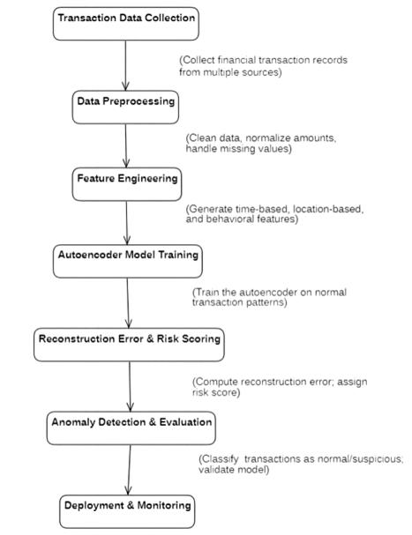
ARCHITECTURE
The system collects and processes financial transaction data, then trains an autoencoder model to learn normal patterns.
The trained model detects suspicious transactions by identifying anomalies and is deployed for real-time monitoring.

Slide 14
MODULES
Module List
Data Collection and Preprocessing
Autoencoder-Based Anomaly Detection
Risk Scoring Framework
Alert and Monitoring System
Feedback and Model Updating

Slide 15
MODULE DESCRIPTION
Data Collection and Preprocessing:
This module focuses on gathering transactional data from various sources, such as banking systems, online payment platforms, and financial databases. Here, we used Customer Transaction dataset. The collected data undergoes thorough preprocessing to ensure it is suitable for training the machine learning model.
Data Sources: Includes structured financial data such as transaction IDs, timestamps, account details, transaction amounts, locations, and categories.
Cleaning: Handles missing values, duplicates, and outliers to improve data quality.
Normalization: Scales features like transaction amounts and frequencies to a uniform range, ensuring that no single feature dominates the model.

Slide 16
MODULE DESCRIPTION
Feature Engineering: Extracts and transforms raw data into meaningful attributes such as transaction velocity, time of day, and account usage history to enhance model learning.
Autoencoder-Based Anomaly Detection:
Employs an unsupervised learning model to learn patterns in legitimate data.
Flags transactions with high reconstruction errors.
Risk Scoring Framework:
Assigns risk scores based on transaction parameters.
Ranks flagged anomalies for prioritization.
Alert and Monitoring System:
Displays suspicious transactions on a user-friendly dashboard.
Sends real-time alerts to relevant stakeholders.

Slide 17
MODULE DESCRIPTION
Feedback and Model Updating:
Incorporates user feedback into the training process for continuous improvement.
Model Architecture: The autoencoder consists of an encoder that compresses input data into a latent representation and a decoder that reconstructs the original input. Reconstruction errors are analyzed to identify anomalies.
Training: The model is trained exclusively on legitimate transactional data to learn the patterns and reduce false positives.
Detection: Transactions with high reconstruction errors are flagged as suspicious, indicating deviations from normal behavior.

Slide 18
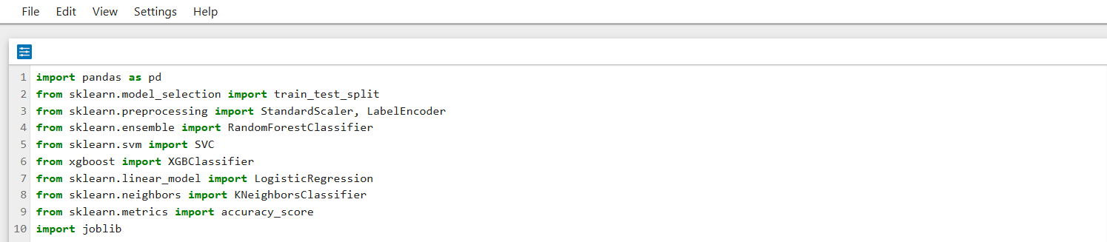
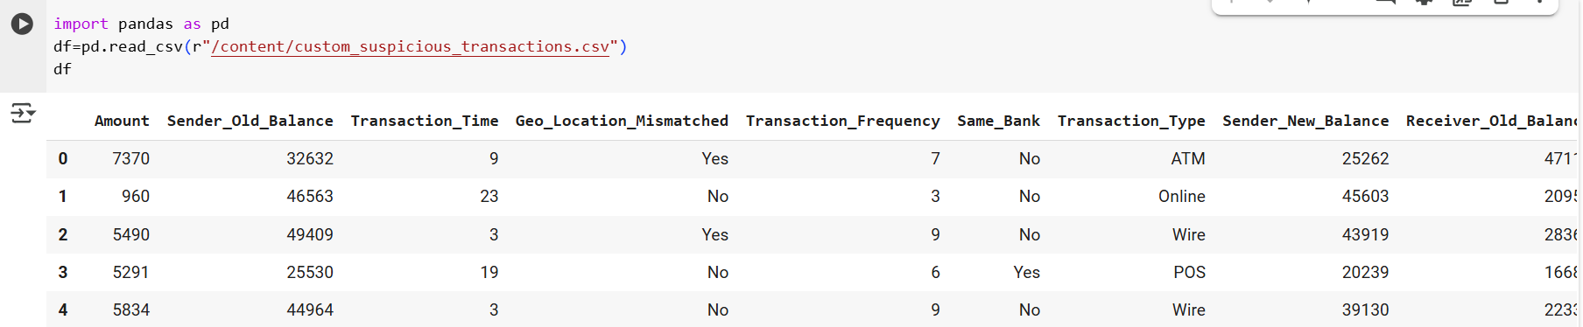
PROJECT IMPLEMENTATION
Importing required libraries and modules
Importing dataset

Slide 19
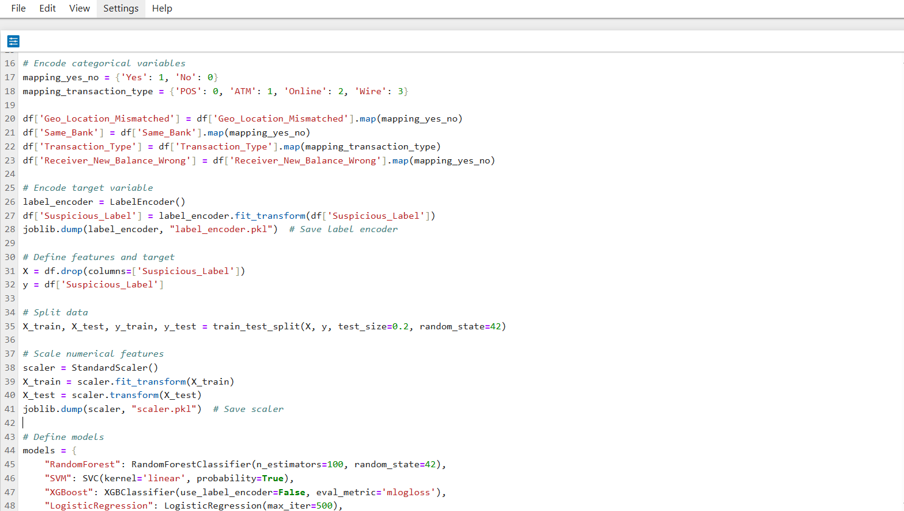
PROJECT IMPLEMENTATION

Slide 20
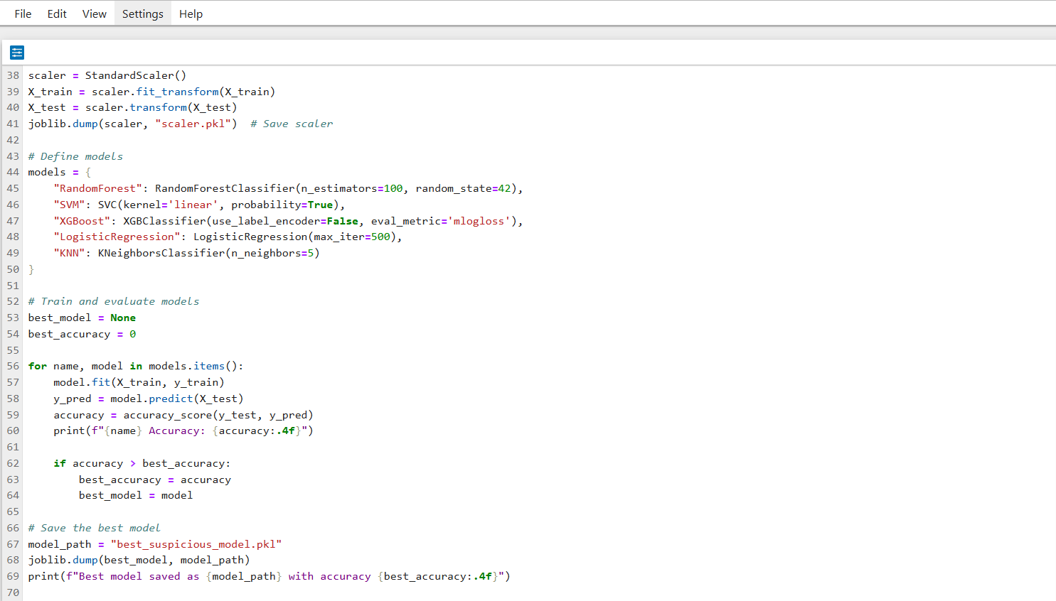
PROJECT IMPLEMENTATION

Slide 21
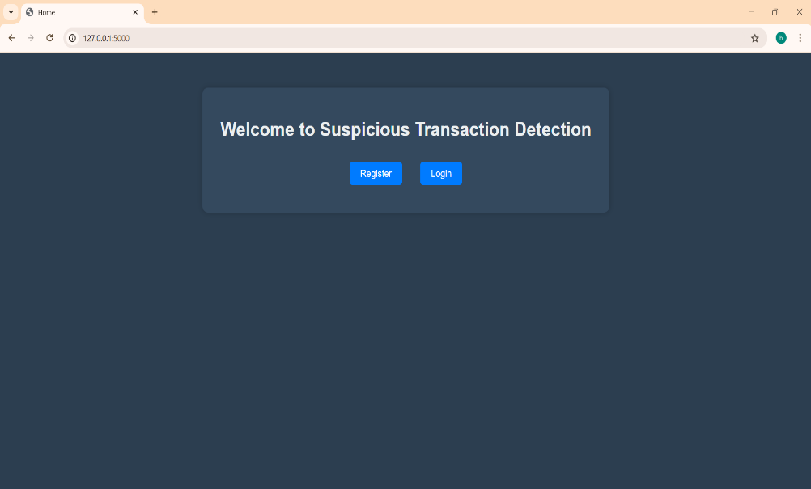
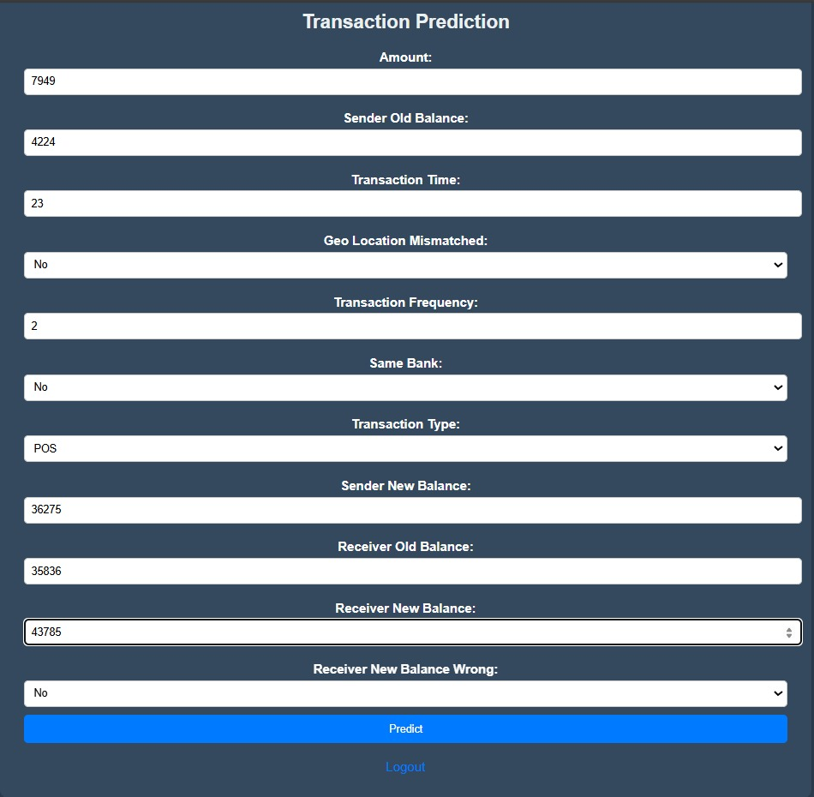
RESULTS

Slide 22
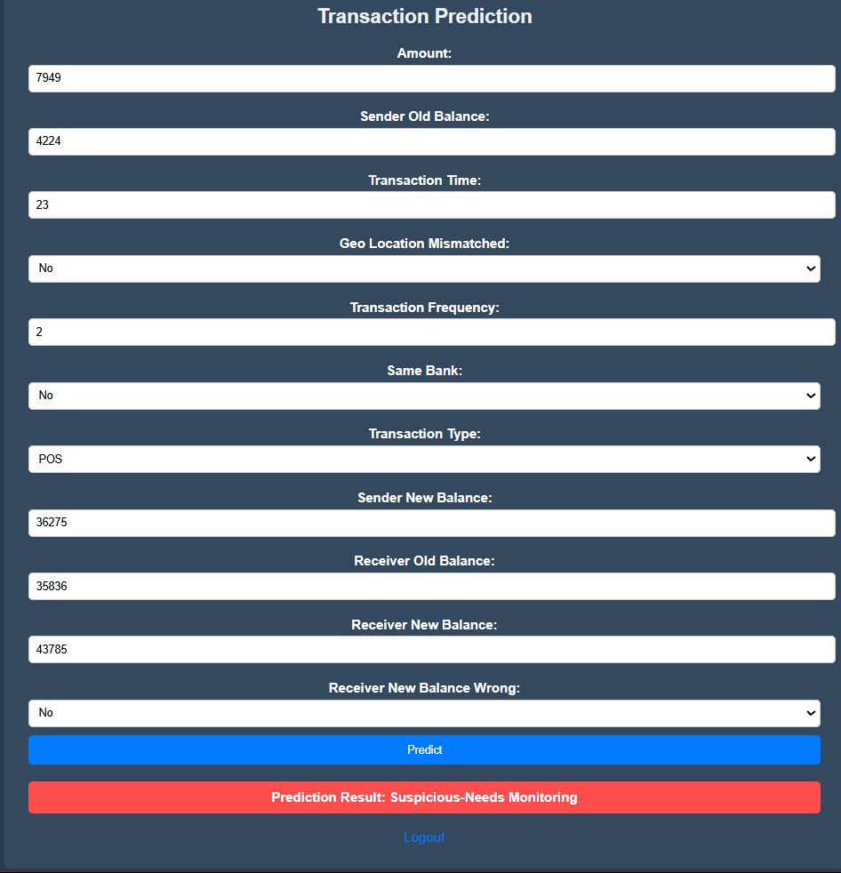
RESULTS

Slide 23
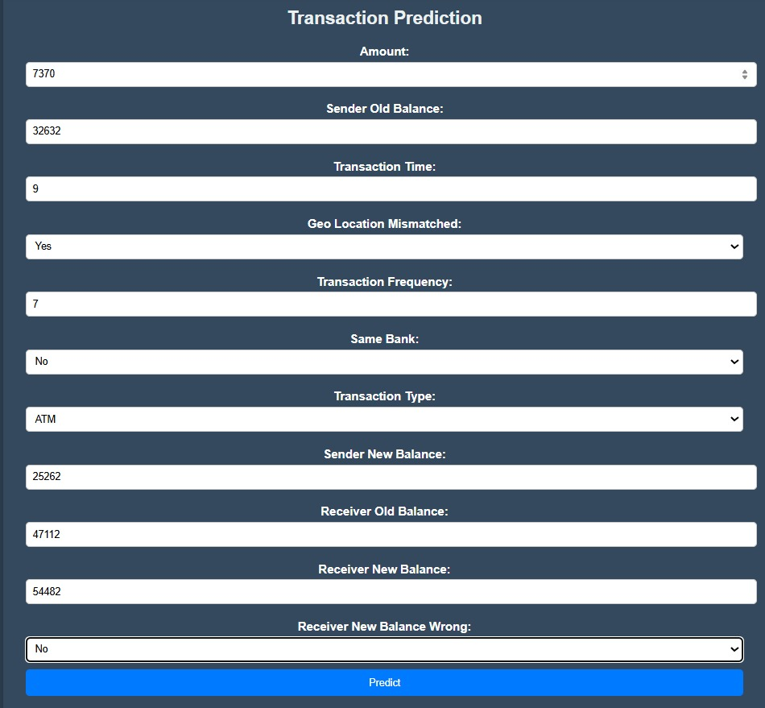
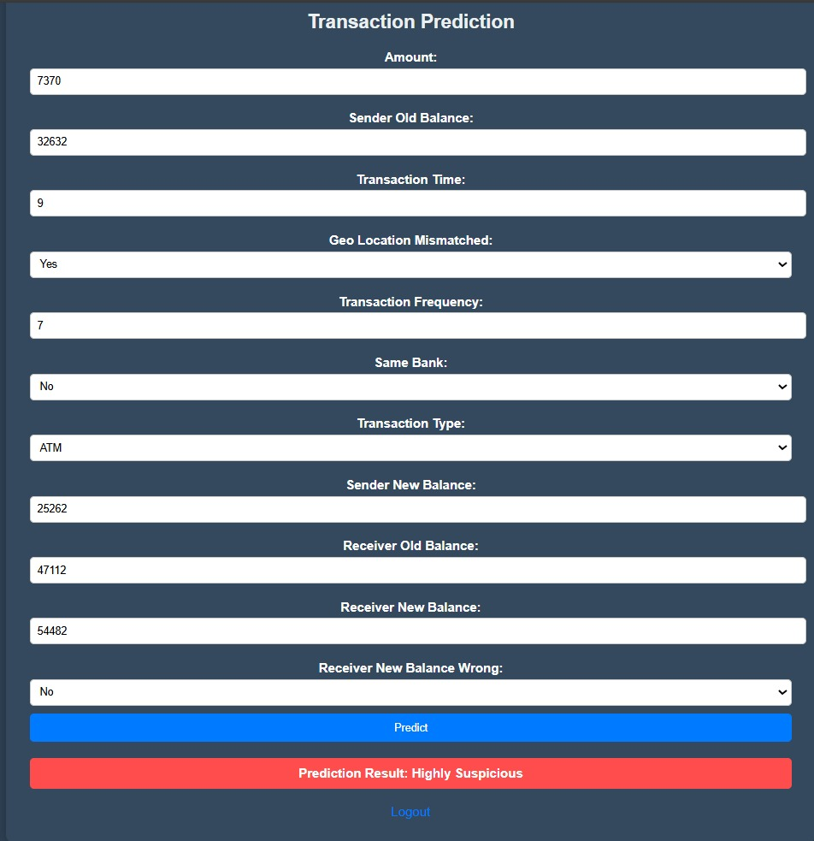
RESULTS

Slide 24
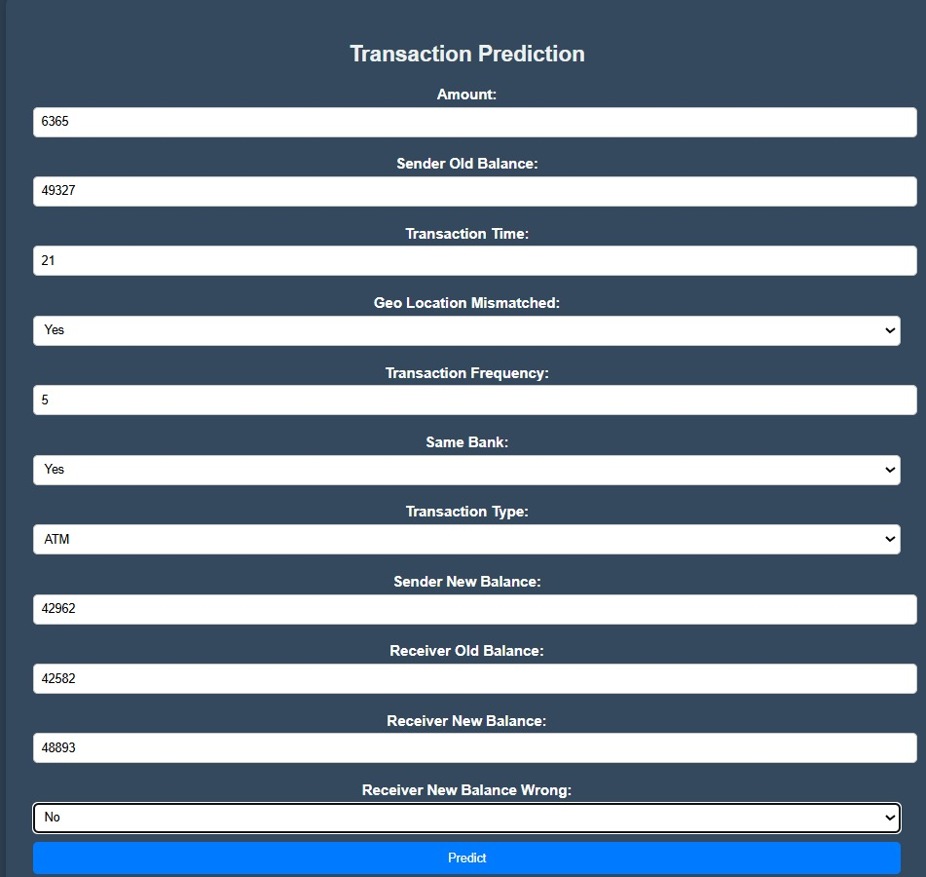
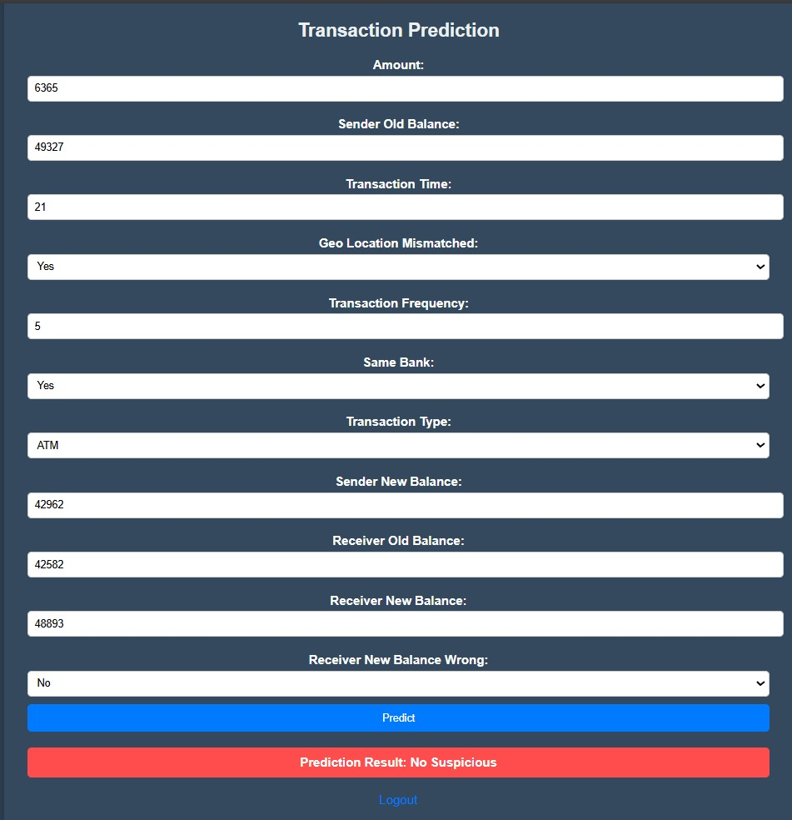
RESULTS

Slide 25
Boost Model Efficiency
FUTURE ENHANCEMENTS
Boost Model Efficiency
Make the model faster and more reliable by cutting delays, checking how complex it is, and testing its performance to find areas for improvement.
Enhance Risk Assessment
Improve fraud detection by using varied data from different industries, creating fake fraud examples for training, and working with other organizations to share insights.
Ensure Explainable AI
Keep AI decisions clear and easy to understand, use flexible risk scoring, and continuously update the model to adapt to new fraud tricks.
Adopt Advanced Technologies
Use edge computing for quick, on-the-spot fraud detection and NLP (Natural Language Processing) to scan text data (like customer complaints) for hidden clues.
Support Compliance & Scalability
Follow regulations easily with adjustable compliance tools and standard APIs, allowing safe data sharing and making the system work globally.

Slide 26
CONCLUSION
The proposed model overcomes the shortcomings of conventional fraud detection systems by combining autoencoder-based anomaly detection with a risk-based assessment approach. This hybrid framework enables precise, real-time identification of suspicious financial activities while efficiently allocating resources and minimizing manual intervention. By harnessing machine learning, the system continuously adapts to emerging fraud tactics, enhancing scalability and operational efficiency to provide a strong defense against financial fraud. Future advancements, such as explainable AI and blockchain integration, promise to further strengthen its capabilities, ensuring its continued relevance in the evolving financial sector.
Integrating anomaly detection through autoencoders with a risk-based evaluation mechanism, the model introduces a revolutionary approach to fraud identification. Unlike traditional methods, this solution is dynamic, scalable, and equipped to respond to evolving fraud strategies. Its ability to function in real time allows for swift action, mitigating financial and reputational risks for organizations

Slide 27
REFERENCES
[1] H. Zhang and W. K. Chan, ‘‘Apricot: A weight-adaptation approach to fixing deep learning models,’’ in Proc. 34th IEEE/ACM Int. Conf. Automated Softw. Eng. (ASE), Nov. 2019, pp. 376–387.
[2] W.Fang,X.Li,P.Zhou,J.Yan,D.Jiang,andT.Zhou,‘‘Deeplearninganti fraud model for Internet loan: Where we are going,’’ IEEE Access, vol. 9, pp. 9777–9784, 2021.
[3] C. Dhasarathan, M. K. Hasan, S. Islam, S. Abdullah, U. A. Mokhtar, A. R. Javed, and S. Goundar, ‘‘COVID-19 health data analysis and personal data preserving: Ahomomorphicprivacyenforcementapproach,’’ Comput. Commun., vol. 199, pp. 87–97, Feb. 2023.
[4] T. Verma and A. Misra, ‘‘Financial fraud detection in financial institutions usingtwo-layer-deeplearningandself-improvedhoneybadgeralgorithm,’’ J. Int. Finance Econ., vol. 23, no. 3, pp. 30–54, Oct. 2023.
[5] Z. Chen, W. M. Soliman, A. Nazir, and M. Shorfuzzaman, ‘‘Varia tional autoencoders and Wasserstein generative adversarial networks for improving the anti-money laundering process,’’ IEEE Access, vol. 9, pp. 83762–83785, 2021

Slide 28
Thank You

