Slide 1
Failed Banking Transaction Analysis
By Praveen Kumar

Slide 2
Project Objective
• Ingest banking transaction data from multiple CSVs into Google Cloud.
• Clean and merge the data using PySpark on a Dataproc cluster.
• Filter failed transactions and store them in Cloud SQL.
• Enable advanced analysis and visualization using BigQuery.

Slide 3
Tools & Technologies Used
• Google Cloud Storage (GCS)
• Cloud SQL (MySQL)
• Cloud Dataproc (PySpark)
• PySpark & Spark SQL
• Google BigQuery
• gsutil & gcloud CLI

Slide 4
Architecture Overview
1. Upload CSVs to Cloud Storage bucket.
2. Submit PySpark job on Dataproc to clean and merge the data.
3. Store cleaned data in GCS and filter failed transactions.
4. Insert failed transactions into Cloud SQL.
5. Import into BigQuery for analytics.

Slide 5
Step-by-Step Workflow
• Step 1: Upload 15 CSVs from 3 cities, 5 branches each to GCS.
• Step 2: Create Cloud SQL instance and 'bank_db' database.
• Step 3: Launch Dataproc single-node cluster.
• Step 4: Submit PySpark job to clean null/blank data.
• Step 5: Submit PySpark job to filter 'FAILED' transactions.
• Step 6: Load the final data into Cloud SQL.
• Step 7: Import into BigQuery for querying.

Slide 6
Key Outputs
• Cleaned transaction data stored in GCS.
• Failed transactions stored in Cloud SQL table 'failed_transactions'.
• Structured and queryable data imported into BigQuery.
• Ready for visualization and dashboarding.

Slide 7
Key Learnings
• Real-world GCP services integration and orchestration.
• Writing PySpark jobs for data cleaning and transformation.
• Efficient use of GCS, Cloud SQL, and BigQuery.
• Working with CLI tools like gsutil and gcloud.

Slide 8
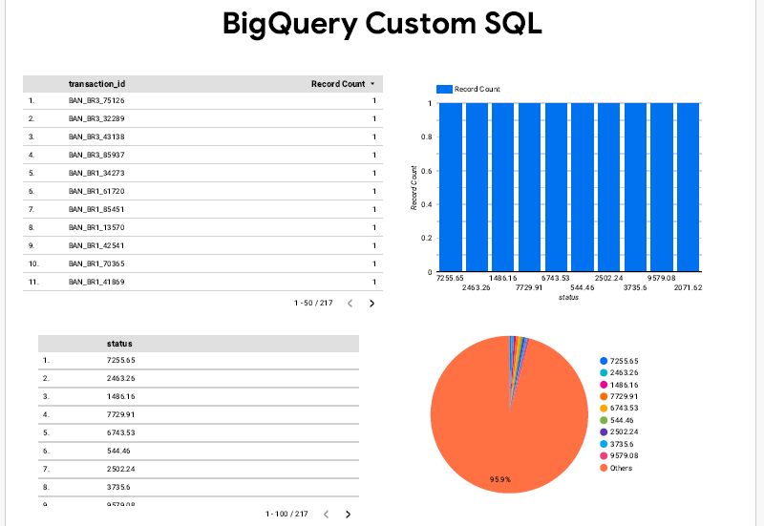

Slide 9
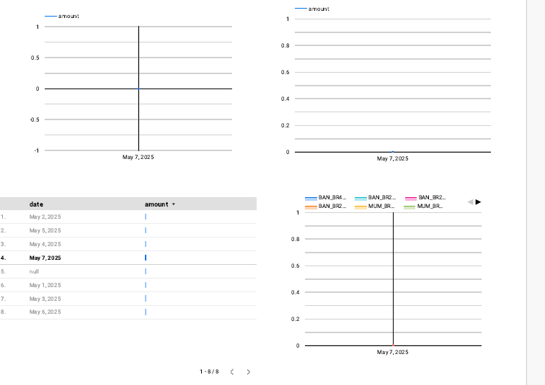

Slide 10
Conclusion
This project demonstrates the ability to process and manage real-time
banking transaction data using scalable and modern cloud services.
It enables deeper insights into failure patterns for decision-making.

Slide 11
Thank You
Presented by: Praveen Kumar

