Slide 1
BATCH NO --- C1
EARLY DETECTION OF PARKINSON’S DISEASE
USING
MACHINE LEARNING
Team Guide
Dr.R.SATYA PRASAD
PROFESSOR & DEAN(R&D)
Team
S.Saba yasmeen 208T1A05H4
Y.Priyanka 208T1A05I8
R.Alekhya 208T1A05J0
T.Sowmya 208T5A05H9
B.Praveen kumar 208T1A05D6
U.Sravanthi 208T1A05I5

Slide 2
ABSTRACT
Parkinson's disease is a disorder of the central nervous system that affects movement,often including tremors.Nerve cell damage in the brain causes dopamine levels to drop,leading to the symptoms of Parkinson’s. According to the statistics of World Health Organization, the prevalence of PD has doubled in the past 25 years.Global estimates in 2019 showed over 8.5 million individuals with PD.Current estimates suggests that,in 2019,PD resulted in 5.8 million disability adjusted life years,an increase of 81% since 2000 and caused 3,29,000 deaths.According to Union Ministry and Family Healthcare statistics PD is projected to increased
by 19% by 2050.
Parkinson’s disease is a cumulative disorder in the nervous system.PD patients may experience difficulty in movement and speaking due to damages in certain parts of the brain. In this study,researchers have used two types of ensemble learning methods: Stacking Classifier and Voting Classifier,which are potential methods of PD detection using machine learning.Stacking classifier method obtained accuracy of 92.2% and voting classifier obtained accuracy of 83.57% respectively.This study would help come out with higher detection accuracy for medical applications such as this chronic disease.
In our project we are using XGB(extreme gradient boosting algorithm) to detect Parkinson's disease.It has become one of the most popular and widely used machine learning algorithms due to its ability to handle large datasets and its ability to achieve a state of high accuracy in machine learning. Along with this we are also using a Random forest algorithm which predicts the output with high accuracy.

Slide 3
INTRODUCTION
Parkinson's disease is a progressive neurological disorder that affects movement and often includes symptoms like tremors, bradykinesia (slowness of movement), rigidity, and postural instability.
Early detection and accurate diagnosis of Parkinson's disease are crucial for effective treatment and management.
Provides an opportunity for patients to access appropriate treatments and therapies.
Increases the chances of maintaining a higher quality of life and slowing down disease progression.
In this project, we will explore how Machine Learning (ML) techniques can aid in the early detection of Parkinson's disease.
Machine Learning involves the development of algorithms that can learn patterns from data.
ML algorithms can identify intricate patterns within complex datasets that might not be easily recognizable to human observers.

Slide 4
EXISTING SYSTEM
Parkinson's disease detection using stacking and voting classifiers is an approach that leverages ensemble learning techniques to enhance the accuracy of identifying individuals with Parkinson's disease. Ensemble learning combines the predictions of multiple machine learning models to create a more robust and accurate final prediction.
A stacking classifier is an ensemble machine learning technique that combines multiple base classifiers to create a more powerful and accurate predictive model. The concept behind stacking is to leverage the diverse strengths of different algorithms to improve overall prediction performance.
A voting classifier is an ensemble machine learning technique that combines the predictions of multiple base classifiers to make a final prediction. It's a simpler form of ensemble learning compared to stacking, but it can still improve predictive accuracy by leveraging the collective decisions of different algorithms.

Slide 5
LITERATURE SURVEY
[1] akmak, Y. O¨. ; O¨ lc¸ek, S.C.; O¨ zsoy, B.; Go¨kc¸ay, D.” Quantitative Measurement of Bradykinesia in Parkinson’s Disease Using Commercially Available Leap Motion.” Biosignals, Proceedings of the 11th International Joint Conference on Biomedical Engineering Systems and Technologies; Funchal: Madeira, Portugal, 2018; Volume 3, pp. 227–232. 2018. Parkinson’s Disease (PD) is a neurodegenerative disease caused by the depletion of dopamine in the brain. Tremor, bradykinesia, rigidity and postural stability are the four major symptoms. Like other symptoms, bradykinesia causing unnatural stillness/slowness in motions affects the daily life of the patients. The levels of these symptoms are clinically assessed by a scoring system based on Unified Parkinson's Disease Rating Scale (UPDRS). However, UPDRS relies on the visual observations of physicians rather than a test based on quantitative measurements. This makes it not only difficulty to repeat but also subjective. Because of these two major disadvantages, researchers build custom devices for their studies. But this leads to the reliability issues and non-standard measurements. Thus, 24 PD patients were bilaterally UPDRS III (motor subsection) scored and recorded for finger motion (pinching) by using commercially available off-the-shelf (COTS) product called Leap Motion. The various features extracted from recordings and UPDRS III scores were analyzed for correlation. After the analysis, a linear model was created to estimate UPDRS III score. The study revealed that Leap Motion, a COTS device, can be used to estimate bradykinesia of a patient with PD

Slide 6
[2]Adams, WR. “The detection of hand tremor through the characteristics of finger movements while typing.” Posted August 5, 2018. bioRxiv 385286; doi:https://doi.org/10.1101/385286. Accessed online September 17, 2018., 2018.
Parkinson’s Disease (PD) is a neurodegenerative movement disease affecting over 6 million people worldwide. Current diagnosis is based on clinical and observational criteria only, resulting in a high misdiagnosis rate. Approximately 75% of people with PD have hand tremor, which can precede clinical diagnosis by up to 6 years. Previous studies have shown that early PD can be accurately detected from keystroke features while typing, and this study investigated whether tremor can be detected as well.
[3]Lonini, L., Dai, A., Shawen, N. et al. “Wearable sensors for Parkinson’s disease: which data are worth collecting for training symptom detection models.” npj Digital Med 1, 64 (2018) doi:10.1038/s41746-018-0071-z., 2018.
Deep learning algorithms that use data streams captured from soft wearable sensors have the potential to automatically detect PD symptoms and inform clinicians about the progression of disease. However, these algorithms must be trained with annotated data from clinical experts who can recognize symptoms, and collecting such data are costly. Understanding how many sensors and how much labeled data are required is key to successfully deploying these models outside of the clinic. Here we recorded movement data using 6 flexible wearable sensors in 20 individuals with PD over the course of multiple clinical assessments conducted on 1 day and repeated 2 weeks later.

Slide 7
[4]Yao, L., Brown, P., Shoaran, M., “Resting Tremor Detection in Parkinson’s Disease with Deep Learning and Kalman Filtering.”, 2018 IEEE Biomedical Circuits and Systems Conference (BioCAS). doi:10.1109/biocas.2018.8584721, 2018.
Adaptive deep brain stimulation (aDBS) is an emerging method to alleviate the side effects and improve the efficacy of conventional open-loop stimulation for movement disorders. However, current adaptive DBS techniques are primarily based on single-feature thresholding, precluding an optimized delivery of stimulation for precise control of motor symptoms. Here, we propose to use a Deep learning approach for resting-state tremor detection from local field potentials (LFPs) recorded from subthalamic nucleus (STN) in 12 Parkinson’s patients.
[5]Di Biase, Lazzaro et al., “Quantitative Analysis of Bradykinesia and Rigidity in Parkinson’s Disease.”, Frontiers in neurology vol. 9 121. doi:10.3389/fneur.2018.00121, 2018.
Background In the last decades, several studies showed that wearable sensors, used for assessing Parkinson’s disease (PD) motor symptoms and recording their fluctuations, could provide a quantitative and reliable tool for patient’s motor performance monitoring. Objective The aim of this study is to make a step forward the capability of quantitatively describing PD motor symptoms

Slide 8
PROPOSED SYSTEM
The algorithm that we are going to implement in our project are XGB classifier.
XGBoost (Extreme Gradient Boosting) is a powerful and widely used machine learning algorithm that has gained popularity for its high performance in various tasks, including classification, regression, and ranking. It's an ensemble learning method based on the gradient boosting framework. XGBoost builds multiple decision tree models sequentially, each addressing the errors of the previous model, and then combines their predictions to produce a final output.
The Random Forest algorithm is a popular machine learning technique that is used for both classification and regression tasks. It falls under the category of ensemble learning methods, where multiple individual models are combined to create a stronger overall model. Random Forest is known for its versatility, ease of use, and robust performance across a wide range of datasets.

Slide 9
EXTENSIONS MADE
In our proposed system we have used Random forest and XGB algorithms .we have used these algorithms for classification of data.
Now as an extension of the project we have also implemented CNN,RESNET and MOBILENET algorithms .we used these algorithms for feature extraction.
Convolution Neural Networks:
CNNs work by applying a series of convolution and pooling layers to an input image or video. Convolution layers extract features from the input by sliding a small filter, or kernel, over the image or video and computing the dot product between the filter and the input. Pooling layers then downsample the output of the convolution layers to reduce the dimensionality of the data and make it more computationally efficient.
RESNET:
The ResNet architecture is usually divided into four parts, each containing multiple residual blocks with different depths. The first part of the Network comprises a single convolutional layer, followed by max pooling, to reduce the spatial dimensions of the input. The second part of the Network contains 64 filters, while the third and fourth parts contain 128 and 256 filters, respectively. The final part of the Network consists of global average pooling and a fully connected layer that produces the output.
MOBILENET:
MobileNet is a type of convolutional neural network designed for mobile and embedded vision applications. They are based on a streamlined architecture that uses depthwise separable convolutions to build lightweight deep neural networks that can have low latency for mobile and embedded devices.

Slide 10
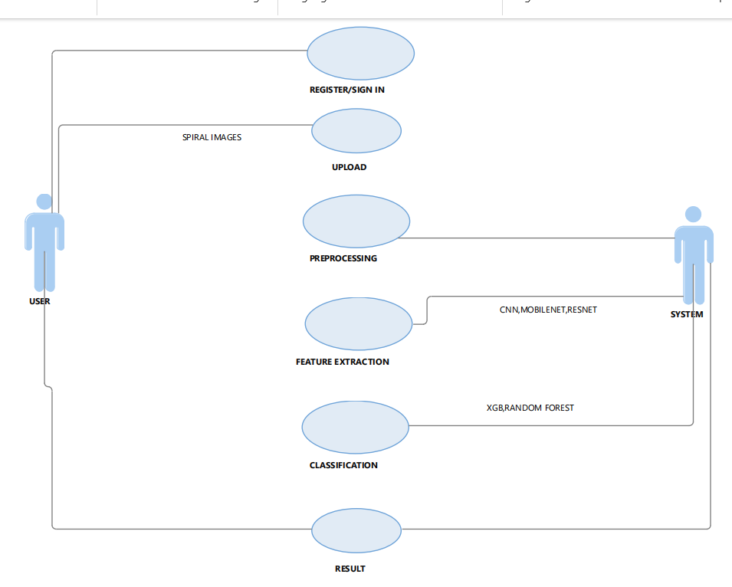
USE CASE DIAGRAM

Slide 11
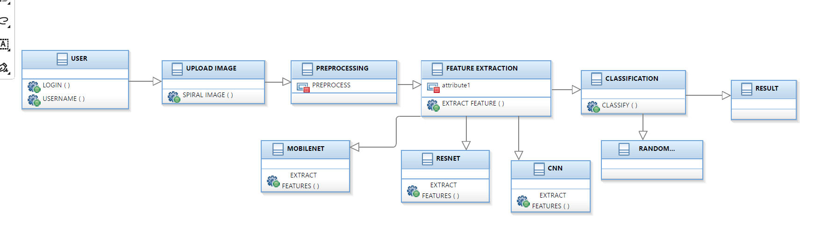
CLASS DIAGRAM

Slide 12
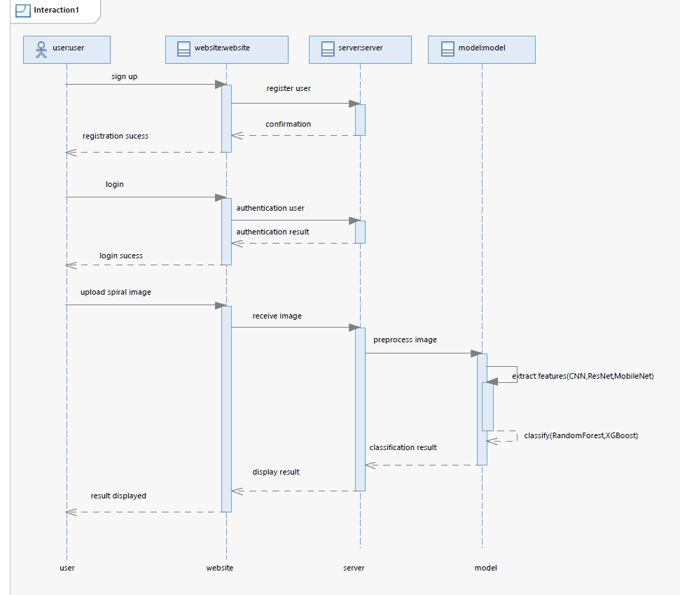
SEQUENCE DIAGRAM

Slide 13
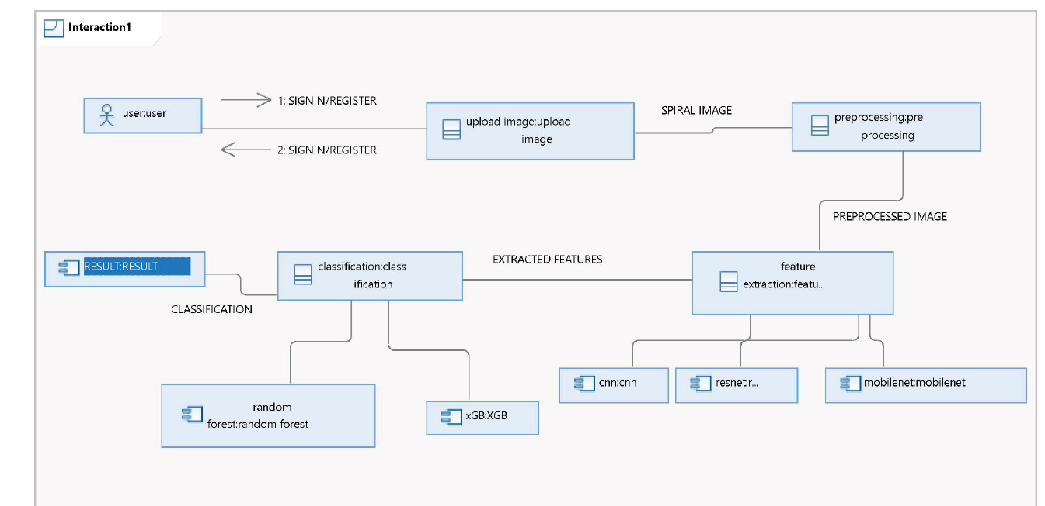
COLLABORATION DIAGRAM

Slide 14
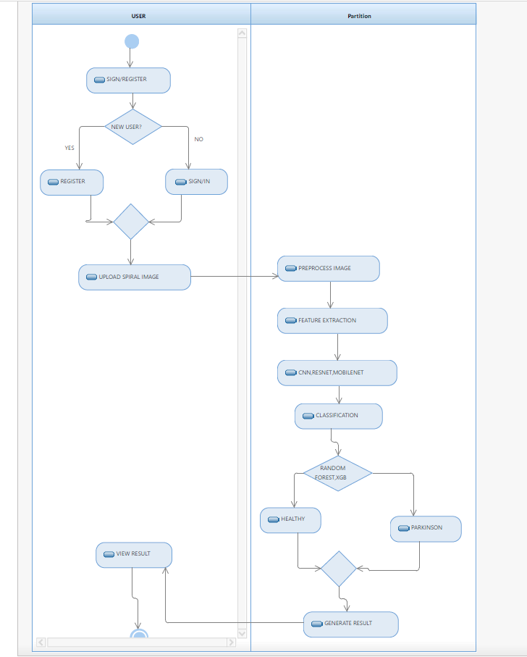
ACTIVITY DIAGRAM

Slide 15
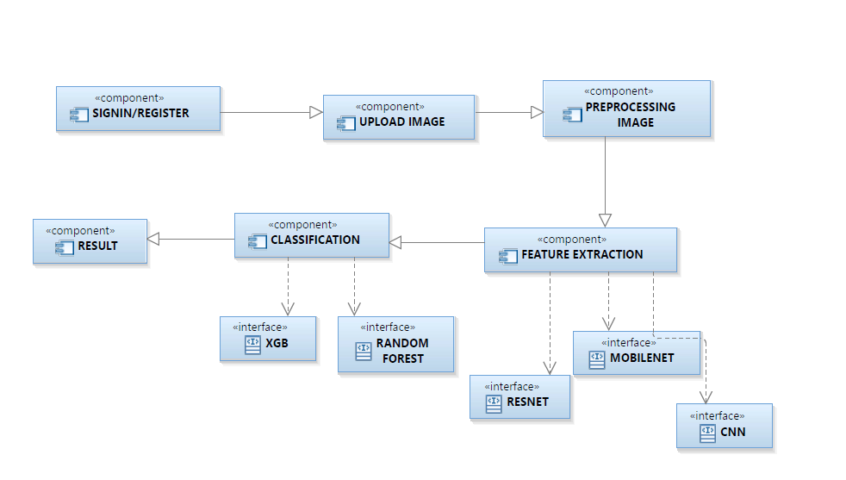
COMPONENT DIAGRAM

Slide 16
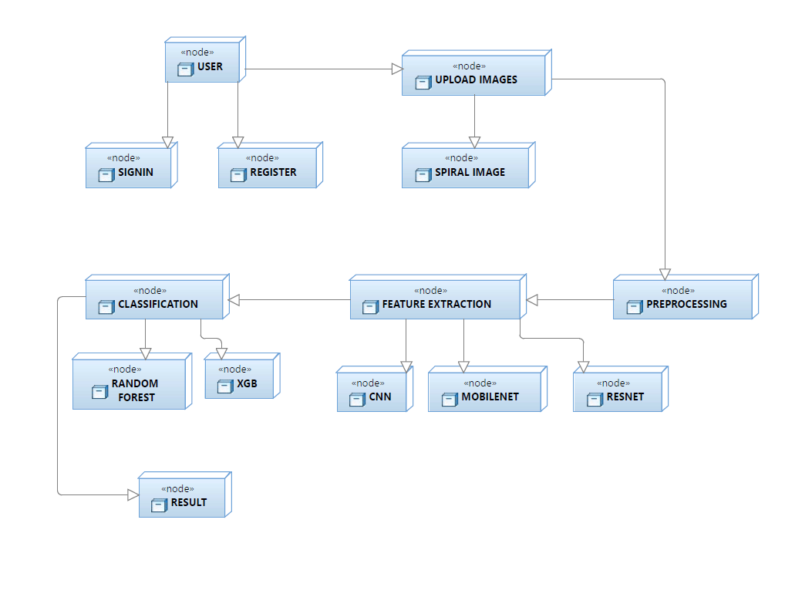
DEPLOYMENT DIAGRAM

Slide 17
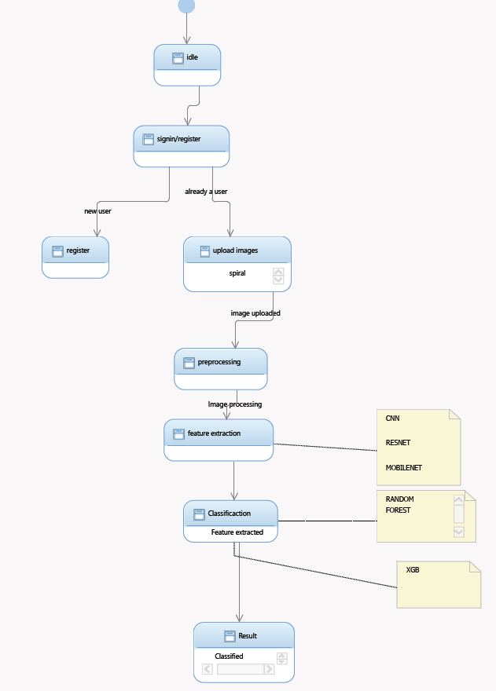
STATE MACHINE DIAGRAM

Slide 18
SYSTEM REQUIREMENTS
Hardware requirements:
I5 PROCESSOR
16GB RAM
LAPTOP OR DESKTOP
512 SSD
Software requirements:
NUMPY
PANDAS
SKLEARN
JUPYTER NOTEBOOK
FLASK
PYTHON3
PIP
VISUAL STUDIO CODE
ANY WEB BROWSER

Slide 19
ALGORITHMS
CNN ALGORITHM
STEP-1:Image Data Generation:
The ImageDataGenerator class from Keras is used for real-time data augmentation and preprocessing.
It generates batches of tensor image data with real-time data augmentation.
In this case, images are rescaled by dividing pixel values by 255 and split into training and validation sets.
STEP-2:Splitting the data and resizing the images :
The flow_from_directory method generates batches of data from images stored in a directory.
It automatically infers the labels from the directory structure.
Two generators are created, train_generator and test_generator, for the training and validation subsets, respectively.
The target size is set to (256, 256), and the batch size is set to 20. Images are resized to fit this size during training.
STEP-3:Model Architecture Setup:
The model is created as a sequential model, meaning layers are added sequentially.
The first layer is a convolutional layer (Conv2D) with 32 filters, each having a kernel size of (5, 5), using the ReLU activation function.
The input shape is (256, 256, 3), indicating the height, width, and channels (RGB) of the input image.
Another convolutional layer with similar parameters follows, maintaining the same padding.

Slide 20
A max-pooling layer (MaxPool2D) with a pool size of (2, 2) is added to downsample the feature maps obtained from convolutional layers.
This pattern repeats with two more pairs of convolutional layers followed by max-pooling layers, gradually increasing the number of filters to 64 in the subsequent layers.
STEP-4:Flatten and Dense Layers:
The Flatten layer is added to convert the 2D feature maps into a 1D feature vector, preparing it for input into a fully connected Dense layer.
A fully connected Dense layer with 256 neurons and ReLU activation function is added.
Finally, a Dense layer with 2 neurons equal to the number of classes and softmax activation function is added, which outputs the probabilities for each class ,in this case, 2 classes: Parkinson's and healthy.
STEP-5:Model Summary:
The summary() method is called on the model to display a summary of its architecture, including details like layer type, output shape, and number of parameters.
STEP-6:Model Compilation:
The compile() method is called on the model to configure its learning process.
optimizer="adam": Adam optimization algorithm is chosen as the optimizer. Adam is an adaptive learning rate optimization algorithm that is commonly used for training deep neural networks.

Slide 21
loss="categorical_crossentropy": Categorical cross-entropy is chosen as the loss function.
It is commonly used for multi-class classification problems.
metrics=['accuracy', precision, recall, sensitivity, specificity]: Metrics to monitor during training are specified.
The metrics include accuracy, precision, recall, sensitivity, and specificity.
These metrics help in evaluating the performance of the model during training and validation.
STEP-7:Model Training:
The fit() method is called on the model to train it on the training data (train_generator) for a specified number of epochs.
epochs=15: The number of epochs is set to 15, indicating that the entire training dataset will be passed through the network 15 times during training.
Validation_data=test_generator: The validation data (test_generator) is provided to evaluate the model's performance on unseen data after each epoch. This helps in monitoring the model's generalization ability and detecting overfitting.
STEP-8:Training History:
The fit() method returns a History object (hist in this case) that contains information about the training history, including loss and metrics values at each epoch.
This history object can be used to visualize the training progress, analyze the model's performance, and identify any issues such as overfitting or underfitting.

Slide 22
RESNET50 ALGORITHM
STEP-1:Image Data Preparation:
Define img_height and img_width as 256.
Set batch_size to 20.
Create an instance of ImageDataGenerator named train_datagen. This object will perform data augmentation and normalization. It also splits the data into training and validation sets using the validation_split parameter, where 30% of the data is used for validation.
Use flow_from_directory method to generate batches of data from images stored in a directory (data_dir). Two generators are created, train_generator
For the training subset and test_generator for the validation subset. Images are resized to (256, 256) and batched into groups of 20.
STEP-2:Base Model Setup:
Initialize the base model as ResNet50 using tf.keras.applications.ResNet50.
Specify input_shape as (256, 256, 3) indicating the height, width, and channels (RGB) of the input image.
Set include_top to False to exclude the fully-connected layers at the top of the network.
Initialize the weights with pre-trained ImageNet weights by setting weights to 'imagenet'.

Slide 23
STEP-3:Model Construction:
Create a Sequential model named model.
Add the base_model3 (ResNet50) as the first layer of the model.
Add a GlobalAveragePooling2D layer to reduce the spatial dimensions of the feature maps obtained from the base model.
Add a Dense layer with 64 neurons and ReLU activation function.
Add a BatchNormalization layer to normalize the activations of the previous layer.
Add a Dropout layer with a dropout rate of 0.2 to prevent overfitting.
Finally, add a Dense layer with 2 neurons and sigmoid activation function, which outputs the probabilities for each class (2 classes: Parkinson's and healthy).
STEP-4:Model Summary:
Call the summary() method on the model to display a summary of its architecture, including details like layer type, output shape, and number of parameters.

Slide 24
STEP-5:Model Compilation:
Compile the model using compile() method.
Use Adam optimizer.
Set loss function to categorical cross-entropy.
Specify metrics to monitor during training, including accuracy, precision, recall, sensitivity, and specificity.
STEP-6:Model Training:
Train the model using the fit() method.
Pass train_generator and test_generator as training and validation data, respectively.
Set the number of epochs to 15.

Slide 25
MOBILENET ALGORITHM
STEP-1:Image Data Generators Setup:
Two ImageDataGenerator objects, train_datagen and test_datagen, are initialized for data augmentation and preprocessing.
rescale=1./255: Pixel values of images are rescaled to be in the range [0, 1] to normalize them.
flow_from_directory method is used to generate batches of data from images stored in directories.
For the train_generator, images are loaded from the train_dir directory, and for the test_generator, images are loaded from the test_dir directory.
target_size=(img_height, img_width): Images are resized to the specified target size (256x256 pixels in this case).
batch_size=batch_size: The number of images in each batch is set to 20.
class_mode='categorical': The labels are provided in categorical format.
STEP-2:Base Model Initialization:
MobileNet is chosen as the base model for feature extraction. It is pre-trained on the ImageNet dataset and thus capable of extracting useful features from images.
input_shape=(img_height, img_width, 3): Specifies the input shape of the images (256x256 pixels with 3 channels for RGB).

Slide 26
include_top=False: Excludes the top (classification) layers of the MobileNet model, as they will be replaced with custom layers suited for the specific classification task.
weights='imagenet': Initializes the model with pre-trained weights from ImageNet.
STEP-3:LAYERS CLASSIFICATION:
A new Sequential model (model1) is created to build the classification layers on top of the base MobileNet model.
The base MobileNet model is added as the first layer of the Sequential model.
GlobalAveragePooling2D() layer is added to reduce the spatial dimensions of the feature maps to a vector by taking the average across the spatial dimensions.
Dense layer with 64 neurons and ReLU activation is added for further feature processing.
BatchNormalization() layer is added to normalize the activations of the previous layer, improving stability and speed up convergence during training.
Dropout(0.2) layer is added to prevent overfitting by randomly dropping 20% of the neurons during training.
Final Dense layer with 2 neurons and softmax activation is added for binary classification (2 classes: Parkinson's and healthy).
STEP-4:Model Summary:
summary() method is called on model1 to display a summary of its architecture, including details like layer type, output shape, and number of parameters.

Slide 27
STEP-5:Model Compilation:
The compile() method is called on model1 to configure its learning process.
optimizer='Adam': Adam optimizer is chosen for optimization during training. Adam is an adaptive learning rate optimization algorithm that is effective for training deep neural networks.
loss='categorical_crossentropy': Categorical cross-entropy is selected as the loss function. This loss function is suitable for multi-class classification problems.
metrics=["accuracy"]: The accuracy metric is chosen to monitor the performance of the model during training.
STEP-6:Model Training:
The fit() method is called on model1 to train the model on the training data (train_generator) for a specified number of epochs.
epochs=35: The number of epochs is set to 35, indicating that the entire training dataset will be passed through the network 35 times during training.
validation_data=test_generator: The validation data (test_generator) is provided to evaluate the model's performance on unseen data after each epoch.
verbose=1: This parameter controls the verbosity of the training process. Setting it to 1 displays progress bars for each epoch.

Slide 28
STEP-7:Training History:
The fit() method returns a History object (hist1 in this case) that contains information about the training history, including loss and accuracy values at each epoch.
This history object can be used to visualize the training progress, analyze the model's performance, and identify any issues such as overfitting or underfitting.

Slide 29
FLASK
In our implementation flask is used because it is light weighted , which is flexible to use
for page routing we use python decorator (@) for example
@app.route(“main”)
def main():
return render_template(“index.html”)
Handling the post and get methods also done with the parameters in the routing
Form the webpage the file input is handled with the flask in which it will pass the image into the model that is selected in the dropdown menu
For each dropdown the condition for the selection is handled by the conditional control statements for each specific algorithm (Mobilenet , CNN , Resnet50)

Slide 30
Flask routes are defined for handling various HTTP requests:
‘/’: Renders the index.html template.
‘/upload/<filename>’: Sends the uploaded image file from the "images" directory
‘/upload’: Handles POST and GET requests for image uploads
HTML Templates:
1)index.html: This template likely contains a form for users to upload an image.
2)result.html: This template likely displays the result of the classification along with the uploaded image and accuracy percentage.
Running the Application:
The Flask application is run with debugging enabled
You can run the server in localhost can be accessible within the network with specific port by modifying the app.run() , just specify the host=“localhost” and port=3698 in run() for an example.
app.run(host=“localhost”,port=3698)
Now open browser to access to the web application by address localhost:3698 ,if you haven’t specify any parameters to it by default it will run in the localhost with port 5000

Slide 31
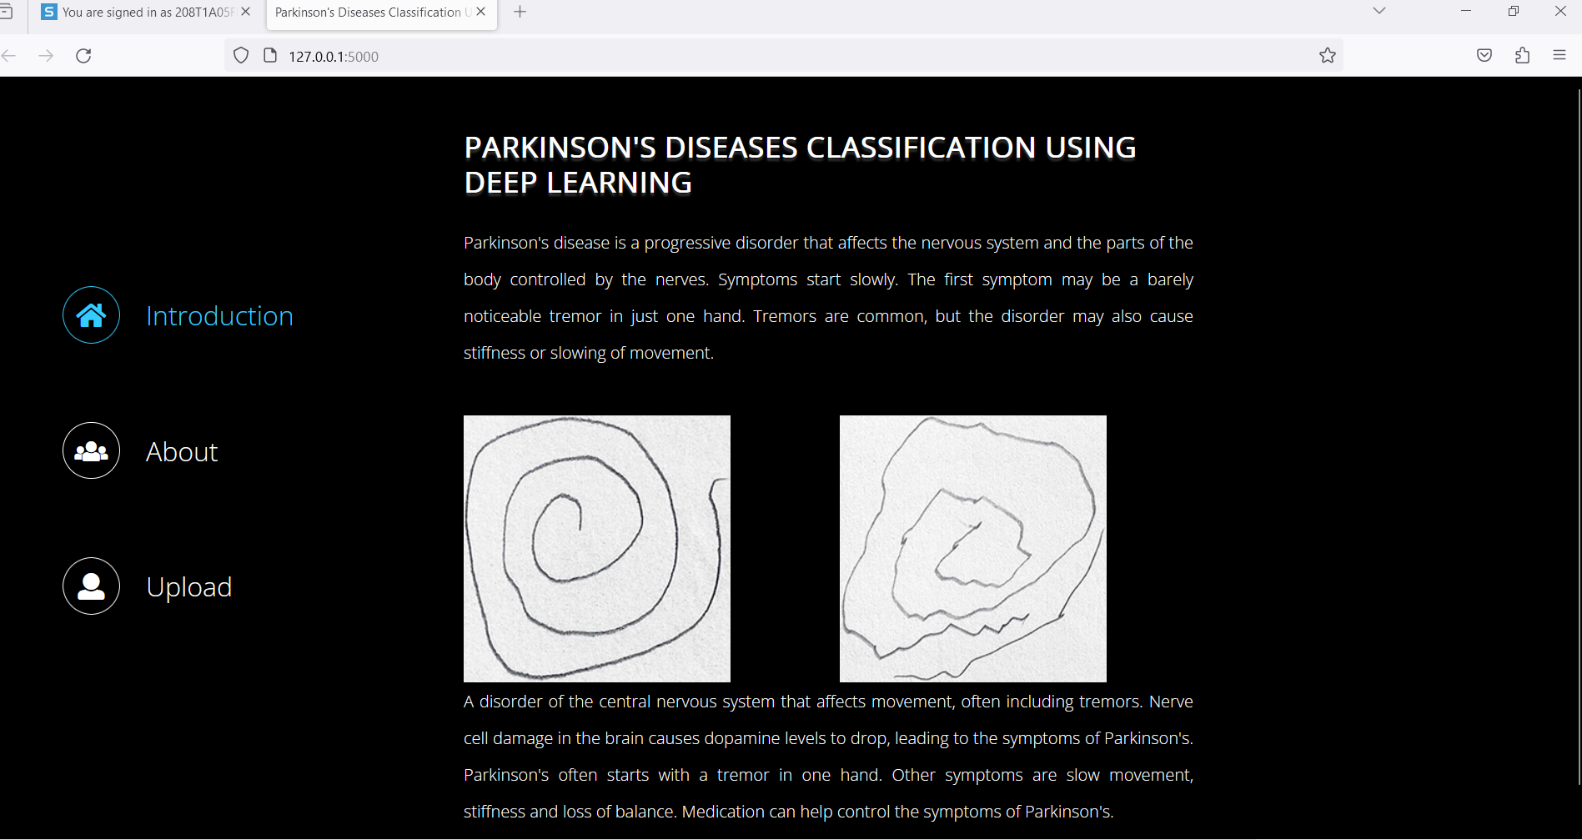
TECHNICAL DESIGN

Slide 32
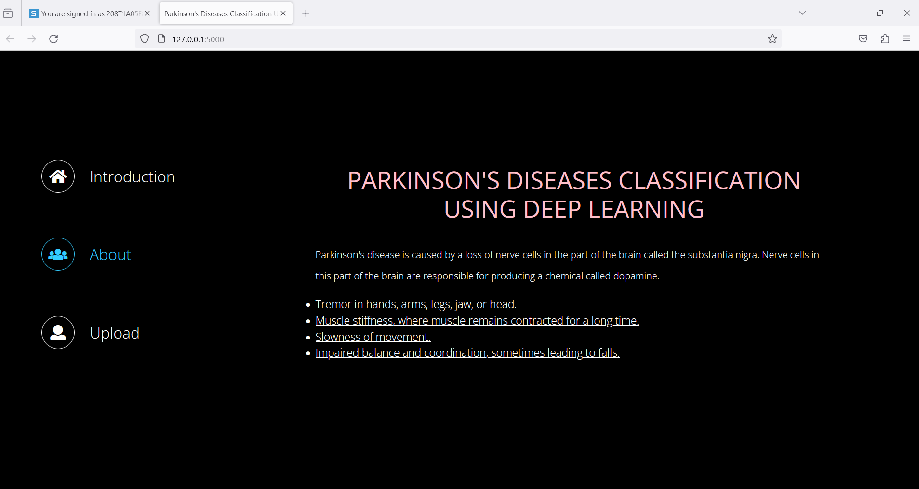

Slide 33
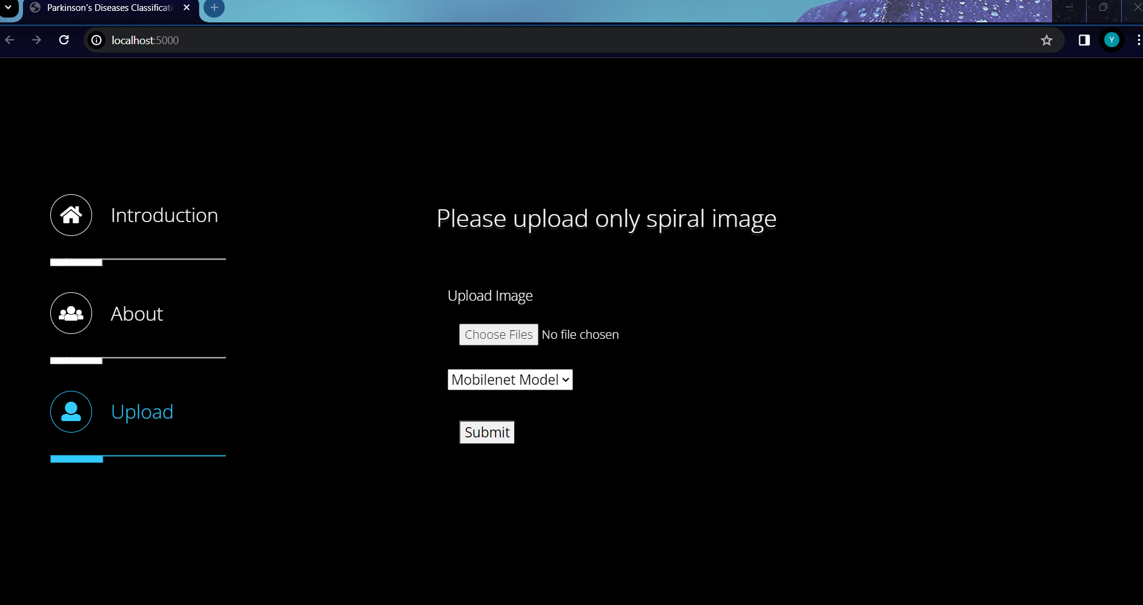

Slide 34
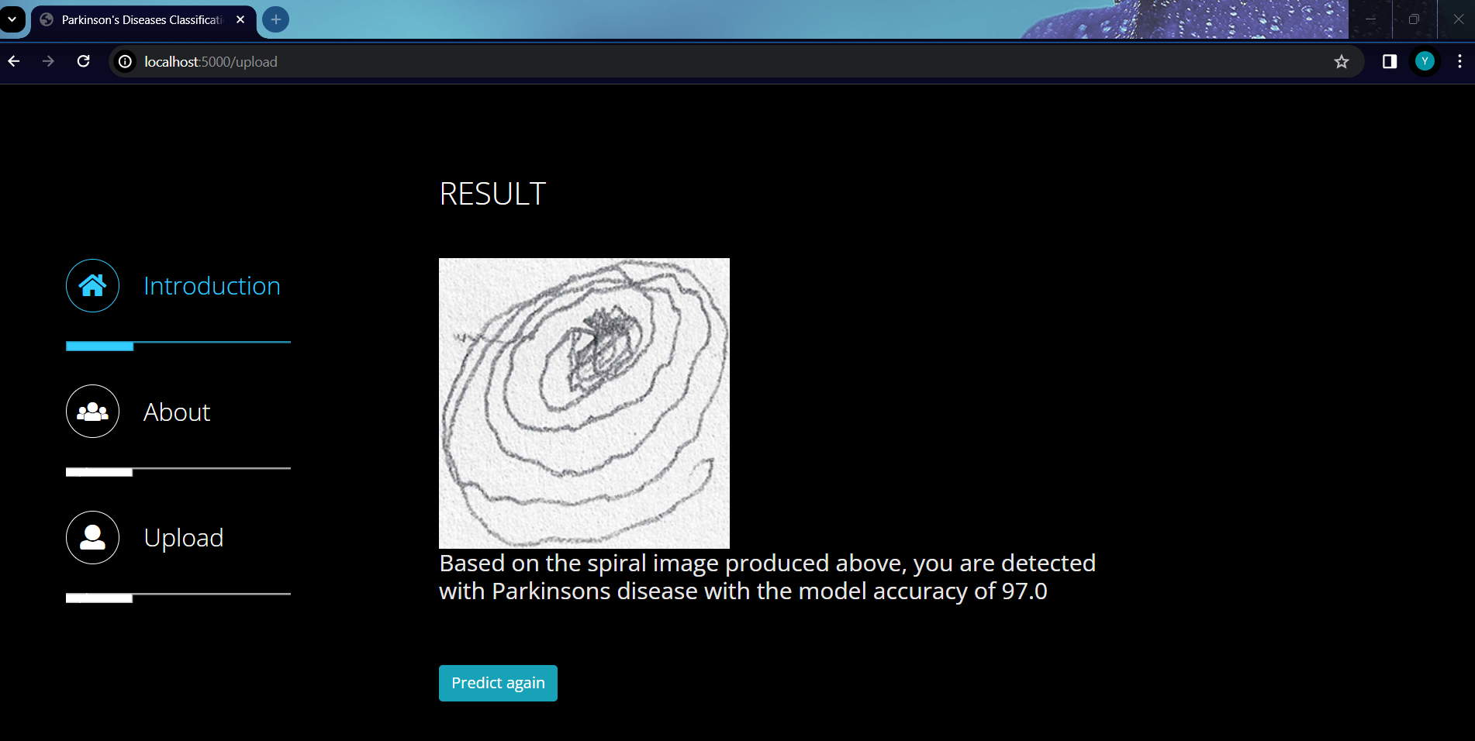

Slide 35
TEST CASES
TEST CASE | INPUTINPUT | AACTION | EXPECTED OUTCOME | ACTUAL OUTCOME | RESULT (P/F)
Input image retrieval | A set of spiral images representing individuals with and without Parkinson's disease. | Retrieve a sample set of spiral images from the database. | Images are to be retrieved without errors. | Images retrieved successfully. | pass
Read the datasets. | Dataset’s path. | generating image datasets | Datasets need to read successfully. | Datasets fetched successfully. | pass
Classification | spiral images being classified as healthy and parkinsons | Uploading the images and appplying the algorithms | Images need to be correctly classified. | Images are classified correctly | pass

Slide 36
TEST CASE | INPUTINPUT | AACTION | EXPECTED OUTCOME | ACTUAL OUTCOME | RESULT (P/F)
Browser Compatibility Testing | Test the system functionality on the latest versions of popular browsers | Testing the code in different chrome browsers like chrome,firefox | The system should function as intended without any errors or visual inconsistencies across all browsers. | The system is functioning as intended without any errors or visual inconsistencies across all browsers. | pass
 | Test the system on an older version of a popular browser . | Testing the code in the older versions of the chrome like chrome 2 versions | The website need to work completely fine without errors | The website is working correctly in all browser versions | pass
 | Test the system on a less popular browser | Test the system on a less popular browser (e.g., Opera). | The system should function to a reasonable degree, but minor visual inconsistencies or limitations might be acceptable. | The system is functioning to a reasonable degree, but minor visual inconsistencies or limitations might be acceptable. | pass

Slide 37
TEST CASE | INPUTINPUT | AACTION | EXPECTED OUTCOME | ACTUAL OUTCOME | RESULT (P/F)
Operating System Compatibility Testing | Test the system on the latest version of Windows (e.g., Windows 11). | Testing the code in different versions of windows like windows 11 | The system should function as intended without any errors or compatibility issues. . | The systemi is functioning as intended without any errors or compatibility issues. | pass
 | Test the system on a previous version of Windows (e.g., Windows 10). | Testing the code in the older versions of the windows | The system should still function with minimal to no issues. | The system is still functioning with minimal to no issues. | pass

Slide 38
TEST CASE | INPUTINPUT | AACTION | EXPECTED OUTCOME | ACTUAL OUTCOME | RESULT (P/F)
System Configuration Testing | Test the system on a computer with high-end specifications | Testing the system on a compter with high end specifications like powerful CPU | The system should function smoothly and efficiently. | The system is functioning smoothly and efficiently. | pass
 | Test the system on a computer with moderate specifications .. | Testing the system on a computer with moderate specificatins like average CPU | - The system should still function adequately, although performance might be slightly slower. | - The system is still functioning adequately, although performance might be slightly slower. | pass

Slide 39
TEST CASE | INPUTINPUT | AACTION | EXPECTED OUTCOME | ACTUAL OUTCOME | RESULT (P/F)
Model Performance Testing | Test each model (Mobilenet, ResNet, CNN) with a set of diverse healthy and Parkinson's spiral images . | Testing the model performance using various metrics | Compare the accuracy, precision, recall, and F1-score of each model. | comparison of three models is done successfully | pass
 | Test the models with variations in lighting conditions (bright, dim, shadows) for the spiral images. | Testing the models with variations in lighting conditions (bright, dim, shadows) for the spiral images. | The model performance (accuracy, etc.) should not significantly decrease with different lighting conditions. . | The model performance is working well in all type of lighting conditions | pass

Slide 40
TEST CASE | INPUTINPUT | AACTION | EXPECTED OUTCOME | ACTUAL OUTCOME | RESULT (P/F)
User Interface Testing | Verify the user interface is user-friendly and intuitive. | verifying the user interacation with system | The upload process, model selection, and result display should be clear and easy to follow. | The upload process, model selection, and result display is clear and easy to follow. | pass
 | Test the system on different screen sizes and resolutions. | Testing the system on different screen sizes like depends on the system configurations | The user interface should be properly displayed and functional on various devices. | The user interface is properly displayed and functional on various devices. | pass

Slide 41
CONCLUSION
In conclusion, our study presents a significant advancement in the early detection of Parkinson's disease (PD) utilizing state-of-the-art machine learning algorithms, namely CNN, MobileNet, and ResNet. Achieving accuracies of 96%, 97%, and 98% respectively, our models demonstrate robust capabilities in accurately classifying PD data. This high level of accuracy is crucial in ensuring timely diagnosis and intervention, potentially improving patient outcomes and quality of life. Moreover, our research highlights the feasibility and effectiveness of leveraging machine learning in healthcare, as evidenced by the successful implementation and reduction in implementation costs. By efficiently utilizing resources and optimizing algorithms, we have not only enhanced diagnostic accuracy but also streamlined the process, making it more accessible and cost-effective. Overall, our findings underscore the potential of machine learning as a powerful tool in the early detection and management of Parkinson's disease, offering promising avenues for further research and clinical application in the realm of neurological disorders.

Slide 42
References
https://www.sciencedirect.com/science/article/pii/S187705091930821X
https://youtu.be/GrJP9FLV3FE?si=Czd_xZ0YmA1gd4qR
https://machinelearningmastery.com/extreme-gradient-boosting-ensemble-in-python/
[1] D. B. Calne “Is idiopathic parkinsonism the consequence of an event or a process” Neurology, Vol. 44, no. 15, pp. 5–5, 1994.
[2] J. Parkinson “An Essay on Shaking Palsy. London: Whittingham and Rowland Printing 1817.
[3] Surathi, P., Jhunjhunwala, K., Yadav, R., Pal, P. K. ”Research in Parkinson’s disease in India: A review : Annals of Indian Academy of Neurology” 19(1), 9–20. doi:10.4103/0972-2327.167713, 2016.
[4] Muthane UB, Chickabasaviah YT, Henderson J, Kingsbury AE, Kilford L, Shankar SK, et al. “Melanized nigral neuronal numbers in Nigerian and British individuals” Mov Disord. 2006;21:123941.
[5] Baldereschi M, Di Carlo A, Rocca WA, Vanni P, Maggi S, Perissinotto E, et al. “Parkinson’s disease and parkinsonism in a longitudinal study: Two-fold higher incidence in men. ILSA Working Group. Italian Lon- gitudinal Study on Aging.” Neurology. 2000;55:135863.
[6] Steven T. DeKosky, Kenneth Marek “Looking Backward to Move For- ward: Early Detection of Neurodegenerative Disorders” The American Association for the Advancement of Science Vol. 302, Issue 5646, pp. 830-834 DOI: 10.1126/science.1090349, 2003.
[7] Farhad Soleimanian Gharehchopogh, Peyman Mohammadi and Parvin Hakimi “Application of Decision Tree Algorithm for Data Mining in Healthcare Operations: A Case Study.” International Journal of Com- puter Applications, Vol: 52, No:6, PP:21-26, 2012.

Slide 43
[8] A. Schrag, C. D. Good, K. Miszkiel, H. R. Morris, C. J. Mathias, A. J. Lees, and N. P. Quinn “Differentiation of atypical parkinsonian syndromes with routine MRI.” Neurology, Vol. 54, pp. 697–702, 2000.
[9] R. Angel, W. Alston, and J. R. Higgins. “Control of movement in Parkinson’s disease.” Brain, Vol. 93, no. 1, pp. 1–14, 1970.
[10] S. L. Wu, R. M. Liscic, S. Kim, S. Sorbi, and Y. H. Yang “Nonmotor symptoms of Parkinson’s disease.” Parkinson’s Dis., 2017. DOI:10.1155/2017/4382518, 2017.
[11] T. Yousaf, H. Wilson, and M. Politis “Imaging the nonmotor symptoms in Parkinson’s disease.” Int. Rev. Neurobiol., Vol. 133, pp. 179–257, 2017.
[12] C. G. Goetz, et al. “Movement disorder society-sponsored revision of the unified Parkinson’s disease rating scale (MDSUPDRS): Scale presentation and clinimetric testing results.” Mov. Disord., Vol. 23, no. 15, pp. 2129–70, 2008.
[13] B. Post, M. P. Merkus, R. M. de Bie, R. J. de Haan, and J. D. Speelman “Unified Parkinson’s disease rating scale motor examination: Are ratings of nurses, residents in neurology, and movement disorders specialists interchangeable?” Movement Dis., Vol. 20, pp. 1577–84, 2005.
[14] R.L. Albin, A.B. Young and J.B. Penney, “The functional anatomy of basal ganglia disorders.” Trends Neurosci 1989; 12: 366–75, 1989.
[15] M.R. DeLong “Primate models of movement disorders of basal ganglia origin.” Trends Neurosci. 1990 Jul;13(7):281-5, 1990.

Slide 44
Thank You…

