Slide 1
HADOOP2.x and WordCount
Praveen Kumar Chandaliya, DoAI, SVNIT

Slide 2
Hadoop Storage Scalability
KB (Kilobyte) = 10³ bytes -> MB (Megabyte) = 10⁶ bytes
GB (Gigabyte) = 10⁹ bytes-> TB (Terabyte) = 10¹² bytes
PB (Petabyte) = 10¹⁵ bytes ->EB (Exabyte) = 10¹⁸ bytes
ZB (Zettabyte) = 10²¹ bytes- >YB (Yottabyte) = 10²⁴ bytes
At the lower end (KB–GB):
Hadoop is not efficient for very small files (like KB or MB scale) because each file creates metadata overhead in the NameNode. A few GB can be managed, but traditional databases or file systems are usually better at this scale.
Medium scale (TB–PB):
Hadoop truly shines here.
Large-scale enterprises, research labs, and social networks typically manage terabytes to petabytes of logs, images, videos, and structured/unstructured data in HDFS.
The default block size (64MB, 128 MB, or 256 MB) makes it efficient for splitting huge files and distributing them across DataNodes.
Large scale (EB–YB):
Modern Hadoop clusters (especially with cloud + commodity hardware) can scale up to exabytes of storage.
Companies like Facebook, Yahoo, and LinkedIn maintain multi-exabyte Hadoop clusters.
Yottabyte scale is more theoretical as of now (no single Hadoop cluster yet runs at yottabyte scale), but HDFS design can extend horizontally by just adding nodes.

Slide 3
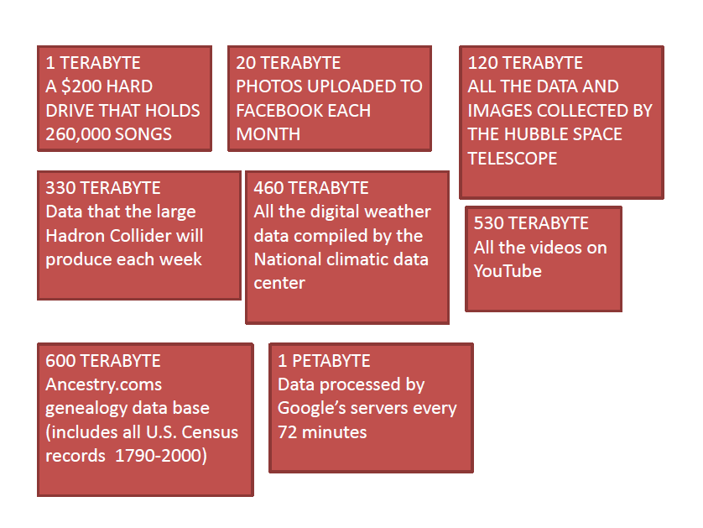
Data Fact

Slide 4
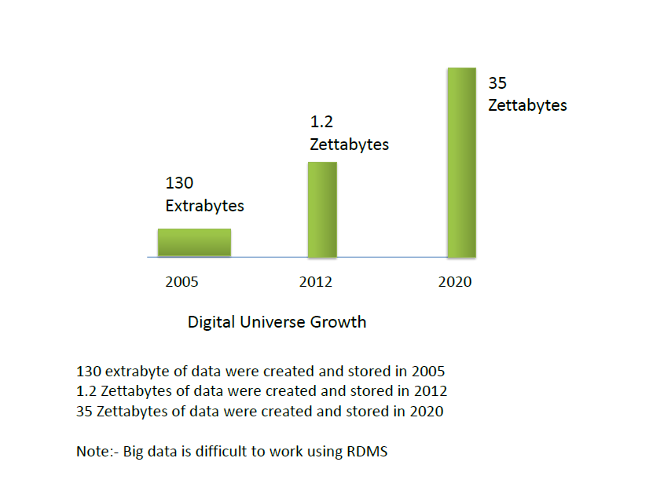

Slide 5


Slide 6
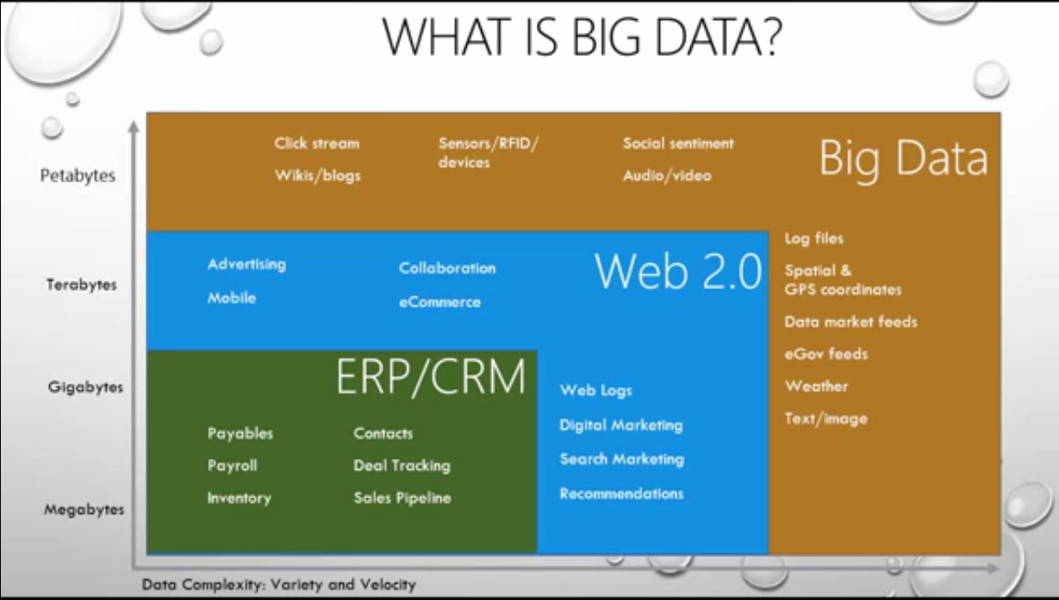

Slide 7
Big Data Definition
Big data is high volume, high velocity and high-variety information assets that demand cost effective, innovative forms of information processing for enhanced insight and decision making-Gartner.
Big data refers to large data sets that are challenging to store, search, share, visualize and analyze.
With big data the value is discovered through a refining modeling process. Make hypothesis, create statistical, visual, semantic models validate then make a new hypothesis.

Slide 8
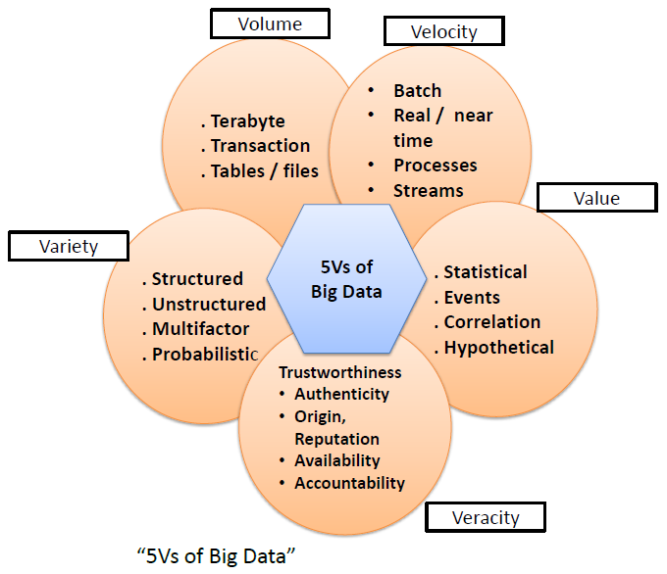


Slide 9
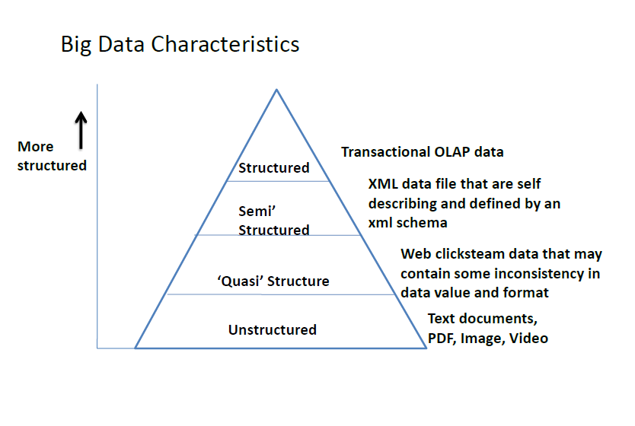
OLAP: Online transaction Processing

Slide 10
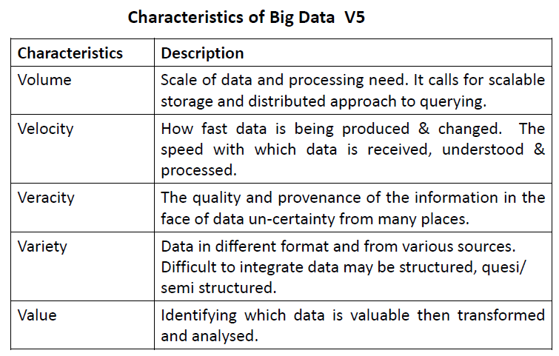

Slide 11
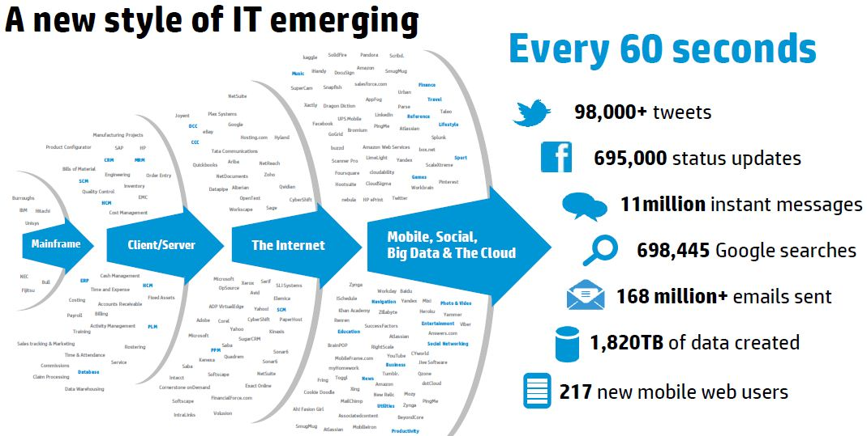

Slide 12


Slide 13
What is Hadoop?
Hadoop is an open-source software framework for storing and processing massive amounts of data (Big Data) across clusters of commodity computers using simple programming models.
Characteristic
HDFS is designed to store a very large amount of information(TB & PB). This requires spreading the data across a large number of machines. It also supports much larger file sizes than NFS.
HDFS should store data reliably. If individual machines in the cluster malfunction(fail), data should still be available.
HDFS should provide fast, scalable access to this information. it should be possible to serve a large number of clients by simply adding more machines to the cluster.
HDFS should integrate well with Hadoop MapReduce, allowing data to be read and computed upon locally when possible.

Slide 14
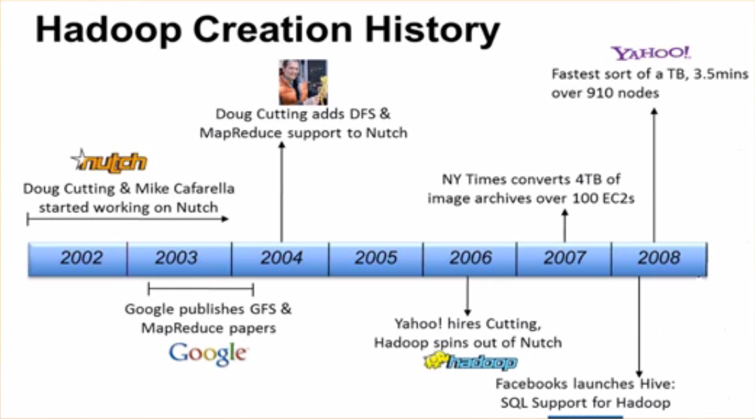
2013–2017
2017 Onward
YARN
Hadoop3.0

Slide 15
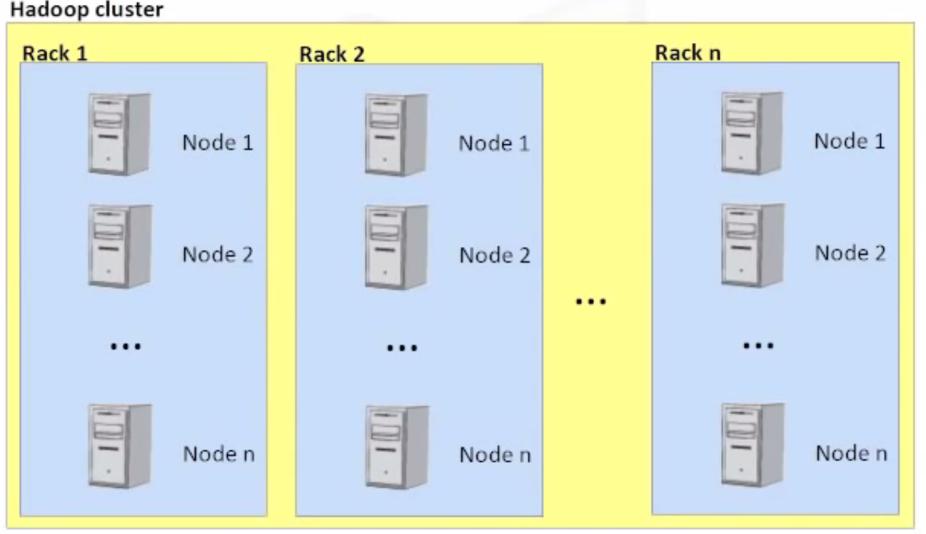

Slide 16
HDFS
It is a specially designed file system for storing huge data sets with a cluster of commodity hardware with a streaming access pattern(write one, read any number of times, but do not try to change the content of the file that was written in HDFS).

Slide 17
NORMAL FILE SYSTEM
sector
1TB HD
Block
Size 4kb
2kb
Block
Size Storage 2kb

Slide 18
Four Main Modules of Hadoop
Hadoop is composed of four key modules that work together:
1. Hadoop Distributed File System (HDFS) - The Storage Layer
This is the storage system of Hadoop.
How it works: It breaks down huge files into smaller blocks (typically 64MB, 128MB, or 256MB) and distributes and replicates these blocks across multiple machines in a cluster.
Key Features:
Fault Tolerance: If one machine (or disk) fails, the data is still available on other machines because it's replicated. The system automatically handles this.
Scalability: You can easily add more machines to the cluster to increase storage capacity.
Designed for Hardware Failure: It assumes that hardware failures are common and handles them gracefully.

Slide 19
HDFS Components
NameNode
It is also known as the Master node. NameNode does not store actual data or a dataset. NameNode stores Metadata, i.e., number of blocks, their location, on which Rack, which Datanode the data is stored, and other details. It consists of files and directories.
Tasks of HDFS NameNode
Manage file system namespace., Regulates client’s access to files, Executes file system execution such as naming, closing, opening files and directories.
ii. DataNode
It is also known as Slave. HDFS Datanode is responsible for storing actual data in HDFS. Datanode performs read and write operation as per the request of the clients. Replica block of Datanode consists of 2 files on the file system.
Tasks of HDFS DataNode
DataNode performs operations like block replica creation, deletion, and replication according to the instruction of NameNode.
DataNode manages data storage of the system. This was all about HDFS as a Hadoop Ecosystem component.

Slide 20
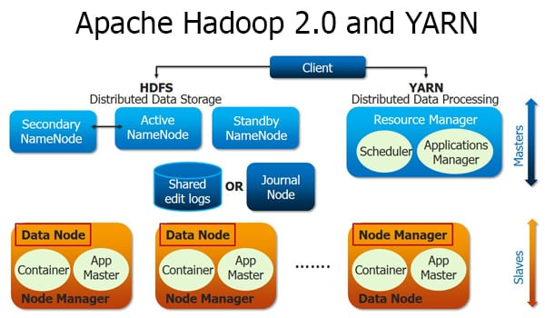
2. Yet Another Resource Negotiator (YARN)
Yet Another Resource Negotiator (YARN) - The Resource Manager
YARN is the brain of the Hadoop ecosystem, managing the cluster's resources and job scheduling.
How it works: It acts as an operating system for Hadoop. When a user submits a data processing job, YARN allocates the necessary resources (CPU, memory) from the cluster to the application.
Key Function: It separates the responsibilities of resource management from the data processing logic, making Hadoop more efficient and allowing it to run a variety of processing frameworks (like Spark, Tez, etc.), not just the original MapReduce.

Slide 21
3. MapReduce - The Processing Model
This is a programming model for processing large datasets in parallel.
How it works: It works in two stages:
Map Stage: takes a set of data and converts it into another set of data, where individual elements are broken down into tuples (key/value pairs).
Reduce Stage: Takes the output from the Map stage, shuffles and sorts it, and then aggregates the results to produce the final output.
Features of MapReduce
Simplicity – MapReduce jobs are easy to run. Applications can be written in any language, such as Java, C++, and Python.
Scalability – MapReduce can process petabytes of data.
Speed – By means of parallel processing problems that take days to solve, it is solved in hours and minutes by MapReduce.
Fault Tolerance – MapReduce takes care of failures. If one copy of data is unavailable, another machine has a copy of the same key pair, which can be used for solving the same subtask.
Note: While foundational, MapReduce is often replaced today by faster frameworks like Apache Spark, which can run on top of Hadoop's YARN and HDFS.

Slide 22
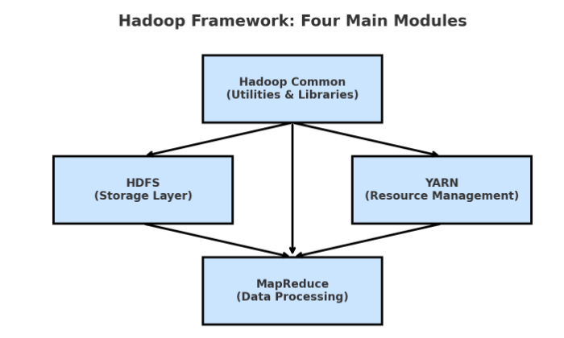
4. Hadoop Common
The foundation of the entire Hadoop ecosystem.
Provides common utilities, libraries, and Java APIs needed by other Hadoop modules.
Includes components like configuration files, I/O utilities, RPC (Remote Procedure Call), and serialization libraries.
Basically, it ensures that the other Hadoop modules can work together seamlessly.

Slide 23
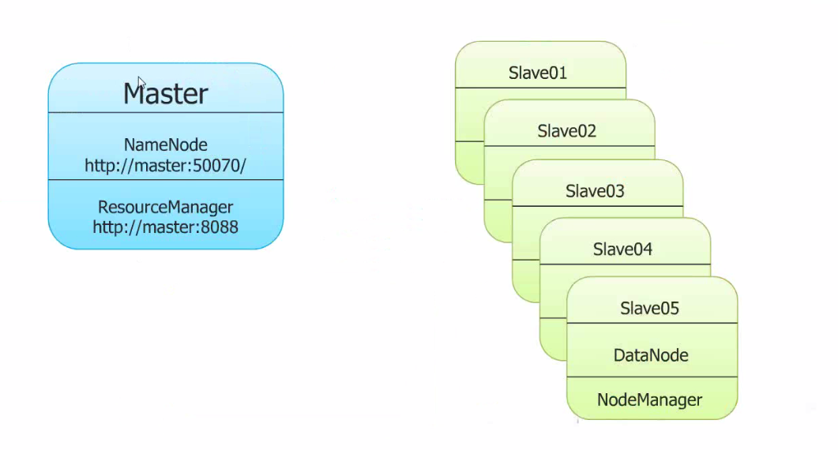
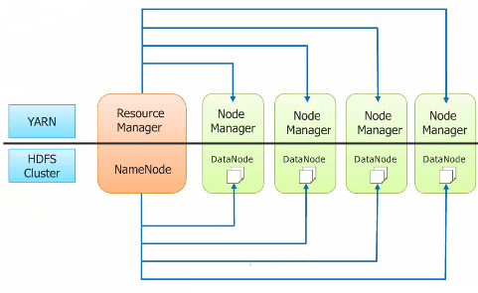
Hadoop2.x Architecture & Hadoop Component

Slide 24
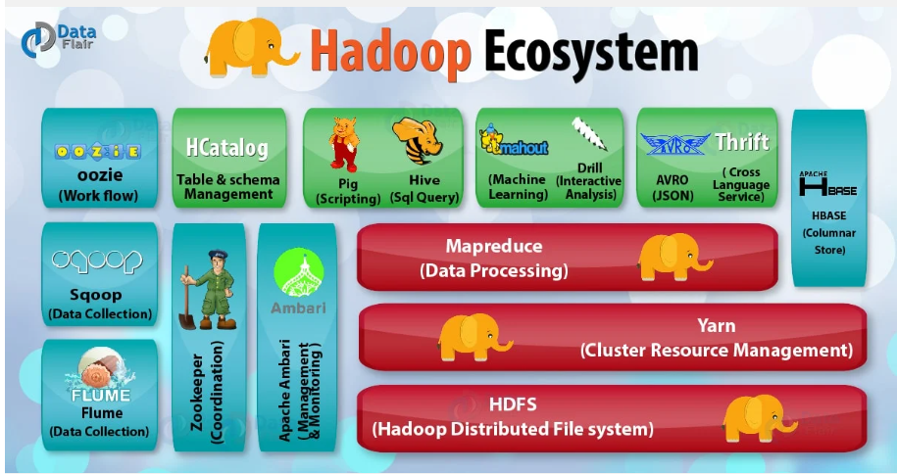
Hadoop Ecosystem
Top 15 Hadoop Analytics Tools for 2025 – Take a Dive into Analytics - DataFlair
Hadoop Ecosystem and Their Components - A Complete Tutorial - DataFlair

Slide 25
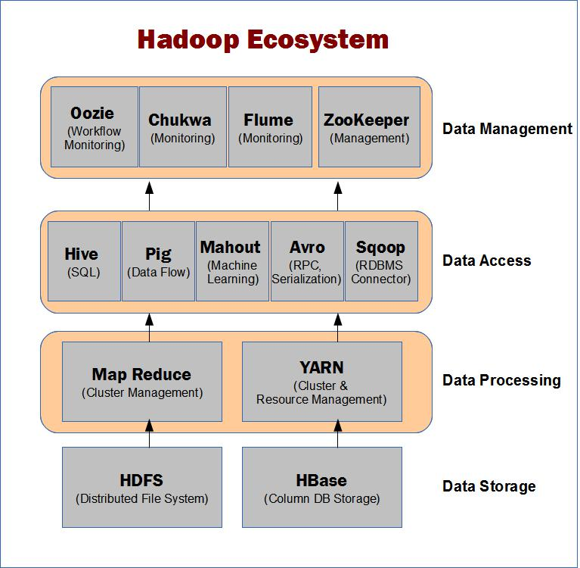
Hadoop Ecosystem

Slide 26
Map Reduce
WordCount Job/Program
input.txt (200MB)
hi how are you how is your job | 64MB
how is your family how is your brother | 64MB
how is your sister what is the time now | 64MB
what is the strength of hadoop | 8MB
Input File Formats :
TextInputFormat
KeyValueTextInputFormat
SequenceFileInputFormat

Slide 27
Objective types used for (key, value) pairs:
Java data types are mapped to Hadoop Writable types for use in MapReduce jobs
Wrapper classes (in Java) | Primitive types | Box classes (in Hadoop)
Integer | int | IntWritable
Long | long | LongWritable
Float | float | FloatWritable
Double | double | DoubleWritable
String | String | Text
int num = 42;
IntWritable writableNum = new IntWritable(num); // primitive → Hadoop box
int backToPrimitive = writableNum.get(); // Hadoop box → primitive
long bigNum = 100000L;
LongWritable writableLong = new LongWritable(bigNum);
long backToPrimitive = writableLong.get();
boolean flag = true;
BooleanWritable writableBool = new BooleanWritable(flag);
boolean backToPrimitive = writableBool.get();
String msg = "Hello Hadoop";
Text writableText = new Text(msg);
String backToPrimitive = writableText.toString();

Slide 28
Primitive | Hadoop Box Class | To Box Class | Back to Primitive
int | IntWritable | new IntWritable(i) | writable.get()
long | LongWritable | new LongWritable(l) | writable.get()
float | FloatWritable | new FloatWritable(f) | writable.get()
double | DoubleWritable | new DoubleWritable(d) | writable.get()
boolean | BooleanWritable | new BooleanWritable(b) | writable.get()
byte | ByteWritable | new ByteWritable(b) | writable.get()
String | Text | new Text(str) | writable.toString()
null | NullWritable | NullWritable.get() | (no value)

Slide 29
TextInputFormat (Default)
Most commonly used input format in Hadoop.
How it works:
Splits input files into lines.
Each line is treated as a record.
The key = line’s byte offset in the file.
The value = contents of the line (text).
Input Line: "hi how are you"
Mapper Input: <0, "hi how are you">
WordCount jobs, log processing, CSV/TSV files
2. KeyValueTextInputFormat
Used when data is structured as key-value pairs separated by a delimiter (default = tab \t).
How it works:
Splits each line into key and value.
Left side of delimiter → key, right side → value.
name John
age 25
city Surat
<"name", "John">
<"age", "25">
<"city", "Surat">
Use case: datasets already in key-value form

Slide 30
3. SequenceFileInputFormat
Hadoop’s binary file format.
Stores serialized key-value pairs in a compressed, splittable way.
How it works:
Reads key-value pairs directly from binary sequence files.
More efficient than plain text.
<1001, "hi how are you">
<1002, "how is your job">
Intermediate data, machine learning datasets, and large-scale binary storage
images, serialized objects, feature vectors
Used in computer vision pipelines on Hadoop

Slide 31
Input.txt(200MB)
Input Split
Input Split
Input Split
Input Split
Record Reader
Record Reader
Record Reader
Record Reader
byteoffest , line
(0,hi how are you)
(16,how is you job)
byteoffest , line
(0,how is you family)
(19,how is you brother)
byteoffest , line
(0,how is you sister)
(19,what is time now)
byteoffest , line
(0,what is strength of hadoop)
Mapper
Mapper
Mapper
Mapper
(hi,1) (how,1) (how,1) (how,1) (how,1) (what,1) (what,1)
(how,1) (is,1) (is,1) (is,1) (is,1) (is,1) (is,1)
(are,1) (you,1) (you,1) (you,1) (you,1) (time,1) (strength,1)
(you,1) (job,1) (family,1)(brother,1) (sister,1) (now,1) (of,1)
(hadoop,1)
Shuffling Sorting
(how,[1,1,1,1,1])
Reducer
Intermediate data
Record Writer
output file

Slide 32
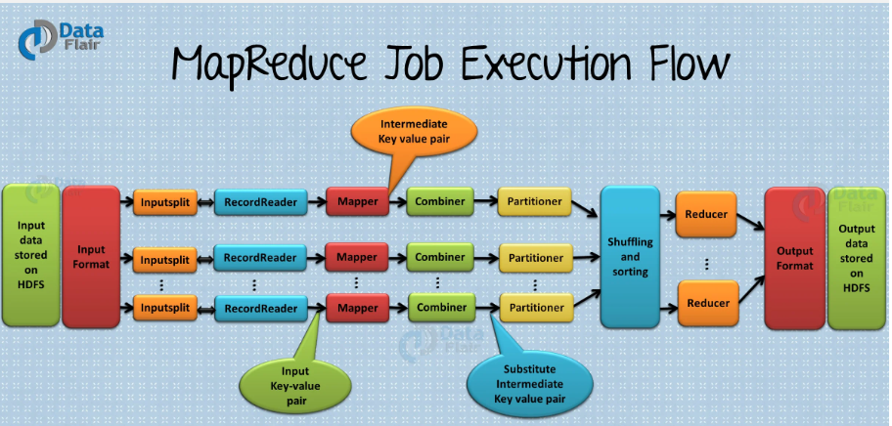
Combiner is also known as “Mini-Reducer”. Use of a combiner decreases the time taken for data transfer between the mapper and reducer. The combiner increases the overall performance of the reducer. It reduces the amount of data that the reducer has to process.
Hadoop Ecosystem and Their Components - A Complete Tutorial - DataFlair
Hadoop Tutorial For Beginners | Hadoop Crash Course | Learn Hadoop From Scratch | Simplilearn

Slide 33
Shuffling:
Shuffling is a phase on intermediate data to combine all values into a collection associated with the same key.
(how, [1,1,1,1,1])
(is, [1,1,1,1,1])
Sorting :
Sorting is another phase on intermediate data to sort all (key, value) pairs. Because of the shuffling phase, all unique keys will compare with each other and give output in some sorting order. Basically, this sorting will be done because of Box classes as we have seen….
IntWritable
LongWritable
FloatWritable
DoubleWritable
Text
All the above classes implemented the Writable and WritableComparable interfaces so that they can compare with each other.

Slide 34
Step 3: Sort Phase : Keys are sorted (lexicographically by default).
(Hadoop, [1])
(are, [1,1])
(hi, [1,1])
(how, [1,1,1])
(is, [1])
(you, [1,1])
Step 4: Reduce Phase : Reducer aggregates values for each key.
(Hadoop,1)
(are,2)
(hi,2)
(how,3)
(is,1)
(you,2)
Step 5: Final WordCount Output
Hadoop 1
are 2
hi 2
how 3
is 1
you 2

Slide 35
Hadoop Distribute File System command
$hadoop fs -ls
$hadoop fs -mkdir <directory>
$hadoop fs -put <local src directory> <hdfs des directory>
$hadoop fs -copyFromLocal <local src directory> <hdfs des directory>
$hadoop fs -moveFormLocal <local src directory> <hdfs des directory> //cut and past
$hadoop fs -get <hdf src directory> <local des directory>
$hadoop fs -copyToLocal <hdf src directory> <local des directory>
$hadoop fs -moveToLocal <hdf src directory> <local des directory>
$hadoop fs -cat <file name>
$hadoop fs -rm <file name> //remove file
$hadoop fs -rmr <directory name> //remove directory
$hadoop fs –cp <src-location> <des-location>
$hadoop fs –mv <src-location> <des-location>
$hadoop fs –du <file name> //disk use

Slide 36
MAPPER CLASS
Name of the Mapper Class which inherits Super Class Mapper
public static class Map extends
Mapper<LongWritable, Text, Text, IntWritable> {
Mapper Class takes 4 Arguments i.e.
Mapper<KEYIN, VALUEIN, KEYOUT, VALUEOUT>
//Defining a local variable one of type IntWritable
private final static IntWritable one = new IntWritable(1);
//Defining a local variable word of type Text
private Text word = new Text();
We override the map method which is defined in the Parent (Mapper) Class. It takes 3 arguments as Inputs
map ( KEYIN key, VALUEIN value, Context context )
public void map(LongWritable key, Text value, Context context)
throws IOException, InterruptedException {

Slide 37
//Converting the record (single line) to String and storing it
in a String variable line
String line = value.toString();
//StringTokenizer is breaking the record (line) into words
StringTokenizer tokenizer = new StringTokenizer(line);
//Running while loop to get each token(word) one by one from StringTokenizer
while (tokenizer.hasMoreTokens()) {
//Saving the token(word) in a variable word
word.set(tokenizer.nextToken());
//Writing the output as (word, one), the value Of word will be equal to token and value of one is 1
context.write(word, one);
}
}
In the map method, we receive a record (single line). It is stored in a string variable line. Using StringTokenizer, we are breaking the line into individual words called tokens, on the basis of space as delimiter. If the line was Hello There, StringTokenizer will give two tokens Hello and There. Finally using the context object we are dumping the Mapper output. So as per our example the Output from the Mapper will be
Hello 1 & There 1 and so on.
The Output from the Mapper is taken as Input by the Reducer

Slide 38
Name of the Reducer Class that inherits the Super Class Reducer
public static class Reduce extends
Reducer<Text, IntWritable, Text, IntWritable> {
Reducer Class takes 4 Arguments i.e.
Reducer <KEYIN, VALUEIN, KEYOUT, VALUEOUT>
We override the reduce method which is defined in the Parent (Reduce) Class. It takes 3 arguments as Inputs
reduce ( KEYIN key, VALUEIN value, Context context )
public void reduce(Text key, Iterable<IntWritable> values,
Context context) throws IOException, InterruptedException {
//Defining a local variable sum of type int
int sum = 0;
//Running for loop to iterate over the values present in
Iterator
for (IntWritable val : values) {
//We are adding the value to the variable over every iteration
sum = sum + val.get();
//Finally writing the key and the value of sum(number of times
the word occurred in the input file) to the output file
context.write(key, new IntWritable(sum));
}}

Slide 39
In the reduce method, we receive a key as word and a list of values as input.
For Example: Hello <1,1,1,1>
To find out the occurrence of the word ‘Hello’ in the input file then we simply have to sum all the values of the list. Hence, we run a for loop to iterate over the values one by one and adding it to variable sum.
Finally, we will write the output, i.e, key (word) & value (sum) using the context object.
So as per the above example the output will be:
Hello 4
The main method is known as the entry point of the application. This is the method that is called as soon as jar is executed
public static void main(String[] args) throws Exception {
//Creating an object of Configuration class, which loads the configuration parameters
Configuration conf = new Configuration();
//Creating the object of the Job class and passing the conf object and Job name as arguments. The Job class allows the user to configure the job, submit it, and control its execution.
Job job = new Job(conf, "wordcount");

Slide 40
//Setting the jar by finding where a given class came from
job.setJarByClass(WordCountNew.class);
//Setting the key class for job output data
job.setOutputKeyClass(Text.class);
//Setting the value class for job output data
job.setOutputValueClass(IntWritable.class);
//Setting the mapper for the job
job.setMapperClass(Map.class);
//Setting the reducer for the job
job.setReducerClass(Reduce.class);
//Setting the Input Format for the job
job.setInputFormatClass(TextInputFormat.class);
//Setting the Output Format for the job
job.setOutputFormatClass(TextOutputFormat.class);
//Adding a path which will act as an input for the MR job. args[0] means it will use the first argument written on the terminal as the input path
FileInputFormat.addInputPath(job, new Path(args[0]));
//Setting the path to a directory where the MR job will dump the output. args[1] means it will use the second argument written on the terminal as the output path
FileOutputFormat.setOutputPath(job,new Path(args[1]));
//Submitting the job to the cluster and waiting for its completion
job.waitForCompletion(true);

Slide 41
Step to Develop Word Count Problem Using Eclipse IDE
Step 1: Create a file (inputfile.txt).
Step 2 : Make a hdfs directory
$ hadoop fs -mkdir -p /home/user/input
Step 3 :loading inputfile.txt from local file system to HDFS.
$hadoop fs –put /home/user/inputfile.txt /home/user/input
Step 4: Write Java programs for processing using Eclipse ID
i) DriverCode.java ii) MapperCode.java iii) ReducerCode.java
Step 5 : Set the Java Build path(class path) and Eclipse IDE Compile All java file.
Step 6 : Create jar file using Eclipse IDE.
Step 7: Run jar file
$hadoop jar WordCount.jar /home/user/input/inputfile.txt /home/user/output DriverCode args[0] args[1]
Note : if Main methods file is selected at the time of the jar file creation
$hadoop jar WordCount.jar /home/user/input/inputfile.txt /home/user/output
Step 8: View the result
$hadoop fs -cat /home/user/output/part-r-00000
or
$ hadoop fs -cat /home/user/output/part-00000
Step 9 : if want to remove the folder created using hdfs
$hadoop fs –rm -R /home/user/output

