Slide 1
Suspicious IP Checker
IP Reputation | Live Monitoring | Alerts
Educational Cybersecurity Mini Project
Built with Python + Streamlit

Slide 2
Problem Statement
System admins need to identify malicious IPs on their servers
Enterprise SIEM tools are expensive and complex
Goal: Lightweight tool for IP reputation + log monitoring + alerts
Must be educational, transparent, and ethically responsible

Slide 3
Solution Overview
Multi-source IP Reputation Checking (4 threat intel providers)
Real-time log file monitoring with configurable thresholds
Tiered alert system (Dashboard + Email)
Batch CSV analysis with visualization
5-tab Streamlit web dashboard

Slide 4
Technology Stack
Python 3.10+ | Streamlit (web UI framework)
Pandas + Matplotlib (data analysis, charts)
requests (HTTP API calls to threat intel)
smtplib (email alerts via Gmail SMTP)
threading (background log monitoring)
python-docx, python-pptx (report generation)

Slide 5
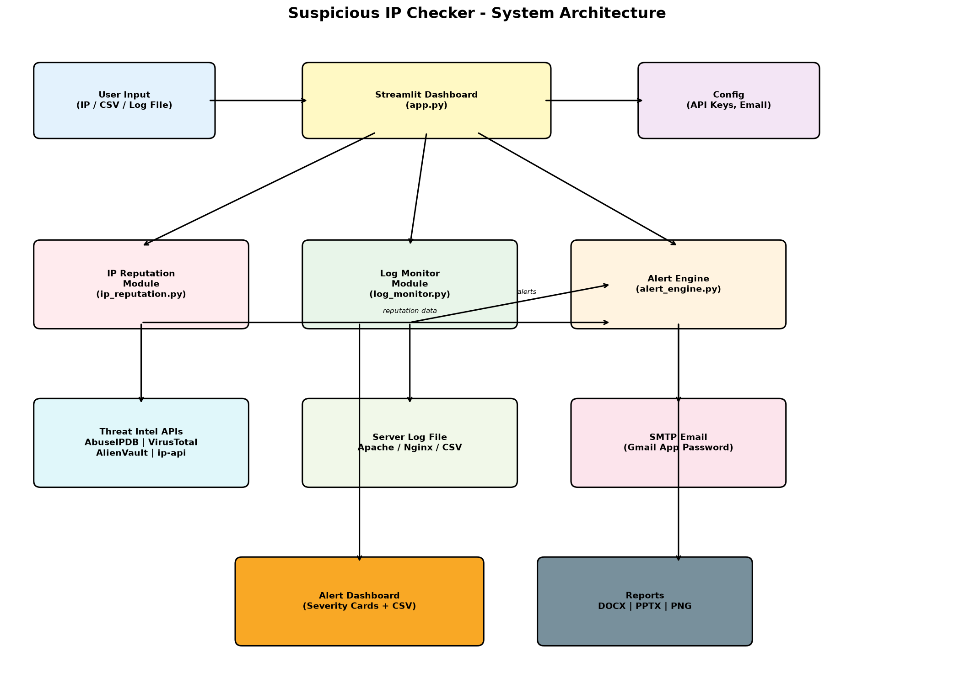
System Architecture

Slide 6
Project Modules
app.py - Main dashboard (5 tabs: Reputation, Monitor, Alerts, Analysis, Help)
config.py - Settings management (API keys, email, thresholds)
ip_reputation.py - Threat intel API integrations
log_monitor.py - Real-time file tailing + threshold detection
alert_engine.py - Alert creation + SMTP email dispatch

Slide 7
IP Reputation Checking
AbuseIPDB: Abuse confidence score (0-100%), reports, ISP
VirusTotal: Detection ratio from 90+ security engines
AlienVault OTX: Reputation score + threat pulse associations
ip-api.com: Geolocation, proxy/hosting flags (FREE, no key!)
Combined verdict: Flag if ANY source indicates risk

Slide 8
Live Log Monitoring
Polls a log file (Apache/Nginx/CSV) every N seconds
Background thread processes new lines
Per-IP activity tracking (requests, failures, paths)
Configurable thresholds trigger automatic alerts
Works with any file you append new lines to

Slide 9
Alert System
4 severity levels: Low, Medium, High, Critical
Dashboard: Visual alert cards with acknowledge/clear
Email: Auto-sent for High + Critical severity
Gmail SMTP with App Password authentication
Sources: Live monitor, reputation check, batch analysis

Slide 10
API Keys & Limitations
ip-api.com: Free, no key needed (45 req/min limit)
AbuseIPDB: Free tier = 100 req/day
VirusTotal: Free tier = 4 req/min, 500 req/day
AlienVault OTX: Free = ~10,000 req/day (soft)
Limitations: Rate limits, false positives, private IPs, no attribution

Slide 11
Demo / Sample Testing
Test IP 8.8.8.8: CLEAN, geolocation shows Google DNS
Sample logs: Brute-force pattern from 203.0.113.25 flagged
Path scanning from 203.0.113.99: /admin, /.env, /phpmyadmin
Alert appears in dashboard with Medium severity
Email sent for high-severity reputation matches

Slide 12
Conclusion
Successfully demonstrated multi-source IP reputation
Real-time monitoring with threshold-based detection
Tiered alerting via dashboard + email
Modular design allows easy extension (new providers, channels)
Ethical: Analyze only authorized systems, no blocking/scanning
Future: Add more APIs, ML-based anomaly detection, Slack/Teams alerts

Slide 13
Thank You!
Questions?
GitHub / Report / Demo available

