Slide 1

Project report on
Information gathering using Web Scrapper
A Dissertation submitted in partial fulfillment of the Academic requirements for the award of the degree of
Bachelor of Technology
In
Computer Science & Engineering
(Cyber Security)
Submitted by
K.Madhukar Swamy (21H51A6223)
K.Mahender Kumar (21H51A6227)
K.Praveen Kumar (21H51A6231)
Under the esteemed Guidance of Dr.R.Venkateswara Reddy (Associate Professor and HOD,CSC)
Department of Cyber Security
CMR COLLEGE OF ENGINEERING & TECHNOLOGY
(Autonomous)
(NAAC Accredited with ‘A+’ Grade & NBA Accredited) (Approved by AICTE, Permanently Affiliated to JNTU Hyderabad)
KANDLAKOYA, MEDCHAL ROAD, HYDERABAD-501401

Slide 2
CMR COLLEGE OF ENGINEERING & TECHNOLOGY
(Autonomous)
(NAAC Accredited with ‘A+’ Grade & NBA Accredited) (Approved by AICTE, Permanently Affiliated to JNTU Hyderabad)
KANDLAKOYA, MEDCHAL ROAD, HYDERABAD-501401
DEPARTMENT OF CYBER SECURITY
CERTIFICATE
This is to certify that the Mini Project -1 report entitled “Information gathering using Web Scrapper” being submitted by K.Madhukar Swamy (21H51A6223), K.Mahender Kumar(21H51A6227), K.Praveen Kumar (21H51A6231) in partial fulfillment for the award of Bachelor of Technology in Computer Science and Engineering (Cyber Security) is a record of bonafide work carried out his/her under my guidanceand supervision.
The results embodied in this project report have not been submitted to any other University or Institute for the award of any Degree.
Mr.Praveen Vens Assistant Professor Dept. of CSC
Dr. R. Venkateswara Reddy Associate Professor & HOD Dept. of CSC

Slide 3
ACKNOWLEDGEMENT
With great pleasure I want to take this opportunity to express my heartfelt gratitude to all the people
who helped in making this project a grand success.
I am grateful to Mr.Praveen Vens, Assistant Professor, Dept. of Computer Science and Engineering for her valuable suggestions and guidance during the execution of this project.
I would like to thank Dr. R. Venkateswara Reddy, Head of the Department of Computer Science and Engineering, for his moral support throughout the period of my study in CMRCET.
I am highly indebted to Major Dr. V.A. NARAYANA, Principal CMRCET, for giving permission to carry out this project in a successful and fruitful way.
I would like to thank the Teaching & Non- teaching staff of the Department of Computer Science and Engineering for their co-operation.
Finally, I express my sincere thanks to Mr. CH. GOPAL REDDY, Secretary, CMR Group of Institutions, for his continuous care. I sincerely acknowledge and thank all those who gave support directly and indirectly in the completion of this project work.
K.Madhukar Swamy
(22H51A6223)
K.Mahender Kumar
(22H51A6227)
K.Praveen Kumar
(22H51A6231)

Slide 4
ABSTRACT
A web scraper is an automated tool used to extract data from websites by simulating human browsing behavior. It sends HTTP requests to web pages, retrieves the HTML content, and parses it to extract specific information based on predefined rules or patterns. This process often involves navigating through the website's structure using techniques like CSS selectors or XPath to locate and scrape desired data elements such as text, images, links, or tables.
Web scrapers are valuable across industries for tasks such as competitive analysis, market research, price monitoring, content aggregation, and lead generation. They enable organizations to gather large volumes of data quickly and efficiently, which can then be processed, analyzed, and used for various purposes including business intelligence, decision-making, and automation.
However, web scraping is not without challenges. Legal and ethical considerations around data ownership, copyright, and website terms of service must be carefully navigated. Additionally, technical challenges like handling dynamic content, managing IP blocking, and circumventing CAPTCHA mechanisms may require advanced techniques or tools such as headless browsers (e.g., Puppeteer) to execute scripts and interact with websites.

Slide 5
Table Of Content
CHAPTERS | DESCRIPTION | PAGE NUMBERS
1 | INTRODUCTION | 2
1.1 | AIM | 3
1.2 | SCOPE | 4
2 | LITERATURE REVIEW | 6
3 | EXISTING SOLUTIONS | 8
4 | PROPOSED SYSTEM | 10
4.1 | REQUIREMENT ANALYSIS | 11
4.2.1 | HARDWARE REQUIREMENTS | 11
4.2.2 | SOFTWARE REQUIREMENTS | 11
4.2 | MERITS AND DEMERITS | 12
5 | DESIGN DESCRIPTION | 14
5.1 | CONCEPTUAL DESIGN | 14
6 | IMPLEMENTATION AND DISCUSSION | 16
7 | RESULT | 18
8.1 | CONCLUSION | 20
8.2 | REFERENCES | 21

Slide 6
CHAPTER 1
1

Slide 7
1. INTRODUCTION
• Web scraping is an automated method used to extract large amounts of data from websites, converting unstructured data into a structured format.
• It serves various purposes such as data analysis, price monitoring, market research, content aggregation, and academic research.
• Different tools and libraries are utilized for web scraping, including Beautiful Soup and Scrapy in Python, Puppeteer in JavaScript, and Selenium for browser automation.
• Common techniques involve parsing the HTML structure of web pages, using CSS selectors or XPath to locate data, handling pagination to scrape multiple pages, and managing delays or CAPTCHA to mimic human behaviour and avoid detection.
• Despite its power, web scraping raises legal and ethical concerns; scrapers should respect website terms of service, use proper request rates, and ensure they do not violate laws related to data usage and privacy.
• Web scraping faces challenges such as dynamic content loading through JavaScript, anti-scraping measures like IP blocking or CAPTCHA, and changing website structures, requiring effective scrapers to handle these obstacles and adapt to different website designs.
2

Slide 8
1.1 AIM
The aim of a web scraper is to efficiently extract relevant data from websites in an automated manner, converting unstructured web content into a structured format for easy analysis and utilization. This allows businesses and researchers to gather insights, monitor trends, and make informed decisions based on comprehensive data collections. Web scrapers streamline the data acquisition process, saving time and reducing the potential for human error.
By automating repetitive tasks, they enable large-scale data gathering and provide up-to-date information, which is crucial for competitive analysis, market research, and academic studies. Additionally, web scrapers can handle vast amounts of data across multiple sources, ensuring a broad perspective and a more accurate representation of the desired information. They can be tailored to specific needs, such as tracking price changes, aggregating news articles, or monitoring social media trends, making them versatile tools for various applications.
3

Slide 9
1.2 SCOPE
The scope of this web scraping project encompasses the automated extraction of relevant data from multiple targeted websites, transforming unstructured content into a structured format for comprehensive analysis. This project will include the development and deployment of customized scraping scripts capable of handling dynamic content, pagination, and various anti-scraping measures. It aims to gather real-time data for purposes such as market analysis, trend monitoring, and competitive intelligence, ensuring up-to-date and accurate information. Additionally, the project will implement robust data cleaning and validation processes to ensure the quality and reliability of the extracted data.
TOOLS
Puppeteer and Cheerio are two popular tools used for web scraping, each with distinct capabilities that cater to different scraping needs.
Puppeteer is a Node.js library that provides a high-level API to control headless Chrome or Chromium browsers. It allows users to perform a wide range of actions on web pages, such as navigating, clicking, typing, and capturing screenshots. Puppeteer is particularly effective for scraping websites that rely heavily on JavaScript for content rendering. By simulating a real browser, Puppeteer can interact with dynamic content, handle client-side rendering, and navigate through complex site structures. This makes it ideal for scraping single-page applications (SPAs) and websites with content that loads asynchronously.
Cheerio, on the other hand, is a fast, flexible, and lean implementation of core jQuery designed specifically for server-side manipulation of HTML. It parses HTML and XML, providing a jQuery-like syntax to traverse and manipulate the resulting document. Cheerio is highly efficient for extracting data from static HTML pages. It does not render JavaScript, so it is best suited for sites where content is readily available in the initial HTML response. Its lightweight nature makes it ideal for quick and straightforward scraping tasks, where the focus is on parsing and extracting data without the need for interaction or dynamic content handling.
In summary, Puppeteer is powerful for handling dynamic, JavaScript-heavy sites, while Cheerio excels in parsing and extracting data from static HTML content efficiently. Together, they provide a comprehensive toolkit for tackling a wide range of web scraping challenges.

Slide 10
CHAPTER 2

Slide 11
2. LITERATURE REVIEW
Web scraping, an automated technique for extracting data from websites, has become indispensable across various fields due to its capability to gather vast amounts of information efficiently. Methodologically, it involves parsing HTML or interacting with dynamic content using tools like Beautiful Soup, Scrapy, Puppeteer, and Selenium. These tools enable scraping of both static and JavaScript-rendered pages, facilitating applications in e-commerce, finance, research, and more.
Literature underscores challenges such as navigating anti-scraping mechanisms (e.g., CAPTCHAs, IP blocking) and addressing ethical dilemmas related to data privacy and terms of service compliance. Researchers emphasize the importance of legal considerations and ethical guidelines to ensure responsible scraping practices.
Applications of web scraping range from competitive intelligence and price monitoring in business to sentiment analysis in financial markets and large-scale data collection for academic research. Future directions in the field include enhancing scraping efficiency with advanced algorithms, integrating AI for smarter data extraction, and developing frameworks for ethical scraping practices.
Overall, while web scraping offers substantial benefits in data-driven decision-making, ongoing advancements and ethical frameworks are essential to mitigate challenges and ensure its sustainable use across diverse domains.

Slide 12
CHAPTER 3

Slide 13


3. EXISTING SOLUTION
1. Beautiful Soup
Description: Beautiful Soup is a Python library used for parsing HTML and XML documents. It provides a simple interface for navigating and manipulating parsed data.
Key Features:
Ease of Use: Designed for quick and efficient parsing of HTML, making it ideal for beginners and experienced developers alike.
Flexibility: Supports various parsers (like xml and html5lib) to handle different types of markup, ensuring compatibility with diverse web pages.
Fig 1: BeatifulSoup
2. Scrapy
Description: Scrapy is a powerful web scraping framework for Python that provides a complete toolset for extracting structured data from websites.
Key Features:
Full-Featured: Offers built-in support for handling requests, managing cookies, and following redirects, streamlining the scraping process.
Scalability: Designed for large-scale scraping projects with robust mechanisms for asynchronous operations and distributed crawling.
Fig 2: Scrapy

Slide 14
CHAPTER 4

Slide 15
4.1 PROPOSED SYSTEM
The proposed system uses Node.js application leverages Puppeteer and Cheerio for efficient web scraping and data management. It connects to MongoDB to store and retrieve scraped data, enhancing reliability and scalability. Upon receiving a username, it checks the database for existing data; if absent, it uses Puppeteer to automate login and data extraction from a specific website. Cheerio aids in parsing the extracted HTML content for relevant data like name and CGPA, which are then stored in MongoDB for future retrieval. Users interact through a web interface where they submit usernames and view corresponding data or extracted marks details. This approach ensures real-time data availability and robust data management practices, making it suitable for educational institutions or similar applications requiring secure and efficient data retrieval and storage from web sources.

Slide 16


4.2 REQUIREMENT ANALYSIS
4.2.1 Software Requirements:
Node.js Environment
Express Framework
Puppeteer
Cheerio
MongoDB Driver
Body Parser Middleware
4.2.2 Hardware Requirements:
Server Infrastructure
Network Connectivity
Storage Requirements

Slide 17
4.2 MERITS AND DEMERITS
Merits of Web Scraping:
Automation: Web scrapers automate data extraction tasks, reducing manual effort and increasing efficiency.
Large-Scale Data Collection: Enables gathering large volumes of data from multiple sources quickly, which is beneficial for market research and analysis.
Real-Time Data: Provides up-to-date information from websites, allowing businesses to make informed decisions based on current trends.
Customization: Can be customized to extract specific data fields or types, tailoring the scraping process to meet specific needs.
Competitive Advantage: Helps businesses monitor competitors' prices, strategies, and product offerings, facilitating competitive intelligence.
Cost-Effectiveness: Compared to traditional methods, web scraping can be cost-effective for acquiring data at scale without extensive human resources.
Integration: Data extracted via web scraping can be integrated into internal systems or databases for further analysis and reporting.
Research: Supports academic and scientific research by providing access to large datasets for analysis and study.
Demerits of Web Scraping:
Legal Issues: Violates terms of service of websites in some cases, leading to legal consequences if not properly managed.
Ethical Concerns: Raises ethical dilemmas regarding data ownership, privacy, and fair use of information extracted from websites.
Technical Challenges: Faces challenges like anti-scraping measures (CAPTCHA, IP blocking) and dynamic content rendering that require advanced solutions.
Data Quality: Depending on website changes and scraping methods, data quality may vary, requiring validation and cleaning processes to ensure accuracy.

Slide 18
CHAPTER 5
13

Slide 19

5. DESIGN DESCRIPTION
5.1 CONCEPTUAL DESIGN
The diagram shows the steps involved in Web Scraper
Fig 6: Steps for Web Scraping
14

Slide 20
CHAPTER 6
15

Slide 21
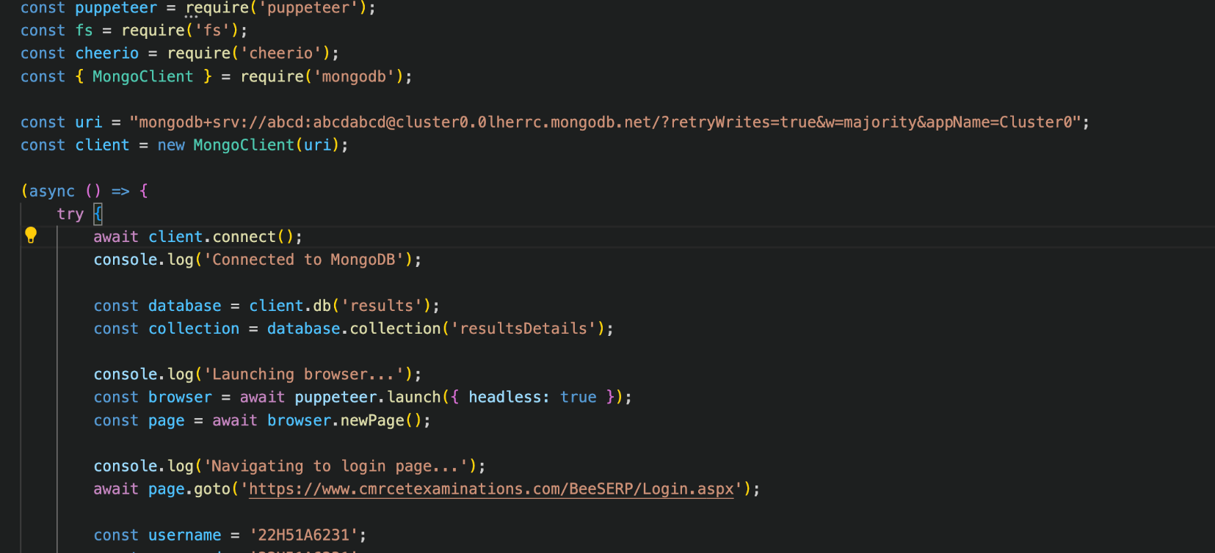
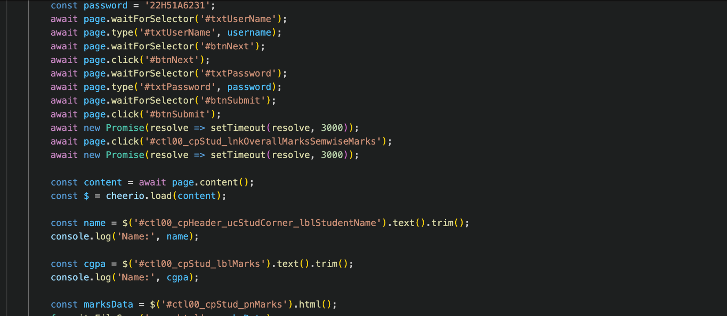
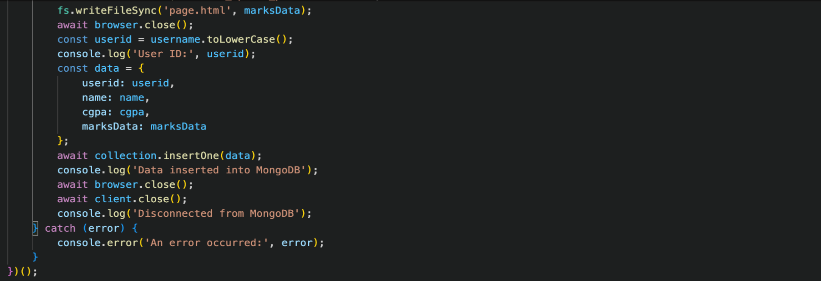
6. IMPLEMENTATION AND DISCUSSION
6.1. IMPLEMENTATION
17
16

Slide 22
CHAPTER 7
17

Slide 23
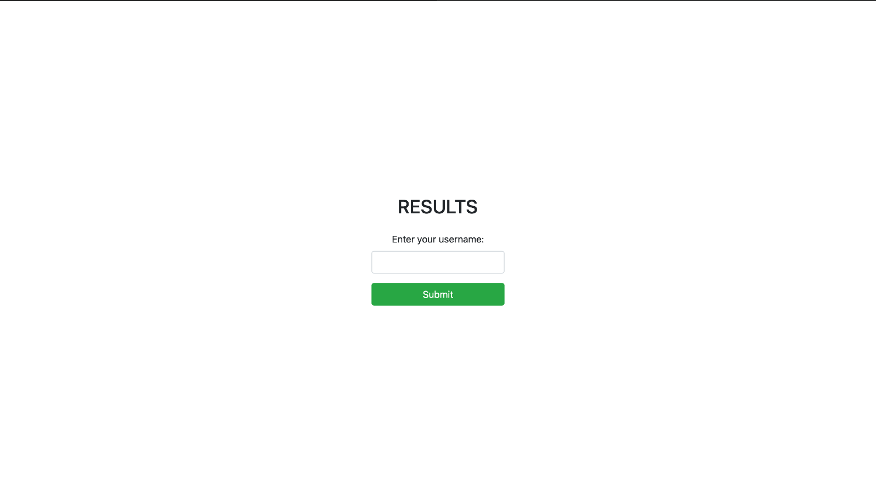
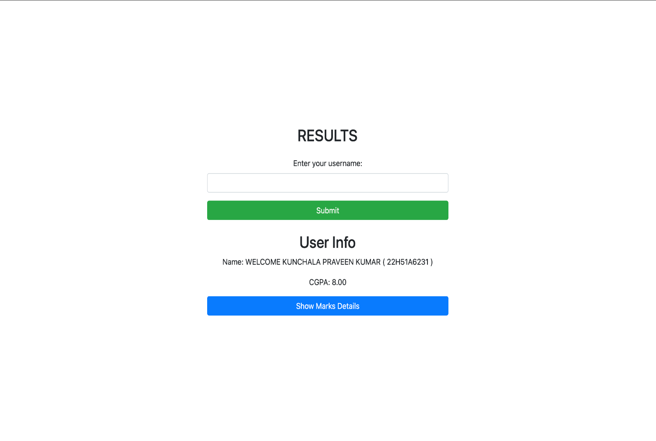
7. RESULT
Fig 11
Website interaface:
Fig 12
18

Slide 24
CHAPTER 8
19

Slide 25
8. CONCLUSION AND FUTURE ENHANCEMEMT
8.1. CONCLUSION
Efficiency Boost: Implementing Puppeteer and Cheerio in our Node.js application significantly enhances efficiency by automating data extraction and parsing tasks.
Real-Time Data Access: Users benefit from real-time access to educational results, improving transparency and reducing administrative overhead.
Scalability: Leveraging MongoDB ensures scalable data storage and retrieval, accommodating future growth in user base and data volume.
User Experience: The intuitive web interface powered by Express.js facilitates seamless interaction, enhancing user experience with minimal latency.
Compliance and Ethics: Adherence to legal and ethical standards in web scraping practices is crucial to maintain trust and avoid legal issues.
Data Integrity: Robust data processing ensures scraped information is accurate and reliable, supporting informed decision-making.
Continuous Improvement: Regular updates and maintenance of scraping scripts and database management ensure ongoing reliability and performance optimization.
Educational Insight: Facilitating access to detailed academic performance data fosters insights into student progress and educational trends.
20

Slide 26
8.2 REFERENCES
Node.js Official Website
Express.js Documentation
Puppeteer GitHub Repository
Cheerio Documentation
MongoDB Official Documentation
MDN Web Docs - HTML
W3Schools - JavaScript
21

