Slide 1
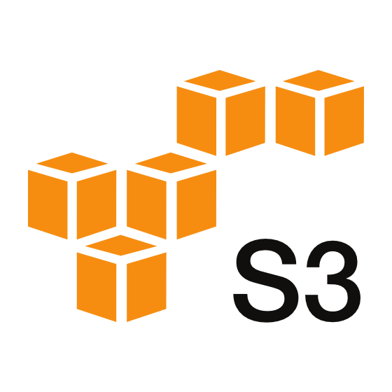
☁️ S3 Storage Using Terraform
Bucket creaion

Slide 2
S3 Bucket Creation by using terraform
Introduction to AWS S3
What is Amazon S3?
Key Features and Use Cases
S3 Storage Classes
Creating and Managing S3 Buckets
Creating an S3 Bucket
Configuring Bucket Policies & Permissions
Enabling Versioning and Encryption
Access Control and Security
IAM Policies for S3
Bucket Policies vs. Access Control Lists (ACLs)
Enabling Server-Side Encryption (SSE)
S3 → Amazon S3 (Simple Storage Service) is a highly scalable object storage service in AWS, For free aws account we can store the data upto 5gb.
→ Maximum Object or file we can store data is 5TB.
→ Maximum Number of Buckets per AWS account is 100.

Slide 3
Key Features & Use Cases of Amazon S3
Unlimited Storage
Store any amount of data with no size limit on the bucket
Each object can be up to 5 TB
Durability & Availability
99.999999999% (11 9’s) durability ensures data is never lost
99.99% availability for Standard Storage
Security & Access Control
Encryption: Supports SSE-S3, SSE-KMS, SSE-C
IAM Policies & Bucket Policies control access
MFA Delete adds extra protection
Versioning & Object Lock
Keep multiple versions of files to protect against accidental deletion
Use Object Lock for data immutability (ideal for compliance)

Slide 4
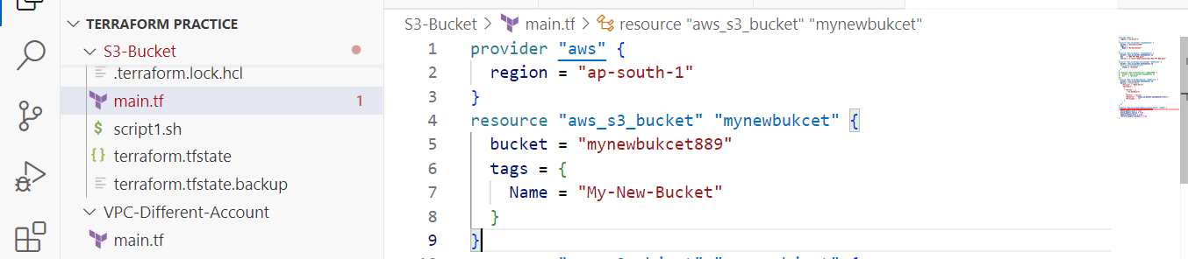
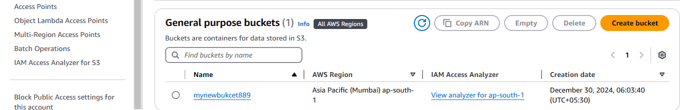
To Create S3 Storage Bucket by using Terraform
→ Below is a Terraform configuration to create an S3 bucket with versioning, encryption, and access control.

Slide 5
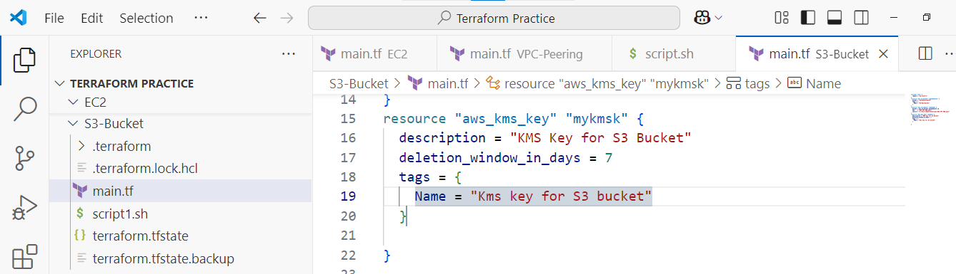
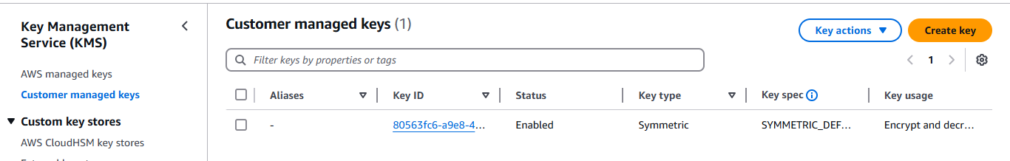
KMS Key by Using Terraform
→ AWS KMS (Key Management Service) is a managed encryption service that allows you to create, manage, and control cryptographic keys for securing your AWS resources.

Slide 6
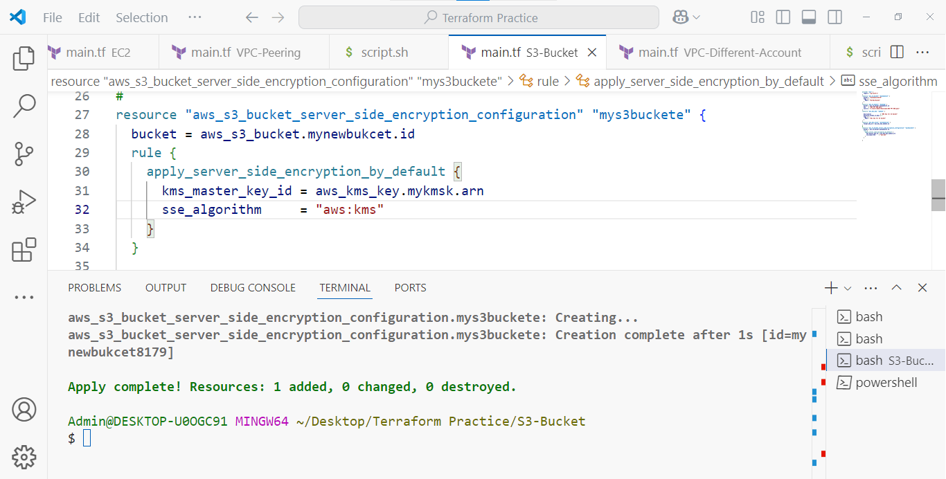
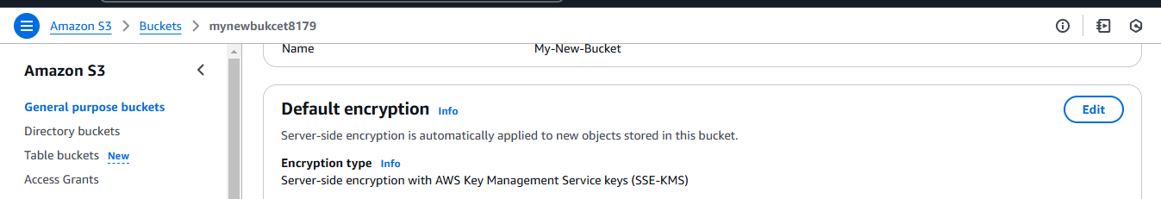
S3 Bucket Server-Side Encryption
→ Server-Side Encryption (SSE) is a mechanism where AWS encrypts data at rest before storing it and decrypts it when accessed. It ensures data confidentiality and meets compliance requirements.

Slide 7
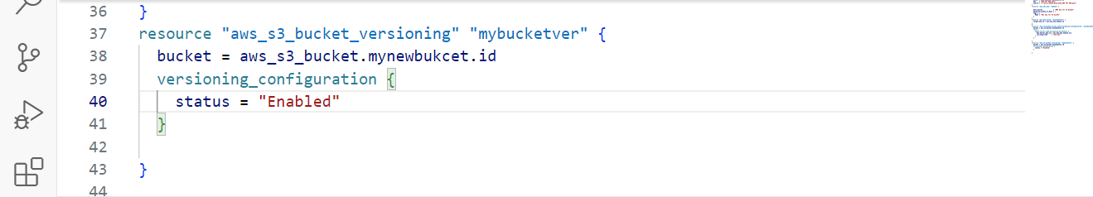
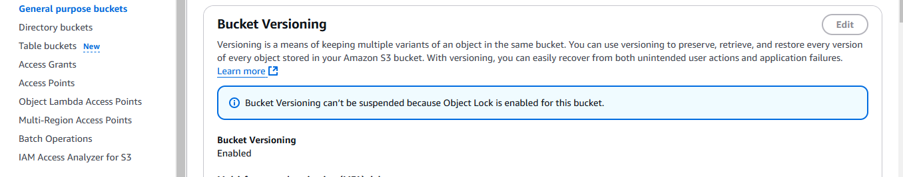
S3 Bucket Versioning Enabled by using Terraform
→ S3 Versioning is a feature that allows you to keep multiple versions of an object in an S3 bucket. This helps in recovering deleted or overwritten files.

Slide 8
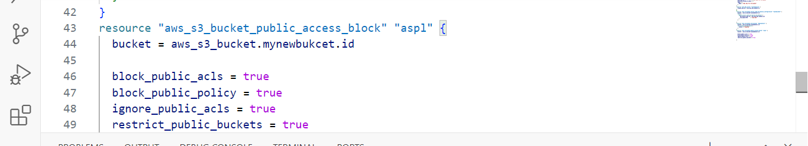
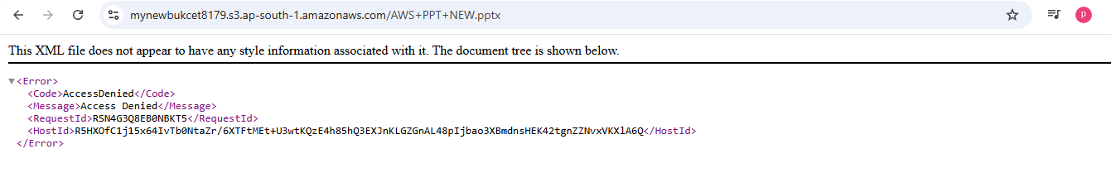
S3 Block Public Access by using Terraform
→ AWS S3 Block Public Access is a security feature that prevents accidental public access to S3 buckets and objects. It helps protect sensitive data by blocking all public ACLs and bucket policies.

Slide 9
CONCLUSION
(Simple Storage Service) is a highly scalable object storage solution. Terraform automates S3 bucket creation, versioning, encryption, and access control.
Enable Server-Side Encryption (SSE-KMS) for security.
Use Lifecycle Policies to optimize storage costs.
Block Public Access to prevent unauthorized access.
Enable Versioning to protect against accidental deletions.
Cost Optimization – Various storage classes (Standard, Intelligent-Tiering, Glacier, etc.) allow cost optimization based on access frequency and retention needs.
Performance & Availability – S3 offers high availability and fast data retrieval, with options like S3 Transfer Acceleration for global access.

Slide 10
THANK YOU!
S k Praveen Kumar

