Slide 1
Bandit Model Investigation
Why the Model Can't Learn
Model 195001001 (NIG Thompson Sampling) | Feb 2026
Phase 1: Model Health | Phase 2: Root Cause Analysis | Convergence Simulation

Slide 2
Executive Summary
The bandit model is mathematically correct but structurally unable to learn
  Root cause: data sparsity -- 92 treatments compete for ~750 opens/day
  Each treatment gets ~8 opens/day on average -- far too few to differentiate
Fix: reduce treatment pool from 92 to 10 treatments
  Simulation proves: convergence drops from 115 days to 28 days (4x faster)
  Non-convergence drops from 37.5% to 0%
Not a software bug -- a statistical reality
Hypothesis | Verdict | Details
H1: Bad training data | Minor | 877 phantom clicks (0.11%), 0 dupes, 0 time-travel
H2: Model misconfigured | Partial | 92 treatments in pool; Jan 23 score anomaly
H3: Structural limitation | PRIMARY | 115-day convergence, 37.5% never converge

Slide 3
How the Bandit Works
NIG Thompson Sampling
Prior
NIG(1,1,0,1)
Observe
Opens & Clicks
Update
Posterior
Sample
Thompson
Select
Treatment
Model trains on CTR of opens: clicks / opens (not clicks / sends)
  Retrains from scratch daily using ~120 days of historical data
  NIG prior: Normal-Inverse-Gamma(mu0=1, lambda=1, alpha=0, beta=1)
Posterior mean: mu = clicks / (1 + opens)
  Thompson Sampling: draw random sample from posterior, select highest
  Per request: only 4-7 treatments eligible (fitment-filtered)
Scores are raw CTR posteriors (~0.05-0.15 range)
  Not comparable to Random arm scores (boost-weighted, 0.5-1.0 range)

Slide 4
Phase 1 Recap
Model Updates But Doesn't Learn
Finding | Evidence | Implication
Scores shift daily | 0.001-0.005/day movement | Model IS updating
Click feedback broken | Clicks move scores ~0.001, often negative | Learning loop disconnected
Bandit CTR ~ Random | Within 0.15pp post-50/50 | No exploitation benefit
Near-uniform distribution | Top treatment = 6.28% share | No winner differentiation
User stickiness good | Only 2.2% see both arms | Clean experiment
Score anomaly (Jan 23) | 1,587 scores > 1.0 (max 4.32) | Requires investigation
Conclusion: The model retrains daily and produces slightly different scores, but individual clicks have negligible impact. The bandit acts as another random distribution.

Slide 5
Phase 2: Three Hypotheses
H1: Bad Training Data
Ruled Out
877 phantom clicks (0.11%) -- negligible.
0 duplicates, 0 time-travel events.
Is the model being fed incorrect data?
H2: Model Misconfigured
Partially
92 treatments in pool (too many).
31 new treatments added Jan 23 -> score anomaly.
Is the bandit set up wrong?
H3: Structural Limitation
PRIMARY
115 days to converge, 37.5% never.
Each treatment gets ~37 opens/day -- too few.
Can the model learn at this data volume?

Slide 6
Data Quality Is Clean (H1)
Training data audit: 120-day window
Metric | Value | Severity
Total LIVE sends | 821,740 | --
Phantom clicks (clicked=1, opened=0) | 877 (0.11%) | Low
Phantom clicks (bandit only) | 209 (0.03%) | Negligible
Duplicate treatment_tracking_ids | 0 | Clean
Non-LIVE sends (SIMULATION/QA) | 150,650 | Filtered correctly
Time-travel clicks (click before send) | 0 | Clean
Time-travel opens (open before send) | 0 | Clean
Sends with score <= 0 | 2 | Negligible
Sends with score > 1.0 | 1,686 | Investigated (Q14)
VERDICT
Data is NOT the problem.
Zero duplicates, zero time-travel. 877 phantom clicks are from image-blocking email clients -- a known, negligible issue.

Slide 7
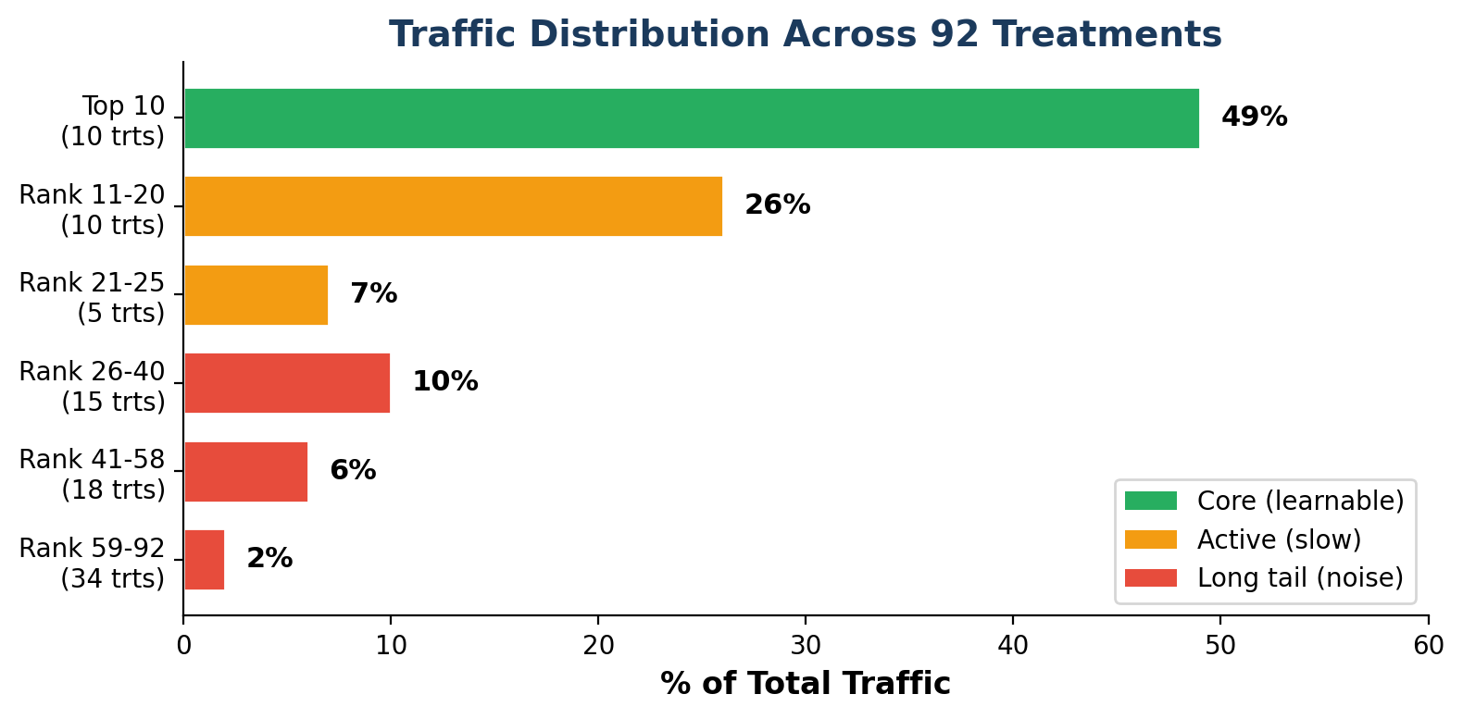
Treatment Count: 92 in Pool (H2)
Traffic heavily concentrated at top
92 treatments in bandit pool
Top 10: ~250 sends/day each
  ~37 opens/day each
Rank 11-20: 103-189 sends/day
Rank 21-92: < 50 sends/day each
  34 treatments get 1-7 sends/day
Per user: only 4-7 eligible
  Fitment requirements narrow the pool
Long-tail noise undermines learning

Slide 8
The Score Anomaly (Jan 23)
31 new treatments added overnight
Date | Invalid Scores | Avg Score | Max Score
Jan 23 | 197 | 1.48 | 4.32
Jan 24 | 233 | 1.41 | 3.82
Jan 25-26 | 461 | 1.39 | 3.82
Jan 27-28 | 347 | 1.43 | 3.14
Jan 29-30 | 317 | 1.43 | 3.10
Jan 31 | 31 | 1.37 | 2.65
Feb 3+ | 1 | 1.09 | 1.09
What happened:
  Jan 23: treatment count jumped from 56 to 87 (+31 overnight)
  Total 1,686 invalid scores > 1.0
Root cause:
  New treatments had 1-29 sends before anomaly
  NIG prior + tiny observations -> extreme Thompson Sampling perturbation
  With lambda=1 and n=1, single click gives mu=0.5, huge stddev
Self-corrected by Feb 1
  As treatments accumulated data, posteriors stabilized
Fix: clamp scores to [0, 1] + cold-start warmup

Slide 9
NIG Math Verification
Model is correct -- not a bug
Treatment | Clicks | Opens | Sends | Expected mu | Actual Score | Delta
17049625 | 102 | 1,462 | 11,797 | 0.0697 | 0.0753 | +0.6pp
21265478 | 142 | 1,232 | 7,008 | 0.1152 | 0.1114 | -0.4pp
21265451 | 123 | 1,347 | 9,735 | 0.0912 | 0.0929 | +0.2pp
16490939 | 41 | 701 | 8,065 | 0.0584 | 0.0603 | +0.2pp
21265506 | 118 | 1,175 | 8,051 | 0.1004 | 0.1003 | -0.01pp
Formula: mu = clicks / (1 + opens)
All 5 treatments match expected NIG posterior mean within 0.01-0.6pp
Model uses opens (not sends) as observation count -- confirmed correct
Within-day score variation (stddev 0.003-0.008) is from Thompson Sampling perturbation, not posterior uncertainty
VERDICT: The math is right. This is NOT a model bug.

Slide 10
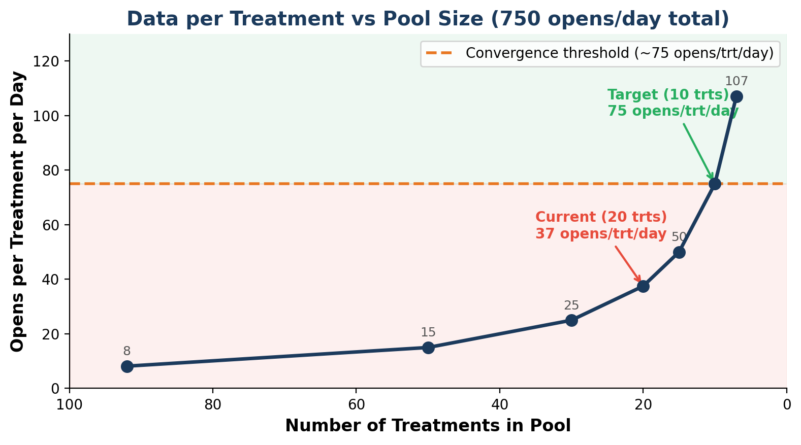
Root Cause: Data Sparsity (H3)
Not enough opens per treatment to differentiate
The math:
  750 opens/day total across all treatments
  20 high-traffic treatments -> 37 opens/trt/day
Why it can't converge:
  Adjacent treatments differ by ~2pp CTR
  Posterior stddev must be < 1pp to differentiate
  Need ~75+ opens/trt/day for that precision
Impact on individual clicks:
  With 12K+ observations, 1 click moves score by 0.00008
  Treatment 17049625: 218 sends/day, click delta essentially invisible

Slide 11
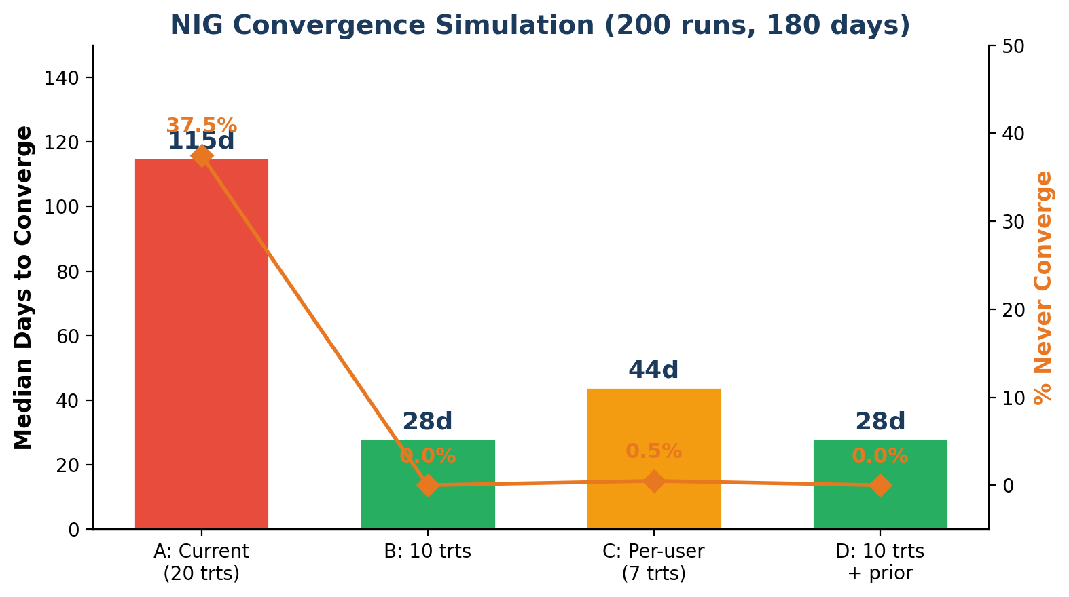
Convergence Simulation Results
NIG simulation: 200 runs x 180 days, 4 scenarios
Scenario | Median Days | P90 Days | Never %
A: Current (20 trts) | 115 | 167 | 37.5%
B: 10 treatments | 28 | 59 | 0.0%
C: Per-user (7 trts) | 44 | 88 | 0.5%
D: 10 trts + prior | 28 | 59 | 0.0%
Key takeaway:
Reducing 20 -> 10 treatments: 4x faster convergence
Non-convergence: 37.5% -> 0%
Informative priors DON'T help -- overwhelmed by data in 1-2 days
Per-user (7 trts) helps but model still maintains 20 global posteriors

Slide 12
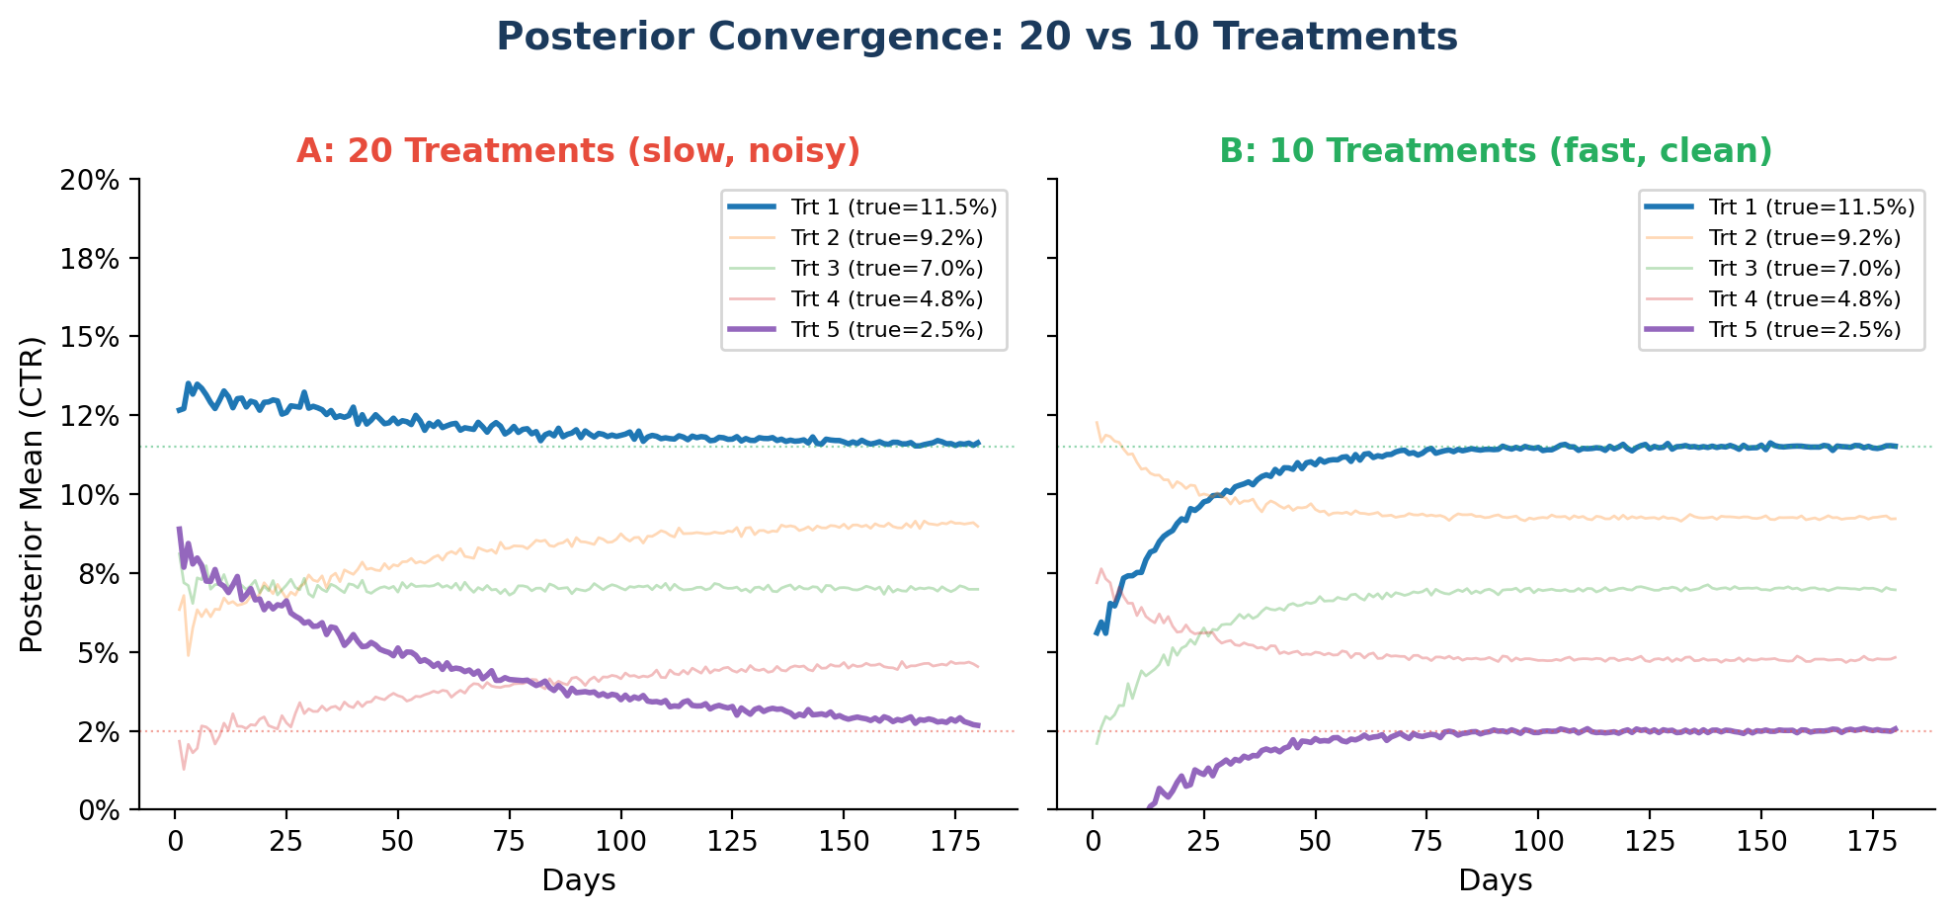
Posterior Evolution Over Time
Why 20 treatments can't separate adjacent CTRs
Left (A): With 20 treatments, posterior means remain noisy and overlapping for months. Adjacent treatments (e.g., 11.5% vs 10%) cannot be separated.
Right (B): With 10 treatments, 2x more data per treatment. Posteriors converge cleanly and the model can identify and exploit winners within 4 weeks.

Slide 13
The Fix: Reduce to 10 Treatments
BEFORE: 92 Treatments
92 treatments maintain posteriors
Top 10 = 49% of traffic
72 treatments get < 50 sends/day
37 opens/treatment/day
115 days to converge
37.5% never converge
AFTER: 10 Treatments
10 treatments with highest traffic
Each gets ~250 sends/day
No long-tail noise
75 opens/treatment/day
28 days to converge
0% never converge
4x
Remove 82 long-tail treatments that get < 50 sends/day
Top 10 already handle 49% of traffic -- minimal user impact
Expected: model starts exploiting winners within 4 weeks

Slide 14
Recommendations -- Prioritized
IMMEDIATE (This Week)
Reduce treatment pool 92 -> 10 -- HIGHEST IMPACT: 4x faster convergence, 0% non-convergence
Clamp scores to [0, 1] -- Prevent score > 1.0 anomaly. Apply MIN(score, 1.0) in serving layer
SHORT-TERM (Next 2 Weeks)
Cold-start warmup (>= 100 sends) -- New treatments excluded from bandit until sufficient data
Revert to 10/90 split -- With reduced pool, give bandit 90% traffic to learn faster
MEDIUM-TERM (Next Month)
Hierarchical learning -- Learn at campaign-type level, then differentiate within
Contextual bandits -- Current model ignores user features -- add vehicle type, engagement history

Slide 15
Summary & Key Numbers
Metric | Value | Source
Treatments in bandit pool | 92 | Q12
Treatments with 100+ sends/day | 20 (75% of traffic) | Q12
Top 10 share of traffic | 49% | Q12
Treatments eligible per user | 4-7 (fitment-filtered) | Q12
Clicks per treatment per week | 0.1-18 | Q16
Phantom clicks | 877 / 821,740 (0.11%) | Q11
Invalid scores (> 1.0) | 1,686 total | Q11/Q14
NIG posterior accuracy | Within 0.2-0.6pp | Q13
Convergence (20 trts) | 115 days, 37.5% never | Simulation
Convergence (10 trts) | 28 days, 0% never | Simulation
Improvement (20 -> 10) | 4x faster | Simulation
Bottom Line
Not a software bug -- a statistical reality to address through treatment consolidation.
Next Steps:
1. Reduce pool 92 -> 10
2. Clamp scores to [0,1]
3. Add cold-start warmup
4. Monitor for 4 weeks

