Slide 1
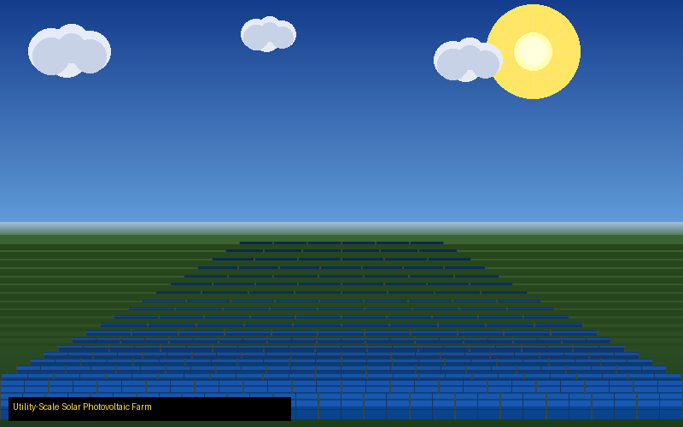
SOLAR
ENERGY
Harnessing the Power of the Sun — From Earth to Space
16 Detailed Slides
Satellite Connection
Case Studies
Global Examples
SEMINAR PRESENTATION • RENEWABLE ENERGY SERIES

Slide 2
TABLE OF CONTENTS
01
Introduction
08
Real-World Examples
Background & history of solar energy
Countries & companies leading solar
02
Definition & Science
09
Where Solar Is Used
What solar energy is & how it works
Top solar nations & regions
03
Types of Technology
10
Solar & Satellites
PV, CSP, Thermal & BIPV
Space power — the full connection
04
Advantages
11
Satellite Deep Dive
Why solar is the future
How satellites run on solar power
05
Disadvantages
12
Key Statistics
Honest challenges & limitations
Numbers shaping the solar future
06
Applications & Uses
13
Future of Solar
Homes, industries, transport & space
Perovskite, space solar & smart grids
07
Case Studies
14
Conclusion
Bhadla, Ivanpah, Benban & Tengger
Summary & key takeaways
2 / 16

Slide 3
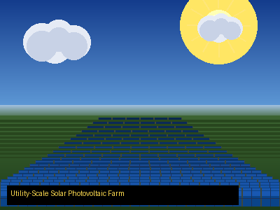
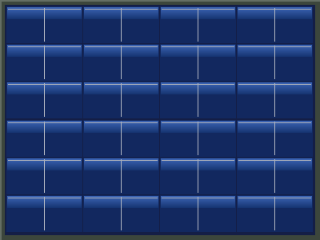
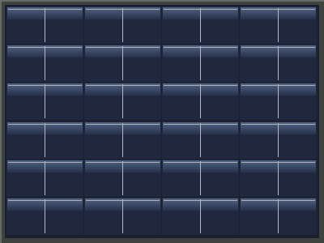

INTRODUCTION — The Story of Solar Energy
Ancient Roots
Humans used sunlight for warmth & food drying since prehistoric times. Greeks & Romans designed south-facing buildings to capture solar heat.
1839 Discovery
French physicist Edmond Becquerel discovered the photovoltaic effect — light striking certain materials generates an electric current.
1954 Breakthrough
Bell Labs built the first practical silicon solar cell at 6% efficiency. NASA adopted it immediately to power satellites — proving its reliability.
Cities rely on stable, scalable power — solar is the answer
Today's Reality
Solar is the world's fastest-growing energy. 1.2+ terawatts installed globally. Costs dropped 90% in a decade. Over 4 million jobs created.
3 / 16

Slide 4

Introduction
VISUAL EXPLANATION
Key Insights
Solar energy has been humanity's companion since ancient times. The Sun delivers 173,000 terawatts of energy continuously to Earth — far exceeding all human energy needs combined. From primitive fire pits aligned with the sun to today's gigawatt-scale power plants, our relationship with solar power has evolved dramatically. In 1839, Edmond Becquerel first observed that light could generate electric current — a discovery that would change civilization. By 1954, Bell Labs created the first practical silicon solar cell. Today, solar is the world's fastest-growing energy source with over 1.2 terawatts installed globally — enough to power entire continents.
Solar Energy & Satellite Technology | Introduction — Illustrated Overview

Slide 5





DEFINITION — What Is Solar Energy & How Does It Work?
Solar energy is radiant light and heat from the Sun, harnessed through technologies such as solar photovoltaics (PV), concentrated solar power (CSP), and solar thermal systems — converting sunlight into electricity or heat for human use.
HOW IT WORKS — The 5-Step Process
1
2
3
4
5
Sunlight
Hits Panel
Electrons
Released
DC Power
Generated
Inverter
to AC Power
Powers
Homes & Grids
The Photovoltaic Effect: Photons strike semiconductor silicon atoms, releasing electrons that flow as electrical current.
4 / 16

Slide 6
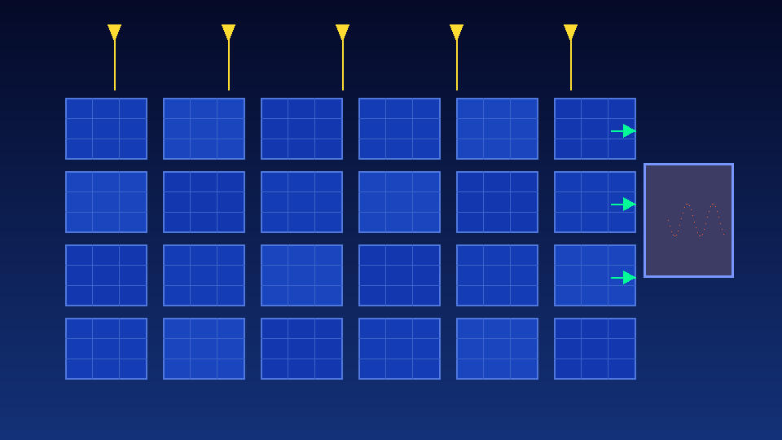
Definition & Science
VISUAL EXPLANATION
Key Insights
Solar energy is radiant light and heat emitted by the Sun, captured and converted into electrical or thermal energy. The photovoltaic (PV) effect occurs when photons from sunlight strike semiconductor silicon atoms and dislodge electrons, creating electric current. Each silicon solar cell generates about 0.5 volts; thousands are wired together to form panels generating hundreds of watts. Sunlight travels 150 million kilometers in just 8 minutes to reach Earth. Every hour, the Sun delivers more energy to Earth's surface than humanity uses in an entire year — making solar the most abundant energy resource on the planet. Modern multi-junction cells used in satellites achieve efficiencies exceeding 40%.
Solar Energy & Satellite Technology | Definition & Science — Illustrated Overview

Slide 7
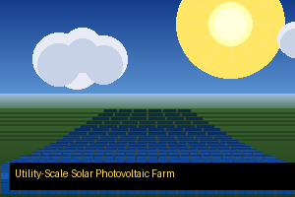
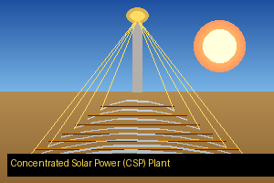
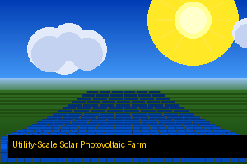

TYPES OF SOLAR TECHNOLOGY
Photovoltaic (PV) Panels
Concentrated Solar Power (CSP)
Most common type worldwide
Uses mirrors/lenses to focus sunlight
Silicon cells convert light to electricity
Heats fluid to drive a steam turbine
Used on rooftops, solar farms & satellites
Best for large utility-scale power plants
Efficiency: 15–23% commercial, 30%+ in space
Can store heat to generate electricity at night
Solar Thermal Systems
Building-Integrated PV (BIPV)
Heats water for homes & buildings
Solar cells built into roof tiles or windows
Common in hotels, hospitals & swimming pools
Tesla Solar Roof is a prime example
Simple tech with low maintenance costs
Aesthetic — no visible separate panels
Widely used in Mediterranean, India & China
Growing in smart & sustainable architecture
5 / 16

Slide 8
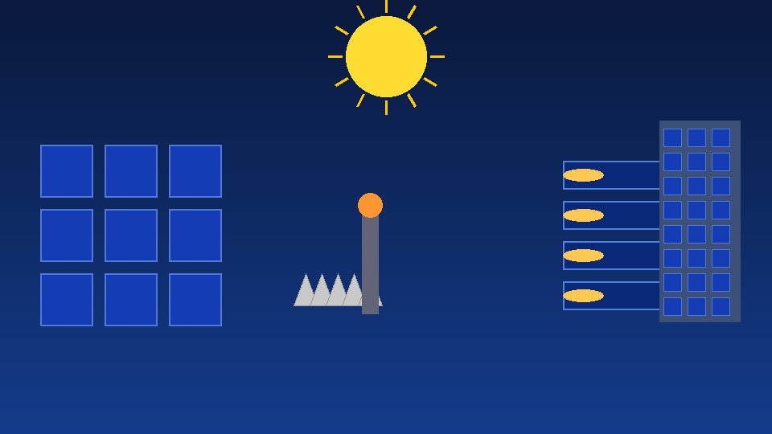
Types of Technology
VISUAL EXPLANATION
Key Insights
Solar technology comes in four major forms, each suited to different applications and scales. Photovoltaic (PV) panels are the most widespread — silicon cells convert sunlight directly into electricity at 15–23% efficiency commercially, and are used on rooftops, farms, and satellites. Concentrated Solar Power (CSP) uses mirrors or lenses to focus sunlight, generating heat that drives steam turbines at utility scale — and can store thermal energy for night-time generation. Solar Thermal systems heat water directly for residential and commercial use, common in Mediterranean, Indian, and Chinese markets. Building-Integrated PV (BIPV) embeds solar cells into roof tiles and architectural glass, with Tesla Solar Roof being the most recognized commercial example, making solar generation invisible within buildings.
Solar Energy & Satellite Technology | Types of Technology — Illustrated Overview

Slide 9






ADVANTAGES OF SOLAR ENERGY
Clean & Renewable
Reduces Electricity Bills
Energy Independence
Zero greenhouse gas emissions during operation. Sunlight is inexhaustible — free for billions of years to come.
Homeowners cut bills by 50–90%. Excess energy can be sold back to the grid through net metering programs.
Nations can reduce reliance on imported fossil fuels. Remote villages can generate their own off-grid power.
Low Maintenance
Creates Millions of Jobs
Scalable & Versatile
No moving parts. Minimal upkeep after installation. Solar panels last 25–30 years with only occasional cleaning.
Solar employs 4M+ people globally across installation, manufacturing, engineering, and research roles.
Works at any scale — from a single solar phone charger to a 2,000 MW national power plant. Easy to expand.
6 / 16

Slide 10
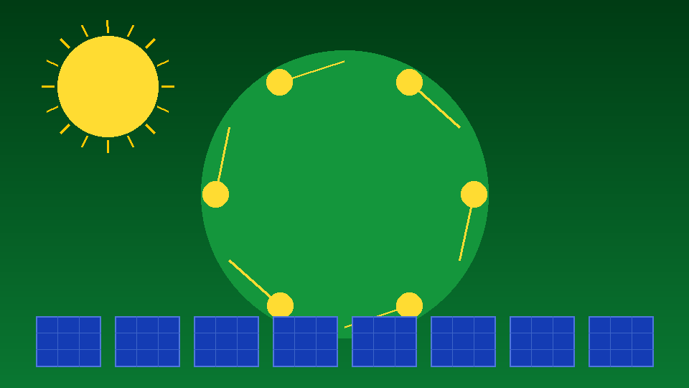
Advantages
VISUAL EXPLANATION
Key Insights
Solar energy offers transformative advantages making it the centerpiece of the global energy transition. It produces zero greenhouse gas emissions during operation, making it among the cleanest energy sources available. Once installed, sunlight is completely free — enabling homeowners to cut electricity bills by 50–90% and sell surplus energy back through net metering. Nations with abundant sunshine can achieve true energy independence, reducing costly fossil fuel imports. Solar panels have no moving parts, require minimal maintenance, and last 25–30 years. The industry now employs over 4 million people globally in installation, manufacturing, engineering, and research. Solar is infinitely scalable — from a single solar lantern lighting a rural home in Africa to a 2,000 MW national power station connecting millions of households.
Solar Energy & Satellite Technology | Advantages — Illustrated Overview

Slide 11






DISADVANTAGES OF SOLAR ENERGY
Intermittent Supply
High Initial Cost
Solar generates power only when the sun shines. Cloudy days and nights require battery storage or backup grid connections.
Home systems cost $10,000–$30,000 upfront. Though prices fell 90% in a decade, the initial investment remains a barrier.
Large Land Requirement
Energy Storage Costs
Utility-scale farms need 5–10 square miles per 1 GW. This competes with agriculture and natural habitats in land-scarce regions.
Lithium-ion batteries to store solar power overnight remain expensive, adding 30–50% to total system cost.
Efficiency Limitations
Manufacturing & Recycling
Commercial panels convert only 15–22% of sunlight. Much energy is lost as heat. Multi-junction cells in space reach 40% but are costly.
Silicon, silver, and cadmium in panels require energy to produce. End-of-life recycling infrastructure is still developing globally.
7 / 16

Slide 12

Disadvantages
VISUAL EXPLANATION
Key Insights
Despite its promise, solar energy faces real challenges for widespread adoption. Solar generates power only when the sun shines — nights and cloudy weather require battery storage or backup grid connections, creating intermittency issues that complicate grid management. Upfront residential system costs of $10,000–$30,000 remain a significant barrier, despite prices dropping 90% over the past decade. Utility-scale solar farms require 5–10 square miles per gigawatt, competing with agricultural land and natural habitats. Battery storage systems to hold excess solar power add 30–50% to total system cost. Commercial panels convert only 15–22% of sunlight into electricity, with most energy lost as heat. Manufacturing requires silicon, silver, and cadmium extraction, and end-of-life recycling infrastructure remains underdeveloped globally, raising lifecycle sustainability concerns.
Solar Energy & Satellite Technology | Disadvantages — Illustrated Overview

Slide 13


APPLICATIONS & USES OF SOLAR ENERGY
Residential
Industrial
Grid-Scale Power
Rooftop panels power homes, heat water, and charge EVs. Millions of households worldwide are now fully energy self-sufficient.
Factories use solar to power production and reduce costs. Solar heat is used in food, textile, pharmaceutical & chemical industries.
Massive solar farms feed electricity into national grids. A single large farm can power hundreds of thousands of homes continuously.
Transportation
Satellites & Space
Agriculture
Solar charges electric vehicles, powers solar boats, planes, and public buses. Solar road panels are being tested in France & USA.
Every satellite and the ISS runs entirely on solar. It is the only viable power source in orbit — without solar, space exploration stops.
Solar-powered irrigation pumps and greenhouses are transforming farming across Africa, India, and South America — without the grid.
8 / 16

Slide 14
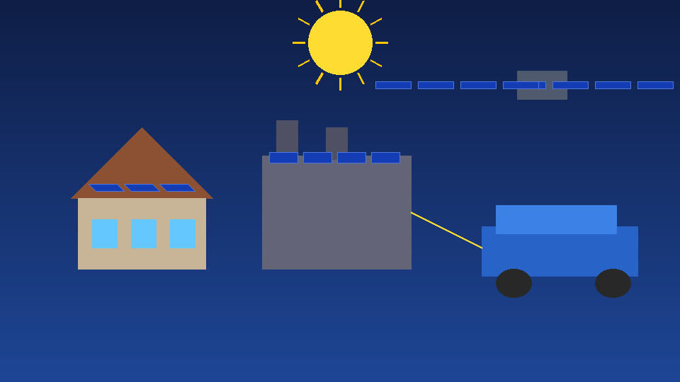
Applications & Uses
VISUAL EXPLANATION
Key Insights
Solar energy's versatility makes it applicable across virtually every sector of modern life. In residential settings, rooftop panels power homes, heat water, and charge electric vehicles — millions of households are now energy self-sufficient. Industrial applications include powering factories and providing process heat for food, textile, pharmaceutical, and chemical industries. Grid-scale solar farms feed clean electricity to national grids — single installations powering hundreds of thousands of homes. Transportation is being transformed by solar — charging EV fleets, powering boats and experimental aircraft, and testing solar road panels in France and the USA. Space exploration depends entirely on solar: every satellite and the International Space Station run purely on solar panels. Agriculture benefits through solar-powered irrigation pumps and greenhouses transforming farming across Africa, India, and South America without grid connections.
Solar Energy & Satellite Technology | Applications & Uses — Illustrated Overview

Slide 15
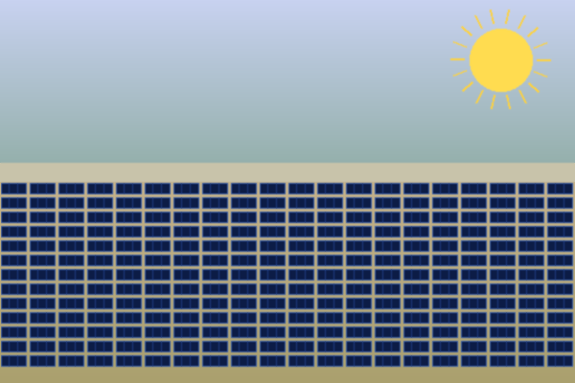
CASE STUDIES — World's Greatest Solar Projects
Bhadla Solar Park
2,245 MW
Rajasthan, India
World's largest solar park — 14,000 acres of desert. Powers over 1 million Indian homes. Built with $1.4 billion investment and completed in 2020.
Ivanpah Solar Electric
392 MW
Mojave Desert, USA
Concentrated Solar Power plant using 170,000 heliostats to focus sunlight onto three towers. Generates power for 140,000 California homes.
Benban Solar Hub
1,650 MW
Aswan, Egypt
Africa's largest solar installation — 40 individual projects. Supports Egypt's target of 42% renewable electricity by 2035 and creates 4,000+ local jobs.
Tengger Desert Solar
1,547 MW
Ningxia, China
Nicknamed the 'Great Wall of Solar' and visible from space. China leads the world with 430+ GW total installed solar capacity as of 2024.
9 / 16
Combined capacity: ~5,834 MW — enough to power 4+ million homes around the clock

Slide 16
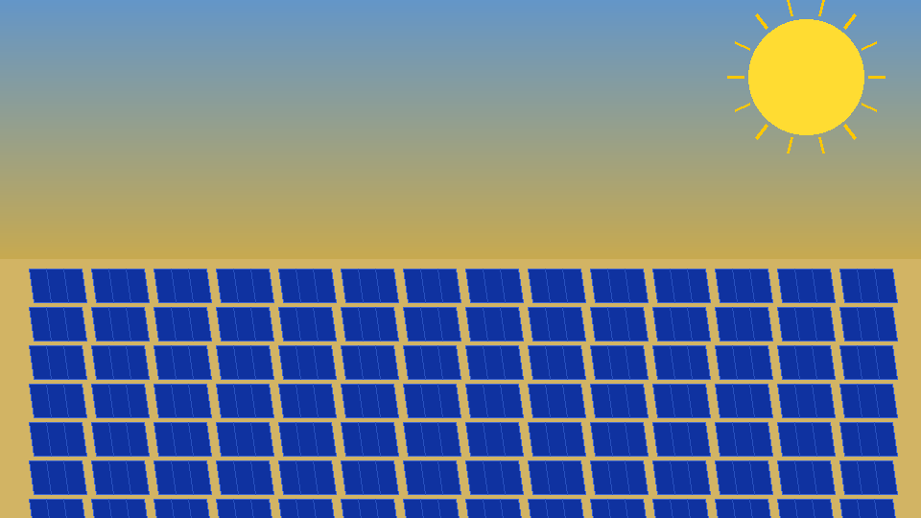
Case Studies
VISUAL EXPLANATION
Key Insights
The world's landmark solar projects demonstrate the technology's extraordinary scale and global impact. Bhadla Solar Park in Rajasthan, India — the world's largest — spans 14,000 acres of Thar Desert, generating 2,245 MW, completed in 2020 and powering over 1 million homes. Ivanpah Solar Electric in California's Mojave Desert uses 170,000 heliostats focusing sunlight onto three 140-meter towers, producing 392 MW CSP for 140,000 homes. Egypt's Benban Solar Hub near Aswan comprises 40 individual projects totaling 1,650 MW — Africa's largest solar installation — supporting Egypt's target of 42% renewable electricity by 2035. China's Tengger Desert Solar Park in Ningxia generates 1,547 MW and is nicknamed the "Great Wall of Solar" — visible from space — reflecting China's world-leading 430+ GW total installed solar capacity.
Solar Energy & Satellite Technology | Case Studies — Illustrated Overview

Slide 17
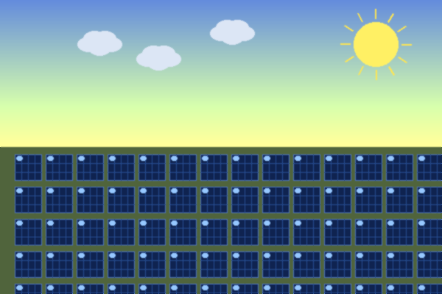
REAL-WORLD EXAMPLES — Solar in Everyday Life
Google Campus — Mountain View, USA
Noor Ouarzazate — Morocco
Google's offices & data centers run on 100% renewable energy. Its Mountain View campus uses 9.5 MW of rooftop and carport solar panels.
World's largest CSP complex (580 MW). Morocco exports solar electricity to Europe through undersea cables, earning revenue from clean energy.
Cochin Airport — India
Tesla Solar Roof — Global
World's first fully solar-powered international airport (2015). Over 50,000 panels generate all the power the airport needs — zero grid dependency.
Tesla replaces roof tiles with solar-integrated tiles that generate power invisibly. Over 200,000 homes worldwide now use this technology.
Solar Street Lights — Sub-Saharan Africa
MS Tûranor PlanetSolar — Ocean Voyage
10+ million solar LED street lights illuminate roads and villages with zero grid connection needed. Reduces crime and improves safety at night.
Swiss solar catamaran circumnavigated Earth in 2012 using only solar power — proving maritime solar viability across oceans.
10 / 16

Slide 18
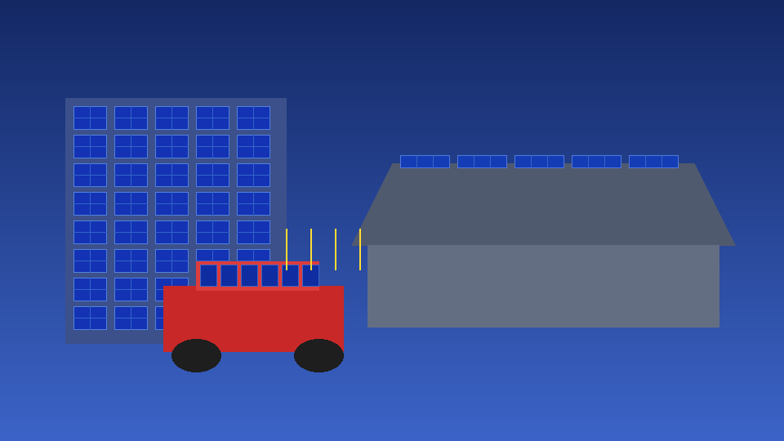
Real-World Examples
VISUAL EXPLANATION
Key Insights
Solar energy powers some of the world's most iconic institutions and innovations. Google's Mountain View campus generates 9.5 MW from rooftop and carport solar; the entire company runs on 100% renewable energy across global operations. Morocco's Noor Ouarzazate complex — the world's largest CSP installation at 580 MW — exports clean electricity to Europe through undersea cables, turning sunshine into export revenue. Cochin International Airport in India became the world's first fully solar-powered airport in 2015, with 50,000+ panels supplying all electricity with zero grid dependency. Tesla's Solar Roof has been installed on over 200,000 homes worldwide, integrating solar cells invisibly into building materials. Over 10 million solar LED street lights now illuminate roads across Sub-Saharan Africa with no grid connection needed, dramatically improving safety and community wellbeing.
Solar Energy & Satellite Technology | Real-World Examples — Illustrated Overview

Slide 19

WHERE IS SOLAR ENERGY USED? — Top Nations & Regions
Top 10 Countries by Installed Solar Capacity (GW, 2024)
Regional Highlights
China
430 GW
ASIA
China produces 30%+ of world's solar. Japan uses floating solar on reservoirs. India adding 50 GW/year.
USA
141 GW
Japan
87 GW
Germany
82 GW
EUROPE
Germany & Spain lead Europe. Portugal ran 100% renewable for 6 days straight in 2023.
India
73 GW
Australia
37 GW
AFRICA
Egypt, Morocco & South Africa are leaders. The Sahara alone could power all of Earth's electricity needs.
Brazil
34 GW
Italy
31 GW
S. Korea
26 GW
AMERICAS
USA has 140+ GW. California leads. Brazil solar capacity growing 50% year-on-year since 2020.
Spain
24 GW
11 / 16

Slide 20
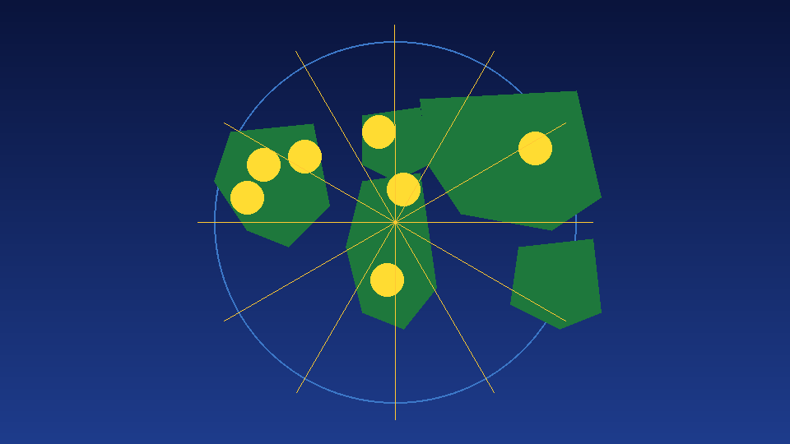
Where Solar Is Used
VISUAL EXPLANATION
Key Insights
Solar energy adoption spans every continent, with regions leveraging their unique solar resources. China dominates globally with 430+ GW installed — 30%+ of world solar output. The United States has surpassed 140 GW with California as its powerhouse. India targets 500 GW by 2030, adding 50 GW per year. Germany leads Europe despite modest sunshine, proving policy and investment can overcome geographic limitations. Portugal ran 100% renewable energy for six straight days in 2023 — a historic milestone. Africa holds immense untapped potential: the Sahara Desert alone could theoretically power all of Earth's electricity. Brazil's solar capacity has grown 50%+ annually since 2020. Floating solar (floatovoltaics) on reservoirs in Japan, India, and South Korea are solving land scarcity in densely populated nations while also reducing water evaporation.
Solar Energy & Satellite Technology | Where Solar Is Used — Illustrated Overview

Slide 21
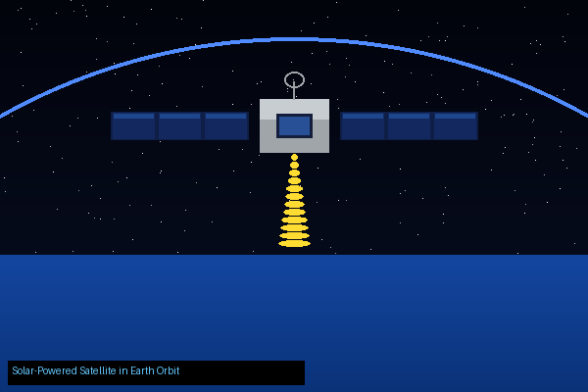
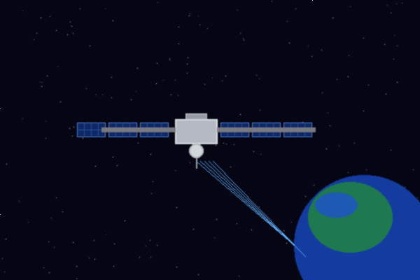
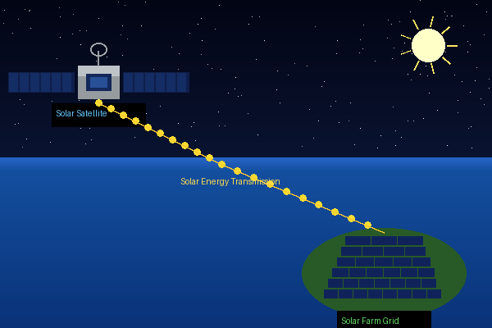
SOLAR ENERGY & SATELLITES — The Space Connection
Satellites Fully Solar-Powered
Since Vanguard 1 (1958), every satellite uses solar panels as its main power source. No other energy source works reliably in orbit long-term.
ISS — 8 Solar Array Wings
Solar Radiation
Data & Signals
SUN
EARTH
The ISS solar wings cover 2,500 m² (an entire acre) and generate 84–120 kW — all the power for 6 crew members and hundreds of experiments.
Solar-powered satellite in Earth orbit
SATELLITE
Solar Satellites Monitor Earth
Satellites like Sentinel, Landsat, and GOES use solar power to track climate change, wildfires, hurricanes, and measure the Sun's energy output.
Space-Based Solar Power (Future)
1958
84 kW
40%
Engineers plan orbiting solar stations that collect energy 24/7 and beam it to Earth as microwaves — solving solar intermittency permanently.
First satellite powered by solar (Vanguard 1)
Electricity generated by ISS solar wings
Solar cell efficiency achieved in space (multi-junction)
12 / 16

Slide 22

Solar & Satellites
VISUAL EXPLANATION
Key Insights
The connection between solar energy and satellites is fundamental and inseparable. Since Vanguard 1 in 1958 — the first solar-powered satellite — every spacecraft has relied on solar panels as its primary power source, as no other energy technology can reliably operate in the vacuum of space over decades. The International Space Station's eight solar array wings span 2,500 square meters — one full acre — generating 84–120 kW of power for its six-person crew and hundreds of scientific experiments continuously. Earth-observing satellites like Sentinel, Landsat, and GOES use solar power to monitor climate change, wildfires, hurricanes, and deforestation in real time. Space-Based Solar Power (SBSP) stations would collect sunlight 24 hours a day in geostationary orbit and beam it to Earth as microwave energy — permanently solving the intermittency problem that limits ground-based solar installations.
Solar Energy & Satellite Technology | Solar & Satellites — Illustrated Overview

Slide 23
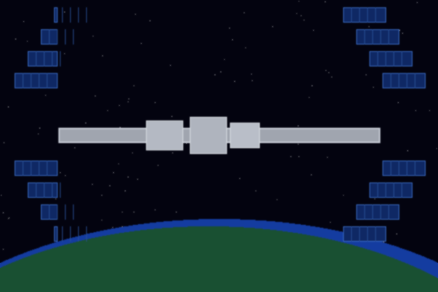
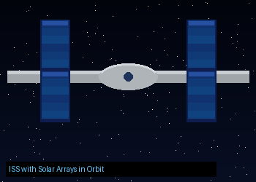
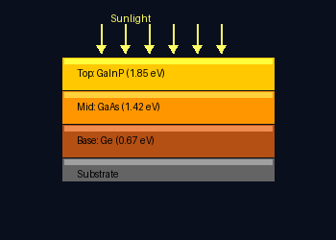
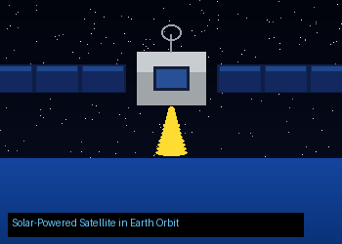
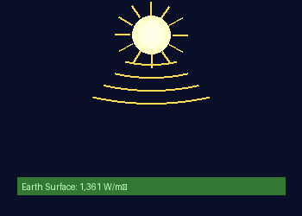
HOW SOLAR PANELS POWER SATELLITES — Technical Deep Dive
Why Solar in Space?
In orbit, the Sun shines 24/7 with no atmosphere reducing its intensity. Solar panels collect far more energy per m² than on Earth's surface — and fuel is impossible to resupply.
Multi-Junction Solar Cells
Satellites use gallium arsenide multi-junction cells achieving 30–40% efficiency, compared to 15–22% for Earth panels. They work in extreme cold (−150°C) and heat (+120°C).
International Space Station — 8 solar wings generating 84-120 kW
Communication Satellites
International Space Station — 8 solar wings, 2,500 m², generating 84–120 kW of power
Every GPS, TV broadcast, weather, and internet satellite (Starlink, Intelsat, DirecTV) runs purely on solar power. Without solar panels, global communications networks collapse.
Solar Irradiance Data
SORCE, DSCOVR & Sentinel satellites measure the Sun's energy output and send real-time data back to Earth — used to model climate change and predict solar storms.
KEY INSIGHT: Solar panels were first proven reliable in space before they became common on Earth — satellites were the original solar technology testbed.
13 / 16

Slide 24
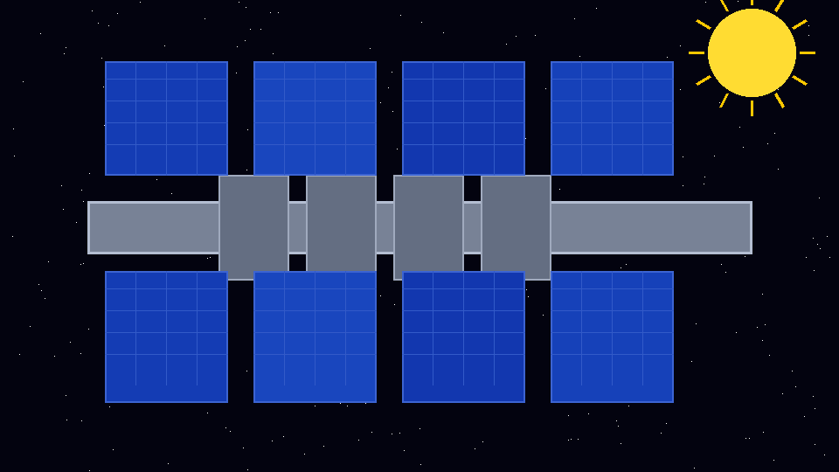
Satellite Deep Dive
VISUAL EXPLANATION
Key Insights
Satellites operate in one of the most extreme environments — temperature swings from −150°C to +120°C, intense radiation, and complete vacuum — yet solar panels power them flawlessly for decades. Unlike Earth-based panels using silicon at 15–22% efficiency, satellites use gallium arsenide multi-junction solar cells achieving 30–40% efficiency, maximizing power in weight-constrained spacecraft. Every GPS satellite, weather satellite, TV broadcast satellite, and internet satellite (including Starlink's 5,000+ constellation) runs purely on solar power. The SOHO, DSCOVR, and Sentinel satellites measure the Sun's energy output and solar wind activity, sending critical data to predict solar storms that could disrupt Earth's power grids. In orbit, sunlight is approximately 1.36 kilowatts per square meter — 30–40% more intense than at Earth's surface because there is no atmosphere absorbing and scattering the energy.
Solar Energy & Satellite Technology | Satellite Deep Dive — Illustrated Overview

Slide 25
KEY STATISTICS — Solar Energy by the Numbers
1.2 TW
90%
4M+
3%
Total global
capacity installed
Cost drop
2010 to 2024
Jobs created
globally
Share of global
electricity today
Global Solar Capacity Growth 2015–2024 (GW)
Global Electricity Mix (2024)
14 / 16

Slide 26

Key Statistics
VISUAL EXPLANATION
Key Insights
The numbers behind solar energy's global rise are staggering and accelerating rapidly. The world has installed over 1.2 terawatts (1,200 gigawatts) of solar capacity — a figure essentially zero just 20 years ago. Solar panel costs have plummeted 90% between 2010 and 2024, making solar the cheapest electricity source in human history in most markets. The solar industry employs over 4 million people globally, with jobs growing 8–10% annually. Solar currently provides approximately 3% of global electricity generation, with that share doubling roughly every three years. China alone added 216 GW of new solar in 2023 — more than the entire world installed in 2021. The IEA projects solar will become the single largest electricity source globally by 2027, surpassing coal, natural gas, nuclear, and hydropower. Global investment in solar energy exceeded $300 billion in 2023 alone.
Solar Energy & Satellite Technology | Key Statistics — Illustrated Overview

Slide 27
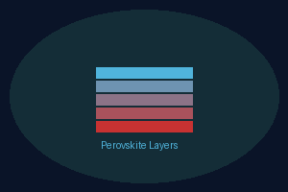
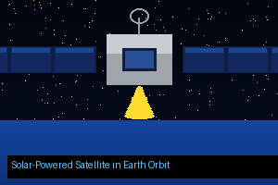




THE FUTURE OF SOLAR ENERGY
Perovskite Solar Cells
Space-Based Solar Power
Solid-State Solar Batteries
Next-gen material with 33%+ efficiency potential at a fraction of silicon's cost. Expected commercial rollout by 2028–2030.
Giant orbiting solar arrays beam microwave energy to Earth 24/7 — no clouds, no night, no interruption. Prototypes planned by 2035.
New battery chemistries will store solar power cheaply for days or weeks — finally eliminating the intermittency problem for good.
Floating Solar (Floatovoltaics)
Solar + EV Smart Homes
25% of Global Power by 2050
Panels on reservoirs and lakes reduce land use, lower water evaporation, and produce power in dense cities — growing 25% per year.
Solar roof + home battery + EV creates a self-sufficient home microgrid. Owners sell surplus energy back to the grid automatically.
The IEA projects solar providing 20–25% of global electricity by 2050. Combined with wind, renewables can reach 90% of global supply.
15 / 16

Slide 28
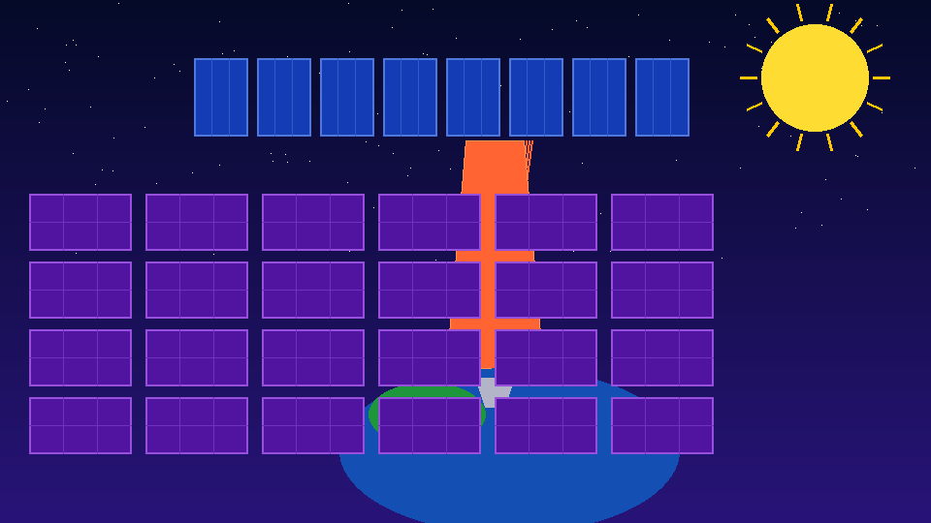
Future of Solar
VISUAL EXPLANATION
Key Insights
Next-generation solar technologies promise to shatter current limitations and transform global energy systems. Perovskite solar cells — a new class of crystalline materials — have achieved 33%+ efficiency in laboratory settings at a fraction of silicon's manufacturing cost, with commercial rollout expected between 2028 and 2030. Space-Based Solar Power (SBSP), being actively developed by ESA, Japan's JAXA, and the UK government, would place giant orbital solar arrays collecting energy 24/7 with no clouds, no night, and no seasonal variation — beaming it to Earth as microwaves by 2035. Solid-state solar batteries using ceramic electrolytes will store solar power cheaply for days or weeks, finally eliminating intermittency. Floating solar grows 25% per year globally, solving land constraints. Solar-EV-battery smart home microgrids are enabling millions of households to achieve complete energy independence from national grids.
Solar Energy & Satellite Technology | Future of Solar — Illustrated Overview

Slide 29
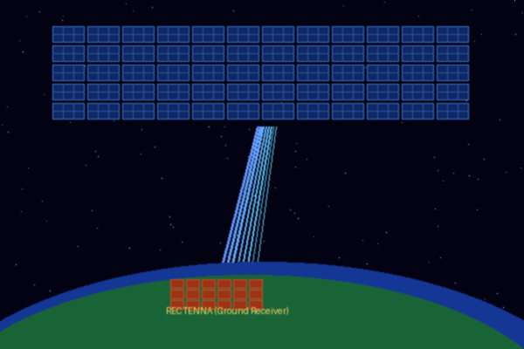
CONCLUSION & KEY TAKEAWAYS
Solar energy is not just a technology — it is the foundation of a sustainable future for all of humanity.
Solar is the world's fastest-growing, cheapest electricity source — costs have fallen 90% in just one decade.
It powers everything from remote African villages to the International Space Station in orbit.
Every satellite and spacecraft runs on solar — satellites were the original proof that solar works reliably.
Space-based solar power beaming microwave energy to Earth
Challenges like intermittency and storage are being rapidly solved through next-gen batteries and technology.
The future: perovskite cells, space-based solar farms, and smart microgrids will make solar dominant by 2050.
THANK YOU • Questions Welcome • The Sun Never Runs Out

Slide 30
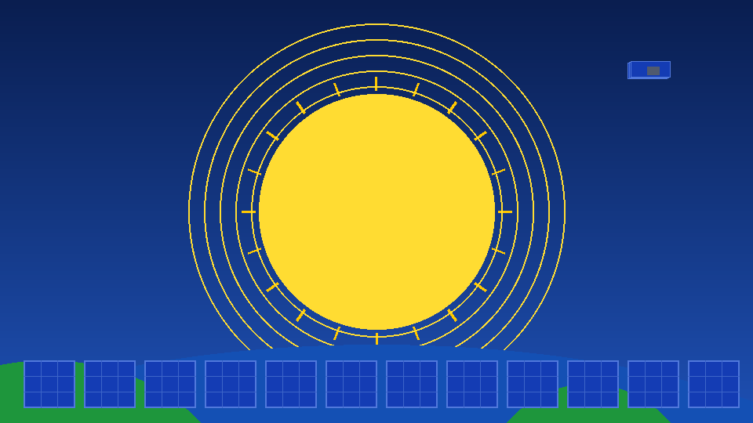
Conclusion
VISUAL EXPLANATION
Key Insights
Solar energy has evolved from a scientific curiosity into the cornerstone of humanity's sustainable energy future. In just one decade, costs have dropped 90%, capacity has grown from megawatts to terawatts, and solar has become the cheapest electricity in history — a transformation without precedent. From powering individual homes in remote African villages to energizing the International Space Station orbiting 400 kilometers above Earth, solar has proven its universal applicability and reliability. Every satellite and spacecraft depends on solar power — underscoring how fundamental and proven this technology truly is. Challenges of intermittency and storage are being rapidly solved through next-generation batteries, space-based collection, and smart grid integration. By 2050, the IEA projects solar will supply 25% of all global electricity, forming the backbone of a civilization powered by clean, inexhaustible energy from our nearest star.
Solar Energy & Satellite Technology | Conclusion — Illustrated Overview

Slide 31

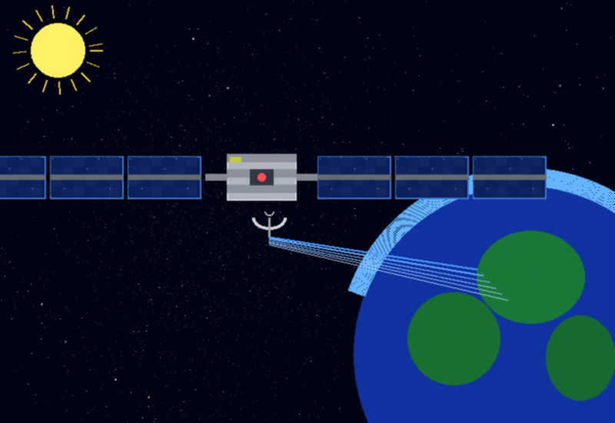
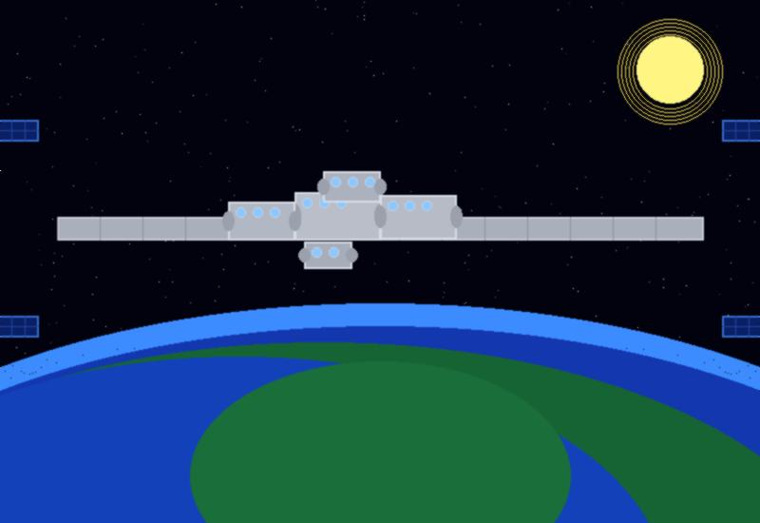
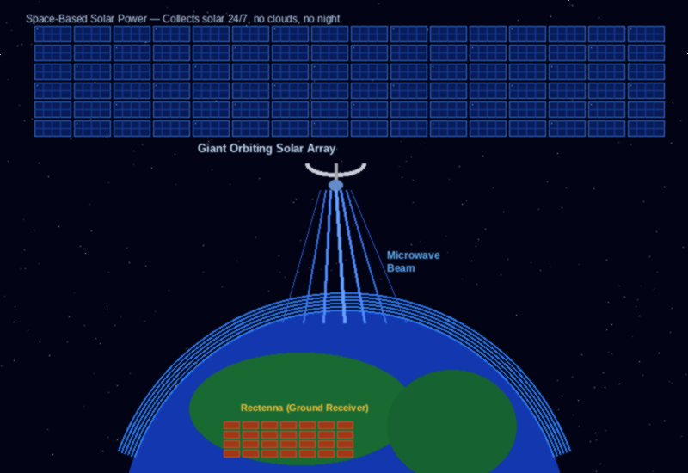

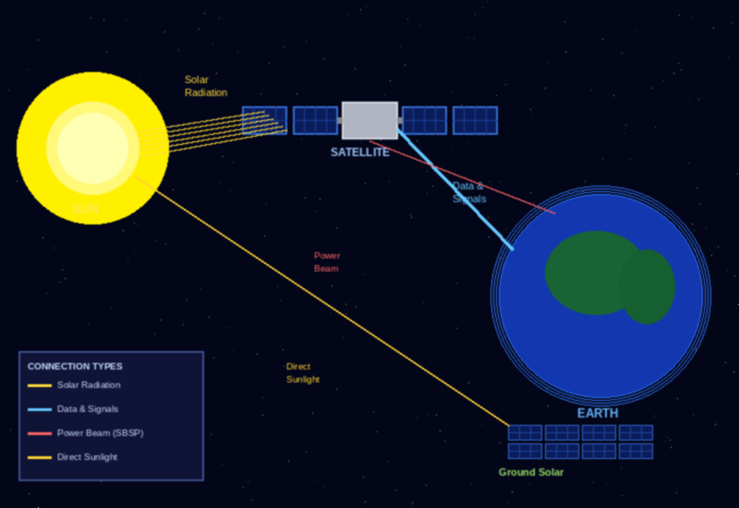
VISUAL GALLERY — Solar Energy & Satellites Explained
1. Utility-Scale Solar Farm
2. Communication Satellite
3. International Space Station
Thousands of PV panels covering desert land. Each farm generates 500–2,000+ MW — enough for millions of homes. Bhadla (India) is the world's largest at 2,245 MW.
Every GPS, TV, weather & internet satellite runs entirely on solar wings. In geostationary orbit (36,000 km), panels receive unfiltered sunlight 24/7.
The ISS has 8 giant solar array wings spanning 2,500 m² — one full acre. They generate 84–120 kW powering all experiments, life support & crew systems.
4. Space-Based Solar Power (SBSP)
5. Residential Rooftop Solar
6. Solar–Satellite–Earth Link
Future concept: giant orbiting solar arrays collect energy 24/7 and beam it to Earth as microwaves. No clouds, no night — clean baseload power globally.
A 5–15 kW rooftop system covers 50–90% of a home's electricity. Combined with a home battery, owners achieve full energy independence from the grid.
Solar radiation hits satellite panels → powers onboard systems → beams data & signals to Earth. Future SBSP will also beam power directly to ground receivers.
17 / 17 • From rooftop panels to orbiting stations — solar power connects Earth and Space

