Slide 1
PANDAS DATA ANALYSIS
Aggregation & Grouping
Summarizing and organizing data with pandas DataFrames
df.groupby("Department")["Marks"].mean()

Slide 2
AGGREGATION
What is Aggregation?
The process of combining multiple values into a single summary value — such as the sum, average, minimum, maximum, or count.
Many values
85
90
78
92
Sum: Adds all the values together
↓ aggregate
Average: Calculates the mean value
86.25
Maximum: Finds the largest value
Minimum: Finds the smallest value
Average Marks
Count: Counts non-empty values
Aggregation vs Grouping in Pandas
2

Slide 3
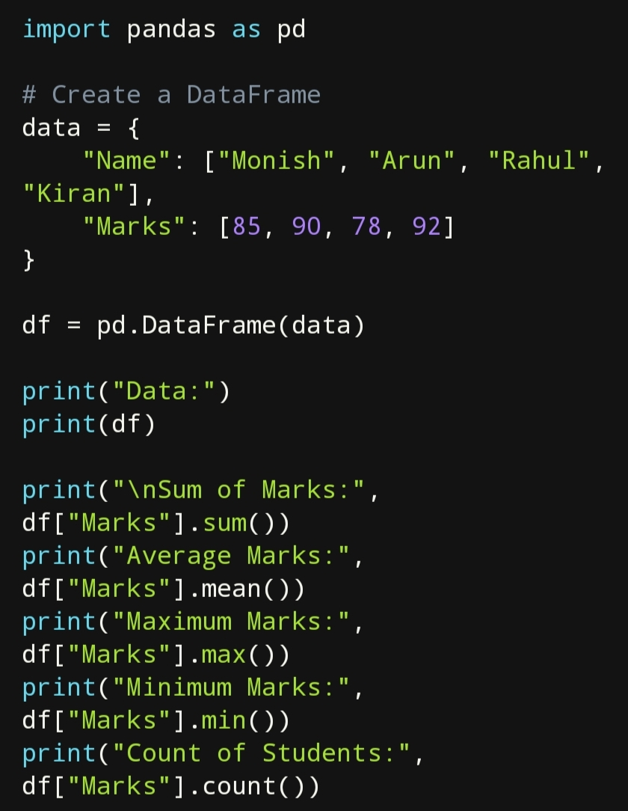
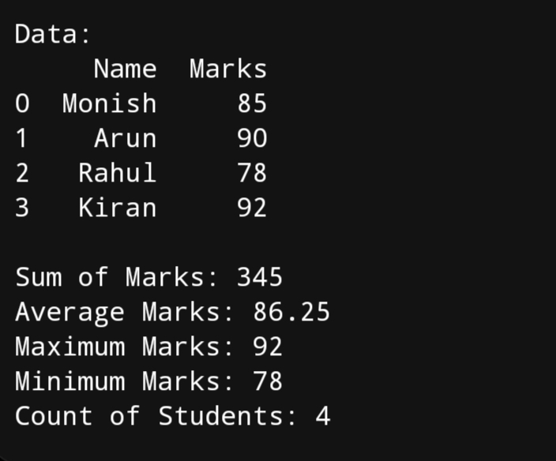
AGGREGATION
Example: Aggregating Student Marks
CODE
OUTPUT
Sum: 345 | Average: 86.25 | Max: 92 | Min: 78 | Count: 4
Aggregation vs Grouping in Pandas
3

Slide 4
AGGREGATION
Functions Used
pd.DataFrame(data)
df["Marks"]
Creates a table (DataFrame)
Selects the Marks column
.sum()
.mean()
Adds all values
Calculates the average
.max()
.min()
Finds the largest value
Finds the smallest value
.count()
print()
Counts non-empty values
Displays the output
Aggregation vs Grouping in Pandas
4

Slide 5
GROUPING
What is Grouping?
Dividing data into groups based on a common column, then performing operations such as sum, average, or count on each group separately.
Grouped by Department
CSE
81.5
groupby(column): Groups rows sharing a common value
ECE
89.0
Per-group summary: Each group gets its own result
Common use: Comparing categories, e.g. by department
IT
95.0
Aggregation vs Grouping in Pandas
5

Slide 6
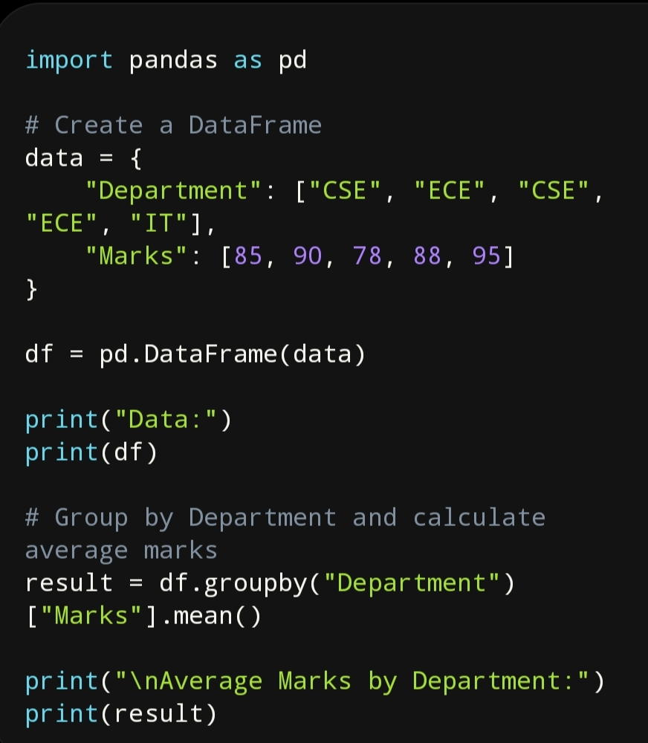
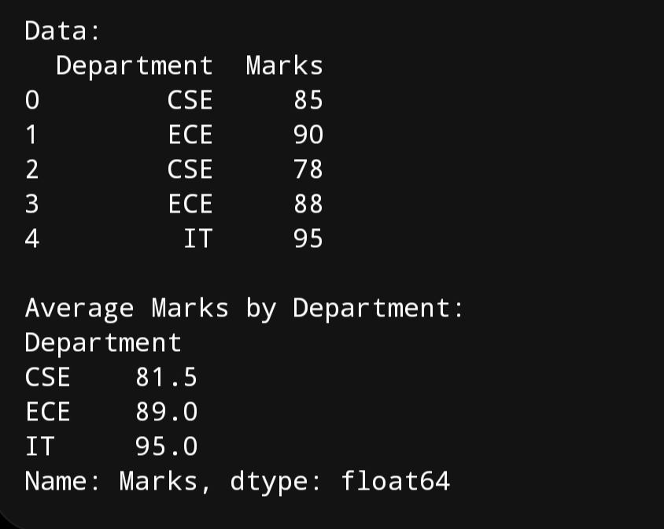
GROUPING
Example: Average Marks by Department
CODE
OUTPUT
groupby("Department")["Marks"].mean() → one average per department
Aggregation vs Grouping in Pandas
6

Slide 7
GROUPING
Functions Used
groupby("Department")
Groups rows based on the Department column
["Marks"]
Selects the Marks column from each group
.mean()
Calculates the average marks for each group
result
Stores the grouped result
print()
Displays the grouped output
Aggregation vs Grouping in Pandas
7

Slide 8
Aggregation vs Grouping
Key differences between the two concepts
AGGREGATION
GROUPING
Summarizes the entire dataset into one value
Divides data into groups before summarizing
Example: average marks of all students
Example: average marks department-wise
Uses functions like sum(), mean(), max(), min(), count()
Uses groupby() along with aggregation functions
Aggregation vs Grouping in Pandas
8

