Slide 1


For Dispatcher

Slide 2
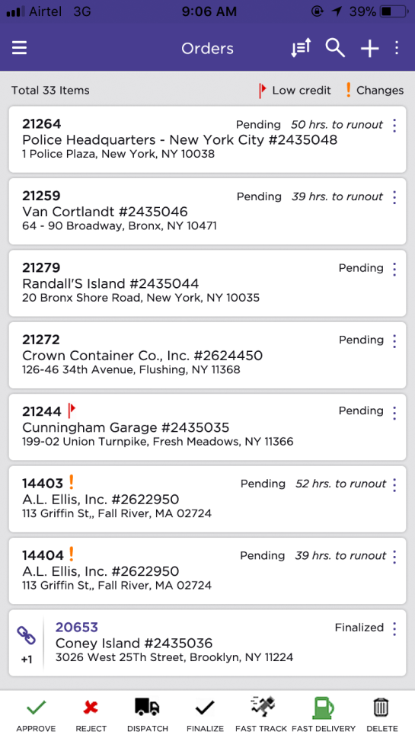
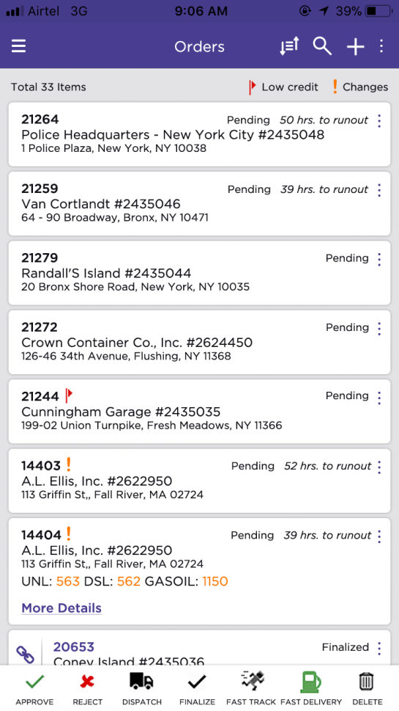
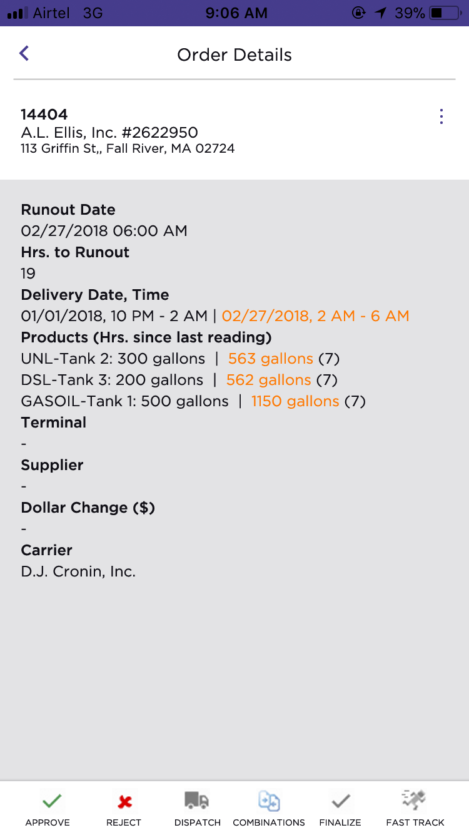
Orders & Details
Tap to view few more details
Tap on ‘More Details’ to view complete Information

Slide 3
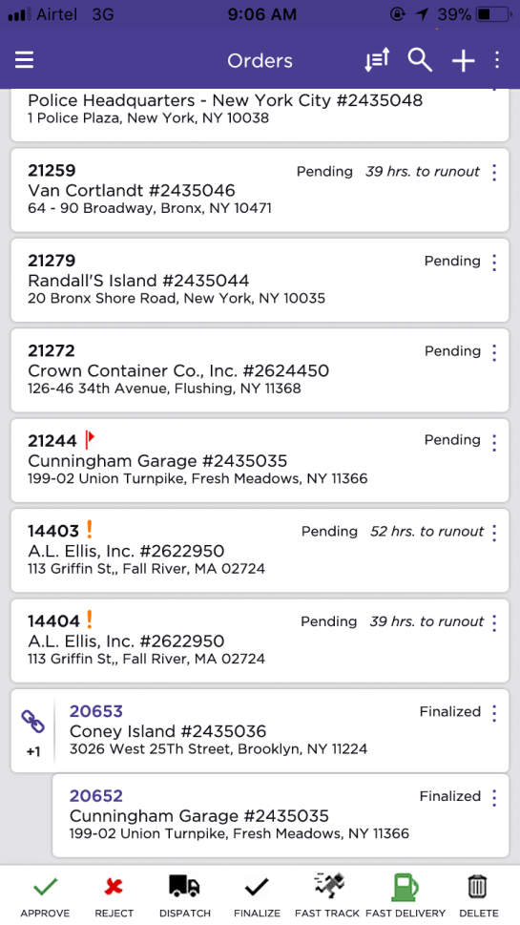
Linked Orders
View linked orders by tapping on ‘Link’ button.

Slide 4
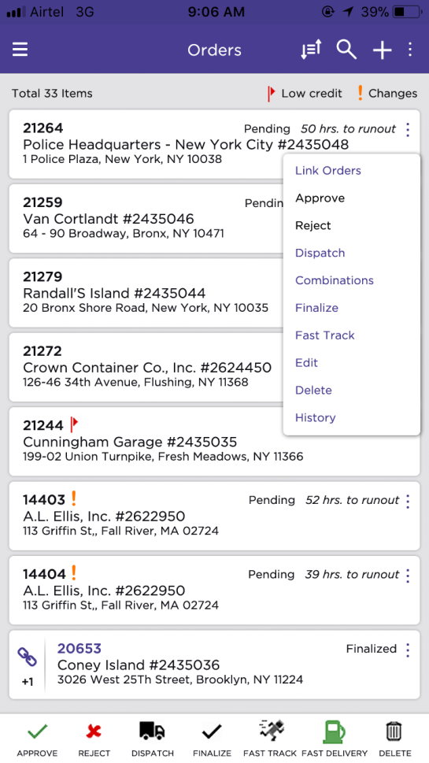
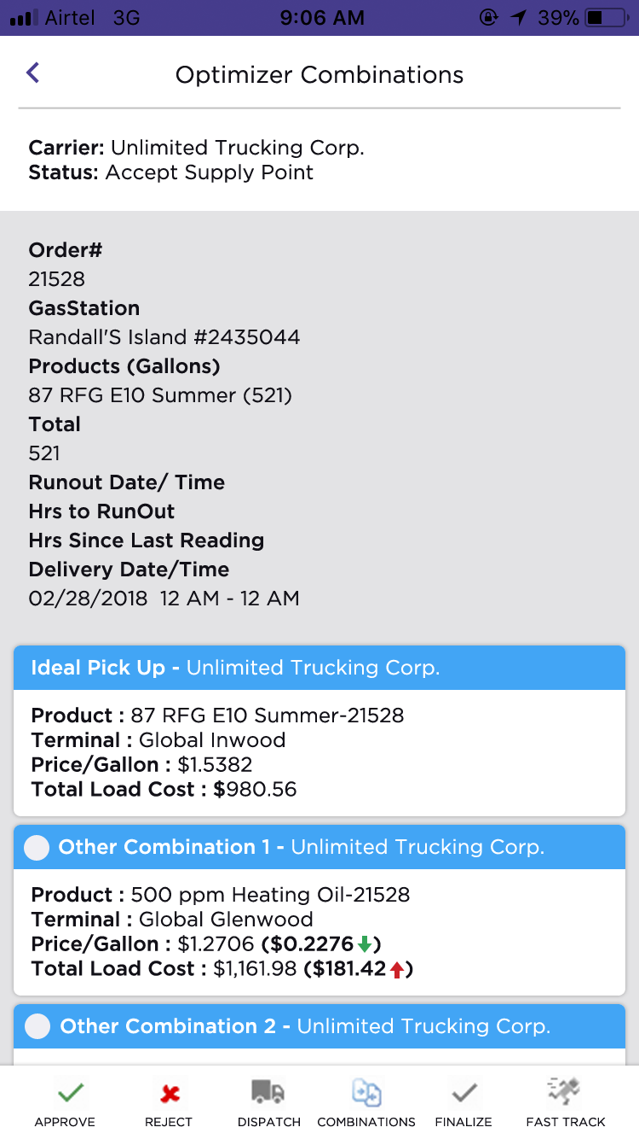
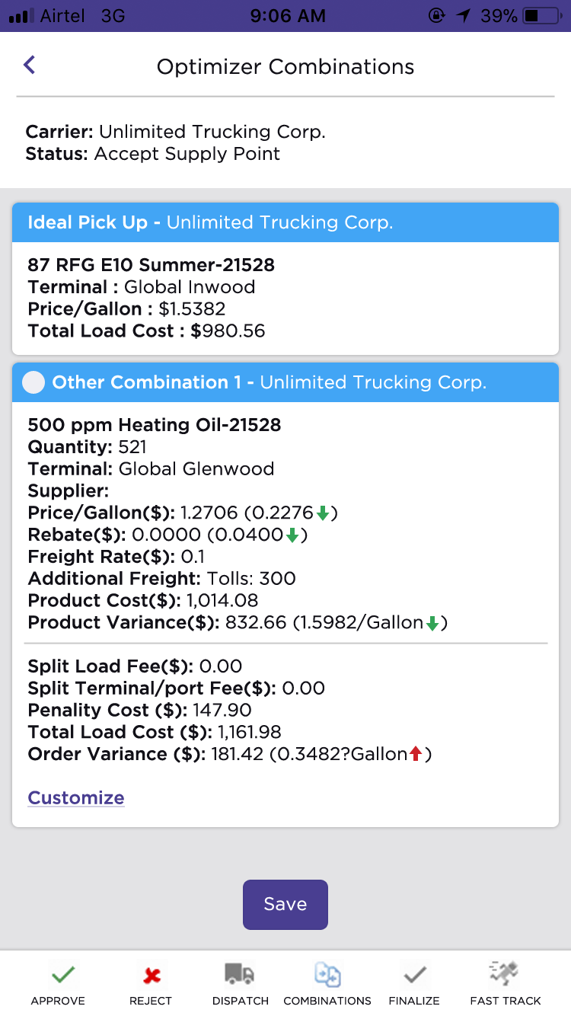
Optimizer Combinations for An Order
Expand to see complete details.

Slide 5
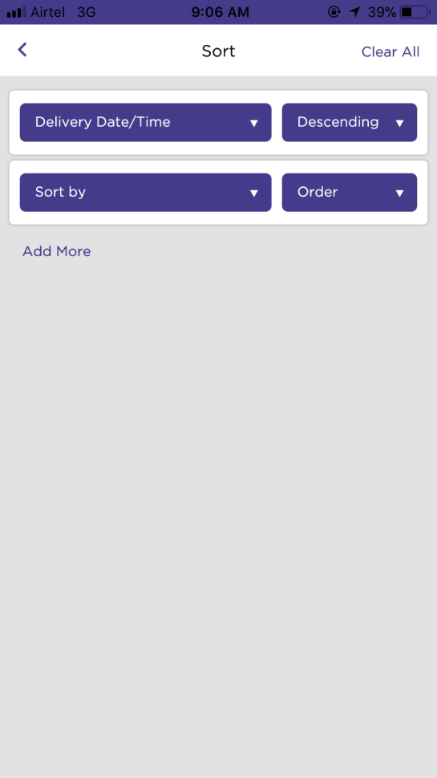
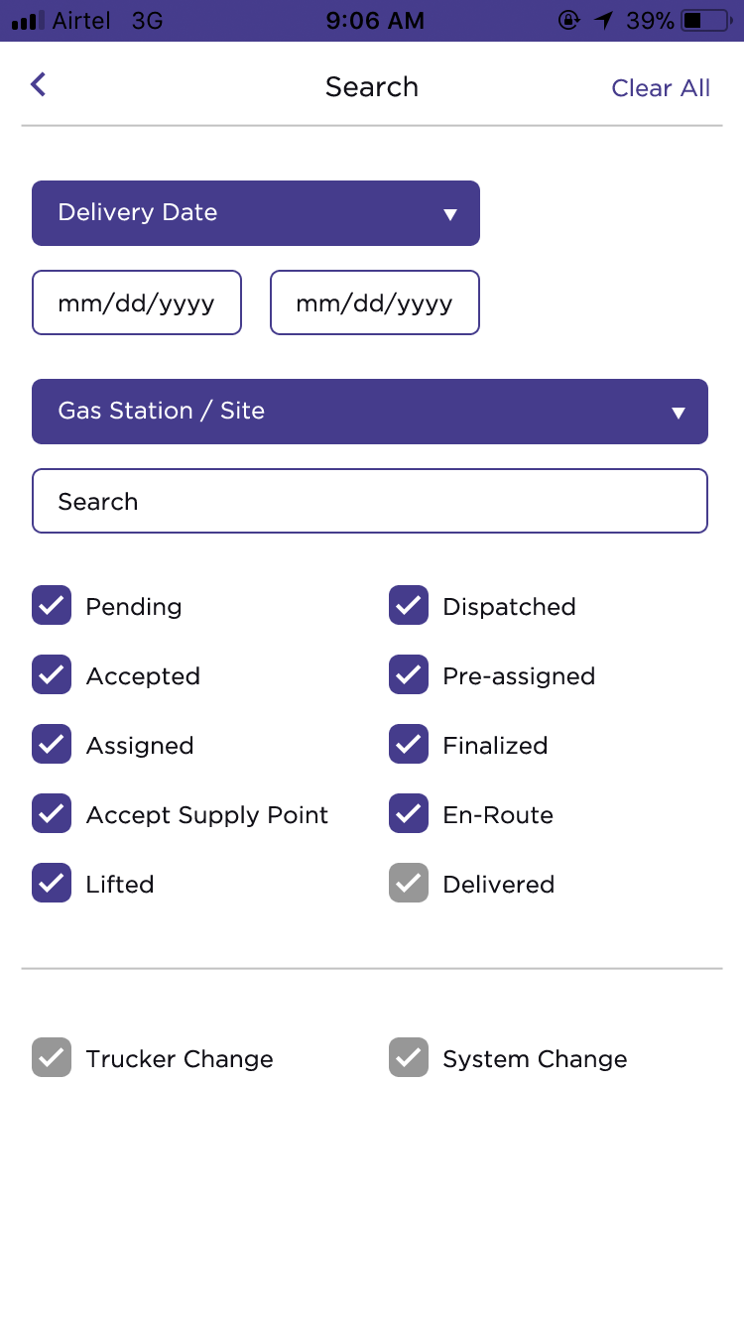
Search and Sort Orders
Sorting Orders’ List.
Advanced Search and Filter.

Slide 6
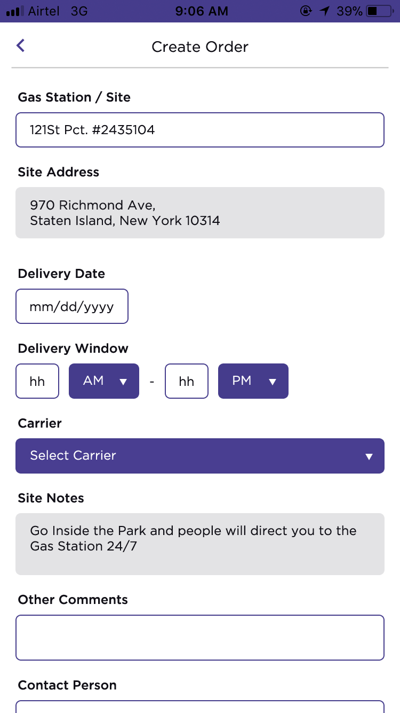
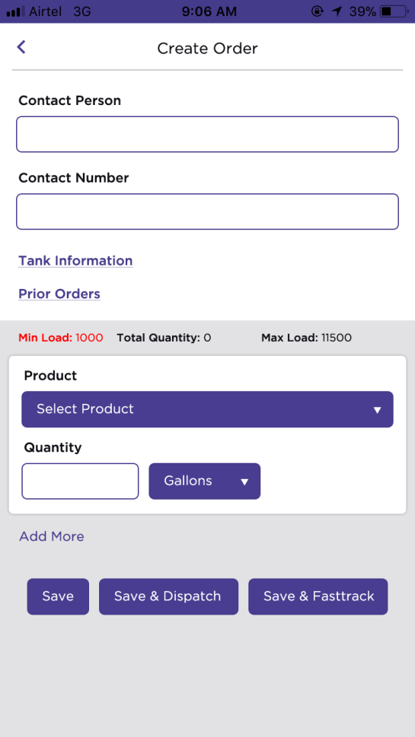
Create A New Order

Slide 7
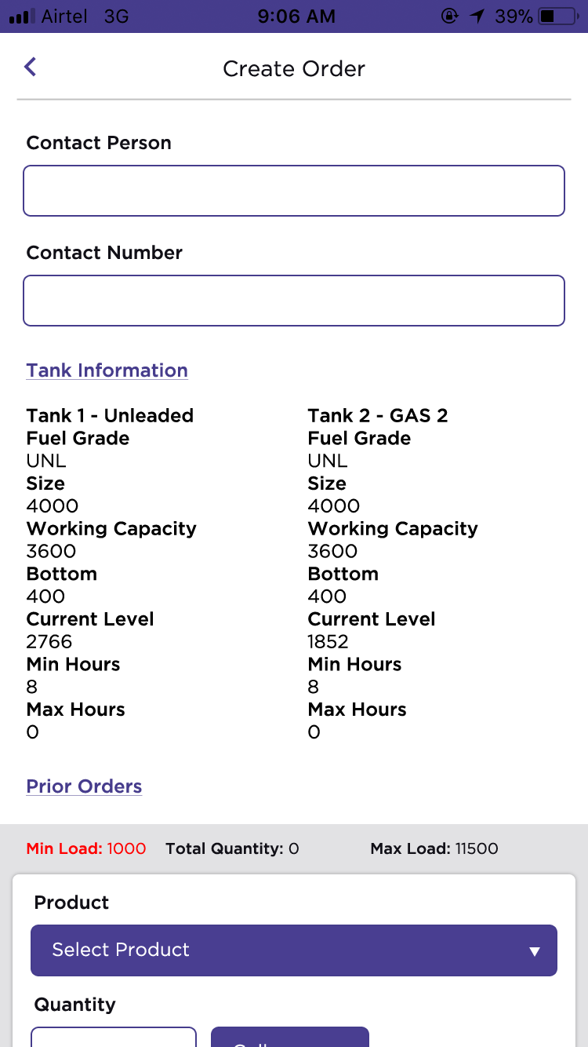
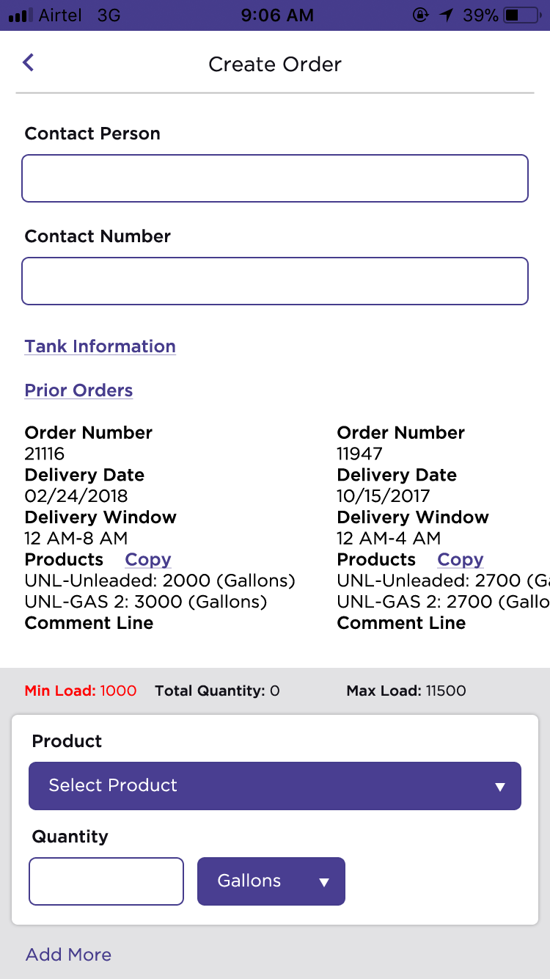
Tanks Details & Prior Orders
Expand Tank Information and Prior Orders.
Tap to view expand Prior Orders.
Copy from prior orders
Swipe horizontally to see more orders

Slide 8
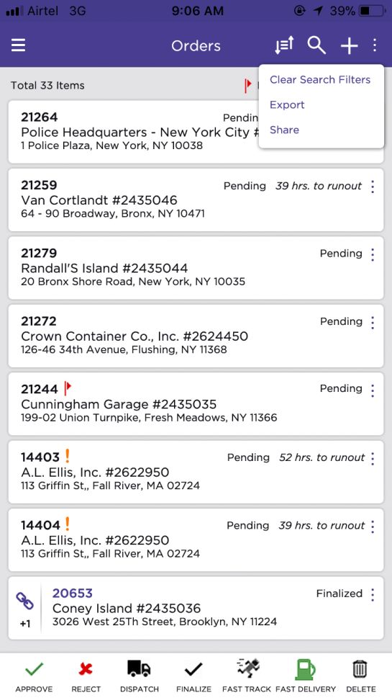
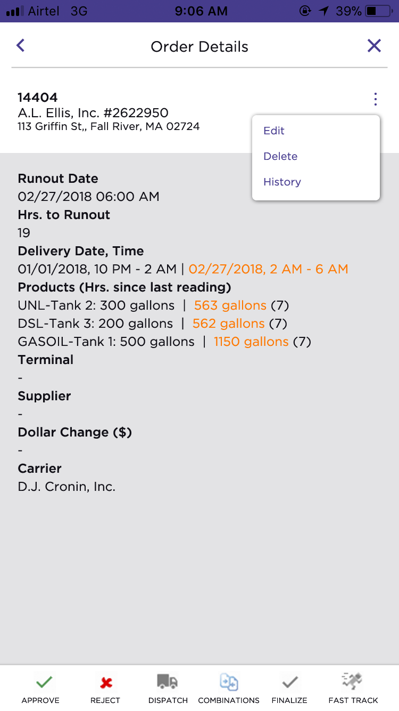
All Other Actions To Orders
Actions pertaining to an order.
More actions to the list of orders.
Bulk actions for selected orders.

Slide 9
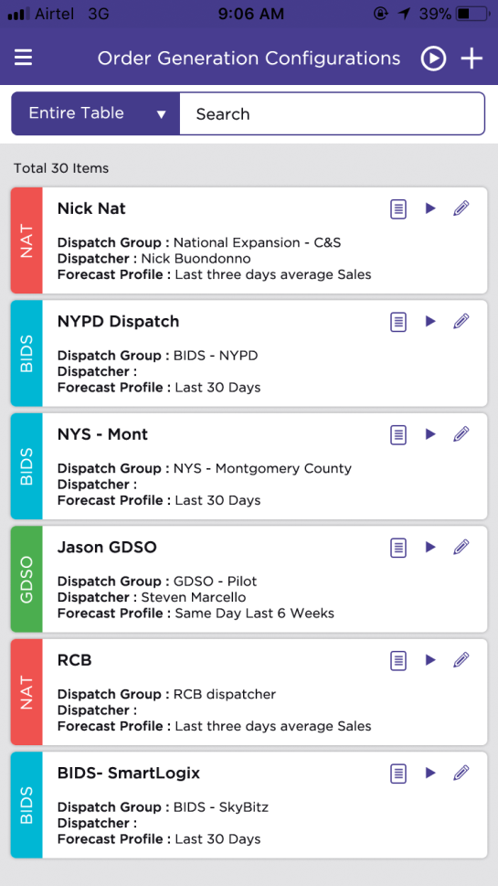
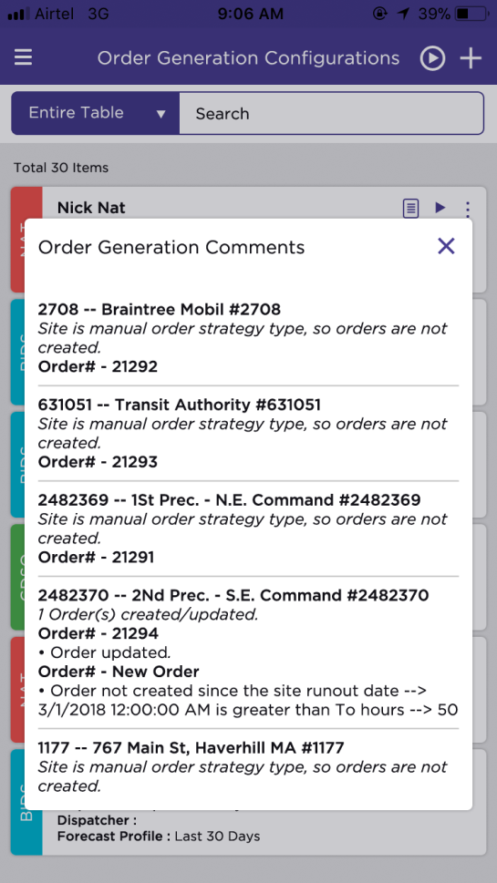
Order Generation Configurations
Order Generation Comments.

Slide 10
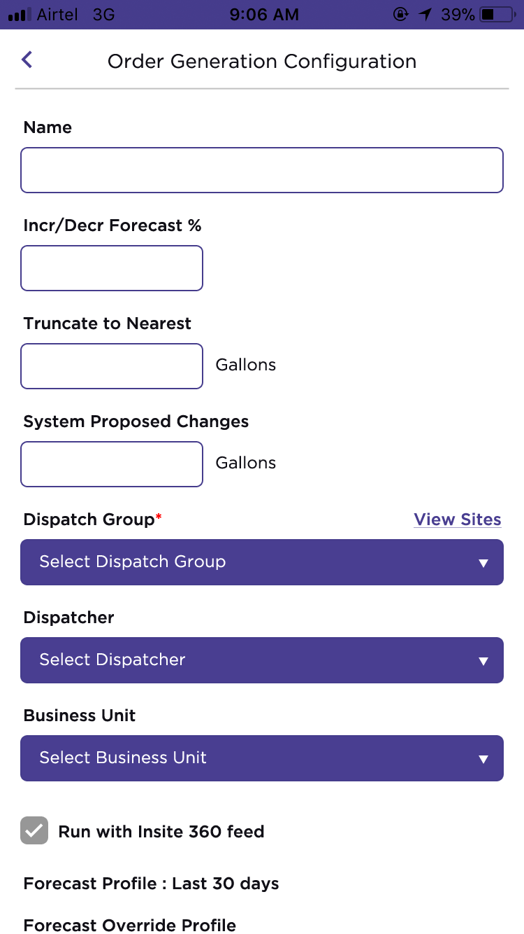
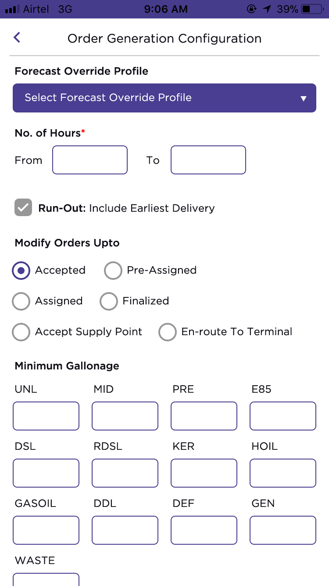
New Order Generation Configuration

Slide 11
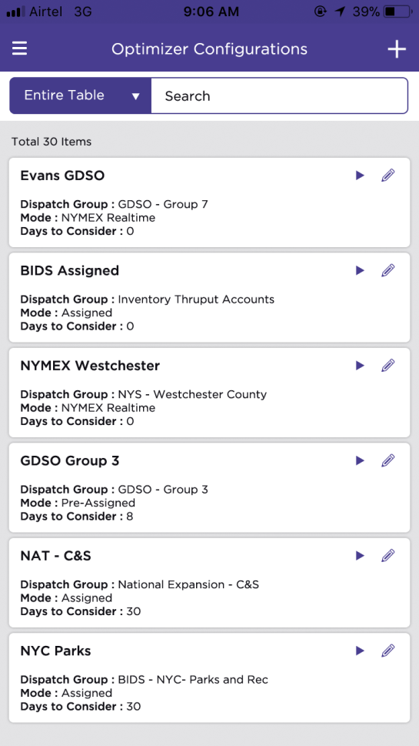
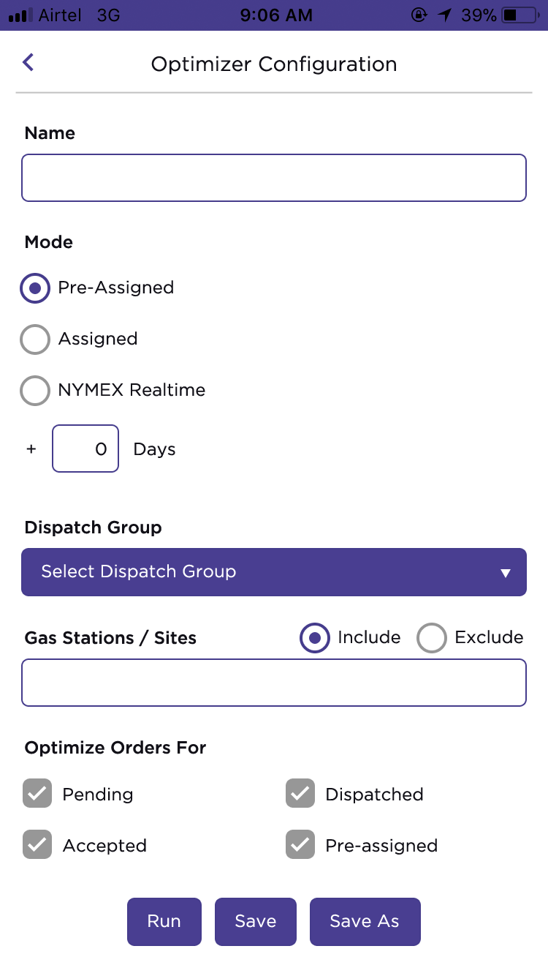
Optimizer Configurations Setup

