Slide 1


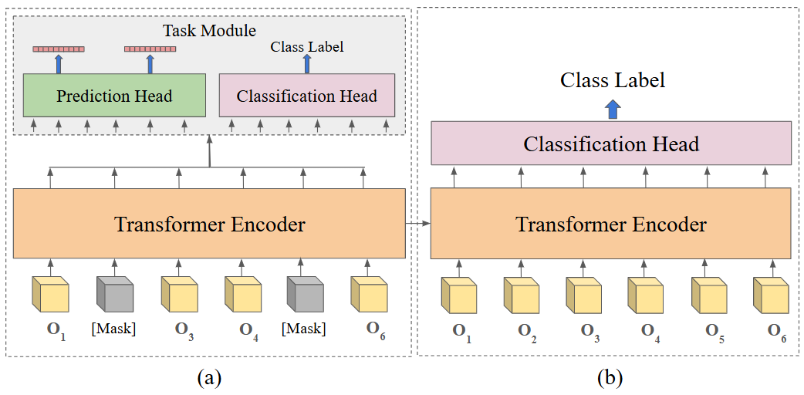
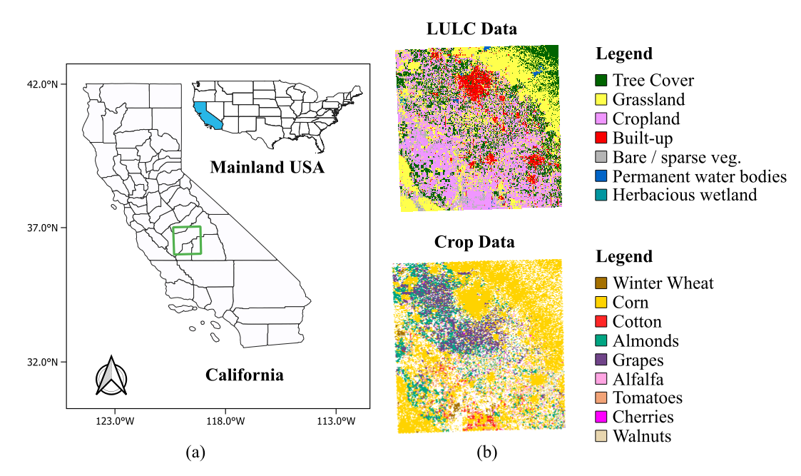
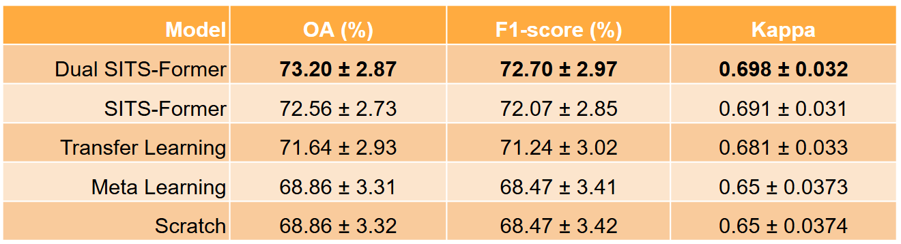
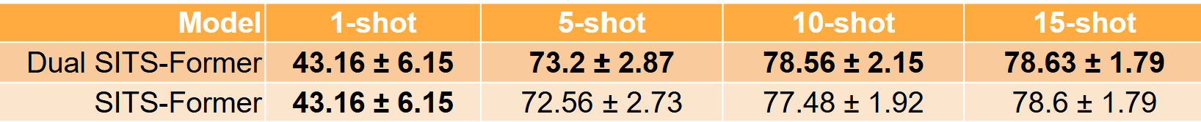
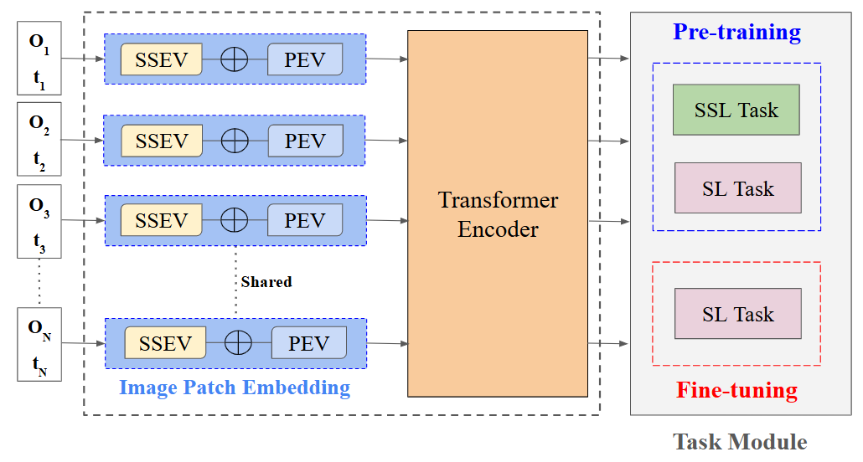
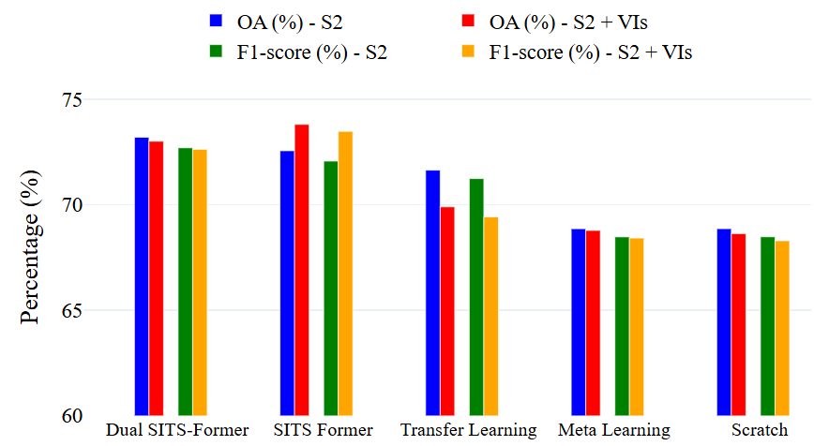
FUSING SELF-SUPERVISED AND SUPERVISED LEARNING: A UNIFIED PRE-TRAINING FRAMEWORK FOR CROP MAPPING
Rojarani Akkisetty^{1,2}, Kumar Rajamani¹, Narayanan C Krishnan², Praveen Pankajakshan³
¹CropIn Technology Solutions, India; ²Indian Institute of Technology Palakkad, India; ³Amrita Vishwa Vidyapeetham, India
ABSTRACT
Pre-training Stage: Learns generalizable features using SSL proxy task and LULC-based supervision.
Fine-tuning Stage: Adapts model to crop classification in data-scarce settings with minimal labels.
Accurate crop mapping is key to food security, but labeled data is often scarce.
We present a unified framework that combines self-supervised learning with land-cover-based supervision.
Using Sentinel-2 time-series data, our model learns rich spatio-temporal features and performs well even with limited labels.
DATA PREPARATION
Pre-Training Data
Sentinel-2 (T11SKA, CA), 18,705 time-series samples from ESA WorldCover.
Spatio-spectral data (10 bands) from Jan–Dec 2021, 5×5 patches, cloud cover ≤10%.
Crop Classification Data
USDA CDL (confidence >80%), 9 crops.
Few-shot setup: 5 samples/class (45 total) and 89,980 test samples.
Fig. 3: (a) Pre-training stage. (b) Fine-tuning stage.
RESULTS
Performance Comparison: 5-Shot Learning
Dual SITS-Former excels by fusing self-supervised and supervised learning.
Meta learning and scratch methods lag in limited-shot scenarios.
Table 1. 5-shot setting performance metrics of different techniques
Effect of Increasing Shots on OA
Increasing shots substantially boosts OA for both models.
At 10-shots, Dual SITS-Former showed a notable 1% improvement in OA, demonstrating superior adaptability in few-shot learning scenarios.
Fig. 1: Study area (a) Sentinel-2 tile location, (b) ESA WorldCover LULC map, and USDA CDL crop map (2021).
METHOD
Dual SITS-Former (ours) comprises three modules:
Image patch embedding module (blue) shared across timesteps: Captures spatio-spectral context using Conv3D and Day-of-Year encoding.
Transformer encoder (orange): Learns temporal dependencies via multi-head self-attention.
Task module (gray): Enables pre-training with SSL (masked prediction) and SL (LULC classification); later fine-tuned for crop classification.
Table 2. Overall Accuracy (%) over the k-shots
Impact of Spectral Indices
Adding handcrafted spectral indices lowers performance in most models.
Improves slightly when spectral indices are included.
Maintains stable OA with marginal performance reduction.
Questions utility of manual indices; deep models learn features automatically.
Fig. 2: Architecture of Dual SITS-Former
Fig. 4: Performance comparison with and without satellite-derived indices as added features.
REFERENCES
M. Rußwurm, S. Wang, B. Kellenberger, R. Roscher, and D. Tuia, “Meta-learning to address diverse earth observation problems across resolutions,” Communications Earth & Environment, vol. 5, no. 1, p. 37, 2024.
Y. Yuan, L. Lin, Q. Liu, R. Hang, and Z.-G. Zhou, “Sits-former: A pre-trained spatio-spectral-temporal representation model for sentinel-2 time series classification,” International Journal of Applied Earth Observation and Geoinformation, vol. 106, p. 102651, 2022.
H. Najjar, F. Mena, M. Nuske, and A. Dengel, “Xai-guided enhancement of vegetation indices for crop mapping,” in IGARSS 2024 - 2024 IEEE International Geoscience and Remote Sensing Symposium, July 2024, pp. 4140–4144.

