Slide 1
USE CASE 1:
Fetch status, count of transaction_id, distinct count of transaction_id, distinct counterparty, sum of amount, and sum of usd_amount for a duration of one month.

Slide 2
Input format: parquet
Database: pp_tables
Table: wtransaction_30m
Table location: hdfs://horton/sys/pp_dm/dm_hdp_batch/spark_poc/simba/PP_TABLES/WTRANSACTION/PARQUET/incremental/intraday

Slide 3
PySpark:
from pyspark.sql import SQLContext
from pyspark import SparkContext
import datetime
#storing the current time in the start variable
start = datetime.datetime.now()
# Creating SparkContext(Main entry point for Spark functionality) and giving our application a name.
sc = SparkContext(appName = “wt_parquet”)
#Creating SQLContext
sqlC = SQLContext(sc)
#reading parquet file present inside the folder. It's read and stored in dataframe. pf is a dataframe
pf=sqlC.read.parquet("/sys/pp_dm/dm_hdp_batch/spark_poc/simba/PP_TABLES/WTRANSACTION/PARQUET/incremental/intraday")
#Taking only those rows whose commit time lies between 1st April to 1st May.
pf_filter=pf.filter(pf.db_commit_timestamp<datetime.datetime(2015,5,1,0,0,0,)).filter(pf.db_commit_timestamp>datetime.datetime(2015,4,1,0,0,0))
#Storing the dataframe in the temporary table so that we can perform sql like syntax operations
pf_filter.registerTempTable("wt_temp")
#executing spark sql command and storing the results. We have grouped the rows by status.
results = sqlC.sql("select status, count(transaction_id) as transaction_id_count, count(distinct transaction_id) as transaction_id_distinct_count, count(distinct counterparty) as counterparty_distinct, sum(amount) as amount_sum, sum(usd_amount) as usd_amount_sum from wt_temp group by status")
#displaying the results
print results.show()
#storing the current time
after_results = datetime.datetime.now()
#saving the results so that we can use it later.
results.write.save(”wt_temp_results”)
end = datetime.datetime.now()
#printing all the three time.
print start,after_results,end

Slide 4
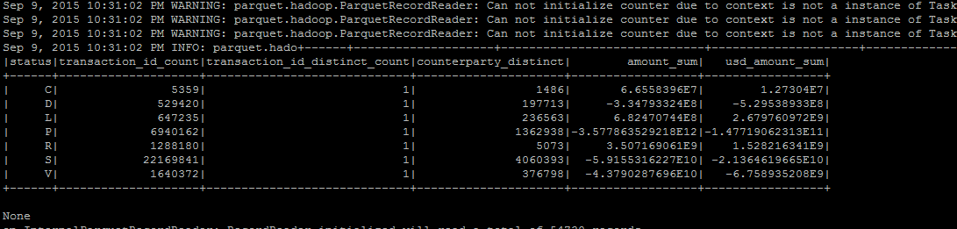
PySpark Performance

Slide 5
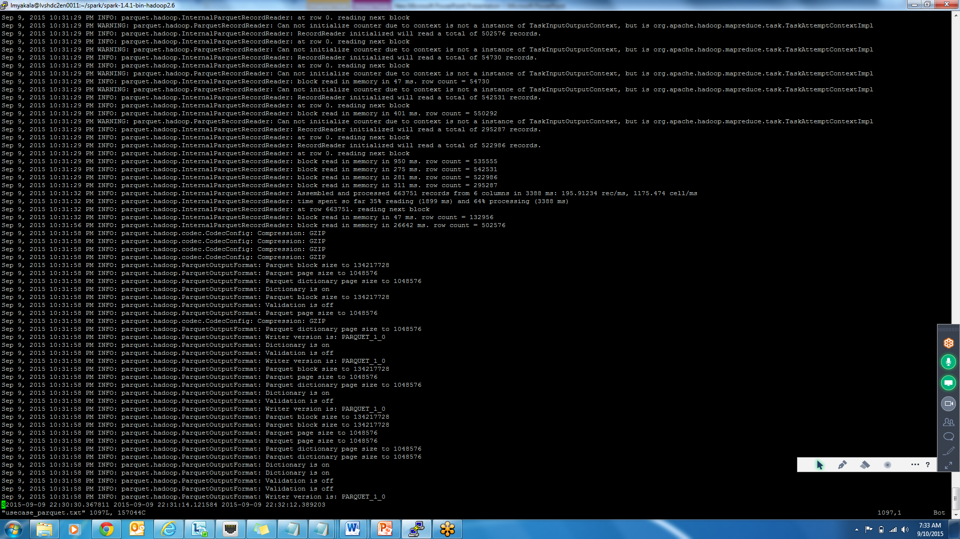
PySpark Performance
Total taken:
44secconds to get the select query results
58 seconds to store the results in the table

Slide 6
Hive
create table default.pp_wt_temp as
select status, count(transaction_id) as transaction_id_count, count(distinct transaction_id) as transaction_id_distinct_count, count(distinct counterparty) as counterparty_distinct, sum(amount) as amount_sum, sum(usd_amount) as usd_amount_sum from wtransaction_30m where db_commit_timestamp < cast('2015-05-01 00:00:00.000' as timestamp) and db_commit_timestamp > cast('2015-04-01 00:00:00.000' as timestamp) group by status;

Slide 7
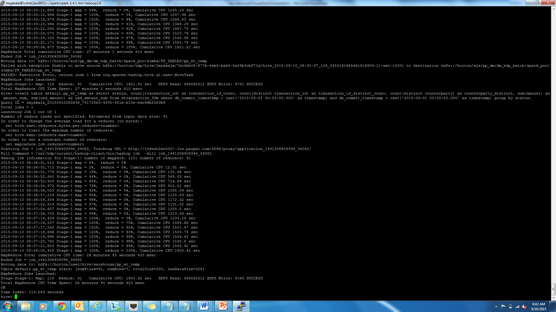
Hive Performance
Time taken for get the select query results and store in a table: 119.264 seconds

Slide 8
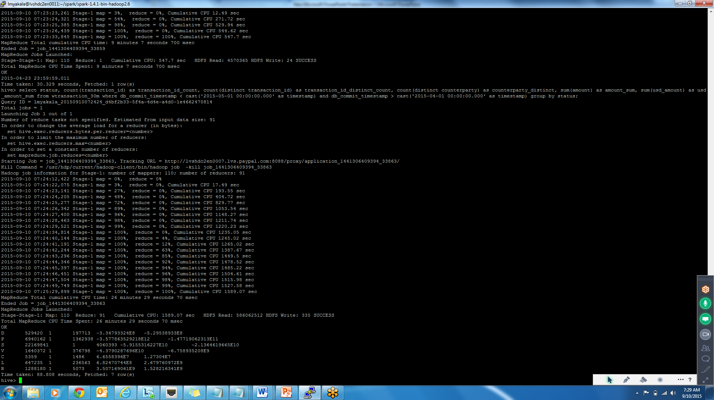
Hive Performance
Time taken for getting the select query results : 88.808 seconds

Slide 9
 | Time taken to get the select query results | Time to store the results in the table
PySpark | 44 seconds | 58 seconds
Hive | 88.808 seconds | 119.264 – 88.808 = 30.456 seconds

