Slide 1
Assignment for Software Engineering Intern Role (Backend) at Leap
Submitted by:
Praveen Kumar Raghav

Slide 2
Problem Statement
Technology and Framework Used
Build a file-based key-value data store that supports the basic CRD (create, read, and delete) operations.
Java 1.8 Version
IDE : Intellij
Note
To run the program JSON Jar file required (org.json.simple.JSONObject)

Slide 3
Approach
We found out Following Entity
Database: (It act as whole system and Instancation of this class Object will allow CRD operations).
KeyValue: (This class is for Organizing the data with all the specified properties).
CRDOperation: (This class act as utility class that contains several utility methods that can be used by any Customer concurrently).
Customer: (This class is responsible to test the functionalities of that Database)

Slide 4
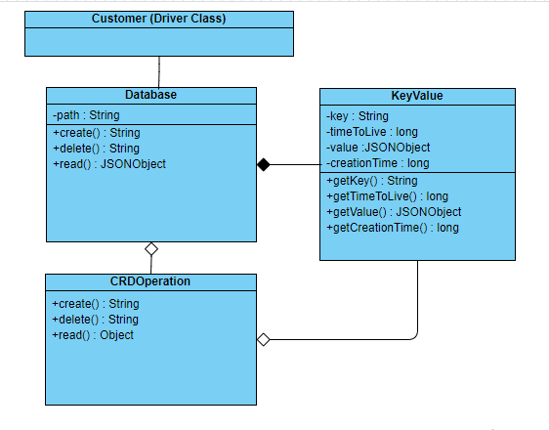
Class Diagram

Slide 5
Various Approaches used for different types of Problems
Thank you!
Synchronization Problem :- Software can be instantiated by any number of users. And Accessing their Data Securely in Thread Safe manner. For thread safety I used Reentrantlock for Synchronization that are without busy waiting problem.
Data Consistency :- We are direct reading data from files and Updating the data directly into the file.
TimeToLive Problem :- When any request is occurse for accessing any data key(Entry) read the data from the file and first check whether it’s timeToLive is expired or not. if(CurrentTme > (CreationTime + TimeToLive)) Time Expired
else Element is still present
If expire the remove that entry from file and update the file with remaining entry.

