Slide 1
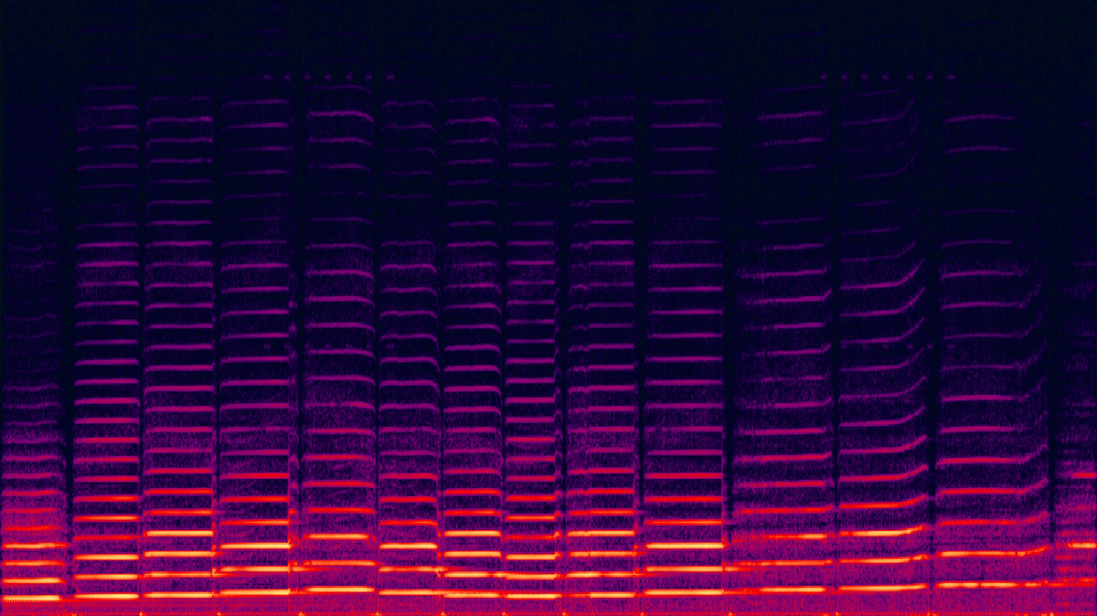

Sound Classification using ML.Net
Praveen Raghuvanshi
@praveenraghuvan

Slide 2
Introduction
Technical Architect @ Harman, A Samsung Company
Area of Expertise: Cloud, Distributed computing
Area of Interest: AI/ML and IoT
Location: Bangalore, India
Member: .Net Foundation

Slide 3
Agenda
Basics of Sound
Sound Classification
Exploratory Data Analysis
Framework and Tools
Classification using ML.Net
Demo

Slide 4
Basics of Sound
Sound : A pressure wave created by a vibrating object.
Amplitude : Measure of height of a wave or loudness
Frequency : Total # of waves produced per second. Human(20Hz – 20KHz)
SampleRate : How many times per second a sound is sampled. 44.1KHz, 96KHz
BitRate : Amount of data transferred into audio. 8-bit, 16-bit, 24-bit.
Channels : Represents spatial experience of sound. Mono/Stereo/Surround
FFT : Fast Fourier Transform. A way to convert signal from time to frequency domain

Slide 5
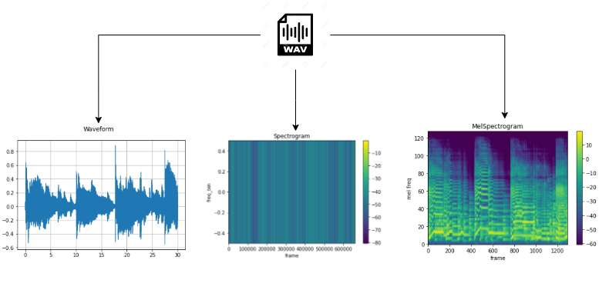
Visual Representation
https://musiclab.chromeexperiments.com/spectrogram

Slide 6
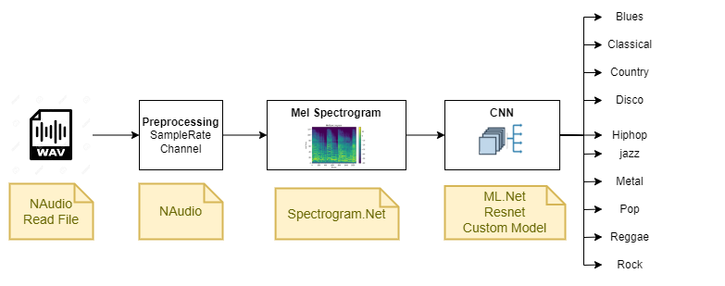
Sound Classification

Slide 7



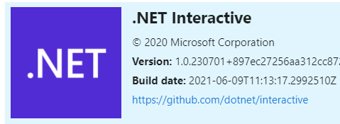
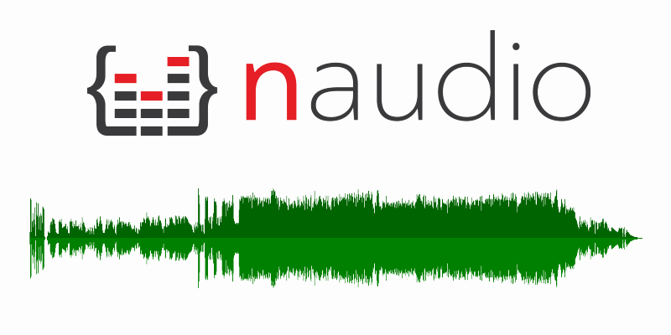
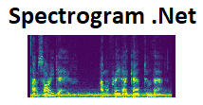
Framework and Tools

Slide 8
Demo

Slide 9

Resources
https://github.com/praveenraghuvanshi/tech-sessions/tree/master/14042022-Practical-ML-Net-Sound-Classification

Slide 10




Thank you Q & A
https://in.linkedin.com/in/praveenraghuvanshi
https://github.com/praveenraghuvanshi
@praveenraghuvan
https://t.me/joinchat/IifUJQ_PuYT757Turx-nLg

