Slide 1

Cricket Analytics ML.Net
Praveen Raghuvanshi
@praveenraghuvan

Slide 2
AGENDA
01
Cricket
02
Dataset
03
Data Cleaning and Analysis
04
Analysis using ML.Net
05
Prediction using ML.net
06
Demo

Slide 3



INTRODUCTION!
Cloud Architect @
Domain: Professional Audio, Video & Control
Area of Expertise: Cloud, Distributed computing
Area of Interest: AI/ML, Cloud and IoT
Location: Bangalore, India
Azure certified
Member

Slide 4
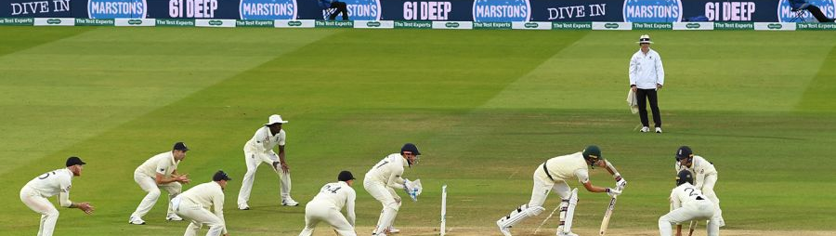
History
Formats
Statistics(2019-2020)
Invented in 1550, originated by England
First International Match was played between Canada and USA in New York
First ODI was played in 1971
First Cricket World Cup in 1975
First T20 Match was played in 2003
ODI – One Day International
Test Match
T20
County
IPL
Played by 104 Nations
IPL Valuation: $6.7 billion
IPL Viewers : 370 Million

Slide 5
PROBLEM STATEMENT
Perform Analysis on cricket dataset
Predict the team score till 6 overs

Slide 6





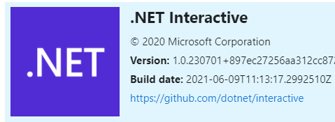

TOOLS AND FRAMEWORKS

Slide 7
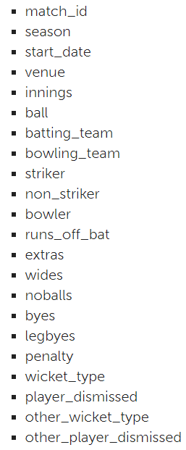
Dataset
Source: Cricksheet.org
T20 Matches-Men
Duration: 2017 – 2021
Matches : 1010
Teams: 56
Columns: 22
Records: 231 K
Mix of number and strings

Slide 8
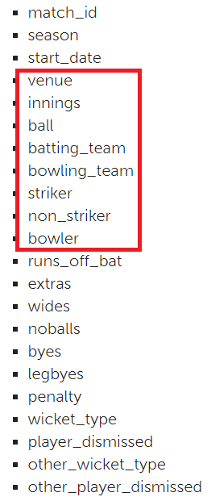
Data Cleaning
Filter dataset to include records till 6 over. Low memory and fast execution
Check for Null Values
Aggregation : Score per ball → runs_off_bat + extras
Cumulative sum : Total Score per ball
Remove features/columns

Slide 9
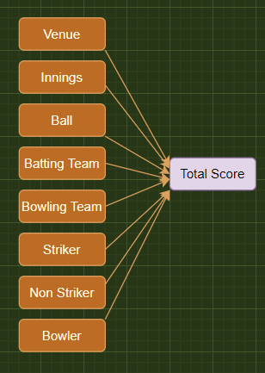
Prediction
Regression Problem using ML.Net
Define Classes : Match, MatchScorePrediction
Load Dataset
Split Dataset: Train/Test : 80/20
One Hot Encoding
Model Algorithm : FastTree
Train → Evaluate → Predict the Model

Slide 10
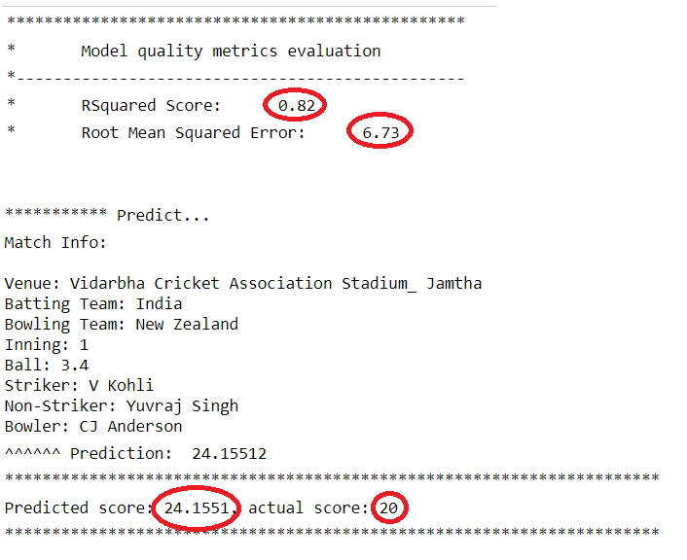
ML.Net – API(Jupyter Notebook)

Slide 11
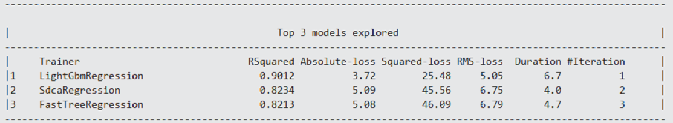
ML.Net – Model Builder

Slide 12
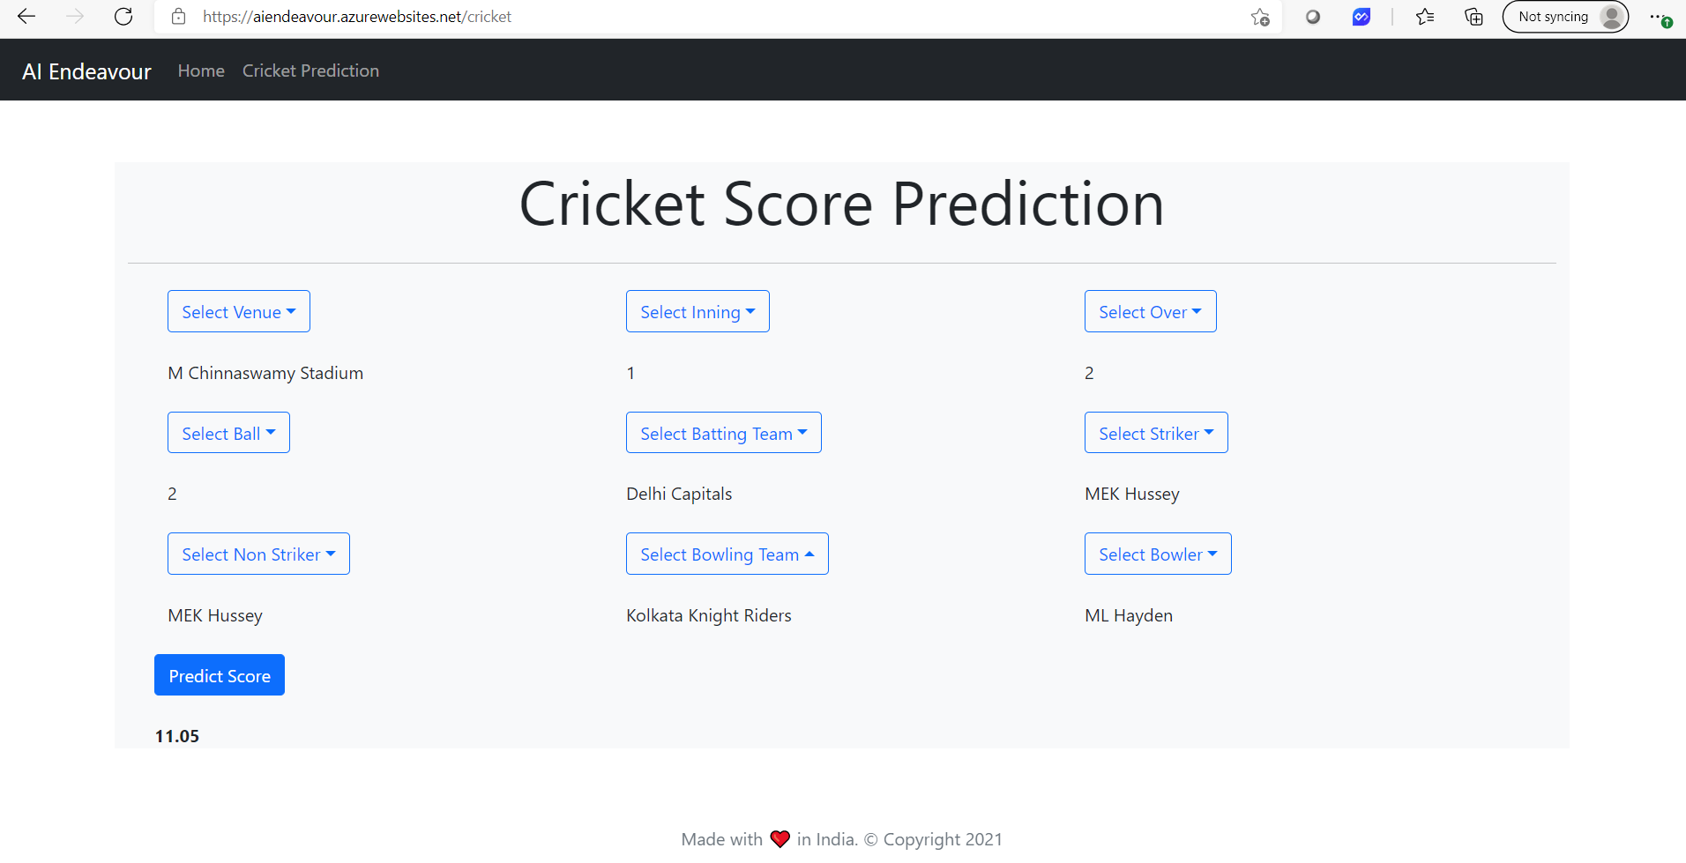
ML.Net - WebApp

Slide 13
06 DEMO

Slide 14
IMPROVEMENTS
Large Dataset
Feature selection strategies
Algorithm

Slide 15
RESOURCES
Getting Started: https://dotnet.microsoft.com/apps/machinelearning-ai/ml-dotnet
Slides and Source: https://github.com/praveenraghuvanshi/tech-sessions/tree/master/16062021-Global-AI-Community-2021

Slide 16

THANK YOU FOR WATCHING!
ANY QUESTIONS?
https://linktr.ee/praveenraghuvanshi
@praveenraghuvan
Github: praveenraghuvanshi

