Slide 1


Intro to Model Context Protocol(MCP) in .Net
Praveen Raghuvanshi
@praveenraghuvan
19-Apr-2025

Slide 2
Introduction
Technical Architect @ Harman, A Samsung Company
Area of Expertise : Building Cloud Native applications
Area of Interest : AI/ML, LLMs, SDV
Location: Bangalore, India

Slide 3
Agenda
What is Model Context Protocol(MCP) ?
Why do we need MCP?
Architecture of MCP?
How MCP works ?
Building MCP server in C#

Slide 4
What is Model Context Protocol (MCP) ?
MCP is a standard protocol for connecting applications to Large Language Models (LLMs).
Think of it as a universal connector for AI applications.
A protocol defined by Anthropic in Nov 2024

Slide 5
Why MCP ?
Standardization: Provides a consistent way to connect AI models to data sources.
Integration: Enhances LLM capabilities by integrating with various tools and data.
Flexibility: Allows switching between different LLM providers.
Security: Ensures secure data handling.

Slide 6
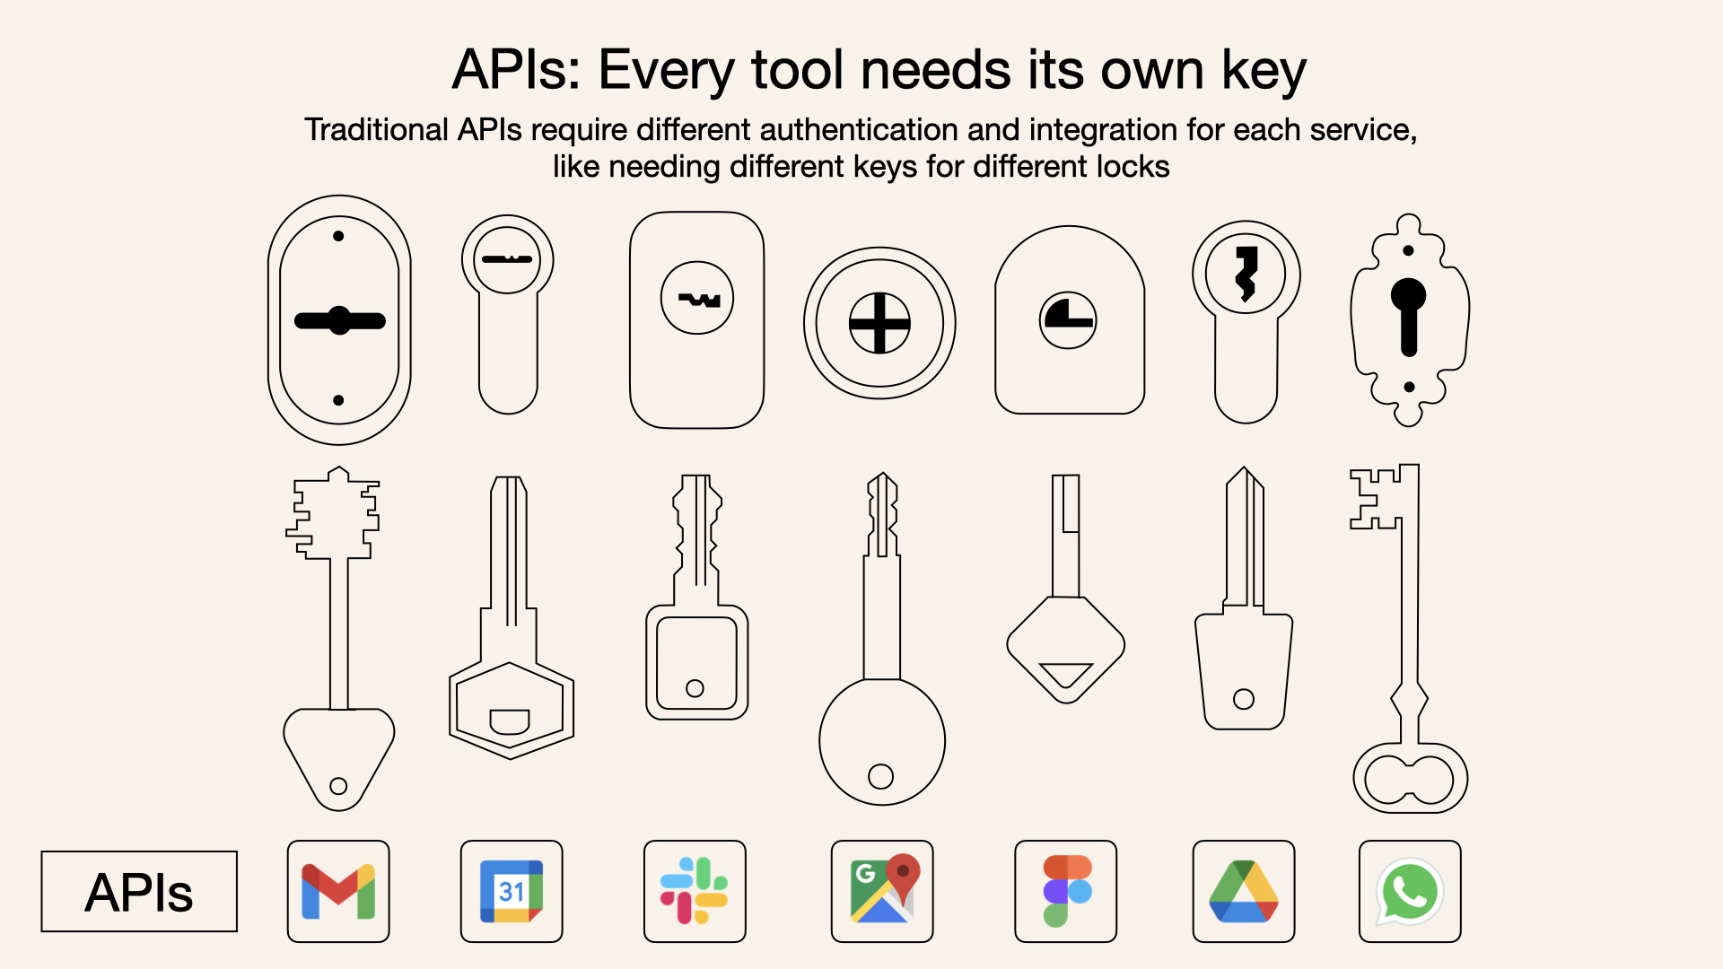
Source: https://norahsakal.com/blog/mcp-vs-api-model-context-protocol-explained/

Slide 7
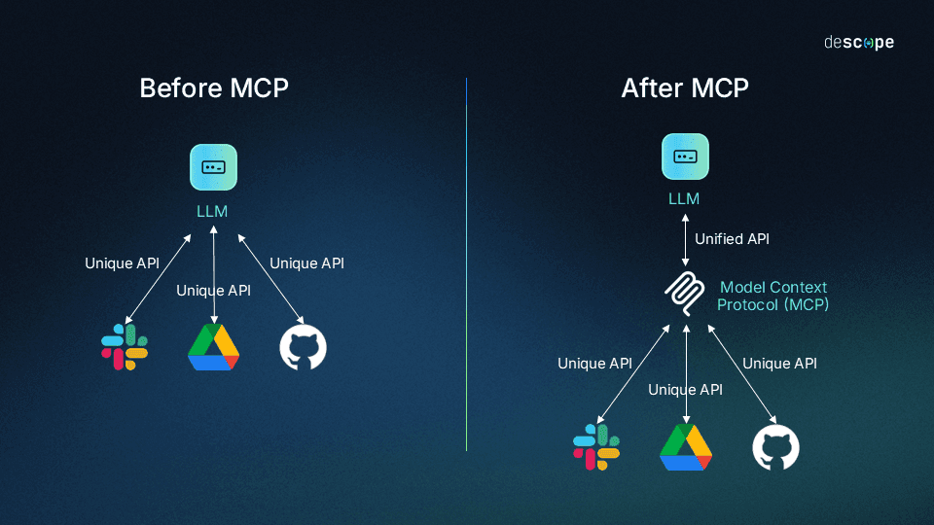
Why MCP ?
Source: https://www.descope.com/learn/post/mcp

Slide 8
MCP Architecture (Client-Server)
MCP Hosts: Programs that want to access data through MCP.
MCP Clients: Maintain connections with servers.
MCP Servers: Expose specific capabilities through MCP.
Transport Layer: STDIO and HTTP + SSE(Server-Side Events)

Slide 9
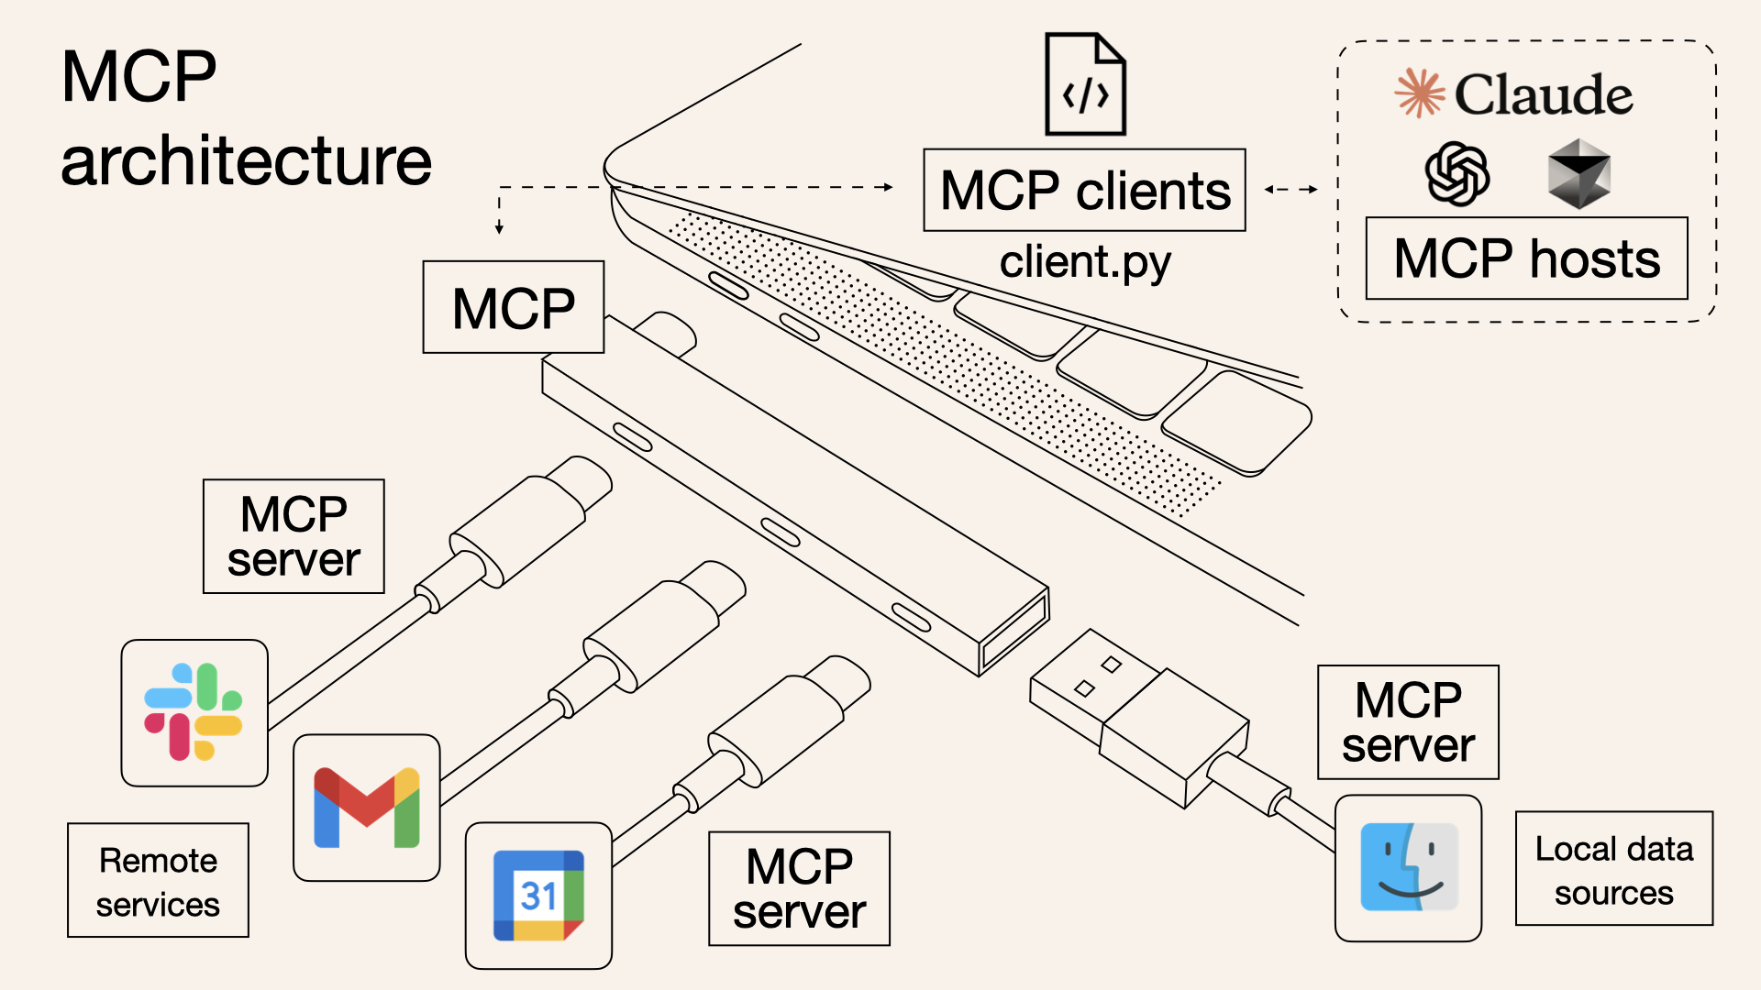
Source: https://norahsakal.com/blog/mcp-vs-api-model-context-protocol-explained/

Slide 10
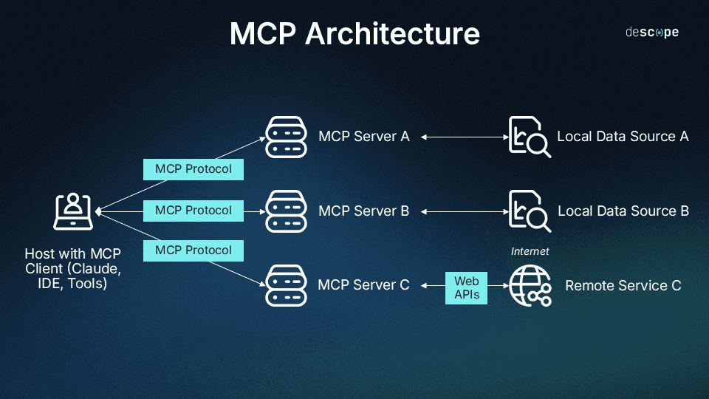
Source: https://www.descope.com/learn/post/mcp

Slide 11
How MCP works ?
Host requests data.
Client connects to the server.
Server provides the requested data.

Slide 12
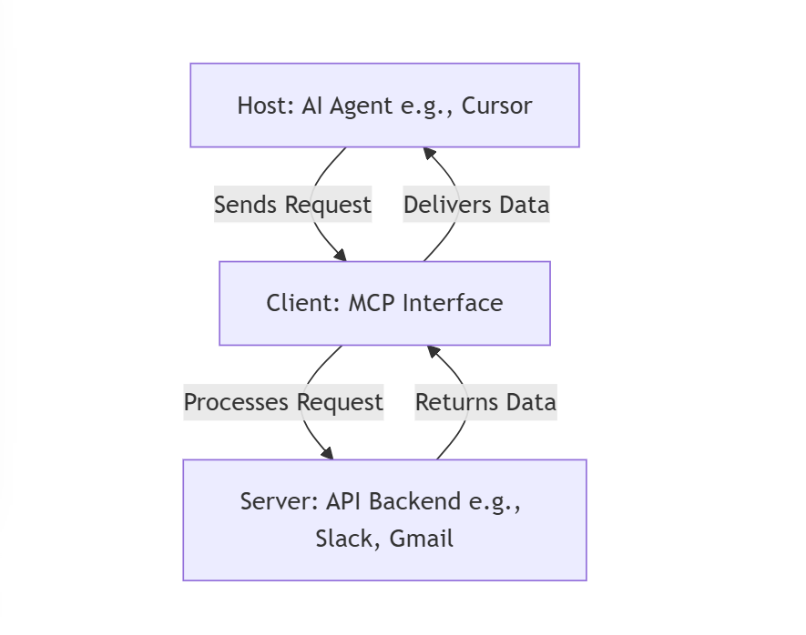
How MCP works ?
Source: https://ssojet.com/blog/the-model-context-protocol-mcp-explained-a-game-changer-for-ai-and- startups/

Slide 13
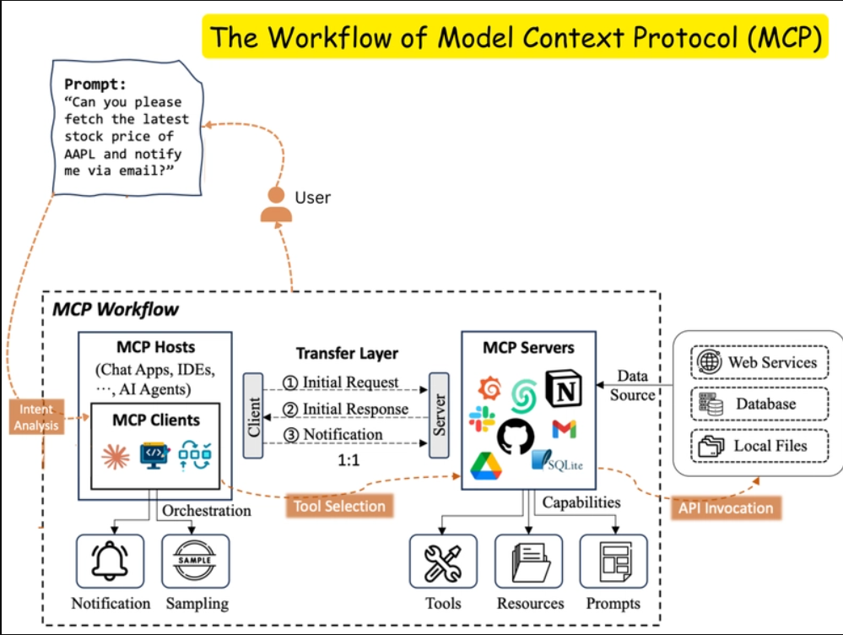
https://arxiv.org/pdf/2503.23278

Slide 14
Distribution
Source Code Package
Docker

Slide 15

MCP Server – Time Source Code - Packages
Microsoft.Extensions.Hosting
ModelContextProtocol

Slide 16
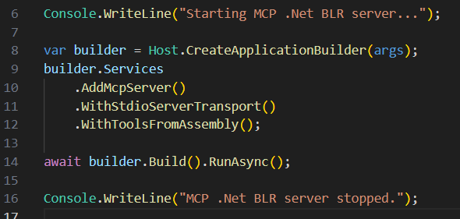
MCP Server – Time Source Code - Server

Slide 17
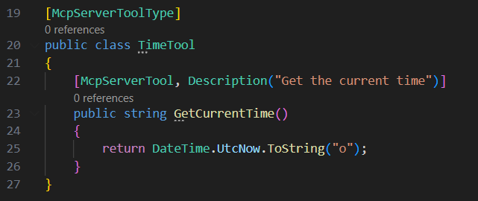
MCP Server – Time Source Code - Tool

Slide 18
Demo

Slide 19
References
https://arxiv.org/pdf/2503.23278
https://github.com/modelcontextprotocol/csharp-sdk
https://devblogs.microsoft.com/dotnet/build-a-model-context-protocol-mcp-server-in-csharp/
https://laurentkempe.com/2025/03/22/model-context-protocol-made-easy-building-an-mcp-server-in-csharp/

Slide 20




Thank you – Q & A
https://in.linkedin.com/in/praveenraghuvanshi
https://github.com/praveenraghuvanshi
@praveenraghuvan
https://t.me/joinchat/IifUJQ_PuYT757Turx-nLg

