Slide 1
Hangfire
Praveen raghuvanshi

Slide 2

Background Process – What?
A background process is a process that runs behind the scenes without user intervention

Slide 3
Background Process - Example
Fire and Forget
Sending a welcome email on user signup
Delayed
Discount coupons after sometime a user has signed up
Scheduled
Invoice generation
Batch imports from xml, csv, json
Cleanup such as Deleting users
Automated renewals

Slide 4
Background Process - Why
Offloading
Better utilization of resources
Responsive application

Slide 5
Background Process - Challenges
Multiple ways to implement various scenarios (Threads, Timers, Tasks, daemons, windows services)
Platform dependent implementations
Clean API's
Reliability
Persistence
Monitoring
Distributed

Slide 6
hangfire
Hangfire is an open-source framework that helps you to create, process and manage your background jobs, i.e. operations you don't want to put in your request processing pipeline:

Slide 7
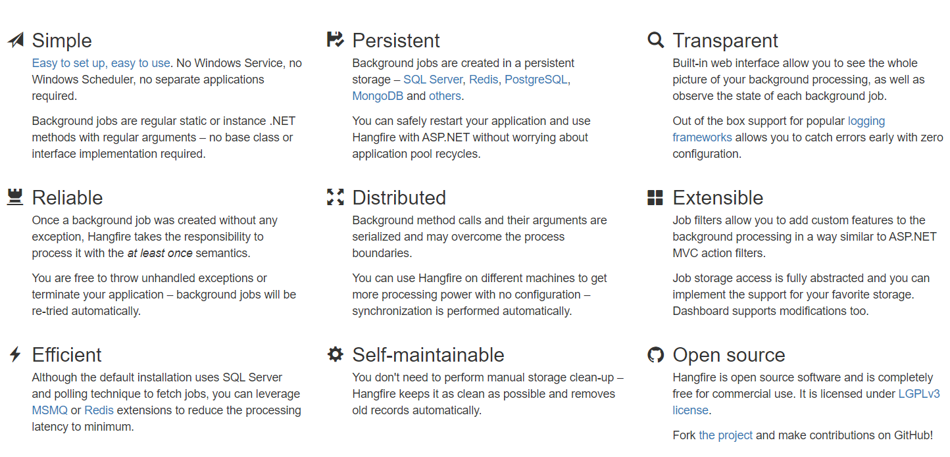
hangfire

Slide 8
Hangfire – Overview
https://www.hangfire.io/overview.html

Slide 9
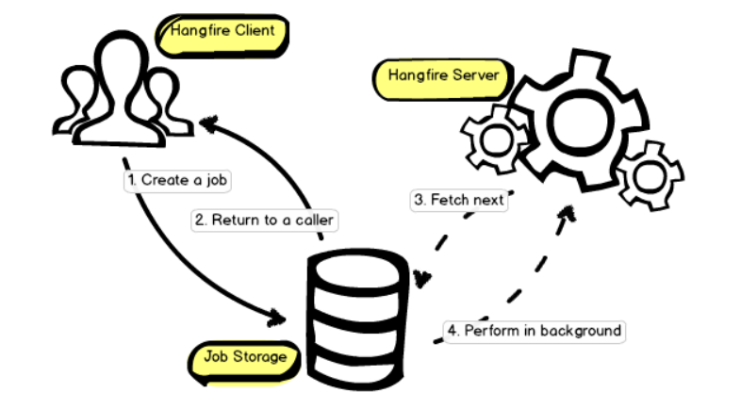
Hangfire - Working

Slide 10
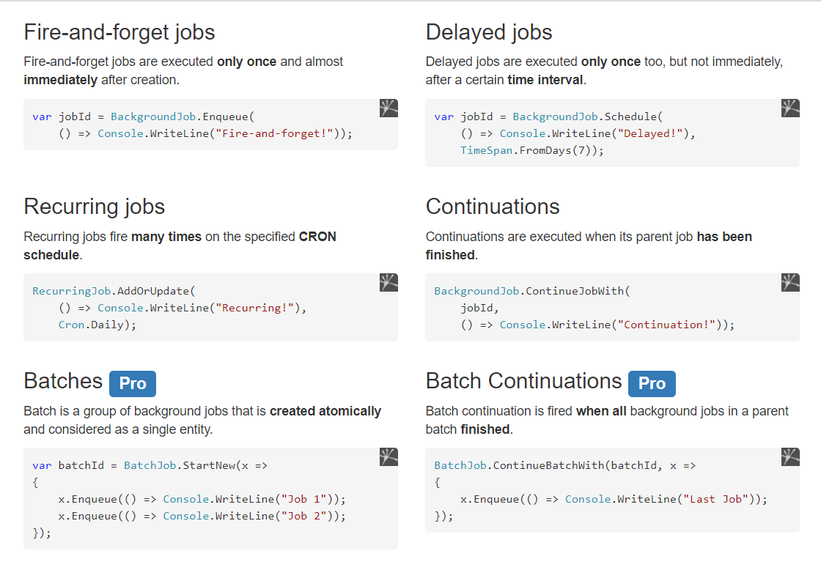
Hangfire - Capabilities

Slide 11
Hangfire – Demo

Slide 12
Hangfire - References
Hangfire(https://www.hangfire.io/)
ASP.Net Core: Background Processing with Hangfire(https://www.youtube.com/playlist?list=PL2Q8rFbm-4rtH-5o6mzOFA0tombRfr4Be)
Scheduling recurring jobs with Hangfire(In ASP.Net Core 3.1)(https://www.youtube.com/watch?v=sQyY0xvJ4-o)
Running background tasks in ASP.Net core(https://www.youtube.com/watch?v=UAWDMYKy8PM)
Background tasks without a separate service(https://www.youtube.com/watch?v=bwBEYxePENk)

Slide 13
Hangfire
Thank you

