Slide 1
Building Distributed Applications using Microsoft Orleans
Praveen Raghuvanshi
@praveenraghuvan

Slide 2
LET’S BEGIN NOW!

Slide 3

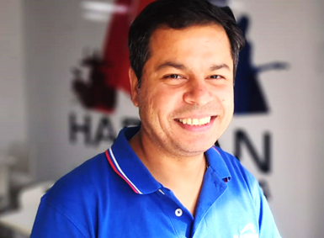

INTRODUCTION!
Cloud Architect @
Domain: Professional Audio, Video & Control
Area of Expertise: Cloud, Distributed computing
Area of Interest: AI/ML, Cloud and IoT
Location: Bangalore, India
Azure certified
Member

Slide 4
AGENDA
01
Actor Model
Threading, Concurrency, Actors, Different APM frameworks
02
Project ‘Microsoft Orleans’
History, About, Use cases
03
Components of Orleans
Grains(Virtual Actors), Silo, Cluster
04
Deployment Models
In-process, Single or Multiple host, Cloud
05
Dashboard
06
Demo

Slide 5
01 ACTOR MODEL

Slide 6
THREADING, CONCURRENCY AND PARALLELISM
Simultaneously, not parallel. (context switch)
A logical distinction.
Can be worked with single core
Processor's power physically
Multi-core

Slide 7
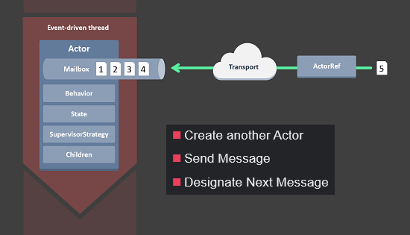
ACTOR MODEL
Invented by Carl Hewitt in 1973
An actor is a computer process with an address.
It encapsulates state and behavior within it.
Message passing and async communication
Single thread execution
Sequential message processing
Location Transparency
No data sharing.
No locks, thread management and concurrency issues
Easy to scale, highly performance and fault-tolerant.
Notes:
An actor is a computer process with an address.
The address is how you send a message to an actor. It's the equivalent of an e-mail address.
Like e-mail addresses, actors can have multiple addresses or a single address.
You can also assign one address to multiple actors.
This way you can scale your application to meet traffic demands if one actor is not enough.
Actors and Objects are pretty much the same thing.
We usually expect Message sends in Object-Oriented Systems to be synchronous, instantaneous, reliable, and ordered,
while no such guarantees exist for Actors.
Actors are Objects where Messages may get lost, re-ordered, take a long time, and are asynchronous. (The only guarantee is that a Message may get delivered At Most Once.) Also, the Receiver of a Message typically has no implicit reference to the Sender, so if the Receiver wants to reply to the Message, the Sender needs to pass its own reference along with the Message (unlike typical Object-Oriented Systems, where I can always return something to the Sender).
https://stackoverflow.com/questions/47248820/difference-in-definition-of-actors-vs-threads#:~:text=Actors%20are%20at%20a%20higher,about%20how%20Actor%20uses%20Threads.

Slide 8


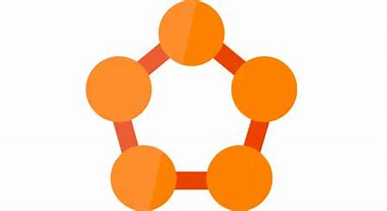



ACTOR MODEL FRAMEWORK

Slide 9

02 MICROSOFT ORLEANS

Slide 10

GOALS
SIMPLE
SCALABLE
ABSTRACTED
Simple for developers, widely accessible programming model.
Scalable, something that can be deployed to single or multiple node.
Abstract the underlying intricacies of distributed computing/programming.

Slide 11
OVERVIEW
Created by Microsoft Research
Open Sourced in January 2015
Built with Azure in mind
Based on Virtual actor
Used in Halo 4 and 5
Used in various Azure services
Support multiple deployment
No Concurrency Issues

Slide 12
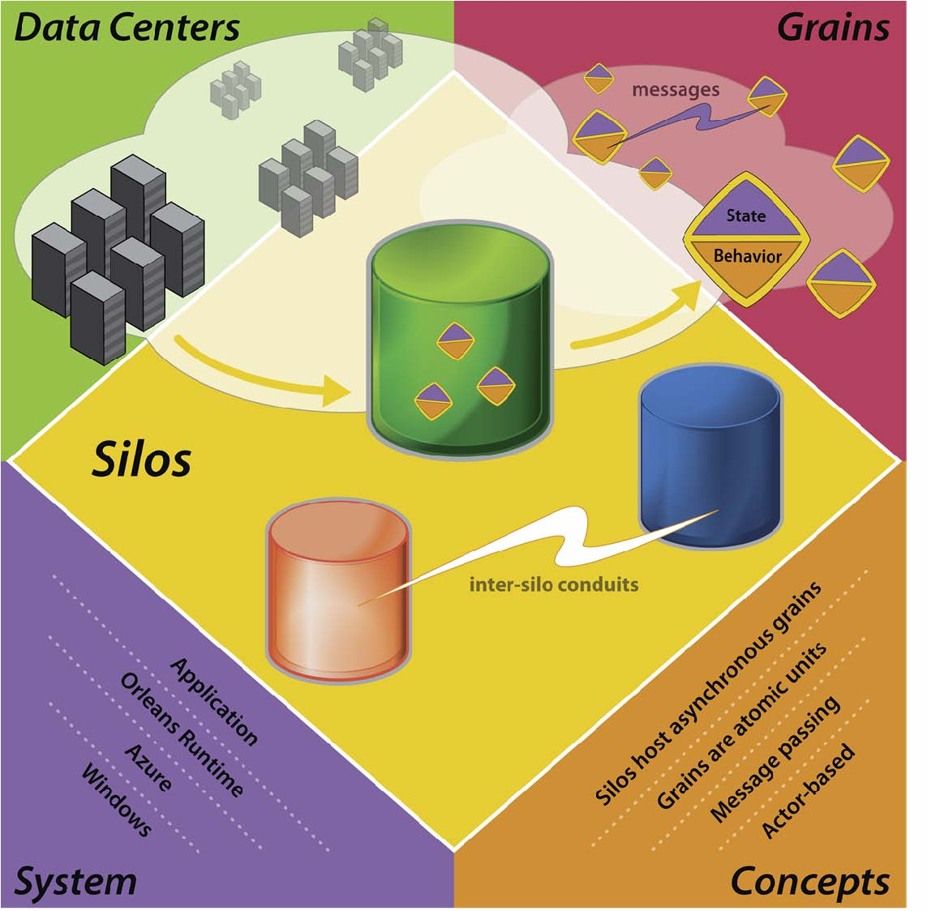
03 ORLEANS COMPONENTS

Slide 13
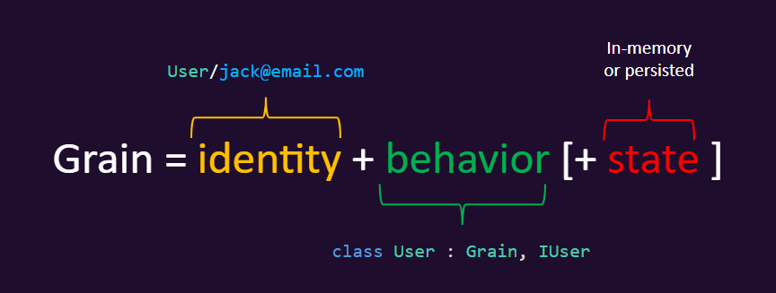
ACTOR
LIFECYCLE
STORAGE
Grains are implementations of Actors
They have an identity
Loosely Coupled(Backed by an Interface)
Terminated to free compute resources
Activating
Active
Deactivating
Persisted
It can be stored in memory(Volatile)
Stored in DB for persistence

Slide 14
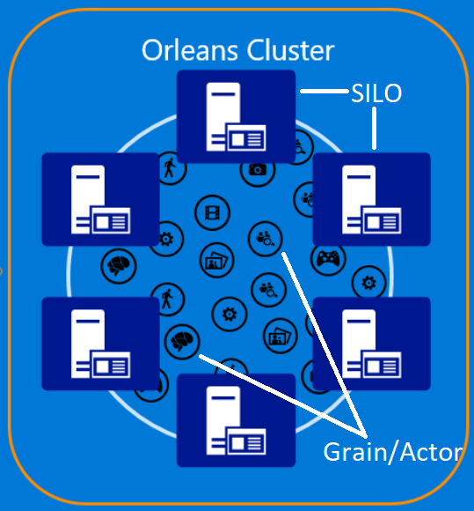
SILOS
Its an host for a Grain
Manages lifecycle of a Grain
Generally have 1 silo per Node/Container/Machine
A cluster is used for fault tolerance and Scalability

Slide 15
04 DEPLOYMENT

Slide 16
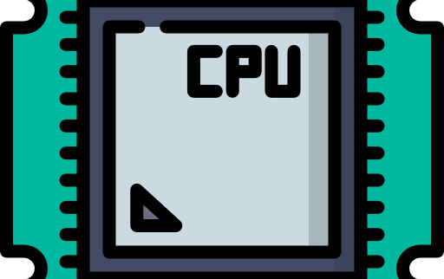

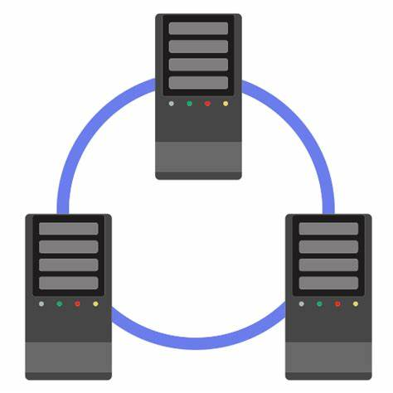
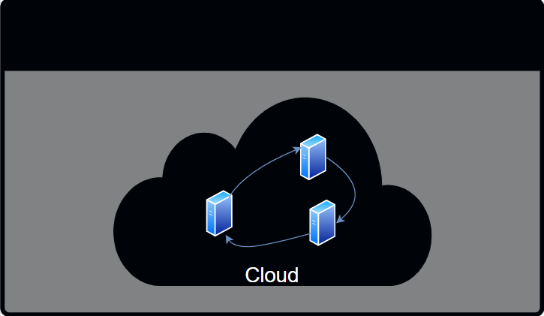

DEPLOYMENTS
In Process
Host
Cluster
Cloud
Kubernetes

Slide 17
05 DASHBOARD

Slide 18
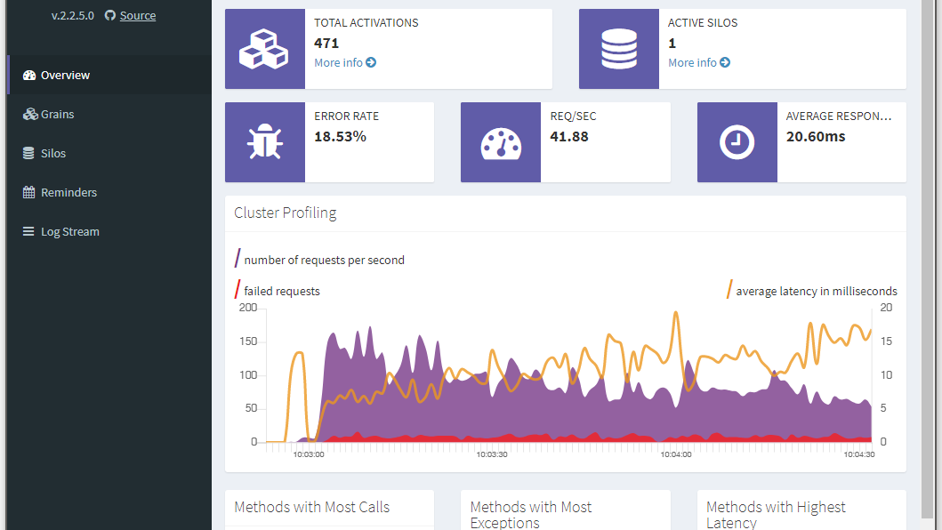

Slide 19
06 DEMO

Slide 20
RESOURCES
Getting Started https://dotnet.github.io/orleans/
Samples: https://github.com/dotnet/orleans/tree/main/Samples
Documentation: https://dotnet.github.io/orleans/docs/index.html
Community Support : Github or Gitter (https://gitter.im/dotnet/Orleans)
Slides and Source: https://github.com/praveenraghuvanshi/tech-sessions/tree/master/17052021-MS-Orleans-dotnet-cambridge

Slide 21
THANK YOU FOR WATCHING!
ANY QUESTIONS?
https://linktr.ee/praveenraghuvanshi
@praveenraghuvan
Github: praveenraghuvanshi

