Slide 1

Machine Learning with
A Machine learning framework from Microsoft
Praveen Raghuvanshi
Notes:
Welcome to session on ML.Net
Thanks for taking time and joining on Saturday.
Thanks to the particip members : .Net Community, Anand and DevOn
About Me:
Working as Principal Engineer, playing role of cloud architect @ Harman
Around 15 yrs of experience developing enterprise applications using Microsoft Technologies.

Slide 2
おはよ ございます
O ha yo Go za I ma su
Good Morning
Notes:
O-ha-yo Go-za-i-ma-su

Slide 3
Quiz : Type of ML
Is this A or B?
How much – or – How many?
How is this organized?
What should I do next?
Is number a Armstrong?

Slide 4
Machine learning
ML is a method of training algorithms such that they can learn how to make decisions.
Machine learning is getting computers to program themselves.
If programming is automation, then machine learning is automating the process of automation
Traditional Programming
Machine learning
Data
Program
Output
Data
Output
Program
Computer
Computer
Notes:
Machine Learning (ML) deals with making your machine learn from the external environment.
This external environment can be in the form of sensors, electronic components, external data storage devices and many other.
What ML does is, based on the user input or a query by the user, the system checks whether it is present in the knowledge base or not. If it is present, it will return the result to the user associated with that query, but if it is not stored initially, the machine will learn the user input and will improve its knowledge base, so as to provide better value to the end user.

Slide 5
Pre-Requisites of ML
A Pattern should exist
Mathematical model / algorithm is unknown
Lots of data

Slide 6
Types of Machine Learning
Machine
Learning
Supervised
(Task based)
Unsupervised
(Data Driven)
Reinforcement
(Algorithms learns to react to an environment)
Classification
Regression
Clustering
Notes:
Supervised Algorithm : Regression, Decision Tree, Random Forest, KNN, Logistic Regression
Unsupervised Algorithm: Apriori algorithm, K-means
Reinforcement Learning: Markov Decision Process

Slide 7
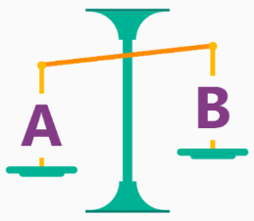
Is it A or B?
Classification Algorithm
Will this tire fail in the next 1,000 miles : Yes or No ?
Which brings in more customers: a $5 coupon or a 25% discount ?

Slide 8
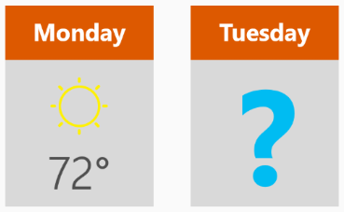
How much? How many?
Regression Algorithm
What will the temperature be next Tuesday?
What will my fourth quarter sales be?
They help answer any questions that asks for a number

Slide 9
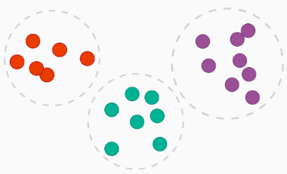
How is this organized?
Clustering Algorithm
Which viewers like the same type of movies?
Which printer model fail the same way?

Slide 10

What should I Do now?
Reinforcement learning Algorithm
If I'm a self-driving car: At a yellow light, brake or accelerate?
For a robot vacuum: Keep vacuuming, or go back to the charging station?

Slide 11
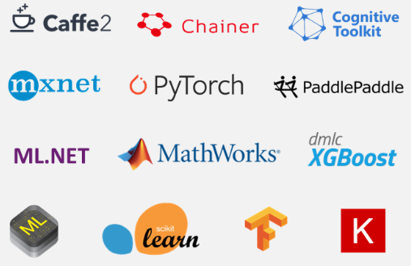
ML Frameworks

Slide 12
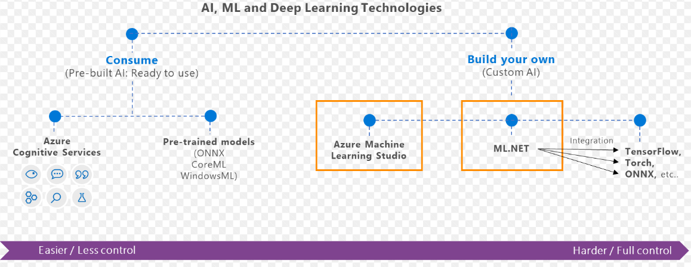
What is ML.Net?
ML framework from Microsoft for developing Custom AI/ML applications
Originated in 2002 as part of Microsoft Research project

Slide 13
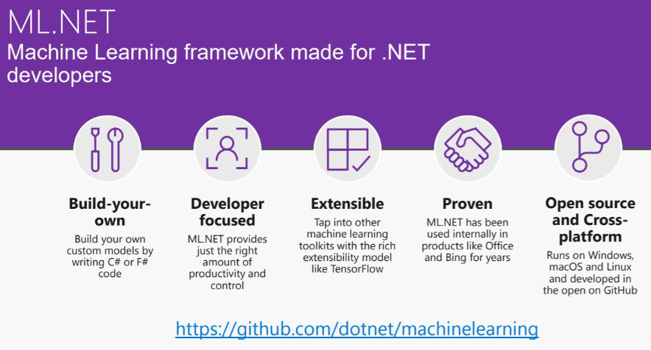

Slide 14
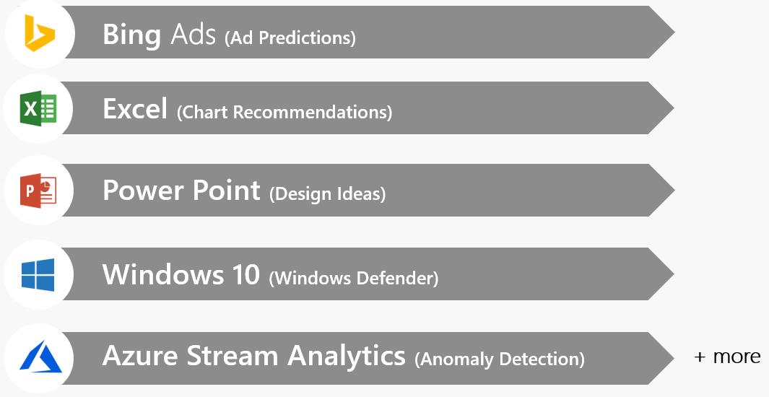
Proven at scale, Enterprise ready

Slide 15
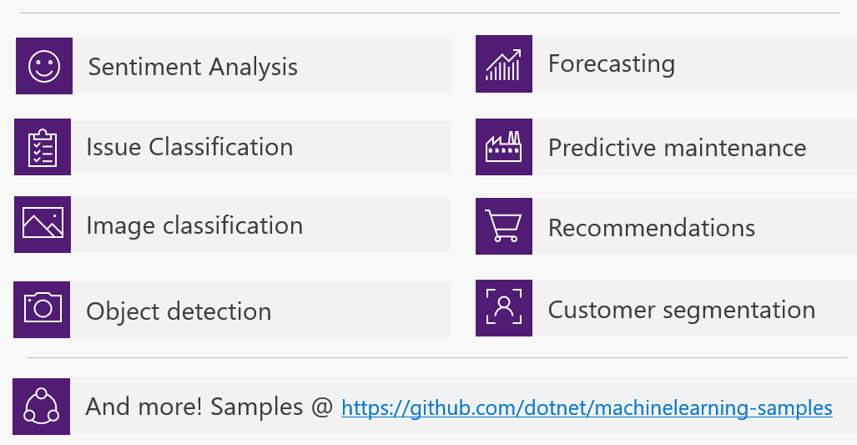
Possibilities

Slide 16
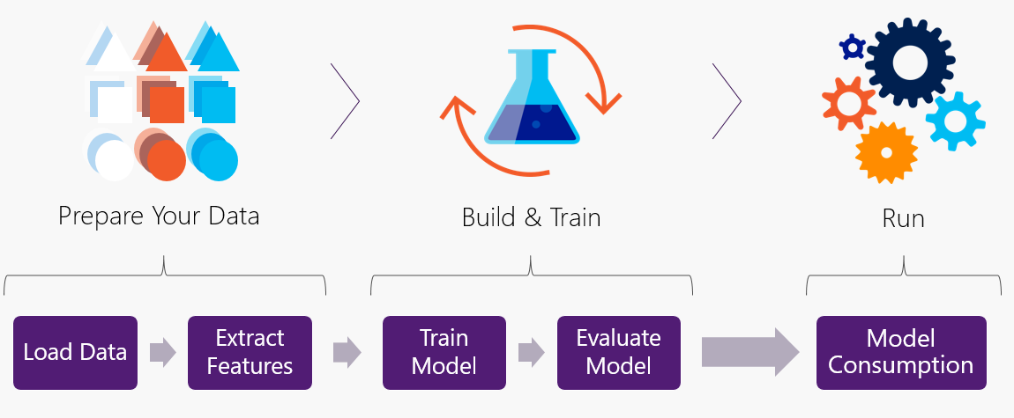
Workflow

Slide 17
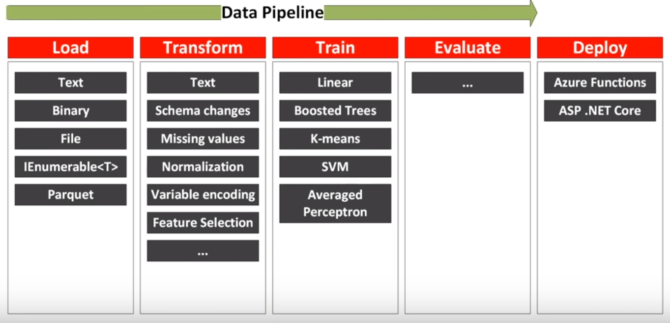
Data pipeline

Slide 18
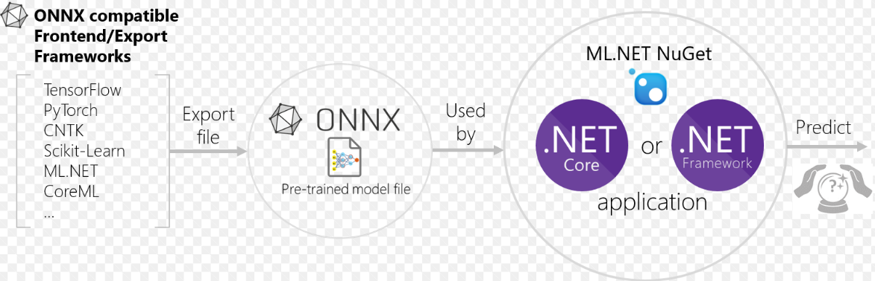
Interoperability: ONNX Open Neural Network Exchange Format
ONNX is developed and maintained by a community of partners such as Microsoft, Facebook.
ONNX files could be viewed using Netron

Slide 19
Code Demo(s)

Slide 20

Binary Classification
Titanic - Survival Prediction
Label and Features
Train model using ML.Net
Train using AutoML
Code generation
Accuracy improvement
Data: https://web.stanford.edu/class/archive/cs/cs109/cs109.1166/problem12.html
Notes:
British Passenger ship sunk in 1912 after colliding with an iceberg. Around 2000 passengers and crew were aboard and more than 1500 died.
Let’s see if we can use ML.Net to predict the chance of survival for any passenger onboard
Start by walking through sample data and introduce what we are trying to do
1. Create Solution
dotnet new console -o titanicPredictions
dotnet add package Microsoft.ML
2. Open solution - command Load, Transform, Train, Evaluate and Predict
3. Talk about train/test and add csv to solution.
4. Set them to Copy Always
5. Explore the training data : 0-Survived 1-Not survived, Passenger class 0-3, Sex - male/female, Name(non-float values) : One-hot encoding, Age - missing (mean), delete age record
6. Mention that the algorithms only works on float vectors - thus we need to convert SEX.
7. Add Microsoft.ML nuget package
8. Create ML Context
9. Create schema object Passenger (float and bool)
10. Read data via LoadFromTextFile<Passenger>. Specify hasHeader and SeparatorChar ‘,’
a. Set hasHeaderSplit to true
b. Specify SeparatorChar as comma ‘,’.
c. Split data using TrainTestSplit (80/20)
11. Transform data:
a. Convert non-float(Sex : male/female) to float (0/1) using One-hot encoding
b. Replace missing values : Age - Mean
b. Concatenate feature : Columns to be used for prediction - PClass, Sex, SiblingsAboard, ParentsAboard
12. Train model
a. Assign algorithm : Binary Classification with Logistic regression. It’s a hit and trial. Not sure if this is the best algorithm
b. Train/Fit Model: pass training set
13. Evaluate model
a. Get the score
b. Evaluate gives various score that help determine accuracy of model based on output column.
Gives accuracy of 80%
14. Modify anything(Add/remove Features/Parameters/algorithm) and try to get better accuracy
15. Save
a. Save Model schema as Model.zip to be re-used
b. Reuse this model.zip in various application such as web, desktop, Azure serverless functions
16. Completed in less than 40 lines of code.
17. Predict : PredictionEngine, Prediction class and Sample,
18. AutoML : Automatic Machine learning using ML.Net - PREVIEW
a. Manual process is a tedious
i. Selecting algorithm
Ii.Time consuming (running models for different algorithms/hyperparameters)
b. AutoML
i. Runs different algorithm
Ii. Best algorithm
Iii. Summary of multiple algorithm used
Iv. Auto-Generate code
c. Show summary and improved accuracy from 80% to 84%
d. Show generated code and compare with manual code
19. Sow matrices

Slide 21
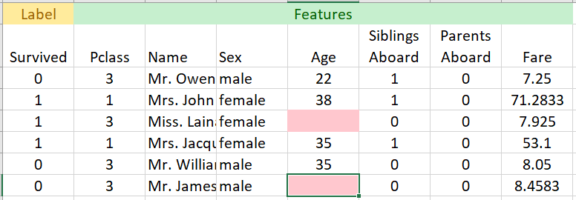
Titanic Data
Notes:
1. One-hot encoding : Sex column
2. Missing or wrong values : Average/Mean

Slide 22
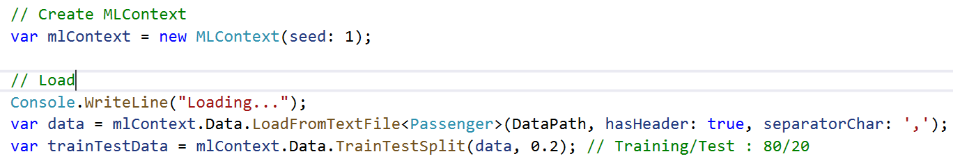
Load
Notes:
1. One-hot encoding : Sex column
2. Missing or wrong values : Average/Mean

Slide 23
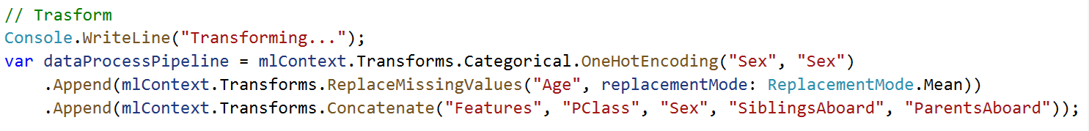
Load -> Transform
Notes:
1. One-hot encoding : Sex column
2. Missing or wrong values : Average/Mean

Slide 24
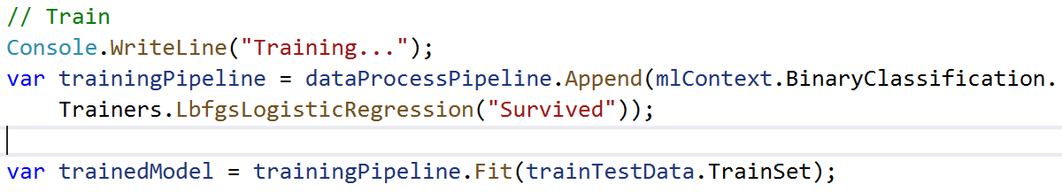
Load -> Transform -> Train
Notes:
1. Choose algorithm : Binary classification

Slide 25
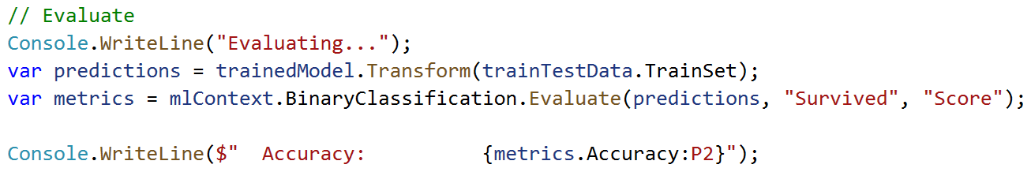
Load -> Transform -> Train -> Evaluate
Notes:
1. Evaluate on Test data

Slide 26
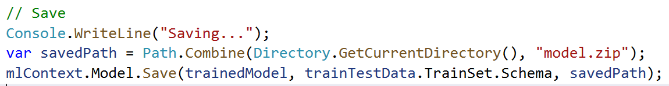
Load -> Transform -> Train -> Evaluate -> Save
Notes:
1. Choose algorithm : Binary classification

Slide 27
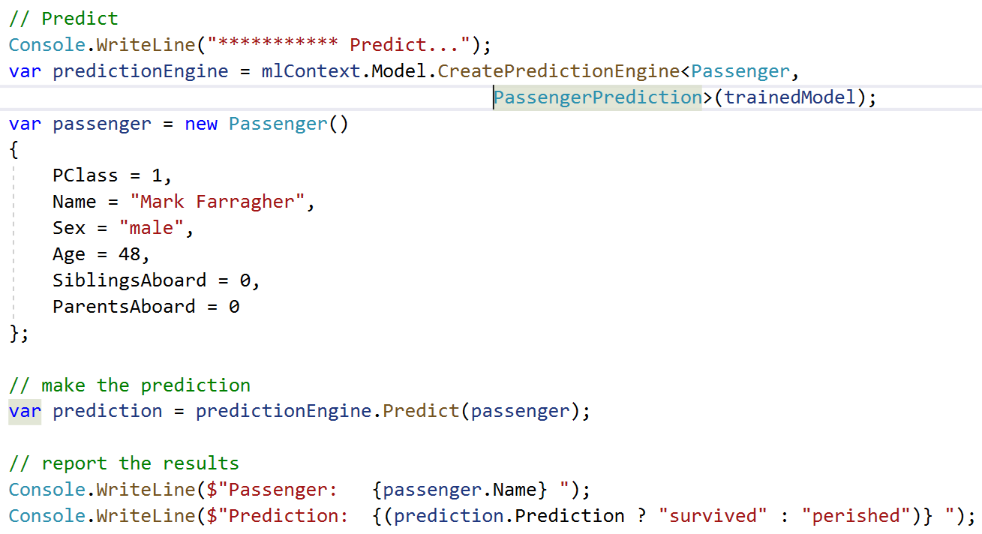
Load -> Transform -> Train -> Evaluate -> Save -> Predict
Notes:
Predict for a single passenger

Slide 28
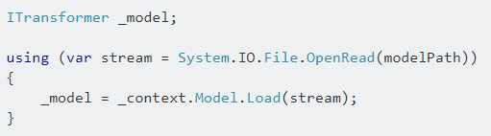
Load a model
Notes:
Load a model

Slide 29
AutoML – In Preview
S.No | Custom ML | AutoML
1. | Manually experiment with different algorithms | Runs different algorithms
2 | Time consuming in identifying best algorithm | Runs many algorithm without code changes
3 | Provides better control of algorithms | No control over algorithm selection
4 | Manually write code | Auto-generates code
mlnet auto-train --task binary-classification --dataset "titanic.csv" --label-column-index 0 --has-header true --max-exploration-time 30
Notes:
- Auto ML comparison
Execute command
mlnet auto-train --task binary-classification --dataset "titanic.csv" --label-column-index 0 --has-header true --max-exploration-time 30

Slide 30
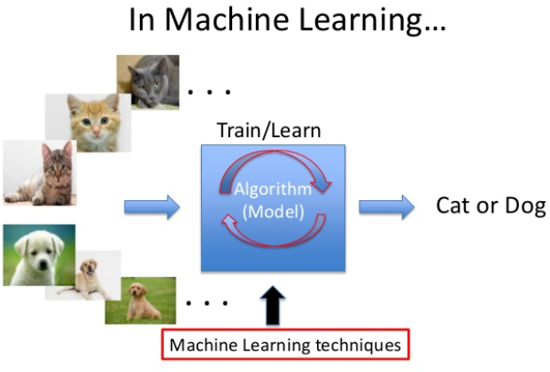
Interoperability
Photo-Search
ML.Net + ONNX
Keras CNN Model
No rewrite of algorithms/model
Save effort and time
Notes:
We are going to have a Photo-Search application.
It takes a model developed using Keras and converted to ONNX format
Display onnx file in NETRON located at D:\Praveen\Personal\Technical\AI_ML\ML.Net\Meetup 29 June 2019\Demo\MLDemoMeetup\PhotoSearchDemo\PhotoSearchNetCore3\model.onnx
1. Run PhotoSearchNetCore3 project
2. Select ALL and click Search : Display all items within folder
3. Select Cat and select items
4. Stop application
5. Google horse image and save it to d:\temp\photos
5. Start app and search for horse

Slide 31
References
ML.Net : https://dotnet.microsoft.com/apps/machinelearning-ai/ml-dotnet
ML.Net: https://devblogs.microsoft.com/cesardelatorre/what-is-ml-net-1-0-machine-learning-for-net/
ONNX : https://onnx.ai/
Photo-Search (ONNX) : https://github.com/Tak-Au/Photo-Search
Music Repair : https://www.youtube.com/watch?v=nnV-1q-z9uE
ML Cookbook : https://github.com/dotnet/machinelearning/blob/master/docs/code/MlNetCookBook.md
Deploy to Azure functions : http://luisquintanilla.me/2018/08/21/serverless-machine-learning-mlnet-azure-functions/
https://rubikscode.net/2019/02/18/ultimate-guide-to-machine-learning-with-ml-net/
https://www.youtube.com/watch?v=dojO4zEL9sg
https://www.youtube.com/watch?v=zy7Y9CHji2k

Slide 32






Thank you Q & A
praveenraghuvanshi@gmail.com
https://in.linkedin.com/in/praveenraghuvanshi
https://github.com/praveenraghuvanshi1512
@praveenraghuvan
https://www.surveymonkey.com/r/T9TD93G
https://github.com/praveenraghuvanshi1512/AIML/tree/master/Meetup_DotNet_10_Aug_2019

