Slide 1
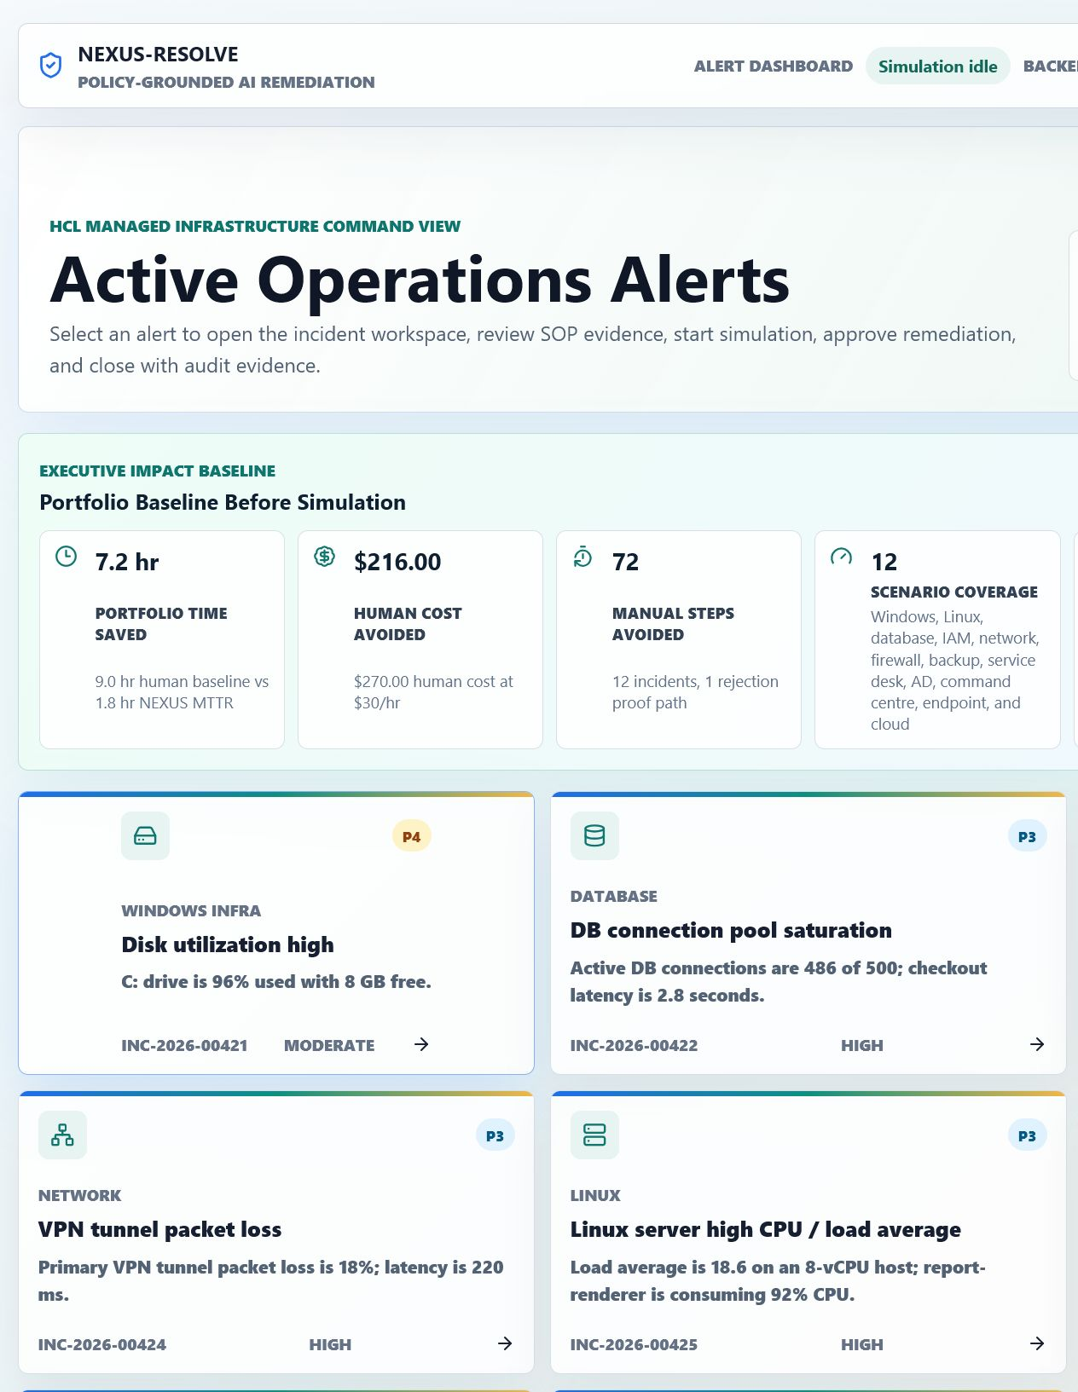
NEXUS-RESOLVE
FastAPI + React + OpenAI Responses API
How to use NEXUS-RESOLVE completely
Synthetic data only. No real host execution.
Run the hackathon project end to end: local setup, replay and live modes, approval-gated mock remediation, OpenAI proof, ServiceNow evidence, audit export, and judge demo flow.
Complete usage guide
01

Slide 2
What this deck teaches
1. Start
2. Operate
3. Prove
Install prerequisites, copy .env for live mode, and launch the local demo with the one-command script.
Use the dashboard to select a synthetic incident, start simulation, review evidence, approve, validate, and close.
Show live OpenAI tool-loop proof, ServiceNow work-note preview, audit packet/PDF, and E2E browser verification.
4. Explain
5. Demo
6. Troubleshoot
Position the safety model clearly: policy gate, human approval, mock execution, validation, and explicit closure.
Use the judge console for frontend plus backend evidence and keep public Pages as replay-only.
Know which ports, scripts, modes, and API credentials matter during a live presentation.
02

Slide 3
Project mental model
Replay mode
Local live mode
Mock fallback
Static JSONL replay. Works on GitHub Pages. No backend, no OpenAI key, no secrets.
FastAPI backend, WebSocket timeline, local OpenAI Responses API calls, and optional ServiceNow PDI.
Deterministic golden outputs keep the demo resilient if OpenAI is unavailable.
Scenario
Policy
OpenAI
Approval
Audit
Backend owns policy, approval, mock execution, validation, and audit events. AI proposes structured evidence and plans inside those guardrails.
03

Slide 4
Prerequisites and repo map
Required local tools
Key folders
- Python 3.12 with venv support
- Node.js and npm.cmd
- Git
- OpenAI API key only for local live mode
- Optional ServiceNow developer instance
data/
Synthetic scenarios, SOPs, replay streams
services/backend/
FastAPI orchestrator, policy gates, tests
apps/dashboard/
cd "D:\Hackathon - API\nexus-resolve"
.\scripts\setup-all.cmd
.\scripts\check-all.cmd
React operations console and browser E2E tests
docs/
Architecture, demo script, scoring map, runbooks
04

Slide 5
Launch the local demo
One command
Demo URLs
Live mode key
Use scripts\start-demo.cmd from the nested nexus-resolve repo. It starts or reuses backend, dashboard, and deep-dive servers.
Dashboard: localhost:5173. Deep dive: 127.0.0.1:5174/apps/deep-dive/#both. Backend health: 127.0.0.1:8000/api/health.
Copy .env.example to .env and set OPENAI_API_KEY. Keep .env out of git.
.\scripts\start-demo.cmd
Open dashboard and deep-dive URLs printed by the script.
OPENAI_API_KEY=...
OPENAI_MODEL=gpt-5.5
APP_MODE=live
SERVICENOW_* optional
05

Slide 6
Use the alert dashboard
Start from the operations alert view. Select the default Windows Infra disk incident or another synthetic scenario.
What to point out:
- 12 scenario coverage
- baseline impact metrics
- replay/live mode labels
- backend status indicator
06

Slide 7
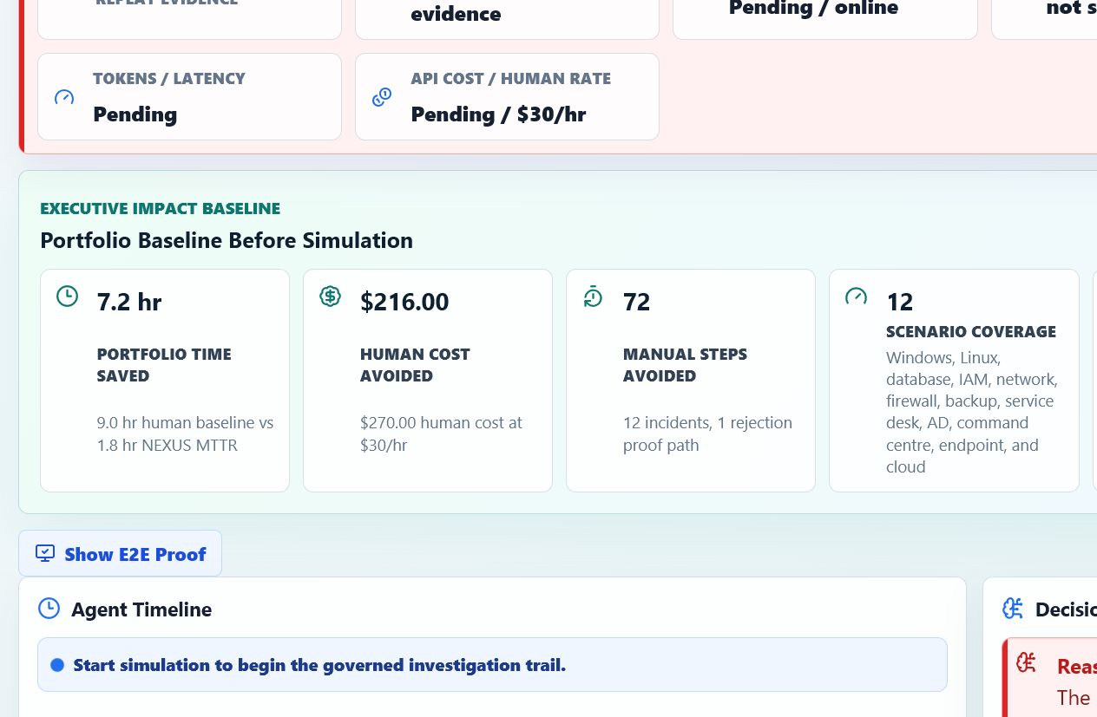
Run an incident workspace
The incident screen is the operator workflow surface. Use Start Simulation, then watch the timeline move from evidence to approval to closure.
Core actions:
1. Choose Replay or Live
2. Start Simulation
3. Review SOP/history evidence
4. Approve mock-only remediation
5. Close or Observe after RCA
07

Slide 8
End-to-end incident lifecycle
SOP beats history
Human approval
Unsafe historical precedent is surfaced and blocked, even when it came from a past ticket.
The workflow pauses before mock remediation and records operator metadata for audit evidence.
Intake
SOP
History
Plan
Approve
Mock exec
Validate
RCA
Close
Use this sentence in the demo: the AI does not execute remediation; it produces structured evidence and plans that the backend subjects to policy, approval, mock execution, validation, and audit.
08

Slide 9
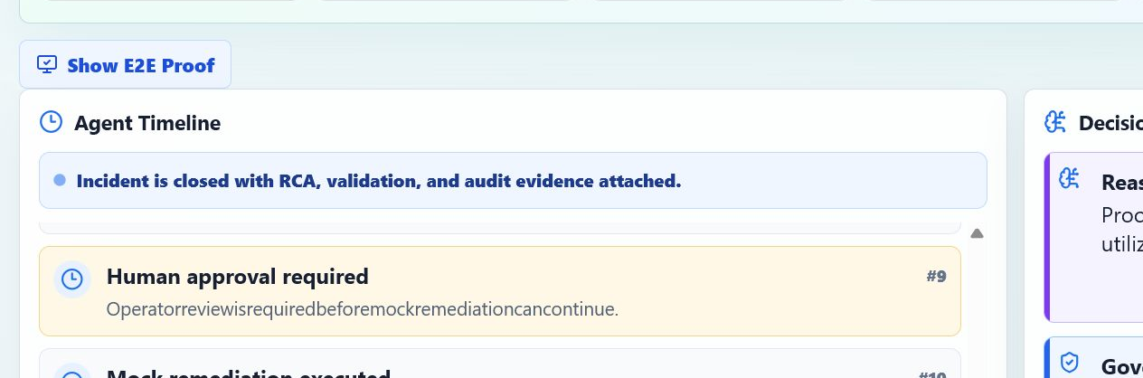
Safety controls judges will ask about
No real execution
Policy gate
Approval gate
Host remediation remains mock-only. Roadmap connectors are explicitly outside the hackathon demo.
Blocks protected resources, missing approval, missing dry-run/mock guard, missing validation, and real execution markers.
Operators approve, reject, observe, or close. The system records who approved and why.
Validation
Replay safety
Evidence export
Scenario-specific metrics must improve before RCA and closure.
Public Pages uses static replay only. No backend, no secrets, no side effects.
Audit packet and PDF prove the run, policy checks, approval, RCA, and closure state.
09

Slide 10
OpenAI live mode proof
When OPENAI_API_KEY is configured, evidence and plan generation run through a real Responses API tool loop over safe local tools.
What to show:
- Live AI Proof strip
- Source: OpenAI Responses API + local tool loop
- Model and token/latency telemetry
- Tool Loop local call count
4
0
1
Local tools
Secrets in UI
Fallback path
SOP, history, initial state, policy preview
API key stays server-side
Deterministic golden response if unavailable
10

Slide 11
ServiceNow evidence path
Default
Optional PDI
Boundary
The connector returns dry-run payloads. This is free for testing and safe for public demo.
Set SERVICENOW_INSTANCE_URL, SERVICENOW_USERNAME, and SERVICENOW_PASSWORD for developer-instance work notes.
It writes RCA/audit evidence only. It does not execute host remediation.
ServiceNow Note button
GET /api/connectors/servicenow/status
POST /api/runs/{run_id}/servicenow/work-note
Body: { dry_run: true }
Use it after the run reaches audit-ready state. Without credentials it previews the exact work note: incident id, RCA, audit hash, policy outcome, and telemetry.
11

Slide 12
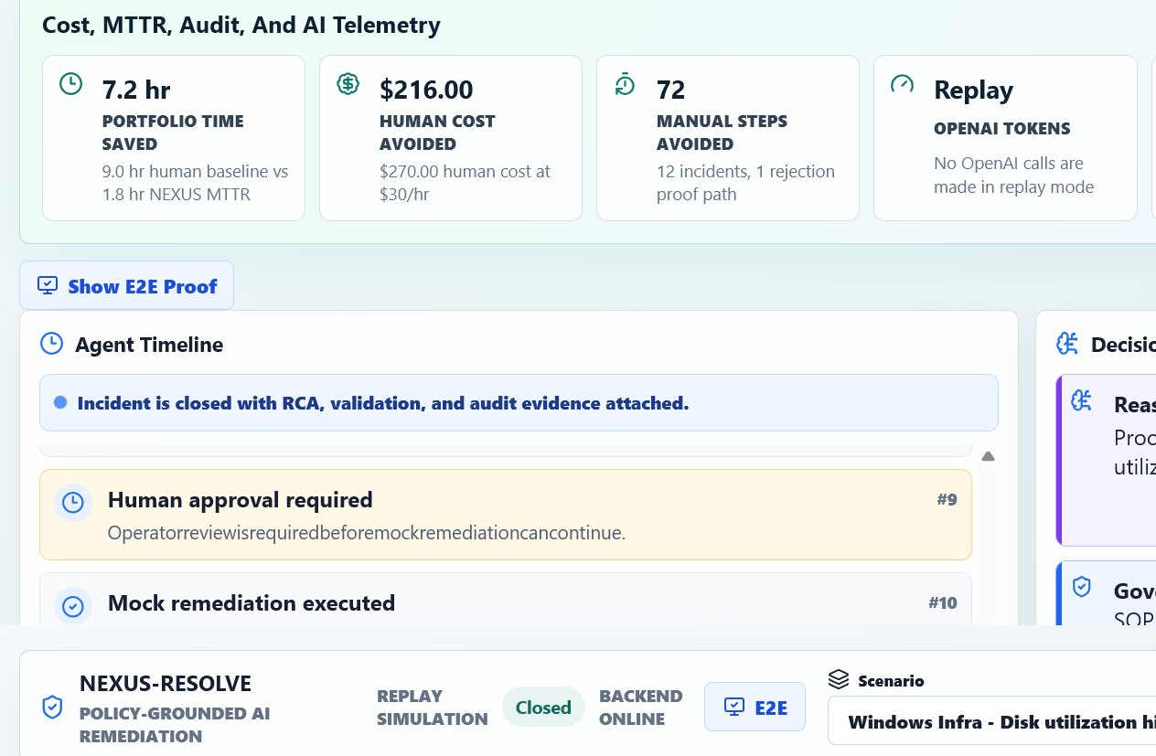
Audit export and closure
A complete run ends with RCA, validation, audit packet/PDF, then a closure or observation decision.
Use this order:
1. Confirm RCA generated
2. Show audit packet or PDF
3. Preview ServiceNow Note
4. Choose Observe or Close INC
5. Point to incident.closed event
12

Slide 13
Verification commands
Run these before any judged demo. They prove backend policy, dashboard behavior, build health, browser flow, and live OpenAI when configured.
.\scripts\check-all.cmd
.\scripts\run-e2e.cmd
.\scripts\verify-live-openai.cmd
check-all
run-e2e
pytest, lint, unit tests, and production build
live start, approval, RCA, ServiceNow preview, deep-dive rendering
verify-live-openai
Browser smoke
real Responses API path and no fallback
actual click and state transitions in the UI
13

Slide 14
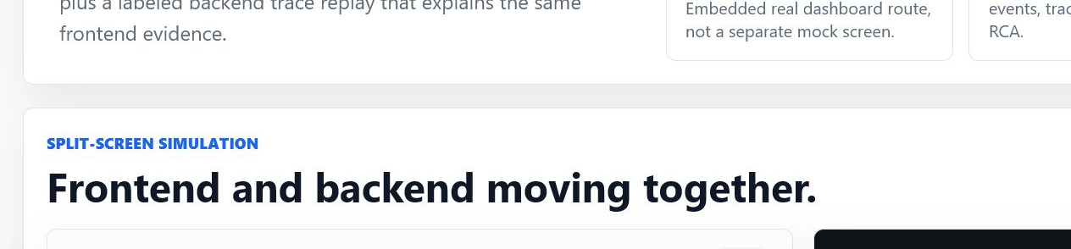
Public replay vs local live
Keep the story clear: public GitHub Pages is replay-only; local live is where backend, WebSocket, OpenAI, and optional ServiceNow evidence run.
Public Pages
Local live
Judge console
Static dashboard build. No backend. No OpenAI key. Safe to share publicly.
Backend on 8000, dashboard on 5173, deep-dive on 5174, OpenAI server-side.
Shows the real dashboard iframe beside live FastAPI JSON or labeled replay trace.
14

Slide 15
3 to 5 minute judge demo flow
0:00 Problem
0:20 Trigger
0:45 Evidence
Manual infra tickets are slow, and unsafe automation is worse.
Open disk-space alert, show scenario coverage and portfolio baseline.
SOP retrieval, historical comparison, unsafe precedent warning.
1:50 Plan
2:30 Approval
3:45 RCA
Show target, expected effect, safeguards, validation, and Live AI Proof.
Approve mock remediation. Emphasize policy gate and human control.
Show RCA, audit export, ServiceNow Note preview, observe/close.
Close with: this is not AI deletes files. It is policy-grounded, approval-gated remediation.
15

Slide 16
Troubleshooting and Q&A
Dashboard not loading
OpenAI fallback
ServiceNow disabled
Run scripts\start-demo.cmd again. Check ports 8000, 5173, and 5174.
Confirm .env has OPENAI_API_KEY and run verify-live-openai.cmd. Fallback is expected without a key.
That is normal. Dry-run is the free demo mode. PDI write-back needs developer-instance credentials.
Real execution question
Public link question
Evidence question
Say it is intentionally not implemented for the hackathon. Production connectors need change windows and guardrails.
Public Pages is replay-only. Show local live for real OpenAI proof.
Use deep-dive JSON cards, audit packet, PDF report, E2E proof, and screenshots.
16

Slide 17
Final operator checklist
Before demo
During demo
Message
- Pull latest code
- Copy .env only for local live
- Run check-all and E2E
- Run live OpenAI verification
- Launch start-demo
- Start from alert dashboard
- Use disk-space incident first
- Show SOP beats history
- Approve mock remediation
- Export audit evidence
AI accelerates triage and planning, while the product keeps policy, approval, validation, and audit ownership in deterministic backend controls.
Synthetic-only. Mock-only. Approval-gated. Audit-ready.
17

