Slide 1
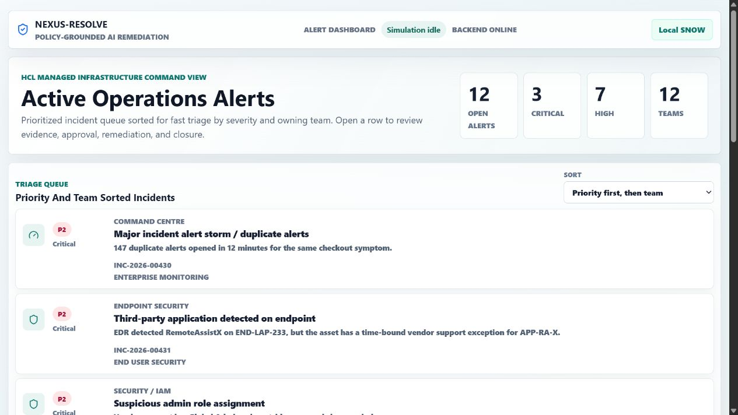
JUDGE USER GUIDE
NEXUS-RESOLVE
How to run, click, explain, and defend the hackathon demo
12
4
0
priority-sorted incidents
AI decision stages
external side effects in demo mode
Main message
Policy-grounded, approval-gated AI remediation for synthetic enterprise infrastructure operations.
NEXUS-RESOLVE judge guide
01

Slide 2
POSITIONING
What this project proves
Use this slide to frame the demo before touching the app.
SOP beats past ticket history when history is unsafe.
It is not a chatbot
It is an operations console where AI must retrieve SOP, compare history, reject unsafe precedent, ask for human approval, execute only mock remediation, validate metrics, then produce RCA and audit evidence.
Approval is required before any remediation step.
Execution is synthetic-only for the hackathon demo.
Audit PDF and run evidence are produced for judge review.
Best one-line pitch
NEXUS-RESOLVE turns repetitive infrastructure tickets into governed, explainable, and auditable remediation runs.
NEXUS-RESOLVE judge guide
02

Slide 3
RUNBOOK
Start the correct project
Run from the nested product repo, not the top launchpad folder.
cd "D:\Hackathon - API\nexus-resolve"
scripts\start-demo.cmd
If you see Launchpad
You are looking at the wrong app on port 5173. Re-run scripts\start-demo.cmd from the nested nexus-resolve folder and reopen http://localhost:5173/.
What this starts
Correct title check
Backend API on 8000, dashboard on 5173, deep-dive console on 5174, and Local SNOW simulator on 5177. For the no-ServiceNow judge demo it forces APP_MODE=mock.
The correct browser tab title is NEXUS-RESOLVE and the first page headline is Active Operations Alerts.
NEXUS-RESOLVE judge guide
03

Slide 4
HOSTS
Open these links during judging
Keep this slide beside you as the shortest navigation guide.
Surface
URL
Use it for
All issues
http://localhost:5173/
Priority-sorted incident list and portfolio triage.
Live simulation
http://localhost:5173/#/incident/disk-space
Disk-space story with approval, mock execution, RCA.
Local SNOW
http://127.0.0.1:5177/apps/local-snow/
ServiceNow-style synthetic incident desk and work notes.
Deep dive
http://127.0.0.1:5174/apps/deep-dive/#both
Real dashboard iframe plus live FastAPI proof cards.
Backend health
http://127.0.0.1:8000/api/health
Quick proof that backend is online.
NEXUS-RESOLVE judge guide
04

Slide 5
DASHBOARD
Where all issues are listed
This is the page you wanted: priority first, then team, with clickable incident rows.
1
Open root dashboard
Use http://localhost:5173/ for the full incident list.
2
Show priority ordering
P2 critical incidents appear first, then P3/P4/P5 by team.
3
Click an incident
Each row opens the same governed workflow for that scenario.
4
Use disk-space first
It is the cleanest story for judges and works well with Local SNOW.
NEXUS-RESOLVE judge guide
05

Slide 6
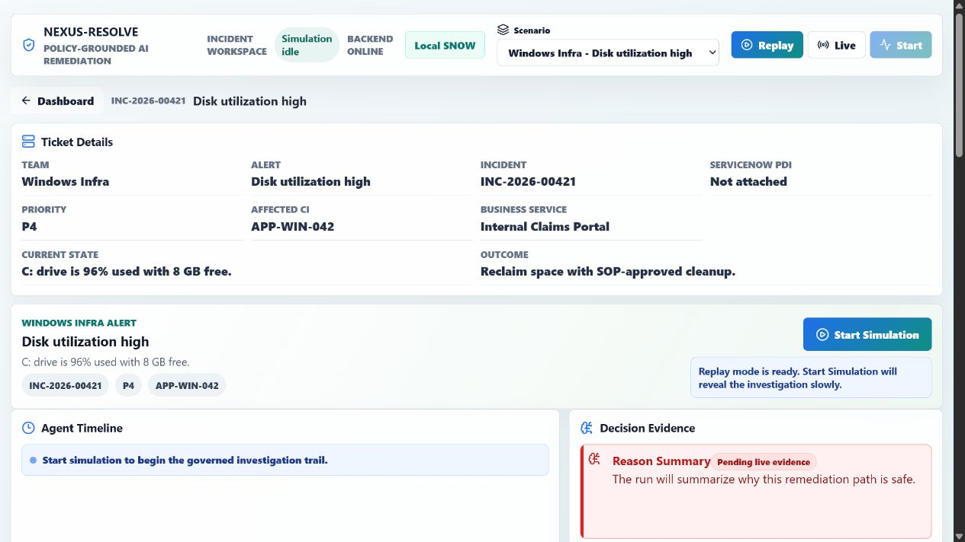
LIVE SIMULATION
Recommended judge story: disk-space incident
This is the safest and clearest end-to-end path.
1
Open disk-space
http://localhost:5173/#/incident/disk-space
2
Choose Live
Use the local backend path, not static replay.
3
Start Simulation
Watch alert, SOP, history, policy, and plan events.
4
Approve only after review
This proves the human approval gate.
5
Show RCA and close
End with audit evidence and validation.
NEXUS-RESOLVE judge guide
06

Slide 7
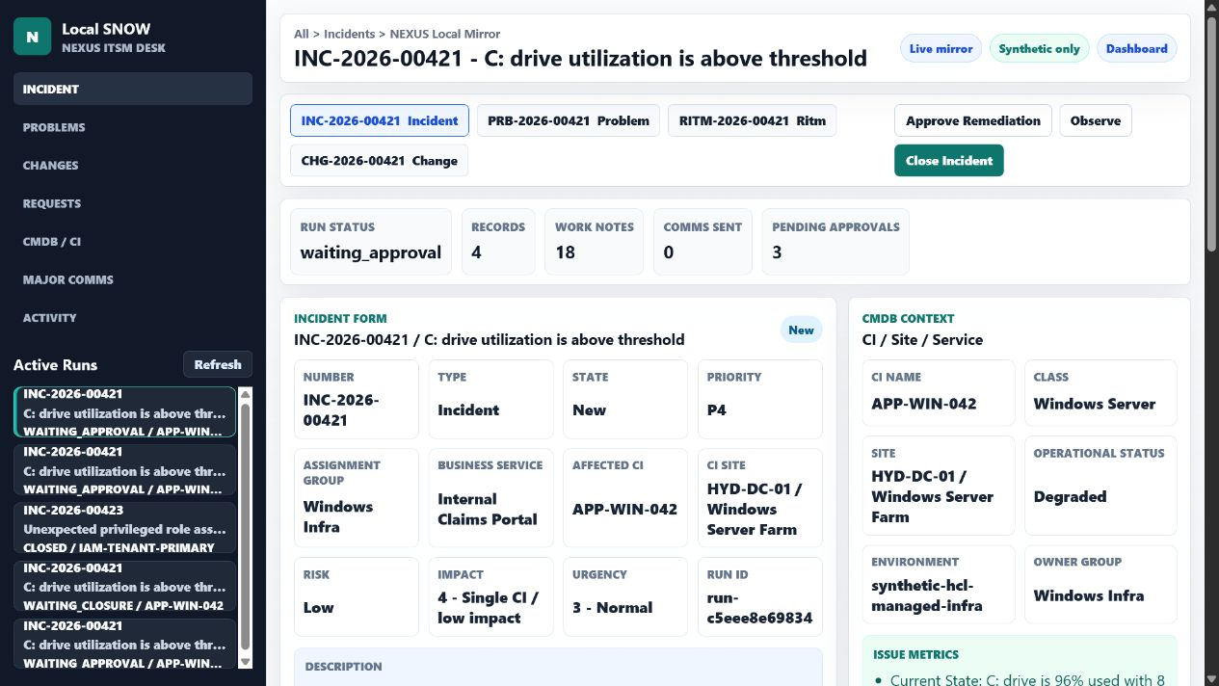
SERVICENOW-STYLE DEMO
Use Local SNOW when you do not have a PDI
This is the correct no-ServiceNow judge path.
What judges see
Incident form, active runs, CI/site context, related Problem/RITM/Change records, work notes, activity, and communication approvals.
What to say
This is not a real ServiceNow account. It is a synthetic ServiceNow-style simulator that mirrors the same NEXUS run safely for demo and testing.
NEXUS-RESOLVE judge guide
07

Slide 8
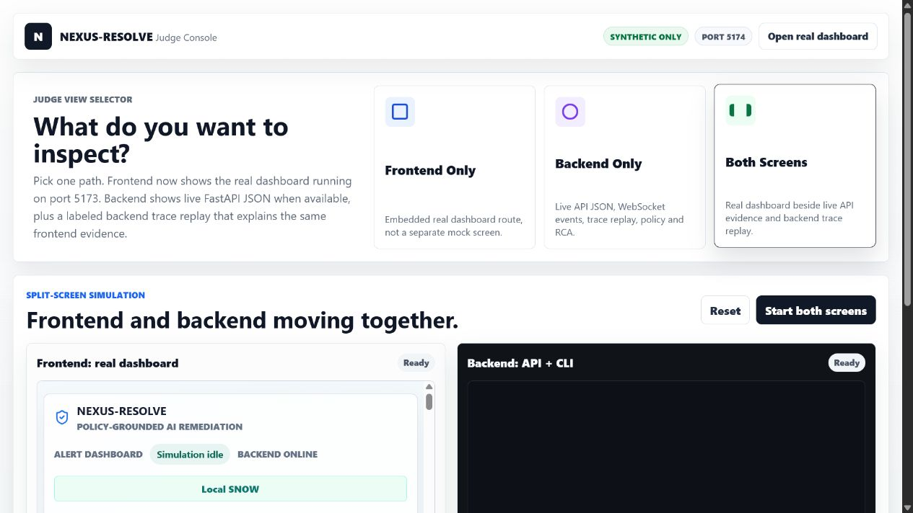
PROOF CONSOLE
Use Deep Dive when judges ask for internals
It shows the real dashboard plus backend proof in one page.
Open #both to show frontend and backend together.
Explain that the iframe is the real dashboard on port 5173.
Backend cards use live FastAPI JSON when the backend is online.
Use it for policy block, audit hash, RCA, and trace explanation.
NEXUS-RESOLVE judge guide
08

Slide 9
TALK TRACK
Four-minute judge script
Use this timing if you feel lost during the presentation.
Time
Show
Say
0:00-0:30
Dashboard root
Enterprise tickets waste time and become risky when automation copies unsafe history.
0:30-1:10
Disk incident
NEXUS retrieves SOP and compares history instead of guessing.
1:10-1:45
Unsafe precedent
SOP beats history. A bad past ticket is flagged, not repeated.
1:45-2:30
Approval gate
AI proposes a guarded plan but cannot execute until a human approves.
2:30-3:20
Local SNOW
Work notes and related records update in a ServiceNow-style synthetic desk.
3:20-4:00
RCA and audit
Close with validation, RCA, PDF evidence, and no real host side effects.
NEXUS-RESOLVE judge guide
09

Slide 10
OPENAI USAGE
Why the audit PDF can show $0 OpenAI cost
This is correct for the current no-ServiceNow judge launcher.
Current judge launcher
OPENAI_API_KEY=sk-proj-...
OPENAI_MODEL=gpt-5.5
scripts\verify-live-openai.cmd
scripts\start-demo.cmd forces APP_MODE=mock. That means deterministic fallback responses are used and the OpenAI API key is intentionally not called.
When the key is used
The backend uses OPENAI_API_KEY only in live mode for evidence summary, remediation plan, approval summary, and RCA. The key stays server-side and is never exposed in the frontend.
What to tell judges
$0 cost means fallback mode for this safe demo, not a broken report. Run verify-live-openai.cmd separately when you want proof that the OpenAI path works.
NEXUS-RESOLVE judge guide
10

Slide 11
SERVICENOW
What is possible with real ServiceNow
Be honest: today you have a demo simulator, not a real ServiceNow PDI.
Path
Needs
Cost / demo position
Local SNOW
No external account. Start with start-demo.cmd.
Free for testing and judging. Synthetic-only.
OpenAI live proof
OPENAI_API_KEY in local .env.
Small API usage cost. Use verify-live-openai.cmd.
Real PDI write-back
ServiceNow developer instance plus username/password.
Possible, but blocked until a real PDI exists.
Production
Enterprise ServiceNow, change policy, secrets vault, connector approval.
Outside hackathon demo. Use as roadmap.
Do not overclaim
Say: We built the connector shape and a Local SNOW simulator. Real ServiceNow write-back requires a real PDI and credentials.
NEXUS-RESOLVE judge guide
11

Slide 12
GOVERNANCE
Safety model and evidence
This is the part that makes the demo enterprise-grade.
No real host remediation is executed in demo mode.
Audit report
Protected resources and unsafe precedent are blocked.
After a run reaches RCA, use the Audit Export PDF link. If fallback mode is active, OpenAI cost should be shown as $0 with a fallback explanation.
Human approval is required before mock execution.
Validation metrics prove recovery before closure.
Strong judge sentence
RCA, audit hash, and PDF report preserve evidence.
This is not AI deleting files. It is policy-grounded, approval-gated remediation with mock execution and audit evidence.
NEXUS-RESOLVE judge guide
12

Slide 13
PROOF COMMANDS
Commands to run if judges ask for evidence
Use these in PowerShell from D:\Hackathon - API\nexus-resolve.
scripts\run-e2e.cmd
# browser suite: live start, approval, RCA, policy block,
# audit link, ServiceNow preview, security rejection, deep dive
scripts\check-all.cmd
# backend tests, dashboard tests, build checks,
# product-level verification
scripts\verify-live-openai.cmd
# proves the OpenAI path when OPENAI_API_KEY is set
scripts\verify-live-servicenow.cmd
# use only after a real ServiceNow PDI exists
NEXUS-RESOLVE judge guide
13

Slide 14
Q AND A
Short answers for hard questions
Use direct answers. Do not hide current demo limits.
Question
Best short answer
Is this real ServiceNow?
No. Current judging path uses Local SNOW, a synthetic ServiceNow-style simulator. Real PDI write-back is possible when credentials exist.
Why is OpenAI cost $0?
Because start-demo.cmd runs APP_MODE=mock for a safe no-PDI demo. Use verify-live-openai.cmd to test the real OpenAI path.
Does it execute real fixes?
No. It executes mock state changes only. That is intentional for safety.
What is the innovation?
AI is constrained by SOP, history, policy gates, approval, validation, RCA, and audit evidence.
What wins the hackathon?
One polished enterprise story: fast triage, governed automation, measurable savings, and honest limits.
NEXUS-RESOLVE judge guide
14

Slide 15
FINAL CHECKLIST
Before the judge watches
Use this checklist immediately before presenting.
Run scripts\start-demo.cmd from the nested nexus-resolve folder.
Demo order
Open http://localhost:5173/ and confirm Active Operations Alerts.
Dashboard -> disk-space live simulation -> approval gate -> Local SNOW work notes -> RCA/audit -> Deep Dive if judges ask for internals.
Open disk-space incident and keep Local SNOW ready in another tab.
Use APP_MODE=mock language unless live OpenAI or PDI verifiers passed.
Most important correction
End with RCA, audit PDF, and no-real-side-effects safety message.
All issues are on http://localhost:5173/. The hash route opens one incident workspace, not the full list.
NEXUS-RESOLVE judge guide
15

