Slide 1
Capstone Project The Battle of Neighborhoods Week 5

Slide 2
Introduction
The City of New York, is the most populous city in the United States. It is diverse and is the financial capital of USA. New York City is often referred to collectively as the five boroughs, and in turn, there are hundreds of distinct neighborhoods throughout the boroughs, many with a definable history and character to call their own
As it is highly developed city so cost of doing business is also one of the highest. Thus, any new business venture or expansion needs to be analyzed carefully. The insights derived from analysis will give good understanding of the business environment which help in strategically targeting the market.

Slide 3
Business problem
The City of New York is famous for numerous excellent cuisines across many nations with an array of international cuisines Indian restaurants have become so popular in the United States due to huge population of Asian immigrants. So, starting an Indian cuisine restaurant can be a great business opportunity and we need to determine the right location to cover wider customers.
Client is interested to open a new Indian cuisine restaurant and in need of suggestion for a suitable neighborhood within the city with low risk

Slide 4

Data Selection
In order to determine the characteristics of our competitors in the New York City, we would need to identify the number of existing restaurants in each neighborhood.
We used geographical coordinates of New York City: 40.7127281, -74.0060152 to determine the map of the neighborhood
We had a total of 1081 Indian restaurants in Manhattan as of today.

Slide 5
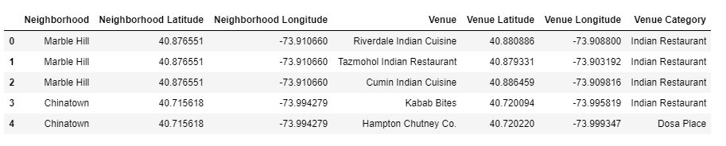
Data Selection
To find the best location for our Indian Restaurant, we will use the following sources of information:
Indian category Id - 4bf58dd8d48988d10f941735
Next, we used Google Map API to find their geographic coordinates of the 5 locations shortlisted for our Indian Restaurants
Data frame containing geographic coordinates of our 5 shortlisted locations

Slide 6
Methodology
I have used Foursquare API to explore neighborhoods in Manhattan, New York. After that, explore function to get Indian restaurant categories in each neighborhood.
Then use this feature to group the neighborhoods into clusters K-means clustering algorithm will be use to complete this task. And also, the Folium library to visualize the neighborhoods in Manhattan and its emerging clusters

Slide 7
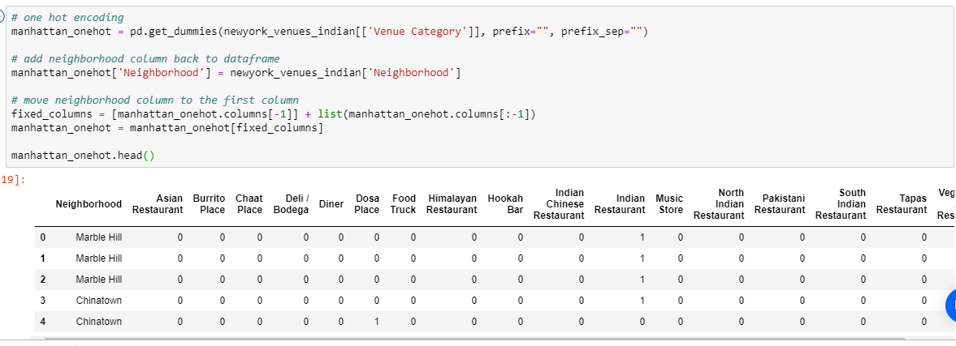
Methodology
Restaurants based on category

Slide 8
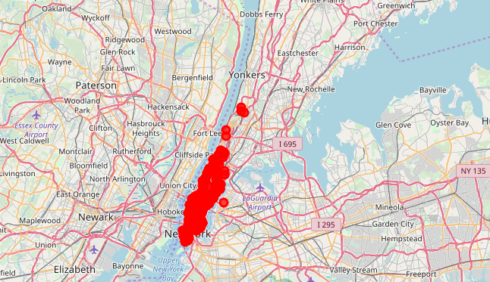
Methodology
Indian restaurants in Manhattan

Slide 9
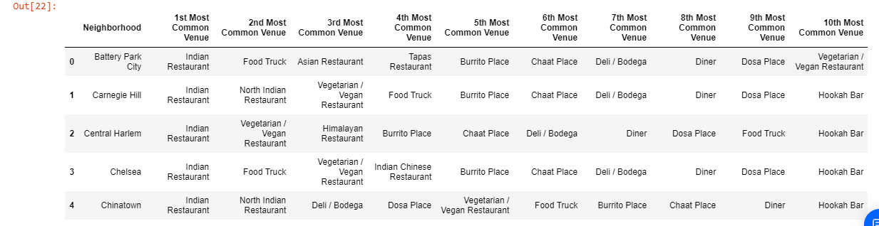
Methodology
Using this feature, group the neighborhoods into clusters K-means clustering algorithm will be use to complete this task. And also, the Folium library to visualize the neighborhoods in Manhattan and its emerging clusters.

Slide 10
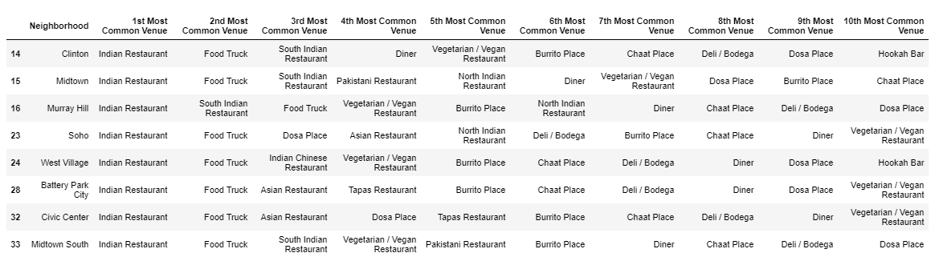
Results
Using K-mean to clustering data area with less number of sushi bars
Cluster 0

Slide 11
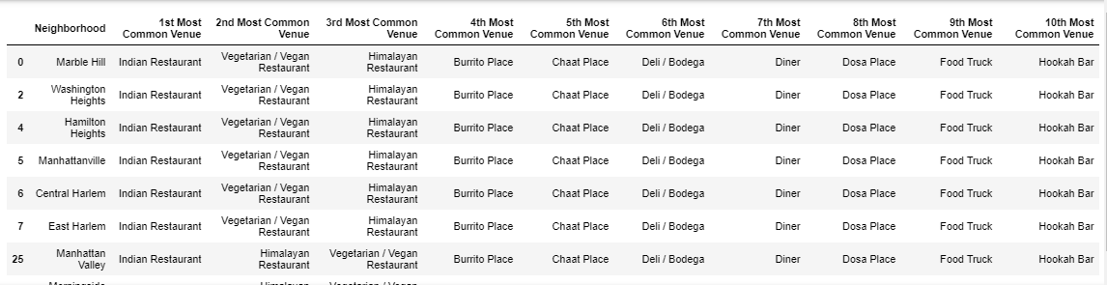
Result
Cluster 1

Slide 12
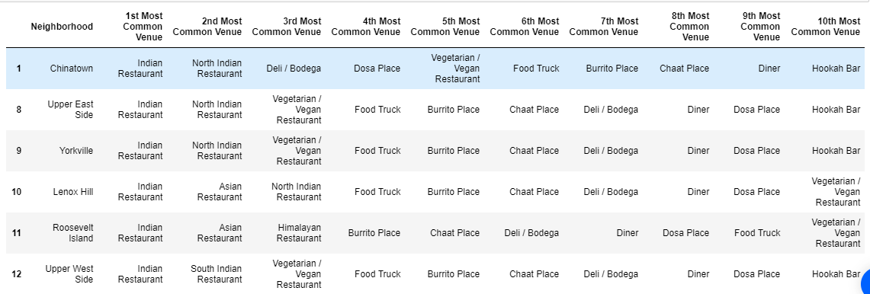
Result
Cluster 2

Slide 13
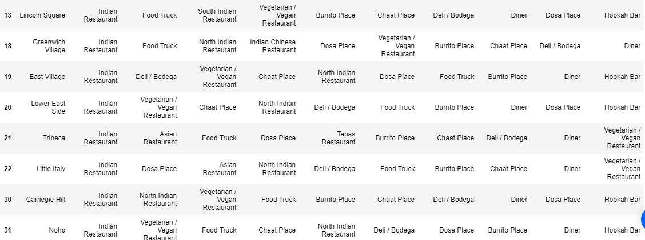
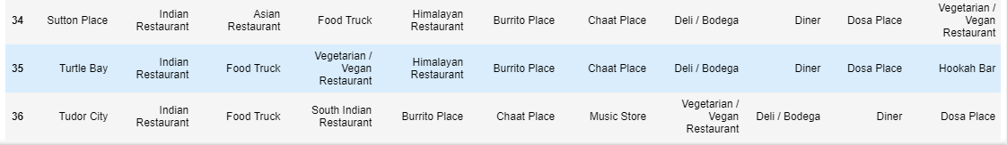
Result
Cluster 2 Contd….

Slide 14
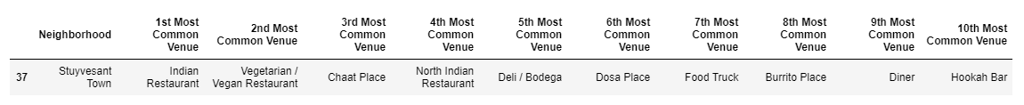
Result
Cluster 3

Slide 15
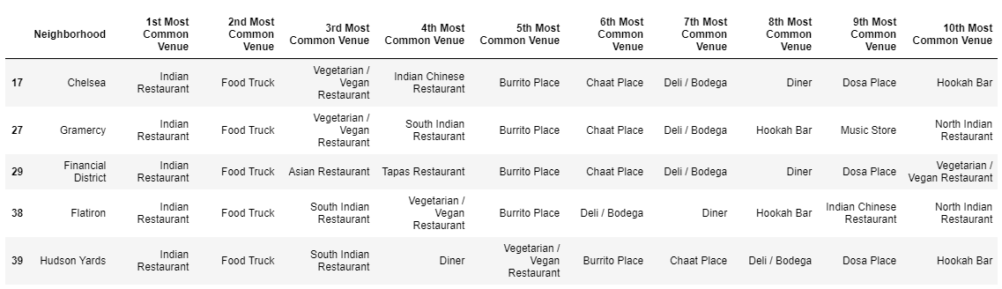
Result
Cluster 4

Slide 16
Discussion
Based on the above cluster analysis, Cluster 3 will be most ideal location to open Indian restaurant followed by Cluster 4 as there are less number of restaurants available today.
Stuyvesant Town neighborhood (under Cluster 3) has only one existing restaurant and this is the most viable location to open new Indian restaurant.
Cluster 2 has numerous Indian based restaurants (close to 36) and this is the most risker zone to open new business.

Slide 17
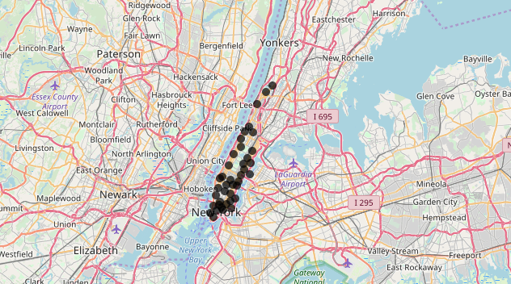
Conclusion
Finally, we used Foursquare, Folium, K mean cluster to identify the zone to open Indian restaurant in New York neighborhood.

