Slide 1
Every image signed. Every cluster checks.
A private Sigstore on AWS, anchored in the corporate root CA, enforced on EKS, AKS, OpenShift and on-prem
Notes:
Purpose: approve the design and the five decisions D1–D5 so the key ceremony can be booked.

Slide 2
Today we cannot prove where a running image came from
Today
After this programme
Any cluster runs any image it can pull: built on a laptop, copied from the internet, or changed in a registry.
For an incident or an audit we cannot show who built an image, from which source, or that it is unchanged.
Pipelines sign images with their GitHub workflow identity; engineers sign images and commits (gitsign) with their corporate login. No signing keys to manage.
Every signature is in logs we operate. Clusters verify against trust data next to them and deny unsigned images.
Evidence regulators and auditors ask for: NIST SSDF, SLSA, PCI DSS 4.0 software integrity.
Notes:
Regulatory drivers: NIST SSDF, SLSA, PCI DSS 4.0 software integrity.

Slide 3
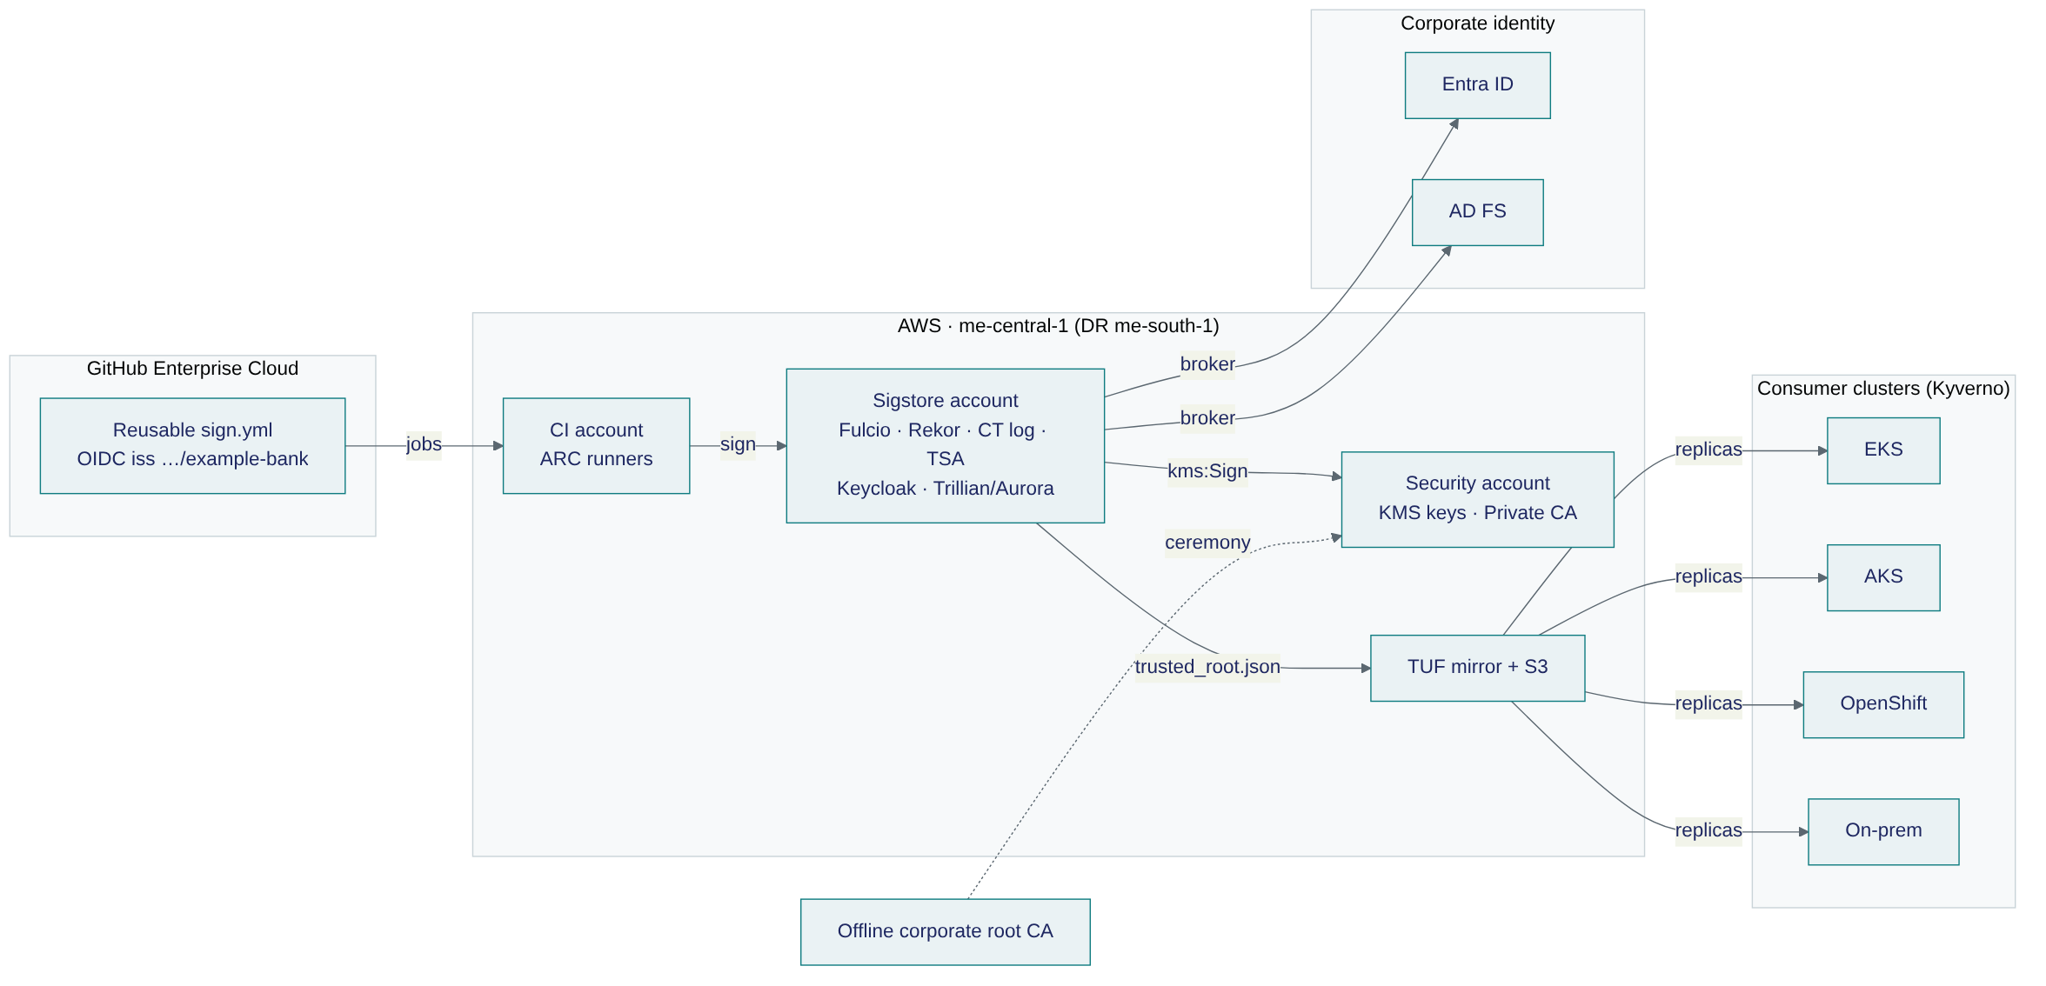
Sign centrally in AWS, verify locally everywhere
Notes:
Signing needs the AWS platform; verification never does. A Region outage stops new signatures only.

Slide 4
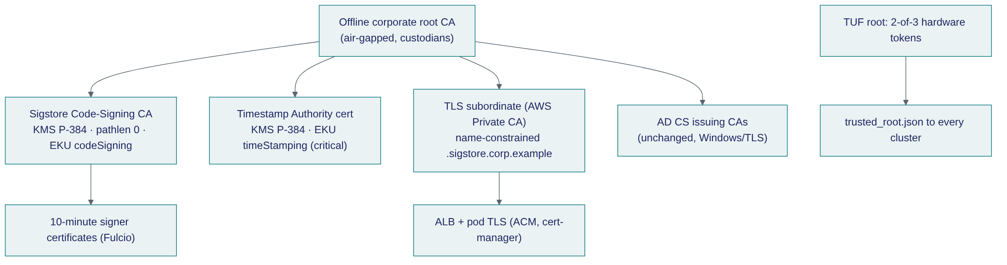
Trust is anchored in our own root CA
Key facts
CA, TSA and log keys live in AWS KMS: non-exportable, every use logged.
AD CS is unchanged.
Trust updates reach every cluster through TUF, signed 2-of-3 by custodians.
One recorded ceremony: the offline root signs the Sigstore CA, the TSA certificate and two TLS subordinates.
Ceremony scripts were tested against real Fulcio and TSA binaries, including the certificates they must reject.

Slide 5
One policy pack enforces on every platform
EKS
AKS
OpenShift
On-prem
Kyverno 1.19
ECR · TUF mirror in AWS
Kyverno 1.19
ACR · Azure Blob replica
Kyverno 1.19
ACR / Quay · nearest replica
Kyverno 1.19
Harbor · on-prem replica
How it works
Kyverno checks each Pod's images against the signer identity and the bank's TUF root, offline, at admission. Rollout goes Audit first, then Deny by tier. A per-namespace break-glass label can be set only by the platform Argo CD and pages security on-call. OpenShift's native image policy cannot match pipeline identities, so it is only an optional second layer.

Slide 6
Twelve recorded decisions
ADR | Decision
0001 | Private Sigstore, not public-good
0002 | Rekor v1 now, v2 when AWS supports KMS signing
0003 | Keys in AWS KMS (multi-Region)
0004 | Sigstore CA directly under the offline root
0005 | Keycloak brokers Entra ID and AD FS
0006 | GitHub enterprise-unique OIDC issuer
ADR | Decision
0007 | Kyverno on every platform
0008 | TUF trust distribution, 2-of-3 custodians
0009 | Self-hosted runners in AWS
0010 | Build on upstream; RHTAS as exit path
0011 | IRSA, no static AWS keys
0012 | TLS from a name-constrained Private CA

Slide 7
Built to fail safe, checked before it ships
≤ 1 min
1 h
7 days
0
log data loss on Region failure
to restore signing in me-south-1
clusters keep verifying if publishing stops
static AWS keys
Validation so far (static; nothing deployed yet)
Terraform validate, tflint and checkov with 0 failures · 647 Kubernetes objects valid against real CRD schemas · Kyverno policy tests · TUF tooling end to end with tamper detection · offline laptop stack end to end, including gitsign · an independent reviewer checked the design against source code and vendor docs, and every finding was fixed.
First deployment goes to a sandbox account set and must pass an 11-step smoke test.

Slide 8
Eight weeks to adoption, then enforcement by tier
0
1
2
3
4
Decisions
Foundations + ceremony
Pilot: 3 repos, 2 clusters
Adoption, Audit everywhere
Deny by tier
Weeks 1–2
Weeks 2–3
Weeks 3–4
Weeks 4–8
2 weeks per tier
Exit criteria
Pilot: 100% of pilot images signed for two weeks and no false positives. Each enforcement tier: two weeks without unplanned denials and a tested break-glass.

Slide 9
Decisions needed to book the ceremony
D1 AWS KMS (FIPS 140-3 L3) for the CA key, or CloudHSM
D2 Enable the GitHub enterprise-unique OIDC issuer
D3 me-south-1 (Bahrain) as the DR Region
D4 Build on upstream; RHTAS as the exit path
D5 No public-good Rekor for internal artifacts
Name 2 root custodians and 3 TUF key holders

